Slide 1
Chemistry
Third Edition
Julia Burdge
Lecture PowerPoints
Chapter 8
Chemical Bonding I: Basic Concepts
Copyright © 2012, The McGraw-Hill Compaies, Inc. Permission required for reproduction or display.
1

Slide 2
8
Chemical Bonding I: Basic Concepts
8.1 | Lewis Dot Symbols
8.2 | Ionic Bonding
8.3 | Covalent Bonding
8.4 | Electronegativity and Polarity
8.5 | Drawing Lewis Structures
8.6 | Lewis Structures and Formal Charge
8.7 | Resonance
8.8 | Exceptions to the Octet Rule
8.9 | Bond Enthalpy
Copyright © 2012, The McGraw-Hill Compaies, Inc. Permission required for reproduction or display.
2

Slide 3
8.1
Lewis Dot Symbols
Lewis Dot Symbols
Copyright © 2012, The McGraw-Hill Compaies, Inc. Permission required for reproduction or display.
3

Slide 4
8.1
Lewis Dot Symbols
Lewis Dot Symbols
The development of the periodic table and the concept of electron configuration gave chemists a way to explain the formation of compounds.
The explanation, formulated by Gilbert Lewis, is that atoms combine to achieve a more stable electron configuration.
Maximum stability results when an atom is isoelectronic with a noble gas.
Copyright © 2012, The McGraw-Hill Compaies, Inc. Permission required for reproduction or display.
4

Slide 5
8.1
Lewis Dot Symbols
Lewis Dot Symbols
When atoms interact to form compounds, it is their valence electrons that actually interact.
Therefore, it is helpful to have a method for depicting the valence electrons of the atoms involved.
This can be done using Lewis dot symbols.
A Lewis dot symbol consists of the element’s symbol surrounded by dots, where each dot represents a valence electron.
Copyright © 2012, The McGraw-Hill Compaies, Inc. Permission required for reproduction or display.
5

Slide 6
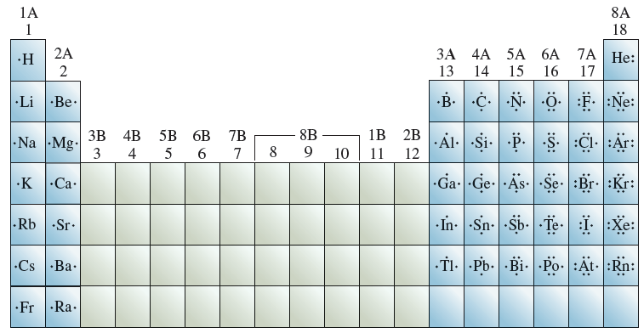
8.1
Lewis Dot Symbols
Lewis Dot Symbols
For the main group elements, the number of dots in the Lewis dot symbol is the same as the group number
Copyright © 2012, The McGraw-Hill Compaies, Inc. Permission required for reproduction or display.
6

Slide 7
8.1
Lewis Dot Symbols
8.1
Write Lewis dot symbols for (a) fluoride ion (F–), (b) potassium ion (K⁺), and (c) sulfide ion (S^{2–}).
Strategy
Starting with the Lewis dot symbol for each element, add dots (for anions) or remove dots (for cations) as needed to achieve the correct charge on each ion.
Don’t forget to include the appropriate charge on the Lewis dot symbol.
Lewis Dot Symbols
Copyright © 2012, The McGraw-Hill Compaies, Inc. Permission required for reproduction or display.
7

Slide 8
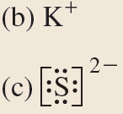
8.1
Lewis Dot Symbols
8.1
Setup
Solution
Lewis Dot Symbols
Copyright © 2012, The McGraw-Hill Compaies, Inc. Permission required for reproduction or display.
8

Slide 9
8.2
Ionic Bonding
Lattice Energy
The Born-Haber Cycle
Copyright © 2012, The McGraw-Hill Compaies, Inc. Permission required for reproduction or display.
9

Slide 10
8.2
Ionic Bonding
Lattice Energy
Ionic bonding refers to the electrostatic attraction that holds these oppositely charged ions together in an ionic compound.
When potassium and iodine atoms come into contact with each other, the valence electron of potassium is transferred to the iodine atom.
We can imagine these processes taking place separately and represent each process using Lewis dot symbols.
Copyright © 2012, The McGraw-Hill Compaies, Inc. Permission required for reproduction or display.
10

Slide 11
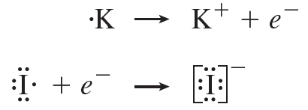
8.2
Ionic Bonding
Lattice Energy
Ionization of potassium: +419 kJ/mol
Electron affinity of iodine: –295 kJ/mol
If a mole of KI were to form as we have described it, an input of [419 + (–295)] = 124 kJ of energy would be required.
Copyright © 2012, The McGraw-Hill Compaies, Inc. Permission required for reproduction or display.
11

Slide 12
8.2
Ionic Bonding
Lattice Energy
The formation of ionic bonds is highly exothermic and more than compensates for the energy input required to transfer electrons from metal atoms to nonmetal atoms.
We can quantify the energy change associated with the formation of ionic bonds with lattice energy.
Copyright © 2012, The McGraw-Hill Compaies, Inc. Permission required for reproduction or display.
12

Slide 13
8.2
Ionic Bonding
Lattice Energy
Lattice energy is the amount of energy required to convert a mole of ionic solid to its constituent ions in the gas phase.
For example, the lattice energy of potassium iodide is 632 kJ/mol. Thus, it takes 632 kJ of energy to convert 1 mole of KI(s) to 1 mole each of K⁺(g) and I–(g).
Copyright © 2012, The McGraw-Hill Compaies, Inc. Permission required for reproduction or display.
13

Slide 14
8.2
Ionic Bonding
Lattice Energy
The magnitude of lattice energy is a measure of an ionic compound’s stability. The greater the lattice energy, the more stable the compound.
Copyright © 2012, The McGraw-Hill Compaies, Inc. Permission required for reproduction or display.
14

Slide 15
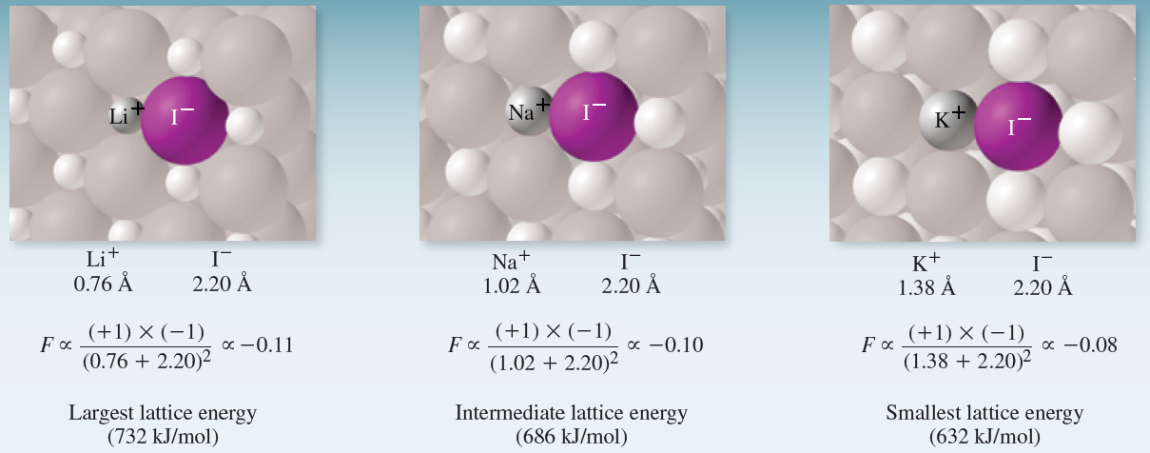
8.2
Ionic Bonding
Lattice Energy
Copyright © 2012, The McGraw-Hill Compaies, Inc. Permission required for reproduction or display.
15

Slide 16
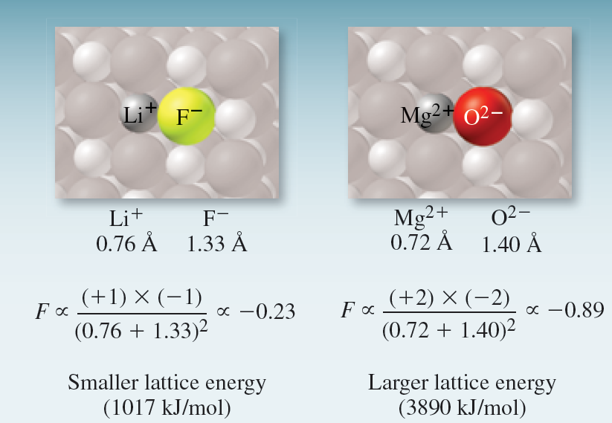
8.2
Ionic Bonding
Lattice Energy
Copyright © 2012, The McGraw-Hill Compaies, Inc. Permission required for reproduction or display.
16

Slide 17
8.2
Ionic Bonding
8.2
Arrange MgO, CaO, and SrO in order of increasing lattice energy.
Strategy
Consider the charges on the ions and the distances between them.
Apply Coulomb’s law to determine the relative lattice energies.
Lattice Energy
Copyright © 2012, The McGraw-Hill Compaies, Inc. Permission required for reproduction or display.
17

Slide 18
8.2
Ionic Bonding
8.2
Setup
MgO, CaO, and SrO all contain the same anion (O^{2–}), and all contain cations with the same charge (+2).
The ionic radii are 0.72 Å (Mg²⁺), 1.00 Å (Ca²⁺), and 1.18 Å (Sr²⁺).
Solution
Lattice Energy
Copyright © 2012, The McGraw-Hill Compaies, Inc. Permission required for reproduction or display.
18

Slide 19
8.2
Ionic Bonding
The Born-Haber Cycle
Na⁺(g) + e–(g) + Cl(g)
Na(g) + Cl(g)
Na⁺(g) + Cl–(g)
Na(g) + ½Cl₂(g)
Lattice
Energy
Na(s) + ½Cl₂(g)
NaCl(s)
Copyright © 2012, The McGraw-Hill Compaies, Inc. Permission required for reproduction or display.
19

Slide 20
8.2
Ionic Bonding
The Born-Haber Cycle
By Hess’ law:
Copyright © 2012, The McGraw-Hill Compaies, Inc. Permission required for reproduction or display.
20

Slide 21
8.2
Ionic Bonding
8.3
Using data from Figures 7.8 and 7.10 and Appendix 2, calculate the lattice energy of cesium chloride (CsCl).
Strategy
Combine the pertinent thermodynamic data and use Hess’s law to calculate the lattice energy.
The Born-Haber Cycle
Copyright © 2012, The McGraw-Hill Compaies, Inc. Permission required for reproduction or display.
21

Slide 22
8.2
Ionic Bonding
8.3
Setup
The Born-Haber Cycle
Copyright © 2012, The McGraw-Hill Compaies, Inc. Permission required for reproduction or display.
22

Slide 23
8.2
Ionic Bonding
8.3
Solution
The Born-Haber Cycle
= –(–442.8 kJ/mol ) + 76.50 kJ/mol + 121.7 kJ/mol
+ 376 kJ/mol – 349.0 kJ/mol
= 668 kJ/mol
Copyright © 2012, The McGraw-Hill Compaies, Inc. Permission required for reproduction or display.
23

Slide 24
8.3
Covalent Bonding
Lewis Structures
Multiple Bonds
Comparison of Ionic and Covalent Compounds
Copyright © 2012, The McGraw-Hill Compaies, Inc. Permission required for reproduction or display.
24

Slide 25
8.3
Covalent Bonding
Lewis Structures
When compounds form between elements with more similar properties, electrons are not transferred from one element to another but instead are shared to give each atom a noble gas electron configuration.
It was Gilbert Lewis who first suggested that a chemical bond involves atoms sharing electrons, and this approach is known as the Lewis theory of bonding.
Copyright © 2012, The McGraw-Hill Compaies, Inc. Permission required for reproduction or display.
25

Slide 26
8.3
Covalent Bonding
Lewis Structures
or
Two H atoms move close enough to each other to share the electron pair.
This arrangement allows each H atom to “count” both electrons as its own and to “feel” as though it has the noble gas electron configuration of helium.
This type of arrangement, where two atoms share a pair of electrons, is known as covalent bonding, and the shared pair of electrons constitutes the covalent bond.
Copyright © 2012, The McGraw-Hill Compaies, Inc. Permission required for reproduction or display.
26

Slide 27
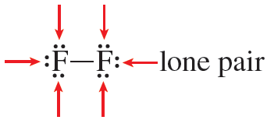
8.3
Covalent Bonding
Lewis Structures
Lewis summarized much of his theory of chemical bonding with the octet rule.
According to the octet rule, atoms will lose, gain, or share electrons to achieve a noble gas electron configuration.
Copyright © 2012, The McGraw-Hill Compaies, Inc. Permission required for reproduction or display.
27

Slide 28
8.3
Covalent Bonding
Lewis Structures
The structures used to represent molecules held together by covalent bonds, such as H₂ and F₂, are called Lewis structures.
A Lewis structure is a representation of covalent bonding in which shared electron pairs are shown either as dashes or as pairs of dots between two atoms, and lone pairs are shown as pairs of dots on individual atoms.
Copyright © 2012, The McGraw-Hill Compaies, Inc. Permission required for reproduction or display.
28

Slide 29
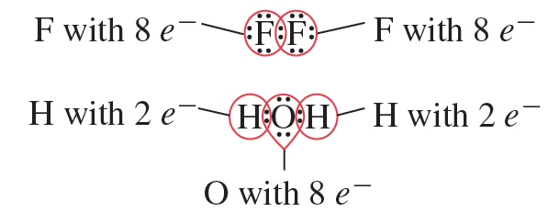
8.3
Covalent Bonding
Lewis Structures
The octet rule works best for elements in the second period of the periodic table. In Section 8.8, we will discuss some important exceptions to the octet rule.
Copyright © 2012, The McGraw-Hill Compaies, Inc. Permission required for reproduction or display.
29

Slide 30
8.3
Covalent Bonding
Multiple Bonds
In a single bond, two atoms are held together by one electron pair.
Multiple bonds form, on the other hand, when two atoms share two or more pairs of electrons.
A multiple bond in which the atoms share two pairs of electrons is called a double bond.
Copyright © 2012, The McGraw-Hill Compaies, Inc. Permission required for reproduction or display.
30

Slide 31
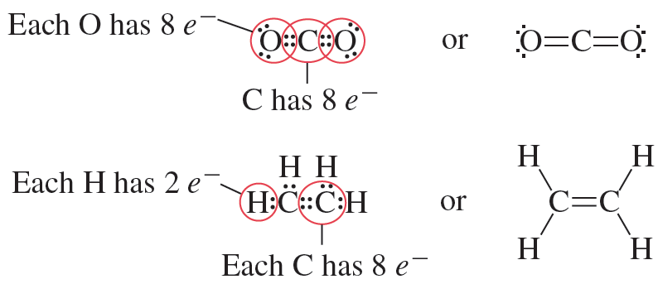
8.3
Covalent Bonding
Multiple Bonds
Copyright © 2012, The McGraw-Hill Compaies, Inc. Permission required for reproduction or display.
31

Slide 32
8.3
Covalent Bonding
Multiple Bonds
A triple bond arises when two atoms share three pairs of electrons:
Copyright © 2012, The McGraw-Hill Compaies, Inc. Permission required for reproduction or display.
32

Slide 33
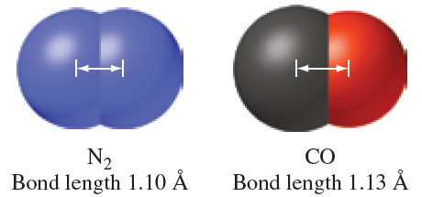
8.3
Covalent Bonding
Multiple Bonds
Bond length is defined as the distance between the nuclei of two covalently bonded atoms in a molecule.
Copyright © 2012, The McGraw-Hill Compaies, Inc. Permission required for reproduction or display.
33

Slide 34
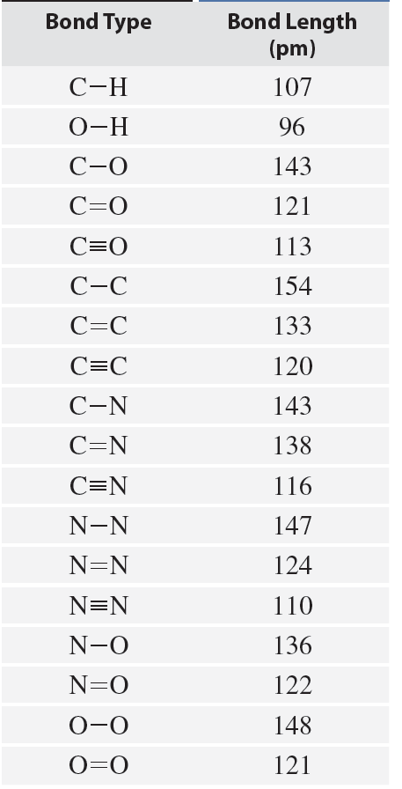
8.3
Covalent Bonding
Multiple Bonds
Multiple bonds are shorter
than single bonds.
Copyright © 2012, The McGraw-Hill Compaies, Inc. Permission required for reproduction or display.
34

Slide 35
8.3
Covalent Bonding
Comparison of Ionic and Covalent Compounds
Ionic and covalent compounds differ markedly in their general physical properties because of differences in the nature of their bonds.
There are two types of attractive forces in covalent compounds, the intramolecular bonding force that holds the atoms together in a molecule, and the intermolecular forces between molecules.
Copyright © 2012, The McGraw-Hill Compaies, Inc. Permission required for reproduction or display.
35

Slide 36
8.3
Covalent Bonding
Comparison of Ionic and Covalent Compounds
Intermolecular forces are usually quite weak compared to the forces holding atoms together within a molecule, so molecules of a covalent compound are not held together tightly.
As a result, covalent compounds are usually gases, liquids, or low- melting solids.
Copyright © 2012, The McGraw-Hill Compaies, Inc. Permission required for reproduction or display.
36

Slide 37
8.3
Covalent Bonding
Comparison of Ionic and Covalent Compounds
On the other hand, the electrostatic forces holding ions together in an ionic compound are usually very strong, so ionic compounds are solids at room temperature and have high melting points.
Many ionic compounds are soluble in water, and the resulting aqueous solutions conduct electricity because the compounds are strong electrolytes.
Copyright © 2012, The McGraw-Hill Compaies, Inc. Permission required for reproduction or display.
37

Slide 38
8.3
Covalent Bonding
Comparison of Ionic and Covalent Compounds
Most covalent compounds are insoluble in water, or if they do dissolve, their aqueous solutions generally do not conduct electricity, because the compounds are nonelectrolytes.
Molten ionic compounds conduct electricity because they contain mobile cations and anions; liquid or molten covalent compounds do not conduct electricity because no ions are present.
Copyright © 2012, The McGraw-Hill Compaies, Inc. Permission required for reproduction or display.
38

Slide 39
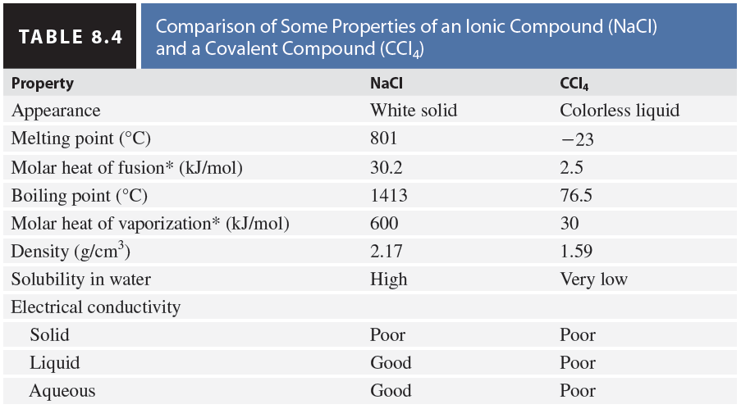
8.3
Covalent Bonding
Comparison of Ionic and Covalent Compounds
Copyright © 2012, The McGraw-Hill Compaies, Inc. Permission required for reproduction or display.
39

Slide 40
8.4
Electronegativity and Polarity
Electronegativity
Dipole Moment, Partial Charges, and Percent Ionic Character
Copyright © 2012, The McGraw-Hill Compaies, Inc. Permission required for reproduction or display.
40

Slide 41
8.4
Electronegativity and Polarity
Electronegativity
So far, we have described chemical bonds as either ionic, when they occur between a metal and a nonmetal, or covalent, when they occur between nonmetals.
In fact, ionic and covalent bonds are simply the extremes in a spectrum of bonding.
Bonds that fall between these two extremes are polar, meaning that electrons are shared but are not shared equally. Such bonds are referred to as polar covalent bonds.
Copyright © 2012, The McGraw-Hill Compaies, Inc. Permission required for reproduction or display.
41

Slide 42
8.4
Electronegativity and Polarity
Electronegativity
Copyright © 2012, The McGraw-Hill Compaies, Inc. Permission required for reproduction or display.
42

Slide 43
8.4
Electronegativity and Polarity
Electronegativity
Electronegativity is the ability of an atom in a compound to draw electrons to itself.
Elements with high electronegativity have a greater tendency to attract electrons than do elements with low electronegativity.
Electronegativity is related to electron affinity and ionization energy. An atom such as fluorine, which has a high electron affinity (tends to accept electrons) and a high ionization energy (does not lose electrons easily), has a high electronegativity.
Copyright © 2012, The McGraw-Hill Compaies, Inc. Permission required for reproduction or display.
43

Slide 44
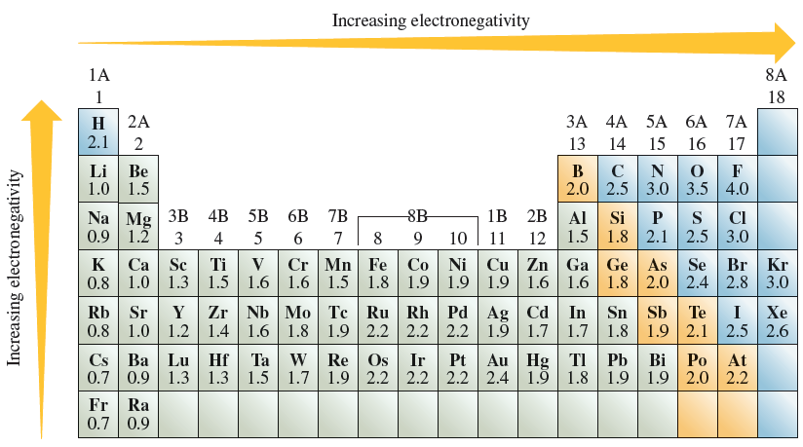
8.4
Electronegativity and Polarity
Electronegativity
Copyright © 2012, The McGraw-Hill Compaies, Inc. Permission required for reproduction or display.
44

Slide 45
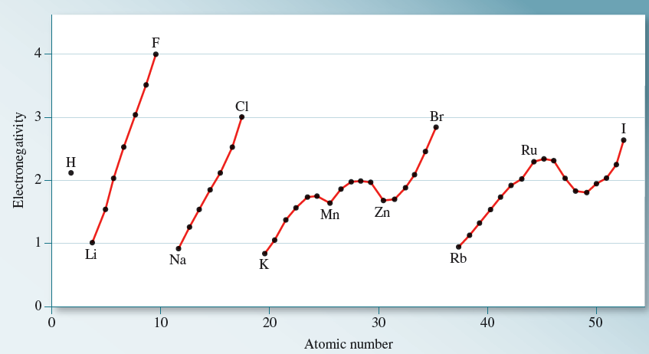
8.4
Electronegativity and Polarity
Electronegativity
Copyright © 2012, The McGraw-Hill Compaies, Inc. Permission required for reproduction or display.
45

Slide 46
8.4
Electronegativity and Polarity
Electronegativity
There is no sharp distinction between nonpolar covalent and polar covalent or between polar covalent and ionic, but the following guidelines can help distinguish among them:
A bond between atoms whose electronegativities differ by less than 0.5 is generally considered purely covalent or nonpolar.
A bond between atoms whose electronegativities differ by the range of 0.5 to 2.0 is generally considered polar covalent.
A bond between atoms whose electronegativities differ by 2.0 or more is generally considered ionic.
Copyright © 2012, The McGraw-Hill Compaies, Inc. Permission required for reproduction or display.
46

Slide 47
8.4
Electronegativity and Polarity
8.4
Classify the following bonds as nonpolar, polar, or ionic:
the bond in ClF
the bond in CsBr
the carbon-carbon double bond in C₂H₄
Setup
Electronegativity values are:
Cl (3.0), F (4.0), Cs (0.7), Br (2.8), C (2.5)
Electronegativity
Copyright © 2012, The McGraw-Hill Compaies, Inc. Permission required for reproduction or display.
47

Slide 48
8.4
Electronegativity and Polarity
8.4
Solution
The difference between the electronegativities of F and Cl is 4.0 – 3.0 = 1.0, making the bond in ClF polar.
In CsBr, 2.8 – 0.7 = 2.1, making the bond ionic.
In C₂H₄, the two atoms are identical. (Not only are they the same element, but each C atom is bonded to two H atoms.) The carbon-carbon double bond in C₂H₄ is nonpolar.
Electronegativity
Copyright © 2012, The McGraw-Hill Compaies, Inc. Permission required for reproduction or display.
48

Slide 49
8.4
Electronegativity and Polarity
Dipole Moment, Partial Charges, and Percent Ionic Character
The shift of electron density in a polar bond is symbolized by a crossed arrow (a dipole arrow).
Copyright © 2012, The McGraw-Hill Compaies, Inc. Permission required for reproduction or display.
49

Slide 50
8.4
Electronegativity and Polarity
Dipole Moment, Partial Charges, and Percent Ionic Character
A quantitative measure of the polarity of a bond is its dipole moment (μ):
Q refers to the magnitude of the partial charges and the calculated value of μ is always positive.
Dipole moments are usually expressed in debye units (D). In terms of more familiar SI units,
Copyright © 2012, The McGraw-Hill Compaies, Inc. Permission required for reproduction or display.
50

Slide 51
8.4
Electronegativity and Polarity
Dipole Moment, Partial Charges, and Percent Ionic Character
Copyright © 2012, The McGraw-Hill Compaies, Inc. Permission required for reproduction or display.
51

Slide 52
8.4
Electronegativity and Polarity
8.5
Determine the magnitude of the partial positive and partial negative charges in the HF molecule.
Setup
According to Table 8.5, μ = 1.82 D and r = 0.92 Å for HF.
The dipole moment must be converted from debye to C·m and the distance between the ions must be converted to meters.
Dipole Moment, Partial Charges, and Percent Ionic Character
Copyright © 2012, The McGraw-Hill Compaies, Inc. Permission required for reproduction or display.
52

Slide 53
8.4
Electronegativity and Polarity
8.5
Setup
Dipole Moment, Partial Charges, and Percent Ionic Character
Copyright © 2012, The McGraw-Hill Compaies, Inc. Permission required for reproduction or display.
53

Slide 54
8.4
Electronegativity and Polarity
8.5
Solution
Dipole Moment, Partial Charges, and Percent Ionic Character
Copyright © 2012, The McGraw-Hill Compaies, Inc. Permission required for reproduction or display.
54

Slide 55
8.4
Electronegativity and Polarity
Dipole Moment, Partial Charges, and Percent Ionic Character
Copyright © 2012, The McGraw-Hill Compaies, Inc. Permission required for reproduction or display.
55

Slide 56
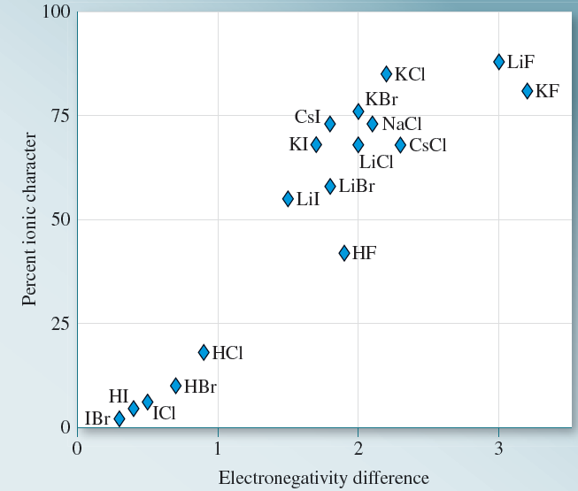
8.4
Electronegativity and Polarity
Dipole Moment, Partial Charges, and Percent Ionic Character
Copyright © 2012, The McGraw-Hill Compaies, Inc. Permission required for reproduction or display.
56

Slide 57
8.4
Electronegativity and Polarity
8.6
Using data from Table 8.5, calculate the percent ionic character of the bond in HI.
Setup
From Table 8.5, the bond length in HI is 1.61Å (1.61 × 10^{–10} m) and the measured dipole moment of HI is 0.44 D.
Dipole Moment, Partial Charges, and Percent Ionic Character
Copyright © 2012, The McGraw-Hill Compaies, Inc. Permission required for reproduction or display.
57

Slide 58
8.4
Electronegativity and Polarity
8.6
Solution
The dipole moment we would expect if the magnitude of charges were 1.6022 × 10^{–19} C is
Dipole Moment, Partial Charges, and Percent Ionic Character
Copyright © 2012, The McGraw-Hill Compaies, Inc. Permission required for reproduction or display.
58

Slide 59
8.5
Drawing Lewis Structures
Drawing Lewis Structures
Copyright © 2012, The McGraw-Hill Compaies, Inc. Permission required for reproduction or display.
59

Slide 60
8.5
Drawing Lewis Structures
Drawing Lewis Structures
From the molecular formula, draw the skeletal structure of the compound, using chemical symbols and placing bonded atoms next to one another. In general, the least electronegative atom will be the central atom. (H cannot be a central atom because it only forms one covalent bond.) Draw a single covalent bond (dash) between the central atom and each of the surrounding atoms.
Copyright © 2012, The McGraw-Hill Compaies, Inc. Permission required for reproduction or display.
60

Slide 61
8.5
Drawing Lewis Structures
Drawing Lewis Structures
Count the total number of valence electrons present. For polyatomic ions, add electrons to the total number to account for negative charges; sub tract electrons from the total number to account for positive charges.
Copyright © 2012, The McGraw-Hill Compaies, Inc. Permission required for reproduction or display.
61

Slide 62
8.5
Drawing Lewis Structures
Drawing Lewis Structures
For each bond (dash) in the skeletal structure, subtract two electrons from the total valence electrons to determine the number of remaining electrons.
Use the remaining electrons to complete the octets of the terminal atoms (those bonded to the central atom) by placing pairs of electrons on each atom. If there is more than one type of terminal atom, complete the octets of the most electronegative atoms first.
Copyright © 2012, The McGraw-Hill Compaies, Inc. Permission required for reproduction or display.
62

Slide 63
8.5
Drawing Lewis Structures
Drawing Lewis Structures
If any electrons remain after step 4, place them in pairs on the central atom.
If the central atom has fewer than eight electrons after completing steps 1 to 5, move one or more pairs from the terminal atoms to form multiple bonds between the central atom and the terminal atoms. (Unless the central atom is a Group 3A element.)
Copyright © 2012, The McGraw-Hill Compaies, Inc. Permission required for reproduction or display.
63

Slide 64
8.5
Drawing Lewis Structures
8.7
Draw the Lewis structure for carbon disulfide (CS₂).
Setup
Step 1: C and S have identical electronegativities. We will draw the skeletal structure with the unique atom, C, at the center.
Step 2: The total number of valence electrons: 2(6) + 4 = 16.
Step 3: Subtract four electrons to account for the bonds in the skeletal structure, leaving us 12 electrons to distribute.
Copyright © 2012, The McGraw-Hill Compaies, Inc. Permission required for reproduction or display.
64

Slide 65
8.5
Drawing Lewis Structures
8.7
Setup
Step 4: Distribute the 12 remaining electrons as three lone pairs on each S atom.
Step 5: There are no electrons remaining after step 4, so step 5 does not apply.
Step 6: To complete carbon’s octet, use one lone pair from each S atom to make a double bond to the C atom.
Copyright © 2012, The McGraw-Hill Compaies, Inc. Permission required for reproduction or display.
65

Slide 66
8.6
Lewis Structures and Formal Charge
Lewis Structures and Formal Charge
Copyright © 2012, The McGraw-Hill Compaies, Inc. Permission required for reproduction or display.
66

Slide 67
8.6
Lewis Structures and Formal Charge
Lewis Structures and Formal Charge
Formal charge can be used to determine the most plausible Lewis structures when more than one possibility exists for a compound.
All the atom’s nonbonding electrons are associated with the atom.
Half of the atom’s bonding electrons are associated with the atom.
Copyright © 2012, The McGraw-Hill Compaies, Inc. Permission required for reproduction or display.
67

Slide 68
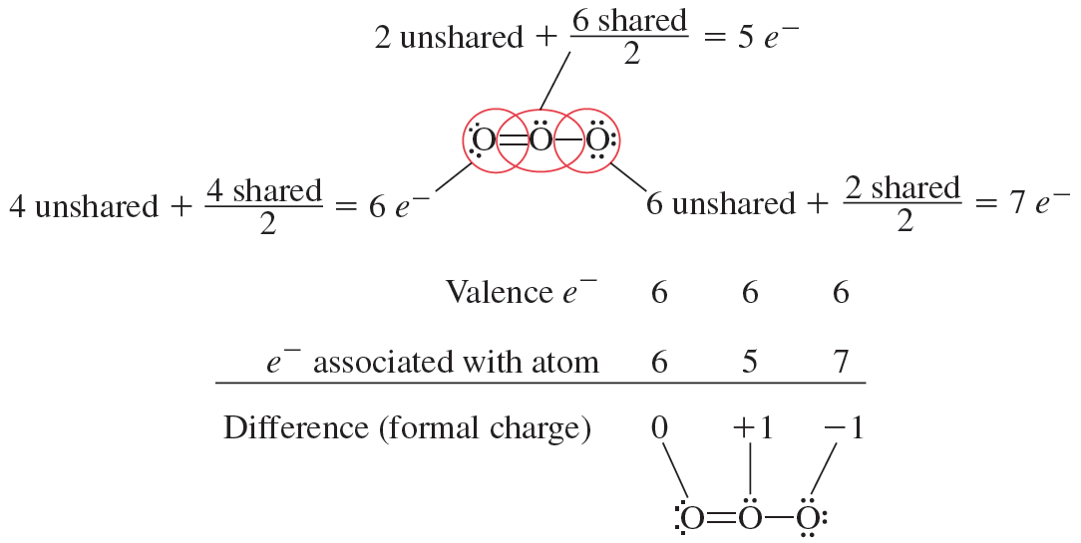
8.6
Lewis Structures and Formal Charge
Lewis Structures and Formal Charge
Copyright © 2012, The McGraw-Hill Compaies, Inc. Permission required for reproduction or display.
68

Slide 69
8.6
Lewis Structures and Formal Charge
Lewis Structures and Formal Charge
For molecules, the formal charges must sum to zero.
For ions, the formal charges must sum to the overall charge on the ion.
Copyright © 2012, The McGraw-Hill Compaies, Inc. Permission required for reproduction or display.
69

Slide 70
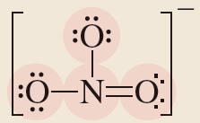
8.8
Determine the formal charges on each atom in the nitrate ion (NO₃– ).
Setup
Solution
The formal charges are as follows: +1 (N atom), –1 (singly bonded O atoms), and 0 (doubly bonded O atom).
Copyright © 2012, The McGraw-Hill Compaies, Inc. Permission required for reproduction or display.
70

Slide 71
8.6
Lewis Structures and Formal Charge
Lewis Structures and Formal Charge
When there is more than one possible skeletal arrangement of atoms, we often can select the best skeletal arrangement by using formal charges and the following guidelines:
For molecules, a Lewis structure in which all formal charges are zero is preferred to one in which there are nonzero formal charges.
Lewis structures with small formal charges (0 and ±1) are preferred to those with large formal charges (±2, ±3, and so on).
Copyright © 2012, The McGraw-Hill Compaies, Inc. Permission required for reproduction or display.
71

Slide 72
8.6
Lewis Structures and Formal Charge
Lewis Structures and Formal Charge
When there is more than one possible skeletal arrangement of atoms, we often can select the best skeletal arrangement by using formal charges and the following guidelines:
The best skeletal arrangement of atoms will give rise to Lewis structures in which the formal charges are consistent with electronegativities.
Copyright © 2012, The McGraw-Hill Compaies, Inc. Permission required for reproduction or display.
72

Slide 73
8.6
Lewis Structures and Formal Charge
8.9
Formaldehyde (CH₂O), which can be used to preserve biological specimens, is commonly sold as a 37% aqueous solution. Use formal charges to determine which skeletal arrangement of atoms shown here is the best choice for the Lewis structure of CH₂O.
Copyright © 2012, The McGraw-Hill Compaies, Inc. Permission required for reproduction or display.
73

Slide 74
8.6
Lewis Structures and Formal Charge
8.9
Strategy
Complete the Lewis structures for each of the CH₂O skeletons shown and determine the formal charges on the atoms in each one.
Setup
Copyright © 2012, The McGraw-Hill Compaies, Inc. Permission required for reproduction or display.
74

Slide 75
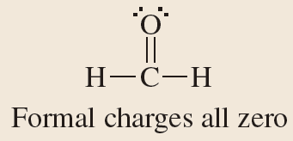
8.6
Lewis Structures and Formal Charge
8.9
Solution
Copyright © 2012, The McGraw-Hill Compaies, Inc. Permission required for reproduction or display.
75

Slide 76
8.7
Resonance
Resonance
Copyright © 2012, The McGraw-Hill Compaies, Inc. Permission required for reproduction or display.
76

Slide 77
8.7
Resonance
Resonance
A resonance structure is one of two or more Lewis structures for a single molecule that cannot be represented accurately by only one Lewis structure.
Copyright © 2012, The McGraw-Hill Compaies, Inc. Permission required for reproduction or display.
77

Slide 78
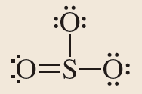
8.10
Draw all possible resonance structures of sulfur trioxide, SO₃.
Setup
Copyright © 2012, The McGraw-Hill Compaies, Inc. Permission required for reproduction or display.
78

Slide 79
8.10
Solution
Copyright © 2012, The McGraw-Hill Compaies, Inc. Permission required for reproduction or display.
79

Slide 80
8.8
Exceptions to the Octet Rule
Incomplete Octets
Odd Numbers of Electrons
Expanded Octets
Copyright © 2012, The McGraw-Hill Compaies, Inc. Permission required for reproduction or display.
80

Slide 81
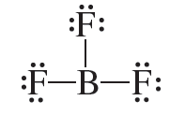
8.8
Exceptions to the Octet Rule
Incomplete Octets
In some compounds the number of electrons surrounding the central atom in a stable molecule is fewer than eight.
Copyright © 2012, The McGraw-Hill Compaies, Inc. Permission required for reproduction or display.
81

Slide 82
8.8
Exceptions to the Octet Rule
Odd Numbers of Electrons
Some molecules contain an odd number of electrons. The octet rule cannot be obeyed for all the atoms in these molecules.
Molecules with an odd number of electrons are sometimes referred to as free radicals (or just radicals).
Copyright © 2012, The McGraw-Hill Compaies, Inc. Permission required for reproduction or display.
82

Slide 83
8.11
Draw the Lewis structure of chlorine dioxide (ClO₂).
Strategy
Setup
There are a total of 19 valence electrons.
Copyright © 2012, The McGraw-Hill Compaies, Inc. Permission required for reproduction or display.
83

Slide 84
8.11
Solution
Copyright © 2012, The McGraw-Hill Compaies, Inc. Permission required for reproduction or display.
84

Slide 85
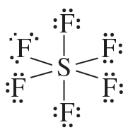
8.8
Exceptions to the Octet Rule
Expanded Octets
Atoms of the second-period elements cannot have more than 8 valence electrons around them, but atoms of elements in and beyond the 3rd period of the periodic table can.
In addition to the 3s and 3p orbitals, elements in the third period also have 3d orbitals that can be used in bonding.
Ex: SF₆
Copyright © 2012, The McGraw-Hill Compaies, Inc. Permission required for reproduction or display.
85

Slide 86
8.12
Draw the Lewis structures of
boron triiodide (BI₃)
arsenic pentafluoride (AsF₅)
xenon tetrafluoride (XeF₄)
Strategy
Copyright © 2012, The McGraw-Hill Compaies, Inc. Permission required for reproduction or display.
86

Slide 87
8.12
Setup
24 valence electrons, 18 to distribute
40 valence electrons, 30 to distribute
36 valence electrons , 28 to distribute
Copyright © 2012, The McGraw-Hill Compaies, Inc. Permission required for reproduction or display.
87

Slide 88
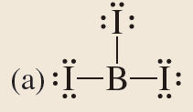
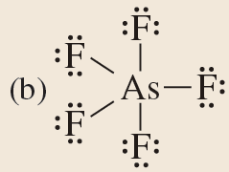
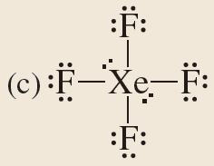
8.12
Solution
Copyright © 2012, The McGraw-Hill Compaies, Inc. Permission required for reproduction or display.
88

Slide 89
8.9
Bond Enthalpy
Bond Enthalpy
Copyright © 2012, The McGraw-Hill Compaies, Inc. Permission required for reproduction or display.
89

Slide 90
8.9
Bond Enthalpy
Bond Enthalpy
One measure of the stability of a molecule is its bond enthalpy, which is the enthalpy change associated with breaking a particular bond in 1 mole of gaseous molecules.
Copyright © 2012, The McGraw-Hill Compaies, Inc. Permission required for reproduction or display.
90

Slide 91
8.9
Bond Enthalpy
Bond Enthalpy
Measuring the strength of covalent bonds in polyatomic molecules is more complicated than for diatomic molecules.
For polyatomic molecules, therefore, we speak of the average bond enthalpy of a particular bond.
Copyright © 2012, The McGraw-Hill Compaies, Inc. Permission required for reproduction or display.
91

Slide 92
8.9
Bond Enthalpy
Bond Enthalpy
The approximate enthalpy of a reaction can be calculated by using the average bond enthalpies.
Copyright © 2012, The McGraw-Hill Compaies, Inc. Permission required for reproduction or display.
92

Slide 93
8.9
Bond Enthalpy
Bond Enthalpy
Copyright © 2012, The McGraw-Hill Compaies, Inc. Permission required for reproduction or display.
93

Slide 94
8.9
Bond Enthalpy
Bond Enthalpy
Copyright © 2012, The McGraw-Hill Compaies, Inc. Permission required for reproduction or display.
94

Slide 95
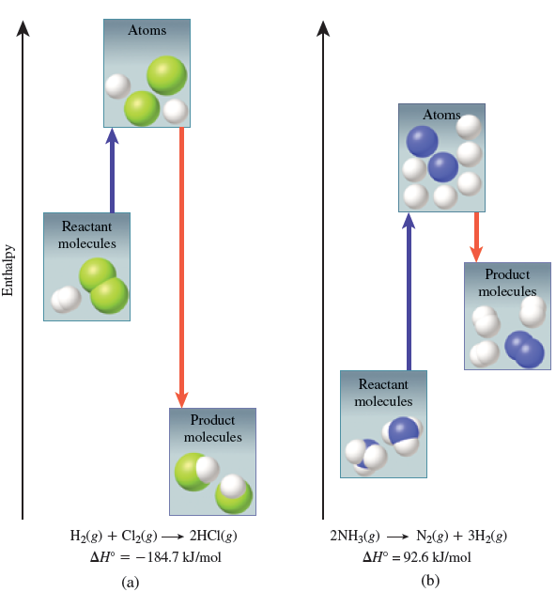
8.9
Bond Enthalpy
Bond Enthalpy
Copyright © 2012, The McGraw-Hill Compaies, Inc. Permission required for reproduction or display.
95

Slide 96
8.13
Use bond enthalpies from Table 8.6 to estimate the enthalpy of reaction for the combustion of methane:
Setup
Copyright © 2012, The McGraw-Hill Compaies, Inc. Permission required for reproduction or display.
96

Slide 97
8.13
Solution
Copyright © 2012, The McGraw-Hill Compaies, Inc. Permission required for reproduction or display.
97

