Slide 1


Chemistry
Third Edition
Julia Burdge
Lecture PowerPoints
Chapter 5
Thermochemistry
Copyright © 2012, The McGraw-Hill Compaies, Inc. Permission required for reproduction or display.
1

Slide 2
5
Thermochemistry
5.1 | Energy and Energy Changes
5.2 | Introduction to Thermodynamics
5.3 | Enthalpy
5.4 | Calorimetry
5.5 | Hess’s Law
5.6 | Standard Enthalpies of Formation
Copyright © 2012, The McGraw-Hill Compaies, Inc. Permission required for reproduction or display.
2

Slide 3
5.1
Energy and Energy Changes
Forms of Energy
Energy Changes in Chemical Reactions
Units of Energy
Copyright © 2012, The McGraw-Hill Compaies, Inc. Permission required for reproduction or display.
3

Slide 4

5.1
Energy and Energy Changes
Forms of Energy
Energy is usually defined as the capacity to do work or transfer heat.
All forms of energy are either kinetic or potential.
Kinetic energy is the energy that results from motion. It is calculated with the equation
where m is the mass of the object and u is its velocity.
Copyright © 2012, The McGraw-Hill Compaies, Inc. Permission required for reproduction or display.
4

Slide 5
5.1
Energy and Energy Changes
Forms of Energy
One form of kinetic energy of particular interest to chemists is thermal energy, which is the energy associated with the random motion of atoms and molecules.
We can monitor changes in thermal energy by measuring temperature changes.
Copyright © 2012, The McGraw-Hill Compaies, Inc. Permission required for reproduction or display.
5

Slide 6
5.1
Energy and Energy Changes
Forms of Energy
Potential energy is the energy possessed by an object by virtue of its position.
The two forms of potential energy of greatest interest to chemists are chemical energy and electrostatic energy.
Chemical energy is energy stored within the structural units (molecules or polyatomic ions) of chemical substances. The amount of chemical energy in a sample of matter depends on the types and arrangements of atoms in the structural units that make up the sample.
Copyright © 2012, The McGraw-Hill Compaies, Inc. Permission required for reproduction or display.
6

Slide 7

5.1
Energy and Energy Changes
Forms of Energy
Electrostatic energy is potential energy that results from the interaction of charged particles.
Oppositely charged particles attract each other, whereas particles of like charges repel each other.
The magnitude of the resulting electrostatic potential energy is proportional to the product of the two charges (Q₁ and Q₂) divided by the distance (d) between them.
Copyright © 2012, The McGraw-Hill Compaies, Inc. Permission required for reproduction or display.
7

Slide 8
5.1
Energy and Energy Changes
Forms of Energy
Kinetic and potential energy are interconvertible.
For example, dropping an object and allowing it to fall converts potential energy to kinetic energy.
Likewise, a chemical reaction that gives off heat converts chemical energy (potential) to thermal energy (kinetic).
Copyright © 2012, The McGraw-Hill Compaies, Inc. Permission required for reproduction or display.
8

Slide 9
5.1
Energy and Energy Changes
Forms of Energy
Although energy can assume many different forms that are interconvertible, the total amount of energy in the universe is constant.
When energy of one form disappears, the same amount of energy must appear in another form or forms. This principle is known as the law of conservation of energy.
Copyright © 2012, The McGraw-Hill Compaies, Inc. Permission required for reproduction or display.
9

Slide 10
5.1
Energy and Energy Changes
Energy Changes in Chemical Reactions
The system is defined as the specific part of the universe that is of interest to us.
The rest of the universe outside the system constitutes the surroundings.
Copyright © 2012, The McGraw-Hill Compaies, Inc. Permission required for reproduction or display.
10

Slide 11
5.1
Energy and Energy Changes
Energy Changes in Chemical Reactions
Heat is the transfer of thermal energy between two bodies that are at different temperatures.
Although the term heat by itself implies the transfer of energy, we customarily talk of “heat flow,” meaning “heat absorbed” or “heat released,” when describing the energy changes that occur during a process.
Thermochemistry is the study of heat (the transfer of thermal energy) in chemical reactions.
Copyright © 2012, The McGraw-Hill Compaies, Inc. Permission required for reproduction or display.
11

Slide 12
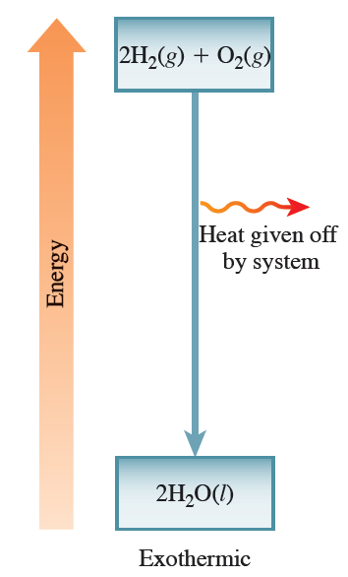
5.1
Energy and Energy Changes
Energy Changes in Chemical Reactions
An exothermic process is a process that gives off heat.
Copyright © 2012, The McGraw-Hill Compaies, Inc. Permission required for reproduction or display.
12

Slide 13
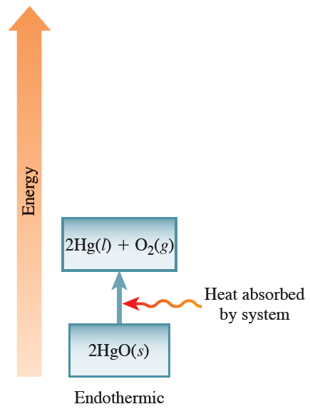
5.1
Energy and Energy Changes
Energy Changes in Chemical Reactions
An endothermic process is a process that absorbs thermal energy as heat.
Copyright © 2012, The McGraw-Hill Compaies, Inc. Permission required for reproduction or display.
13

Slide 14


5.1
Energy and Energy Changes
Units of Energy
The SI unit of energy is the joule (J). It is the amount of kinetic energy possessed by a 2-kg mass moving at a speed of 1 m/s.
The joule can also be defined as the amount of energy exerted when a force of 1 newton (N) is applied over a distance of 1 meter.
Copyright © 2012, The McGraw-Hill Compaies, Inc. Permission required for reproduction or display.
14

Slide 15
5.1
Energy and Energy Changes
5.1
Calculate the kinetic energy of a helium atom moving at a speed of 125 m/s.
How much greater is the magnitude of electrostatic attraction between an electron and a nucleus containing three protons versus that between an electron and a nucleus containing one proton? (Assume that the distance between the nucleus and the electron is the same in each case.)
Energy Changes in Chemical Reactions
Copyright © 2012, The McGraw-Hill Compaies, Inc. Permission required for reproduction or display.
15

Slide 16
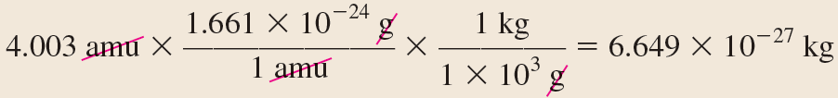
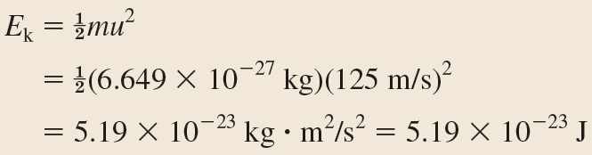
5.1
Energy and Energy Changes
5.1
Solution
(a)
Energy Changes in Chemical Reactions
Copyright © 2012, The McGraw-Hill Compaies, Inc. Permission required for reproduction or display.
16

Slide 17
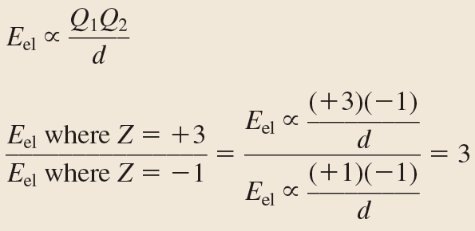
5.1
Energy and Energy Changes
5.1
Solution
(b)
Energy Changes in Chemical Reactions
The electrostatic potential energy between charges of +3 and –1 is three times that between charges of +1 and –1.
Copyright © 2012, The McGraw-Hill Compaies, Inc. Permission required for reproduction or display.
17

Slide 18



5.1
Energy and Energy Changes
Units of Energy
Another unit used to express energy is the calorie (cal).
Copyright © 2012, The McGraw-Hill Compaies, Inc. Permission required for reproduction or display.
18

Slide 19
5.2
Introduction to Thermodynamics
States and State Functions
The First Law of Thermodynamics
Work and Heat
Copyright © 2012, The McGraw-Hill Compaies, Inc. Permission required for reproduction or display.
19

Slide 20
5.2
Introduction to Thermodynamics
States and State Functions
Thermochemistry is part of a broader subject called thermodynamics, which is the scientific study of the interconversion of heat and other kinds of energy.
An open system can exchange mass and energy with its surroundings.
A closed system allows the transfer of energy but not mass.
An isolated system does not exchange either mass or energy with its surroundings.
Copyright © 2012, The McGraw-Hill Compaies, Inc. Permission required for reproduction or display.
20

Slide 21
5.2
Introduction to Thermodynamics
States and State Functions
In thermodynamics, we study changes in the state of a system, which is defined by the values of all relevant macroscopic properties, such as composition, energy, temperature, pressure, and volume.
Energy, pressure, volume, and temperature are said to be state functions—properties that are determined by the state of the system, regardless of how that condition was achieved.
Copyright © 2012, The McGraw-Hill Compaies, Inc. Permission required for reproduction or display.
21

Slide 22


5.2
Introduction to Thermodynamics
The First Law of Thermodynamics
The first law of thermodynamics, which is based on the law of conservation of energy, states that energy can be converted from one form to another but cannot be created or destroyed.
Copyright © 2012, The McGraw-Hill Compaies, Inc. Permission required for reproduction or display.
22

Slide 23

5.2
Introduction to Thermodynamics
The First Law of Thermodynamics
The change in internal energy of a system, ΔU, is given by
Copyright © 2012, The McGraw-Hill Compaies, Inc. Permission required for reproduction or display.
23

Slide 24
5.2
Introduction to Thermodynamics
Work and Heat
Energy is defined as the capacity to do work or transfer heat.
When a system releases or absorbs heat, its internal energy changes.
Likewise, when a system does work on its surroundings, or when the surroundings do work on the system, the system’s internal energy also changes.
Copyright © 2012, The McGraw-Hill Compaies, Inc. Permission required for reproduction or display.
24

Slide 25

5.2
Introduction to Thermodynamics
Work and Heat
The overall change in the system’s internal energy is given by
where q is heat (released or absorbed by the system) and w is work (done on the system or done by the system).
Neither q nor w is a state function. Each depends on the path between the initial and final states of the system.
Their sum, ΔU, does not depend on the path between initial and final states because U is a state function.
Copyright © 2012, The McGraw-Hill Compaies, Inc. Permission required for reproduction or display.
25

Slide 26
5.2
Introduction to Thermodynamics
5.2
Calculate the overall change in internal energy, ΔU, (in joules) for a system that absorbs 188 J of heat and does 141 J of work on its surroundings.
Setup
The system absorbs heat, so q is positive. The system does work on the surroundings, so w is negative.
Solution
Work and Heat
Copyright © 2012, The McGraw-Hill Compaies, Inc. Permission required for reproduction or display.
26

Slide 27
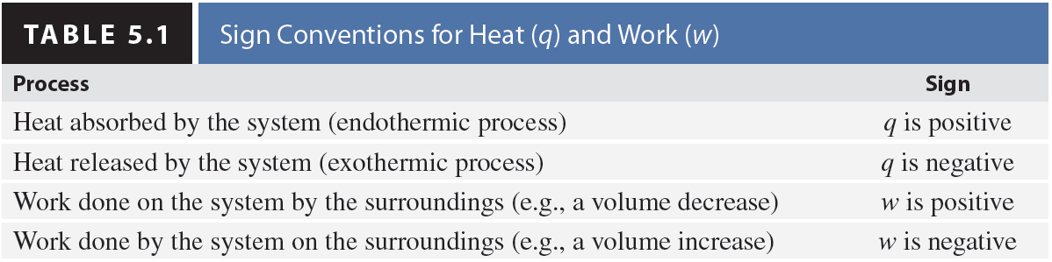
5.2
Introduction to Thermodynamics
Work and Heat
Copyright © 2012, The McGraw-Hill Compaies, Inc. Permission required for reproduction or display.
27

Slide 28
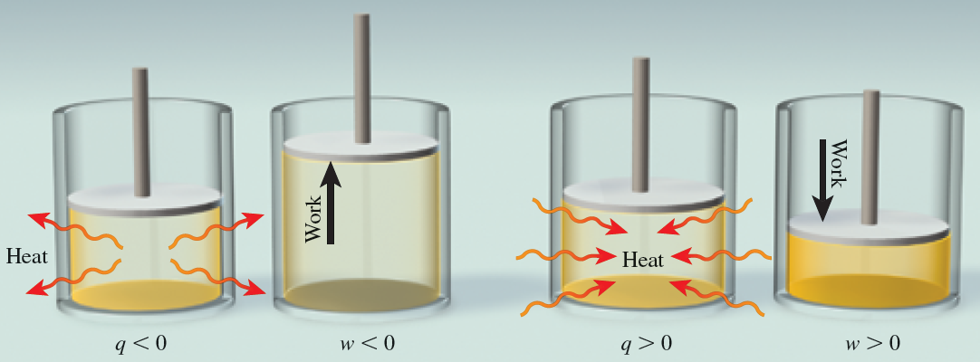
5.2
Introduction to Thermodynamics
Work and Heat
Copyright © 2012, The McGraw-Hill Compaies, Inc. Permission required for reproduction or display.
28

Slide 29
5.3
Enthalpy
Reactions Carried Out at Constant Volume or at Constant Pressure
Enthalpy and Enthalpy Changes
Thermochemical Equations
Copyright © 2012, The McGraw-Hill Compaies, Inc. Permission required for reproduction or display.
29

Slide 30
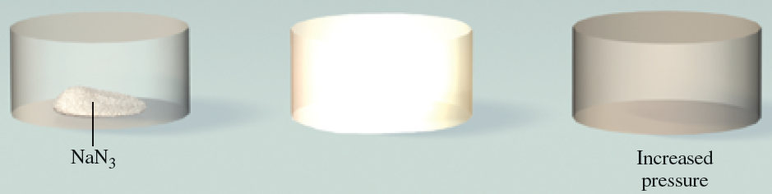
5.3
Enthalpy
Reactions Carried Out at Constant Volume or at Constant Pressure
Copyright © 2012, The McGraw-Hill Compaies, Inc. Permission required for reproduction or display.
30

Slide 31
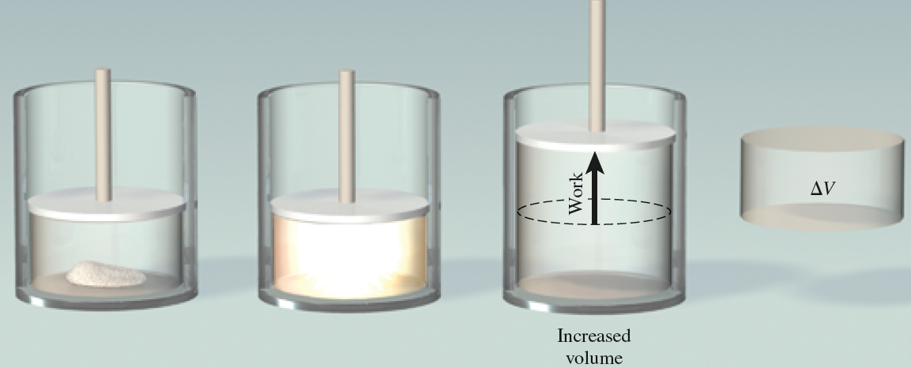

5.3
Enthalpy
Reactions Carried Out at Constant Volume or at Constant Pressure
Copyright © 2012, The McGraw-Hill Compaies, Inc. Permission required for reproduction or display.
31

Slide 32




5.3
Enthalpy
Reactions Carried Out at Constant Volume or at Constant Pressure
For a system that can do only PV work:
If volume is constant:
If pressure is constant:
Copyright © 2012, The McGraw-Hill Compaies, Inc. Permission required for reproduction or display.
32

Slide 33



5.3
Enthalpy
Enthalpy and Enthalpy Changes
There is a thermodynamic function of a system called enthalpy (H), which is defined as
H is a state function.
For any process, the change in enthalpy is given by
At constant pressure:
Copyright © 2012, The McGraw-Hill Compaies, Inc. Permission required for reproduction or display.
33

Slide 34




5.3
Enthalpy
Enthalpy and Enthalpy Changes
Copyright © 2012, The McGraw-Hill Compaies, Inc. Permission required for reproduction or display.
34

Slide 35
5.3
Enthalpy
Enthalpy and Enthalpy Changes
Because most laboratory reactions are constant-pressure processes, the heat exchanged between the system and surroundings is equal to the change in enthalpy for the process.
For any reaction, we define the change in enthalpy, called the enthalpy of reaction (ΔH), as the difference between the enthalpies of the products and the enthalpies of the reactants:
Copyright © 2012, The McGraw-Hill Compaies, Inc. Permission required for reproduction or display.
35

Slide 36


5.3
Enthalpy
Thermochemical Equations
Thermochemical equations are chemical equations that show the enthalpy changes as well as the mass relationships.
The ΔH value of –890.4 kJ/mol can be expressed in any of the following ways:
Copyright © 2012, The McGraw-Hill Compaies, Inc. Permission required for reproduction or display.
36

Slide 37
5.3
Enthalpy
Thermochemical Equations
The following guidelines are helpful in interpreting, writing, and manipulating thermochemical equations:
Always specify the physical states of all reactants and products, because they help determine the actual enthalpy changes.
[In the equation for the combustion of methane, for example, changing the liquid water product to water vapor changes the value of ΔH.]
Copyright © 2012, The McGraw-Hill Compaies, Inc. Permission required for reproduction or display.
37

Slide 38
5.3
Enthalpy
Thermochemical Equations
If we multiply both sides of a thermochemical equation by a factor n, then ΔH must also change by the same factor.
Copyright © 2012, The McGraw-Hill Compaies, Inc. Permission required for reproduction or display.
38

Slide 39

5.3
Enthalpy
Thermochemical Equations
When we reverse a chemical equation, we change the roles of reactants and products. Consequently, the magnitude of ΔH for the equation remains the same, but its sign changes.
Copyright © 2012, The McGraw-Hill Compaies, Inc. Permission required for reproduction or display.
39

Slide 40


5.3
Enthalpy
5.3
Given the thermochemical equation for photosynthesis,
calculate the solar energy required to produce 75.0 g of C₆H₁₂O₆.
Setup
The molar mass of C₆H₁₂O₆ is 180.2 g/mol, so 75.0 g of C₆H₁₂O₆ is
Thermochemical Equations
Copyright © 2012, The McGraw-Hill Compaies, Inc. Permission required for reproduction or display.
40

Slide 41

5.3
Enthalpy
5.3
Solution
Thermochemical Equations
Therefore, 1.17 × 10³ kJ of energy in the form of sunlight is consumed in the production of 75.0 g of C₆H₁₂O₆.
Copyright © 2012, The McGraw-Hill Compaies, Inc. Permission required for reproduction or display.
41

Slide 42
5.4
Calorimetry
Specific Heat and Heat Capacity
Constant-Pressure Calorimetry
Constant-Volume Calorimetry
Copyright © 2012, The McGraw-Hill Compaies, Inc. Permission required for reproduction or display.
42

Slide 43
5.4
Calorimetry
Specific Heat and Heat Capacity
The specific heat (s) of a substance is the amount of heat required to raise the temperature of 1 g of the substance by 1°C.
The heat capacity (C) is the amount of heat required to raise the temperature of an object by 1°C.
Copyright © 2012, The McGraw-Hill Compaies, Inc. Permission required for reproduction or display.
43

Slide 44


5.4
Calorimetry
Specific Heat and Heat Capacity
For example, we can use the specific heat of water,
4.184 J/(g ⋅ °C), to determine the heat capacity of a kilogram of water:
Note that specific heat has the units J/(g ⋅ °C) and heat capacity has the units J/°C.
Copyright © 2012, The McGraw-Hill Compaies, Inc. Permission required for reproduction or display.
44

Slide 45


5.4
Calorimetry
Specific Heat and Heat Capacity
For a substance with specific heat s and mass m:
For an object with heat capacity C:
Copyright © 2012, The McGraw-Hill Compaies, Inc. Permission required for reproduction or display.
45

Slide 46
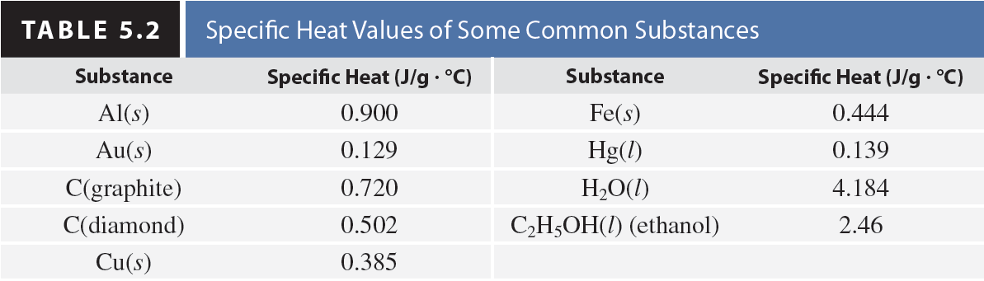
5.4
Calorimetry
Specific Heat and Heat Capacity
Copyright © 2012, The McGraw-Hill Compaies, Inc. Permission required for reproduction or display.
46

Slide 47
5.4
Calorimetry
5.4
Calculate the amount of heat (in kJ) required to heat 255 g of water from 25.2°C to 90.5°C.
Strategy
Use q = smΔT to calculate q.
Setup
m = 255 g, s = 4.184 J/g · °C, ΔT = 90.5°C – 25.2°C = 65.3°C
Specific Heat and Heat Capacity
Copyright © 2012, The McGraw-Hill Compaies, Inc. Permission required for reproduction or display.
47

Slide 48
5.4
Calorimetry
5.4
Solution
Specific Heat and Heat Capacity
Copyright © 2012, The McGraw-Hill Compaies, Inc. Permission required for reproduction or display.
48

Slide 49
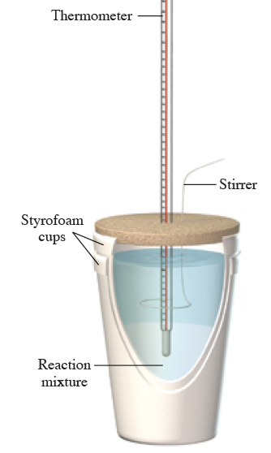



5.4
Calorimetry
Constant-Pressure Calorimetry
Copyright © 2012, The McGraw-Hill Compaies, Inc. Permission required for reproduction or display.
49

Slide 50
5.4
Calorimetry
5.5
A metal pellet with a mass of 100.0 g, originally at 88.4°C, is dropped into 125 g of water originally at 25.1°C.
The final temperature of both the pellet and the water is 31.3°C.
Calculate the heat capacity C (in J/°C) of the pellet.
Strategy
Use q = smΔT to determine the heat absorbed by the water; then use q = CΔT to determine the heat capacity of the metal pellet.
Constant-Pressure Calorimetry
Copyright © 2012, The McGraw-Hill Compaies, Inc. Permission required for reproduction or display.
50

Slide 51
5.4
Calorimetry
5.5
Setup
m_{water} = 125 g s_{water} = 4.184 J/g · °C
ΔT_{water} = 31.3°C – 25.1°C = 6.2°C
The heat absorbed by the water must be released by the pellet:
q_{water} = –q_{pellet} · m_{pellet} = 100.0 g and
ΔT_{pellet} = 31.3°C – 88.4°C = 257.1°C
Constant-Pressure Calorimetry
Copyright © 2012, The McGraw-Hill Compaies, Inc. Permission required for reproduction or display.
51

Slide 52

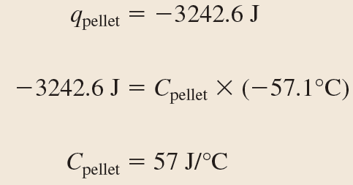
5.4
Calorimetry
5.5
Solution
Constant-Pressure Calorimetry
Copyright © 2012, The McGraw-Hill Compaies, Inc. Permission required for reproduction or display.
52

Slide 53
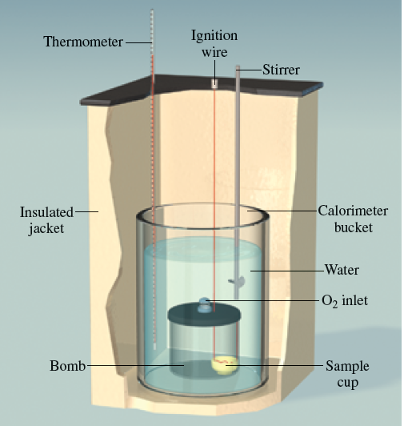
5.4
Calorimetry
Constant-Volume Calorimetry
Copyright © 2012, The McGraw-Hill Compaies, Inc. Permission required for reproduction or display.
53

Slide 54



5.4
Calorimetry
Constant-Volume Calorimetry
Because no heat enters or leaves the system during the process, the heat change of the system overall (q_{system}) is zero and we can write
Copyright © 2012, The McGraw-Hill Compaies, Inc. Permission required for reproduction or display.
54

Slide 55
5.4
Calorimetry
5.6
A Famous Amos bite-sized chocolate chip cookie weighing 7.25 g is burned in a bomb calorimeter to determine its energy content.
The heat capacity of the calorimeter is 39.97 kJ/°C.
During the combustion, the temperature of the water in the calorimeter increases by 3.90°C.
Calculate the energy content (in kJ/g) of the cookie.
Constant-Volume Calorimetry
Copyright © 2012, The McGraw-Hill Compaies, Inc. Permission required for reproduction or display.
55

Slide 56
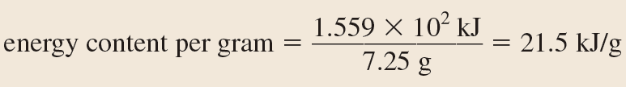
5.4
Calorimetry
5.6
Strategy
Use q_{rxn} = –C_{cal}ΔT to calculate the heat released by the combustion of the cookie. Divide the heat released by the mass of the cookie to determine its energy content per gram.
Setup
Solution
Constant-Volume Calorimetry
Copyright © 2012, The McGraw-Hill Compaies, Inc. Permission required for reproduction or display.
56

Slide 57
5.5
Hess’s Law
Hess’s Law
Copyright © 2012, The McGraw-Hill Compaies, Inc. Permission required for reproduction or display.
57

Slide 58
5.5
Hess’s Law
Hess’s Law
Because enthalpy is a state function, the change in enthalpy that occurs when reactants are converted to products in a reaction is the same whether the reaction takes place in one step or in a series of steps.
This observation is called Hess’s law.
Copyright © 2012, The McGraw-Hill Compaies, Inc. Permission required for reproduction or display.
58

Slide 59




5.5
Hess’s Law
5.7
Given the following thermochemical equations,
determine the enthalpy change for the reaction
Hess’s Law
Copyright © 2012, The McGraw-Hill Compaies, Inc. Permission required for reproduction or display.
59

Slide 60
5.5
Hess’s Law
5.7
Strategy
Arrange the given thermochemical equations so that they sum to the desired equation.
Make the corresponding changes to the enthalpy changes, and add them to get the desired enthalpy change.
Hess’s Law
Copyright © 2012, The McGraw-Hill Compaies, Inc. Permission required for reproduction or display.
60

Slide 61
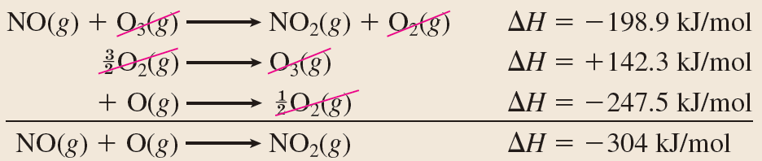
5.5
Hess’s Law
5.7
Solution
Hess’s Law
Copyright © 2012, The McGraw-Hill Compaies, Inc. Permission required for reproduction or display.
61

Slide 62
5.6
Standard Enthalpies of Formation
Standard Enthalpies of Formation
Copyright © 2012, The McGraw-Hill Compaies, Inc. Permission required for reproduction or display.
62

Slide 63
5.6
Standard Enthalpies of Formation
Standard Enthalpies of Formation
There is no way to measure the absolute value of the enthalpy of a substance.
Only changes in enthalpy are measureable; that is, only values relative to an arbitrary reference can be determined.
Copyright © 2012, The McGraw-Hill Compaies, Inc. Permission required for reproduction or display.
63

Slide 64
5.6
Standard Enthalpies of Formation
Standard Enthalpies of Formation
Chemists have agreed on an arbitrary reference point for enthalpy.
The “sea level” reference point for all enthalpy expressions is called the standard enthalpy of formation (ΔH°_{f}), which is defined as the heat change that results when 1 mole of a compound is formed from its constituent elements in their standard states.
Copyright © 2012, The McGraw-Hill Compaies, Inc. Permission required for reproduction or display.
64

Slide 65

5.6
Standard Enthalpies of Formation
Standard Enthalpies of Formation
The importance of the standard enthalpies of formation is that once we know their values, we can readily calculate the standard enthalpy of reaction (ΔH°_{rxn}), defined as the enthalpy of a reaction carried out under standard conditions.
Copyright © 2012, The McGraw-Hill Compaies, Inc. Permission required for reproduction or display.
65

Slide 66
5.6
Standard Enthalpies of Formation
5.8
Using data from Appendix 2, calculate ΔH°_{rxn} for
Setup
The ΔH°_{f} values for Ag⁺(aq), Cl–(aq), and AgCl(s) are 1105.9, 2167.2, and 2127.0 kJ/mol, respectively.
Standard Enthalpies of Formation
Copyright © 2012, The McGraw-Hill Compaies, Inc. Permission required for reproduction or display.
66

Slide 67
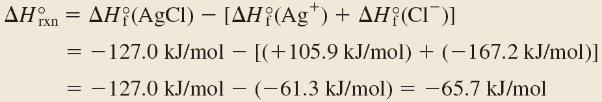
5.6
Standard Enthalpies of Formation
5.8
Solution
Standard Enthalpies of Formation
Copyright © 2012, The McGraw-Hill Compaies, Inc. Permission required for reproduction or display.
67

Slide 68
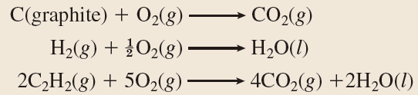
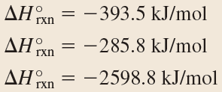

5.6
Standard Enthalpies of Formation
5.9
Given the following information, calculate the standard enthalpy of formation of acetylene (C₂H₂) from its constituent elements:
Standard Enthalpies of Formation
Copyright © 2012, The McGraw-Hill Compaies, Inc. Permission required for reproduction or display.
68

Slide 69
5.6
Standard Enthalpies of Formation
5.9
Strategy
Arrange the equations that are provided so that they will sum to the desired equation.
This may require reversing or multiplying one or more of the equations.
For any such change, the corresponding change must also be made to the ΔH°_{rxn} value.
Standard Enthalpies of Formation
Copyright © 2012, The McGraw-Hill Compaies, Inc. Permission required for reproduction or display.
69

Slide 70
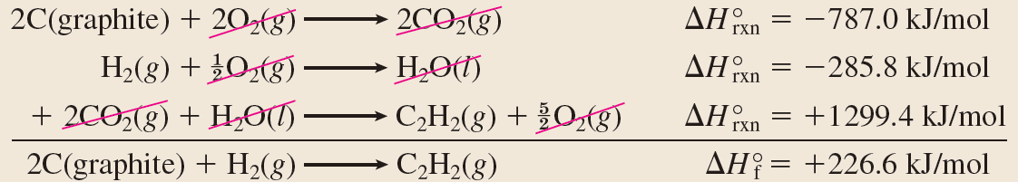
5.6
Standard Enthalpies of Formation
5.9
Solution
Standard Enthalpies of Formation
Copyright © 2012, The McGraw-Hill Compaies, Inc. Permission required for reproduction or display.
70

