Slide 1
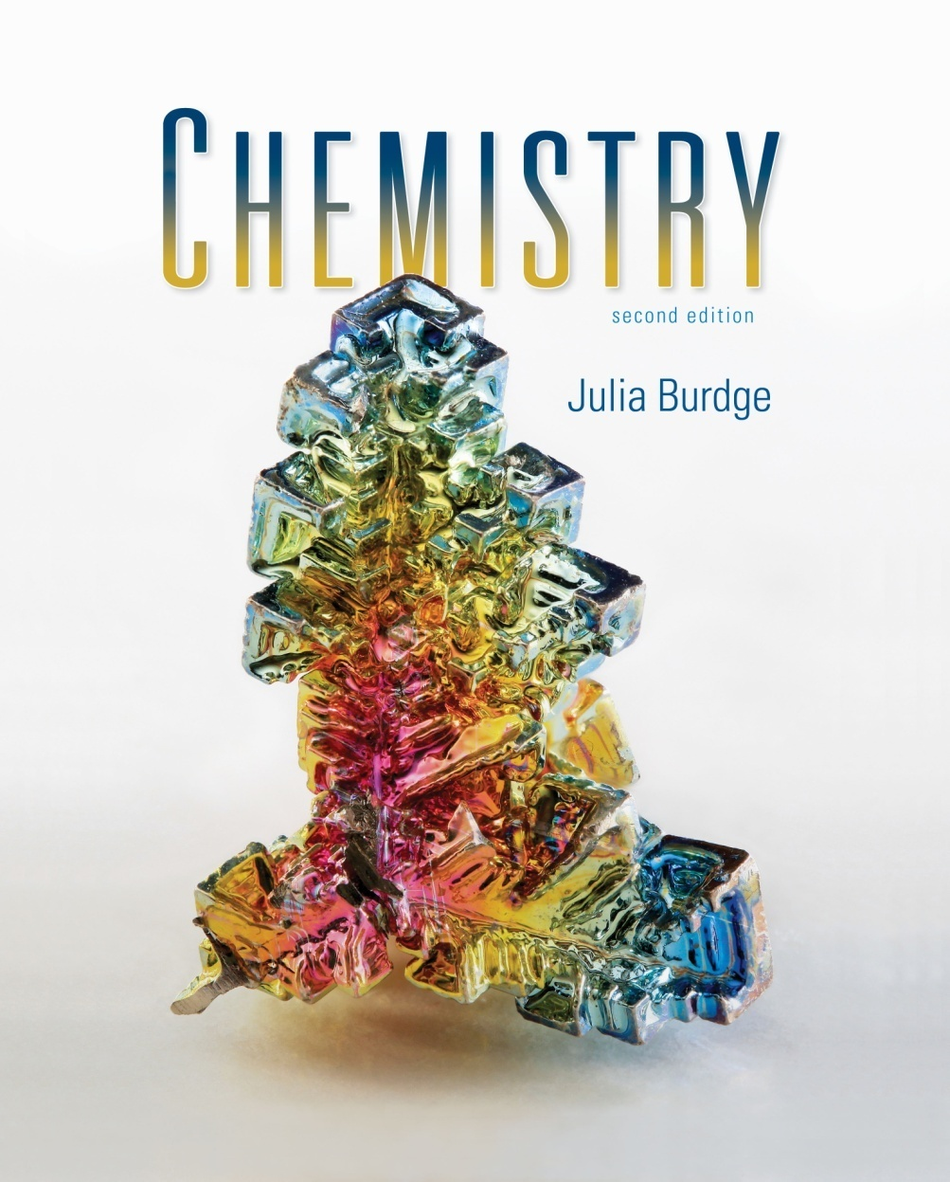
Chemistry
Second Edition
Julia Burdge
Lecture PowerPoints
Jason A. Kautz
University of Nebraska-Lincoln
5
Thermochemistry
1
Copyright (c) The McGraw-Hill Companies, Inc. Permission required for reproduction or display.

Slide 2
Thermochemistry
5
5.1 Energy and Energy Changes
Forms of Energy
Energy Changes in Chemical Reactions
Units of Energy
5.2 Introduction to Thermodynamics
States and State Functions
The First Law of Thermodynamics
Work and Heat
5.3 Enthalpy
Reactions Carried Out at Constant Volume or at Constant Pressure
Enthalpy and Enthalpy Changes
Thermochemical Equations
5.4 Calorimetry
Specific Heat and Heat Capacity
Constant-Pressure Calorimetry
Constant-Volume Calorimetry
5.5 Hess’s Law
5.6 Standard Enthalpies of Formation

Slide 3
Energy and Energy Changes
5.1
Energy is the capacity to do work or transfer heat.
All forms of energy are either kinetic or potential.
Kinetic energy (E_{K}) is the energy of motion.
m is the mass of the object in kilograms
u is the velocity in meters per second.
1
E_{K} = mu²
2

Slide 4
Energy and Energy Changes
Potential energy is the energy possessed by an object by virtue of its position.
Chemical energy is energy stored within the structural units of
chemical substances.
Electrostatic energy is potential energy that results from the interaction of charged particles.
Q₁ and Q₂ represent two charges separated by the distance, d.

Slide 5
Energy and Energy Changes
Kinetic and potential energy are interconvertible.
The law of conservation of energy states that the total amount of energy in the universe is constant.
When energy of one form disappears, the same amount of energy reappears in another form or forms.

Slide 6
Energy and Energy Changes
The system is a part of the universe that is of specific interest.
The surroundings constitute the rest of the universe outside the system.
The system is usually defined as the substances involved in chemical and physical changes.
System
Surroundings
Universe = System + Surroundings

Slide 7
Energy and Energy Changes
Thermochemistry is the study of heat (the transfer of thermal energy) in chemical reactions.
Heat is the transfer of thermal energy.
Heat is either absorbed or released during a process.
heat
Surroundings

Slide 8
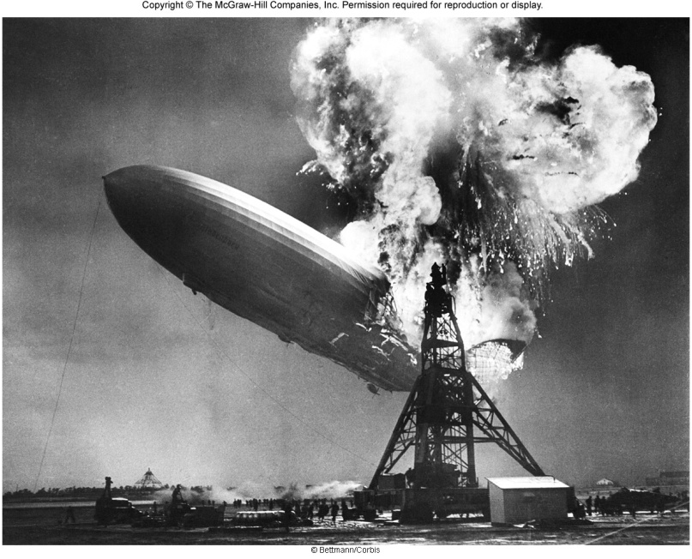
Energy and Energy Changes
An exothermic process occurs when heat is transferred from the system to the surroundings.
“Feels hot!”
System
2H₂(g) + O₂(g)
2H₂O(l) + energy
heat
Surroundings
Universe = System + Surroundings

Slide 9
Energy and Energy Changes
An endothermic process occurs when heat is transferred from the surroundings to the system.
“Feels cold”
System
energy + 2HgO(s)
2Hg(l) + O₂(g)
heat
Surroundings
Universe = System + Surroundings

Slide 10
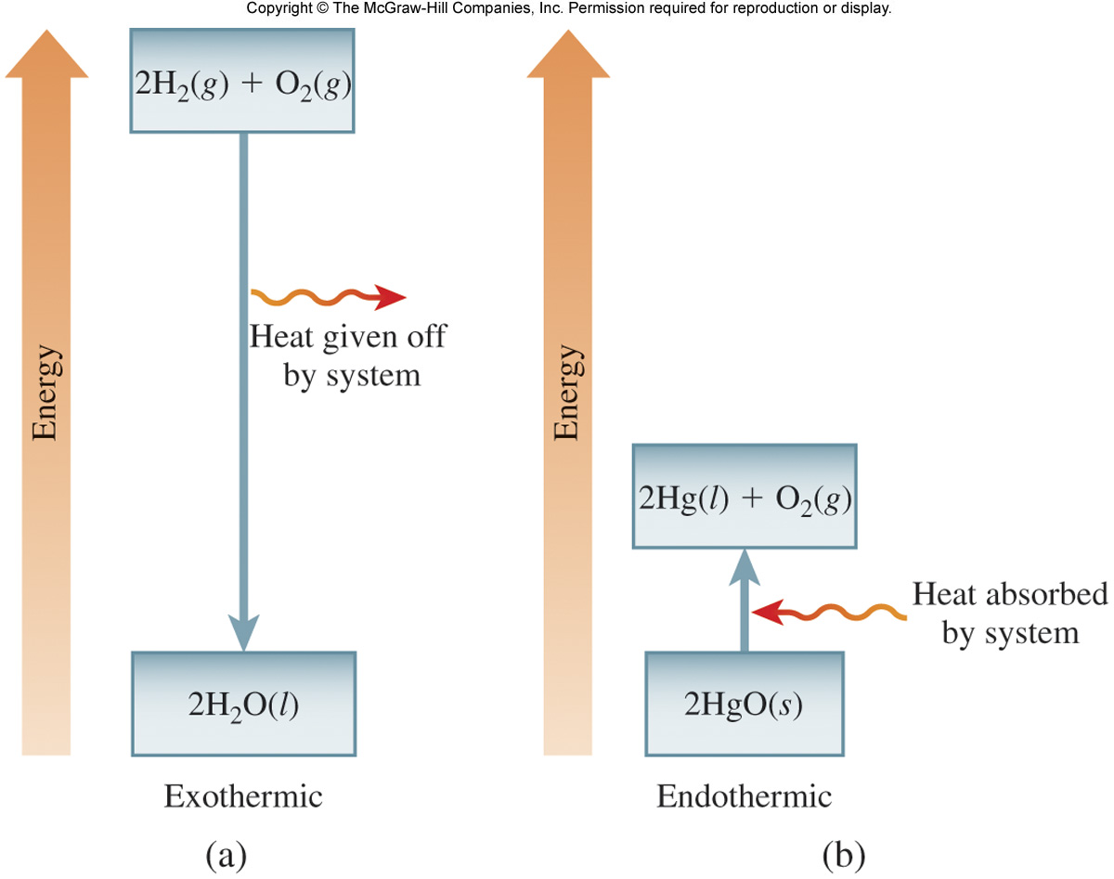
Energy and Energy Changes

Slide 11
Energy and Energy Changes
Calculate the energy in joules of a 5.25 g object moving at a speed of 655 m/s.
Solution:
Step 1: First convert grams to kilograms. (0.00525 kg)
Step 2: Substitute into the equation for kinetic energy and solve.

Slide 12
Introduction to Thermodynamics
5.2
Thermodynamics is the study of the interconversion of heat and other kinds of energy.
In thermodynamics, there are three types
of systems:
An open system can exchange mass and
energy with the surroundings.

Slide 13
Introduction to Thermodynamics
Thermodynamics is the study of the interconversion of heat and other kinds of energy.
In thermodynamics, there are three types
of systems:
An open system can exchange mass and
energy with the surroundings.
A closed system allows the transfer
of energy but not mass.

Slide 14
Introduction to Thermodynamics
Thermodynamics is the study of the interconversion of heat and other kinds of energy.
In thermodynamics, there are three types
of systems:
An open system can exchange mass and
energy with the surroundings.
A closed system allows the transfer
of energy but not mass.
An isolated system does not exchange
either mass or energy with its
surroundings.

Slide 15
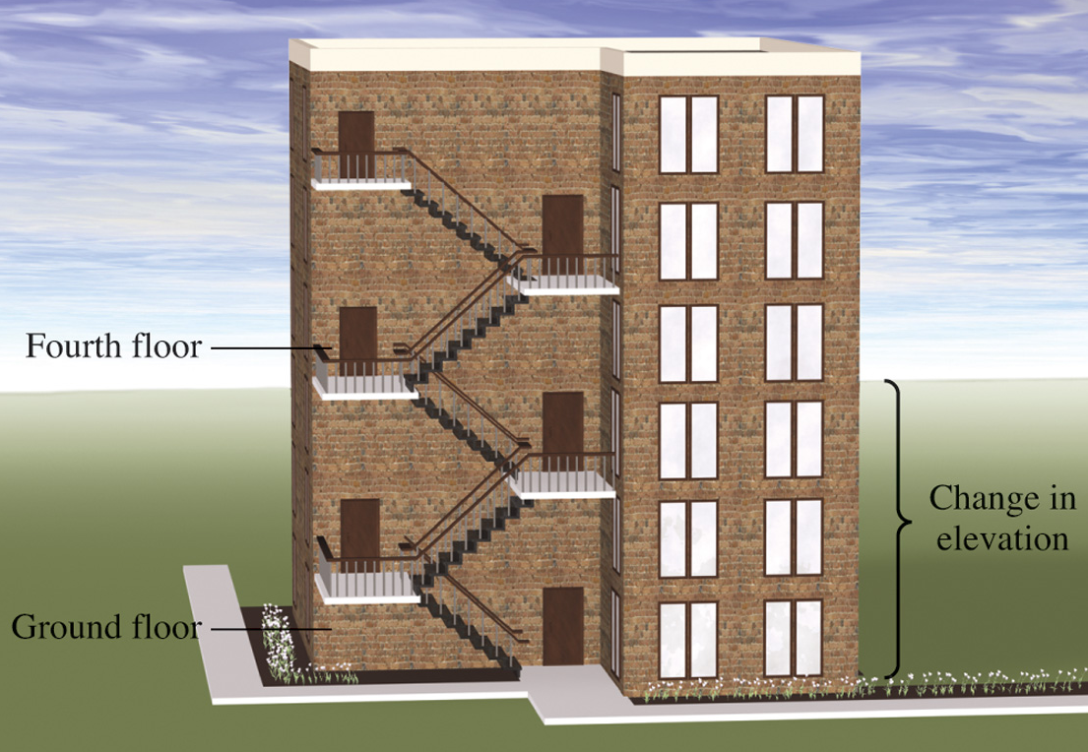
Introduction to Thermodynamics
State functions are properties that are determined by the sate of the system, regardless of how that condition was achieved.
The magnitude of change depends only on the initial and final states of the system.
Energy
Pressure
Volume
Temperature

Slide 16
Introduction to Thermodynamics
The first law of thermodynamics states that energy can be converted from one form to another, but cannot be created or destroyed.
ΔU is the change in the internal energy.
“sys” and “surr” denote system and surroundings, respectively
ΔU = U_{f} – U_{i}; the difference in the energies of the initial and final states.
ΔU_{sys} + ΔU_{surr} = 0
ΔU_{sys} = –ΔU_{surr}

Slide 17
Introduction to Thermodynamics
The overall change in the system’s internal energy is given by:
q is heat
q is positive for an endothermic process (heat absorbed by the system)
q is negative for an exothermic process (heat released by the system)
w is work
w is positive for work done on the system
w is negative for work done by the system
ΔU = q + w

Slide 18
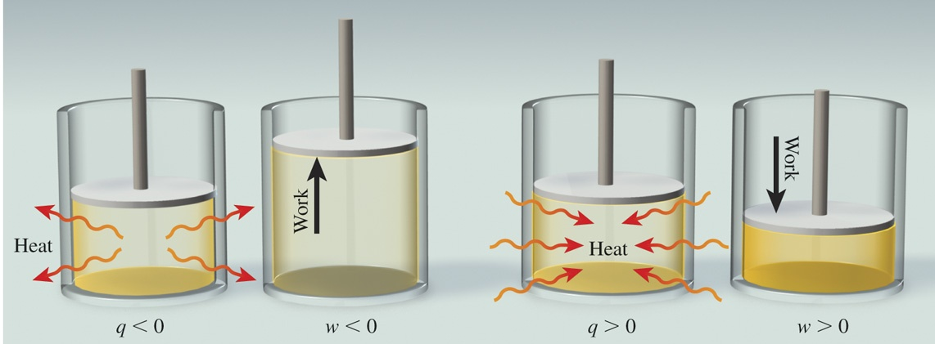
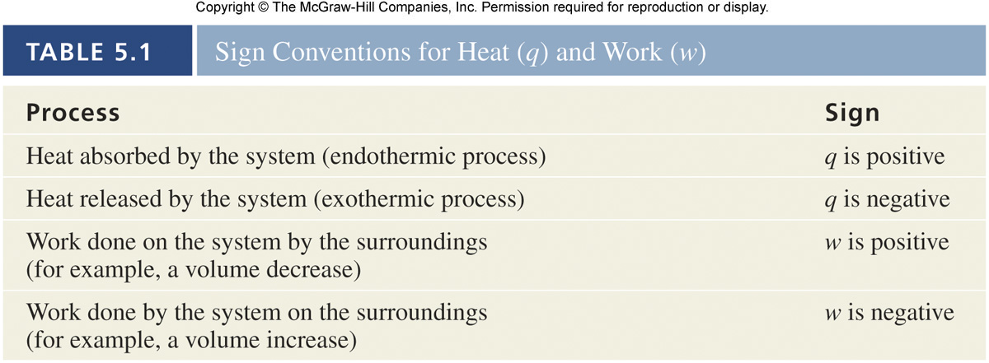
Introduction to Thermodynamics
ΔU = q + w

Slide 19
Enthalpy
5.3
Sodium azide detonates to give a large quantity of nitrogen gas.
Under constant volume conditions, pressure increases:
2NaN₃(s)
2Na(s) + 3N₂(g)

Slide 20
Enthalpy
Sodium azide detonates to give a large quantity of nitrogen gas.
Under constant pressure conditions, volume increases:
2NaN₃(s)
2Na(s) + 3N₂(g)

Slide 21
Enthalpy
Pressure-volume, or PV work, is done when there is a volume change under constant pressure.
w = −PΔV
P is the external opposing pressure
ΔV is the change in the volume of the container

Slide 22
Enthalpy
Pressure-volume, or PV work, is done when there is a volume change under constant pressure.
w = −PΔV
substitute
ΔU = q + w
ΔU = q − PΔV
When a change occurs at constant volume, ΔV = 0 and no work is done.
q_{v} = ΔU

Slide 23
Enthalpy
Under conditions of constant pressure:
ΔU = q + w
ΔU = q − PΔV
q_{p} = ΔU + PΔV

Slide 24
Enthalpy
The thermodynamic function of a system called enthalpy (H) is defined by the equation:
H = U + PV
A note about SI units:
Pressure: pascal; 1Pa = 1 kg/(m . s²)
Volume: cubic meters; m³
PV: 1kg/(m . s²) x m³ = 1(kg . m²)/s² = 1 J
Enthalpy: joules
U, P, V, and H are all state functions.

Slide 25
Enthalpy
For any process, the change in enthalpy is:
ΔH = ΔU + Δ(PV)
(1)
If pressure is constant:
ΔH = ΔU + PΔV
(2)
Rearrange to solve for ΔU:
ΔU = ΔH + PΔV
(3)
Remember, q_{p}:
q_{p} = ΔU + ΔV
(4)
Substitute equation (3) into equation (4) and solve:
q_{p} = (ΔH − PΔV) + PΔV
(5)
q_{p} = ΔH
for a constant-pressure process

Slide 26
Enthalpy
The enthalpy of reaction is the difference between the enthalpies of the products and the enthalpies of the reactants:
Assumes reactions in the lab occur at constant pressure
ΔH > 0 (positive) endothermic process
ΔH < 0 (negative) exothermic process
ΔH = H(products) – H(reactants)

Slide 27
Enthalpy
H₂O(s)
H₂O(l) ΔH = +6.01 kJ/mol
Concepts to consider:
Is this a constant pressure process?
What is the system?
What are the surroundings?
ΔH > 0 endothermic

Slide 28
Enthalpy
CH₄(g) + 2O₂(g)
CO₂(g) + 2H₂O(l) ΔH = −890.4 kJ/mol
Concepts to consider:
Is this a constant pressure process?
What is the system?
What are the surroundings?
ΔH < 0 exothermic

Slide 29
Enthalpy
Enthalpy is an extensive property.
Extensive properties are dependent on the amount of matter involved.
H₂O(l) → H₂O(g) ΔH = +44 kJ/mol
2H₂O(l) → 2H₂O(g) ΔH = +88 kJ/mol
Double the amount of matter
Double the enthalpy
Units refer to
mole of reaction as written

Slide 30
Enthalpy
The following guidelines are useful when considering thermochemical equations:
1) Always specify the physical states of reactants and products because
they help determine the actual enthapy changes.
CH₄(g) + 2O₂(g)
CO₂(g) + 2H₂O(g)
ΔH = −802.4 kJ/mol
different states
different enthalpies
CH₄(g) + 2O₂(g)
CO₂(g) + 2H₂O(l)
ΔH = +890.4 kJ/mol

Slide 31
Enthalpy
The following guidelines are useful when considering thermochemical equations:
2) When multiplying an equation by a factor (n), multiply the ΔH value by same factor.
CH₄(g) + 2O₂(g)
CO₂(g) + 2H₂O(g)
ΔH = − 802.4 kJ/mol
2CH₄(g) + 4O₂(g)
2CO₂(g) + 4H₂O(g)
ΔH = − 1604.8 kJ/mol
3) Reversing an equation changes the sign but not the magnitude of ΔH.
CH₄(g) + 2O₂(g)
CO₂(g) + 2H₂O(g)
ΔH = − 802.4 kJ/mol
CO₂(g) + 2H₂O(g)
CH₄(g) + 2O₂(g)
ΔH = +802.4 kJ/mol

Slide 32
Enthalpy
Calculate the solar energy required to produce 5255 g of C₆H₁₂O₆ given the thermochemical equation for photosynthesis:
Solution:
Step 1: Determine the moles of C₆H₁₂O₆. (29.16 mol C₆H₁₂O₆)
Step 2: Multiply the thermochemical equation, including the enthalpy change by 29.16 in order to write the equation in terms of the appropriate amount of C₆H₁₂O₆.
6H₂O(l) + 6CO₂(g)
C₆H₁₂O₆(s) + 6O₂(g)
ΔH = +2803 kJ/mol
29.16 mol
6H₂O(l) + 6CO₂(g)
C₆H₁₂O₆(s) + 6O₂(g)
ΔH = +2803 kJ/mol
175.0H₂O(l) + 175.0CO₂(g)
29.16C₆H₁₂O₆(s) + 175.0O₂(g)
ΔH = +81,740 kJ

Slide 33
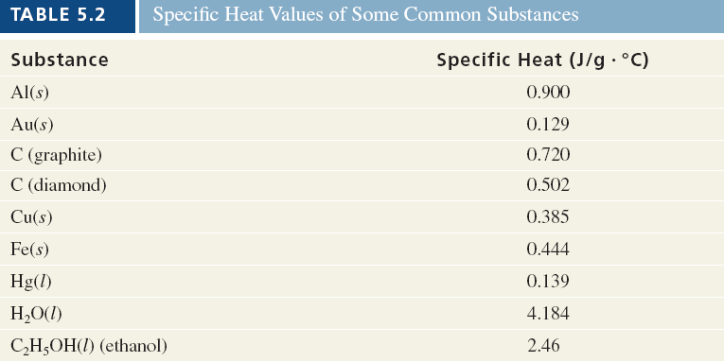
Calorimetry
5.4
Calorimetry is the measurement of heat changes.
Heat changes are measured in a device called a calorimeter.
The specific heat (s) of a substance is the amount of heat required to raise the temperature of 1 g of the substance by 1 °C.

Slide 34
Calorimetry
The heat capacity (C) is the amount of heat required to raise the temperature of an object by 1°C.
The “object” may be a given quantity of a particular substance.
Specific heat capacity has units of J/(g • °C)
Heat capacity has units of J/°C
Specific heat capacity of water
heat capacity of
1 kg water

Slide 35
Calorimetry
The heat associated with a temperature change may be calculated:
m is the mass.
s is the specific heat.
ΔT is the change in temperature (ΔT = T_{final} – T_{initial}).
C is the heat capacity.
q = msΔT
q = CΔT

Slide 36
Calorimetry
Calculate the amount of heat required to heat 1.01 kg of water from 0.05°C to 35.81°C.
Solution:
Step 1: Use the equation q = msΔT to calculate q.

Slide 37
Calorimetry
A coffee-cup calorimeter may be used to measure the heat exchange for a variety of reactions at constant pressure:
Heat of neutralization:
HCl(aq) + NaOH(aq) → H₂O(l) + NaCl(aq)
Heat of ionization:
H₂O(l) → H⁺(aq) + OH‒(aq)
Heat of fusion:
H₂O(s) → H₂O(l)
Heat of vaporization:
H₂O(l) → H₂O(g)

Slide 38
Calorimetry
Concepts to consider for coffee-cup calorimetry:
q_{p} = ΔH
System: reactants and products (the reaction)
Surroundings: water in the calorimeter
For an exothermic reaction:
the system loses heat
the surroundings gain (absorb) heat
q_{sys} = −msΔT
q_{surr} = msΔT
q_{sys} = −q_{surr}
The minus sign is used to keep sign conventions consistent.

Slide 39
Calorimetry
A bolt is heated to 100.0°C and is dropped into a coffee-cup calorimeter containing 125 g of water at 25.0°C. The final temperature of both the bolt and the water is 35.8°C. Calculate the heat capacity of the bolt.
Solution:
Step 1: Calculate the heat absorbed by the water.
Step 2: The heat absorbed by the water must be released by the bolt.
q_{water} = −q_{bolt}
q_{bolt} = −5648.4 J
q = msΔT

Slide 40
Calorimetry
A bolt is heated to 100.0°C and is dropped into a coffee-cup calorimeter containing 125 g of water at 25.0°C. The final temperature of both the bolt and the water is 35.8°C. Calculate the heat capacity of the bolt.
Solution:
Step 3: Determine the heat capacity of the bolt
−5648.4 J = C_{bolt}(35.8°C – 100.0°C)
C_{bolt} = 88.0 J/°C.
q = CΔT

Slide 41
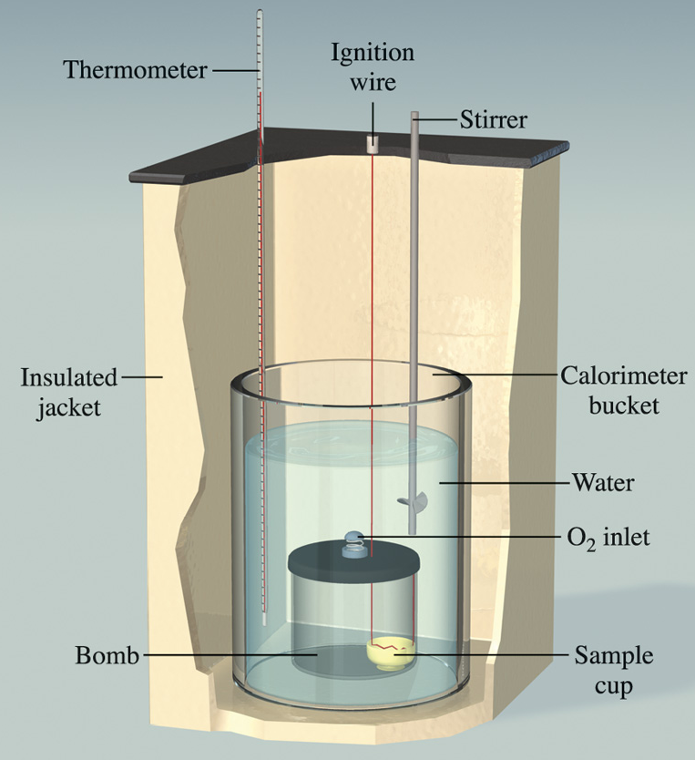
Calorimetry
Constant volume calorimetry is carried out in a device known as a constant-volume bomb.
A constant-volume calorimeter is an isolated system.
Bomb calorimeters are typically used to determine heats of combustion.
q_{cal} = −q_{rxn}

Slide 42
Calorimetry
q_{cal} = C_{cal}ΔT
q_{rxn} = −q_{cal}
To calculate q_{cal}, the heat capacity of the calorimeter must be known.
q_{rxn} = −C_{cal}ΔT

Slide 43
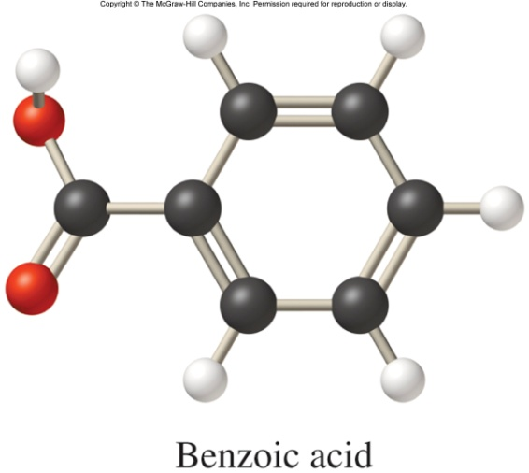
Calorimetry
Solution:
Step 1: Calculate the heat capacity using the equation q_{rxn} = −C_{cal}ΔT.
−26.38 kJ = −C_{cal}(27.20°C – 23.40°C)
C_{cal} = 6.94 kJ/°C
A 1.000 g sample of benzoic acid is burned in a bomb calorimeter. The reaction gives off 26.38 kJ of heat and the temperature of the water in the calorimeter increased from 23.40°C to 27.20°C.
What is the heat capacity of the calorimeter?
26.38 kJ of heat given off

Slide 44
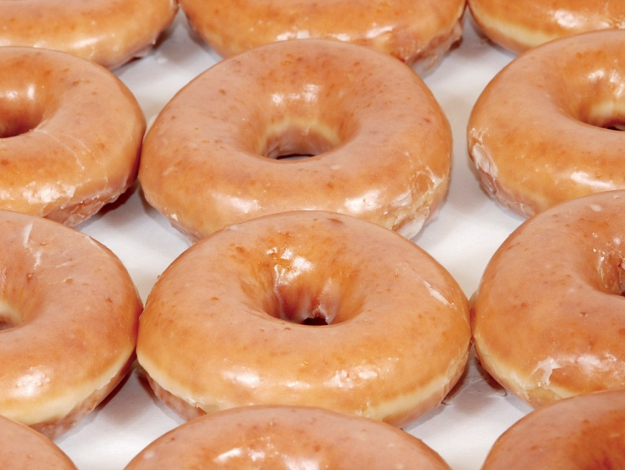
Calorimetry
When 10.0 g of a Krispy Kreme doughnut is burned in a bomb calorimeter with a heat capacity of 6.94 kJ/°C, the temperature inside the calorimeter increases by 23.2°C.
What is the energy content per gram?
Solution:
Step 1: Calculate the heat using the equation q_{rxn} = −C_{cal}ΔT.
q_{rxn} = −6.94 kJ/°C x (23.2°C)
q_{rxn} = −161 kJ

Slide 45
Calorimetry
When 10.0 g of a Krispy Kreme doughnut is burned in a bomb calorimeter with a heat capacity of 6.94 kJ/°C, the temperature inside the calorimeter increases by 23.2°C.
What is the energy content per gram?
Solution:
Step 2: Determine the energy content per gram.
Note: Energy content per gram is a positive value.

Slide 46
Hess’s Law
5.5
Hess’s law states that the change in enthalpy for a stepwise process is the sum of the enthalpy changes for each of the steps.
CH₄(g) + 2O₂(g)
CO₂(g) + 2H₂O(l)
ΔH = −890.4 kJ/mol
2H₂O(l)
2H₂O(g)
ΔH = +88.0 kJ/mol
CH₄(g) + 2O₂(g)
CO₂(g) + 2H₂O(g)
ΔH = −802.4 kJ/mol
CH₄(g) + 2O₂(g)
Enthalpy
ΔH = −802.4 kJ
ΔH = −890.4 kJ
CO₂(g) + 2H₂O(g)
CO₂(g) + 2H₂O(l)
ΔH = +88.0 kJ

Slide 47
Hess’s Law
When applying Hess’s Law:
1) Manipulate thermochemical equations in a manner that gives the overall desired equation.
2) Remember the rules for manipulating thermochemical equations:
3) Add the ΔH for each step after proper manipulation.
4) Process is useful for calculating enthalpies that cannot be found directly.
Always specify the physical states of reactants and products because they help determine the actual enthalpy changes.
When multiplying an equation by a factor (n), multiply the ΔH value by same factor.
Reversing an equation changes the sign but not the magnitude of ΔH.

Slide 48
Hess’s Law
Determine the ΔH for the following reaction:
Fe₂O₃(s) + 3CO(g) → 2Fe(s) + 3CO₂(g)
Given the information below.
Solution:
Step 1: Arrange the thermochemical equations so that they sum to the desired equation.
Reverse equation (1); remember to change the sign of ΔH.
2Fe(s) + O₂(g) → Fe₂O₃(s) ΔH = −824.2 kJ/mol (1)
3
2
CO(g) + O₂(g) → CO₂(g) ΔH = −282.7 kJ/mol (2)
1
2
Fe₂O₃(s) → 2Fe(s) + O₂(g) ΔH = +824.2 kJ/mol (1)
3
2

Slide 49
Hess’s Law
Determine the ΔH for the following reaction:
Fe₂O₃(s) + 3CO(g) → 2Fe(s) + 3CO₂(g)
Given the information below.
Solution:
Step 2: Multiply equation (2) by a factor of 3.
2Fe(s) + O₂(g) → Fe₂O₃(s) ΔH = −824.2 kJ/mol (1)
3
2
CO(g) + O₂(g) → CO₂(g) ΔH = −282.7 kJ/mol (2)
1
2
3CO(g) + O₂(g) → 3CO₂(g) ΔH = −848.1 kJ/mol (2)
3
2

Slide 50
Hess’s Law
Determine the ΔH for the following reaction:
Fe₂O₃(s) + 3CO(g) → 2Fe(s) + 3CO₂(g)
Solution:
Step 3: Sum all the steps and their enthalpy changes.
Fe₂O₃(s) → 2Fe(s) + O₂(g) ΔH = +824.2 kJ/mol
3
2
3CO(g) + O₂(g) → 3CO₂(g) ΔH = −848.1 kJ/mol
3
2
Fe₂O₃(s) + 3CO(g) → 2Fe(s) + 3CO₂(g) ΔH = −23.9 kJ/mol

Slide 51
Standard Enthapies of Formation
5.6
The standard enthalpy of formation (ΔH _{f}°) is defined as the heat change that results when 1 mole of a compound is formed from its constituent elements in their standard states.
C(graphite) + O₂(g)
CO₂(g)
ΔH _{f}° = −393.5 kJ/mol
Elements in standard states
1 mole of product

Slide 52
Standard Enthapies of Formation
The standard enthalpy of formation (ΔH _{f}°) is defined as the heat change that results when 1 mole of a compound is formed from its constituent elements in their standard states.
The superscripted degree sign denotes standard conditions.
1 atm pressure for gases
1 M concentration for solutions
“f” stands for formation.
ΔH _{f}° for an element in its most stable form is zero
ΔH _{f}° for many substances are tabulated in Appendix 2 of the textbook.

Slide 53
Standard Enthapies of Formation
The standard enthalpy of reaction (ΔH °_{rxn}) is defined as the enthalpy of a reaction carried out under standard conditions.
aA + bB → cC + dD
n and m are the stoichiometric coefficients for the reactants and products
ΔH °_{rxn} = [cΔH _{f}°(C) + dΔH _{f}°(D) ] – [aΔH _{f}°(A) + bΔH _{f}°(B)]
ΔH °_{rxn} = ΣnΔH _{f}°(products) – ΣmΔH _{f}°(reactants)

Slide 54
Standard Enthapies of Formation
Use the data provided to calculate ΔH °_{rxn} for the following reaction:
CaCO₃(s) → CaO(s) + CO₂(g) ΔH °_{rxn} = ?
Solution:
Step 1: Use the equation below to calculate ΔH °_{rxn}.
Substance | ΔH _{f}° (kJ/mol)
CaCO₃(s) | −1206.9
CaO(s) | −635.6
CO₂(g) | −393.5
ΔH °_{rxn} = ΣnΔH _{f}°(products) – ΣmΔH _{f}°(reactants)
ΔH °_{rxn} = [1ΔH _{f}° CaO(s) + 1ΔH _{f}° CO₂(g) ] – [1ΔH _{f}° CaCO₃(s)]
ΔH °_{rxn} = [1(−635.6 kJ/mol) + 1(−393.5 kJ/mol) ] – [1(−1206.9 kJ/mol)] = 177.8 kJ/mol

Slide 55
Standard Enthalpies of Formation
Use the following data to calculate ΔH _{f}° for CS₂(l):
Solution:
Step 1: Write the equation corresponding to the standard enthalpy of formation of CS₂(l).
C(graphite)(s) + O₂(g)
CO₂(g) ΔH_{rxn} = –393.5 kJ/mol (1)
°
S(rhombic)(s) + O₂(g)
SO₂(g) ΔH_{rxn} = –296.4 kJ/mol (2)
°
CS₂(l) + 3O₂(g)
CO₂(g) + 2SO₂(g) ΔH_{rxn} = –1073.6 kJ/mol (3)
°
C(graphite)(s) + 2S(rhombic)(s)
CS₂(l) ΔH_{rxn} = ?
°

Slide 56
Standard Enthalpies of Formation
Use the following data to calculate ΔH _{f}° for CS₂(l):
Solution:
Step 2: Include Equation (1) and its ΔH_{rxn} value as is:
C(graphite)(s) + O₂(g)
CO₂(g) ΔH_{rxn} = –393.5 kJ/mol (1)
°
S(rhombic)(s) + O₂(g)
SO₂(g) ΔH_{rxn} = –296.4 kJ/mol (2)
°
CS₂(l) + 3O₂(g)
CO₂(g) + 2SO₂(g) ΔH_{rxn} = –1073.6 kJ/mol (3)
°
°
C(graphite)(s) + O₂(g)
CO₂(g) ΔH_{rxn} = –393.5 kJ/mol
°

Slide 57
Standard Enthalpies of Formation
Use the following data to calculate ΔH _{f}° for CS₂(l):
Solution:
Step 3: Multiply Equation (2) and its ΔH_{rxn} value by 2:
C(graphite)(s) + O₂(g)
CO₂(g) ΔH_{rxn} = –393.5 kJ/mol (1)
°
S(rhombic)(s) + O₂(g)
SO₂(g) ΔH_{rxn} = –296.4 kJ/mol (2)
°
CS₂(l) + 3O₂(g)
CO₂(g) + 2SO₂(g) ΔH_{rxn} = –1073.6 kJ/mol (3)
°
°
2S(rhombic)(s) + 2O₂(g)
2SO₂(g) ΔH_{rxn} = –592.8 kJ/mol
°

Slide 58
Standard Enthalpies of Formation
Use the following data to calculate ΔH _{f}° for CS₂(l):
Solution:
Step 4: Reverse Equation (3) and change the sign of its ΔH_{rxn} value:
C(graphite)(s) + O₂(g)
CO₂(g) ΔH_{rxn} = –393.5 kJ/mol (1)
°
S(rhombic)(s) + O₂(g)
SO₂(g) ΔH_{rxn} = –296.4 kJ/mol (2)
°
CS₂(l) + 3O₂(g)
CO₂(g) + 2SO₂(g) ΔH_{rxn} = –1073.6 kJ/mol (3)
°
°
CO₂(g) + 2SO₂(g)
CS₂(l) + 3O₂(g) ΔH_{rxn} = 1073.6 kJ/mol
°

Slide 59
Standard Enthalpies of Formation
Solution:
Step 5: Sum the resulting equations and enthalpy values:
C(graphite)(s) + O₂(g)
CO₂(g) ΔH_{rxn} = –393.5 kJ/mol
°
2S(rhombic)(s) + 2O₂(g)
2SO₂(g) ΔH_{rxn} = –592.8 kJ/mol
°
CO₂(g) + 2SO₂(g)
CS₂(l) + 3O₂(g) ΔH_{rxn} = 1073.6 kJ/mol
°
C(graphite)(s) + 2S(rhombic)(s)
CS₂(l) ΔH_{rxn} = 87.3 kJ/mol
°

Slide 60
Chapter Summary: Key Points
5
Energy and Energy Changes Forms of Energy Energy Changes in Chemical Reactions Units of Energy Introduction to Thermodynamics States and State Functions The First Law of Thermodynamics Work and Heat Enthalpy Reactions Carried Out at Constant Volume or at Constant Pressure Enthalpy and Enthalpy Changes Thermochemical Equations Calorimetry Specific Heat and Heat Capacity | Constant-Pressure Calorimetry Constant-Volume Calorimetry Hess’s Law Standard Enthalpies of Formation
System
Surroundings
Universe = System + Surroundings

