Slide 1
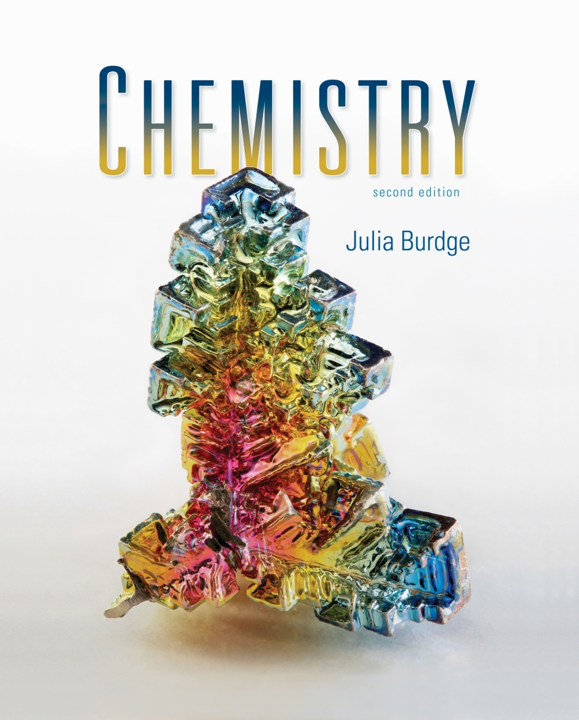
Chemistry
Second Edition
Julia Burdge
Lecture PowerPoints
Jason A. Kautz
University of Nebraska-Lincoln
3
Stoichiometry: Ratios of Combination
1
Copyright (c) The McGraw-Hill Companies, Inc. Permission required for reproduction or display.

Slide 2
Stoichiometry: Ratios of Combination
3
3.1 Molecular and Formula Masses
3.2 Percent Composition of Compounds
3.3 Chemical Equations
Interpreting and Writing Chemical Equations
Balancing Chemical Equations
3.4 The Mole and Molar Mass
The Mole
Determining Molar Mass
Interconverting Mass, Moles, and Numbers of Particles
Empirical Formula from Percent Composition
3.5 Combustion Analysis
Determination of Empirical Formula
Determination of Molecular Formula
3.6 Calculations with Balanced Chemical Equations
Moles of Reactants and Products
Mass of Reactants and Products
3.7 Limiting Reactants
Determining the Limiting Reactant
Reaction Yield

Slide 3
Molecular and Formula Masses
3.1
The molecular mass is the mass in atomic mass units (amu) of an individual molecule.
To calculate molecular mass, multiply the atomic mass for each element in a molecule by the number of atoms of that element and then total the masses
Molecular mass of H₂O = 2(atomic mass of H) + atomic mass of O
= 2(1.008 amu) + 16.00 amu
= 18.02 amu

Slide 4
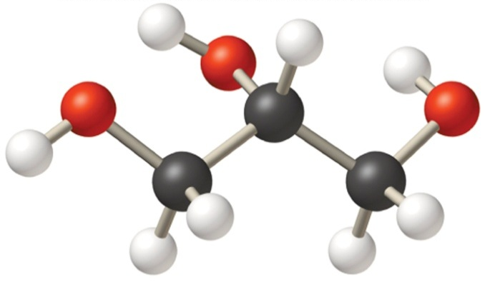
Molecular and Formula Masses
Calculate the molecular mass of ibuprofen, C₁₃H₁₈O₂.
Solution:
Molecular mass = 13(12.01 amu) + 18(1.008 amu) + 2(16.00 amu)
= 206.27 amu
Calculate the molecular mass of glycerol,C₃H₈O₃.
Solution:
Molecular mass = 3(12.01 amu) + 8(1.008 amu) + 3(16.00 amu)
= 92.09 amu

Slide 5
Percent Composition of Compounds
3.2
A list of the percent by mass of each element in a compound is known as the compound’s percent composition by mass.
where n is the number of atoms of the element in a molecule or formula unit of the compound.

Slide 6
Percent Composition of Compounds
For a molecule of H₂O₂:

Slide 7
Percent Composition of Compounds
Determine the percent composition by mass of each element in acetaminophen (C₈H₉NO₂).
Solution:
Step 1: First determine the molecular mass:
MM = 8(12.01 amu) + 9(1.008 amu) + 1(14.01 amu) + 2(16.00 amu)
= 151.16 amu
Step 2: Calculate the percent by mass of each element:

Slide 8
Chemical Equations
3.3
A chemical equation uses chemical symbols to denote what occurs in a chemical reaction.
NH₃ + HCl → NH₄Cl
Ammonia and hydrogen chloride react to produce ammonium chloride.
Each chemical species that appears to the left of the arrow is called a reactant.
NH₃ and HCl
Each species that appears to the right of the arrow is called a product.
NH₄Cl

Slide 9
Chemical Equations
Labels are used to indicate the physical state:
(g) gas
(l) liquid
(s) solid
(aq) aqueous (dissolved in water)
NH₃(g) + HCl(g) → NH₄Cl(s)
SO₃(g) + H₂O(l) → H₂SO₄(aq)

Slide 10
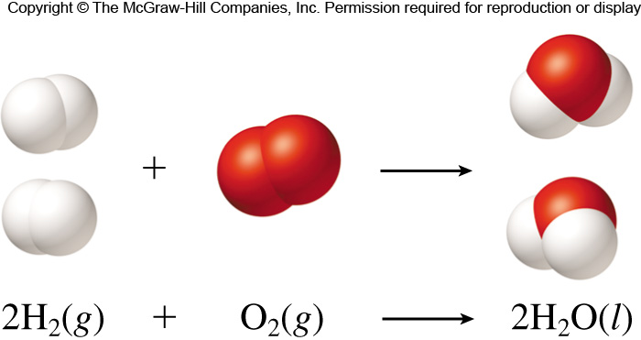
Chemical Equations
Chemical equations must be balanced so that the law of conservation of mass is obeyed.
Balancing is achieved by writing stoichiometric coefficients to the left of the chemical formulas.

Slide 11
Chemical Equations
Generally, it will facilitate the balancing process if you do the following:
1) Change the coefficients of compounds before changing the coefficients of elements.
2) Treat polyatomic ions that appear on both sides of the equation as
units.
3) Count atoms and/or polyatomic ions carefully, and track their numbers each time you change a coefficient.

Slide 12
Chemical Equations
Write the balanced chemical equation that represents the combustion of propane.
Solution:
Step 1: Write the unbalanced equation:
C₃H₈(g) + O₂(g) → CO₂(g) + H₂O(l)
Step 2: Leaving O₂ until the end, balance each of the atoms:
C₃H₈(g) + 5O₂(g) → 3CO₂(g) + 4H₂O(l)
Step 3: Double check to make sure there are equal numbers of each type
on atom on both sides of the equation.

Slide 13
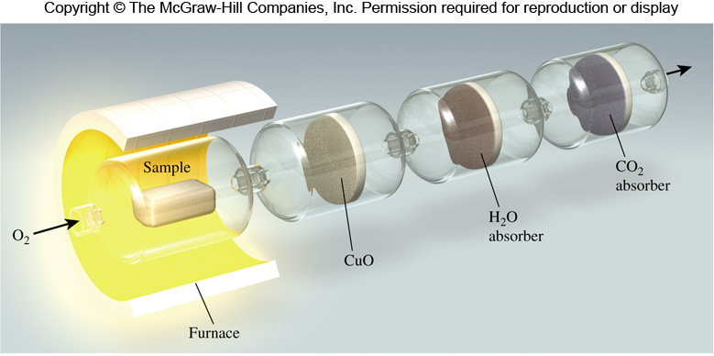
The Mole and Molar Mass
3.4
The mole is defined as the amount of a substance that contains as many elementary entities as there are atoms in exactly 12 g of carbon-12.
The experimentally determined number is called Avogadro’s number (N_{A})
N_{A} = 6.0221415 x 10²³

Slide 14
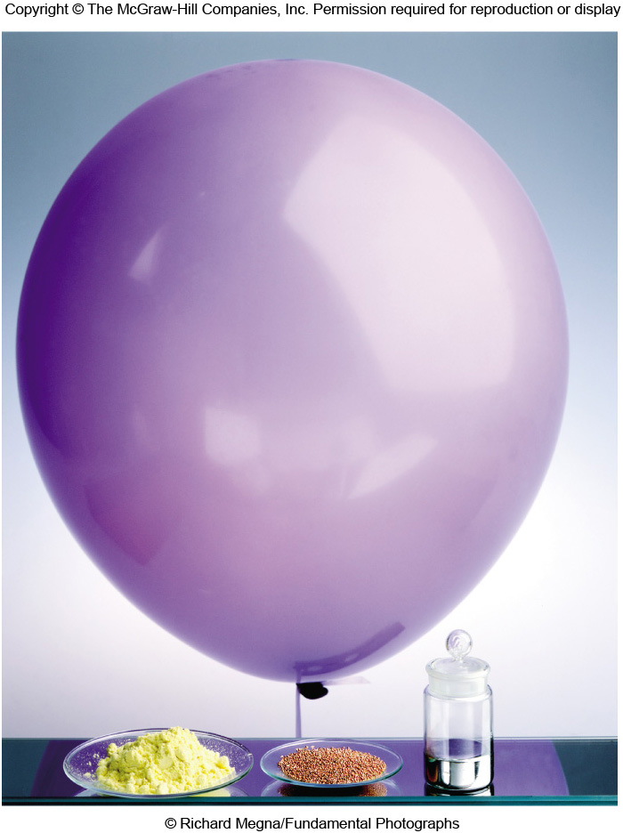
The Mole and Molar Mass
One mole each of some familiar substances:
sulfur (left)
copper (middle)
mercury (right)
helium (in balloon)
N_{A} = 6.0221415 x 10²³

Slide 15
The Mole and Molar Mass
The coefficients in chemical equations are used to represent either molecules or moles of molecules.
In either instance, the ratio is always conserved.
2H₂(g) + O₂(g) → H₂O(l)

Slide 16
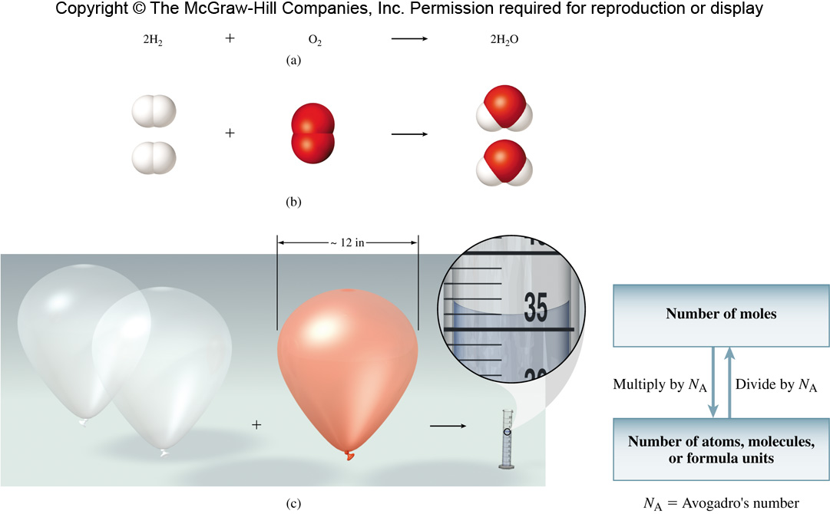
The Mole and Molar Mass
The same ratio is also conserved on the macroscopic scale:
2H₂(g) + O₂(g) → 2H₂O(l)

Slide 17
The Mole and Molar Mass
Potassium is the second most abundant metal in the human body. Calculate the number of atoms in 7.31 moles of potassium.
Solution:

Slide 18
The Mole and Molar Mass
Calculate the number of moles of potassium that contains 8.91 x 10²⁵ potassium atoms
Solution:

Slide 19
The Mole and Molar Mass
Remember from Chapter 2:
1 amu = 1.661 x 10^{–24} g
This is the reciprocal of Avogadro’s number.
Expressed another way:
1 g = 6.022 x 10²³ amu

Slide 20
The Mole and Molar Mass
The molar mass of a substance is the mass in grams of 1 mole of the substance.
sulfur (left) 32.07 g/mol
copper (middle) 63.55 g/mol
mercury (right) 200.6 g/mol
helium (in balloon) 4.003 g/mol

Slide 21
The Mole and Molar Mass
It is important to be able to convert between mass, moles, and the number of particles.

Slide 22
The Mole and Molar Mass
Determine the mass in grams of 2.75 moles of glucose (C₆H₁₂O₆)
Solution:
Step 1. Use the periodic table to calculate the molar mass of glucose.
MM = 180.16 g/mol
Step 2. Use the molar mass of glucose to find grams.

Slide 23
The Mole and Molar Mass
Determine the number of moles in 59.8 g of sodium nitrate, NaNO₃
Solution:
Step 1. Use the periodic table to calculate the molar mass of NaNO₃.
MM = 85.00 g/mol
Step 2. Use the molar mass to find grams.

Slide 24
The Mole and Molar Mass
Calculate the number of oxygen molecules in 35.5 g of O₂.
Solution:
Step 1. Use the periodic table to calculate the molar mass of O₂.
MM = 32.00 g/mol
Step 2. Use the molar mass and N_{A} to find molecules.

Slide 25
The Mole and Molar Mass
Using the concept of the mole and molar mass, along with percent composition, it is possible to determine empirical formulas.
Determine the empirical formula of a compound that is 52.15 %C, 13.13 % H and 34.73 % O.
Step 1: Assume 100 g sample so that the mass percentages of carbon and oxygen given correspond to the masses of C, H and O in the compound.
Carbon: 52.15 % of 100 g = 52.15 g C
Hydrogen: 13.13 % of 100 g = 13.13 g H
Oxygen: 34.73 % of 100 g = 34.73 g O

Slide 26
The Mole and Molar Mass
Step 2: Convert the grams of each element to moles:

Slide 27
The Mole and Molar Mass
Step 3: Use the number of moles as subscripts in the empirical formula, reducing them to the lowest possible whole numbers for the final
answer.
C_{4.3422}H_{13.0258} O_{2.1706}
Carbon: 4.3422/2.1706 = 2.0005 ≈ 2
Hydrogen: 13.0258/2.1706 = 6.0010 ≈ 6
Oxygen: 2.1706/2.1706 = 1
Empirical Formula: C₂H₆O₁

Slide 28
The Mole and Molar Mass
Determine the empirical formula of a compound that is 85.63 % C and 14.37 % H.
Solution:
Step 1: Assume 100 g; 85.63 g C and 14.37 g of H
Step 2: Determine the moles of each element.
Step 3: Find the simplest whole number ratio.
C_{7.1299}H_{14.2560} = CH₂

Slide 29
Combustion Analysis
3.5
The experimental determination of an empirical formula is carried out by combustion analysis.

Slide 30
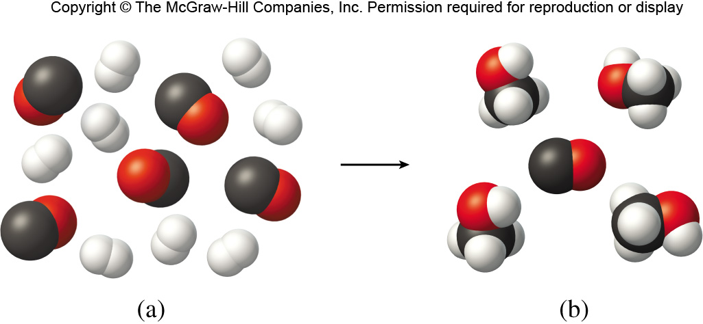
Combustion Analysis
In the combustion of 18.8 g of glucose,
27.6 g of CO₂ and 11.3 g or H₂O are produced.
It is possible to determine the mass of carbon
and hydrogen in the original sample as follows:
The remaining mass is oxygen:
18.8 g glucose – (7.53 g C + 1.26 g H) = 10.0 g O

Slide 31
Combustion Analysis
It is now possible to calculate the
empirical formula.
Step 1: Determine the number of moles of
each element.
Step 2: Determine the smallest whole number ratio and write the
empirical formula.
C_{0.627}H_{1.25}O_{0.626} simplifies to CH₂O

Slide 32
Combustion Analysis
The molecular formula may be
determined from the empirical
formula if the approximate
molecular mass is known.
To determine the molecular formula, divide the
molar mass by the empirical formula mass.
For glucose:
Empirical formula: CH₂O
Empirical formula mass: [12.01 g/mol + 2(1.008 g/mol) +
16.00 g/mol] ≈ 30 g/mol
Molecular mass: 180 g/mol
Molecular mass/Empirical mass: 180/30 = 6
Molecular formula = [CH₂O] x 6 = C₆H₁₂O₆

Slide 33
Combustion Analysis
The combustion of a 28.1 g sample of ascorbic acid (vitamin C) produces 42.1 g CO₂ and 11.5 g H₂O. Determine the empirical and molecular formulas of ascorbic acid. The molar mass of ascorbic acid is approximately 127 g/mol.
Solution:
Step 1: Determine the empirical formula by calculating the number of moles of carbon, hydrogen and oxygen in the sample and then find the simplest ratio.
Empirical formula: C₃H₄O₃
Step 2: Divide the molar mass by the empirical formula mass. Multiply the subscripts in the empirical formula by this same number.
176/88 = 2; molecular formula = [C₃H₄O₃] x 2 = C₆H₈O₆
The remaining mass is oxygen:
18.8 g glucose – (7.53 g C + 1.26 g H) = 10.0 g O

Slide 34
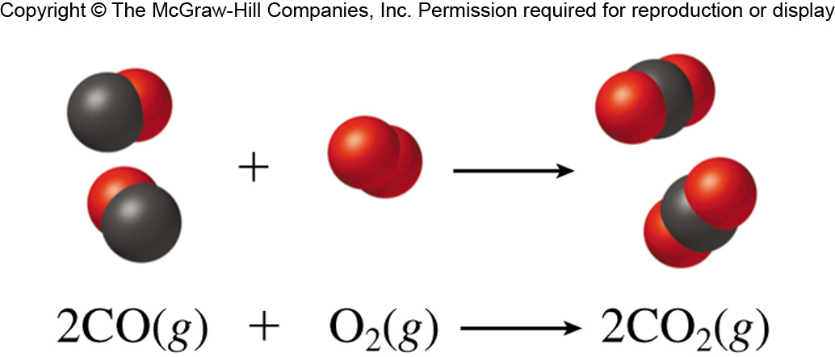
Calculations with Balanced Chemical Equations
3.6
Balanced chemical equations are used to predict how much product will form from a given amount of reactant.
2 moles of CO combine with 1 mole of O₂ to produce 2 moles of CO₂.
2 moles of CO is stoichiometrically equivalent to 2 moles of CO₂.

Slide 35
Calculations with Balanced Chemical Equations
Consider the complete reaction of 3.82 moles of CO to form CO₂. Calculate the number of moles of CO₂ produced.

Slide 36
Calculations with Balanced Chemical Equations
Consider the complete reaction of 3.82 moles of CO to form CO₂. Calculate the number of moles of O₂ needed.

Slide 37
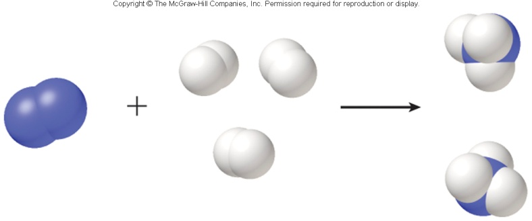
Calculations with Balanced Chemical Equations
Nitrogen and hydrogen react to form ammonia according to the following balanced equation:
Calculate the number of moles of hydrogen required to react with 0.0880 mol of nitrogen.
Solution:
Use the balanced chemical equation to determine the correct stoichiometric conversion factors.
N₂(g) + 3H₂(g) → 2NH₃(g)

Slide 38
Calculations with Balanced Chemical Equations
Nitrogen and hydrogen react to form ammonia according to the following balanced equation:
Calculate the number of moles of ammonia produced from 0.0880 mol of nitrogen.
Solution:
Use the balanced chemical equation to determine the correct stoichiometric conversion factors.
N₂(g) + 3H₂(g) → 2NH₃(g)

Slide 39
Calculations with Balanced Chemical Equations
What mass of water is produced by the metabolism of 56.8 g of glucose?
Solution:
Use the balanced chemical equation to determine the correct stoichiometric conversion factors; use the molar mass of water to calculate grams.
C₆H₁₂O₆(aq) + 6O₂(g) → 6CO₂(g) + 6H₂O(l)

Slide 40
Calculations with Balanced Chemical Equations
The reactant used up first in a reaction is called the limiting reactant.
Excess reactants are those present in quantities greater than necessary to react with the quantity of the limiting reactant.
CO(g) + 2H₂(g) → CH₃OH(l)

Slide 41
Calculations with Balanced Chemical Equations
Consider the reaction between 5 moles of CO and 8 moles of H₂ to produce methanol.
How many moles of H₂ are necessary in order for all the CO to react?
How many moles of CO are necessary in order for all of the H₂ to react?
10 moles of H₂ required; 8 moles of H₂ available; limiting reactant.
4 moles of CO required; 5 moles of CO available; excess reactant.
CO(g) + 2H₂(g) → CH₃OH(l)

Slide 42
Calculations with Balanced Chemical Equations
How much of the excess reactant (CO) remains?
4 moles of CO are consumed:
5 moles CO (available)
– 4 moles CO (consumed)
1 mole CO (excess)
CO(g) + 2H₂(g) → CH₃OH(l)

Slide 43
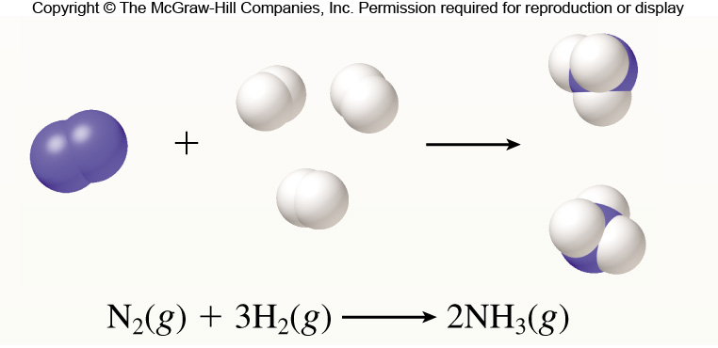
Calculations with Balanced Chemical Equations
Ammonia is produced according to the following equation:
Calculate the mass of ammonia produced when 35.0 g of nitrogen react with 12.5 grams of hydrogen. Which is the excess reagent? How much of it will be left over?

Slide 44
Calculations with Balanced Chemical Equations
Solution:
Step 1: Convert each mass to moles and determine the limiting reagent.
2.0668 moles of N₂ are required; only 1.2491 are available; N₂ is limiting.
N₂(g) + 3H₂(g) → 2NH₃(g)

Slide 45
Calculations with Balanced Chemical Equations
Solution:
Step 2: Calculate the number of moles of ammonia produced from the
number of moles of limiting reactant (N₂) consumed.
Step 3: Convert this amount to grams:
16.9 moles of H₂ are required; only 6.20 are available; H₂ is limiting.
N₂(g) + 3H₂(g) → 2NH₃(g)

Slide 46
Calculations with Balanced Chemical Equations
Solution:
Step 4: To determine the mass of excess reactant (H₂) left over, first
calculate the amount of H₂ that will react; convert to mass and
subtract from the initial amount of H₂.
12.5 g H₂ – 7.5546 g H₂ = 4.9 g H₂
N₂(g) + 3H₂(g) → 2NH₃(g)

Slide 47
Calculations with Balanced Chemical Equations
The theoretical yield is the amount of product that forms when all the limiting reactant reacts to form the desired product.
The actual yield is the amount of product actually obtained from a reaction.
The percent yield tells what percentage the actual yield is of the theoretical yield.

Slide 48
Calculations with Balanced Chemical Equations
Diethyl ether is produced from ethanol according to the following equation:
2CH₃CH₂OH(l) → CH₃CH₂OCH₂CH₃(l) + H₂O(l)
Calculate the percent yield if 68.6 g of ethanol reacts to produce 16.1 g of ether.
Solution:
Step 1: Determine the theoretical yield.
Step 2: Determine the % yield.

Slide 49
Chapter Summary: Key Points
3
Molecular and Formula Masses
Percent Composition of Compounds
Interpreting and Writing Chemical Equations
Balancing Chemical Equations
The Mole
Determining Molar Mass
Interconverting Mass, Moles, and Numbers of Particles
Empirical Formula from Percent Composition
Determination of Empirical Formula
Determination of Molecular Formula
Moles of Reactants and Products
Mass of Reactants and Products
Determining the Limiting Reactant
Reaction Yield

