Slide 1
Kinetics and Reactor Design
CHE-402
INSTRUCTOR: Dr. Nabeel Salim Abo-Ghander
Chapter 1
Chemical Reactions and Rate of Reactions

Slide 2
Introduction
Kinetics and Reactor Design
Chemical kinetics is defined as rate of chemical reactions, that is, with the quantitative description of how fast chemical reactions occur, and factors affecting these rates.
Confines where chemical reactions take place.
OR
A device in which change in composition of matter occurs by chemical reactions
Obtain sizing parameters such as area, length, volume …etc

Slide 3
Basic Definitions
Chemical Reaction:
Classification of Chemical Reactions
Phase
Reversibility
Molecularity
Unimolecular reactions:
Bimolecular reactions:
Termolecular reaction
Homogeneous reactions
Heterogeneous reactions
Reversible reactions
Irreversible reactions

Slide 4
Chemical Reactions and Rate of Reactions:
Rate of reaction is change of concentration with respect to time!
The rate equation (i.e. rate law) is an algebraic equation that is solely a function of the properties of the reacting materials and reaction conditions including species, temperature, pressure or type of catalyst, if any at a point in the system.
Reaction rate definition is independent of reactor type.
Mathematically, it can be represented as:
Dimension:
Units:

Slide 5
Chemical Reactions and Rate of Reactions:
It is defined for each species in the chemical reaction, i.e.
All species reaction rates in a certain reactions are interrelated through the stoichiometric ratios as follows:
Reaction rates can be only obtained experimentally.

Slide 6
Chemical Reactions and Rate of Reactions:
Example 1:
Nitrogen oxide is oxidize to nitrogen dioxide according to the following stoichiometric equation:
If the rate of nitrogen dioxide was measured and found to be 4.0 mol/m³/s, what would be the rate of the two other species?

Slide 7
Reaction Rate Models
Reaction Rate Models
Power Law Models
Complex Rate Model
The product of concentration of concentrations of the individual reacting species, each of which is raised to a power
Unit of the specific reaction rate:
Reactions orders are determined by experimental observation

Slide 8
Batch Reactor:
Definition:
Batch Reactors are defined as reactors in which no flow of mass across the reactor boundaries, once the reactants have been charged.
Schematic Representation of Batch Reactors:
Stirrer
Liquid Surface
V
Tank

Slide 9
Batch Reactor:
Mode of Operation:
Cleaning the reactor
Unloading the reactor
Loading the reactor
Stopping the operation
t = t_{f}
Adding the initiator
t = 0

Slide 10
Batch Reactor:
Characteristics of Batch Reactor:
Each batch is a closed system.
The total mass of each batch is fixed.
The volume or density of each batch may vary as reaction proceeds.
The energy of each batch may vary as reaction proceeds; heat exchanger may be provided to control temperature.
The reaction (residence) time for elements of the reacting fluid is the same.
The operation of the reactor is inherently unsteady-state; batch composition changes with respect to time.
At any time, the batch is uniform in composition, temperature because of the efficient and vigorous stirring

Slide 11
Continuous Stirred Tank Reactor (CSTR):
Definition:
Continuous Stirred Tank Reactors (CSTR) are defined to be flow reactors characterized by intense mixing so that the properties anywhere inside the reactor are exactly the same as that of the exist stream.
Schematic Representation of CSTR:
Stirrer
This model can be used to:
model a bed of catalyst powder, i.e. fluidized-bed reactors.
Slurry bubble column reactor
Polymerization reactors
Liquid Surface
V
Input Rate
Output Rate

Slide 12
Continuous Stirred Tank Reactor (CSTR):
Characteristics of Continuous Stirred Tank Reactor (CSTR):
The flow through the vessel(s), both input and out streams, is continuous but not necessary at a constant rate.
The system mass inside each vessel is not necessary fixed.
The volume or density of each batch may vary as reaction proceeds.
The energy of each batch may vary as reaction proceeds; heat exchanger may be provided to control temperature.
The reaction (residence) time for elements of the reacting fluid is the same.
The operation of the reactor may be steady state or unsteady-state.
The fluid properties are uniform in composition, temperature anywhere in the vessel because of the efficient and vigorous stirring

Slide 13
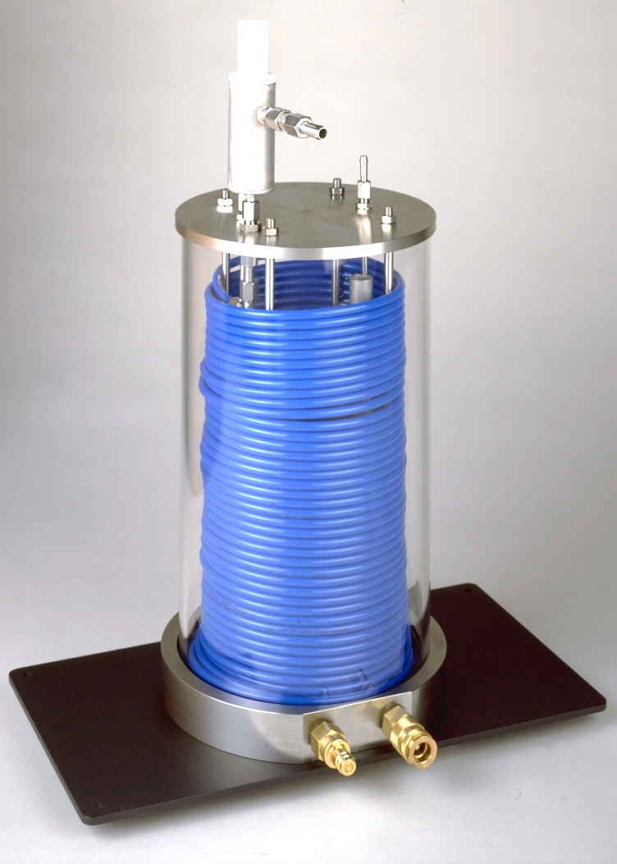
Plug Flow Reactors(PFR):
Definition:
Plug Flow Reactors (PFR) are defined to be flow reactors characterized by the absence of mixing in the direction of flow and absence of variation normal to the direction of flow.
Schematic Representation of PFR:
This model can be used to:
model a tubular-type reactors such as ammonia manufacturing reactor.

Slide 14
Plug Flow Reactors(PFR):
Characteristics of Plug Flow Reactors(PFR):
The flow through the vessel(s), both input and out streams, is continuous but not necessary at a constant rate.
The system mass inside each vessel is not necessary fixed.
The density of the flowing system may vary in the direction of flow.
There is no axial mixing of fluid inside the reactor, composition changes along the flow direction.
There is complete radial mixing of fluid inside the reactor; uniform fluid properties along the direction normal to flow direction.
The energy may vary as reaction proceeds; heat exchanger may be provided to control temperature.
The reaction (residence) time for elements of the reacting fluid is the same.
The operation of the reactor may be steady state or unsteady-state.

Slide 15
Example 2.2
The reaction described by
is to be carried out in a flow reactor. Species A enters the reactor at a molar flowrate of 0.4 mol/s. Using the data provided:
Calculate the volume necessary to achieve 80% conversion in CSTR.
Shade the area that would correspond to the necessary volume.
Calculate the volume necessary to achieve 80% conversion in PFR.
Shade the area that would correspond to the necessary volume.
For two CSTR in series, 40% conversion is achieved in the first reactor. What is the volume of each of the two reactor necessary to achieve 80% overall conversion of the entering species A?
For two PFR in series, 40% conversion is achieved in the first reactor. What is the volume of each of the two reactor necessary to achieve 80% overall conversion of the entering species A?

Slide 16
Example 2.2
X | -r_{A} (mol/m³ × s)
0.0 | 0.45
0.1 | 0.37
0.2 | 0.30
0.4 | 0.195
0.6 | 0.113
0.7 | 0.079
0.8 | 0.05

Slide 17
Example 2.2
X | -r_{A} (mol/m³ × s) | 1/-r_{A} (m³ × s / mol)
0.0 | 0.45 | 2.22
0.1 | 0.37 | 2.70
0.2 | 0.30 | 3.33
0.4 | 0.195 | 5.13
0.6 | 0.113 | 8.85
0.7 | 0.079 | 12.66
0.8 | 0.05 | 20.00

Slide 19
Thank you

