Slide 1
Vectors

Slide 2
Vectors and scalars.
Vector quantity is a quantity that has both magnitude and direction the follow certain (vector) rules and combinations.
Examples: position vector, displacement, velocity, force …. etc.
In the other hand Scalars are quantities that have magnitude only.
Examples: temperature, energy, mass, speed…

Slide 3
Some Vector Properties:
If the length of a set of vectors is the same and they have the same direction, then they are identical vectors.
A vector of some physical quantity can be shifted and will be consider the same vector if its magnitude( length) and direction( arrow direction) are not changed.
B’
B
Tip (Head)
A’
A
Identical vectors
B’’
Tail
A’’

Slide 4
Graphically vectors are represented by arrows.
The length of the arrow indicate the vector magnitude.
The direction of the arrow represent the direction of the vector.

Slide 5
Adding Vectors Geometrically
$\vec{S}=\vec{a}$ +$\vec{b}$
B
$$\vec{a}$$
$$\vec{b}$$
A
C
$$\vec{S}$$

Slide 6

Vector addition properties
$$\vec{b}$$
$\vec{a}$ +$\vec{b}=\vec{b}+\vec{a}$ Commutative law
($\vec{a}$ +$\vec{b})+\vec{c}=\vec{a}+(\vec{b}+\vec{c})$ Associative law
$$\vec{a}$$
$$\vec{a}$$
$$\vec{b}$$
$$\vec{b}$$
$$\vec{a}$$
$$\vec{c}$$
$$\vec{S}$$

Slide 7




The vector $−\vec{b}$ is a vector with same magnitude as vector $\vec{b}$ but has opposite direction and:
$\vec{b }$+ ($−\vec{b})=0$
vector subtraction
$$\vec{d }=\vec{a }−\vec{b}=\vec{a }+(−\vec{b})$$
$$\vec{b}$$
$$−\vec{b}$$
$$−\vec{b}$$
$$\vec{a}−\vec{b}$$
$$\vec{a}$$
$$\vec{b}$$
$$\vec{a}+\vec{b}$$

Slide 8

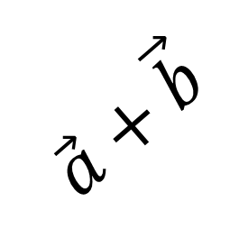

N
${30}^{o}$ North of east
y
$$\vec{a}$$
$${30}^{o}$$
W
E
$$\vec{b}$$
$$\vec{a}+\vec{b}$$
$$\vec{b}$$
$$\vec{b}$$
$$\vec{a}$$
x
S

Slide 9




Components of Vectors
The component of a vector is the projection of the vector on an axis.
$$\vec{a}=\vec{a_{x}}+\vec{a_{y}}$$
$$a_{x}=a cos{θ}$$
$$a_{y}=a sin{θ}$$
$$\tan{θ=\frac{a_{y}}{a_{x}}}$$
$$a=\left|\vec{a}\right|=\sqrt{a_{x}^{2}+a_{y}^{2}}$$
y
$$\vec{a}$$
$$\vec{a_{y}}$$
θ
x
$$\vec{a_{x}}$$

Slide 10
Unit vectors, Adding vectors by components
A unit vector is a vector that has a magnitude of exactly one and point at a particular direction.
We use the unit vectors $\hat{i},$ $\hat{j}$ and $\hat{k}$ as unit vectors that are pointed at the positive direction of x,y, and z axes.
z
$$\vec{a}=\vec{a_{x}} +\vec{a_{y}} + \vec{a_{z}}$$
$$\hat{k}$$
$$\hat{j}$$
y
$$\hat{i}$$
$$\vec{a}=a_{x}\hat{i}+a_{y}\hat{j}+a_{z}\hat{k}$$
x

Slide 11
Addition of two vectors:
$\vec{a}=a_{x}\hat{i}+a_{y}\hat{j}+a_{z}\hat{k}$ and $\vec{b}=b_{x}\hat{i}+b_{y}\hat{j}+b_{z}\hat{k}$
$\vec{c}=\vec{a}+\vec{b}$ $c_{x}=a_{x}+b_{x}$
$c_{y}=a_{y}+b_{y}$
$c_{z}=a_{z}+b_{z}$

Slide 12


Vectors and the laws of physics
The laws of physics are independent of the choice of coordinates system.
$$a=\sqrt{a_{x}^{2}+a_{y}^{2}}$$
$$a=\sqrt{a_{x^{′}}^{2}+a_{y^{′}}^{2}}$$
y
Y’
$$\vec{a}$$
X’
x

Slide 13
Multiplying Vectors:
Multiply a vector by a scalar
$\vec{C}=m\vec{A}$
Vector $\vec{C}$ has the same direction as vector $\vec{A}$ and has a magnitude of m$\left|\vec{A}\right|$
Multiply a vector by another vector:
Scalar product $\vec{A}⋅\vec{B}≡\left|\vec{A}\right|\left|\vec{B}\right|cosθ=A_{x}B_{x}+A_{y}B_{y}+A_{z}B_{z}$
Vector product $\vec{A}×\vec{B}=\vec{C}$ , the magnitude of $\left|\vec{C}\right|$= $\left|\vec{A}\right|\left|\vec{B}\right| sinθ$
and the direction of $\vec{C}$ should be perpendicular to both vectors $\vec{A}$ and $\vec{B}$.
We use the right hand rule to know the direction.

Slide 14



The right hand rule
$$\vec{B}$$
$$\vec{C}$$
$\vec{A}×\vec{B}=\vec{C}$
$$\vec{A}$$

Slide 15
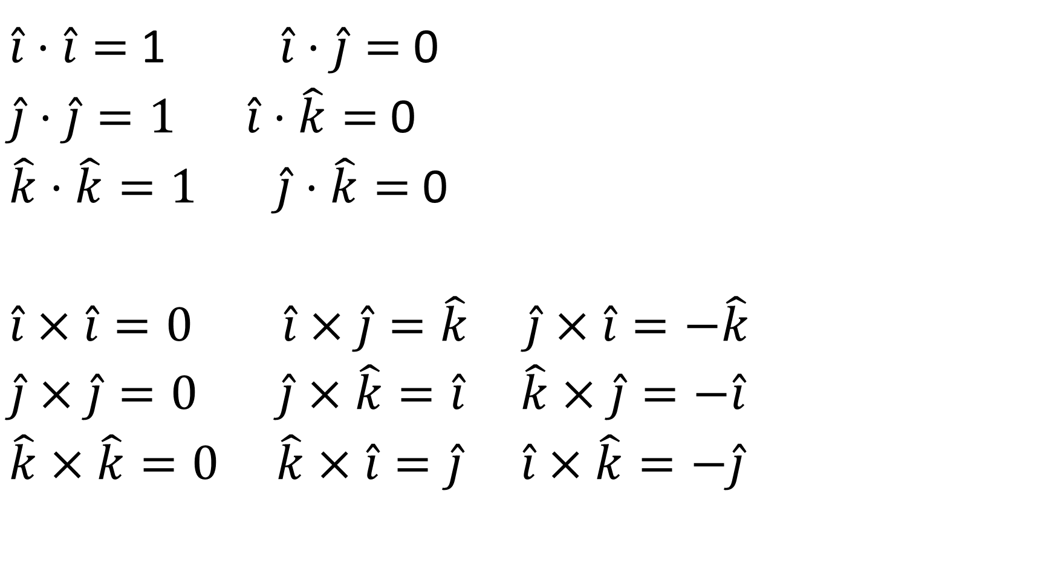



$\hat{i}⋅\hat{i}=$ 1 $\hat{i}⋅\hat{j}=$ 0
$\hat{j}⋅\hat{j}=1$ $\hat{i}⋅\hat{k}=$ 0
$\hat{k}⋅\hat{k}=1 \hat{j}⋅\hat{k}=$ 0
$\hat{i}×\hat{i}=0$ $\hat{i}×\hat{j}=\hat{k} \hat{j}×\hat{i}=−\hat{k}$
$\hat{j}×\hat{j}=0$ $\hat{j}×\hat{k}=\hat{i}$ $\hat{k}×\hat{j}=−\hat{i}$
$\hat{k}×\hat{k}=0$ $\hat{k}×\hat{i}=\hat{j}$ $\hat{i}×\hat{k}=−\hat{j}$
$$\hat{i}$$
$$\hat{k}$$
$$\hat{j}$$

Slide 16
$\vec{A}=A\hat{A} ⇒ \hat{A}=\frac{\vec{A}}{A}$
$\vec{A}⋅\vec{A}={\left|A\right|}^{2}$
$$\vec{A}⋅\hat{i}=\left(A_{x}\hat{i}+A_{y}\hat{j}+A_{z}\hat{k}\right)⋅\hat{i}=A_{x}$$
$$\vec{A}⋅\hat{i}=A_{x}$$
$$\vec{A}⋅\hat{j}=A_{y}$$
$$\vec{A}⋅\hat{k}=A_{z}$$
To get the component of a vector along another vector
$\vec{A}⋅\hat{B}=A_{B} ⇒A_{B}=\vec{A}⋅\frac{\vec{B}}{B}=\frac{\vec{A}⋅\vec{B}}{B}$ This is the component of vector A along vector B

