Slide 1

Optothermal Spectroscopy
Ionization Spectroscopy
Optogalvanic Spectroscopy
Velocity-Modulation Spectroscopy
Laser Magnetic Resonance and Stark Spectroscopy
Prof. Dr M.A Gondal
Department of Physics, KFUPM.
magondal@kfupm.edu.sa
Dated:

Slide 2
Optothermal Spectroscopy
The spectroscopy of vibrational–rotational transitions in molecules in the laser-excited fluorescence is generally not the most sensitive tool.
Optoacoustic spectroscopy, on the other hand, is based on collisional energy transfer and is, therefore, not applicable to molecular beams, where collisions are rare or even completely absent.
For the infrared spectroscopy of molecules in a molecular beam therefore, a new detection technique has been developed, which relies on the collision-free conditions in a beam and on the long radiative lifetimes of vibrational–rotational levels in the electronic ground state.

Slide 3
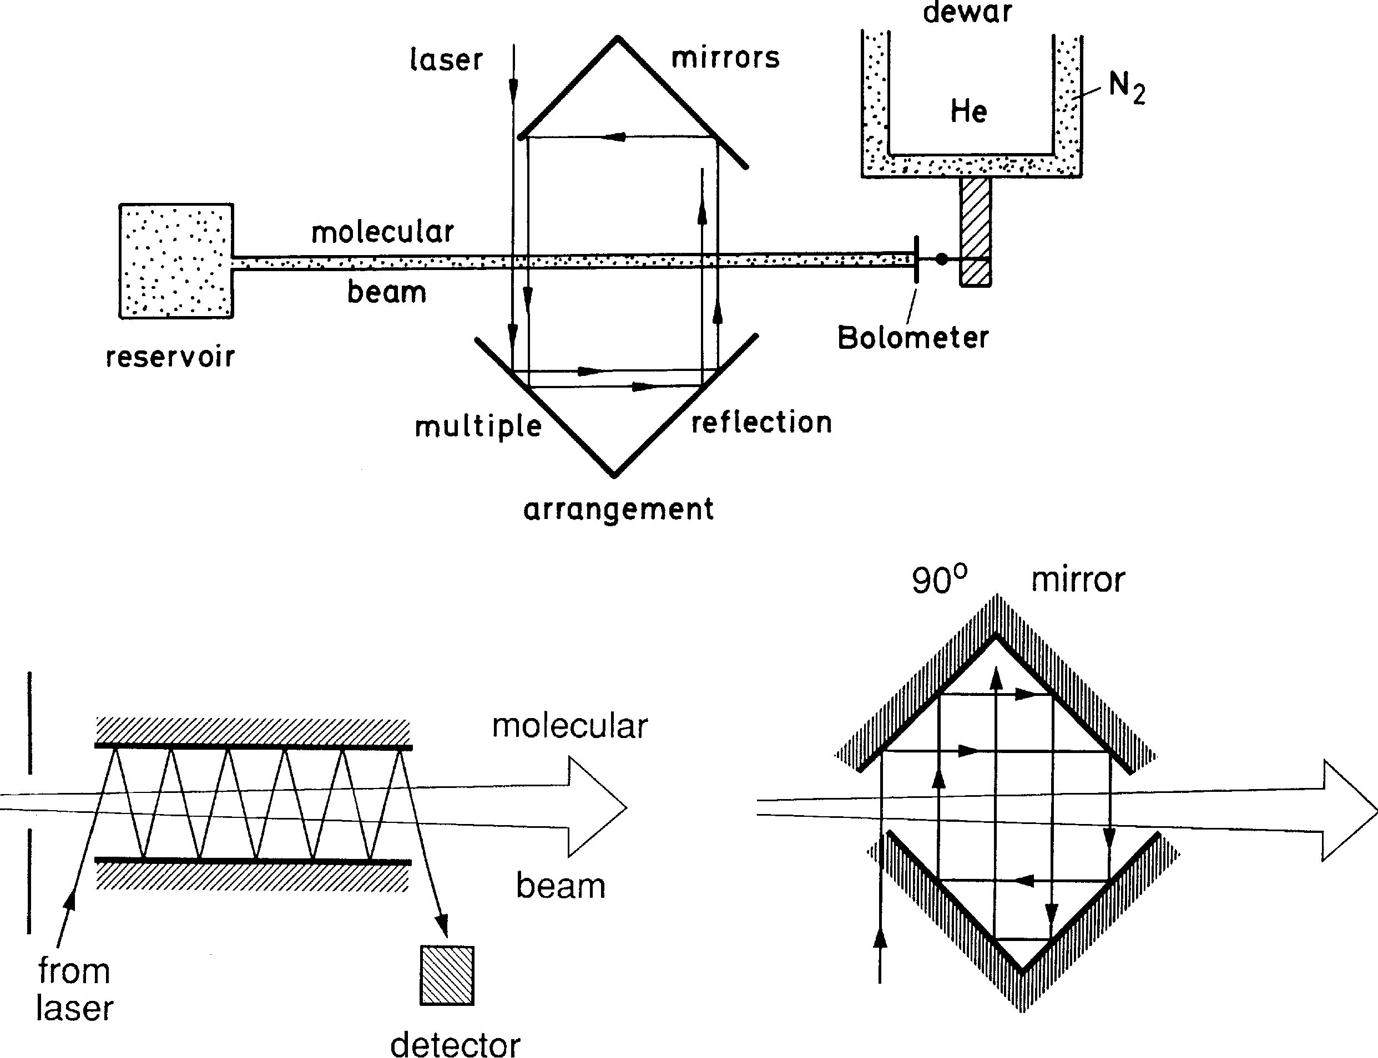
Optothermal Spectroscopy
Optothermal spectroscopy uses a cooled bolometer to detect the excitation of molecules in a beam (Fig).
When the molecules hit the bolometer, they transfer their kinetic and internal thermal energy, thereby increasing the bolometer temperature T₀ by an amount ΔT.
If the molecules are excited by a tunable laser (for example, a color-center laser or a diode laser),
Their vibrational–rotational energy increases by ΔE = hν » E_{kin}.
If the lifetime τ of the excited levels is larger than the flight time t = d/v.

Slide 4
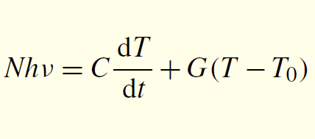
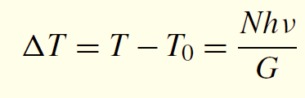
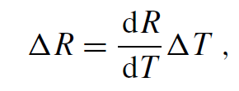
Optothermal Spectroscopy
dQ
_{dt} = NΔE = Nhν.
the heat capacity C of the bolometer and a heat conduction G(T − T₀) the temperature T is determined by
Under stationary conditions ( dT/ dt = 0), we obtain from the temperature rise
If a small electric current i is sent through the crystal with resistance R, a voltage U = R · i is generated across the bolometer. The resistance decreases with increasing temperature. The temperature change ΔT can be measured by
the resulting resistance change

Slide 5
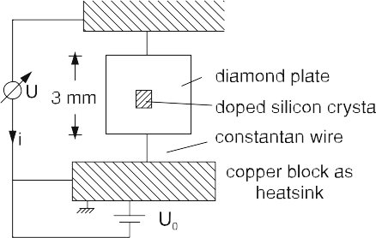
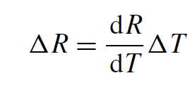
Optothermal Spectroscopy
The bolometer consists of a small (0.25 × 0.25 × 0.25 mm³) doped silicon semiconductor crystal (Fig.), which has a low heat capacity at T = 1.5 K.
If a small electric current i is sent through the crystal with resistance R, a voltage U = R · i is generated across the bolometer. The resistance decreases with increasing temperature. The temperature change ΔT can be measured by the resulting resistance change

Slide 6
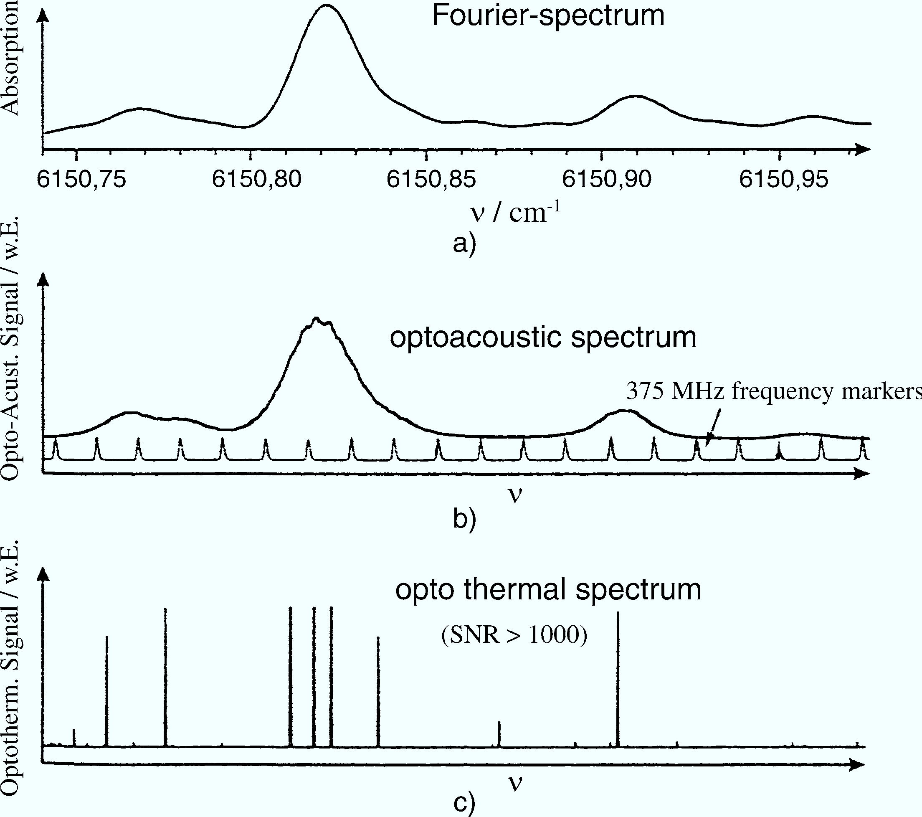
Optothermal Spectroscopy
The sensitivity of the optothermal technique is illustrated by the comparison of the same sections of the overtone spectrum of C₂H₄ molecules, measured with Fourier, optoacoustic, and optothermal spectroscopy, respectively (Fig.).
Note the increase of spectral resolution and signal-to-noise ratio in the optothermal spectrum compared to the two other Doppler-limited techniques.

Slide 7
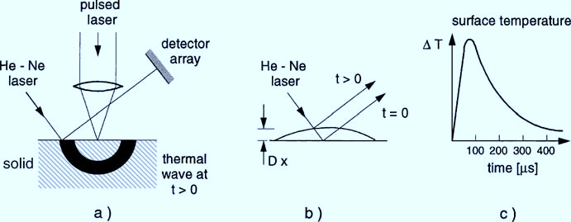
Optothermal Spectroscopy
An interesting modification of this technique for the study of molecules adsorbed at surfaces is illustrated in Fig.
A small spot of a surface is irradiated by a pulsed laser beam. The absorbed power results in a temperature rise of the illuminated spot.
This temperature travels as a thermal shock wave through the solid.
It leads to a slight time-dependent deformation of the surface from thermal expansion.
This deformation is probed by the time-dependent deflection of a low-power HeNe laser beam. In the case of adsorbed molecules, the absorbed power varies when the laser wavelength is tuned over the absorption spectrum of the molecules

Slide 8
Ionization Spectroscopy
Basic Techniques
Ionization spectroscopy monitors the absorption of photons on the
molecular transition E_{i} → E_{k}
detecting the ions or electrons produced by the ionization of
excited state E_{k}
The necessary ionization of the excited molecule may be performed by
Photons,
Collisions, or
An external electric field

Slide 9
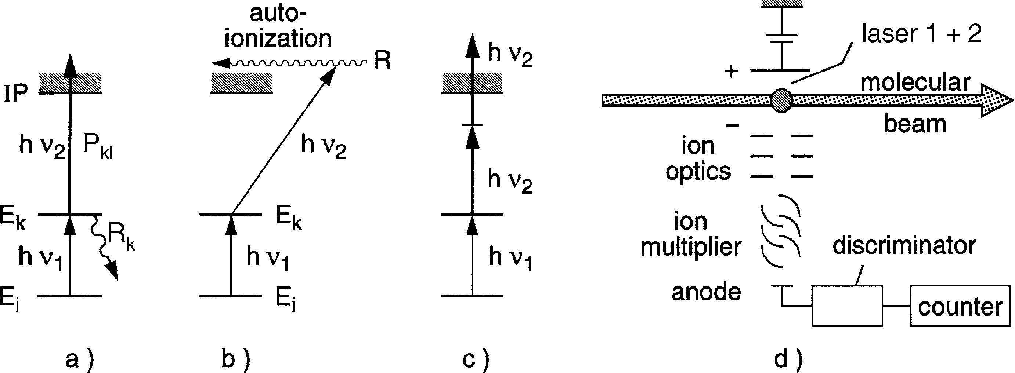
Ionization Spectroscopy
a) Photoionization
M∗(E_{k}) + hν₂ −→ M⁺ + e⁻ + E_{kin} .
The ionizing photon may come either from the same laser that has excited the level E_{k} or from a separate light source, which can be another laser or even an incoherent source (Fig. a).
A very efficient photoionization process is the excitation of high-lying
Rydberg levels above the ionization limit (Fig. b), which decay by an ionization into lower levels of the ion M⁺
M∗(E_{k}) + hν₂ −→ M∗∗ → M⁺ + e⁻ + E_{kin} ( e⁻).
The absorption cross section for this process is generally much larger than that of the bound–free transition .The excited molecule may also be ionized by a nonresonant two-photon process (Fig. c)
M∗(E_{k}) + 2hν₂ −→ M⁺ + e⁻ + E_{kin} ( e⁻).

Slide 10
Ionization Spectroscopy
b) Collision-Induced Ionization
Ionizing collisions between excited atoms or molecules and electrons represent the main ionization process in gas discharges:
M∗(E_{k}) + e⁻ −→ M⁺ + 2 e⁻ .
If the excited level E_{k} is not too far from the ionization limit, the molecule may also be ionized by thermal collisions with other atoms or molecules.
If E_{k} lies above the ionization limit of the collision partner A, Penning ionization becomes an efficient process and proceeds as
M∗(E_{k}) + A −→ M + A⁺ + e⁻ .

Slide 11
Ionization Spectroscopy
c) Field Ionization
If the excited level E_{k} lies closely below the ionization limit, the molecule M∗(E_{k} ) can be ionized by an external electric DC field (Fig. a).
This method is particularly efficient if the excited level is a long-lived, highly excited Rydberg state with
The principal quantum number n,
quantum defect δ, and
ionization energy Ry/n^{∗2},
which can be expressed by the Rydberg constant Ry and the effective quantum number
n∗ = n − δ.

Slide 12
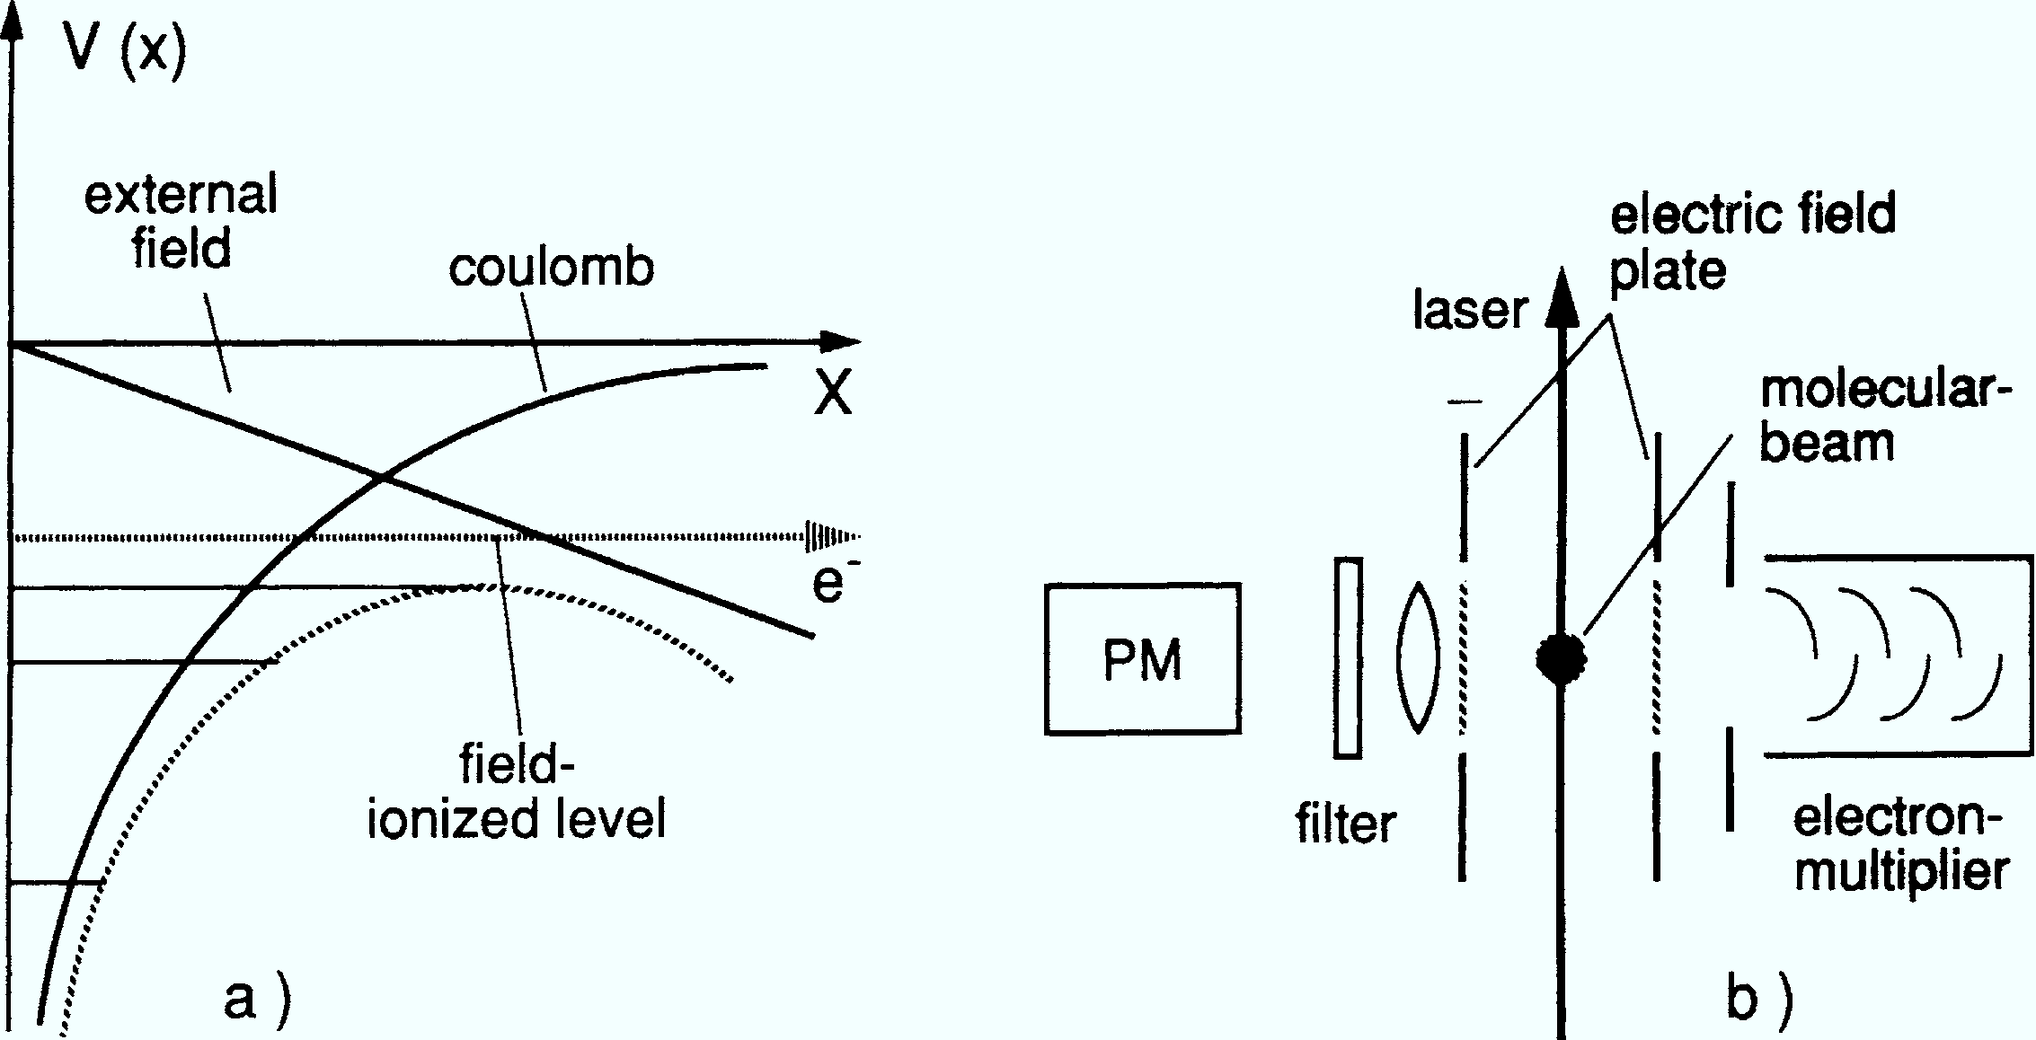
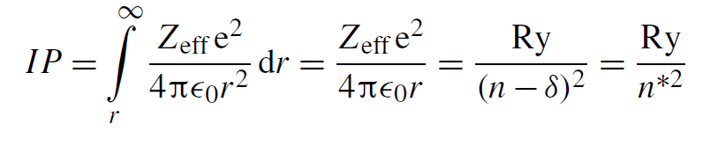
Ionization Spectroscopy
c) Field Ionization
The required minimum electric field can readily be estimated from Bohr’s atomic model, which gives a good approximation for atomic levels with a large principal quantum number n.
Without an external field, the ionization energy for the outer electron at the mean radius r from the nucleus is determined by the Coulomb field of the nucleus shielded by the inner electron core.

Slide 13
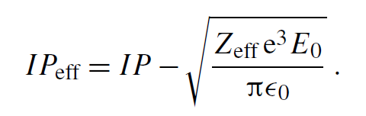
Ionization Spectroscopy
c) Field Ionization
Where eZ_{eff} is the effective nuclear charge, i.e., the nuclear charge eZ is partly screened by the electron cloud.
If an external field E_{ext} = −E₀ x is applied, the effective ionization potential is lowered to the value.
If the energy E of the excited level is above I P_{eff}, it will be field-ionized.
Techniques where the laser excites the atoms but the ionizing step is performed by field ionization have found increasing applications in the detection of Rydberg atoms in atomic beams in analytical chemistry for trace elements, or for small concentrations of pollutants.

Slide 14
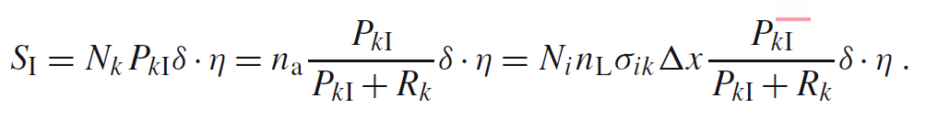
Ionization Spectroscopy
Sensitivity of Ionization Spectroscopy
Let N_{k} be the density of excited molecules in level E_{k} , P_{kI} the probability per second that a molecule in level E_{k} is ionized, and
n_{a} = N_{i}n_{L}σ_{ik} Δx
the number of photons absorbed per second on the transition E_{i} → E_{k}.
If R_{k} is the total relaxation rate of level E_{k} , besides the ionization rate (spontaneous transitions plus collision-induced deactivation) the signal rate in counts per second for the absorption path length Δx and for n_{L} incident laser photons per second under steady-state conditions is:

Slide 15
Ionization Spectroscopy
Sensitivity of Ionization Spectroscopy
With a proper design the collection efficiency δ for the ionized electrons or ions can reach δ = 1. If the electrons or ions are accelerated to several keV.
and detected by electron multipliers or channeltrons, a detection efficiency of η = 1 can also be achieved.
If the ionization probability P_{kI} can be made large compared to the relaxation rate R_{k} of the level |k), the signal S_{I} then becomes with δ = η = 1:
S_{I} ∼ n_{a}
This means that every laser photon absorbed in the transition E_{i} → E_{k} gives rise to a detected ion or electron.
It implies that single absorbed photons can be detected with an overall efficiency close to unity (or 100%).
In experimental practice, there are, of course, additional losses and sources of noise, which limit the detection efficiency to a somewhat lower level.

Slide 16

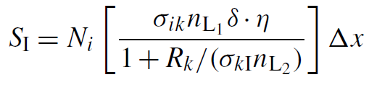


Ionization Spectroscopy
Pulsed Versus CW Lasers for Photoionization
In case of photoionization of the excited level |k), the ionization probability per second
equals the product of the ionization cross section σ_{kI} [cm²] and the photon flux, density n [cm⁻² s⁻¹] of the ionizing laser. We can then write as:
The maximum ion rate S^{max}, which is achieved if
becomes equal to the rate n_{a} of photons absorbed in the transition |i)→ |k):

Slide 17
Ionization Spectroscopy
Pulsed Versus CW Lasers for Photoionization
The advantage of pulsed lasers is the large photon flux during the pulse time ΔT,
which allows the ionization of the excited molecules before they decay by relaxation into lower levels where they are lost for further ionization.
Their disadvantage is their large spectral bandwidth, which is generally larger than the Fourier-limited bandwidth Δν ≥ 1/ΔT, and their low duty cycle.
At typical repetition rates of f_{L} = 10 to 100 s⁻¹ and a pulse duration of ΔT = 10⁻⁸ s, the duty cycle is only 10⁻⁷−10^{−6.}

Slide 18
Optogalvanic Spectroscopy
Optogalvanic spectroscopy is an excellent and simple technique to perform laser spectroscopy in gas discharges.
Even with moderate laser powers (a few milliwatts) large signals (μV to mV) can be achieved in gas discharges of several milliamperes.
Since the absorbed laser photons are detected by the optically induced current change, this very sensitive technique is called optogalvanic spectroscopy

Slide 19
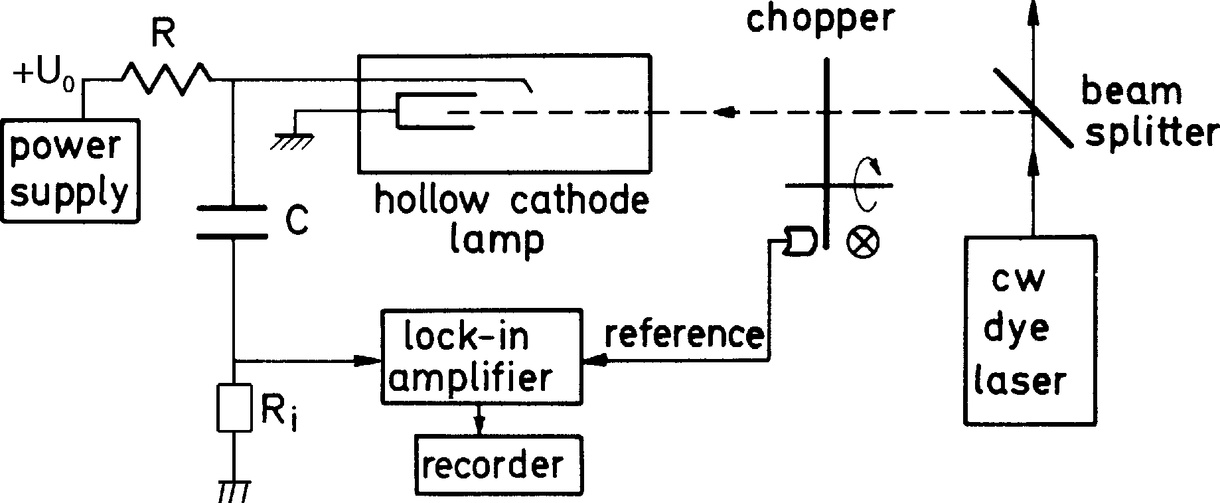
Optothermal Spectroscopy
Assume that the laser beam passes through part of the discharge volume.
When the laser frequency is tuned to the transition Ei → Ek between two levels of atoms or ions in the discharge,
The population densities ni (Ei ) and nk(Ek) are changed by optical pumping.
Because of the different ionization probabilities from the two levels, this population change will result in a change in the number of ions and free electrons and therefore a change ΔI in the discharge current that is detected as a
voltage change ΔU = RΔI across the resistor R at a constant supply voltage U0 (Figure).
When the laser intensity is chopped, an ac voltage is obtained,
which can be directly fed into a lock-in amplifier.

Slide 20
Optothermal Spectroscopy
Both positive and negative signals are observed, depending on the levels E_{i}, E_{k} involved in the laser-induced transition
E_{i} → E_{k}.
If I P(E_{i} ) is the total ionization probability of an atom in level E_{i}, the voltage change ΔU produced by the laser-induced change
Δn_{i} = n_{i0} − n_{iL} is given by
ΔU = RΔI = a[Δn_{i} I P(E_{i} ) − Δn_{k} I P(E_{k} )]

Slide 21
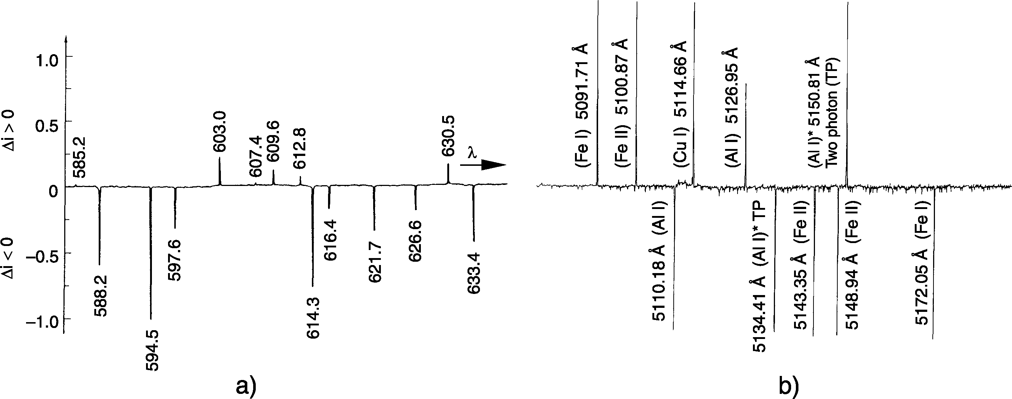
Optothermal Spectroscopy
Figure a shows the optogalvanic spectrum of a Ne discharge (5mA) recorded in a fast scan with 0.1-s time constant. The good signal-to-noise ratio demonstrates the sensitivity of the method.
Figure. b illustrates a section of the optogalvanic spectrum of aluminum, copper, and iron atoms, and ions Al+ and Fe+, measured simultaneously in two hollow cathodes irradiated with a tunable pulsed dye laser.

Slide 22
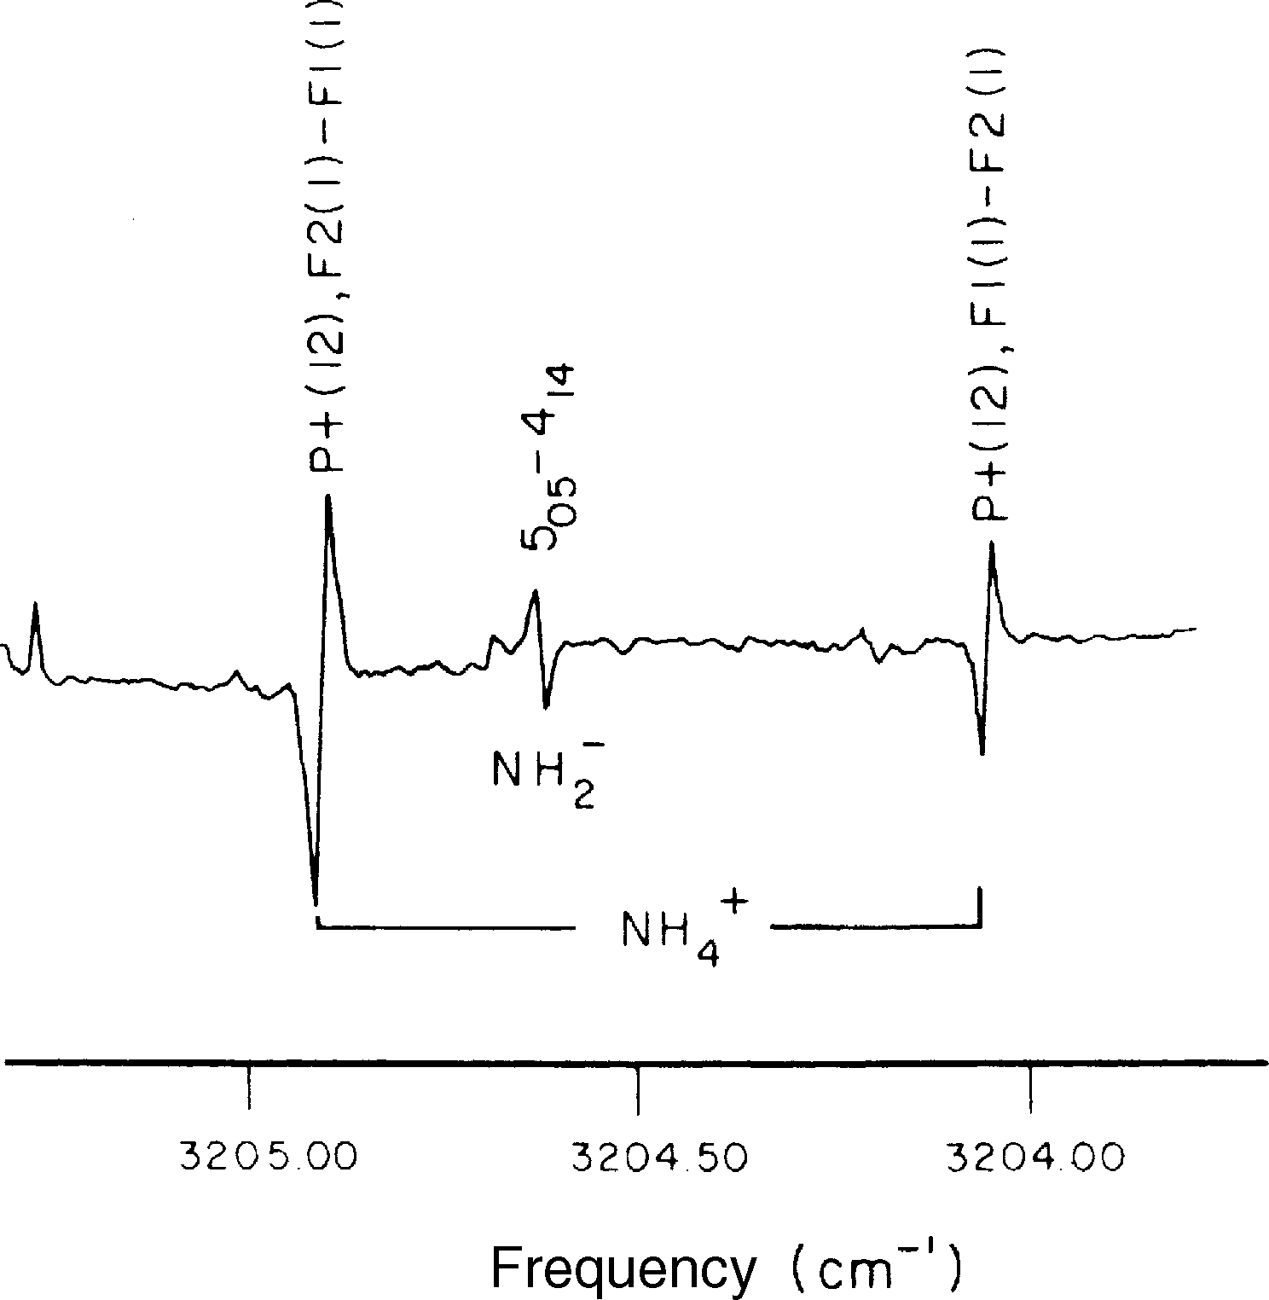
Velocity-Modulation Spectroscopy
An elegant technique developed by Saykally et al. is very helpful in distinguishing between spectra of ionized and neutral species.
The external voltage applied to the gas discharge accelerates the positive ions toward the cathode and the negative ions toward the anode. They, therefore, acquire a drift velocity vD, which causes a corresponding:
Doppler shift Δω =ω−ω0 = k·vD of their absorption frequency ω0.
If an AC voltage of frequency f is applied instead of a DC voltage, the drift velocity is periodically changed, and the absorption frequency
ω = ω0+k· vD
is modulated at the frequency f around the unshifted frequency ω0.
When the laser is scanned through the spectrum, the first derivatives of the ion lines are seen where the phase of the signals is opposite for positive and negative ions, respectively (Figure). The two species can, therefore, be distinguished by the sign of the lock-in output signal.

Slide 23
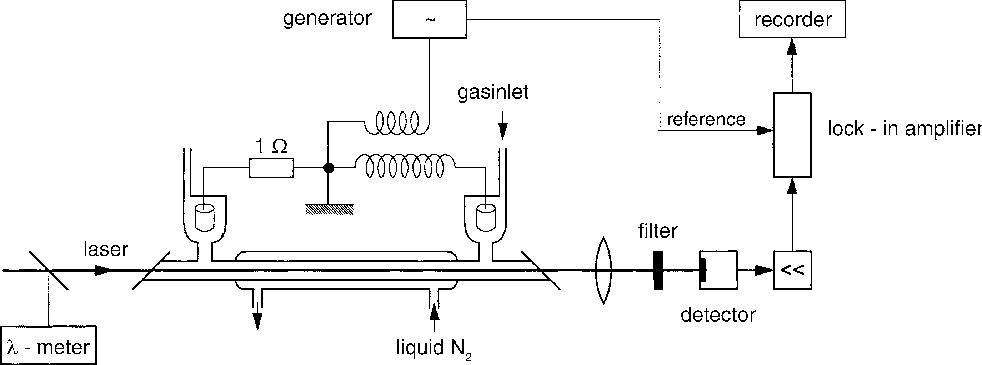
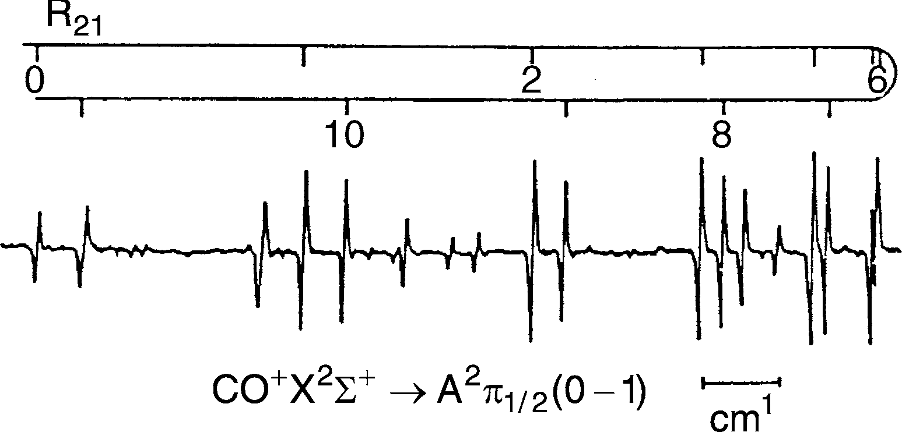
Velocity-Modulation Spectroscopy
A typical experimental arrangement is depicted in Figure 1. With specially designed electron-switching circuits, polarity modulation frequencies up to 50 kHz can be realized for gas discharges of 300V and 3A.
Figure 1
The attainable signal-to-noise ratio is illustrated in Figure 2, which shows the band head of a vibrational band of the
A2Π1/2 ← X2Σg transition of the CO⁺ -ion
Figure 2

Slide 24
Laser Magnetic Resonance and Stark Spectroscopy
For molecules with permanent magnetic or electric dipole moments,
it is often preferable to tune the absorption lines by means of external magnetic or electric fields across a fixed-frequency laser line.
This is particularly advantageous if intense lines of fixed-frequency lasers exist in the spectral region of interest but no tunable source with sufficient intensity is available.
Such spectral regions of interest are, for example, the 3−5μm and the 10μm ranges, where numerous intense lines of HF, DF, CO, N2O, and CO2 lasers can be utilized.
Since many of the vibrational bands fall into this spectral range, it is often called the fingerprint region of molecules.

Slide 25

Laser Magnetic Resonance
The molecular level E0 with the total angular momentum J splits in an
external magnetic field B into (2J +1) Zeeman components
The sublevel with the magnetic quantum number M shifts from the energy E0 at zero field to
E = E₀ − gμ₀ BM
where μ0 is the Bohr magneton, and g is the Land´e factor, which depends on the coupling scheme of the different angular momenta (electronic angular momentum, electron spin, molecular rotation, and nuclear spin).
The frequency ω of a transition (v, J, M)→(v, J, M) is therefore tuned by the magnetic field from its unperturbed position ω₀ to
we obtain on the transition (v^{ii}, J ^{ii}, M^{ii}) → (v^{i}, J ^{i}, M^{i}) three groups of lines with ΔM = M^{ii} − M^{i} = 0, ±1, which degenerate to three single lines if g^{ii} = g^{i} (normal Zeeman effect).
The tuning range depends on the magnitude of gii − gi and is larger for molecules with a large permanent dipole moment.

Slide 26
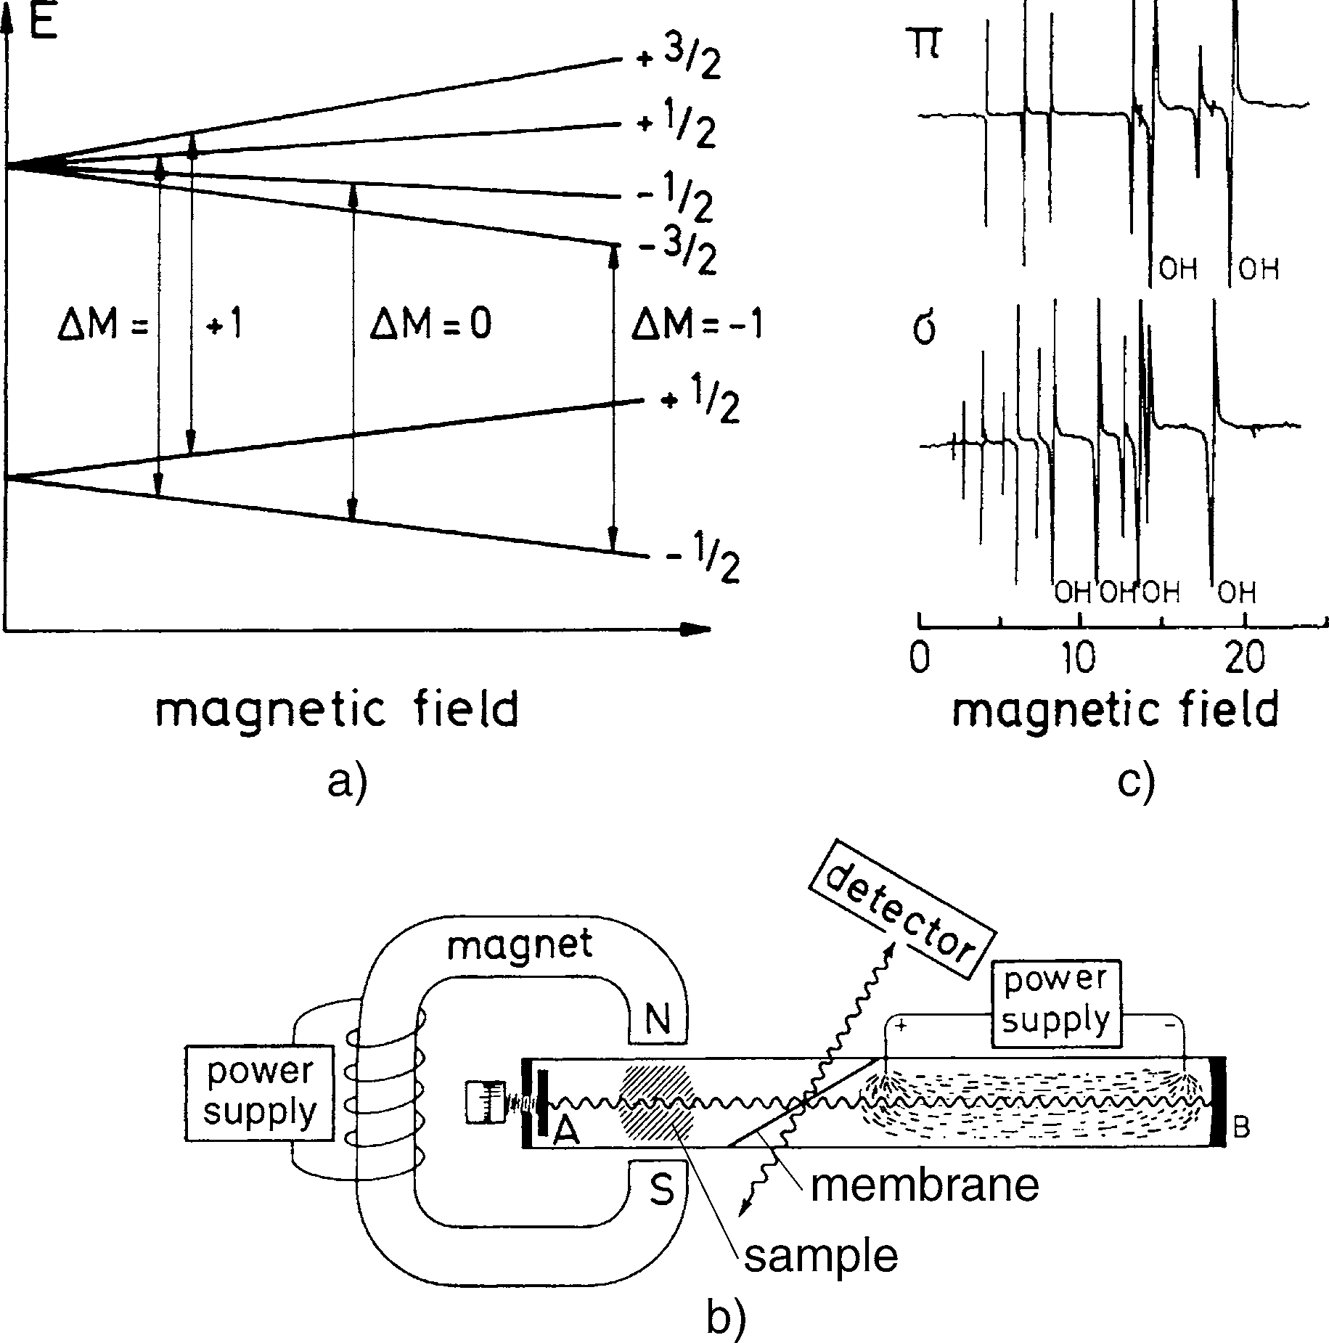
Laser Magnetic Resonance
Figure (a) explains schematically the appearance of resonances between the fixed frequency ω_{L} and the different Zeeman components when the magnetic field B is tuned.
The experimental arrangement is illustrated in Fig. (b). The sample is placed inside the laser cavity, and the laser output is monitored as a function of the magnetic field.
Fig. (c) shows the laser magnetic resonance (LMR) spectrum of the CH radical with some OH lines overlapping. Concentrations of 2 ×108 molecules/cm3 could still be detected with a reasonable signal-to-noise ratio for the detector time constant of 1 s.

Slide 27
Stark Spectroscopy
Stark spectroscopy utilizes the Stark shift of molecular levels in electric fields to tune molecular absorption lines into resonance with lines of fixed-frequency lasers.
In particular, those molecules that have rotational spectra outside spectral regions accessible to conventional microwave spectroscopy.
This modulation technique is also common in microwave spectroscopy.
The accuracy of 10⁻⁴ for the Stark field measurements allows a precise determination of the absolute value for the electric dipole moment.

Slide 28
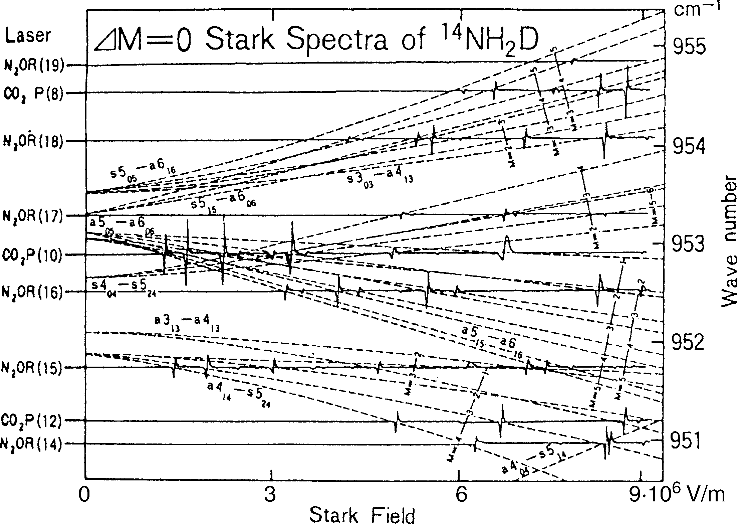
Stark Spectroscopy
The figure illustrates the obtainable sensitivity by a ΔM = 0 Stark spectrum of the ammonia isotope 14NH₂D composed of measurements with several laser lines.

