Slide 1

Direct Determination of Absorbed Photons Including Fluorescence Excitation Spectroscopy Photoacoustic Spectroscopy
Prof. Dr M.A Gondal
Department of Physics, KFUPM.
magondal@kfupm.edu.sa
Dated:

Slide 2
Direct Determination of Absorbed Photons
• Detects energy absorbed by the sample instead of transmitted light.
• Avoids subtraction of two large quantities.
• Improved signal-to-noise ratio for weak absorbers.
• Suitable for low absorption coefficients.
Techniques:
(I) Fluorescence Excitation (II) Photoacoustic Spectroscopy.

Slide 3
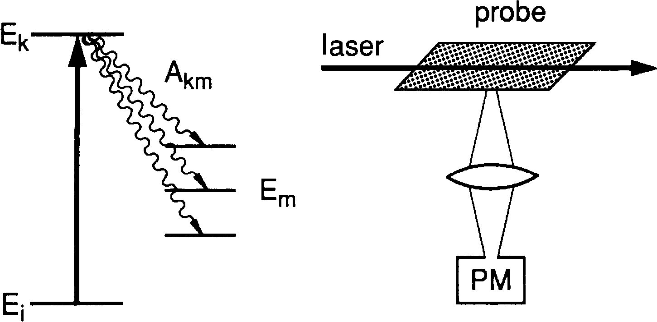
Fluorescence Excitation Spectroscopy
In the visible and ultraviolet regions, a very high sensitivity can be achieved,
if the absorption of laser photons is monitored through the laser-induced fluorescence
(as Fig. below).
When the laser wavelength λ_{L} is tuned to an absorbing molecular transition
E_{i} → E_{k}
the number of photons absorbed per second along the path length Δx is
na = NinLσik Δx------------------------ (i)
Where n_{L} is the number of incident laser
photons per second,
σ_{ik} the absorption cross section per
molecule, and
N_{i} the density of molecules in the
absorbing state i).

Slide 4
Fluorescence Excitation Spectroscopy
The number of fluorescence photons emitted per second from the excited
level E_{k} is
n_{Fl} = N_{k} A_{k} = n_{a} η k -------------------------- (ii)
where A_{k} =A_{km} stands for the total spontaneous transition probability to all levels with E_{m} < E_{k.}
The quantum efficiency of the excited state
η_{k} = A_{k} /( A_{k} + R_{k})
gives the ratio of the spontaneous transition rate to the total deactivation rate, which may also include the radiation-less transition rate R_{k} (e.g., collision-induced transitions)
Quantum Efficiency of the Photocathode
Not every photon impinging onto the photomultiplier cathode releases a photoelectron; only the fraction η_{ph} = n_{pe}/n_{ph} of these photons produces on the average n_{pe} photoelectrons. The quantity η_{ph} is called the quantum efficiency of the photocathode. The number n_{pe} of photoelectrons counted per second is then
n_{pe} = n_{a} η_{k} η_{ph}δ = (N_{i}σ_{ik}n_{L}Δx)η_{k} η_{ph}δ

Slide 5
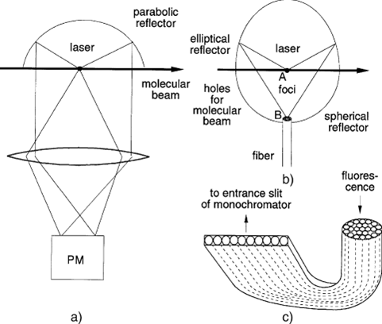
Possible Designs of Systems
The attainable signal is proportional to the fluorescence collection efficiency δ, it is important to design collection optics with optimum values of δ.
possible designs are shown in Fig. that are particularly useful if the excitation volume is small.
One of these collection optics uses a parabolic mirror, which collects the light from a solid angle of nearly 2π. A lens images the light source onto the photomultiplier cathode. The design of Fig.b uses an elliptical mirror where the light source is placed in one focal point A and the polished end of a multifiber bundle into the other B. A half-sphere reflector with its center in A reflects light, which is emitted into the lower half-space back into source A, which is then further reflected by the elliptical mirror and focused into B.
The exit end of the fiber bundle can be arranged to have a rectangular shape in order to match it to the entrance slit of a spectrograph (Fig. c).

Slide 6
Possible Designs of Systems
When the laser wavelength λ_{L} is tuned across the spectral range of the
absorption lines, the total fluorescence intensity I_{Fl}(λ_{L}) ∝ n_{L}σ_{ik} N_{i} monitored
as a function of laser wavelength λ_{L} represents an image of the absorption spectrum called the excitation spectrum. According to the photoelectron rate n_{PE} is directly proportional to the absorption coefficient N_{i}σ_{ik}, where the proportionality factor depends on the quantum efficiency η_{ph} of the photomural- supplier cathode and on the collection efficiency δ of the fluorescence photons
Highest sensitivity: visible, ultraviolet, and near-infrared regions.
Sensitivity decreases with increasing wavelength (λ) due to:
Lower photoelectron rate (nₚₑ): caused by reduced detector efficiency (ηₖ), quantum efficiency (ηₚₕ), and collection efficiency (δ).
Infrared detectors have lower ηₚₕ and poorer signal-to-noise ratio than visible-range detectors.
Infrared absorption excites vibrational–rotational levels with long radiative lifetimes.
At low pressure: Molecules diffuse out before emitting, reducing δ.
At high pressure: Collisional deactivation reduces ηₖ, competing with fluorescence.
In such cases, photoacoustic detection may be more effective.

Slide 7
Introduction
Photoacoustic Spectroscopy
The photoacoustic (PA) or optoacoustic (OA) effect, i.e. the generation of acoustic waves due to the absorption of modulated electromagnetic waves, is an old effect, discovered by Bell in 1880.
This effect is weak; only a very small fraction (<1ppm) of the absorbed optical energy is converted into acoustic energy.

Slide 8
PA spectroscopy in gases
Photoacoustic Spectroscopy
Kreuzer (1971) reported that an ultra low gas concentration can be detected by OA using an infrared laser beam as a light source.
A sensitivity limit of a concentration of 10⁻⁸ of methane in nitrogen was demonstrated, and a limit as low as 10⁻¹³ could be expected with an improved light source.

Slide 9
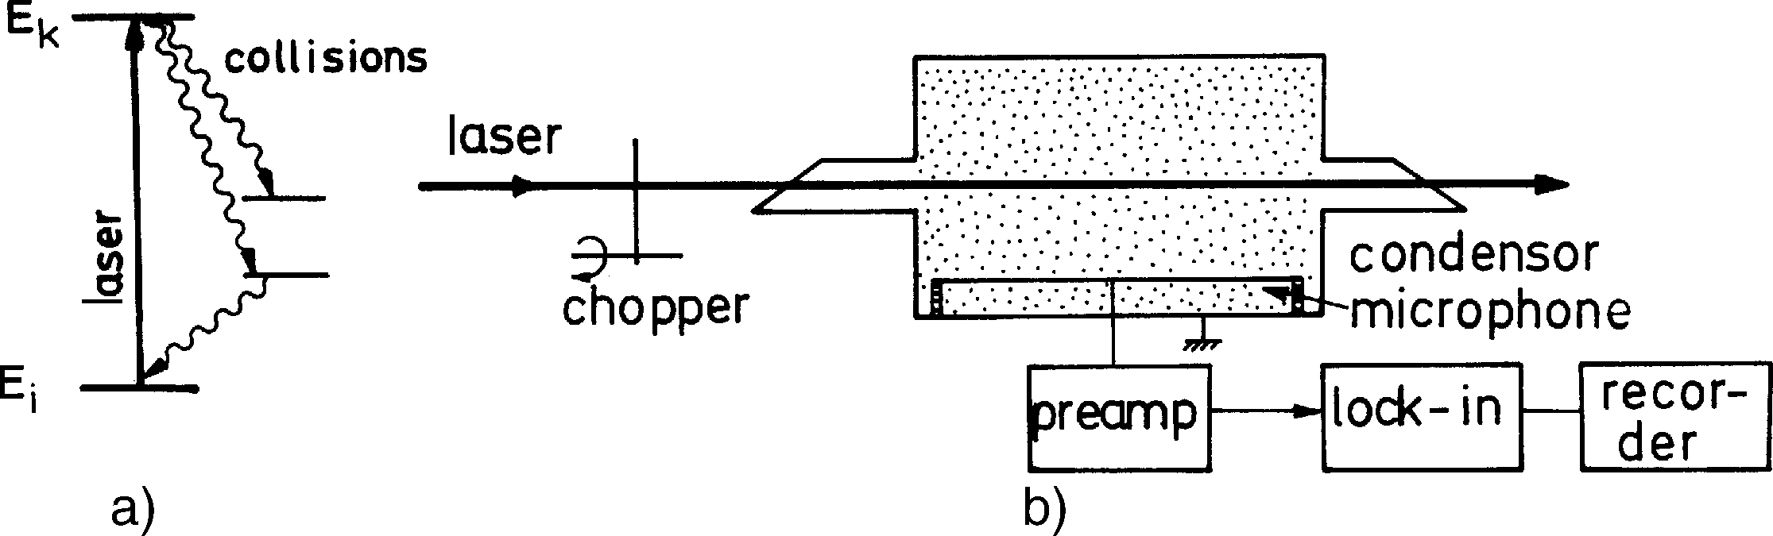
Photoacoustic Spectroscopy
Photoacoustic spectroscopy is a sensitive technique for measuring small absorptions that are mainly applied when minute concentrations of molecular species have to be detected in the presence of other components at higher pressure.
The laser beam is sent through the absorber cell (Fig.). If the laser is tuned to the absorbing molecular transition E_{i} → E_{k}, part of the molecules in the lower level E_{i} will be excited into the upper-level Ek .
When the laser beam is chopped at frequencies Ω< 1/T ,
where T is The mean relaxation time of the excited molecules and periodic pressure variations appear in the absorption cell,
The output signal S [Volt] of the microphone is proportional to the pressure change Δ p induced by the absorbed radiation

Slide 10
Photoacoustic Spectroscopy
power ΔW/Δt.
If saturation can be neglected, the absorbed energy per cycle
ΔW = N_{i}σ_{ik} Δx(1 − η_{K})P_{L}Δt ,
It is proportional to the density Ni [cm−3] of the absorbing molecules in level |i),
absorption cross-section σ_{ik} [cm²],
absorption pathlength Δx, cycle period Δt, and
incident laser power P_{L}.
Contrary to LIF, the optoacoustic signal decreases with increasing quantum efficiency η_{k} (which gives the ratio of emitted fluorescence energy to absorbed laser energy) unless the fluorescence is absorbed inside the cell and contributes to the temperature rise.
Since the absorbed energy ΔW is transferred into kinetic or internal energy of all N molecules per cm³ in the photoacoustic cell with the volume V , the temperature rise ΔT is obtained from
ΔW = fVNkΔT ,
Where f is the number of degrees of freedom that are accessible for each of the N molecules at the temperature T [K]. If the chopping frequency of the laser is sufficiently high, the heat transfer to the walls of the cell during the pressure rise time can be neglected. From the equation of state pV = NVkT, we finally obtain
Δ p = NkΔT =
2ΔW
fV

Slide 11

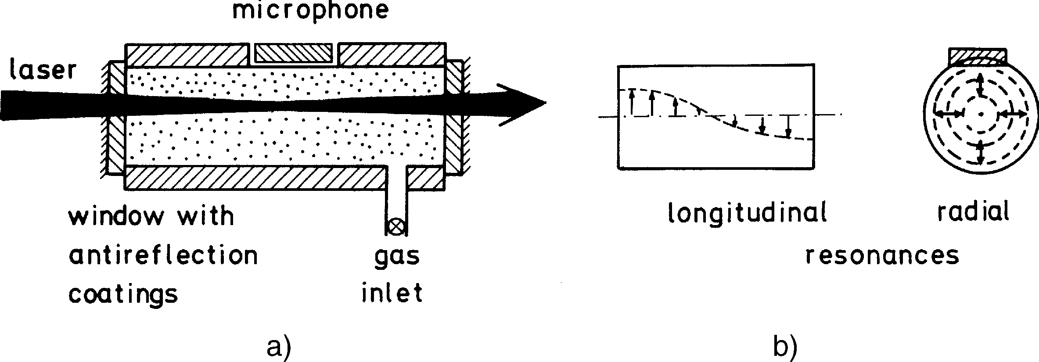
Photoacoustic Spectroscopy
It is, therefore, advantageous to keep the volume V of the photoacoustic cell small. The output signal S from the microphone is then
where the sensitivity S_{m} [Volt/Pascal] of the microphone not only depends on the characteristics of the microphone but also on the geometry of the photoacoustic cell.
The idea of the spectraphone is very old and was demonstrated by Bell and Tyndal in 1881. However, the impressive detection sensitivity attained today could only be achieved with the development of lasers, sensitive capacitance microphones, low-noise amplifiers, and lock-in techniques. Con- centration down to the parts per billion range (ppb, or 10⁻⁹) at total pressures of 1 mbar up to several atmospheres are readily detectable with a modern spectraphone (Fig.).

Slide 12
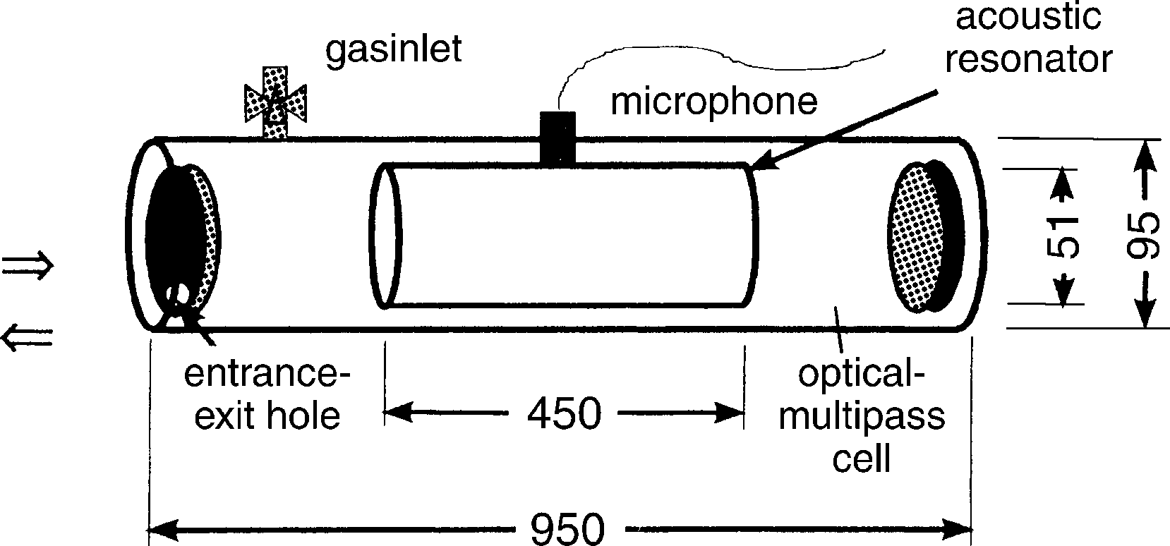
Photoacoustic Spectroscopy
The sensitivity can be further enhanced by frequency modulation of the laser and by intracavity absorption techniques. With the spectra-phone inside the laser cavity, the photoacoustic signal due to nonsaturating transitions is increased by a factor q as a result of a q-fold increase in the laser intensity inside the resonator.
The optoacoustic cell can be placed inside a multipath optical cell (Fig), where an effective absorption path length of about 50 m can be readily realized.

Slide 13
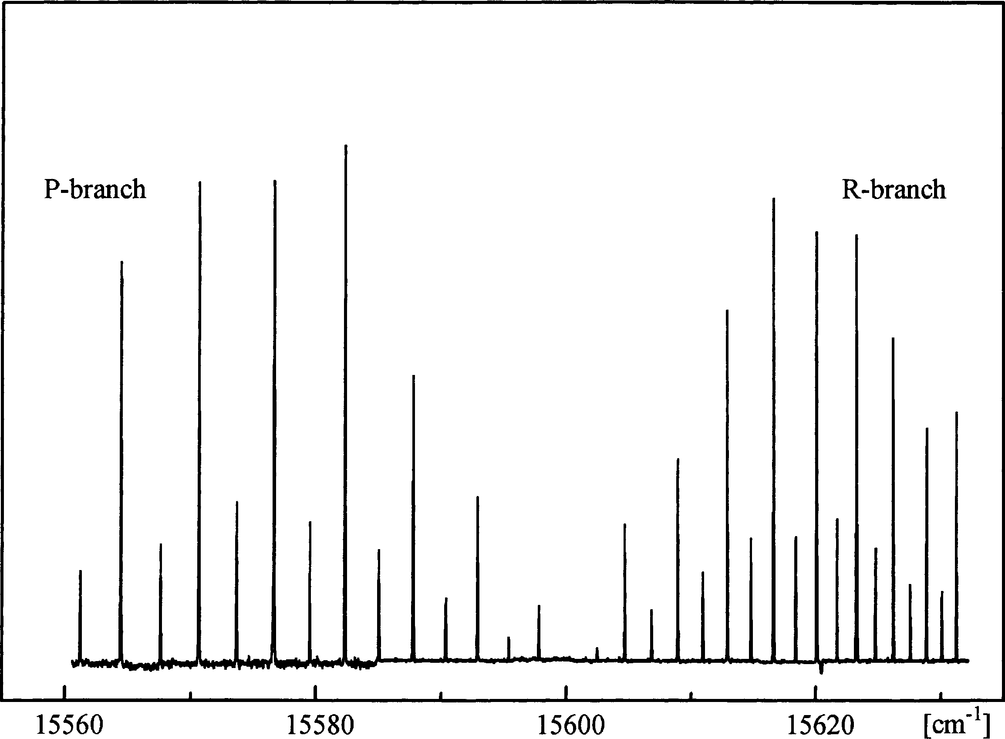
Photoacoustic Spectroscopy: Example
The optoacoustic method has been applied with great success to high-resolution spectroscopy of rotational–vibrational bands of numerous molecules. The figure illustrates as an example a section of the visible overtone absorption spectrum of the C₂H₂ molecule where, in spite of the small absorption coefficient, a good signal-to-noise ratio could be achieved.

Slide 14
Theory
First step: Optical absorption, which results in the production of excited states.
Let’s take a two-level system, which involves the ground state and the excited state (N and N`)
N` can be calculated using the rate equation as:
… 1
Where A_{r} is the radiative decay rate of the excited state, A_{n} is the non-radiative decay rate due to collisions of the excited state, and R is the excitation rate due to the light beam of flux Φ photons per cm⁻² sec⁻¹ with an absorption cross section σ cm².

Slide 15

Theory cont..
In many cases, the modulation frequency of the light is slow (~kHz or less) compared to the excited-state decay rate.
Furthermore, the light intensity is usually weak enough so that (N>>N`) and the stimulated emission from the excited state can be neglected. (slow modulation and weak light)
… 2
Where the lifetime of the excited state
$$τ={\left(A_{r}+A_{n}\right)}^{−1}$$

Slide 16
Theory cont..
Heat production rate (H) due to the excited-state density N` (which depends on position r and time t, because Φ is a function of r and t) is given by:
… 3
Where E` is the average thermal energy released due to a non-radiative de-excitation collision of the excited state.

Slide 17
Theory cont..
If the deexcitation collision results in converting the excited state to the ground state, then the deexcitation energy is simply the energy of the excited state with respect to the ground state.
Equation 3 states that heat source term for the OA signal is proportional to the product of molecular density (N), photon absorption rate Φσ, probability for nonradiative relaxation of the optically excited state τA_{n}, and the heat energy released per deexcitation E`.

Slide 18

Theory cont..
Equation 3 is applicable only when the modulation frequency of the light is slow compared to the excited-state decay rate.
If this condition is not met, we cannot put
$$dN`/dt=0$$
Instead of that, we may rewrite equation 1 as:
where we have again assumed the absence of optical saturation, i.e., we have assumed N`<<N or R<<τ⁻¹. The incident light flux is assumed to be sinusoidally modulated, i.e.,
… 4
… 5

Slide 19
Theory cont..
Where only the real part has physical meaning
We may drop the constant in equation 5 since we are interested only in the modulated heat source which generates a corresponding OA signal.
The solution of equations 4 and 5 is:
where
… 6

Slide 20

Theory cont..
Ψ is the phase lag of the modulation of the excited-state density compared to the optical excitation, and is large when the excited state decays more slowly than the modulated rate of the light intensity.
Note that equation 6 reduces to equation 2 in the limit when
The heat generation term H corresponding to equation 6 is again given by equation 3.
$$ωτ→0$$

Slide 21
Theory cont..
As seen in the schematics, the next step in the theory is the generation of acoustic waves by the heat source H(r,t) of equation 3.
Inhomogeneous wave equation relating the acoustic pressure p and the heat source H:
… 7
After Morse and Ingard (1968)
Where c is the velocity of sound and is the ratio of specific heats of the gas; all dissipative terms have been neglected.

Slide 22
Theory cont..
Equation 7 is usually solved for the sinusoidal modulation case by expressing the Fourier transform of p in terms of “normal acoustic modes” p_{j} which satisfy the appropriate boundary conditions. Thus
with the normal mode p_{j} being solutions of the homogeneous wave equation, i.e.,
… 8

Slide 23
Theory cont..
p_{j} must be chosen to satisfy the boundary condition that the gradient of p normal to the cell wall vanish at the wall, since acoustic velocity is proportional to the gradient of p and must vanish at the wall.
The resultant orthonormal modes in the cylindrical geometry are given by:
after Morse and Ingard (1968)
with a corresponding angular frequency ω_{j} given by
… 9
… 10

Slide 24
Theory cont..
Here g_{j} is a normalization constant; L is the length and R₀ the radius of the gas cell; (r,φ,z) are the cylindrical coordinates of a spatial point; k, m, and n are the longitudinal, azimuthal, and radial mode numbers; J_{m} is a Bessel function; and α_{mn} is the nth solution of the equation dJ_{m}/dr = 0 at r = R₀.
The condition of vanishing pressure gradient at the cell wall requires that the acoustic pressure p(r,ω) be expressed as linear combinations of eigenmodes p_{j} of the form of equation 9 for a cylindrical geometry.

Slide 25
Theory cont..
Solving the expansion coefficients A_{j}(ω)
Fourier transform of equation 7 is:
Substituting equation 8 in the above equation and using the orthonormal conditions for the eigenfunctions p_{j}, we may solve for A_{j} as:
… 11
… 12

Slide 26



Theory cont..
Here V₀ is the cell volume, Q_{j} is the quality factor for the acoustic mode P_{j} ( is the complex conjugate of p_{j}), and the integral is over the volume of the cell.
Q_{j} accounts for the mode damping and avoid the physically unreasonable situation of as
Equation 12 may be further simplified for the case H being given by equations 2 and 3. In this case
$$p_{j}^{∗}$$
$$A_{j}→∞$$
$$ω→ω_{j}$$
Here we have lumped the space- and time-independent coefficients of
Φ₀(r) together as the coefficient q.

Slide 27
Theory cont..
We also assumed that the light beam is Gaussian, i.e.,
where a is the beam radius; beam propagates along the axis of cell so that only eigenmodes are of the form of equation
With an eigenfrequency ω_{j} given by
Special case: Beam along the axis of cylinder OA cell in weak absorption limit, and only
Normal modes can be excited by the heat source, i.e., we need only the radial normal modes.

Slide 28
Theory cont..
The amplitude of the lowest-order radial pressure mode (j=1) is then given by equation 12 as:
Where,
g₁ = normalization factor for
, and L = cell length
and we have used

Slide 29
Theory cont..
Close to resonance (ω=ω₁+δ; δ being small ), this equation reduces to:
… 13
This equation contains the basic physics of the operation of a resonant OA cell.
Resonant enhancement of the amplitude of the radial pressure j=1 is obtained when the fractional detuning from resonance δ is less than (2Q₁)⁻¹.
In general, larger acoustic amplitude is obtained for larger specific heat ratio γ, larger light power absorbed qΦ₀L, smaller beam excitation radius a, and smaller cell volume V₀.

Slide 30
Theory cont..
This equation is valid for near resonance to the lowest radial mode. For the opposite case of far off-resonance (i.e. non resonant OA cell), then:
for ω << ω₁, i.e. the light beam modulation frequency being much less than the lowest-radial-mode resonance frequency
In this nonresonant mode operation (common in OA), the acoustic amplitude lags behind the beam modulation by 90⁰.

Slide 31
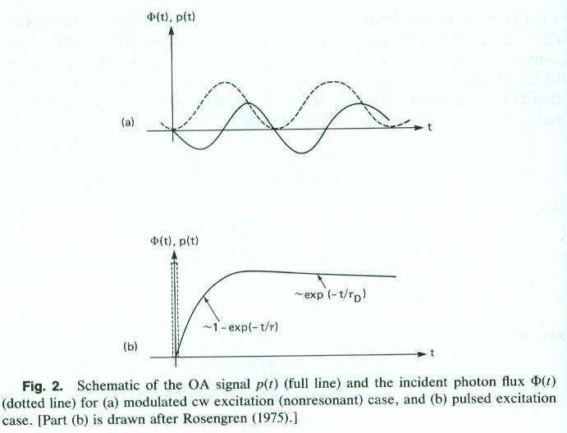
Theory cont..
Page 8, Chap 1, Photoacoustics: Spectroscopy and Other Applications, Andrew C. Tam,
Ultrasensitive Laser Spectroscopy, edited by David S Kliger, Academic Press (1983)

Slide 32
Theory cont..
Final step of the theory of OA is the detection, which is frequently done with a microphone.
If the microphone has a known frequency response, then all the various components A_{j} in equation 12 with frequencies ω_{j} within in the microphone bandwidth will be detected, and suitable frequency analysis of the microphone signal should give the various A_{j}’s.

Slide 33
Theory cont..
In case of pulsed OA excitation, boundary conditions are frequently unimportant when short-duration light pulses are used because the time needed for the acoustic wave to reach the OA cell well is roughly 30 microseconds, which’s much longer than the light pulse duration and much longer than decay times of excited states in most gases.
Thus, interference of the generated acoustic wave and the reflected acoustic waves generally do not occur in contrast to the CW modulated case.
However, Pulsed OA generation does produce a “ringing” acoustic signal due to multiple reflections in the gas cell

Slide 34
Theory cont..
The net heat released up to time t is:
where W is the total number of photons absorbed
The pressure increase of the irradiated column of gas of volume V by using the ideal gas law:
Where R is the universal gas constant, M is the molecular weight, and Cv is the specific
heat per unit mass at constant volume.

Slide 35
Theory cont..
The time dependence of p(t) for the pulsed OA signal is indicated in slide 22(b) for the case of short optical pulse duration and long thermal diffusion time τ_{D,} given by
where a is the beam radius and D is the thermal diffusivity of the gas
The initial rise in p(t) depends on the lifetime of the excited
state, while the final slow decrease of p(t) back to zero
depends on the thermal decay time constant τ_{D}.

Slide 36
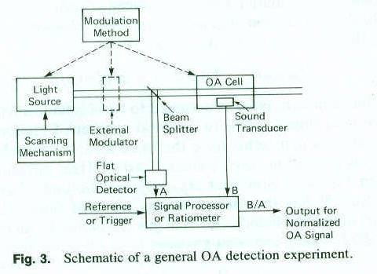
Instrumentation for OA Studies of Gases

Slide 37
Instrumentation for OA Studies of Gases
Instruments:
Light source
OA cell with transducer
A means of modulating the light source (e.g., pulsing a laser or using a chopper), or modulating the sample absorption (e.g., using a modulated electric field for Stark modulation of the absorption)

Slide 38
Instrumentation: Light Source
Two general classes:
Lamps, filament lamps, and glow bars
Inexpensive, usually compact and reliable, and cover broad spectral ranges from the UV to the far IR.
Low spectral brightness, incapability of fast modulation or switching , and necessity of an external spectral selection element like a monochromator.

Slide 39
Instrumentation: Light Source
Lasers
High spectral brightness and collimation, can be readily modulated by extracavity or by intracavity means, and are of narrow spectral linewidth.
Expensive and limited tuning range.

Slide 40
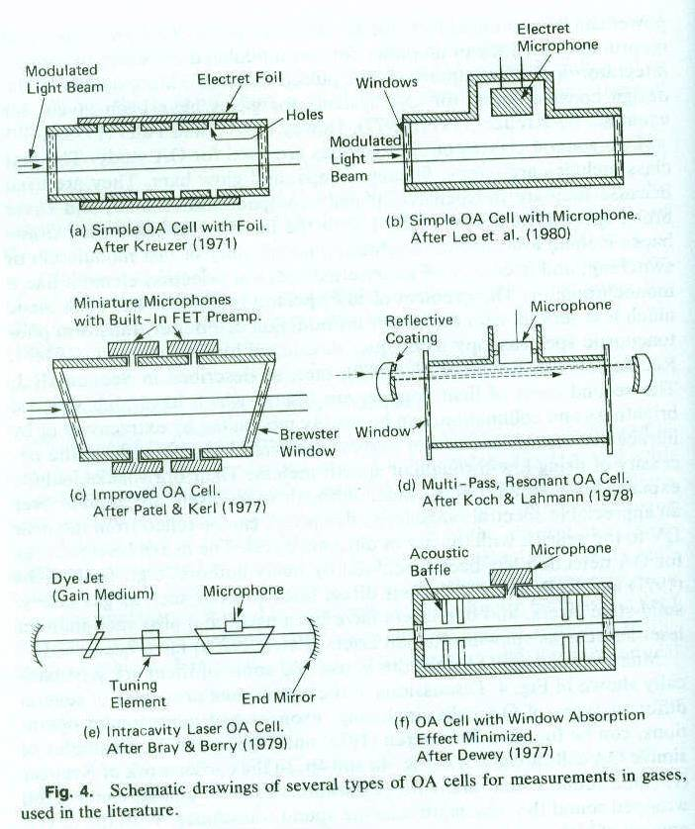
OA cells for gases

Slide 41
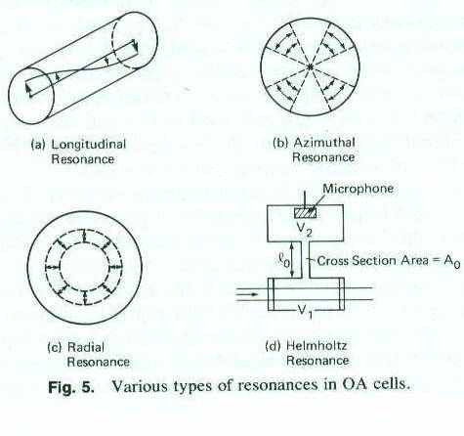
Resonances in OA cells

Slide 42
Applications
Measurement of weak Absorption lines
(~10⁻¹⁰cm⁻¹/cell length ~10cm (Patel et al 1977)
High sensitivity trace detection (SFRL)
Absorption of excited states
Chemically reactive gases
Raman-Gain Spectroscopy (PARS) [non-linear]

Slide 43
PA Spectroscopy in Condensed Matter
Two methods:
The Gas-Coupling Method
The Direct Coupling Method

Slide 44
Gas-Coupling Method
Use of gas-phase microphone for detecting PA signals in condensed matter
PA signal was generated by sinusoidally modulated CW light beam incident on the condensed sample, and the periodic heating of the gas at the irradiated surface of the sample generated the acoustic wave, which was detected by a gas-phase microphone.

Slide 45
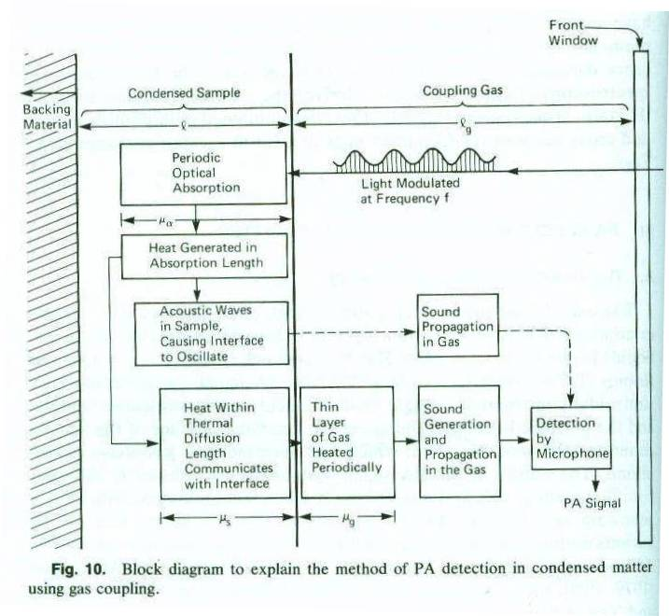
Gas-Coupling Method

Slide 46
Gas-Coupling Method
The periodic heating of the sample occurs in the “absorption length” μ_{α} of the sample.
But only the heat within a diffusion length μ_{s} from the interface can communicate with the gas and heat up a layer of gas of length μ_{g} (diffusion length in gas) which expands periodically, producing acoustic waves.
D_{s} and D_{g} are the thermal diffusivities in the sample and in the gas, respectively
and f is the modulation frequency of the light beam

Slide 47
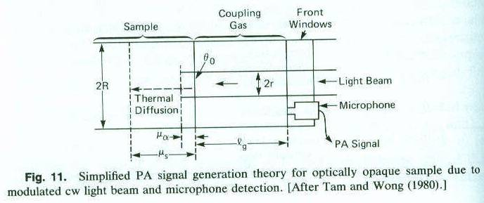
Gas-Coupling Method
A light beam of radius r striking a flat opaque surface of radius R.

Slide 48
Gas-Coupling Method
The heat generated in the thin absorption layer of thickness is mainly conducted into the condensed sample (heat conduction into the gas is much smaller); the heat conduction equation is:
Where θ₀ is the amplitude of the surface temperature modulation and I₀ is the modulated light absorbed
θ₀ is coupled to an active gas volume V_{act} near the sample
surface, given by:
for l_{g} > μ_{g}
for l_{g} < μ_{g}

Slide 49
Gas-Coupling Method
Using the ideal gas law, we obtain the amplitude δV of the volume change of V_{act}:
(T₀ is the ambient temperature)
The corresponding pressure change δP is obtained by considering an adiabatic expansion of an ideal gas:
Where V is the total PA cell volume given by:

Slide 50
Gas-Coupling Method
Here V_{res} is the residual cell volume for l_{g}=0, and can be due to the dead space in front of the microphone. Finally, we have:
where
Optimum l_{g} exists, which’s found to be

Slide 51
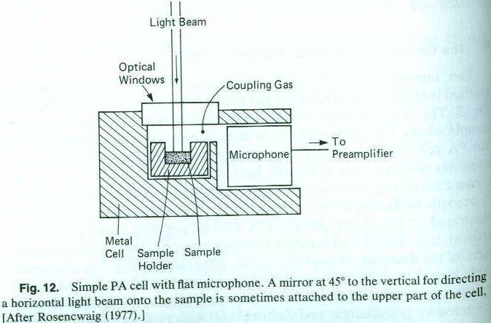
Gas-Coupling Method

Slide 52
Direct-Coupling Method
Problems with Gas-Coupling led to the invention of Direct-Coupling method (microphone signal due to acoustic vibration) .
It involves the insertion or attachment of a transducer (usually piezoelectric) into or onto the sample without the intervention of a gas medium.
Thus, the serious acoustic impedance mismatch from condensed matter to gas can be avoided.

Slide 53
Direct-Coupling Method
Two general types of PA excitation are:
The use of a chopped or modulated CW excitation beam when the detected PA signal depends on the boundary conditions
The use of a pulsed excitation beam when the boundary conditions frequently have no effect on the detected optoacoustic signal, especially if short-duration pulses (<1μs) at low repetition rate (~10 Hz) are used.

Slide 54
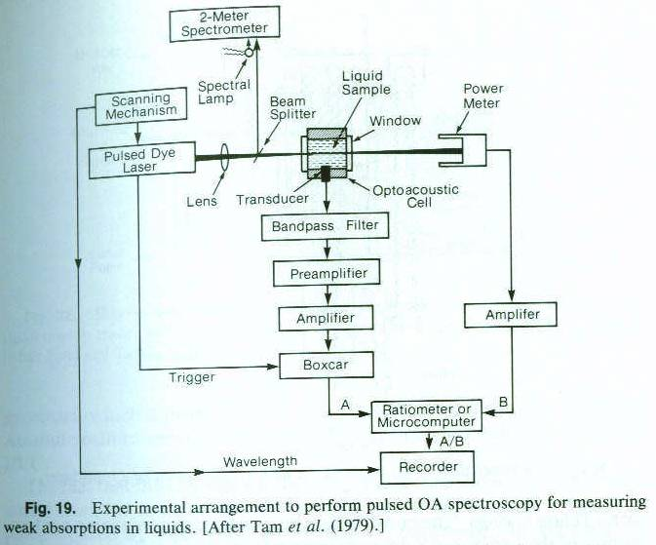
Direct-Coupling Method

Slide 55
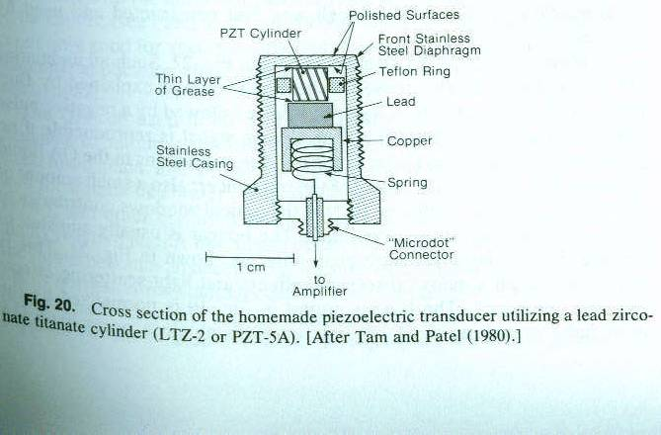
Direct-Coupling Method

