Slide 1
Chap. 5.1 Fundamentals of Lasers
Prepared by Dist. Prof. Dr. M.A. Gondal for Phys 608 Laser Spectroscopy course in KFUPM (Term 251)

Slide 2
Slide 1: Lasers in Spectroscopy — Why They Matter
Provide monochromatic radiation with linewidths far below
10⁻⁶ nm.
Deliver extremely high spectral radiance (power per unit area per unit solid angle per unit bandwidth) exceeding that of conventional lamps by > 10¹⁰.
Supply excellent spatial coherence →
diffraction-limited beams
enable long interaction lengths and tight focusing.
Prepared by Dist. Prof. Dr. M.A. Gondal for Phys 608 Laser Spectroscopy course in KFUPM (Term 251)

Slide 3
Allow precise control of frequency and phase → essential for
Doppler-free, saturation, and heterodyne techniques.
Offer tunability (via dye, Ti:sapphire, OPO, etc.) → access to virtually any atomic / molecular transition when combined with nonlinear optics.
Prepared by Dist. Prof. Dr. M.A. Gondal for Phys 608 Laser Spectroscopy course in KFUPM (Term 251)

Slide 4
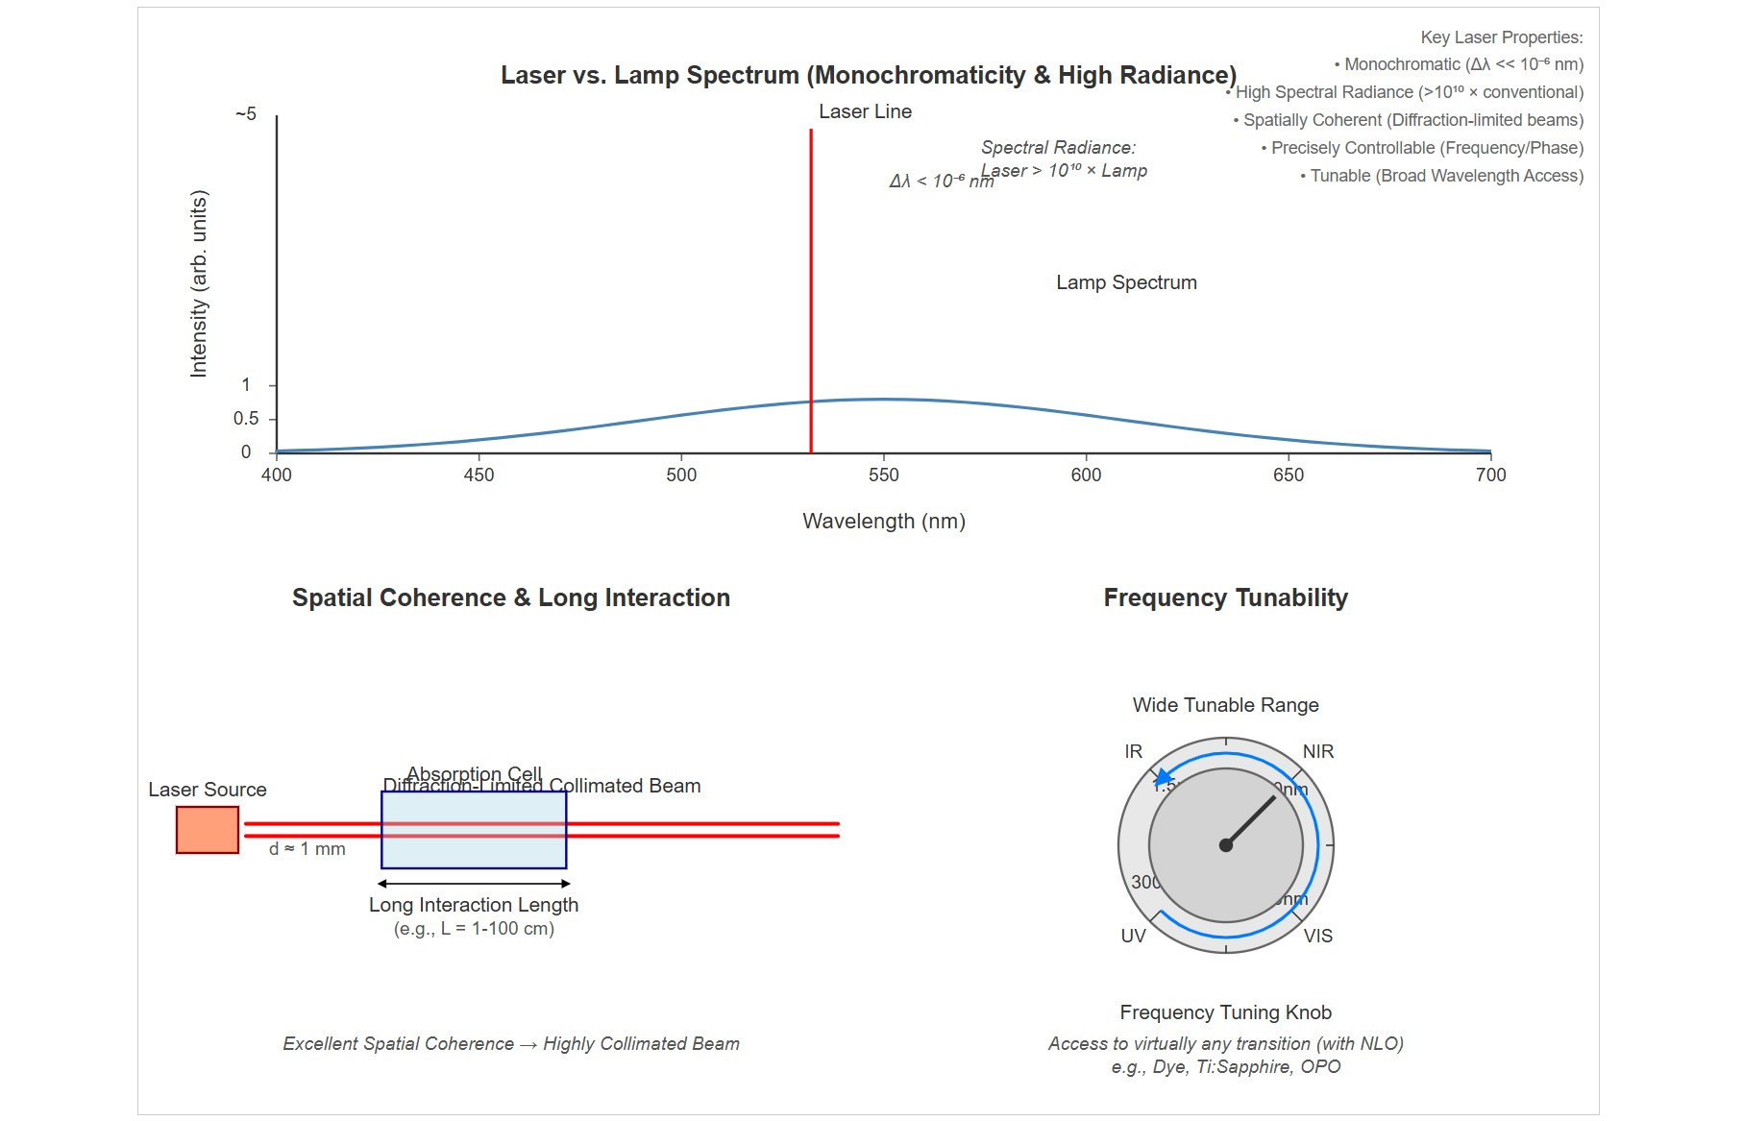
[IMAGE REQUIRED: Provide a montage-style Slide background showing (i) a narrow laser line versus a broad lamp spectrum, (ii) a highly collimated beam passing through an absorption cell, (iii) a frequency-tuning knob symbol, all labelled with quantitative scales.]
Prepared by Dist. Prof. Dr. M.A. Gondal for Phys 608 Laser Spectroscopy course in KFUPM (Term 251)

Slide 5
Slide 2: Minimum Ingredients of Any Laser
Active medium — material that can amplify light.
Contains discrete energy levels 𝐸_{i}, 𝐸_{k} of atoms, ions, molecules, or solid-state centers.
Energy pump — external energy source that drives population inversion.
Examples: electrical discharge, optical flashlamp, chemical reaction, another laser.

Slide 6
Optical resonator — typically two or more mirrors forming a Fabry– Pérot cavity of length 𝑑.
Provides feedback, selects longitudinal and transverse modes, and increases photon dwell time.

Slide 7
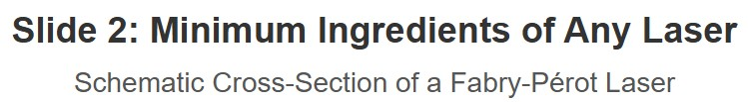
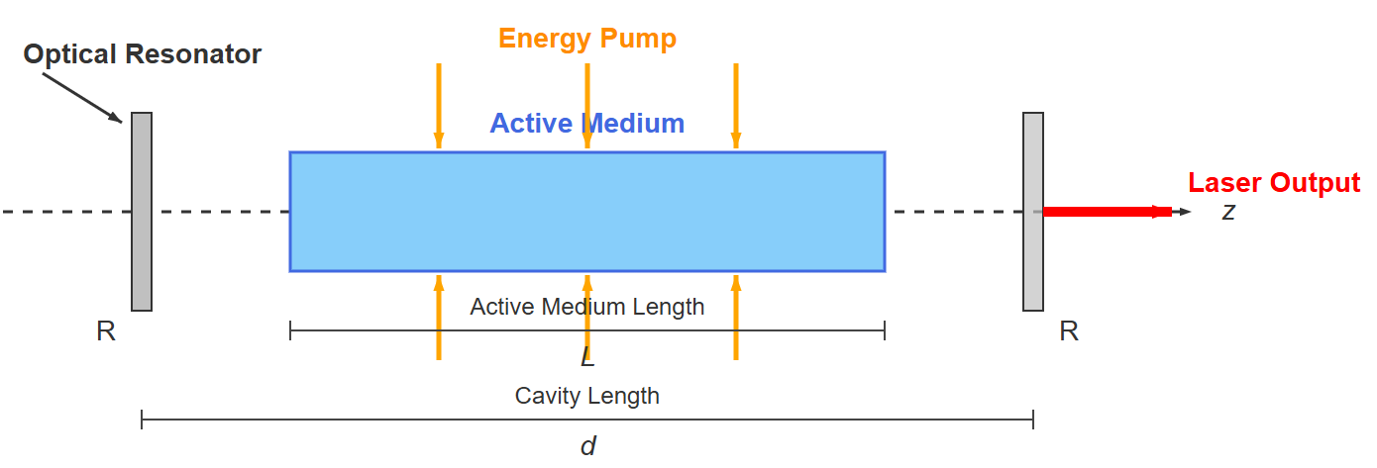
[IMAGE REQUIRED: Schematic cross-section of a Fabry–Pérot laser showing a gain rod between two mirrors, pump arrows into the rod, and
indication of the resonator axis 𝑧. Label mirror reflectivities 𝑅₁, 𝑅₂, cavity length 𝑑, and active medium length 𝐿.]

Slide 8
Slide 3: The Active Medium — Energy Levels and Gain
Thermal equilibrium: population follows Boltzmann law
𝑁_{eq}(𝐸) = 𝑁₀exp[−𝐸/(𝑘_{B}𝑇)]
𝑁₀: density [cm⁻³].
𝑘_{B}:
ground-state population *
Boltzmann
constant 1.38 × 10⁻²³ J K⁻¹. * 𝑇: absolute temperature [K].
Population inversion condition
𝑔_{k}
𝑁_{k} >
𝑁
𝑔
i
i

Slide 9
𝑔_{j}: degeneracy of level 𝑗.
With inversion, stimulated-emission rate exceeds absorption rate:
𝑊_{stim} = 𝑁_{k}𝐵_{𝑘𝑖}𝜌(𝜈) > 𝑁_{i}𝐵_{𝑖𝑘} 𝜌(𝜈)
𝐵_{𝑖𝑘} , 𝐵_{𝑘𝑖} : Einstein 𝐵-coefficients [m³ J⁻¹s⁻²]. * 𝜌(𝜈): spectral energy density [J m⁻³ Hz⁻¹].
Result:
passing electromagnetic wave is amplified instead of
attenuated.

Slide 10
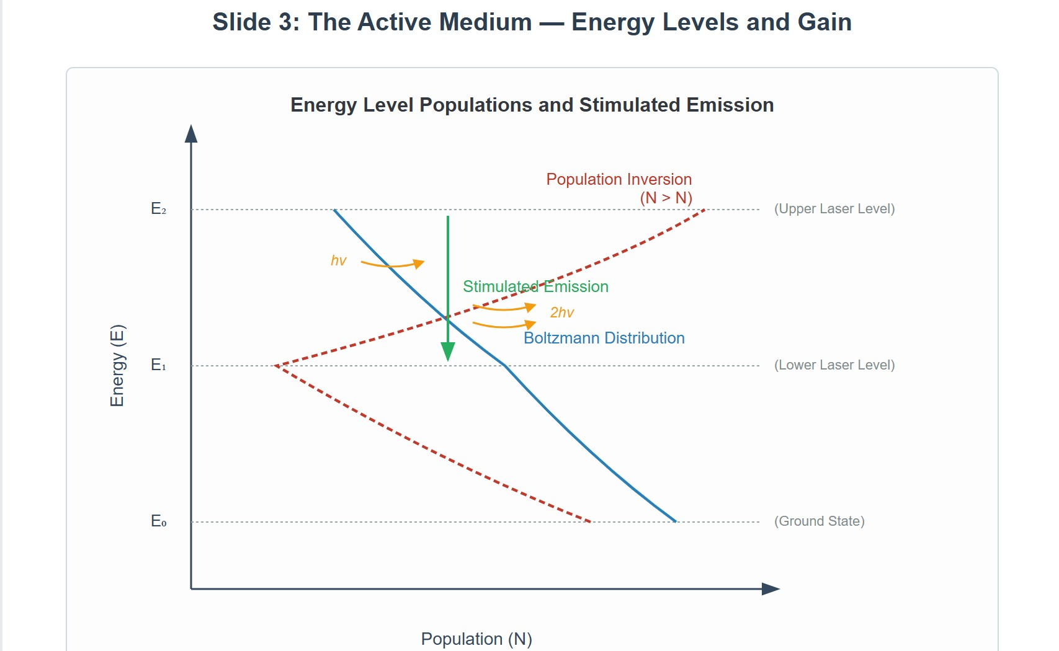
[IMAGE REQUIRED: Energy-level diagram comparing (i) Boltzmann distribution (decaying curve) with (ii) inverted distribution (dashed curve) for a three-level scheme, with arrows indicating stimulated emission.]
---
Prepared by Dist. Prof. Dr. M.A. Gondal for Phys 608 Laser Spectroscopy course in KFUPM (Term 251)

Slide 11
Slide 4: Energy-Pumping Mechanisms — Achieving
Inversion
Optical pumping with broadband flashlamp — used in ruby lasers.
Electrical discharge in low-pressure gas mixtures — He–Ne, Ar⁺, CO₂.
Chemical pumping — HF, DF, and excimer lasers.
Laser-pumped solid-state or dye media — Ti:sapphire pumped by frequency-doubled Nd:YAG.

Slide 12
Key design goal: deposit energy selectively into upper laser level while depleting lower level swiftly (short 𝜏_{eff}).
[IMAGE REQUIRED: Table-style graphic
listing pump types versus pump energy to specific
representative lasers, transition levels.]
---
with arrows from

Slide 13
Slide 5: Spontaneous vs. Stimulated Emission —
Microscopic View
Spontaneous emission probability per excited particle
^{𝐴}𝑘𝑖
_{[s}−1]
Stimulated emission probability density per excited particle
𝐵_{𝑘𝑖} 𝜌(𝜈) [s⁻¹]

Slide 14
Inversion increases 𝐵_{𝑘𝑖} 𝜌(𝜈) → overwhelmingly directs emission into
modes where 𝜌(𝜈) is large.
Optical resonator provides large 𝜌(𝜈) for its eigen-frequencies →
feedback loop.
Above threshold, stimulated processes dominate, making output highly directional and coherent.

Slide 15
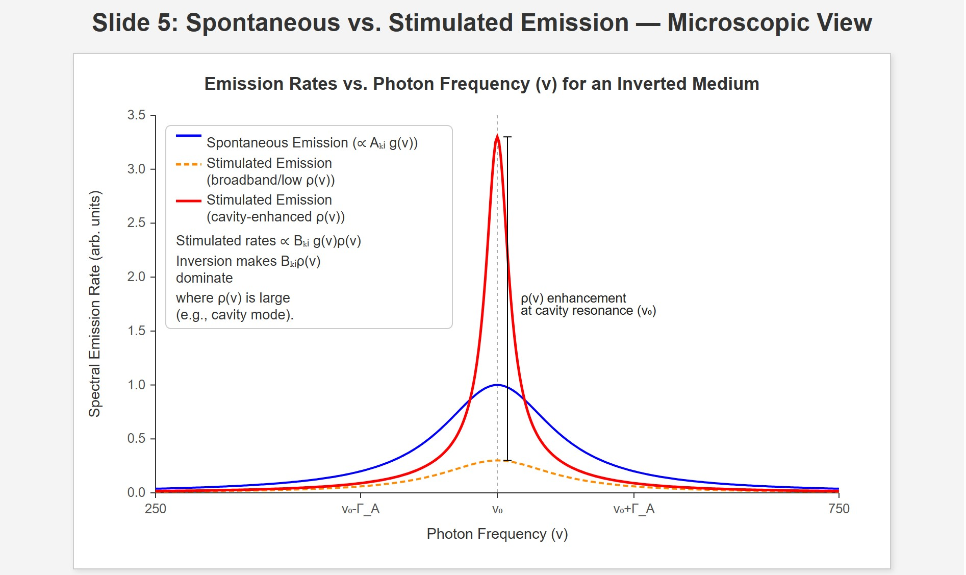
[IMAGE REQUIRED: Plot of emission rates versus photon frequency for an inverted medium inside and outside resonance, marking 𝜌(𝜈) enhancement due to cavity.]
---
Prepared by Dist. Prof. Dr. M.A. Gondal for Phys 608 Laser Spectroscopy course in KFUPM (Term 251)

Slide 16
Slide 6: Optical Resonator — Storage and Mode Selection
Two parallel mirrors form standing-wave cavity.
Allowed longitudinal modes satisfy
𝑞𝑐
𝜈_{q} = _{2𝑑} ,
𝑞 ∈ ℤ
Mirror radii and apertures set transverse mode pattern (TEM_{𝑚𝑛}).
Resonator
acts as frequency-selective filter with linewidth
determined by finesse ℱ.

Slide 17
High 𝑄-factor
energy stored
𝑄 = 2𝜋 ×
energy lost per cycle
enhances photon lifetime → greater amplification per pass.
Coupling mirror (partial reflector) allows controlled extraction of laser power.

Slide 18
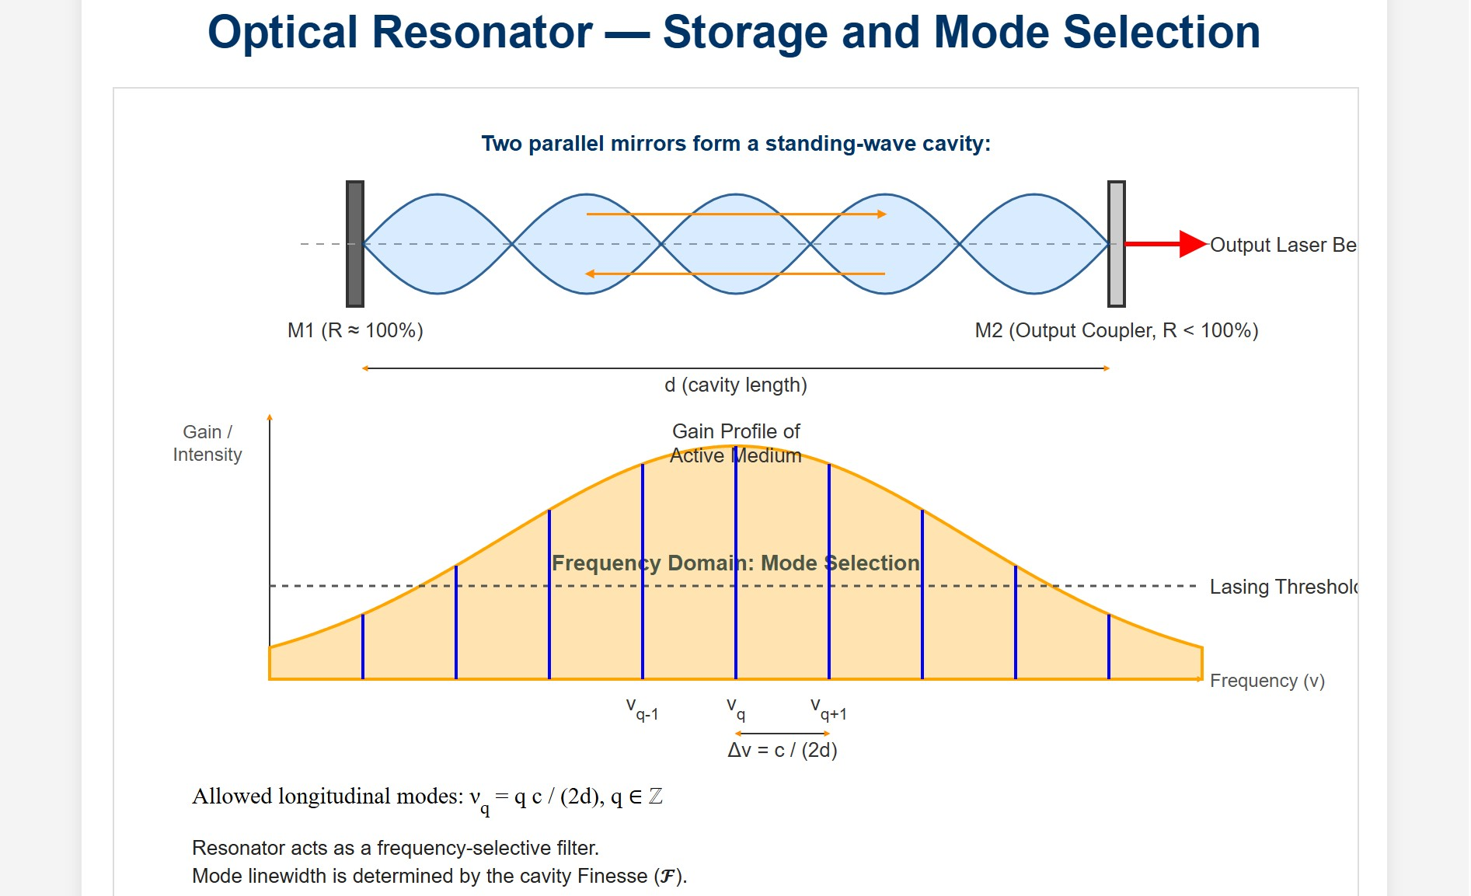
[IMAGE REQUIRED: Resonator diagram showing several longitudinal modes inside gain profile, with arrows indicating mirror reflectivity and output coupling.]
Prepared by Dist. Prof. Dr. M.A. Gondal for Phys 608 Laser Spectroscopy course in KFUPM (Term 251)

Slide 19
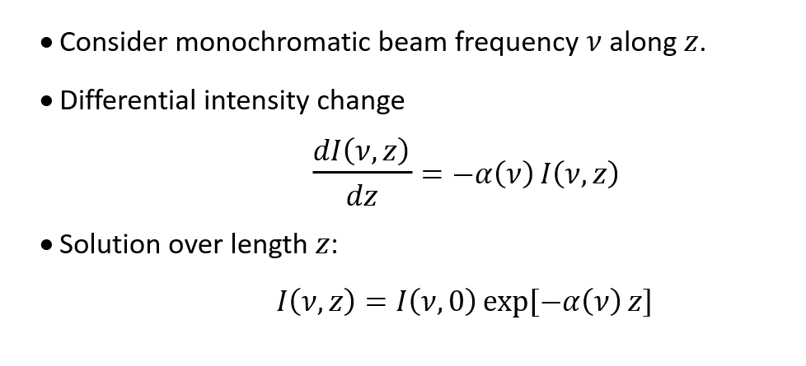
Slide 7: Propagation Through Gain Medium — Intensity
𝛼(𝜈) (alpha of nu): This is the crucial parameter called the "absorption coefficient" (or attenuation coefficient) of the medium at frequency 𝜈. Its units are typically inverse length (e.g., cm⁻¹, per centimeter). * If 𝛼(𝜈) is positive, then 𝑑𝐼𝑑𝑧 is negative (since 𝐼 is positive), meaning the intensity decreases as the beam propagates. This corresponds to absorption or attenuation.
If 𝛼(𝜈) is negative, which can happen in an active medium with population inversion, then −𝛼(𝜈) is positive. In this case, 𝑑𝐼𝑑𝑧 is positive, meaning the intensity increases* as the beam propagates. This corresponds to amplification or gain in laser medium.

Slide 20
Absorption (or gain) coefficient
𝛼(𝜈) = [𝑁_{i} − (𝑔_{i}/𝑔_{k})𝑁_{k}] 𝜎(𝜈)
𝜎(𝜈): stimulated-transition cross-section [cm²].
If inversion satisfies
𝑁_{k} > (𝑔_{k}/𝑔_{i})𝑁_{i} ⇒ 𝛼(𝜈) < 0
→ beam is amplified.

Slide 21
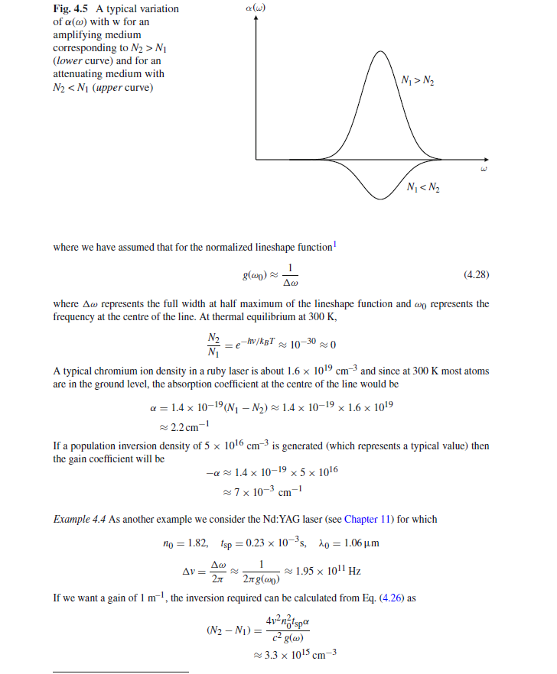

Slide 22
Slide 8: Round-Trip Analysis — Defining Gain & Losses
Active medium length 𝐿; resonator length 𝑑 (possibly 𝑑 > 𝐿).
Pure gain over round-trip (no extraneous loss):
𝐺(𝜈) = exp[−2𝛼(𝜈)𝐿]
Real cavities have distributed losses summarised by dimensionless 𝛾.
Sources: mirror transmission (1 − 𝑅), scattering, diffraction clipping.
window absorption,

Slide 23
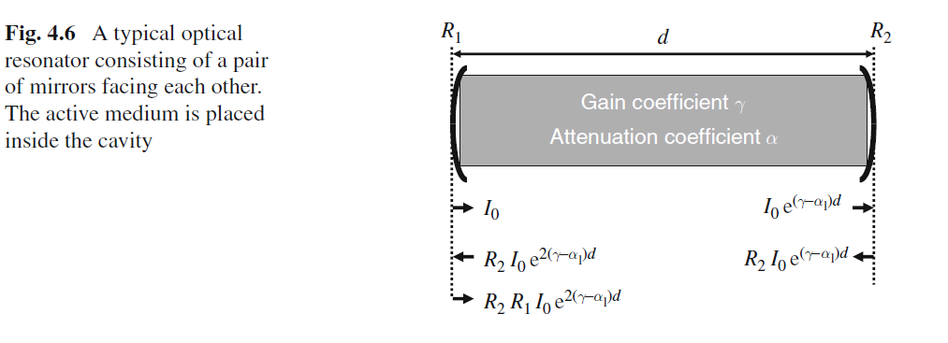

Slide 24
Exponential decay of intensity in empty resonator:
𝐼 = 𝐼₀ 𝑒^{−𝛾𝑦}
where 𝑦: number of round-trips.
Combined effect (single round-trip):
𝐼(𝜈, 2 𝑑) = 𝐼(𝜈, 0) exp[−2𝛼(𝜈)𝐿 − 𝛾]
For the laser to oscillate, the intensity must at least remain constant, and ideally grow, from one round trip to the next. This means the overall argument of the exponential must be greater than or equal to zero: −2𝛼(𝜈)𝐿−𝛾≥0
This implies that the gain term must overcome the loss term: −2𝛼(𝜈)𝐿≥𝛾
Since 𝛼(𝜈) is negative for gain (say, 𝛼(𝜈)=−𝑔(𝜈) where 𝑔(𝜈) is positive gain coefficient), this condition becomes: 2 𝑔(𝜈)𝐿≥𝛾
This is the fundamental condition for lasing threshold: the round-trip gain (2 𝑔(𝜈)𝐿) must equal or exceed the round-trip losses (𝛾). When gain exactly equals loss, the laser is at threshold. When gain exceeds loss, the intensity builds up.

Slide 25
Slide 9: Laser Threshold — Step-by-Step Derivation
Condition for Net Amplification
Net gain required:
−2𝐿𝛼(𝜈) > 𝛾
Substitute 𝛼(𝜈) expression:
2𝐿[𝑁_{k} − (𝑔_{k}/𝑔_{i}) 𝑁_{i}]𝜎(𝜈) > 𝛾
Define inversion density

Slide 26
𝑔_{i}
𝛥𝑁 = 𝑁
− 𝑁
k
𝑔
i
k
Threshold inversion
𝛾
^{𝛥𝑁thr =} 2 𝜎(𝜈) 𝐿
Laser oscillation possible only if
𝛥𝑁 > 𝛥𝑁_{thr}
All symbols: 𝛥𝑁 [cm⁻³], 𝜎 [cm²], 𝐿 [cm], 𝛾 [dimensionless].

Slide 27
Slide 10: Numerical Illustration — He–Ne Laser Example
Parameters:
• 𝐿 = 10 cm
𝛾 = 0.10 (10 % loss per round-trip)
• 𝜎 = 1.0 × 10⁻¹² cm²
Plug into threshold formula
0.10
^{𝛥𝑁thr =} 2 × 1.0 × 10⁻¹² × 10 ^{= 5 × 10}
9
cm
−3

Slide 28
Neon partial pressure 𝑝 = 0.2 mbar ⇒ total neon density
𝑁_{Ne} ≈ 5 × 10¹⁵ cm⁻³
Required inversion fraction
^{𝛥𝑁thr} ≈ 1 × 10⁻⁶
^{𝑁}Ne
→ remarkably small fraction suffices because gain cross-section is large and losses moderate.

Slide 29
Demonstrates practicality of continuous-wave operation in He–Ne gas discharge.
---

Slide 30
Slide 11: Frequency Dependence of Gain — Line Shape
Stimulated-transition cross-section relates to Einstein 𝐵-coefficient and homogeneous/inhomogeneous line profile 𝑔(𝜈 − 𝜈₀).
Unsaturated gain coefficient
ℎ𝜈
𝛼(𝜈) = 𝛥𝑁 𝜎_{𝑖𝑘} (𝜈) = 𝛥𝑁 ( c ) 𝐵_{𝑖𝑘} 𝑔(𝜈 − 𝜈₀)
Peak amplification at line centre 𝜈₀.
Homogeneous broadening → Lorentz profile, width 𝛤_{L}.

Slide 31
Inhomogeneous broadening (Doppler) → Gaussian profile, width
𝛥𝜈_{D}.

Slide 32
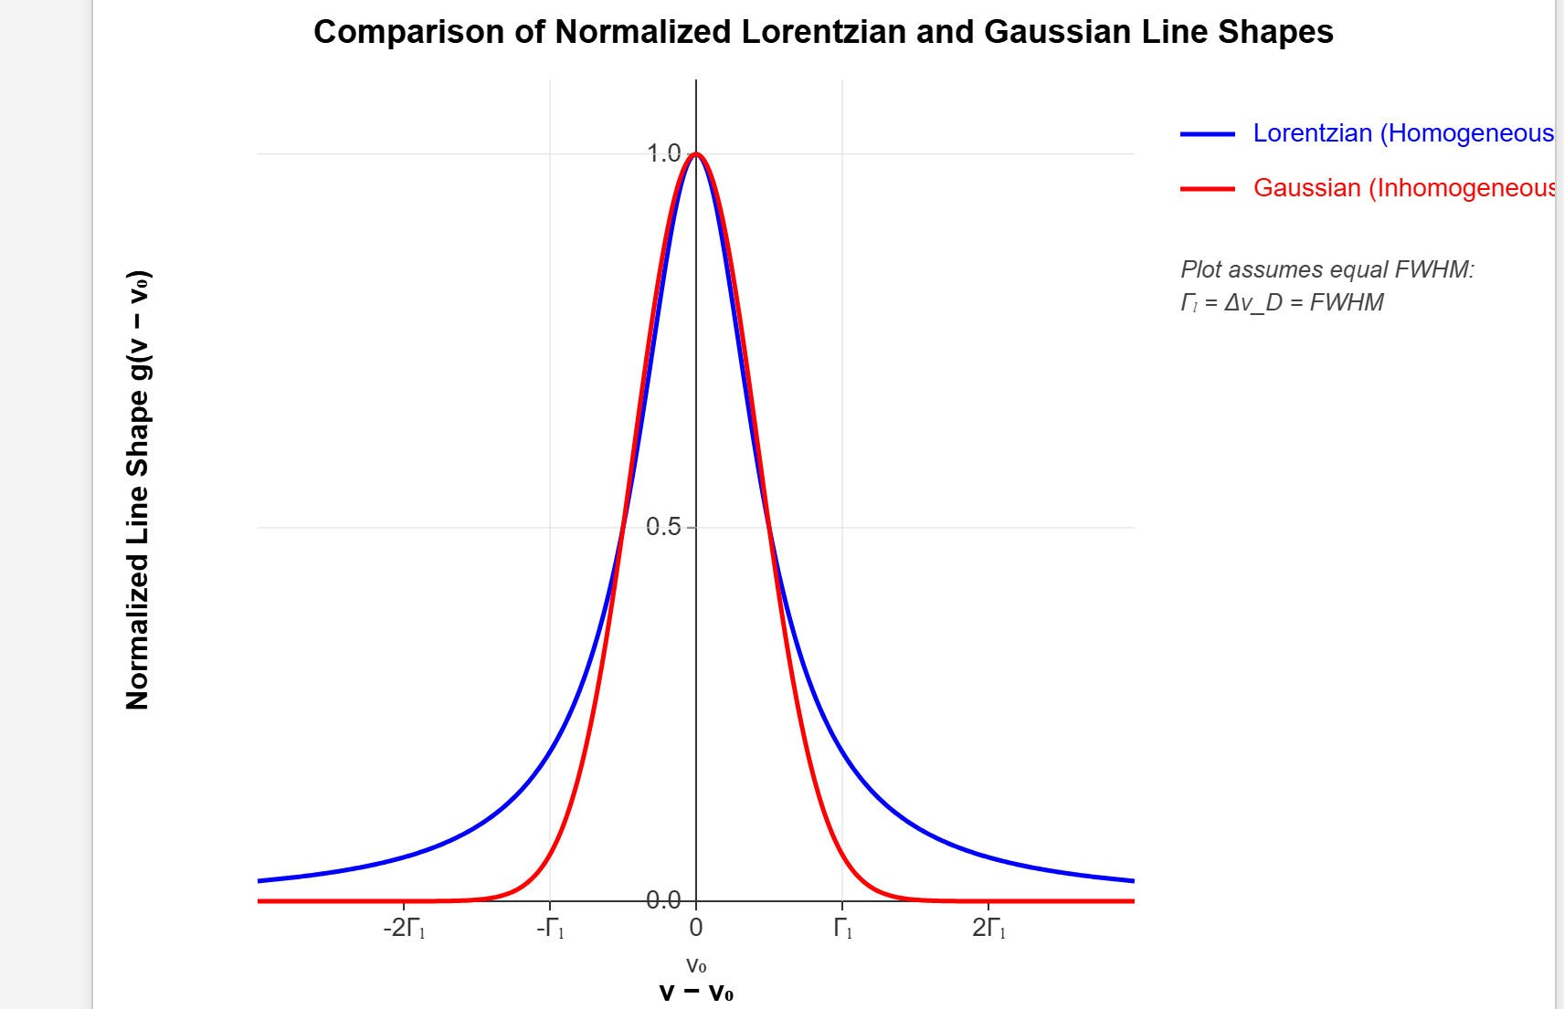
[IMAGE REQUIRED: Overlay plot of Lorentzian and Gaussian gain profiles, both normalized, indicating centre frequency 𝜈₀.]
Prepared by Dist. Prof. Dr. M.A. Gondal for Phys 608 Laser Spectroscopy course in KFUPM (Term 251)

Slide 33
Slide 12: Resonator Loss Factor 𝜸 — Frequency Behaviour
Mirror reflectivity depends on wavelength via coating design.
Diffraction losses vary with mode order → higher-order modes often suppressed.
Total 𝛾(𝜈) therefore has minima aligned with resonator eigen- frequencies.
Intersection of −2 𝐿𝛼(𝜈) and 𝛾(𝜈) curves dictates actual laser spectrum.

Slide 34
Single-mode operation requires cavity and gain bandwidth to support only one intersection.

Slide 35
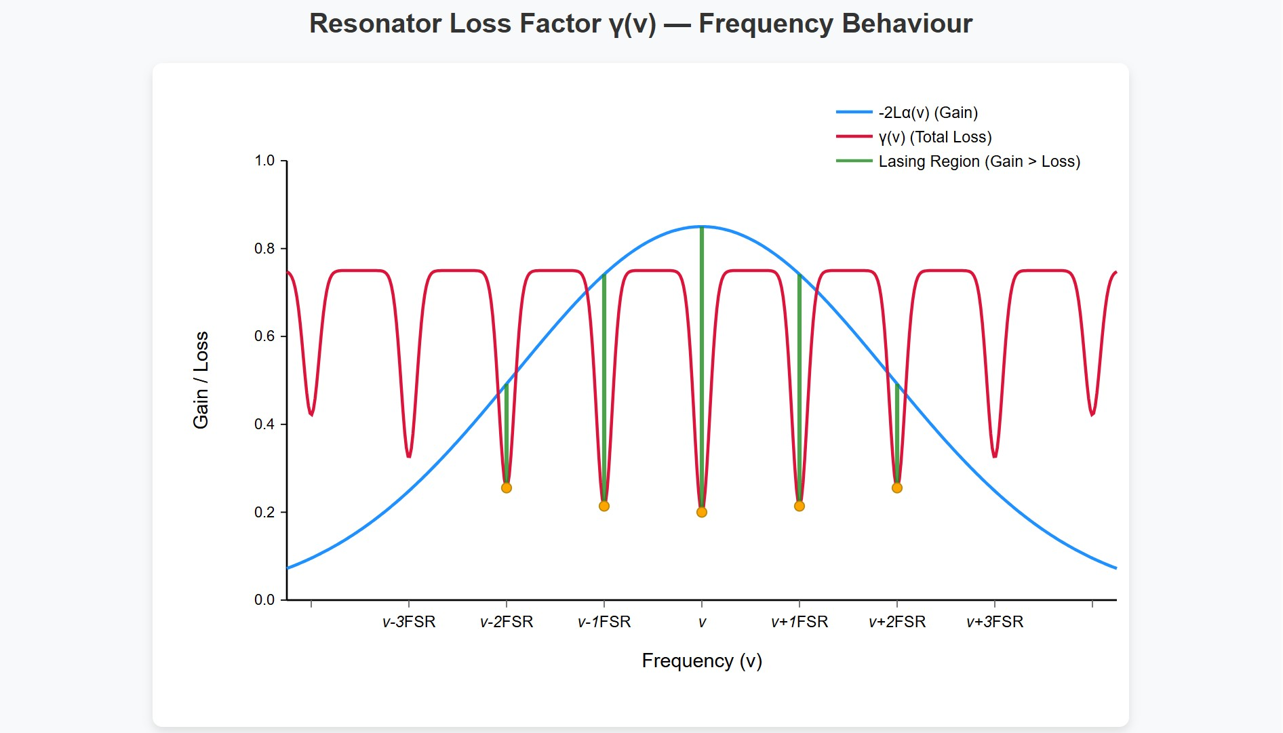
[IMAGE REQUIRED: Graph of net gain versus frequency with gain curve crossing loss curve at discrete mode frequencies.]
---
Prepared by Dist. Prof. Dr. M.A. Gondal for Phys 608 Laser Spectroscopy course in KFUPM (Term 251)

Slide 36
Slide 13: Enter Rate Equations — Tracking Populations &
Photons
Consider four-level system—simplest practical laser scheme.
Define:
𝑃: pump rate into level |2⟩ [atoms cm⁻³ s⁻¹].
𝑅_{i}: non-radiative relaxation rate out of level |𝑖⟩ [s⁻¹].
𝐴₂₁: spontaneous rate between |2⟩ and |1⟩ [s⁻¹].

Slide 37
𝑛: photon density inside cavity [photons cm⁻³].
Neglect quantum coherence → population-rate approximation valid for many cw lasers.

Slide 38
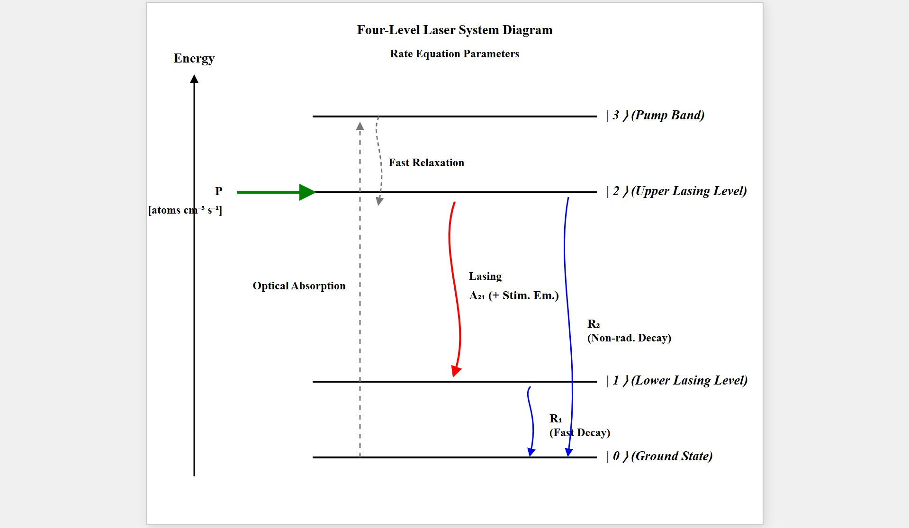
[IMAGE REQUIRED: Four-level diagram with pump arrow to |2⟩, lasing transition |2⟩ → |1⟩, fast decay |1⟩ → |0⟩.]
---
Prepared by Dist. Prof. Dr. M.A. Gondal for Phys 608 Laser Spectroscopy course in KFUPM (Term 251)

Slide 39
Slide 14: Complete Rate-Equation Set
Population of lower laser level |1⟩:
𝑑𝑁
1
= 𝑁 − 𝑁 )𝐵
(
𝑛ℎ𝜈 + 𝑁 𝐴 − 𝑁 𝑅
𝑑𝑡
2 1 21
2 21 1 1
Population of upper laser level |2⟩:
𝑑𝑁
2
( )
= 𝑃 − 𝑁 − 𝑁 𝐵
𝑛ℎ𝜈 − 𝑁 𝐴
− 𝑁 𝑅
𝑑𝑡
2
1 21
2 21
2 2
Photon density inside cavity “n”:

Slide 40
𝑑𝑛
= −𝛽𝑛 + (𝑁₂ − 𝑁₁)𝐵₂₁𝑛ℎ𝜈
𝑑𝑡
𝛽 [s⁻¹]: photon loss rate due to mirror transmission + intracavity absorption.
Coupling
between matter and field explicitly visible
via (𝑁₂ −
𝑁₁)𝐵₂₁𝑛ℎ𝜈.
---

Slide 41
Slide 15: Relating 𝜷 to Cavity Loss 𝜸
One round-trip time
2 𝑑
𝑇 =
𝑐
Fractional energy loss per round-trip 𝛾.
Equate exponential decays:
𝑛(𝑡) = 𝑛(0)𝑒^{−𝛽𝑡}
𝐼 = 𝐼₀𝑒^{−𝛾𝑦}
with 𝑦 = 𝑡/𝑇

Slide 42
Hence
𝛾
𝑇 2 𝑑
𝑐
𝛽 =
= 𝛾
Convenient
link between macroscopic
loss
coefficient and
microscopic photon decay rate.
---

Slide 43
Slide 16: Steady-State Solutions — Pump Power Balance
• Stationary regime: 𝑑𝑁₁/𝑑𝑡 = 𝑑𝑁₂/𝑑𝑡 = 𝑑𝑛/𝑑𝑡 = 0.
Adding population equations yields pump–relaxation balance:
𝑃 = 𝑁₁𝑅₁ + 𝑁₂𝑅₂
Adding upper-level and photon equations gives:
𝑃 = 𝛽𝑛 + 𝑁₂(𝐴₂₁ + 𝑅₂)
Lower-level relaxation must satisfy

Slide 44
𝑁₁𝑅₁ = 𝛽𝑛 + 𝑁₂𝐴₂₁
Physical meaning: pump power splits into useful photon output and unavoidable relaxation losses.
---

Slide 45
Slide 17: Stationary Inversion Expression
Multiply first rate equation by 𝑅₂ and second by 𝑅₁, add:
(𝑅₁ − 𝐴₂₁) 𝑃
𝛥𝑁 =
stat
𝐵 𝑛ℎ𝜈(𝑅 + 𝑅 ) + 𝐴
𝑅 + 𝑅 𝑅
12 1 2 21 1 1 2
Continuous inversion requires
𝑅₁ > 𝐴₂₁
→ lower laser level must empty faster than it is refilled by spontaneous
decay.

Slide 46
In presence of strong field, stricter criterion
𝑅₁ > 𝐴₂₁ + 𝐵₂₁𝜌
ensuring inversion not quenched by stimulated emission into other modes.
---

Slide 47
Slide 18: Threshold Inversion via Rate Equations
Set 𝑑𝑛/𝑑𝑡 = 0 in photon rate equation:
(𝑁₂ − 𝑁₁)𝐵₂₁𝑛ℎ𝜈 = 𝛽𝑛
Solve for inversion:
𝛽
𝛥𝑁 =
𝐵₂₁ℎ𝜈
• Relate 𝛽 to 𝛾 and 𝜎 (using 𝜎 = ℎ𝜈⁄𝑐 𝐵₂₁):

Slide 48
𝛾
𝛥𝑁_{thr} = _{2𝐿𝜎}
Exactly identical to threshold derived from gain–loss balance →
confirms internal consistency of rate-equation approach.
---

Slide 49
Slide 19: He–Ne Laser — Detailed Power Budget Example
Given:
• 𝑁₂ = 1.0 × 10¹⁰ cm⁻³
• 𝐴₂₁ + 𝑅₂ = 2.0 × 10⁷ s⁻¹
Tube volume 𝑉 = 0.075 cm³ ( 𝐿 = 10 cm, diameter 1 mm ).
Incoherent loss rate (upper-level depletion):
𝑁₂(𝐴₂₁ + 𝑅₂)𝑉 = 1.5 × 10¹⁶ s⁻¹

Slide 50
Target output power 𝑃_{L} = 3 mW at 𝜆 = 633 nm → photon rate
𝑃_{L}
𝛽𝑛 =
= 1.0 × 10¹⁶ s⁻¹
ℎ𝑐/𝜆
Required pump rate
𝑃 = (1.5 + 1.0) × 10¹⁶ = 2.5 × 10¹⁶ s⁻¹
Fluorescence (isotropic spontaneous emission) is larger loss channel than mirror transmission in this design.
---

Slide 51
Slide 20: Key Takeaways Before Moving On
Population inversion is quantitative: 𝛥𝑁_{thr} links gain cross-section, medium length, and cavity loss.
Rate
equations provide intuitive bookkeeping of photons and
populations, predicting threshold and output power.
Lower-level depopulation speed is critical — designs favour four-level systems over three-level.

Slide 52
Resonator characteristics (losses, mode spacing) intertwine with gain profile to determine spectral output.
Mastery of these fundamentals is prerequisite for understanding single-mode operation, frequency stabilization, and tunable laser architectures in subsequent sections.

