Slide 1
Chap. 3.6 Saturation & Power Broadening

Slide 2
Slide 1: Saturation & Power Broadening – WHY WE CARE ?
Precise spectroscopy demands linewidths as narrow as possible.
High‐power lasers can unintentionally enlarge these widths.
Two closely related mechanisms are at play:
Saturation of the level populations means: population equalization.
Power (Saturation) broadening of the spectral profile.
Saturation Broadening occurs in spectroscopy when a strong light field saturates an optical transition, causing the observed spectral line to broaden beyond its natural and Doppler width. This effect, also known as power broadening, is an artifact that obscures the intrinsic line shape and the information it conveys, such as atomic velocities. It is a limiting factor in high-resolution spectroscopy, and techniques like saturated absorption spectroscopy use perpendicular beams to minimize its influence and achieve Doppler-free spectra

Slide 3
We concentrate on a strictly homogeneous two-level absorber.
*Homogeneous = every absorber experiences the same natural width 𝛾.
Road-map of Today slides:
Build the two-level rate equation from scratch.
Derive the saturation parameter 𝑆 and discuss population depletion.
Extend the argument to frequency-dependent saturation 𝑆_{𝜔} and show how 𝛾 inflates to 𝛾_{s}.

Slide 4
Re-derive the same broadening with Rabi flopping to illuminate the underlying physics.
Conclude with experimentally relevant side-bands in a pump–probe arrangement.
---

Slide 5
Slide 2: Refresher – What Limits a Linewidth in the First
Place?
Line-shapes are affected by many unrelated physical processes.
Homogeneous Sources: natural lifetime (1/𝜏), collisional de- phasing, transit-time, laser bandwidth, etc.
Inhomogeneous
Sources: Doppler shifts, spatial field gradients,
unresolved hyperfine splittings, etc.

Slide 6
For the moment we suppress every inhomogeneous mechanism.
* Mathematically we keep a single Lorentzian function with half- width at half-maximum 𝛾/2.
Intense radiation alters a homogeneous line shape by:
Depleting the lower level more strongly at resonance than in the wings.
Driving coherent Rabi oscillations that smear out the response.

Slide 7
Outcome: an apparently wider Lorentzian with a reduced peak absorption.
---

Slide 8
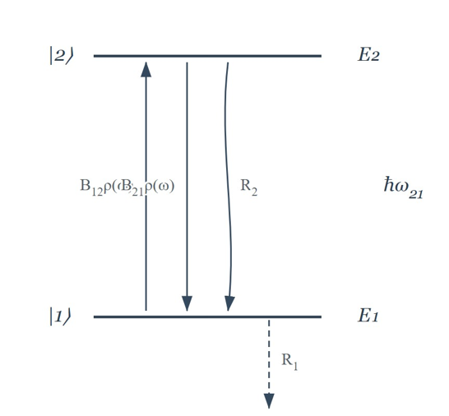
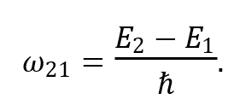
Slide 3: Prototype Two-Level System for derivation
Two discrete, non-degenerate energy levels:
Lower level |1⟩, energy 𝐸₁.
Upper level |2⟩, energy 𝐸₂ (> 𝐸₁).
Transition angular frequency
Population variables (number of atoms per cm³)

Slide 9
𝑁₁(𝑡), 𝑁₂(𝑡).
Allowed processes:
Stimulated absorption |1⟩ → |2⟩.
Stimulated emission |2⟩ → |1⟩.
Spontaneous relaxation |2⟩ → |1⟩ (rate 𝑅₂).
Non-radiative depopulation of |1⟩ (rate 𝑅₁).
No other levels are involved; therefore
𝑁 = 𝑁₁ + 𝑁₂
remains
constant.

Slide 10
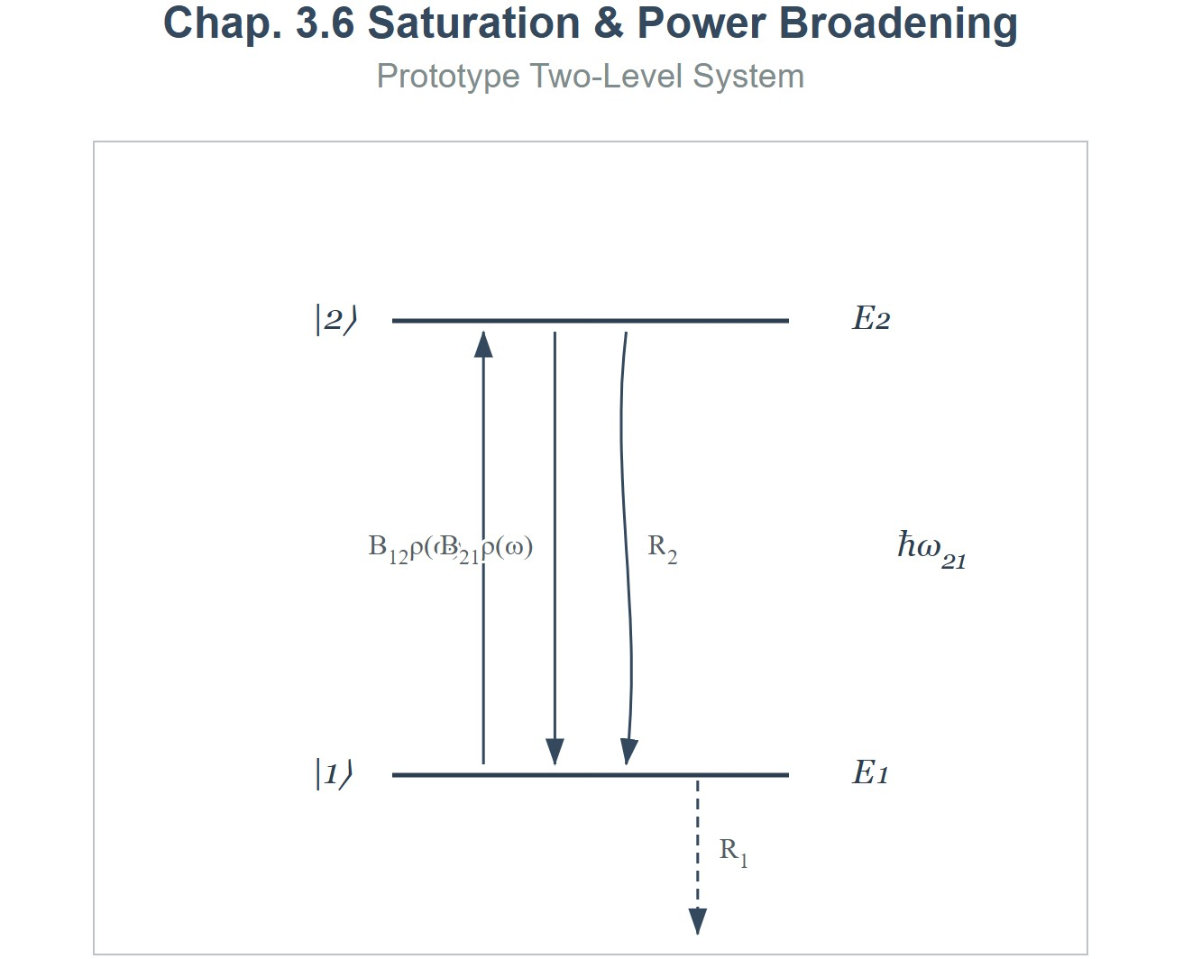
[IMAGE REQUIRED: Energy-level diagram showing |1⟩, |2⟩, upward arrow for absorption, downward arrows for spontaneous and stimulated emission, annotated with rates 𝐵₁₂𝜌(𝜔), 𝑅₂, 𝑅₁.]

Slide 11
Slide 4: Building the Rate Equation – Step by Step
Stimulated absorption probability per atom per second:
^{𝒫}12
= 𝐵₁₂ 𝜌_{p}(𝜔),
𝐵₁₂: Einstein 𝐵 coefficient for absorption (units: s⁻¹ m³ J⁻¹).
𝜌_{P}(𝜔): spectral energy density of the pump field at frequency 𝜔
(units: J m⁻³ Hz⁻¹).
Define shorthand
Prepared by Dist. Prof. Dr. M.A. Gondal for Phys 608 Laser Spectroscopy course in KFUPM (Term 251)

Slide 12
𝑃 =
^{𝒫}12
(convenience symbol for pump rate).
Full differential balance (population gains counted positive):
d𝑁
1
= −𝑃𝑁₁ − 𝑅₁𝑁₁ + 𝑃𝑁₂ + 𝑅₂𝑁₂,
d𝑡
d𝑁
2
= +𝑃𝑁₁ + 𝑅₁𝑁₁ − 𝑃𝑁₂ − 𝑅₂𝑁₂.
d𝑡
Each term is individually interpretable:
−𝑃𝑁₁ → atoms leaving level 1 via absorption.
Prepared by Dist. Prof. Dr. M.A. Gondal for Phys 608 Laser Spectroscopy course in KFUPM (Term 251)

Slide 13
• +𝑃𝑁₂ → stimulated emission returns atoms to 1.
−𝑅₁𝑁₁ → non-radiative loss from 1.
• +𝑅₂𝑁₂ → spontaneous decay feeding 1.
---
Prepared by Dist. Prof. Dr. M.A. Gondal for Phys 608 Laser Spectroscopy course in KFUPM (Term 251)

Slide 14
Slide 5: Stationary Solution of the Rate Equations
Steady state condition
d𝑁_{i = 0}
(𝑖 = 1,2).
d𝑡
Enforce particle conservation
𝑁₁ + 𝑁₂ = 𝑁
(total density, constant).
Insert 𝑃 and solve algebraically for 𝑁₁:
(𝑃 + 𝑅₁)𝑁₁ = (𝑃 + 𝑅₂)(𝑁 − 𝑁₁).
Prepared by Dist. Prof. Dr. M.A. Gondal for Phys 608 Laser Spectroscopy course in KFUPM (Term 251)

Slide 15
Rearrangement yields
𝑃 + 𝑅₂
𝑁 = 𝑁
,
1
2 𝑃 + 𝑅₁ + 𝑅₂
𝑃 + 𝑅₁
𝑁 = 𝑁
.
2
2 𝑃 + 𝑅 + 𝑅
1 2
Important limiting cases:
𝑃 ≪ 𝑅_{i} (weak field) → returns thermal equilibrium populations.
Please read my lecture notes for intermediate steps and more details of these derived expressions in lecture notes 3.6

Slide 16
• 𝑃 ≫ 𝑅_{i}
(very strong field, P=∞ )→ then 𝑁₁ = 𝑁₂ = 𝑁/2. Medium becomes transparent because the populations equalized
Why does this happen? When 𝑃 is very large, stimulated absorption (emptying 𝑁1, filling 𝑁2) and stimulated emission (emptying 𝑁2, filling 𝑁1) are both occurring very rapidly. The system is driven so hard that it can't distinguish much between the up and down transitions; any atom that relaxes down is quickly pumped back up, and any atom pumped up can be quickly stimulated back down. The relaxation rates 𝑅1 and 𝑅2, which try to establish some other equilibrium, become negligible in comparison. The system reaches a state where the upward and downward stimulated rates nearly balance, which occurs when 𝑁1≈𝑁2.
The consequence is that the "Medium becomes transparent." Why? Net absorption of light is proportional to the population difference (𝑁1−𝑁2) times the 𝐵12 coefficient, minus stimulated emission which is proportional to 𝑁2 times 𝐵21. If we assume 𝐵12=𝐵21 (for equal degeneracies), then net absorption is proportional to (𝑁1−𝑁2). If 𝑁1=𝑁2, then (𝑁1−𝑁2)=0. This means there is no net absorption of light from the incident beam.
The number of photons absorbed per unit time is exactly balanced by the number of photons added back into the beam by stimulated emission. The medium neither attenuates nor amplifies the beam; it becomes transparent to the strong resonant light.

Slide 17


Slide 6: Introducing the Saturation Parameter 𝑺
Population difference (net absorbers)
This 𝛥𝑁 is crucial because, as the net rate of absorption of energy from the light field is proportional to this population difference (assuming equal degeneracies for simplicity, so 𝐵12=𝐵21). If 𝛥𝑁>0, there's net absorption. If 𝛥𝑁<0 (population inversion, 𝑁2>𝑁1), there's net stimulated emission and thus optical gain. If 𝛥𝑁=0, the medium is transparent at that frequency.
Unsaturated difference ( 𝑃 = 0 ) i.e no external pump field then population 𝛥𝑁₀
This 𝛥𝑁₀ represents the "natural" population difference established by the incoherent relaxation and
pumping processes 𝑅₁ (1→2) and 𝑅₂ (2→1). For net absorption to occur even with a weak probe, we typically
need 𝛥𝑁₀> 0, which means 𝑅2>𝑅1. If 𝑅1 is thermal excitation and 𝑅2 is thermal relaxation, 𝑅2 will usually
be greater than 𝑅1 at reasonable temperatures for an optical transition where 𝐸₂−𝐸₁≫𝑘𝑇, so 𝛥𝑁₀≈𝑁.
Please read my lecture notes for intermediate steps and more details of these derived expressions in lecture 3.6

Slide 18
Substitute steady-state populations
𝛥𝑁₀
𝛥𝑁 =
.
1 +
2 𝑃
𝑅₁ + 𝑅₂
Define saturation parameter “S”
2 𝑃
𝑅₁ + 𝑅₂
𝑃
= , 𝑅 =
𝑅
𝑅₁ + 𝑅₂
𝑆 =
.
2
𝑆 is the ratio “pumping rate per atom” ÷ “mean relaxation rate”.
Special case: only spontaneous decay from upper level
• 𝑅₁ = 0, 𝑅₂ = 𝐴₂₁.
Please read my lecture notes for intermediate steps and more details of these derived expressions in lecture 3.6

Slide 19
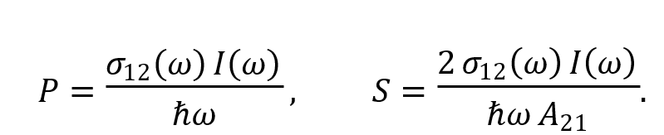
Using intensity 𝐼(𝜔) and absorption cross section 𝜎₁₂(𝜔):
This equation is extremely useful. It directly relates the saturation parameter 𝑆 to:
𝜎12(𝜔): the absorption cross‐section at the laser frequency 𝜔 (a property of the atom).
• 𝐼(𝜔): the intensity of the laser (an experimental parameter we control).
• ℏ𝜔: the photon energy (defined by the laser frequency).
• 𝐴21: the spontaneous emission rate (a property of the atom).
This allows us to calculate 𝑆 if we know the atomic parameters and the laser intensity. Often, we define a "saturation intensity" 𝐼sat(𝜔) such that 𝑆= 𝐼(𝜔)/𝐼_{sat}(𝜔). Comparing with the formula for 𝑆, we can identify:
𝐼_{sat}(𝜔)=ℏ𝜔𝐴₂₁/2 𝜎₁₂(𝜔)
The saturation intensity 𝐼_{sat} is the intensity at which the saturation parameter 𝑆 becomes equal to 1. It's a characteristic intensity for the transition. If your laser intensity 𝐼 is much less than 𝐼_{sat}, you are in the weak field regime (𝑆≪1). If 𝐼 is much greater than 𝐼_{sat}, you are in the strong saturation regime (𝑆≫1).
Please read my lecture notes for intermediate steps and more details of these derived expressions in lecture 3.6

Slide 20
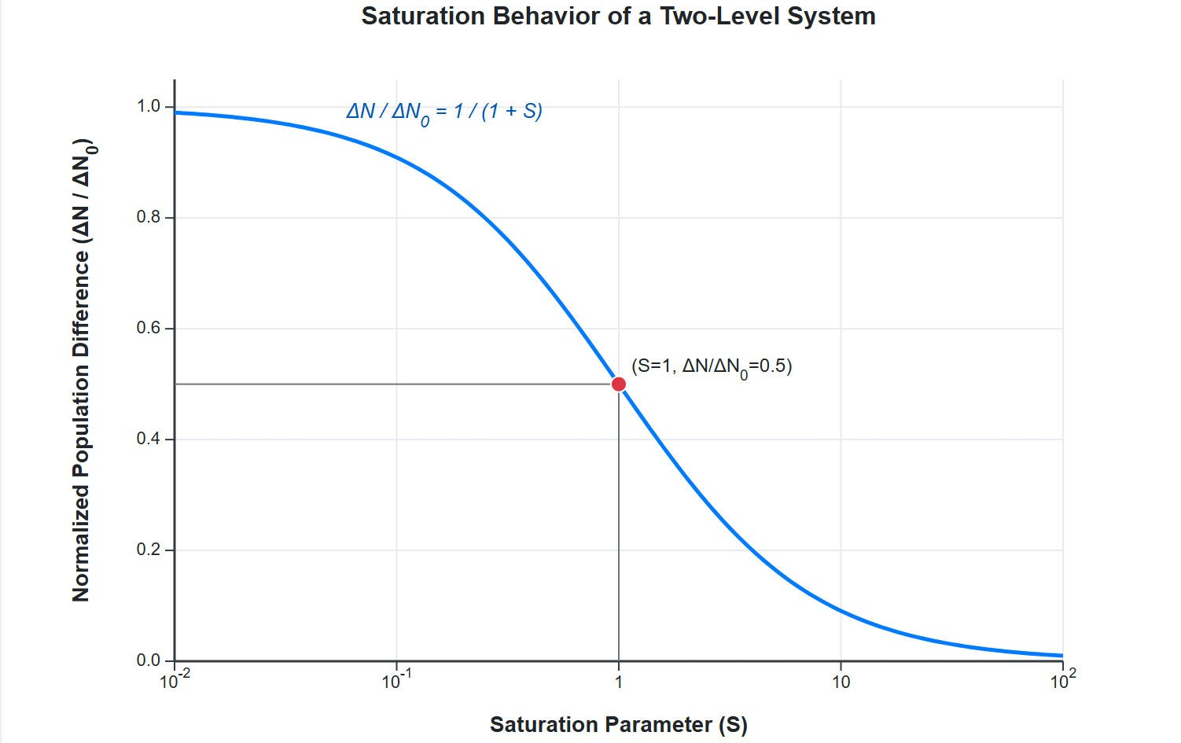
[IMAGE REQUIRED: Plot showing 𝛥𝑁/𝛥𝑁₀ vs 𝑆 on a log scale, highlighting the 1/(1 + 𝑆) decrease.]
Prepared by Dist. Prof. Dr. M.A. Gondal for Phys 608 Laser Spectroscopy course in KFUPM (Term 251)
At very small 𝑆 (e.g., 𝑆=10⁻²), the value of 𝛥𝑁/𝛥𝑁0 is very close to 1. For example, if 𝑆=0.01, then 𝛥𝑁𝛥𝑁0=11.01≈0.99. This confirms that for weak pumping, the population difference is hardly affected.
For 𝑆=100, 𝛥𝑁𝛥𝑁0=1/1+100=1/101≈0.01. As 𝑆 approaches infinity, 𝛥𝑁/𝛥𝑁0 approaches zero, meaning complete saturation where 𝑁1≈𝑁2.

Slide 21
Slide 7: Absorption Coefficient under Saturation
Microscopic absorption cross section 𝜎₁₂(𝜔) (units: m²).
Macroscopic coefficient
𝛼(𝜔) = 𝜎₁₂(𝜔) 𝛥𝑁.
Insert 𝛥𝑁 expression:
𝛼₀(𝜔)
𝛼(𝜔) =
,
1 + 𝑆
• 𝛼₀(𝜔) = 𝜎₁₂(𝜔) 𝛥𝑁₀ is the unsaturated value.
Please read my lecture notes for intermediate steps and more details of these derived expressions in lecture 3.6

Slide 22
Consequences:
Peak absorption diminishes as 1/(1 + 𝑆).
In the limit 𝑆 → ∞, 𝛼 → 0: complete bleaching(media stops absorbing as 𝛥𝑁 close to zero )

Slide 23
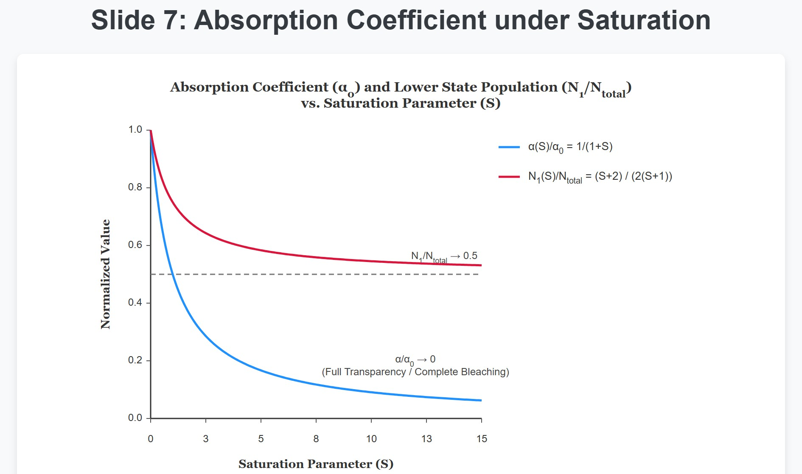
The graph shows the "Absorption Coefficient (𝛼_{S}) and Lower State Population (𝑁1/𝑁total) Vs. Saturation Parameter (𝑆)". (Here 𝛼_{S} is what we called 𝛼(𝜔) or 𝛼).
Please read my lecture notes for more details about this plot under lecture notes 3.6

Slide 24
Slide 8: Saturation Broadening – Conceptual Jump
So far we treated a single frequency at a time. Real lasers have finite spectral width.
Saturation is strongest exactly at 𝜔₀
induced rate is highest at this frequency.
Wings of the Lorentzian are less saturated (smaller 𝑆_{𝜔}).
Important Result: central part flattens while the area (integrated oscillator strength) stays conserved → end result → line broadens outward.
(line centre) because the

Slide 25
Slide 9: Lorentzian Profile & Frequency-Dependent
Saturation
Unsaturated homogeneous line (natural plus collisional)
(𝛾/2)²
( )
= ,
𝐿 𝜔 − 𝜔
0
( )
2 2
𝜔 − 𝜔
( )
+ 𝛾/2
0
𝛾: full width at half maximum (FWHM).
Local saturation parameter

Slide 26
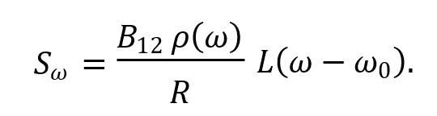

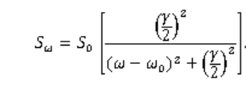
Define peak value
.
Frequency variation therefore reads
• 𝑆_{𝜔} → 0 as |𝜔 − 𝜔₀| → ∞.
(𝑆𝜔 approaches zero as the absolute value of (𝜔−𝜔0) approaches infinity). This means that far out in the wings of the line, where the detuning |𝜔−𝜔0| is very large, the Lorentzian factor 𝐿(𝜔−𝜔0) becomes very small. Consequently, 𝑆𝜔 also becomes very small, regardless of how large 𝑆0 (the on-resonance saturation) is. This implies that far from resonance, the medium is essentially unsaturated. Saturation is a phenomenon that is primarily active near the line center. This differential saturation across the profile is what leads to power broadening.

Slide 27

Slide 10: Deriving the Broadened Linewidth 𝜸_{s}
Power absorbed per unit volume per unit frequency
Substitute 𝑆_{𝜔} expression:
d𝑊₁₂(𝜔)
𝑆₀(𝛾/2)²
= ℏ𝜔 𝑅 𝛥𝑁₀
.
d𝑡
(𝜔 − 𝜔₀)² + (𝛾/2)² (1 + 𝑆₀)

Slide 28
The denominator has exactly the structure of a Lorentzian with an enlarged half-width
𝛾_{s} = 𝛾√ 1 + 𝑆₀ .
Physical meaning:
At 𝑆₀ = 1 the width grows by γ√2.
Scaling is ∝ √𝑃 for large 𝑃 because 𝑆₀ ∝ 𝑃.
---

Slide 29
Slide 11: Absorption Profile in the Saturated Regime
Saturated coefficient
(𝛾/2)²
( ) ( )
𝛼 𝜔 = 𝛼
𝜔
.
s
0 0
(
𝜔 − 𝜔
)
2
( )
2
+ 𝛾 /2
0
s
Alternate but equivalent form
𝛼₀(𝜔)
( )
.
𝛼 𝜔
=
s
1 + 𝑆
𝜔
Observations:

Slide 30
Peak reduction factor 1/(1 + 𝑆₀).
Area under 𝛼(𝜔) remains (nearly) constant – oscillator strength conservation.
Wings asymptotically merge with the unsaturated curve because
𝑆_{𝜔} → 0.
---

Slide 31
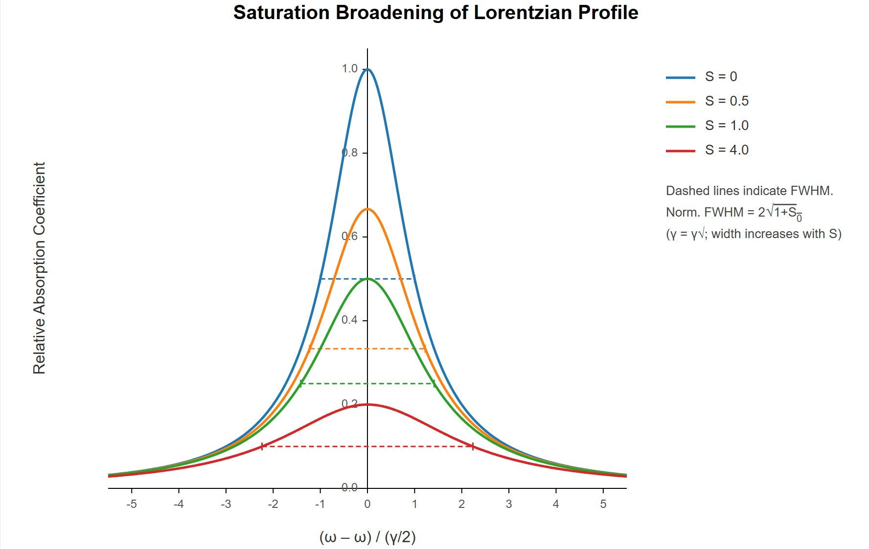

Slide 12: Visualising Saturation Broadening
S = 0.5 (Orange curve): When 𝑆=0.5, the peak height is 1/1+0.5=1/1.5=23≈0.67. The curve is visibly lower and slightly broader than the S=0 curve. * S = 1.0 (Green curve): When 𝑆=1.0, the peak height is 1/1+1=0.5. The curve is further reduced in height and noticeably broader. The FWHM should be 𝛾√2, so the HWHM is (𝛾/2)√2. On our normalized axis, this is √2≈1.41. * S = 4.0 (Red curve): When 𝑆 =4.0, the peak height is 1/1+4=1/5=0.2. This curve is much flatter and significantly broader. The FWHM should be 𝛾√5, so HWHM is (𝛾/2)√5. On the normalized axis, this is √5≈2.24.
Dashed lines indicate FWHM." "Norm. FWHM = 2√1+𝑆₀" (using 𝑆₀ for S here). This refers to the FWHM in units of the original FWHM (𝛾/2). So, This is correct. For 𝑆₀=0, Norm. FWHM = 2. For 𝑆₀=1, Norm. FWHM = 2√2≈2.82. For 𝑆₀=4, Norm. FWHM = 2√5≈4.47. The graph confirms these increasing widths.

Slide 32
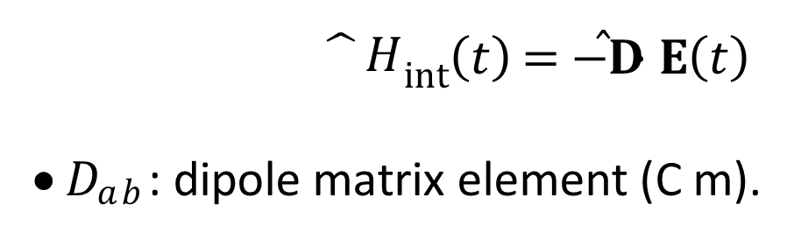
Slide 13: Power Broadening – An Alternative Microscopic
View
Treat the light classically: electric field
𝐸(𝑡) = 𝐸₀cos𝜔𝑡.
Quantum mechanical two-level interaction Hamiltonian
^{𝐷}𝑎𝑏 ^{𝐸}0
$\hat{}H$_{int}(𝑡) = −𝐃̂ ⋅ 𝐄(𝑡)
𝐷_{𝑎𝑏} : dipole matrix element (C m).
→ 𝛺_{R} =
,
ℏ

Slide 33
𝛺_{R}: Rabi flopping frequency (rad s⁻¹).
Population
of upper state |𝑏⟩ without
damping
exhibits
Rabi
oscillations between 0 and 1.
Intuition:
stronger field → faster flopping
→ broader
spectral
response (time–frequency uncertainty).
---

Slide 34
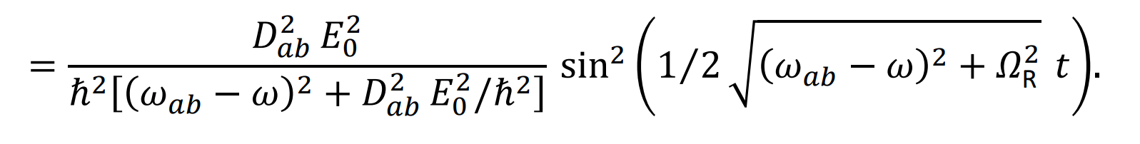
Slide 14: Exact Time-Dependent Excitation Probability
Probability amplitude 𝑏(𝑡) (rotating‐wave approximation):
|𝑏(𝑡)|²
At exact resonance 𝜔 = 𝜔_{𝑎𝑏} the sine term oscillates with frequency
𝛺_{R}.

Slide 35
Without
damping the spectrum would
develop
many
sharp
sidebands (Fourier series of a square wave).
---

Slide 36
Slide 15: Including Relaxation – Time Averaging
Exponential decay of coherence and population from both levels:
We introduce damping constant 𝛾 (s⁻¹).
Mean excitation probability obtained via weighted integral
∞
𝑃_{b}(𝜔) = ∫ 𝛾 e^{−𝛾𝑡} |𝑏(𝑡)|² d𝑡.
0
Result after algebra:

Slide 37
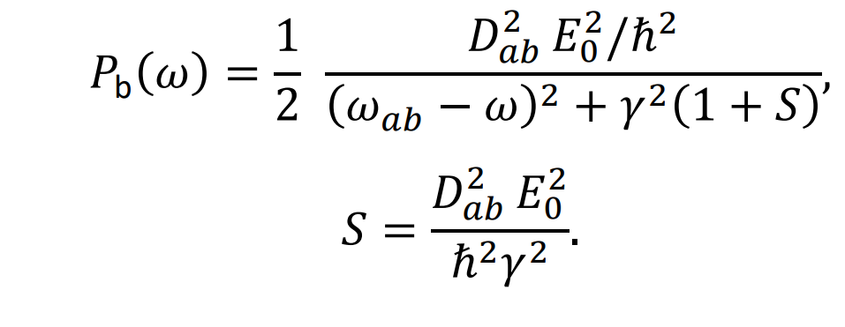
𝑆 again appears as the square of the field amplitude normalised to damping.
---

Slide 38
Slide 16: Identical Broadening Law from the Rabi Picture
Because 𝑃_{b}(𝜔) directly scales with the absorption line, we identify the same Lorentzian as before, but now with
𝛾_{s} = 𝛾√ 1 + 𝑆 .
Connection to the earlier definition:
Replace 𝐷² 𝐸²/ℏ² by 𝐵 𝐼/𝑐 (classical ↔ Einstein coefficients).
𝑎𝑏 0 12
• One recovers 𝑆 = 𝐵₁₂𝜌(𝜔₀)/𝑅 = 𝑆₀.

Slide 39
Conceptual bonus: we see that the broadening stems from the Fourier transform of damped Rabi oscillations.
---

Slide 40
Slide 17: Pump–Probe Scenario & Autler–Townes–Type
Sidebands
Strong “pump” laser exactly resonant: large 𝛺_{R}.
Weak tunable “probe” interrogates the modified absorption profile.
Populations and coherences are modulated at 𝛺_{R}; probe perceives sidebands at
𝜔 = 𝜔₀ ± 𝛺_{R}.

Slide 41
Requirement for clearly resolved doublet
𝛺_{R} > 𝛾_{s}.
Observed features:
Central dip (sometimes called “hole burning” or “Mollow triplet” in fluorescence context).
Two Lorentzian satellites each of width 𝛾_{s}.

Slide 42
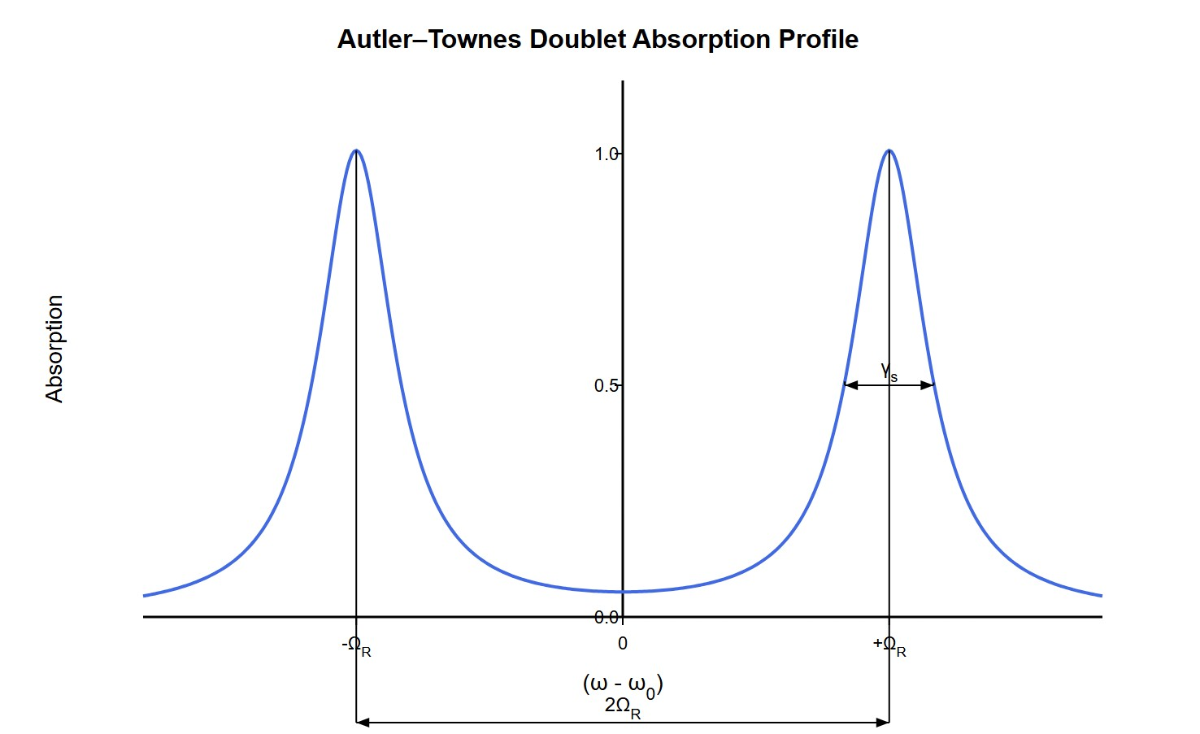
[IMAGE REQUIRED: Spectrum with central dip and two symmetric side peaks; annotate separation 2𝛺_{R} and individual widths 𝛾_{s}.]
Prepared by Dist. Prof. Dr. M.A. Gondal for Phys 608 Laser Spectroscopy course in KFUPM (Term 251)

Slide 43
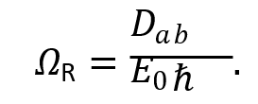
Slide 18: Saturation Paramet for Rabi Oscillations
Saturation parameter
2 𝑃
𝑅₁ + 𝑅₂
𝐵₁₂𝜌(𝜔₀)
2 2
^{𝐷}𝑎𝑏 ^{𝐸}0
,
𝑆 =
= =
.
_{ℏ}2_{𝛾}2
𝑅
Population difference
𝛥𝑁₀
Dipole moment = 𝐷_{𝑎𝑏}
electric field of laser =E₀
𝛥𝑁 =
.
1 + 𝑆
Saturated absorption coefficient (homogeneous line)

Slide 44
𝛼₀(𝜔)
(𝛾/2)²
( )
𝛼 𝜔 =
,
𝑆 = 𝑆
.
s
1 + 𝑆
𝜔
0
(
𝜔 − 𝜔
)
2
( )
2
+ 𝛾/2
𝜔
0
Power-broadened half-width
𝛾_{s} = 𝛾√1 + 𝑆₀.
Rabi frequency (dipole interaction)
^{𝐷}𝑎𝑏 ^{𝐸}0
𝛺_{R} =
.
ℏ
---

Slide 45
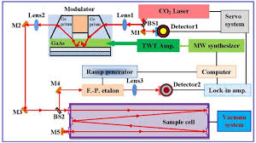
Experimental Setup for Saturation Spectroscopy

Slide 46
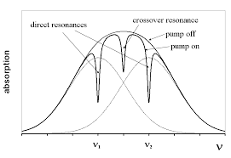
Lamb Dips in Saturation Absorption Spectra for Hyperfine Structural Lines

Slide 47
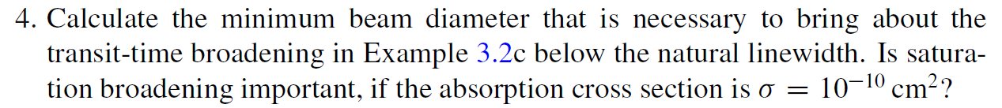

Slide 48
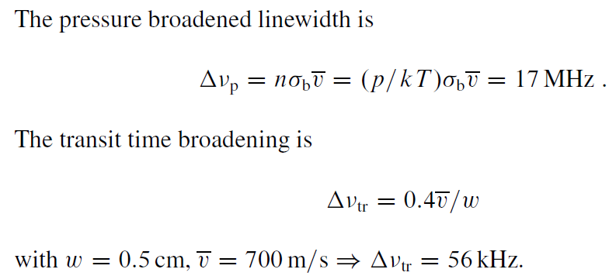
Chap. 3 Problems & Solutions

Slide 49
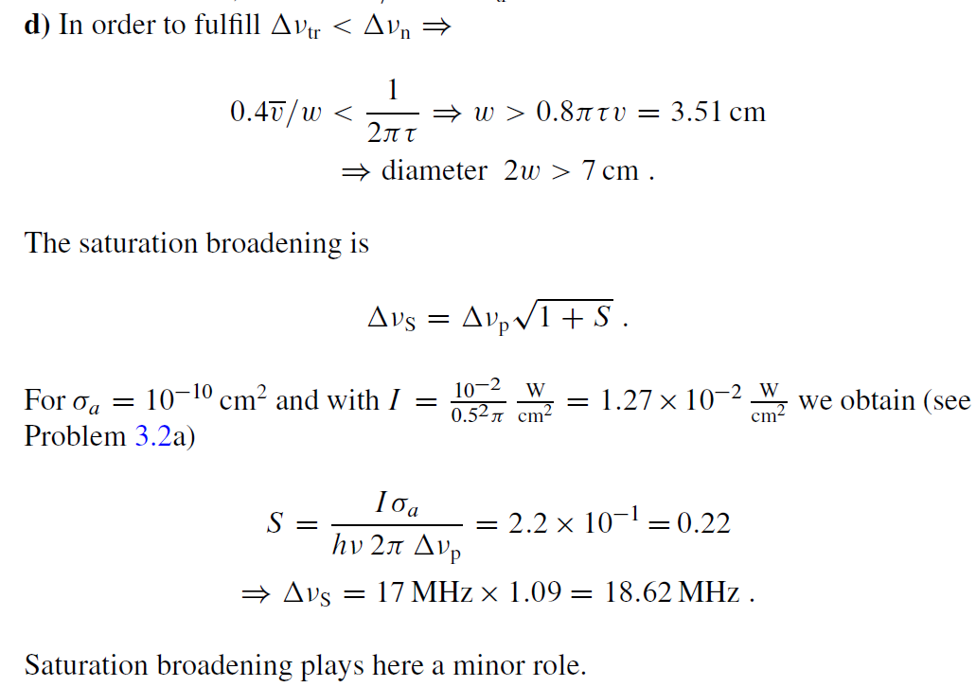
Chap. 3 Problems & Solutions

Slide 50
Chap. 3 Problems & Solutions

