Slide 1
Chap. 2.9 Coherence Properties of Radiation Fields
Prepared by Dist. Prof. Dr. M.A. Gondal for Phys 608 Laser Spectroscopy course in KFUPM (Term 251)

Slide 2
Slide 1: Coherence Properties of Radiation Fields – Big
Picture Overview
Coherence = ability of different portions of an electromagnetic (EM) field to maintain a well-defined phase relationship.
Two complementary aspects:
  Temporal (longitudinal) coherence → correlation in time at a
fixed point.
2. Spatial (transverse) coherence → correlation in space at a fixed
instant.

Slide 3
Both aspects govern interference & diffraction phenomena central to laser spectroscopy.
Best Example : Marching Military Band
Spatial coherence is like all the band members across the parade line stepping in sync sideways.
Temporal coherence is like the whole band keeping the same rhythm in time as they move forward.
Lasers usually have both: the beam is well aligned across its width (spatial coherence) and its waves stay in rhythm over long distances (temporal coherence).
Key Parameters to Derive:
  Coherence time 𝛥𝑡_{c} [s].
  Coherence length 𝛥𝑠_{c} = 𝑐 𝛥𝑡_{c} [m].
  Coherence surface 𝑆_{c} [m²].

Slide 4
4. Coherence volume 𝑉_{c} [m³].
Our Road-map: derive each from fundamental superposition of partial waves emitted by an extended source.
Prepared by Dist. Prof. Dr. M.A. Gondal for Phys 608 Laser Spectroscopy course in KFUPM (Term 251)

Slide 5
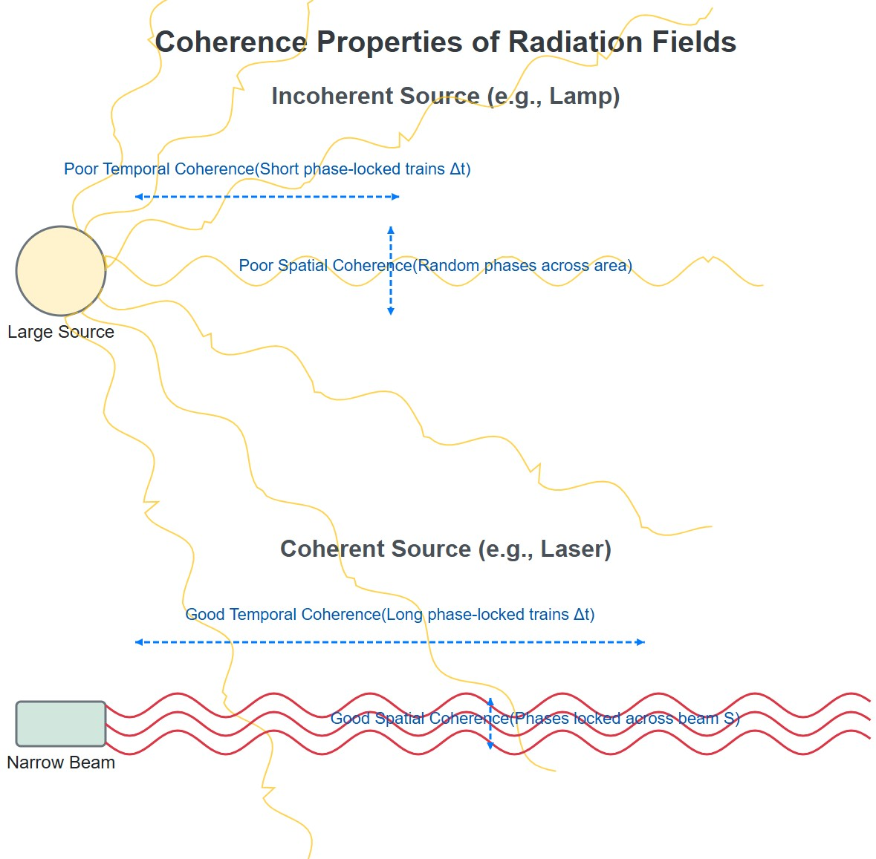
[IMAGE REQUIRED: Conceptual cartoon showing a large incoherent lamp vs. a narrow coherent laser beam illustrating temporal & spatial phase locks.]

Slide 6
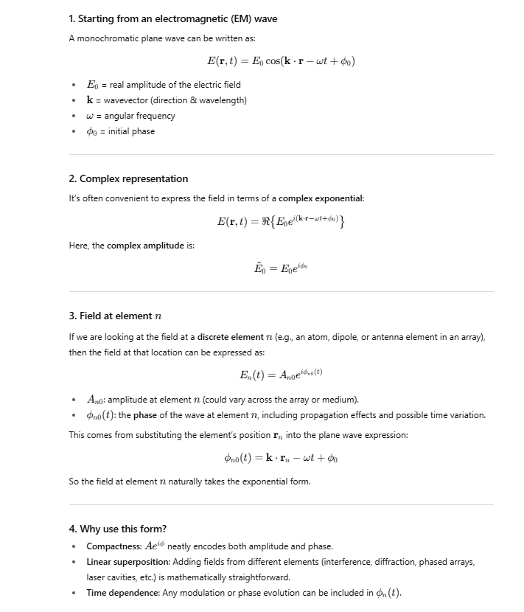

Slide 7
Slide 2: Superposition of Partial Waves – Setting Up the
Problem
Consider an extended optical source S with many infinitesimal surface elements d𝑆.
Each element emits a spherical elementary (partial) wave:
Complex field amplitude at element 𝑛: 𝐴_{𝑛0} 𝑒^{𝑖𝜙𝑛0(𝑡)}.
𝐴_{𝑛0} – real amplitude at the source surface (units V m⁻¹).
Prepared by Dist. Prof. Dr. M.A. Gondal for Phys 608 Laser Spectroscopy course in KFUPM (Term 251)

Slide 8

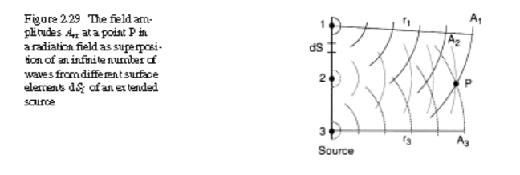
• 𝜙_{𝑛0}(𝑡) = 𝜔𝑡 + 𝜙_{𝑛}(0) – initial phase.
Observation point 𝑃 is at distance 𝑟_{n} from element 𝑛.
Total complex field amplitude at 𝑃:
(
𝜆
]
Notation & units:
𝜔 = 2𝜋𝜈 – angular frequency [rad s⁻¹].
Prepared by Dist. Prof. Dr. M.A. Gondal for Phys 608 Laser Spectroscopy course in KFUPM (Term 251)

Slide 9
𝜆 = 2𝜋𝑐/𝜔 – vacuum wavelength [m].
Summation surface.
[IMAGE REQUIRED: Geometry diagram similar to
approximates an integral over the
entire
radiating
Fig. 2.29 – source
surface elements, distances 𝑟_{n}, and phase increments illustrated.]
Prepared by Dist. Prof. Dr. M.A. Gondal for Phys 608 Laser Spectroscopy course in KFUPM (Term 251)

Slide 10
Slide 3: Phase Accumulation Along Propagation
For each element 𝑛 the full phase at 𝑃 is
2𝜋𝑟_{n}
𝜙_{n}(𝑟_{n}, 𝑡) = 𝜙_{𝑛0}(𝑡) +
⏟
at source
𝜆
⏟
propagation term
Important observations:
1. Propagation adds a deterministic phase proportional to distance.
Prepared by Dist. Prof. Dr. M.A. Gondal for Phys 608 Laser Spectroscopy course in KFUPM (Term 251)

Slide 11
Initial phases 𝜙_{𝑛}(0) may be random (thermal source) or constant (laser).
Interference at 𝑃 follows from coherent sum of all such contributions.
  If phase relationships are stable across 𝑛 and time, interference fringes persist.
Next
slides: quantify “stable” through temporal and spatial
coherence criteria.
Prepared by Dist. Prof. Dr. M.A. Gondal for Phys 608 Laser Spectroscopy course in KFUPM (Term 251)

Slide 12
Slide 4: Defining Temporal Coherence – Phase Stability in
Time
Key Criterion
At fixed position 𝑃, consider two observation instants 𝑡₁ and 𝑡₂.
Phase change for element 𝑛:
𝛥𝜙_{n}
= 𝜙_{n}(𝑃, 𝑡₁) − 𝜙_{n}(𝑃, 𝑡₂)
Temporal coherence exists when
Prepared by Dist. Prof. Dr. M.A. Gondal for Phys 608 Laser Spectroscopy course in KFUPM (Term 251)

Slide 13
:
|𝛥𝜙_{n}| < 𝜋
Meaning: all partial waves drift in phase by less than 180∘ over the time window 𝛥𝑡 = 𝑡₂ − 𝑡₁.
Derived Quantities
Maximum 𝛥𝑡 satisfying above → coherence time 𝛥𝑡_{c} [s].
Corresponding distance light travels → coherence length
𝛥𝑠_{c} = 𝑐 𝛥𝑡_{c}
Smaller spectral bandwidth → slower phase drift → larger 𝛥𝑠_{c}.
Prepared by Dist. Prof. Dr. M.A. Gondal for Phys 608 Laser Spectroscopy course in KFUPM (Term 251)

Slide 14
Slide 5: Defining Spatial Coherence – Phase Stability in
Space
Fix the time 𝑡; inspect two spatial points 𝑃₁ and 𝑃₂.
Phase difference of total field:
𝛥𝜙
= 𝜙(𝑃₁, 𝑡) − 𝜙(𝑃₂, 𝑡)
Spatial coherence exists when
|𝛥𝜙|
< 𝜋 for all 𝑡
Prepared by Dist. Prof. Dr. M.A. Gondal for Phys 608 Laser Spectroscopy course in KFUPM (Term 251)

Slide 15
Set of points satisfying the above inequality for a given source forms the “coherence volume”.
Practically:
Spatial coherence dictates whether Young-type interference can be observed.
Strongly linked to angular size of the source and propagation distance.
---
Prepared by Dist. Prof. Dr. M.A. Gondal for Phys 608 Laser Spectroscopy course in KFUPM (Term 251)

Slide 16
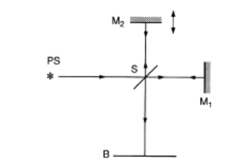
Slide 6: Temporal vs. Spatial Coherence – Quick Contrast
Temporal Coherence
Relates to spectral purity: narrow 𝛥𝜔 ⇒ 𝑙𝑜𝑛𝑔𝛥𝑡_{c}.
Measured
with path-difference devices (e.g., Michelson
interferometer).
Spatial Coherence
Relates to geometric size & distance of source.
Figure 2.30 Michelson interferometer for measurement of the temporal coherence of radiation from
the source S.

Slide 17
Measured with double-slit or pinhole experiments.
Both can be treated within a unified correlation framework (mutual coherence function, later slides).
---
Prepared by Dist. Prof. Dr. M.A. Gondal for Phys 608 Laser Spectroscopy course in KFUPM (Term 251)

Slide 18
Slide 7: Michelson Interferometer – Fundamental
Geometry
Classic apparatus for probing temporal coherence.
Components & notation (refer to next figure):
Beam splitter BS divides incoming beam into two paths.
Mirrors 𝑀₁ and 𝑀₂ retro-reflect partial beams.
Observation plane 𝐵 receives recombined fields.
Prepared by Dist. Prof. Dr. M.A. Gondal for Phys 608 Laser Spectroscopy course in KFUPM (Term 251)

Slide 19
Optical path lengths:
Arm 1: SM₁ + M₁B.
Arm 2: SM₂
+ M₂B.
Path difference (twice mirror displacement):
𝛥𝑠
= 2 ( SM₁ − SM₂ )
Prepared by Dist. Prof. Dr. M.A. Gondal for Phys 608 Laser Spectroscopy course in KFUPM (Term 251)

Slide 20
Slide 8: Interference Condition & Visibility in Michelson
For wavelength 𝜆:
Constructive interference → 𝛥𝑠 = 𝑚 𝜆 (phase change(0, 2π,4π,6π --)bright fringes
Destructive interference → 𝛥𝑠= (𝑚 + 1) 𝜆 / 2. (phase change by π,3π, 5π---)dark fringes
Fringe contrast quantified by visibility “V”
^{𝐼}max ^{− 𝐼}min
𝑉 =
^{𝐼}max ^{+ 𝐼}min
Prepared by Dist. Prof. Dr. M.A. Gondal for Phys 608 Laser Spectroscopy course in KFUPM (Term 251)

Slide 21
Experimental observation: 𝑉 decays as |𝛥𝑠| exceeds coherence length 𝛥𝑠_{c}.
Empirical relation connecting spectral width 𝛥𝜔 to 𝛥𝑠_{c}:
𝑐 𝑐
𝛥𝑠_{c} ≃ =
𝛥𝜔
2𝜋 𝛥𝜈
Very Important Take away:
Hence larger the bandwidth(line broadening), smaller coherence length as most of frequencies donot remain in
phase so affects the Cohenrence Length 𝛥𝑠_{c}. However, laser light has very narrow line width, so coherence length
is much larger for laser light.
• 𝛥𝜈 = 𝛥𝜔/2𝜋 – bandwidth in Hz.
Prepared by Dist. Prof. Dr. M.A. Gondal for Phys 608 Laser Spectroscopy course in KFUPM (Term 251)

Slide 22
Slide 9: Physical Interpretation of 𝜟𝒔_{𝐜} = 𝒄/𝜟𝝎
Finite
bandwidth source = superposition of many quasi-
monochromatic components.
Each component 𝜔_{n} produces a sinusoid; components drift out of phase over time 𝛥𝑡 ≈ 1/𝛥𝜔.
Results into → wave train of finite spatial extent:
𝑐
𝛥𝑠_{c} = 𝑐 𝛥𝑡 ≈ _{𝛥𝜔}
Prepared by Dist. Prof. Dr. M.A. Gondal for Phys 608 Laser Spectroscopy course in KFUPM (Term 251)

Slide 23
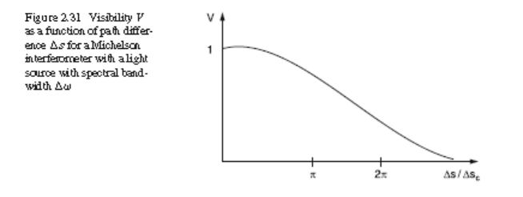
When interferometer arm difference 𝛥𝑠 > 𝛥𝑠_{c}:
Split wave packets do not overlap upon recombination.
Interference term averages to zero; visibility of fringes collapses as shown in Fig 2.31 .
Prepared by Dist. Prof. Dr. M.A. Gondal for Phys 608 Laser Spectroscopy course in KFUPM (Term 251)

Slide 24
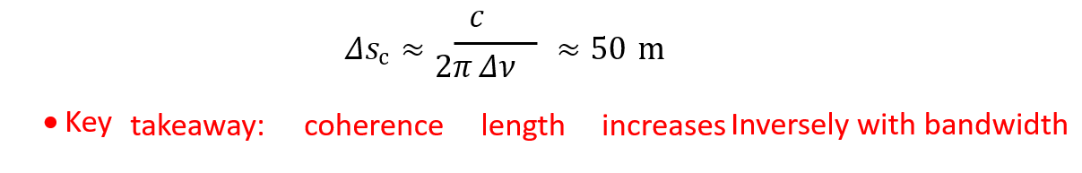
Slide 10: Numerical Examples – Contrast of Sources
Example 1 – Mercury 546 nm line:
Doppler FWHM 𝛥𝜈_{D} = 4 × 10⁹ Hz.
Coherence length:
𝑐
≈ 8 cm
^{𝛥𝑠c ≈} 2𝜋 𝛥𝜈
D
Example 2 – Single-mode He–Ne laser:
Bandwidth 𝛥𝜈 = 1 × 10⁶ Hz.

Slide 25
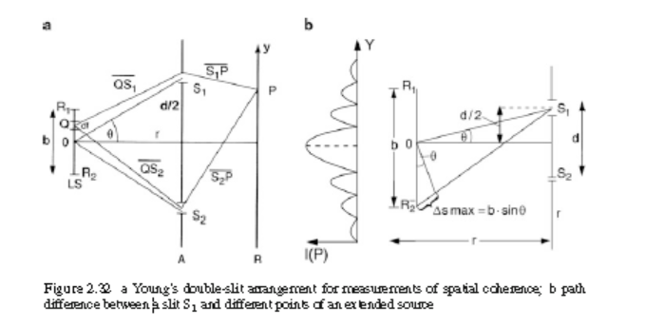
Slide 11: Young’s Double-Slit – Basic of Spatial Coherence Test
Setup: extended light source of width 𝑏 illuminates two slits 𝑆₁, 𝑆₂
separated by 𝑑.
Observation screen at distance 𝑟.
Path difference for light from generic source point 𝑄:
𝛥𝑠_{Q} = 𝑄𝑆₁ − 𝑄𝑆₂
The radiation from an extended source light source of size b illuminates two slits S1 and S2 in the plane A at a distance d apart (Young’s double-slit interference experiment,
Fig. 2.32a). The total amplitude and phase at each of the two slits are obtained by superposition of all partial waves emitted from the different surface elements df of the source, taking into account the different paths df –S1 ₌and df –S2.

Slide 26
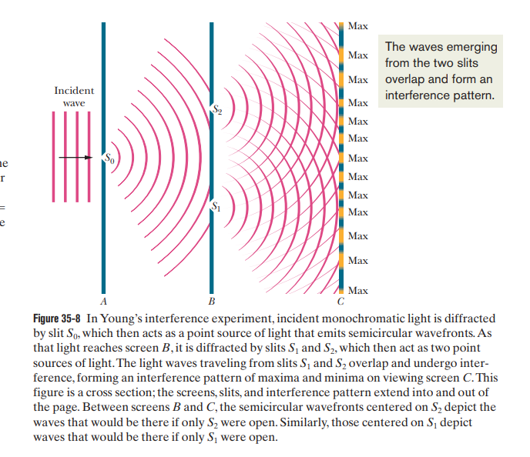

Slide 27
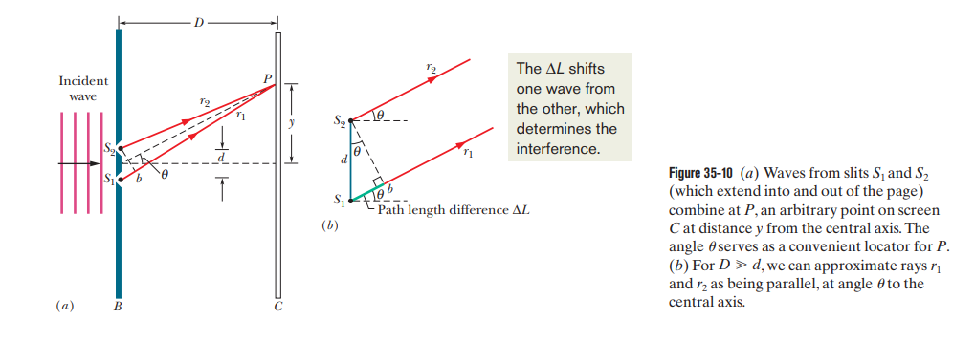
Please note that here D = r in the Demtroeder Book

Slide 28
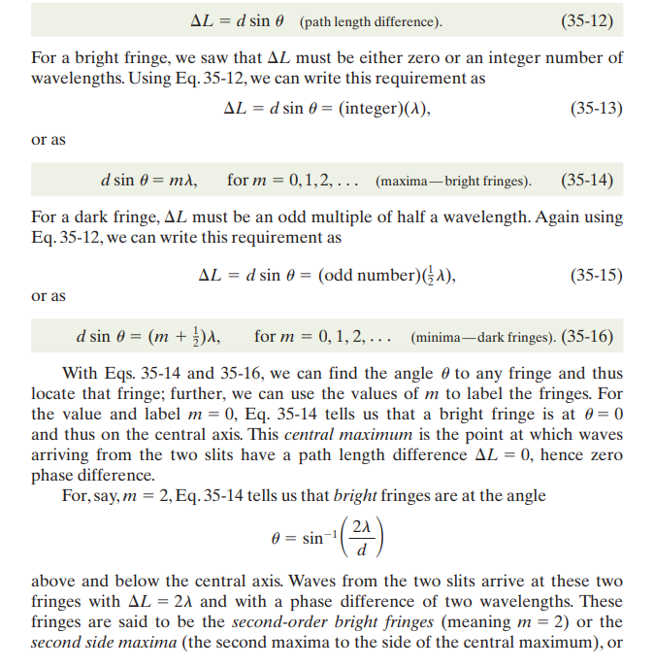

Slide 29
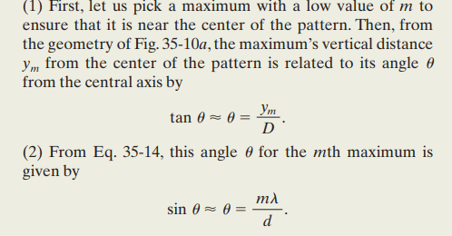
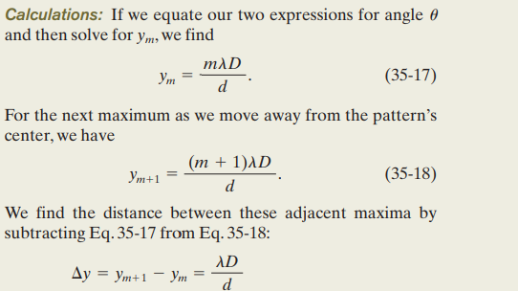

Slide 30
https://www.youtube.com/watch?v=TRZSp2UcROU

Slide 31
The intensity at the point of observation P in the plane B depends on the path
difference S₁P - S₂P and on the phase difference of the total field amplitudes in S₁ and S₂.
ΔS = S₁P - S₂P = n 𝜆 or Constructive Interference
ΔS = S₁P - S₂P = (n +1) 𝜆/2 Destructive interference
Largest 𝛥𝑠_{Q} occurs for extreme points 𝑅₁, 𝑅₂ at source edges.
Approximate geometry 𝑏 ≪ 𝑟 → 𝛥𝑠_{max} ≈ 𝑏 sin𝜃. (path difference between two rays ).
If 𝛥𝑠_{max} > 𝜆/2 → phase differences exceed 𝜋 → fringes then wash out.
r = Distance from the Slits to screen
𝜃 = Angle subtended by the slit separation '𝑑' at the source.
As sin𝜃≈𝜃 ≈ 𝑑/r for very small angle

Slide 33
Slide 12: Criterion for Spatial Coherence Between Two Apertures
Coherent illumination condition for S₁P = S₂P. The crucial condition for observing clear interference fringes is then: If this 𝛥𝑆max (Delta S sub max) is greater than lambda over (𝜆/2), then the phase differences introduced by different parts of the extended source exceed pi (𝜋) radians, and as a result, the fringes wash out.
𝜃
𝜆 2
𝑏 sin ( ) <
2
Using small-angle relation sin𝜃 = 𝑑/𝑟 :
𝑏 𝑑
< 𝜆/2
𝑟
ΔS = S₁P - S₂P = n 𝜆 or Constructive Interference (zero phase difference)
ΔS = S₁P - S₂P = (n +1) 𝜆/2 Destructive interference
Prepared by Dist. Prof. Dr. M.A. Gondal for Phys 608 Laser Spectroscopy course in KFUPM (Term 251)

Slide 34
Interpretation:
Larger source size 𝑏 or slit separation 𝑑 reduces spatial coherence.
Increasingplane.
distance 𝑟 increases coherence area at observation
Fig.2.32 showing path differences from central vs. edge source points.

Slide 35
Slide 13: Coherence Surface & Solid Angle Formulation
Define source area 𝐴_{s} = 𝑏².
Coherence surface area at observation plane 𝐴_{c} = 𝑑².
From previous inequality:
_{𝑏}2 _{𝑑}2
≤ 𝜆
2
_{𝑟}2
Recognize solid angle subtended by 𝐴_{c}:
Prepared by Dist. Prof. Dr. M.A. Gondal for Phys 608 Laser Spectroscopy course in KFUPM (Term 251)

Slide 36
_{𝑑}2
d𝛺 =
_{𝑟}2
Spatial coherence expressed compactly:
𝐴_{s} d𝛺 ≤
_{𝜆}2
Limiting coherent:
solid
angle
within
which radiation
remains
spatially
_{𝜆}2
d𝛺_{max} = _{𝐴}
s
Point source (𝐴_{s} → 0) ⇒ coherence over full 4𝜋 sr.

Slide 37
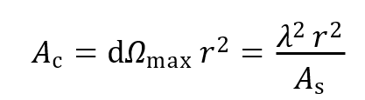
Slide 14: Distance Dependence – Astronomical Relevance
Coherence surface grows quadratically with distance:
Stars: despite large physical diameter, enormous 𝑟 makes 𝐴_{c} exceed telescope aperture.
Consequence: starlight is
spatially coherent across a telescope
mirror → allows stellar interferometry.
Prepared by Dist. Prof. Dr. M.A. Gondal for Phys 608 Laser Spectroscopy course in KFUPM (Term 251)

Slide 38
Slide 15: Putting Temporal & Spatial Together –
Coherence Volume
Combine
longitudinal coherence length
𝛥𝑠_{c}
with
transverse
coherence surface 𝑆_{c}.
Resulting coherence volume:
𝜆² 𝑟² 𝑐
𝑉_{c} = 𝑆_{c} 𝛥𝑠_{c} = _{𝛥𝜔 𝐴}
s
Prepared by Dist. Prof. Dr. M.A. Gondal for Phys 608 Laser Spectroscopy course in KFUPM (Term 251)

Slide 39
Slide 16: Photon Statistics Inside a Coherence Volume
Spectral radiance 𝐿_{𝜔} [W m⁻² sr⁻¹ rad⁻¹].
Number flux density of photons per Hz per sr from unit area:
𝐿_{𝜔} ℎ𝜈
Total photons in coherence volume:
𝐿_{𝜔}
𝑛 =
𝐴_{s} 𝛥𝛺 𝛥𝜔 𝛥𝑡_{c}
ℎ𝜈
Prepared by Dist. Prof. Dr. M.A. Gondal for Phys 608 Laser Spectroscopy course in KFUPM (Term 251)

Slide 40
• Substitute 𝛥𝛺 = 𝜆²/𝐴_{s} and 𝛥𝑡_{c} = 1/𝛥𝜔:
𝐿_{𝜔}
𝑛 = (
) 𝜆²
ℎ𝜈
Remarkably, 𝑛 independent of 𝛥𝜔 or 𝑟.
---
Prepared by Dist. Prof. Dr. M.A. Gondal for Phys 608 Laser Spectroscopy course in KFUPM (Term 251)

Slide 41
Slide 17: Degeneracy Parameter for Thermal Radiation
Planck spectral radiance (single polarization):
ℎ𝜈³
^{𝐿𝜈 =} exp(ℎ𝜈⁄𝑘𝑇) − 1
• Convert 𝐿_{𝜈} to 𝐿_{𝜔} via 𝐿_{𝜔} d𝜔 = 𝐿_{𝜈} d𝜈.
Insert into 𝑛(average no of photons):
1
𝑛 =
exp(ℎ𝜈⁄𝑘𝑇) − 1
Prepared by Dist. Prof. Dr. M.A. Gondal for Phys 608 Laser Spectroscopy course in KFUPM (Term 251)

Slide 42
Interpretation: mean photon number per electromagnetic mode (degeneracy parameter).
Low-frequency (Rayleigh-Jeans) limit → 𝑛 ≫ 1.
High-frequency (Wien) limit → 𝑛 ≪ 1.
---
Prepared by Dist. Prof. Dr. M.A. Gondal for Phys 608 Laser Spectroscopy course in KFUPM (Term 251)

Slide 43
Slide 18: Coherence Volume ↔ Elementary Phase-Space
Cell
Heisenberg uncertainty (3-D):
𝛥𝑝_{x} 𝛥𝑝_{y} 𝛥𝑝_{z} 𝛥𝑥 𝛥𝑦 𝛥𝑧 ≥
_{ℏ}3
For photons escaping an aperture of size 𝑏:
Position uncertainties 𝛥𝑥, 𝛥𝑦 ≈ 𝑏.
Prepared by Dist. Prof. Dr. M.A. Gondal for Phys 608 Laser Spectroscopy course in KFUPM (Term 251)

Slide 44
Diffraction-limited divergence 𝜃 ≈ 𝜆/𝑏 gives transverse momentum spread:
ℎ 𝜆 ℏ
^{𝛥𝑝𝑥 ≈} 𝜆 2𝜋𝑏 ⁼ 𝑏
Spectral width 𝛥𝜔 adds longitudinal momentum spread:
ℏ
𝛥𝑝_{z} = _{𝑐} 𝛥𝜔
Insert into uncertainty product → spatial cell volume reproduces 𝑉_{c}.
Prepared by Dist. Prof. Dr. M.A. Gondal for Phys 608 Laser Spectroscopy course in KFUPM (Term 251)

Slide 45
Conclusion:
coherence
volume
equals
one elementary
photon
phase-space cell.
Prepared by Dist. Prof. Dr. M.A. Gondal for Phys 608 Laser Spectroscopy course in KFUPM (Term 251)

Slide 46
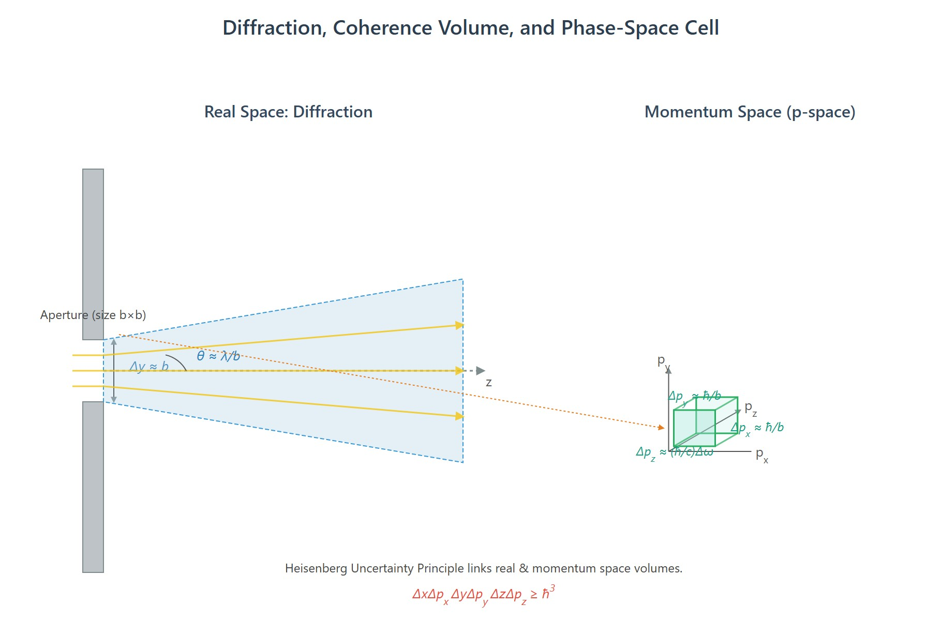
[IMAGE REQUIRED: Schematic showing aperture, diffraction cone, and 𝐩-space volume illustrating uncertainty relations.]
Prepared by Dist. Prof. Dr. M.A. Gondal for Phys 608 Laser Spectroscopy course in KFUPM (Term 251)

Slide 47
Slide 19: Mutual Coherence Function – Formal Definition
Complex electric field at position 𝐫 and time 𝑡:
𝐸(𝐫, 𝑡) = 𝐴₀ 𝑒 ^{𝑖(𝜔𝑡−𝐤⋅𝐫)} + 𝑐. 𝑐.
Two spatial points 𝑆₁, 𝑆₂; introduce time delay 𝜏.
Mutual coherence function (first-order correlation):
𝛤₁₂(𝜏) = ⟨𝐸₁(𝑡 + 𝜏) 𝐸₂ (𝑡)⟩
Angle brackets denote temporal average over interval ≫ 𝛥𝑡_{c}.
∗
Encodes simultaneous spatial and temporal correlations.

Slide 48
Slide 20: Normalized Degree of Coherence
Self-coherence functions at each aperture:
𝛤₁₁(0) = ⟨|𝐸₁(𝑡)|²⟩, 𝛤₂₂(0) = ⟨|𝐸₂(𝑡)|²⟩
Define normalized complex degree of coherence:
𝛤₁₂(𝜏)
𝛾₁₂(𝜏) =
√𝛤₁₁(0) 𝛤₂₂(0)
Properties:

Slide 49
|𝛾₁₂| ≤ 1 by Cauchy-Schwarz inequality.
|𝛾₁₂| = 1 → perfect coherence.
|𝛾₁₂| = 0 → complete incoherence.
Phase of 𝛾₁₂ equals average phase difference between fields.
---

Slide 50
Slide 21: Irradiance at Observation Point – Interference
Law
Superposed field at 𝑃:
𝐸(𝑃, 𝑡) = 𝑘₁ 𝐸₁(𝑡 − 𝑟₁⁄𝑐) + 𝑘₂ 𝐸₂(𝑡 − 𝑟₂⁄𝑐)
𝑘₁, 𝑘₂ – complex transfer factors (include slit area & propagation, units dimensionless).
Time-averaged irradiance:

Slide 51
𝐼_{P} = 𝜖₀𝑐 ⟨|𝐸(𝑃, 𝑡)|²⟩ = 𝐼₁ + 𝐼₂ + 2√𝐼₁𝐼₂ Re[𝛾₁₂(𝜏)]
Master interference formula for partially coherent light.
Visibility when 𝐼₁ = 𝐼₂:
𝑉 = |𝛾₁₂(𝜏)|
Thus fringe contrast directly measures magnitude of degree of coherence.
---

Slide 52
Slide 22: Example – Michelson Interferometer Revisited
Equal amplitudes in both arms: 𝐸 = 𝐸₀𝑒^{𝑖𝜙(𝑡)}.
Degree of temporal coherence:
_{𝛾11(𝜏) = ⟨𝑒} 𝑖[𝜙(𝑡+𝜏)−𝜙(𝑡)]⟩
If source is strictly monochromatic:
𝜙(𝑡) = 𝜔𝑡
⇒ 𝛾₁₁(𝜏) = 𝑒 ^{𝑖𝜔𝜏}, |𝛾₁₁| = 1
Visibility independent of 𝜏.

Slide 53
Broadband source with 𝜏 ≫ 1/𝛥𝜔: phases randomize → 𝛾₁₁ → 0.

Slide 54
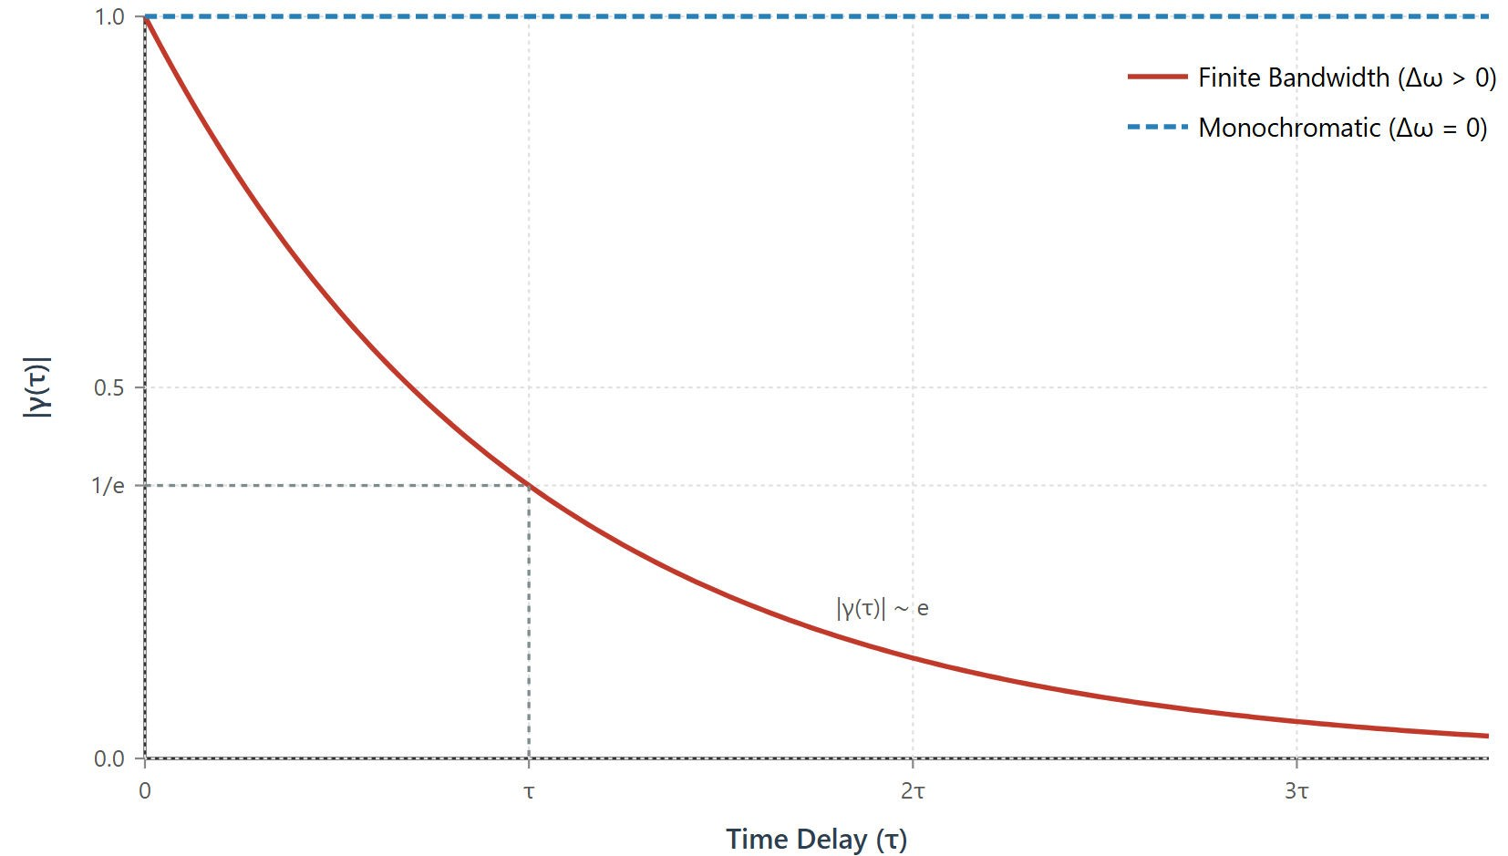
[IMAGE REQUIRED: Plot of |𝛾₁₁(𝜏)| vs. 𝜏 showing exponential-like decay for finite bandwidth.]
by Dist. Prof. Dr. M.A. Gondal for Phys 608 Laser Spectroscopy course in KFUPM (Term 251)
Prepared

Slide 55
Slide 23: Example – Young’s Double-Slit Spatial
Coherence
Plane quasi-monochromatic wave:
_{𝐸 = 𝐸0𝑒} 𝑖(𝜔𝑡−𝑘⋅𝑟)
Optical path difference 𝛥𝑟 = 𝑟₂ − 𝑟₁ induces phase:
𝜙₁₂ = 𝑘 𝛥𝑟
Irradiance pattern:
Prepared by Dist. Prof. Dr. M.A. Gondal for Phys 608 Laser Spectroscopy course in KFUPM (Term 251)

Slide 56
𝐼_{P} = 2 𝐼₀[1 + |𝛾₁₂(0)|cos(𝑘 𝛥𝑟)]
If |𝛾₁₂(0)| = 1 → high-contrast fringes.
Increasing slit separation 𝑑 reduces |𝛾₁₂(0)| according to spatial coherence criterion.
Prepared by Dist. Prof. Dr. M.A. Gondal for Phys 608 Laser Spectroscopy course in KFUPM (Term 251)

Slide 57
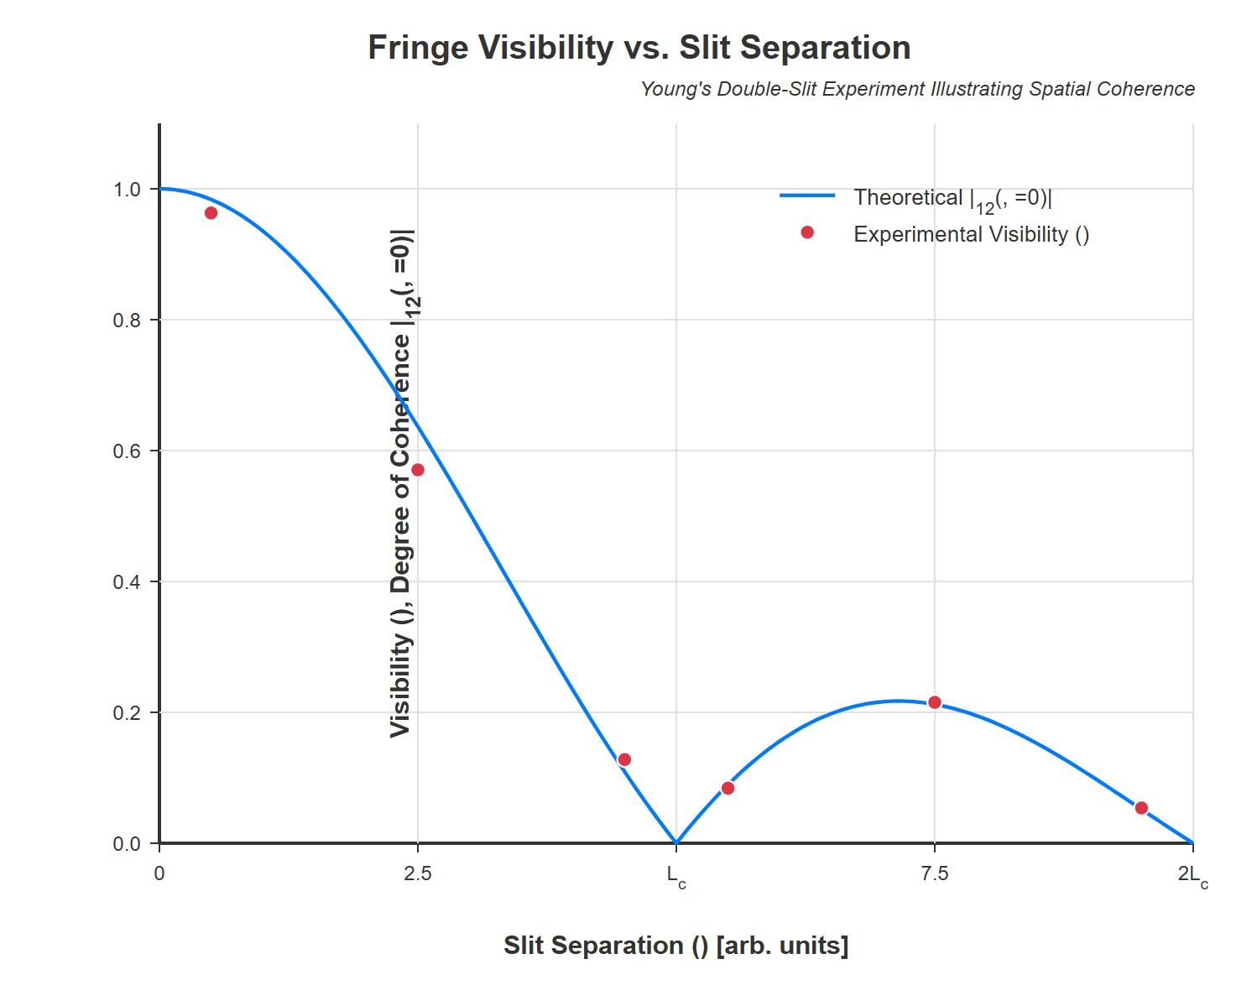
[IMAGE REQUIRED: Experimental visibility curve vs. slit separation overlayed with theoretical |𝛾₁₂|.]
Prepared by Dist. Prof. Dr. M.A. Gondal for Phys 608 Laser Spectroscopy course in KFUP
M (Term 251)

Slide 58
Slide 24: Measuring 𝜸_{𝟏𝟐} Experimentally
Record three intensities at point 𝑃:
𝐼 – both apertures open.
𝐼₁ – only 𝑆₁ open.
𝐼₂ – only 𝑆₂ open.
Compute real part of degree of coherence:
Prepared by Dist. Prof. Dr. M.A. Gondal for Phys 608 Laser Spectroscopy course in KFUPM (Term 251)

Slide 59
𝐼 − 𝐼₁ − 𝐼₂
Re 𝛾₁₂(𝜏) =
2√𝐼₁𝐼₂
When 𝐼₁ = 𝐼₂, visibility simplifies to
^{𝐼}max ^{− 𝐼}min
𝑉 =
= |𝛾₁₂|
^{𝐼}max ^{+ 𝐼}min
Full
complex
^{𝛾}12
recoverable
via additional
phase-shifting
techniques.
---
Prepared by Dist. Prof. Dr. M.A. Gondal for Phys 608 Laser Spectroscopy course in KFUPM (Term 251)

Slide 60
Slide 25: Practical Consequences for Laser Spectroscopy
High temporal coherence of single-mode lasers enables:
Precise heterodyne frequency measurements.
High-resolution Doppler-free spectroscopy (2-photon, saturation).
High spatial coherence enables:
Tight focusing to diffraction-limited spots.
Prepared by Dist. Prof. Dr. M.A. Gondal for Phys 608 Laser Spectroscopy course in KFUPM (Term 251)

Slide 61
Long-baseline interferometry & holography.
Understanding coherence boundaries critical when mixing laser light with incoherent backgrounds or when designing interferometers with finite arm differences.
Prepared by Dist. Prof. Dr. M.A. Gondal for Phys 608 Laser Spectroscopy course in KFUPM (Term 251)

Slide 62
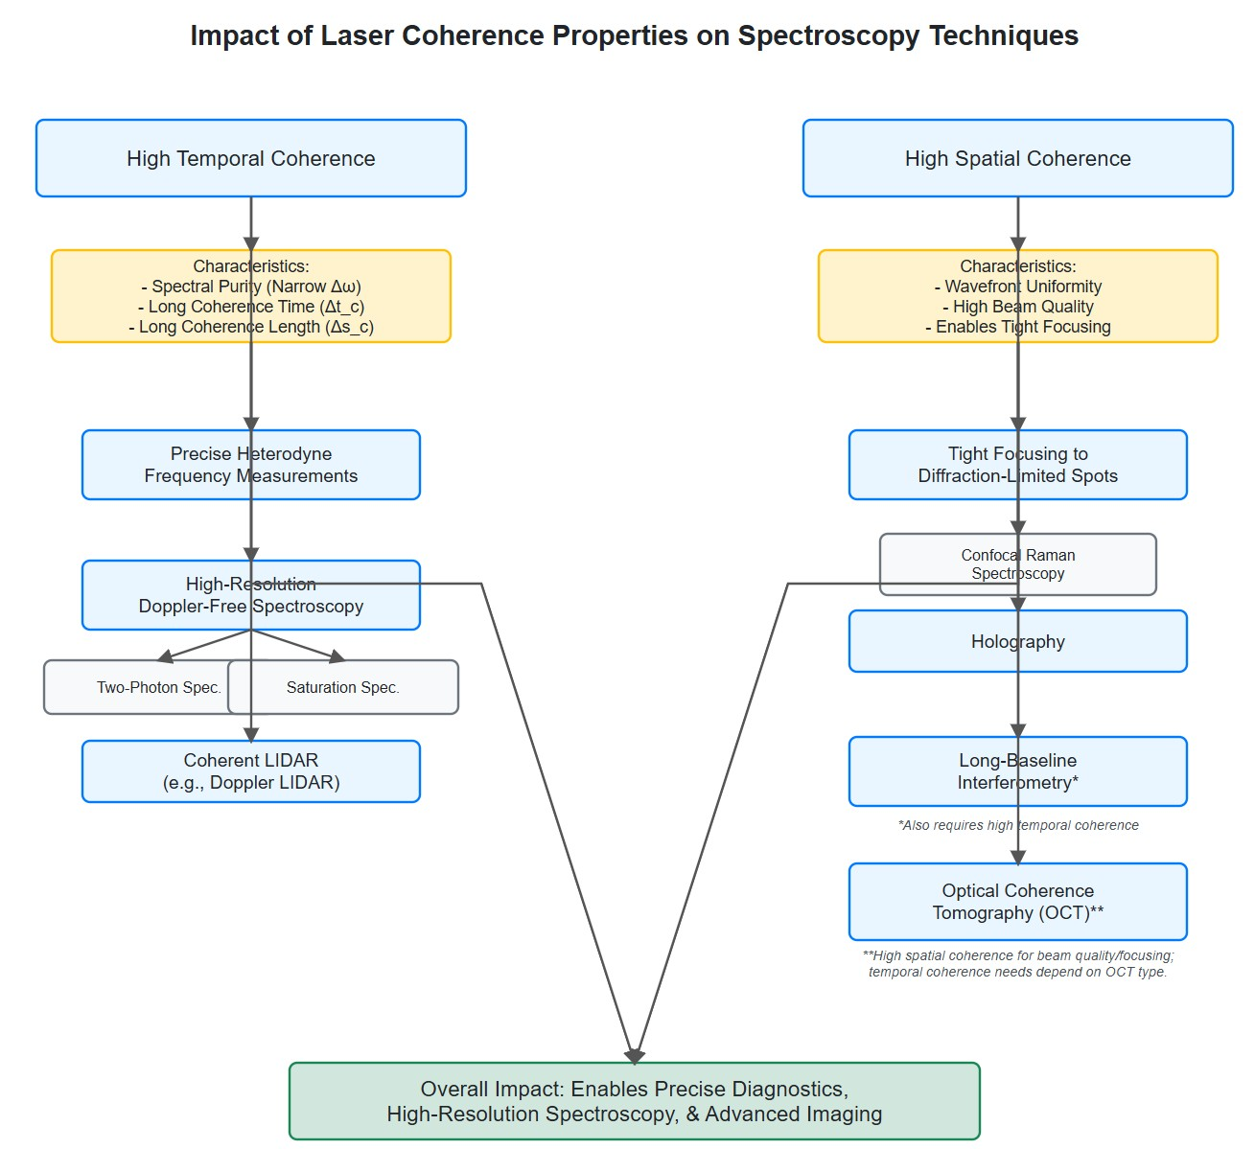
[IMAGE REQUIRED: Flowchart linking coherence properties to specific laser spectroscopy techniques (e.g., Raman, LIDAR, OCT).]
Prepared by Dist. Prof. Dr. M.A. Gondal for Phys 608 Laser Spectroscopy course i
n KFUPM (Term 251)

Slide 63
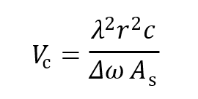
Slide 26: Summary & Key Formulae to Remember from today’s lecture
Temporal coherence length
𝑐
𝛥𝑠_{c} = _{𝛥𝜔}
Spatial coherence condition between two points on wavefront
𝐴_{s} d𝛺 ≤ 𝜆²
Coherence volume
Prepared by Dist. Prof. Dr. M.A. Gondal for Phys 608 Laser Spectroscopy course in KFUPM (Term 251)

Slide 64
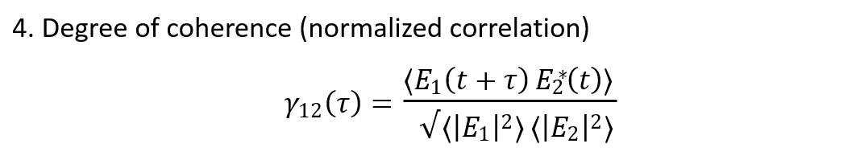
5. Fringe visibility ↔ |𝛾₁₂| for equal intensities.
Master these relations to analyze and design any optical interference experiment in laser spectroscopy
Prepared by Dist. Prof. Dr. M.A. Gondal for Phys 608 Laser Spectroscopy course in KFUPM (Term 251)

Slide 65
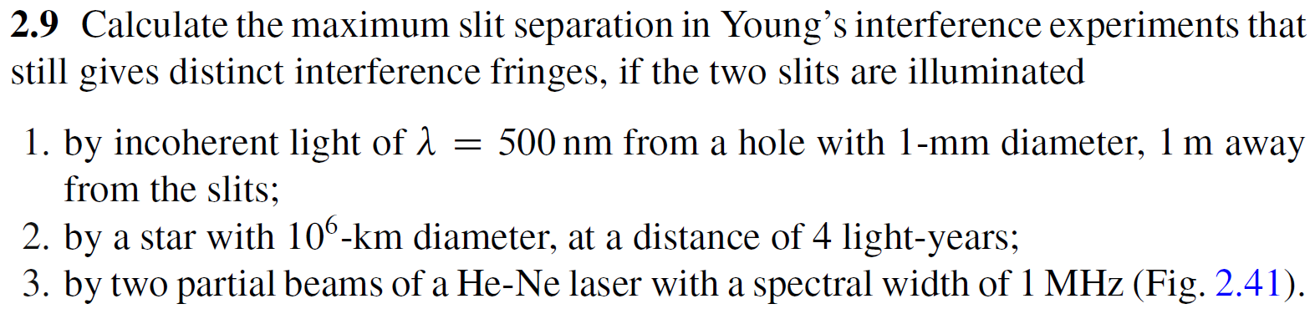
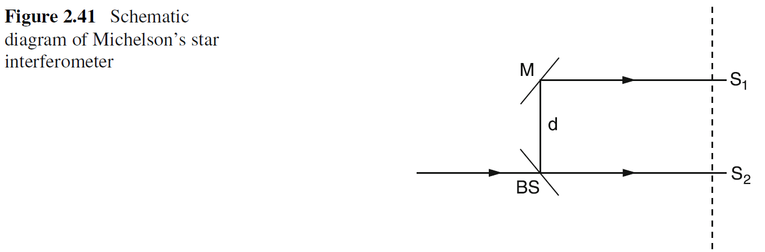
Chap. 2 Problems & Solutions

Slide 66
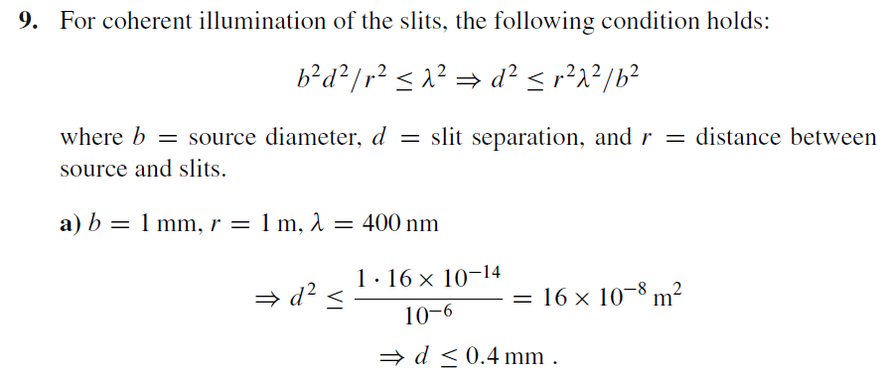
Chap. 2 Problems & Solutions

Slide 67
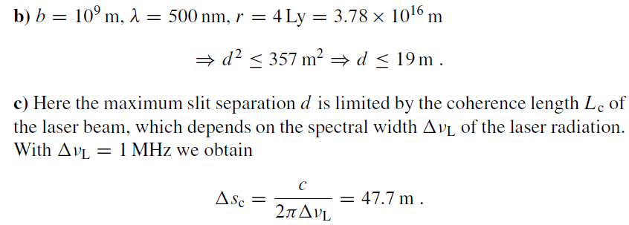
Chap. 2.9 Problems & Solutions

