Slide 1
Chap. 2.8 Transition Probabilities

Slide 2
Slide 1: Transition Probabilities – Why They Matter
Spectral-line intensity 𝐼_{line} depends on two independent factors.
  Population density of the initial (emitting or absorbing) quantum level, conventionally denoted 𝑁_{i} or 𝑁_{k}.
  The transition probability corresponding molecular transitions.
Knowing transition probabilities allows one to reverse-engineer physical conditions from measured spectra.

Slide 3
Application 1:
Transition probability data is important to determine element concentrations in atmospheres or interstellar clouds.
Application 2: To determine temperature 𝑇 of a remote plasma by comparing populations of two excited levels and using transition probability.
In astrophysics the electromagnetic spectrum is often the only information channel. Accurate transition data transform mere light into quantitative diagnostics of chemical composition, density, and thermal balance.

Slide 4
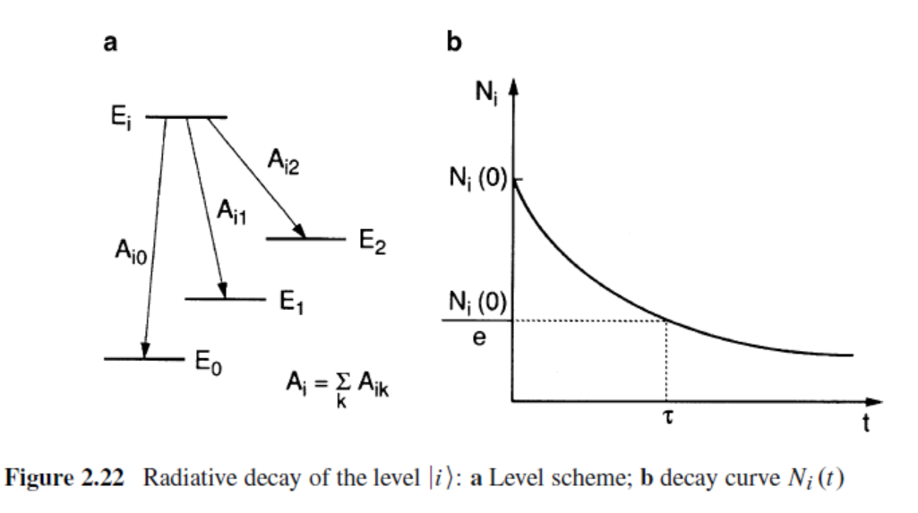
Transition probabilities are also exquisitely sensitive probes of theoretical wavefunctions. Small inaccuracies in the calculated charge distribution of a molecule produce large errors in predicted line strengths, enabling rigorous tests of quantum-chemical models.

Slide 5
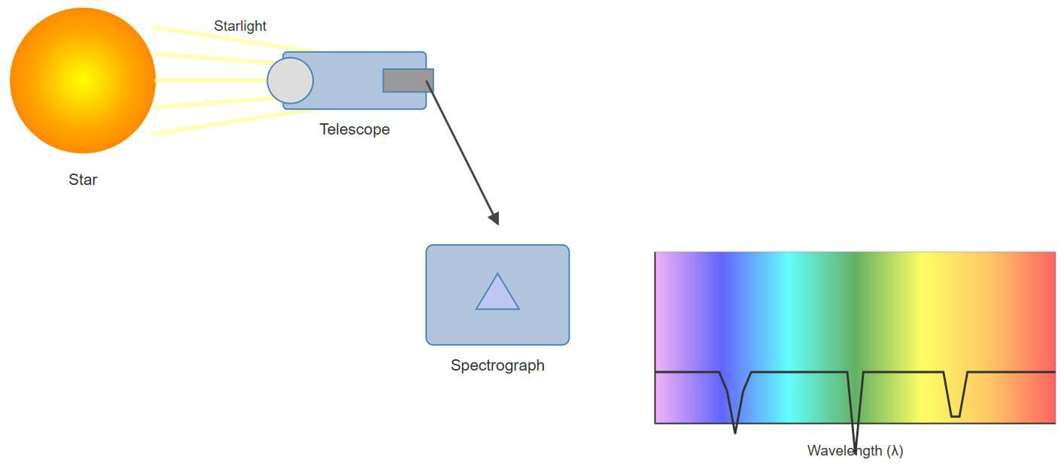
[IMAGE REQUIRED: Illustration showing a star, its emitted spectrum,
and arrows indicating extraction of element abundance and temperature from line intensities. Include labels for population density
𝑁_{i}, transition probability 𝐴_{𝑖𝑘}, telescope, spectrograph.]
---
Prepared by Dist. Prof. Dr. M.A. Gondal for Phys 608 Laser Spectroscopy course in KFUPM (Term 251)

Slide 6
Slide 2: From Populations to Temperature – The
Boltzmann Connection
Consider two different excited levels 𝐸_{i} and 𝐸_{e} that both decay to a common lower level 𝐸_{k}.
Measure intensities 𝐼_{𝑖𝑘} and 𝐼_{𝑒𝑘} of the two spectral lines 𝐸_{i} → 𝐸_{k} and
𝐸_{e} → 𝐸_{k}.
Provided the transition probabilities line-intensity ratio yields
Aik and𝐴_{𝑒𝑘}
are known, the

Slide 7
^{𝐼}𝑖𝑘 ₌ ^{𝑁}i ^{ℎ𝜈}𝑖𝑘 ^{𝐴}𝑖𝑘 .
^{𝐼}𝑒𝑘 ^{𝑁}e ^{ℎ𝜈}𝑒𝑘 ^{𝐴}𝑒𝑘
equilibrium the level
Under
thermal
populations
obey the
Boltzmann law
^{𝑁i} = ^{𝑔i} exp [− ^{𝐸i − 𝐸e}],
𝑁_{e} 𝑔_{e} 𝑘_{B}𝑇
where
𝑔_{i}, 𝑔_{e} statistical weights (degeneracies).

Slide 8
𝑘_{B} Boltzmann constant.
Combining both equations isolates 𝑇. No reliable 𝐴-values → no
accurate astrophysical thermometer.

Slide 9
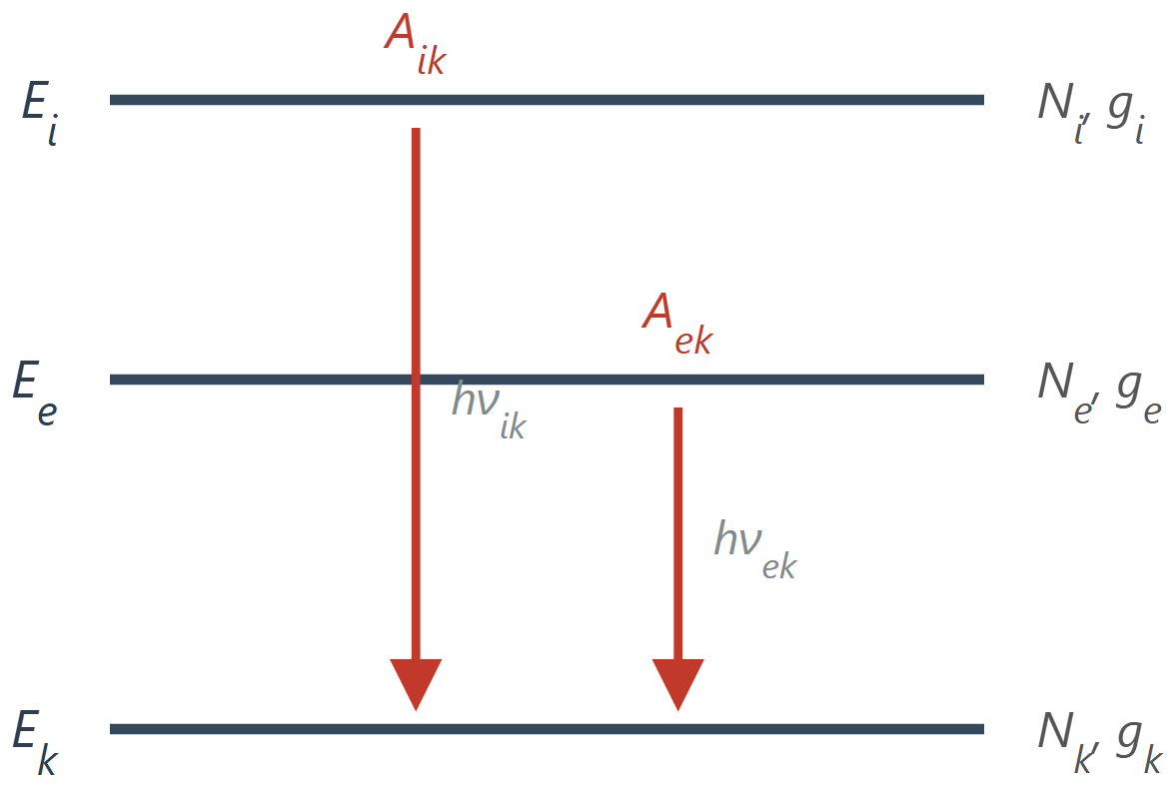
[IMAGE REQUIRED: Energy-level diagram with two upper levels 𝐸_{i}, 𝐸_{e} and common lower level 𝐸_{k}; arrows labelled with 𝐴_{𝑖𝑘} , 𝐴_{𝑒𝑘}.]
Prof. Dr. M.A. Gondal for Phys 608 Laser Spectroscopy course in KFUPM (Term 251)
Prepared by Dist.

Slide 10
Slide 3: Definitions – Einstein Coefficients Refresher For Probibilities
For a pair of stationary states |i⟩ (upper) and |k⟩ (lower) we define
Spontaneous emission coefficient 𝐴_{𝑖𝑘} – probability per unit time that an isolated excited particle in |i⟩ emits a photon and drops to |k⟩.
Stimulated (induced) emission coefficient 𝐵_{𝑖𝑘} – probability per unit time and per spectral energy density 𝜌(𝜈) that a photon causes the same downward transition.

Slide 11
Absorption coefficient 𝐵_{𝑘𝑖} – probability per unit time and per 𝜌(𝜈)
that a photon elevates the system from |k⟩ to |i⟩.
  Einstein showed that thermodynamic equilibrium of matter and radiation enforces precise algebraic relations between 𝐴 and 𝐵 coefficients as well as the Planck black-body spectrum (our lecture 1) .
Our
goal in this lecture is: to relate
^{𝐴}𝑖𝑘^{, 𝐵}𝑖𝑘^{, 𝐵}𝑘𝑖
to
calculable/measureable quantities such as dipole matrix elements
𝐷_{𝑖𝑘} .

Slide 12
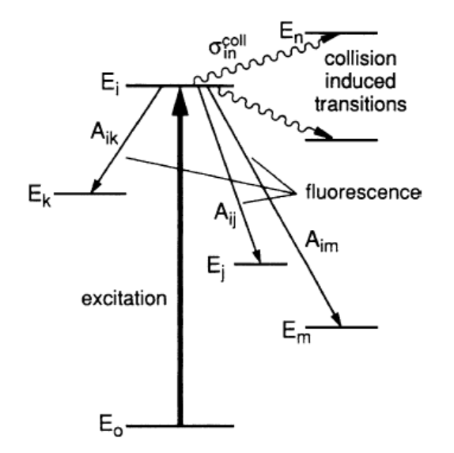
Slide 4: Spontaneous Emission – Population Decay Law
If multiple* lower levels |k⟩ are reachable, each with its own 𝐴_{𝑖𝑘}, define
𝐴_{i} = ∑𝐴_{𝑖𝑘 for all lower states}
Population 𝑁_{i}(𝑡) in level |i⟩ obeys the differential equation
𝑑𝑁
i
= −𝐴 𝑁 . called population decay law
𝑑𝑡
i i

Slide 13
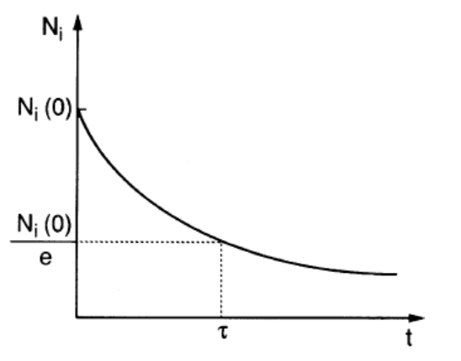
Solution (pure exponential decay)
𝑁_{i}(𝑡) = 𝑁_{𝑖0} exp(−𝐴_{i}𝑡).
Mean spontaneous lifetime
1
𝜏_{i} = _{𝐴} .
i
Physical interpretation: after one lifetime, population drops to 1/𝑒
of its initial value.

Slide 14
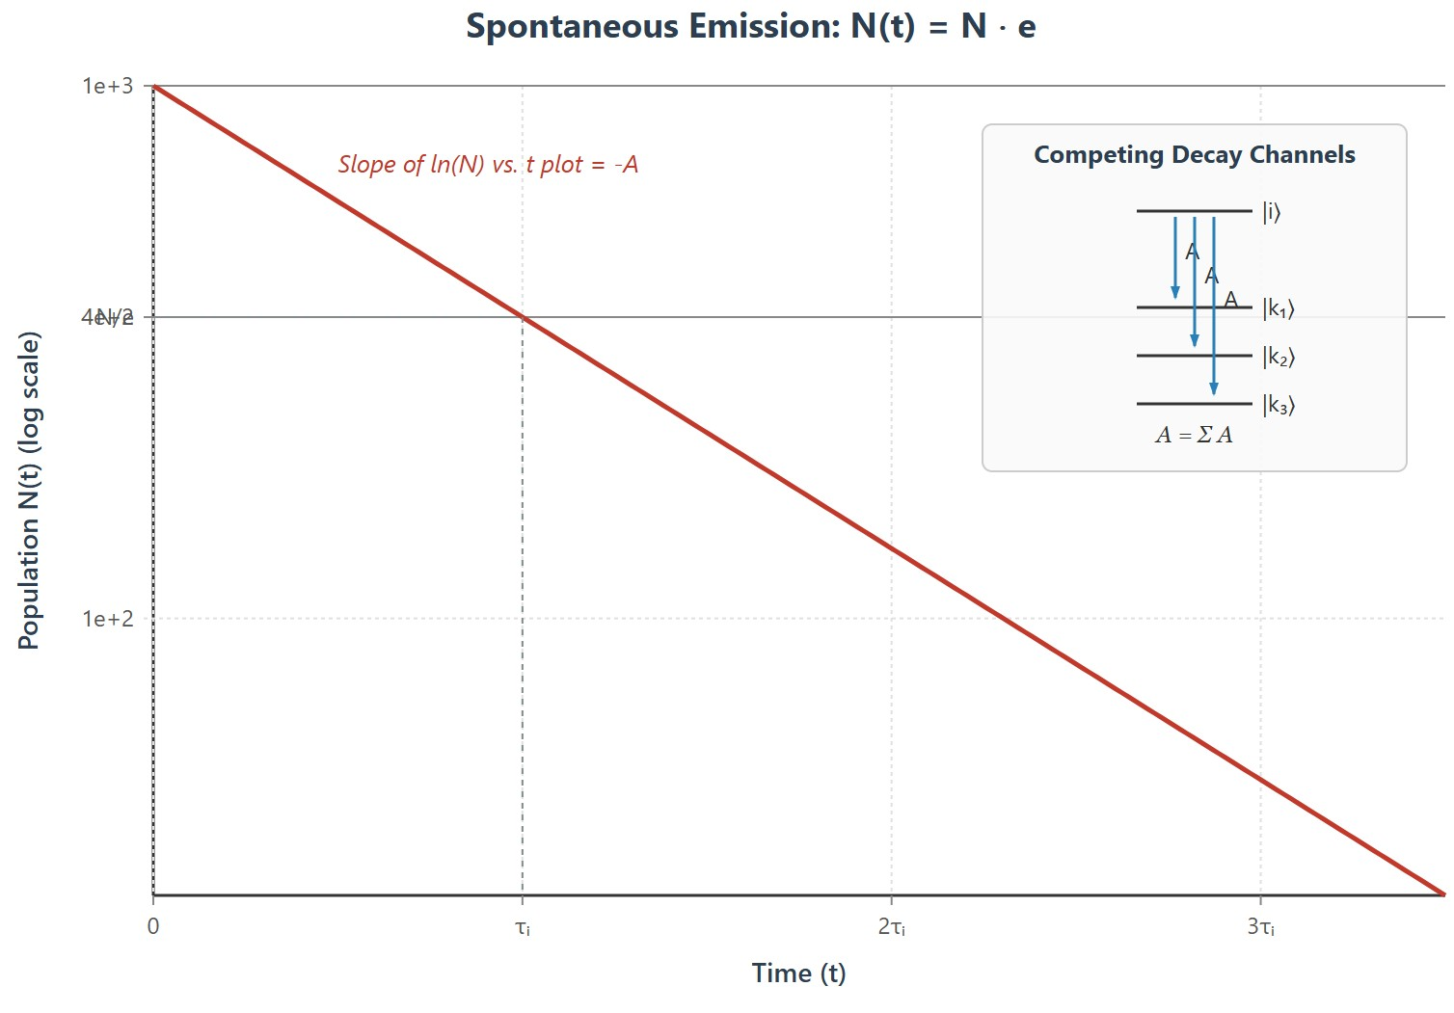
[IMAGE REQUIRED: Semi-log plot of 𝑁_{i}(𝑡) vs. 𝑡 with slope −𝐴_{i}; inset list of competing downward channels.]
--
repared by Dist. Prof. Dr. M.A. Gondal for Phys 608 Laser Spectroscopy course in KFUPM (Term 251)
-
P

Slide 15
Slide 5: Radiant Power of a Spectral Line
For a specific channel |i⟩ →|k⟩:
𝑃_{𝑖𝑘}
= 𝑁_{i}(𝑡) ℎ𝜈_{𝑖𝑘} 𝐴_{𝑖𝑘}.
Symbols and units:
• 𝑃_{𝑖𝑘} – power [W].
ℎ𝜈_{𝑖𝑘} – photon energy [J].
• 𝐴_{𝑖𝑘} – s⁻¹₌ (1/decay time)= A_{ik} is transition probability for i to k state transition .

Slide 16
Line intensity observed along a given direction may further depend on the angular* distribution of emitted photons (dipole pattern,
polarization).
Experimentally, measuring 𝑃_{𝑖𝑘} (𝑡) provides a direct route to 𝐴_{𝑖𝑘} independently known or controllable.
---
if 𝑁_{i}(𝑡) is

Slide 17
Slide 6: Beyond Spontaneous Emission – Additional Decay
Channels
Collision-induced (radiationless) transitions:
Molecule 𝐴(𝐸_{i}) collides with molecule 𝐵.
Transition probability Pi collision per unit time
coll
𝑑𝑃_{𝑖𝑘}
= 𝑣 𝑁 𝜎^{coll},
𝑑𝑡
B
𝑖𝑘
Where 𝑣= relative speed between molecule and B

Slide 18
𝑁_{B} density of 𝐵 molecule[m⁻³].
𝑣 mean relative speed [m s⁻¹].
𝜎_{𝑖𝑘} inelastic cross-section [m ].
Stimulated emission in intense radiation field 𝜌(𝜈_{𝑖𝑘}):
ind
coll 2
𝑑𝑃_{𝑖𝑘}
= 𝜌(𝜈
) 𝐵
.
𝑑𝑡
𝑖𝑘
𝑖𝑘
Effective lifetime including all* channels (spontaneous, induced, collisions)

Slide 19
coll
1
eff ⁼
∑ 𝐴_{𝑖𝑘} + 𝜌(𝜈_{𝑖𝑘}) 𝐵_{𝑖𝑘} + 𝑣 𝑁_{B} 𝜎_{𝑖𝑘} .
𝜏_{i}
⏟
induced
⏟
collisional
𝑘
⏟
spontaneous
Varying 𝜌 or 𝑁_{B}
contributions.
in a Stern–Vollmer plot separates the individual

Slide 20
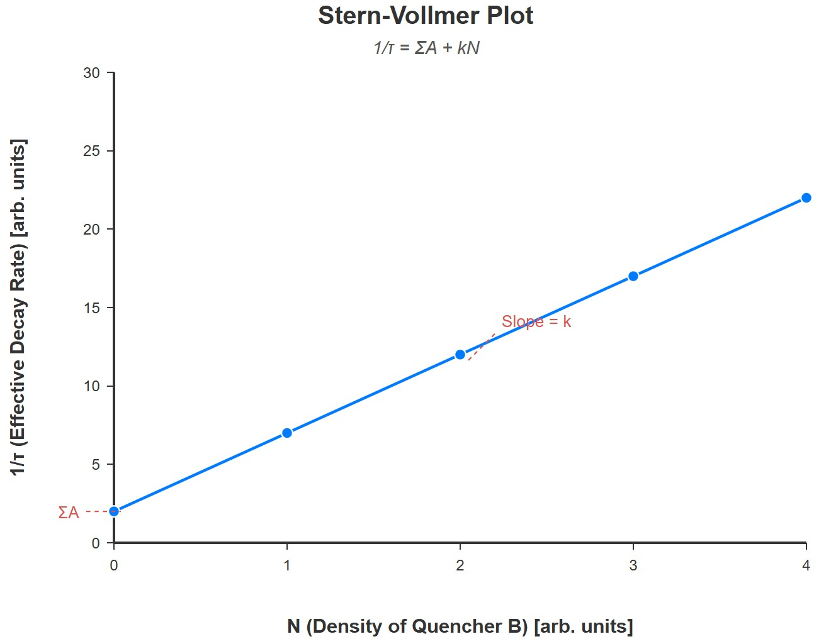
eff
[IMAGE REQUIRED: Stern–Vollmer graph 1/𝜏_{i} vs. 𝑁_{B} exhibiting linear relationship; intercept gives 𝐴_{i}.]
Prepared by Dist. Prof. Dr. M.A. Gondal for Phys 608 Laser Spectroscopy course in KFUPM (T
erm 251)

Slide 21
Slide 7: Two-Level Atom in a Classical Light Field – Basic
Idea
We model the radiation* as a classical plane wave (valid whenever photon statistics are not essential):
𝐄(𝑡) = 𝐸₀cos(𝜔𝑡 − 𝑘𝑧)
The atom* remains fully quantum mechanical with Hamiltonian H_{0.}
unperturbed

Slide 22
We restrict our attention to just two stationary eigenstates
Lower level |a⟩ with energy 𝐸_{a}.
Upper level |b⟩ with energy 𝐸_{b}.
Condition for dipole (long-wavelength) approximation:
Atomic size 𝑑 ≈ 0.1 nm.
Optical wavelength 𝜆 ≈ 500 nm → 𝜆 ≫ 𝑑. As k= 2∏/ 𝜆 ,
kd= (2∏/ 𝜆 )d =0.1/500 is very small
Hence
phase factor k𝑧 ≈ 0 inside atom → spatial
variation
of E field is neglected.

Slide 23
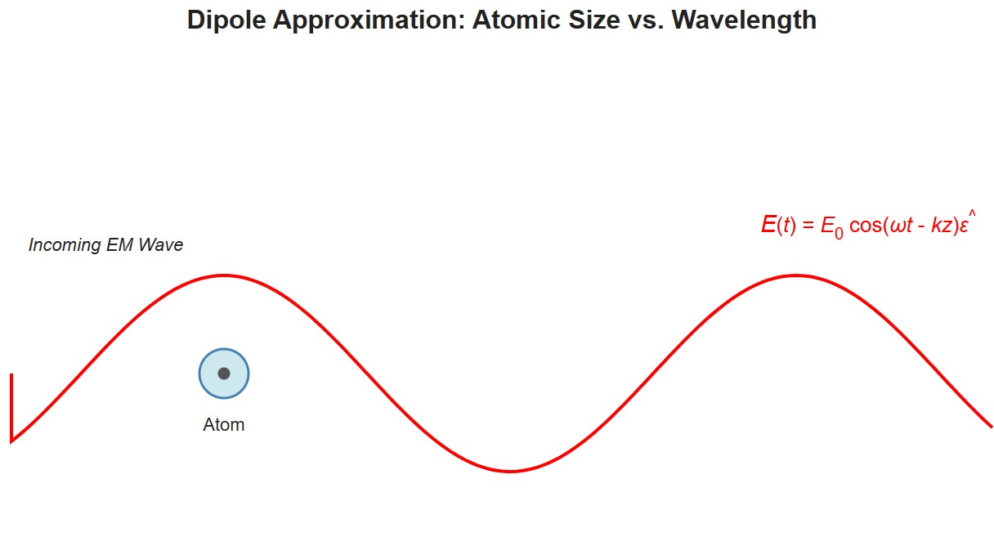
[IMAGE REQUIRED: Sketch comparing atomic dimension 𝑑 to wavelength 𝜆; caption “dipole approximation regime”.]
---
Prepared by Dist. Prof. Dr. M.A. Gondal for Phys 608 Laser Spectroscopy course in KFUPM (Term 251)

Slide 24
Slide 8: Interaction Hamiltonian and Dipole Operator
Total Hamiltonian
of the atom interacting with the light field can be written as a sum of the unperturbed
Hamiltonian H0 of the free atom without the light field plus the perturbation Absorption and Emission of Light operator V, which describes the interaction of the atom with the E field and which reduces in the dipole approximation to
H = H₀ + V(t)
V(t) is also called Perturbation Hamiltonian
Within dipole approximation
V̂ (𝑡) = −𝑒 𝐫 ⋅ 𝐄(𝑡) = −𝑒 𝐫 ⋅ 𝐸₀cos(𝜔𝑡) 𝜖̂.
Let us Introduce dipole moment operator
𝐩̂ = −𝑒 𝐫.

Slide 25

For presentation purposes, rewrite cosine via complex exponentials
Physical picture: atom experiences an oscillating electric force* capable of driving transitions if frequency is near the resonance.
---

Slide 26
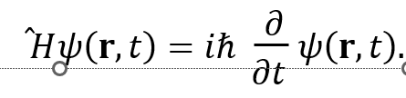
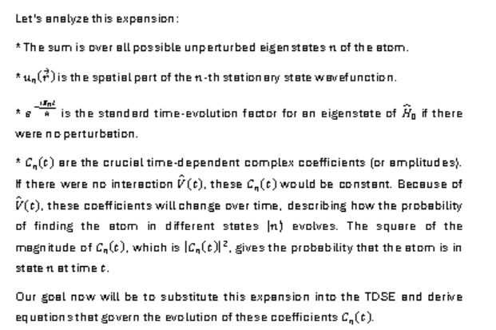
Slide 9: Time-Dependent Schrödinger Equation
State Expansion to understand quantum state of two level interaction with classical light field
We Solve Schrödinger Equation
We Express 𝜓 as superposition of unperturbed eigenstates |n⟩:
𝜓(𝐫, 𝑡) = ∑ 𝐶_{n} (𝑡) 𝑢_{n}(𝐫) 𝑒^{−𝑖𝐸n𝑡/ℏ}.
𝑛

Slide 27
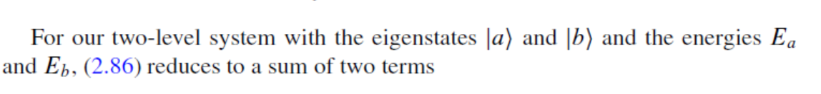
𝜓(𝐫, 𝑡) = 𝑎(𝑡)𝑢_{a}𝑒^{−𝑖𝐸a𝑡/ℏ} + 𝑏(𝑡)𝑢_{b}𝑒^{−𝑖𝐸b𝑡/ℏ}.
Probabilistic meaning
  |𝑎(𝑡)|² – gives probability of atom to find in eigen state |a⟩.
  |𝑏(𝑡)|² – gives probability atom to find in eigenstate |b⟩.
  Normalization: |𝑎|² + |𝑏|² = 1 (if no decay to other states).
The coefficients a(t) and b(t) are the time-dependent probability amplitudes of the
atomic states u_{a} and u_{b}.

Slide 28
Slide 10: Deriving Coupled Amplitude Equations – Full
Algebra to know how state amplitudes a(t) and b(t) evolve
Insert two-level expansion into Schrödinger equation and project onto each state.
Define energy splitting (angular frequency units)
𝜔_{𝑎𝑏}
𝐸_{a} − 𝐸_{b}
=
= −𝜔_{𝑏𝑎}.
ℏ
Introduce dipole matrix element*

Slide 29
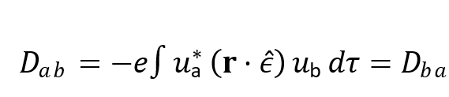

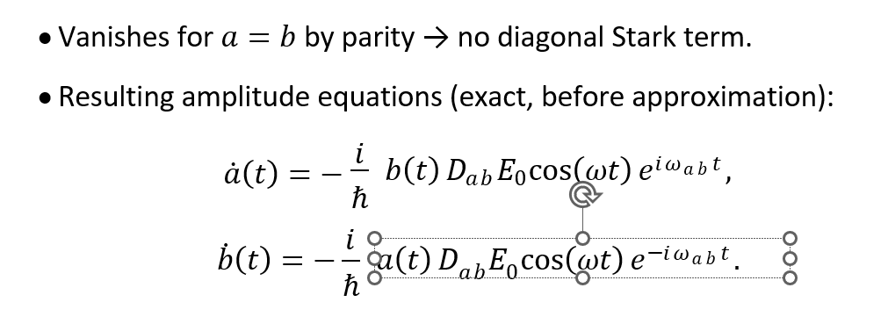
is called the atomic dipole matrix element. It depends on the stationary wave functions
u_{a} and u_{b} of the two states and is determined by the charge
distribution in these states.
∗
𝑖 ℏ
𝑎̇ (𝑡) = −
𝑏(𝑡) 𝐷_{𝑎𝑏}𝐸₀cos(𝜔𝑡) 𝑒^{𝑖𝜔𝑎𝑏𝑡} ,
𝑏̇ (𝑡) = − ^{𝑖}
𝑎(𝑡) 𝐷 𝐸 cos(𝜔𝑡) 𝑒^{−𝑖𝜔𝑎𝑏𝑡} .
ℏ
𝑎𝑏 0
directly from our oscillating electric field. * The exponential terms, exp(𝑖𝜔𝑎𝑏𝑡) and exp(−𝑖𝜔𝑎𝑏𝑡), involve our previously defined atomic transition frequency

Slide 30
Mathematics encodes physically intelligible statement: amplitude of one level a changes proportional to amplitude of the other level b, field strength, and phase mismatch.
---

Slide 31

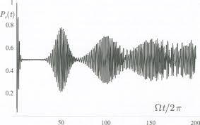
Define Rabi frequency 𝛺_{𝑎𝑏} (strength of coherent coupling)
.
Pls note that: Rabi frequency depends on the applied field amplitude E0
Simplified above amplitude equations in terms of Rabi frequency using RWA
(Rotating Wave Approximation (RWA) as explained next slide
𝑖 2
𝑎̇ (𝑡) = −
𝛺_{𝑎𝑏} 𝑒^{𝑖𝛥𝜔 𝑡} 𝑏(𝑡),
_{𝑒}−𝑖𝛥𝜔 𝑡 _{𝑎(𝑡),}
𝑏̇ (𝑡) = − ^{𝑖} 𝛺
𝑎𝑏
2
where detuning 𝛥𝜔 = 𝜔 − 𝜔_{𝑎𝑏}.
Rabi frequenc

Slide 32
RWA
is exceptionally
accurate
when |𝛥𝜔|, 𝛺_{𝑎𝑏} ≪ 𝜔_{𝑎𝑏}
(optical
domain).
Here's how RWA relates to Rabi frequency:
Rabi oscillations are the periodic oscillations of the atomic population inversion in a two-level system driven by a classical field, especially when the field is resonant or near-resonant with the system's transition frequency.
The Rabi frequency represents the frequency of these oscillations. It signifies the rate at which population transfers between the two energy levels of the quantum system when subjected to an oscillating electromagnetic field .
The Rotating Wave Approximation (RWA) is a common approximation used to simplify the description of the interaction between a quantum system and an oscillating field.
In the RWA, terms that oscillate rapidly are neglected in the system's Hamiltonian. This simplification makes it easier to solve the equations describing the system's dynamics, and it provides a straightforward way to derive the Rabi frequency and analyze Rabi oscillations, especially when the driving field is weak and near resonance.
In summary: The RWA is a crucial approximation in the study of light-matter interactions that helps to simplify the equations describing Rabi oscillations, allowing for the calculation and understanding of the Rabi frequency.

Slide 33
Slide 11: Rotating-Wave Approximation (RWA) and Rabi
Frequency
Write cosine as sum of co-rotating and counter-rotating* exponentials.
Terms 𝑒^{𝑖(𝜔−𝜔𝑎𝑏)𝑡} vary slowly* near resonance.
Terms 𝑒^{𝑖(𝜔+𝜔𝑎𝑏)𝑡} oscillate very* fast → average to zero over relevant
timescales.
Neglecting fast counter-rotating terms of higher frequency like double harmonics etc. is called RWA approximation

Slide 34
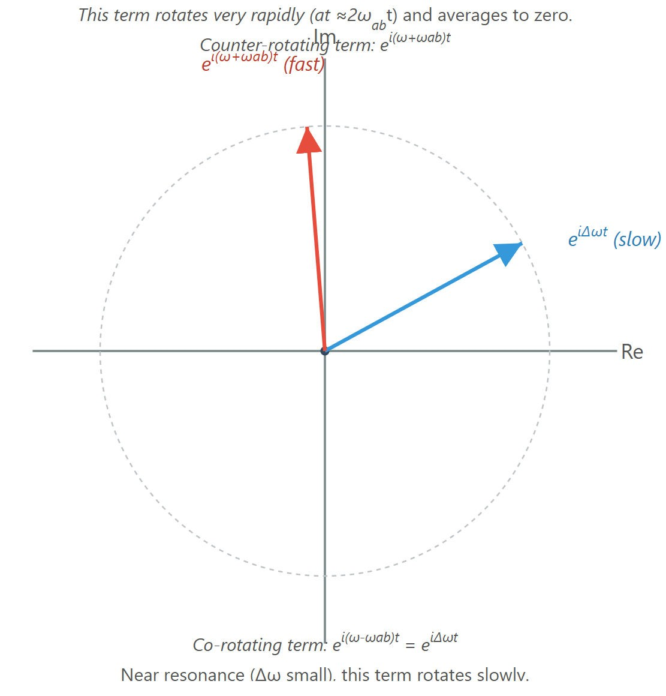
[IMAGE REQUIRED: Phasor diagram comparing co-rotating vs. counter-rotating terms.]
ndal for Phys 608 Laser Spectroscopy course in KFUPM (T

Slide 35
Slide 12: Weak-Field (Perturbative) Approximation
Assume initial condition (all atoms in ground state)
• 𝑎(0) = 1.
• 𝑏(0) = 0.
Further assume field is so weak and interaction time so short that
|𝑏(𝑡)|² ≪ 1 during evolution.
Under these conditions set 𝑎(𝑡) ≈ 1 in right-hand side of equations and integrate for 𝑏(𝑡).

Slide 36
Obtain (keeping both rotating and counter-rotating parts before RWA step)
^{𝛺}𝑎𝑏
_{𝑒}𝑖𝛥𝜔 𝑡 _{− 1 𝑒}𝑖(𝜔+𝜔_{𝑎𝑏})𝑡 ₋ ₁
𝑏(𝑡) =
[ −
].
2 𝛥𝜔
𝜔 + 𝜔_{𝑎𝑏}
Near resonance |𝛥𝜔| ≪ 𝜔_{𝑎𝑏}
drop the second, rapidly oscillating
fraction → standard first-order perturbation result.
---

Slide 37
Slide 13: Transition Probability vs. Detuning – Sine-
Squared Profile
Probability to find atom in |b⟩ after time 𝑡:
^{𝛺}𝑎𝑏
2
) [
2
] .
sin(𝛥𝜔 𝑡⁄2)
𝛥𝜔⁄2
𝑃_{𝑎→𝑏}(𝑡) = |𝑏(𝑡)|² = (
2
Key features:
1. Maximum at exact resonance 𝛥𝜔 = 0.

Slide 38
2. Width of central lobe inversely proportional to interaction time 𝑡
(Fourier limit).
Envelope is classic sine² pattern (cf. single-slit diffraction analogy).
  At resonance transition probability is :
𝛺_{𝑎𝑏}
res
(𝑡) = (
)² t² .
^{𝑃}𝑎→𝑏
2

Slide 39
Validity only
Violates for long
for
pulses
weak-field
or strong
perturbation:
𝛺_{𝑎𝑏} 𝑡/2 ≪ 1.
fields →
need full (non-
perturbative) Rabi solution.

Slide 40
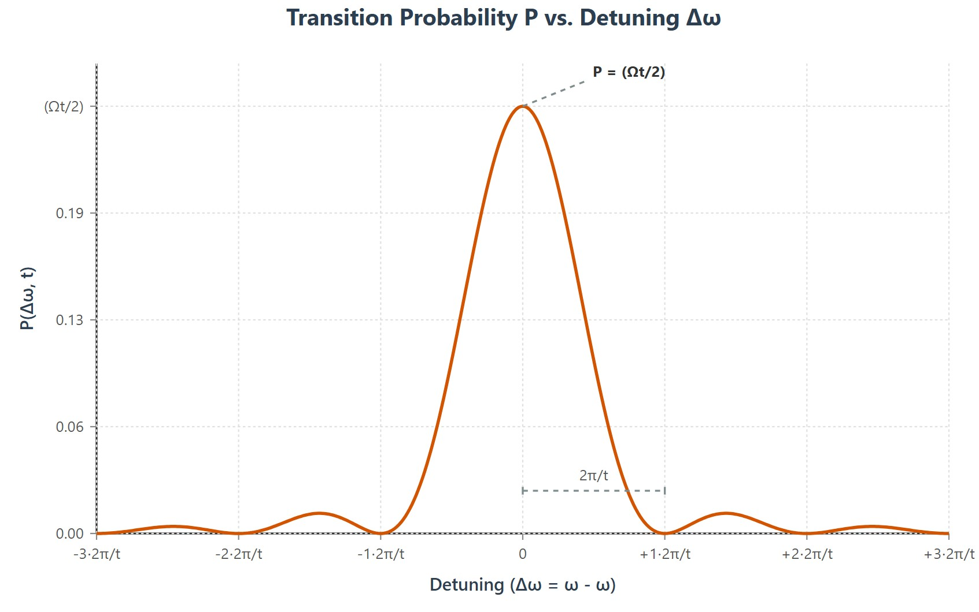
[IMAGE REQUIRED: Plot of 𝑃_{𝑎→𝑏} vs. 𝛥𝜔 showing central sinc-squared peak and side lobes.]
---
Prepared by Dist. Prof. Dr. M.A. Gondal for Phys 608 Laser Spectroscopy course in KFUPM (Term 251)

Slide 41
Slide 14: Interaction Time, Fourier Limit, and Spectral
Resolution
The characteristic time scale is related to Rabi frequency
2 ℏ
𝑇 = = .
^{𝛺}𝑎𝑏 ^{𝐷}𝑎𝑏 ^{𝐸}0
For example, on resonance, the probability of transition 𝑃_{res}= (𝛺_{𝑎𝑏}𝑡/2)².
If we set 𝑃_{res}=1 (a full transition, though this violates perturbation theory), then 𝛺_{𝑎𝑏}𝑡/2=1, so 𝑡=2/𝛺_{𝑎𝑏}.
For 𝑡 ≪ 𝑇 perturbative regime holds and spectral profile derived earlier is valid.
Finite interaction time implies inherent spectral uncertainty: There will be an inherent spread or uncertainty in the frequency response, as we saw with the width of the sinc-squared profile. This is not just a limitation of our instruments; it's a fundamental aspect of quantum mechanics and wave phenomena.

Slide 42
1
𝛥𝜔 ∼ .
𝑡
pulses with duration 𝑡 = 10 ns possess transform-limited
Laser
linewidth (𝛥𝜔 )≈ 100 MHz.
Understanding time–frequency reciprocity is essential for designing selective excitation schemes and high-resolution spectroscopy.
The final bullet point emphasizes the practical importance of this concept: Understanding this time-frequency reciprocity is essential for designing selective excitation schemes and for high-resolution spectroscopy. If you want to excite only a very specific, narrow energy level without affecting nearby levels (selective excitation), you need a spectrally narrow excitation source. This implies, from time-frequency reciprocity, that you need a long interaction time. This could mean using a continuous wave (CW) laser or very long pulses. For high-resolution spectroscopy, where the goal is to distinguish very closely spaced spectral lines, you also need to achieve very narrow effective linewidths. This again points to the need for maximizing the coherent interaction time between the light and the atoms/molecules. Techniques like Ramsey interferometry are specifically designed to achieve long effective interaction times to overcome this limit.

Slide 43
Slide 15: Broadband Radiation – Introducing Spectral
Energy Density
Realistic sources often possess bandwidth 𝛿𝜔 much larger than Fourier limit 1/𝑡.
Replace single-frequency field amplitude with spectral energy density*
𝜌(𝜔) [J m⁻³ rad⁻¹ s].
Definition relates to total field energy:

Slide 44
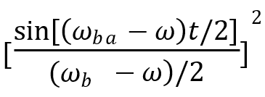
∞
∫ 𝜌 (𝜔) 𝑑𝜔 =
0
2
is total energy density for all positive angular frequencies .
𝜀₀𝐸₀
2
Dipole interaction strength at each frequency becomes
𝛺_{𝑎𝑏} (𝜔) =𝐷_{𝑎𝑏} 𝐸(𝜔)/ℏ.
Transition probability integrated over broadband source:
2 ∞
sin[(𝜔_{𝑏𝑎} − 𝜔)𝑡/2]
2
] 𝑑𝜔.
^{𝐷}𝑎𝑏
𝑃
(
∫ 𝜌 (𝜔) [
−∞
𝑡) =
𝑎𝑏
2𝜀 ℏ
2
(𝜔
− 𝜔)/2
0
𝑏𝑎
This factor shows that transition probability is sharply peaked around 𝜔=𝜔_{ba} (the atomic resonance frequency). Its width is approximately 1/𝑡. If the source spectrum 𝜌(𝜔) is much broader than this width1/𝑡, and doesn't change much across this narrow region, then we can effectively pull 𝜌(𝜔) out of the integral from the previous slide, evaluating it at 𝜔=𝜔_{𝑏𝑎}.

Slide 45
Slide 16: Result for Slowly Varying 𝝆(𝝎) – Linear Growth
in Time
If 𝜌(𝜔) varies slowly across the spectral region where the sinc- squared kernel is appreciable, approximate 𝜌(𝜔) ≈ 𝜌(𝜔_{𝑏𝑎}).
Evaluate integral using standard identity
∞ sin²(𝑥𝑡)
∫
𝑑𝑥 = 2𝜋𝑡.
_{𝑥}2
−∞
Obtain simple expression

Slide 46
( )
𝜋
2
𝑎𝑏
( )
𝑃
𝑡 = 𝐷
𝜌 𝜔
𝑡.
𝑎b𝑏
𝜀 ℏ
2
𝑏𝑎
0
Consequently, rate* of absorption becomes constant:
𝑅_{𝑎𝑏}
𝑑𝑃_{𝑎𝑏} 𝜋
2
𝑎𝑏
≡
= 𝐷
( )
𝜌 𝜔
.
𝑑𝑡 𝜀 ℏ
2
𝑏𝑎
0
Linear-in-time behaviour contrasts with quadratic growth seen for monochromatic resonant excitation in perturbative regime.
---

Slide 47
Slide 17: Connection to Einstein 𝑩 Coefficient
Radiation field used in Einstein’s derivation assumed isotropy*. Our plane-wave result must therefore be angle-averaged.
For randomly oriented dipoles
⟨𝑝_{z} ⟩ = 1⁄3 𝑝² .
The expectation value of 𝑝_{z}2 equals 1/3 times the expectation value of 𝑝2. Here, 𝑝_{z} is the component of the dipole moment along a specific field direction, and 𝑝² is its total squared magnitude.
Replacing 𝐷_{𝑎𝑏} → 𝐷_{𝑎𝑏} /3 in previous rate yields
𝑅_{𝑎𝑏} = 𝜌(𝜔_{𝑏𝑎}) 𝐵_{𝑎𝑏},
2

Slide 48
With Einstein B Co-effcient
𝜋𝑒²
𝐵 =
| |
2
𝐷
.
𝑎b𝑏
3𝜀 ℏ
2
𝑎𝑏
0
Thus experimental determination of 𝐵_{𝑎𝑏} or ab-initio* calculation of 𝐷_{𝑎𝑏}
immediately balance.
---
provides all other Einstein coefficients via detailed

Slide 49
Slide 18: Degeneracy and Line Strength 𝑺_{𝒊𝒌}
For levels possessing degeneracy 𝑔_{i}, 𝑔_{k} transition rate must sum over final sublevels.
(e.g. magnetic sublevels), and average over initial
Define line strength*
𝑔_{i} 𝑔_{k}
(𝑚𝑛) ²
𝑆_{𝑖𝑘} = ∑ ∑ |𝐷_{𝑖𝑘} | .
𝑚=1 𝑛=1

Slide 50
Generalized Einstein coefficient:
𝜋 𝑆_{𝑖𝑘}
𝐵 =
.
𝑔
𝑖𝑘
3𝜀 ℏ
2
0 i
Tables of 𝑆_{𝑖𝑘} are standard outputs of sophisticated atomic-structure codes (e.g. GRASP, CIV3) and directly feed astrophysical modelling software.
Beware of unit conventions: switching from angular frequency 𝜔 to ordinary frequency 𝜈 introduces factor 2𝜋.

Slide 51
Slide 19: Effective Two-Level System with Open Decay
Channels
Reality: neither |a⟩ nor |b⟩ is truly closed; spontaneous emission, collisions, or other mechanisms remove population.
Phenomenologically include decay constants
𝛾_{a} – total decay rate out of |a⟩.
𝛾_{b} – total decay rate out of |b⟩.

Slide 52
Modified amplitude equations (under RWA)
𝑖 2
𝛾_{a}
𝑎̇ = −
_{𝛺𝑎𝑏𝑒}𝑖𝛥𝜔𝑡_{𝑏 −}
𝑎,
2
𝑏̇ = − ^{𝑖} 𝛺
_{𝑒}−𝑖𝛥𝜔𝑡_{𝑎 −} ^{𝛾b} _{𝑏.}
𝑎𝑏
2 2
Decay terms produce damping of Rabi oscillations and lead to steady-state solutions important in fluorescence and saturation spectroscopy.

Slide 53
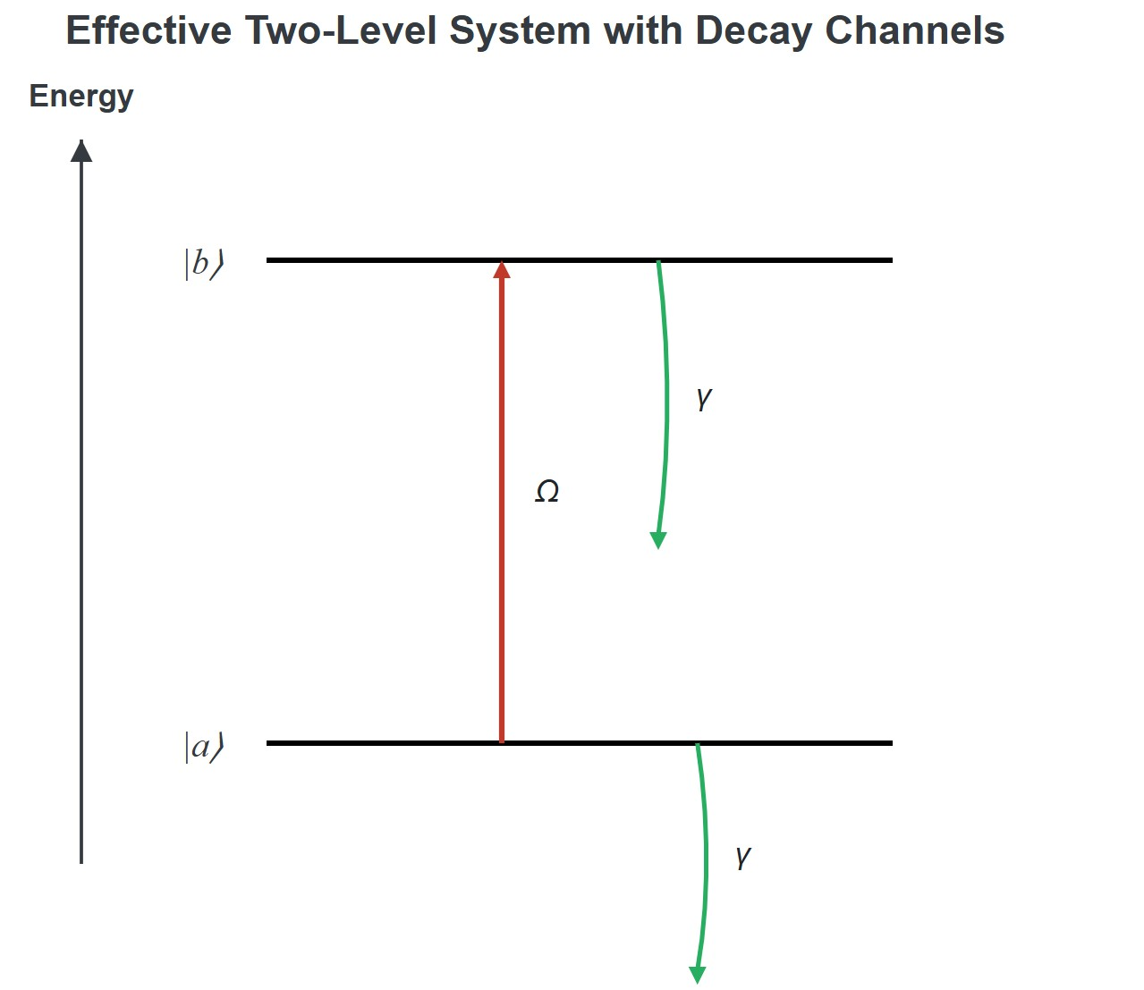
MAGE REQUIRED: Diagram of two-level system with upward driven transition 𝛺_{𝑎𝑏} and downward decay arrows 𝛾_{𝑎}, 𝛾_{𝑏} .]
repared by Dist. Prof. Dr. M.A. Gondal for Phys 608 Laser Spectroscopy course i
[I
P
n KFUPM (Term 251)

Slide 54
Slide 20: Summary and Outlook of todays lecture
Transition probabilities extend spectroscopy from qualitative fingerprints to quantitative diagnostics*.
Spontaneous lifetime 𝜏 connects directly to Einstein 𝐴 coefficient; measurement of 𝜏 is experimentally straightforward (i.e by time-resolved fluorescence).

Slide 55
Semiclassical two-level model reveals how external fields drive transitions; Rabi frequency 𝛺 quantifies coupling strength; weak- field vs. strong-field regimes distinguished.
Broadband excitation yields constant absorption rate proportional to |𝐷_{𝑎𝑏} |² → leads naturally to Einstein 𝐵.
Next steps (not covered here): full density-matrix treatment (Bloch equations), interaction with pulsed lasers, coherent phenomena (Rabi flopping, Ramsey fringes, Autler–Townes splitting).

Slide 56
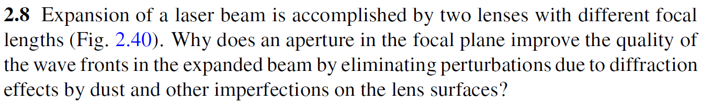
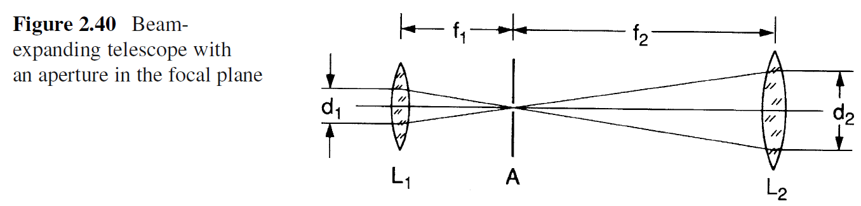
Chap. 2 Problems & Solutions

Slide 57
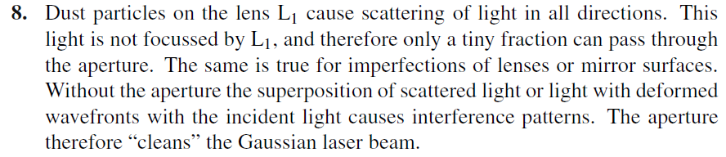
Chap. 2 Problems & Solutions

