Slide 1
Chap. 2.7 Absorption
& Emission Spectra

Slide 2
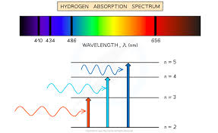
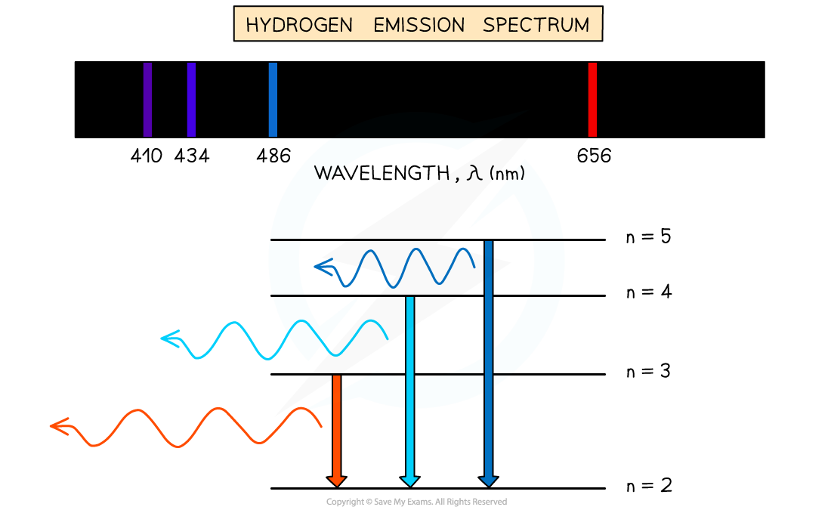
Slide 1: Road-Map for Section 2.7
Section goal: build a rigorous, quantitative understanding of how atoms and molecules exchange energy with light via
Absorption
Spontaneous emission
Stimulated emission.
Tools introduced today:

Slide 3
Clear Understanding of Following Concepts and Terms?
Spectral line observation with a dispersive spectrograph.
Einstein 𝐴, 𝐵 coefficients — microscopic transition probabilities.
Absorption cross section 𝜎_{𝑖𝑘}.
Oscillator strength 𝑓_{𝑖𝑘} .
Line-strength integral 𝑆_{𝑖𝑘}.

Slide 4
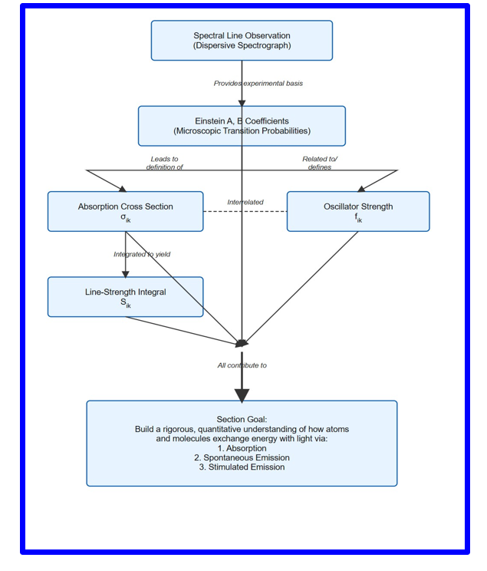

Slide 5
Slide 2: Emission vs. Absorption — Core Definitions
Emission
spectrum: spectral distribution of radiant power that
leaves a source.
Absorption spectrum: difference between incident and transmitted spectra intensity after light pass through the sample.
Two spectral words structure: * Continuous (no gaps) — e.g. black- body radiation. * Discrete (set of sharp lines) — arises from quantised bound-bound transitions.
Planck constant ℎ = 6.626 × 10⁻³⁴ J s. (in all process common)

Slide 6
Slide 3: Discrete Transition Energetics
Consider one atom / molecule with two stationary (bound) states
|𝑖⟩: 𝐸_{i}
|𝑘⟩: 𝐸_{k} (𝐸_{k} > 𝐸_{i})
Energy-frequency relation (Planck–Einstein):
ℎ𝜈_{𝑖𝑘} = 𝐸_{k} − 𝐸_{i} ⇔ 𝜈_{𝑖𝑘} =
𝐸_{k} − 𝐸_{i}
ℎ
Wavenumber 𝜈̃_{𝑖𝑘} = 1/𝜆_{𝑖𝑘} often used in spectroscopy; units cm⁻¹ specially for molecular spectroscopy
. Terminology:

Slide 7
• “Line” ↔ a single 𝜈_{𝑖𝑘} or 𝜆_{𝑖𝑘}. (Atomic lines or spectra)
Multiplet/bands ↔ cluster of related lines (fine/hyperfine/vibrational
(Specially in molecular spectroscopy)

Slide 8
Slide 4: How a Spectrograph Separates Wavelengths
Optical Path
Entrance slit 𝑆 defines spatially narrow source.
Collimating optics create parallel beam.
Dispersive element (prism or diffraction grating) introduces angle– wavelength dependence.
Camera lens refocuses each wavelength to a different horizontal coordinate in focal plane 𝐵.

Slide 9
Detector sees:
Continuous source → bright rainbow band.
Discrete source → series of bright “line” or images of slit.

Slide 10
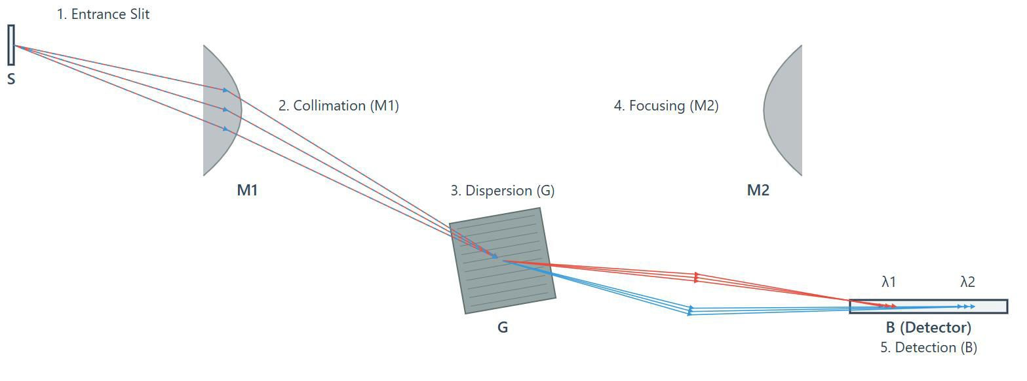
[IMAGE REQUIRED: Plan view of a Czerny–Turner spectrograph with
labelled rays for two different wavelengths.]
---

Slide 11
Slide 5: Resolving Power Requirement
Resolving power 𝑅 ≡ 𝜆/𝛥𝜆.
Here λ is the average wavelength of the two spectral lines being observed, and Δλ is the minimum wavelength separation between these two lines that the instrument can distinguish as separate lines.
To observe distinct lines:
^{𝜆}𝑖𝑘
𝑅 ≫
natural/ Doppler width
If 𝑅 insufficient, adjacent lines appears as blur and ends into continuum.
Continuous spectra remain continuous even for 𝑅 → ∞; discrete spectra become a set of delta-function-like peaks.

Slide 12
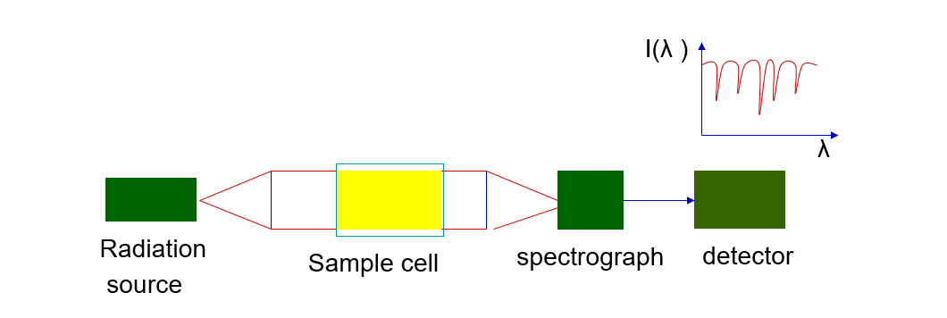
Slide 6: Origin of Absorption Spectra
Incident broadband light field with spectral intensity 𝐼₀(𝜈) passes through gas cell length 𝛥𝑧.
Lower-state
population
𝑁_{i} can absorb photons at their
eigenfrequencies 𝜈_{𝑖𝑘}.
Result: dips (“dark lines”) in transmitted spectrum 𝐼(𝜈) < 𝐼₀(𝜈).
Absorption spectrum defined as

Slide 13
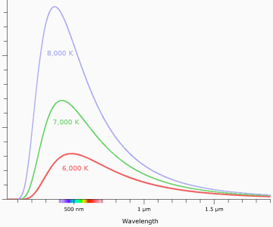
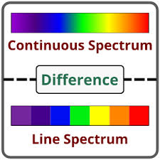
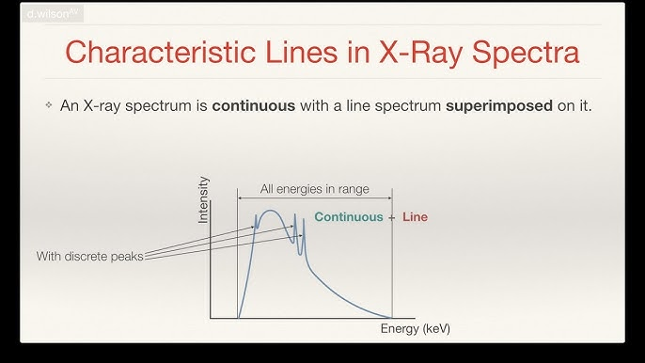
𝛼_{𝑖𝑘}(𝜈)
𝐼₀(𝜈) − 𝐼(𝜈)
≡
𝛥𝑧
Absorption discrete ↔ 𝐸_{k} bound state;
Absorption continuum ↔ 𝐸_{k} ionisation/dissociation continuum in state
Continuous Balack Body Spectrum

Slide 14
Slide 7: Illustrative Cases
Atomic hydrogen: Lyman continuum above 13.6 eV produces continuous ultraviolet absorption.
Molecular iodine: billions of narrow rovibronic lines visible at room temperature owing to many 𝐸_{i}.
Sun’s photosphere + cooler outer layers → Fraunhofer lines (to be
discussed next).
---

Slide 15
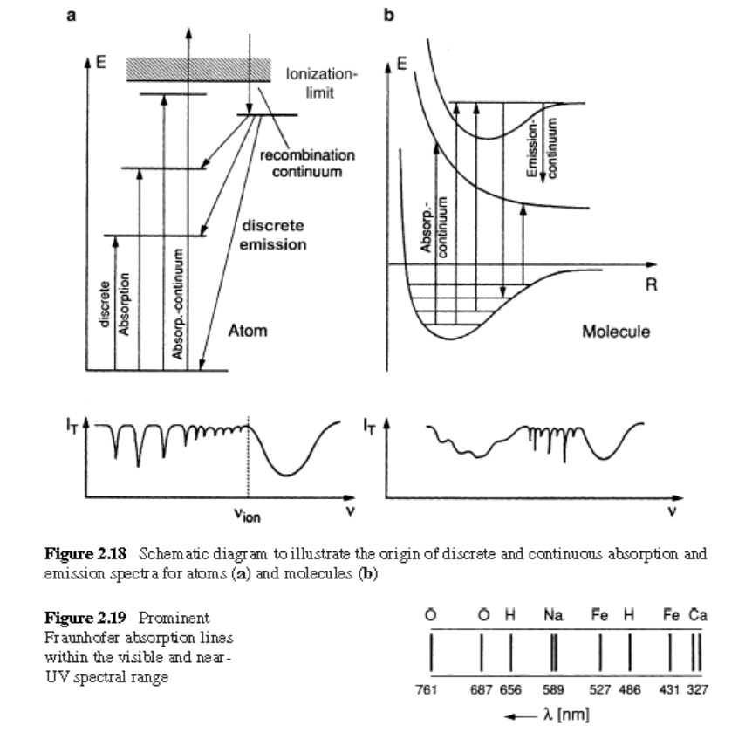

Slide 16
Slide 8: Example — Fraunhofer (German scientist) Lines
Sun’s
interior emits nearly perfect black-body spectrum 𝑇 ≈
5800 K. (originally appeared as dark features absorption lines in solar spectrum due to presence of many elements)
Outer gaseous atmosphere contains atoms (Na, Ca, Fe, …).
Those atoms absorb specific 𝜈_{𝑖𝑘}
continuum.
Famous D₁, 𝐷₂ sodium doublet at 589.0 nm is due sodium presence in the sun atmosphere.

Slide 17
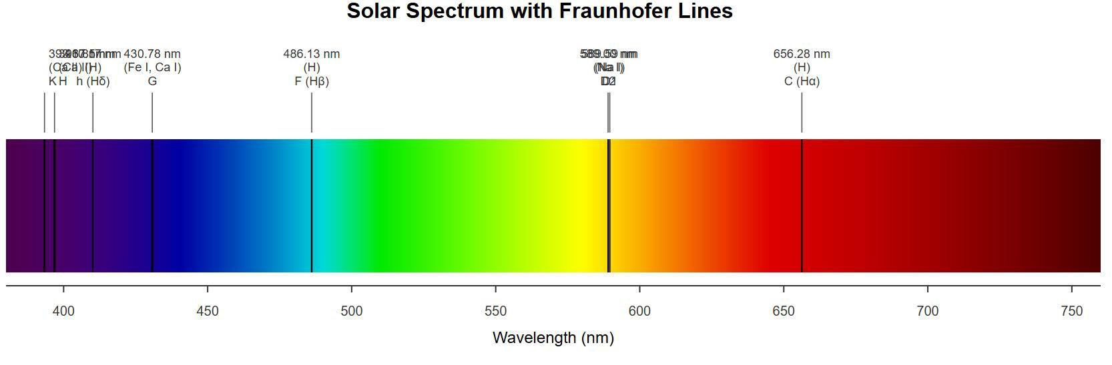
[IMAGE REQUIRED: Solar spectrum with major Fraunhofer lines annotated and their atomic species indicated.]
---

Slide 18
Slide 9: Need for a Quantitative Measure of “Absorption
Strength”
Qualitative
line depth insufficient for comparing different
transitions, pressures, temperatures.
Fundamental
microscopic quantity introduced: absorption cross
section 𝜎_{𝑖𝑘} (𝜔).
Macroscopic measurable quantity: absorption coefficient 𝛼_{𝑖𝑘}(𝜔).
We Links microscopic and macroscopic via population density 𝑁_{i} and path length 𝛥𝑧.

Slide 19

Slide 10: Absorption Cross Section — Geometric Picture
Imagine photons as classical particles moving in parallel beam.
Each atom presents an effective circular “target” of radius
^{𝑟}𝑖𝑘
⇒ 𝜎_{𝑖𝑘} = 𝜋𝑟_{𝑖𝑘}
2 2
[m]
Photon hitting area 𝜎_{𝑖𝑘}
transition |𝑖⟩ → |𝑘⟩.
Cross section depends on frequency 𝜔 – sharply peaked at 𝜔_{𝑖𝑘}.
has probability ≈ 1 to be absorbed on

Slide 20
Slide 11: Deriving the Absorbed Power Expression (Eq.
2.58)
Step-by-step calculation for infinitesimal slice
Spectral intensity of incident beam: 𝐼₀(𝜔) [W m⁻² rad⁻¹ s].
Photon spectral flux density 𝛷 = 𝐼₀(𝜔)/(ℏ𝜔).
Number of photons crossing area 𝐴 in time 𝑑𝑡 and frequency range
𝑑𝜔:

Slide 21
𝑑𝑁_{𝛾} = 𝛷 𝐴 𝑑𝑡 𝑑𝜔
Number of absorbers available in slice thickness 𝛥𝑧: 𝑁_{i}𝐴𝛥𝑧
Net transition powe per absorber:
𝑃_{abs} = 𝜎_{𝑖𝑘} (𝜔) 𝛷 𝑑𝑡
Photons removed(absorbed): 𝑑𝑁_{abs} = 𝑁_{i}𝐴𝛥𝑧 𝑃_{abs}.
Energy removed in 𝑑𝑡:
𝑑𝑊_{𝑖𝑘} = 𝑑𝑁_{abs}(ℏ𝜔) =no of photons x(energy of one photon)
Divide by 𝑑𝑡 to obtain differential power:

Slide 22
𝑔_{i}
𝑑𝑃
( )
( )
( )
ω 𝑑ω = 𝐼 ω [𝑁
−
𝑁 ] σ
ω 𝐴 Δ𝑧 𝑑ω
𝑖𝑘
0 i
𝑔
k 𝑖𝑘
k
Statistical
weights
𝑔_{i}, 𝑔_{k}
(degeneracy)
included
to allow for
stimulated emission correction.

Slide 23
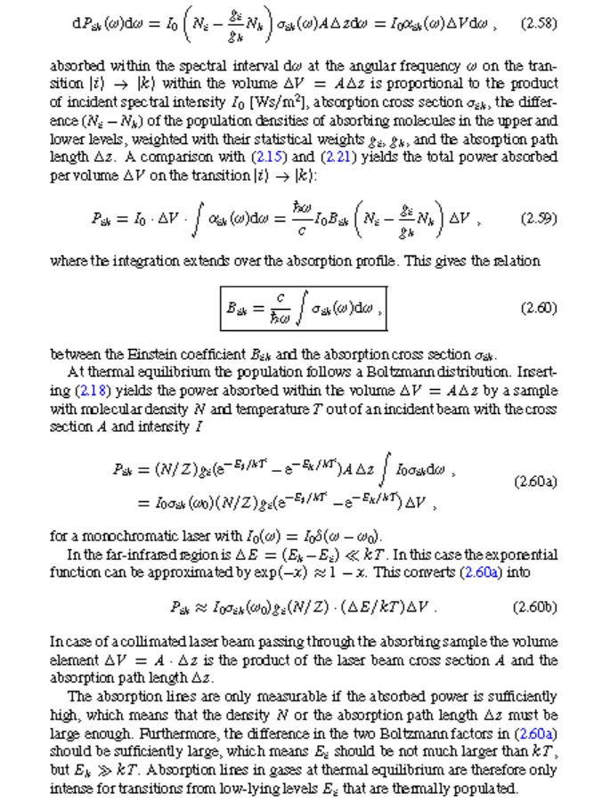

Slide 24

Slide 12: Integrating Over the Line Profile — Link toto 𝑩_{𝒊𝒌}
Define absorption coefficient
𝑔_{i}
𝛼_{𝑖𝑘}(𝜔 )
= 𝜎
( )
𝜔 [𝑁 −
𝑁 ]
𝑖𝑘
i
𝑔
k
k
Absorbed power in volume 𝛥𝑉 = 𝐴𝛥𝑧:
+∞
𝑃_{𝑖𝑘} = 𝐼₀ 𝛥𝑉 ∫
−∞
𝛼_{𝑖𝑘} (𝜔) 𝑑𝜔

Slide 25

Compare
with Einstein rate
expression
(ℎ𝜈/𝑐)𝐼₀𝐵_{𝑖𝑘} (𝑁_{i} −
𝑔_{i}𝑁_{k}/𝑔_{k})𝛥𝑉.
Isolate microscopic parameter:
Integral over 𝜎_{𝑖𝑘} is called “cross-sectional area under the line”.
---

Slide 26
Slide 13: Including Thermal (Boltzmann) Populations
At thermal equilibrium temperature 𝑇:
𝑁𝑔_{i}
𝑁_{i} =
exp[−𝐸_{i}/(𝑘_{B}𝑇)],
𝑍 = ∑ 𝑔_{j} exp[−𝐸_{j}/(𝑘_{B}𝑇)]
j
𝑍
Substituting into previous power formula gives
𝑁
𝑃_{𝑖𝑘} = 𝐼₀ 𝛥𝑉 [_{𝑍} (𝑔_{i}𝑒
−𝐸_{i}/𝑘_{BT} −𝐸_{k}/𝑘_{BT}
)] ∫ 𝜎_{𝑖𝑘} (𝜔) 𝑑𝜔
− 𝑔_{k}𝑒
Low-frequency (FIR) limit (𝐸_{k} − 𝐸_{i}) ≪ 𝑘_{B}𝑇:

Slide 27
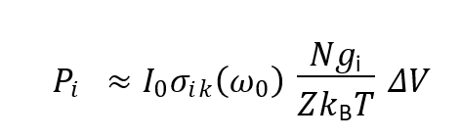
𝑒^{−𝐸k/𝑘B𝑇} ≈ 𝑒^{−𝐸i/𝑘B𝑇} (1 − (𝐸_{k} − 𝐸_{i})/𝑘_{B}𝑇)
leading to
Demonstrates that FIR absorption strength ∝ 1/𝑇; intuitive because lower photon energy competes with thermal excitation.
---
𝑁𝑔_{i}
𝑃
≈ 𝐼 𝜎
( )
𝜔
𝑉
𝑖𝑘
0 𝑖𝑘 0
𝑍𝑘 𝑇
B

Slide 28
Slid 14 “Figure-of-Merit” improvements for Detecting
Absorption
• Signal size ∝ 𝑁_{i}𝜎_{𝑖𝑘} 𝛥𝑧.
To increase detection: 1. Increase number density 𝑁 (raise pressure, but beware of collisional broadening). 2. Prolong path length 𝛥𝑧 (long cell, multi-pass, cavity). 3. Select transitions with large 𝜎_{𝑖𝑘}, typically low 𝐸_{i} and high oscillator strength “f_{i}”

Slide 29
For thermally populated gases: observe transitions originating from the ground or few first excited states; higher 𝐸_{i} levels are sparsely populated.
---

Slide 30
Slide 15: What are Non-Thermal Population Strategies
Optical pumping: use intense narrowband laser to drive population from |𝑔⟩ to excited |𝑒⟩.
Electron impact: in discharge tubes, collisions populate high-lying states.
Result: allows study of absorption lines originating from 𝐸_{i} that are otherwise unpopulated at room temperature.

Slide 31
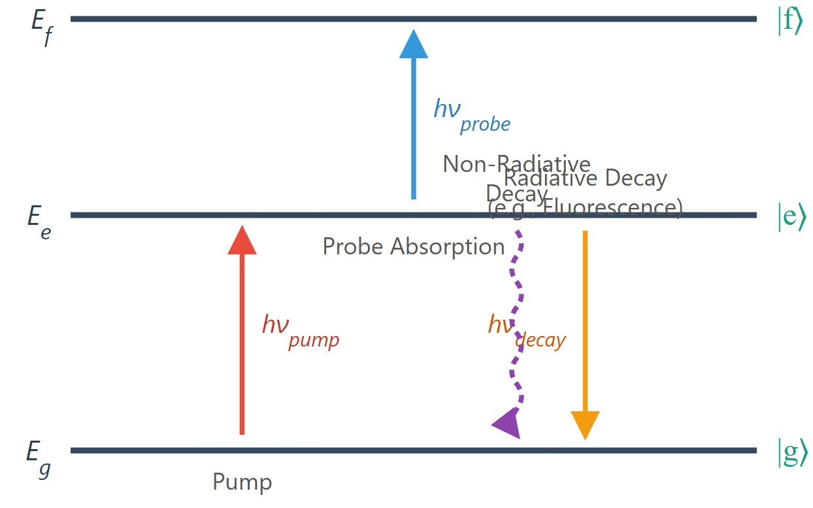
Schematic Energy Levels for Pump-Probe Spectroscopy: Two or more photon Optical Pumping, Probe, and Decay

Slide 32
2.7.2 : Fluorescence — Spontaneous Emission from
Excited States
Excited state 𝐸_{k} can relax by
Spontaneous radiative decay (fluorescence).
Stimulated emission (if strong field present).
Non-radiative through collisions.

Slide 33
If molecular ensemble(together) randomly oriented(gases or liquids), spontaneous emission intensity is isotropic.
Observed spectrum mirrors all allowed 𝐸_{k} → 𝐸_{i} transitions weighted by their probabilities and populations of 𝐸_{k}.

Slide 34
Slide 17: Discrete vs. Continuous Fluorescence
Bound lower state 𝐸_{i}: produces discrete line fluorescence.
Repulsive (dissociative) or continuum 𝐸_{i}: produces broad continuum
fluorescence.
Transition probability vs. internuclear distance 𝑅 determines how vibrational wavefunction bulges imprint modulation on continuum.

Slide 35
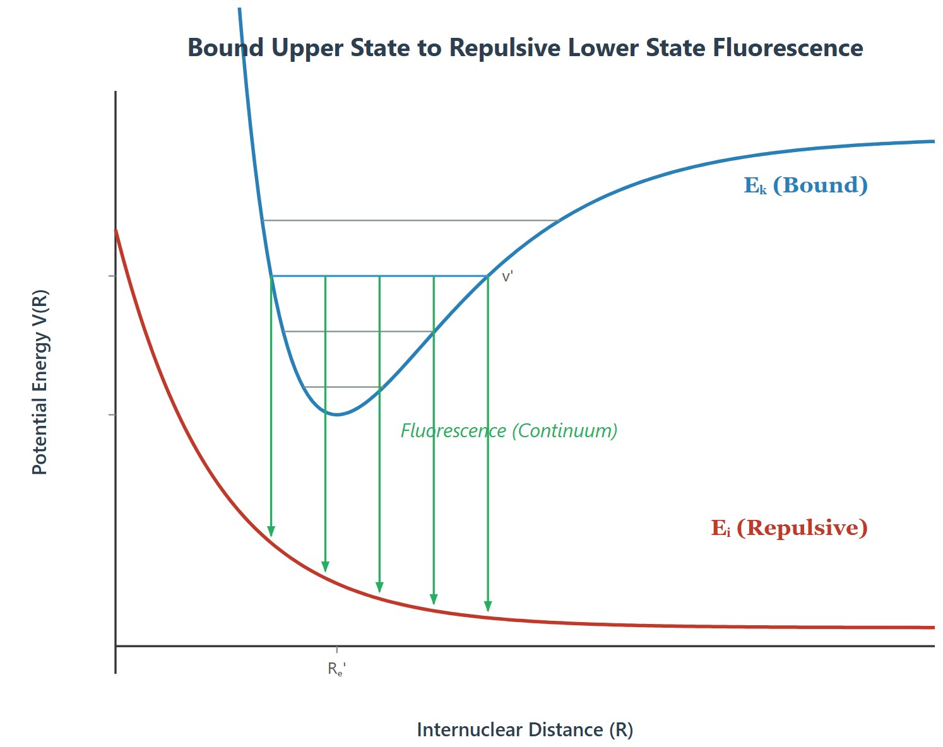
IMAGE REQUIRED: Potential energy curves of a diatomic showing bound upper state and repulsive lower state with arrows indicating transitions.]
repared by Dist. Prof. Dr. M.A. Gondal for Phys 608 Laser Spectroscopy course in KFUPM (
[
P
Term 251)

Slide 36
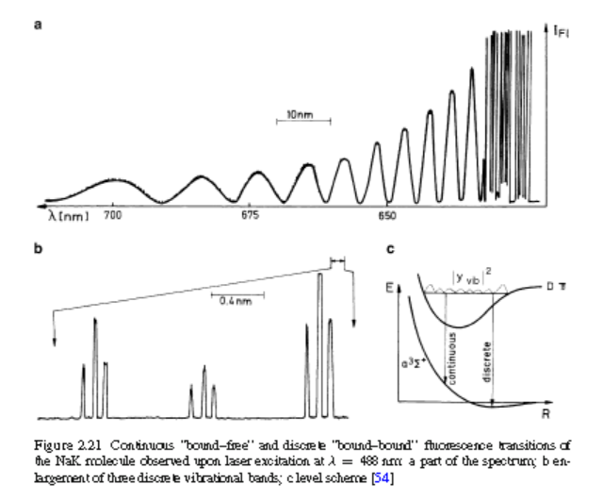

Slide 37
Slide 18: Case Study — NaK Molecule 𝟑𝜫 → 𝟑𝜮
Upper state: bound vibrational level excited by Ar-ion laser.
Lower 3𝛴 state: shallow van der Waals well with dissociation limit just above some 𝐸_{i}.
High-energy part 𝐸_{k} > 𝐷₀ ⇒ continuum fluorescence.
Low-energy part 𝐸_{k} < 𝐷₀ ⇒ discrete bound–bound lines.
Continuum intensity modulated by overlap integral

Slide 38
upper
lower
2
𝐼(𝜈) ∝ |⟨𝜓_{vib} |𝜓_{E} ⟩|
create minima.
upper
where nodes in 𝜓_{vib}

Slide 39
Slide 19: Oscillator Strength (f) Concept — Bridging Classical
& Quantum Phenomenon through this
Classical Lorentz oscillator: single electron of mass 𝑚_{e}, charge −𝑒,
natural frequency 𝜔₀, absorbs all incident power at 𝜔₀.
𝑓 = 1.
Real atom: many allowed 𝑖 → 𝑘 transitions share oscillator strength.
Define dimensionless 𝑓_{𝑖𝑘} such that
𝑁 𝑓𝑖𝑘 Here N is number of atoms
Assign

Slide 40
oscillators mimic absorption strength of 𝑁 atoms on 𝑖 → 𝑘.
Sum rule (Thomas-Reiche-Kuhn):
∑𝑓_{𝑖𝑘}=1
k
when summation includes continuum.
𝑓𝑖𝑘 tells us the "effective number" of classical oscillators that corresponds to the quantum mechanical transition i to k. If 𝑓𝑖𝑘 is, say, 0.5, then the i-to-k transition is half as strong as a classical oscillator. If it's 0.01, it's much weaker. Strong, allowed transitions can have 𝑓𝑖𝑘 values approaching 1.

Slide 41
Slide 20: Physical Meaning and Sign of 𝒇_{𝒊𝒌}
For absorption (lower → upper): 𝑓_{𝑖𝑘} > 0.
For stimulated emission (upper → lower): 𝑓_{𝑘𝑖} = −𝑓_{𝑖𝑘}
because process decreases field energy).
(negative
Large
^{𝑓}𝑖𝑘
⇒ strong transition — short radiative lifetime,
broad
natural linewidth.
Units: none (dimensionless).
---

Slide 42
Slide 21: Example — Sodium ³ 𝑺_{𝟏/𝟐} → ^{𝟑} P_{3/2}
Fine-structure split:
𝐽 = 1⁄2 : 𝑓 = 0.33, 𝐽 = 3⁄2 : 𝑓 = 0.66
• Together, 0.33 + 0.66 = 0.99 ≈ 1.
Remaining < 1% oscillator strength distributed among far-UV lines and the ionisation continuum.
Consequence: Na D lines dominate optical absorption of sodium vapor.

Slide 43
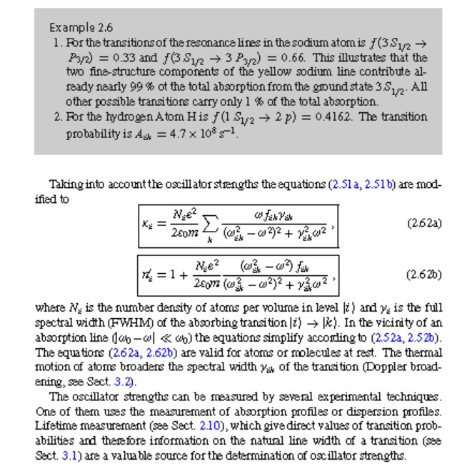

Slide 44
Slide 22: Incorporating 𝒇_{𝒊𝒌} Into Absorption & Dispersion
Macroscopic absorption coefficient for stationary atoms:
𝑁_{i}𝑒²
𝜔 𝑓_{𝑖𝑘} 𝛾_{k}
( )
𝜅 𝜔 =
i
2𝜖 𝑚
2
2𝜔²
0
e (𝜔_{k} − 𝜔²)² + 𝛾_{k}
Real part of refractive index deviation:
𝑁_{i}𝑒²
2−𝜔²)
(𝜔_{k}
^{𝑓}𝑖𝑘
( )
𝑛′ 𝜔 = 1 +
i
2𝜖 𝑚
2−𝜔²)²
2
0
e (𝜔_{k}
+ 𝛾_{k} 𝜔²

Slide 45
𝛾_{k}: full width at half maximum (FWHM) of natural line shape.
Close
to resonance
|𝜔 − 𝜔_{k}| ≪ 𝜔_{k},
expressions simplify to
Lorentzian forms.
---

Slide 46
Slide 23: Influence of Thermal Motion — Doppler
Broadening Preview
At temperature 𝑇, atomic velocity distribution is Maxwellian.
• Doppler shift: 𝜔′ = 𝜔(1 + 𝑣_{z}/𝑐).
Convolution of Lorentzian (natural) with Gaussian (Doppler) yields Voigt profile; effective width
^{𝛾}Voigt ^{≈ √𝛾}k
² + (𝜔 𝑣
/𝑐)²
k rms

Slide 47
Later Section 3.2 will quantify exact formulas.
---

Slide 48
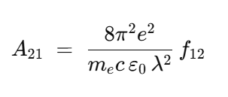
Slide24: How to Measure Oscillator Strengths — Experimental
Routes
1. Absorption or dispersion
previously derived equations.
2. Radiative lifetime 𝜏_{𝑘}:
profile area measurement →
^{𝑓}𝑖𝑘
via
𝐴_{𝑖𝑘} = 1/𝜏_{k}
and 𝐴_{𝑖𝑘} related to 𝑓_{𝑖𝑘} .
3. Branching-ratio spectroscopy in combination with known 𝜏_{k}.

Slide 49
4. Laser-induced fluorescence with absolute intensity calibration.

Slide 50
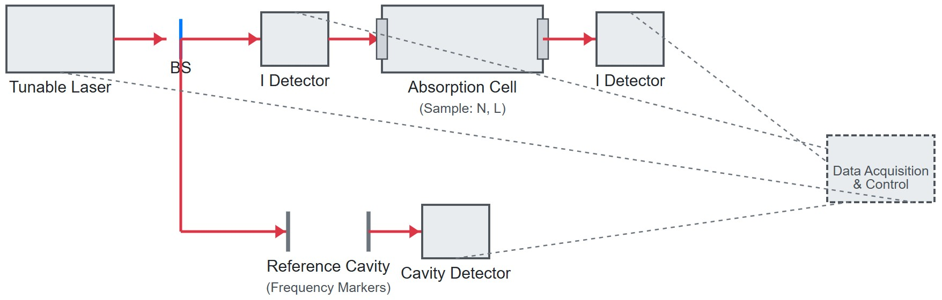
[IMAGE REQUIRED: Experimental setup showing laser absorption cell, detector, and reference cavity for absolute intensity measurement.]

Slide 51
Slide 25: Starting Point for 𝑩_{𝒊𝒌}–𝝈_{𝒊𝒌} Relation
For dilute sample (𝑁_{k} ≈ 0) excitation rate:
𝑑𝑊
𝑖𝑘
= 𝑁 𝐵 𝜌(𝜔) ℎ𝜈 𝛥𝑉
𝑑𝑡
i 𝑖𝑘
Plane wave energy density 𝜌(𝜔) related to spectral intensity 𝐼(𝜔)
by 𝐼(𝜔) = 𝑐 𝜌(𝜔).
Our Goal: express 𝐵_{𝑖𝑘} in terms of experimentally accessible 𝛼_{𝑖𝑘}(𝜔).
---

Slide 52
Slide 26: Full Derivation of Equation 2.64
Express absorbed power differential:
𝑑𝑃(𝜔) = 𝐼(𝜔) 𝛼_{𝑖𝑘}(𝜔) 𝛥𝑉 𝑑𝜔
Integrate across full spectral line shape:
+∞
𝑃_{tot} = 𝛥𝑉 ∫ 𝐼 (𝜔) 𝛼_{𝑖𝑘}(𝜔) 𝑑𝜔
0
Equate with Einstein form 𝑁_{i}𝐵_{𝑖𝑘}𝜌(𝜔_{𝑖𝑘} )ℎ𝜈𝛥𝑉 at steady state where stimulated rate equals integrated absorption.

Slide 53
4. Solve for 𝐵_{𝑖𝑘}:
2𝜋𝑐
𝑁_{i}ℎ𝜔_{𝑖𝑘}
+∞
∫ 𝛼_{𝑖𝑘} (𝜔) 𝑑𝜔
𝐵 =
𝑖𝑘
0
where factor 2𝜋 converts from 𝑑𝜈 to 𝑑𝜔 = 2𝜋 𝑑𝜈.
---

Slide 54
Slide 27: Substituting Lorentz Oscillator Model
Insert 𝛼_{𝑖𝑘}(𝜔) = (2𝜔/𝑐)𝜅_{i}(𝜔) and earlier 𝜅_{i} expression containing
𝑓_{𝑖𝑘} .
Compute integral analytically:
+∞
𝜔 𝛾_{𝑖𝑘} 𝑑𝜔
∫ _{(𝜔2}
0 𝑖𝑘
− 𝜔²)² + 1⁄4 𝛾² 𝜔^{2 = 2𝜋𝜔𝑖𝑘}
𝑖𝑘
Obtain elegant relationship:

Slide 55
𝜋𝑒
2
^{𝐵}𝑖𝑘
(𝜔) ₌
𝑓
2𝑚_{e}𝜖₀ℎ𝜔_{𝑖𝑘}
𝑖𝑘
• Important conversion: 𝐵^{(𝜈)} = 𝐵^{(𝜔)}/(2𝜋) because 𝜌(𝜈) = 2𝜋𝜌(𝜔).
𝑖𝑘 𝑖𝑘
---

Slide 56
Slide 28: Integrated Absorption — Line Strength 𝑺_{𝒊𝒌}
Define line strength:
+∞
+∞
𝜎_{𝑖𝑘} (𝜈) 𝑑𝜈
𝑆_{𝑖𝑘} ≡ ∫
0
units m² Hz or m² s.
Relation to 𝐵_{𝑖𝑘}:
𝜎_{𝑖𝑘} (𝜔) 𝑑𝜔 = ∫
0
2𝜋𝑐 ℏ𝜔
(𝜔)
𝑆
^{𝐵}𝑖𝑘
=
𝑖𝑘
𝑖𝑘

Slide 57
“Area under the cross-section curve” is easier to measure than 𝐵_{𝑖𝑘}
directly.
---

Slide 58
Slide 29: Averaged Absorption Cross Section 𝝈_{𝒊𝒌}
Experimental linewidth (half-width-at-half-maximum) 𝛥𝜈.
Define
1
𝜎_{𝑖𝑘} = _{𝛥𝜈} ∫
𝜎_{𝑖𝑘} (𝜈) 𝑑𝜈
line
Then
𝑆_{𝑖𝑘} = 𝛥𝜈 𝜎_{𝑖𝑘} Line-Strength Integral, 𝑆𝑖𝑘
Combines ease of measuring peak width and integrated area.

Slide 59
Slide 30: Linking 𝝈_{𝒊𝒌} to Einstein 𝑨_{𝒊𝒌}
From spontaneous emission formula
2
8𝜋²𝜈_{𝑖𝑘}𝑒
2
𝐴_{𝑖𝑘} =
^{𝑓}𝑖𝑘
𝑚 𝑐³𝜖
e
0
Substituting and simplifying provides
2 _{𝐴}
^{𝜆}𝑖𝑘
𝑖𝑘
^{𝜎𝑖𝑘 =} 8𝜋𝛥𝜈

Slide 60
If linewidth limited solely by spontaneous emission (natural width
𝛥𝜈_{n} = 𝐴_{𝑖𝑘}/2𝜋):
2
𝜆
^{𝜎}𝑖𝑘
strikingly independent of 𝐴_{𝑖𝑘}.
---
natural
=
𝑖𝑘
4

Slide 61
Slide 31: Numerical Example — Sodium D-Line
Wavelength 𝜆 = 589 nm.
natural
• Using 𝜎_{𝑖𝑘} = 𝜆²/4:
(589 × 10⁻⁹ m)²
^{𝜎}𝑖𝑘 ≈
= 9 × 10⁻¹⁸ m² = 9 × 10⁻¹⁰ cm
2
4
Vapour pressure 10⁻⁶ mbar → number density
𝑁_{i} = 2.5 × 10¹⁰ cm⁻³
Absorption coefficient:

Slide 62
𝛼_{𝑖𝑘} = 𝑁_{i}𝜎_{𝑖𝑘} = 2.5 × 10¹⁰ × 9 × 10⁻¹⁰ = 2 cm⁻¹
Hence intensity attenuates by factor 𝑒⁻¹
strong resonance!
---
after 0.5 cm of path —

Slide 63
Slide 32: Key Take-Aways from Section 2.7
Microscopic
(Einstein coeff, 𝑓, 𝜎) and macroscopic (𝛼, 𝜅) pictures
quantitatively linked.
Integrated quantities 𝑆_{𝑖𝑘} and 𝜎_{𝑖𝑘} are experimentally convenient.
Sum
rule
∑𝑓_{𝑖𝑘} = 1
ensures energy conservation across all
transitions.
Natural linewidth uniquely fixes 𝜎_{𝑖𝑘} irrespective of lifetime.

Slide 64
These
foundations
underpin
modern
high-resolution
laser and
spectroscopy and will be crucial pressure broadening in Chapter 3.
for interpreting Doppler
---

Slide 65
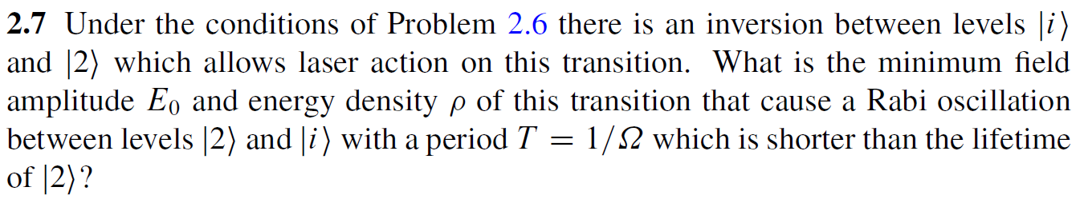
Chap. 2 Problems & Solutions

Slide 66
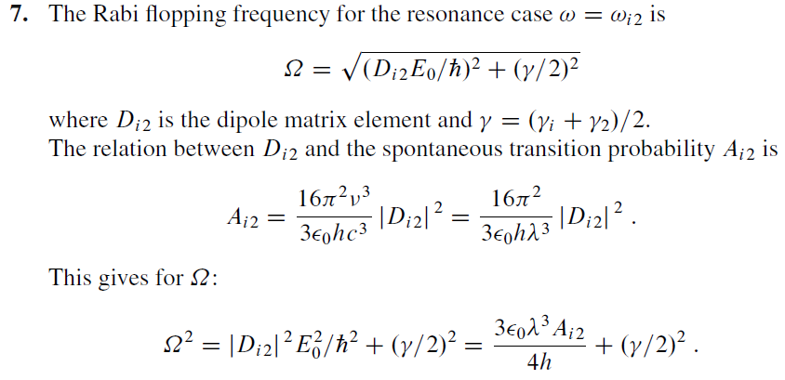

Chap. 2 Problems & Solutions
Rabi Frequency : It tells you how fast the atom flips back and forth between its ground state and excited state under the influence of the applied field. Mathematically, if an atom with dipole moment μ interacts with an electric field of amplitude E, the Rabi frequency is

Slide 67
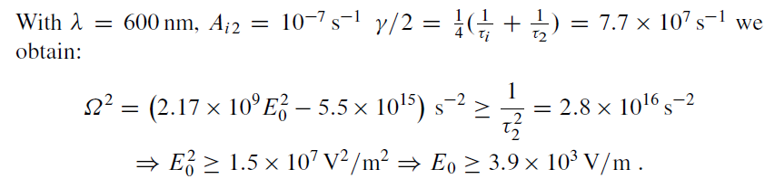
Chap. 2 Problems & Solutions

Slide 68
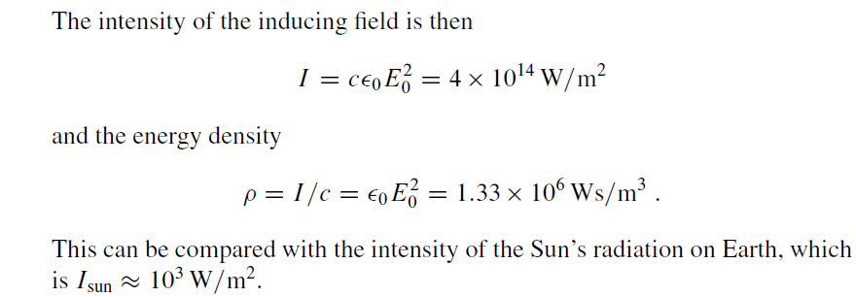
Chap. 2 Problems & Solutions

