Slide 1
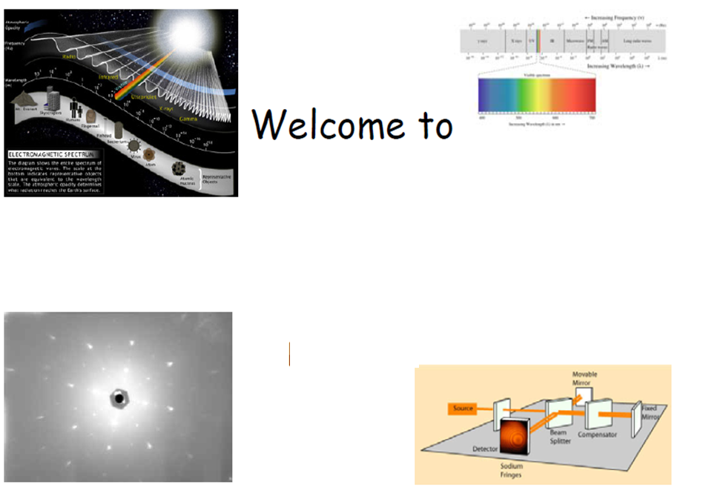


Physics 608
Laser Spectroscopy
251 Semester
Lecture Prepared by Prof. Dr Muhammad Ashraf Gondal

Slide 2
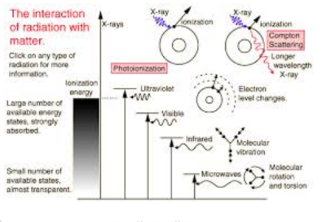
Laser Spectroscopy Course
Instructor: Dr. M. A. Gondal
Office : Room 259 /B Building 6
: Room 153, Building 28
Contact: 8602351/3274
E-mail: magondal@kfupm.edu.sa
Grading Policy:
Assignments: 20
Term Project: 20
First exam : 20
Mid semester : 20
Final Exam : 20
Homework after the deadline will not be accepted unless with official excuses. You may discuss your homework with other students but you are not allowed to copy their work.
The topic of the project is open, but it should be accurately related to laser spectroscopy. It should not be taken out from your thesis or dissertation work. You are advised to choose the topic of your project as soon as possible but no later than 10. 9.2025. You are strongly encouraged to discuss your progress in your project with me during office hours. During the term, you will submit a report and give a presentation.
As per KFUPM Policy, a DN will be assigned if the number of unexcused absences exceeds one-fifth of the total class hours scheduled for the course. That is nine lectures.
Lecture Prepared by Prof. Dr Muhammad Ashraf Gondal

Slide 3
Course Description
PHYS 608 Laser Spectroscopy (3-0-3) Contents
Fundamentals concepts(absorption, emission, stimulated) operation of laser and properties of laser light
Conventional spectroscopic techniques using lasers and broad spectral sources.
Resonant and multiphoton laser absorption processes;
Fluorescence and phosphorescence
Ionization, dissociation, ejected electron spectroscopy,
Mass spectroscopy
Time-of-flight spectroscopy
Photo-acoustic spectroscopy
Analysis and interpretation of spectra from gases, liquids, and solids;
Collisions and other perturbations; Configuration interaction;
Multichannel quantum defect theory and analysis;
Doppler Free Spectroscopy (Supersonic jet molecular spectroscopy;
polarization spectroscopy; saturation spectroscopy(lamb dip spectroscopy) and two photon spectroscopy
Stimulated Raman scattering, coherent effects,
Laser cooling and Bose-Einstein condensation.
Textbooks:
W. Demtröder, Laser spectroscopy (Springer 2015) Edition 4, 5
S. Svanberg, Atomic and molecular spectroscopy: basic aspects and practical applications (Springer 2001)
A. Corney, Atomic and laser spectroscopy (Clarendon Press 1988)
N. B. Colthup, L. H. Daly, S. E. Wiberley; Introduction to infrared and Raman spectroscopy (Academic Press 1990)
P. Hannaford; Femtosecond laser spectroscopy (Springer New York 2005)
J. Michael Hollas, Modern Spectroscopy, 4th edition, Willey, ISBN 0-47084416-7
Lecture Prepared by Prof. Dr Muhammad Ashraf Gondal

Slide 4
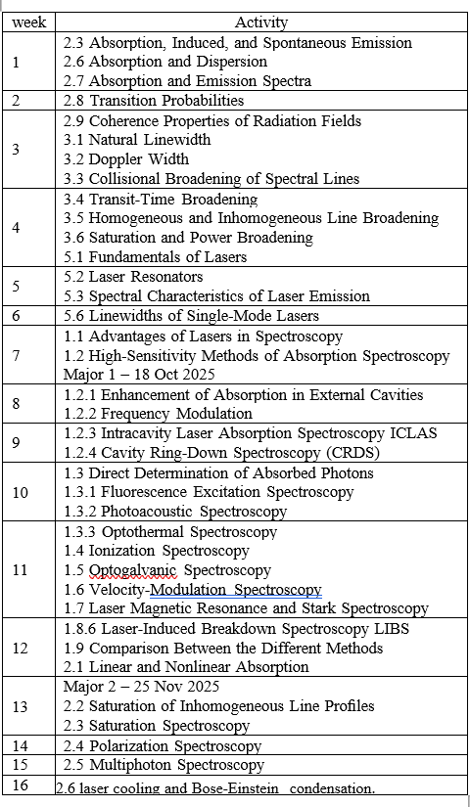
Lecture Schedule
Lecture Prepared by Prof. Dr Muhammad Ashraf Gondal

Slide 5
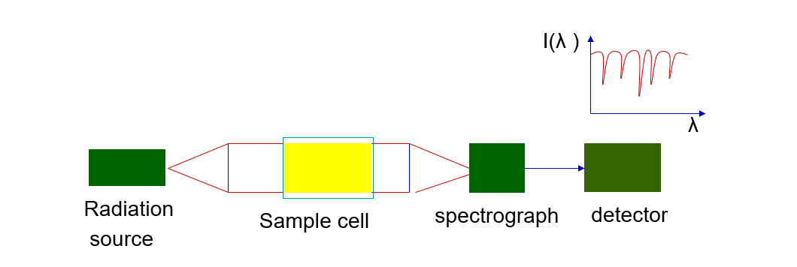
Absorption Spectroscopy Major Components
What is Spectroscopy?
Spectroscopy is study of interaction between matter(atoms, molecules,ions) and electromagnetic radiations (light, microwaves, X-rays, etc.). By analyzing how atoms or molecules absorb, emit, or scatter
radiation, spectroscopy reveals information about their structure, composition, energy levels,
and dynamics. It is a fingerprint tool to identify atoms and molecular species in any test sample
Lecture Prepared by Prof. Dr Muhammad Ashraf Gondal

Slide 6
Properties of Laser Light (with Typical Values)
1. Monochromaticity 🎨
Emits light of a single wavelength (high spectral purity: (Δλ/λ ~ 10⁻⁸ to 10⁻¹²)
(extremely pure wavelength)
Applications - precision measurements
2. Coherence 🔗
Temporal coherence: maintains phase over longer time (Temporal: up to seconds)
Spatial coherence: waves are in phase across beam (beam remains in phase longer distances)
Applications: interference & holography
3. Directionality 🎯
Very low divergence compared to conventional light(Beam divergence:
~0.01–0.1 mrad (vs. ~10⁵ mrad for lamp)
Can travel long distances without spreading
4. High Intensity 💡
Extremely high power density (Power Density: >10⁶ W/cm² (pulsed lasers can reach 10¹⁵ W/cm²)
Applications: cutting, welding, medical surgery
5. Polarization ↔️
Laser light can be linearly, circularly, or elliptically polarized (Typically >99% polarized (linear or circular)
Useful for spectroscopy & optical communications
6. Pulse Width
Very narrow pulse width (autoseconds ~ 10⁻¹⁸ seconds) which results very high output peak powers ~10 Petawatts)

Slide 7
Conventional vs. Laser Spectroscopy
Aspect | Conventional Spectroscopy | Laser Spectroscopy
Light Source | Broad, incoherent (lamps, arcs) | Monochromatic, coherent, intense lasers
Resolution | Limited by source width | Very high (fine/hyperfine structure) can be measured
Sensitivity | Moderate (ppm) | Ultra-sensitive (ppt or single atom)
Selectivity | Broad-band, background interference | Highly selective, tunable transitions
Applications | Routine chemical analysis | Precision research, trace detection, quantum optics

Slide 8
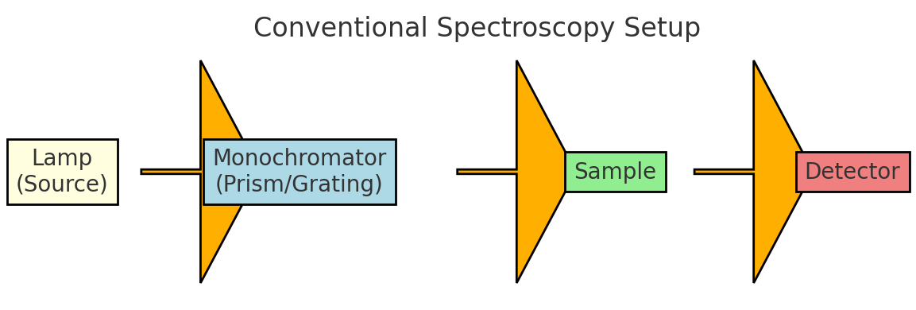
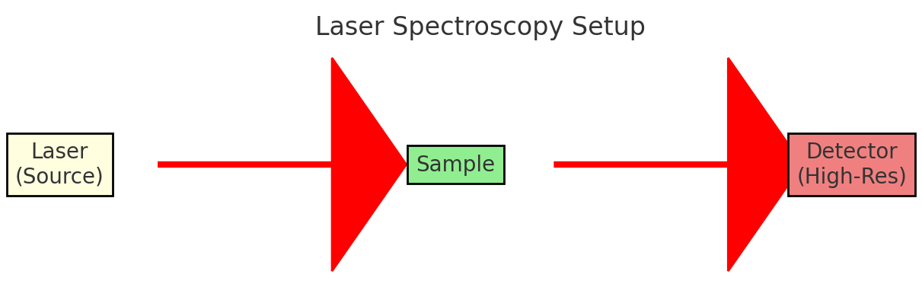
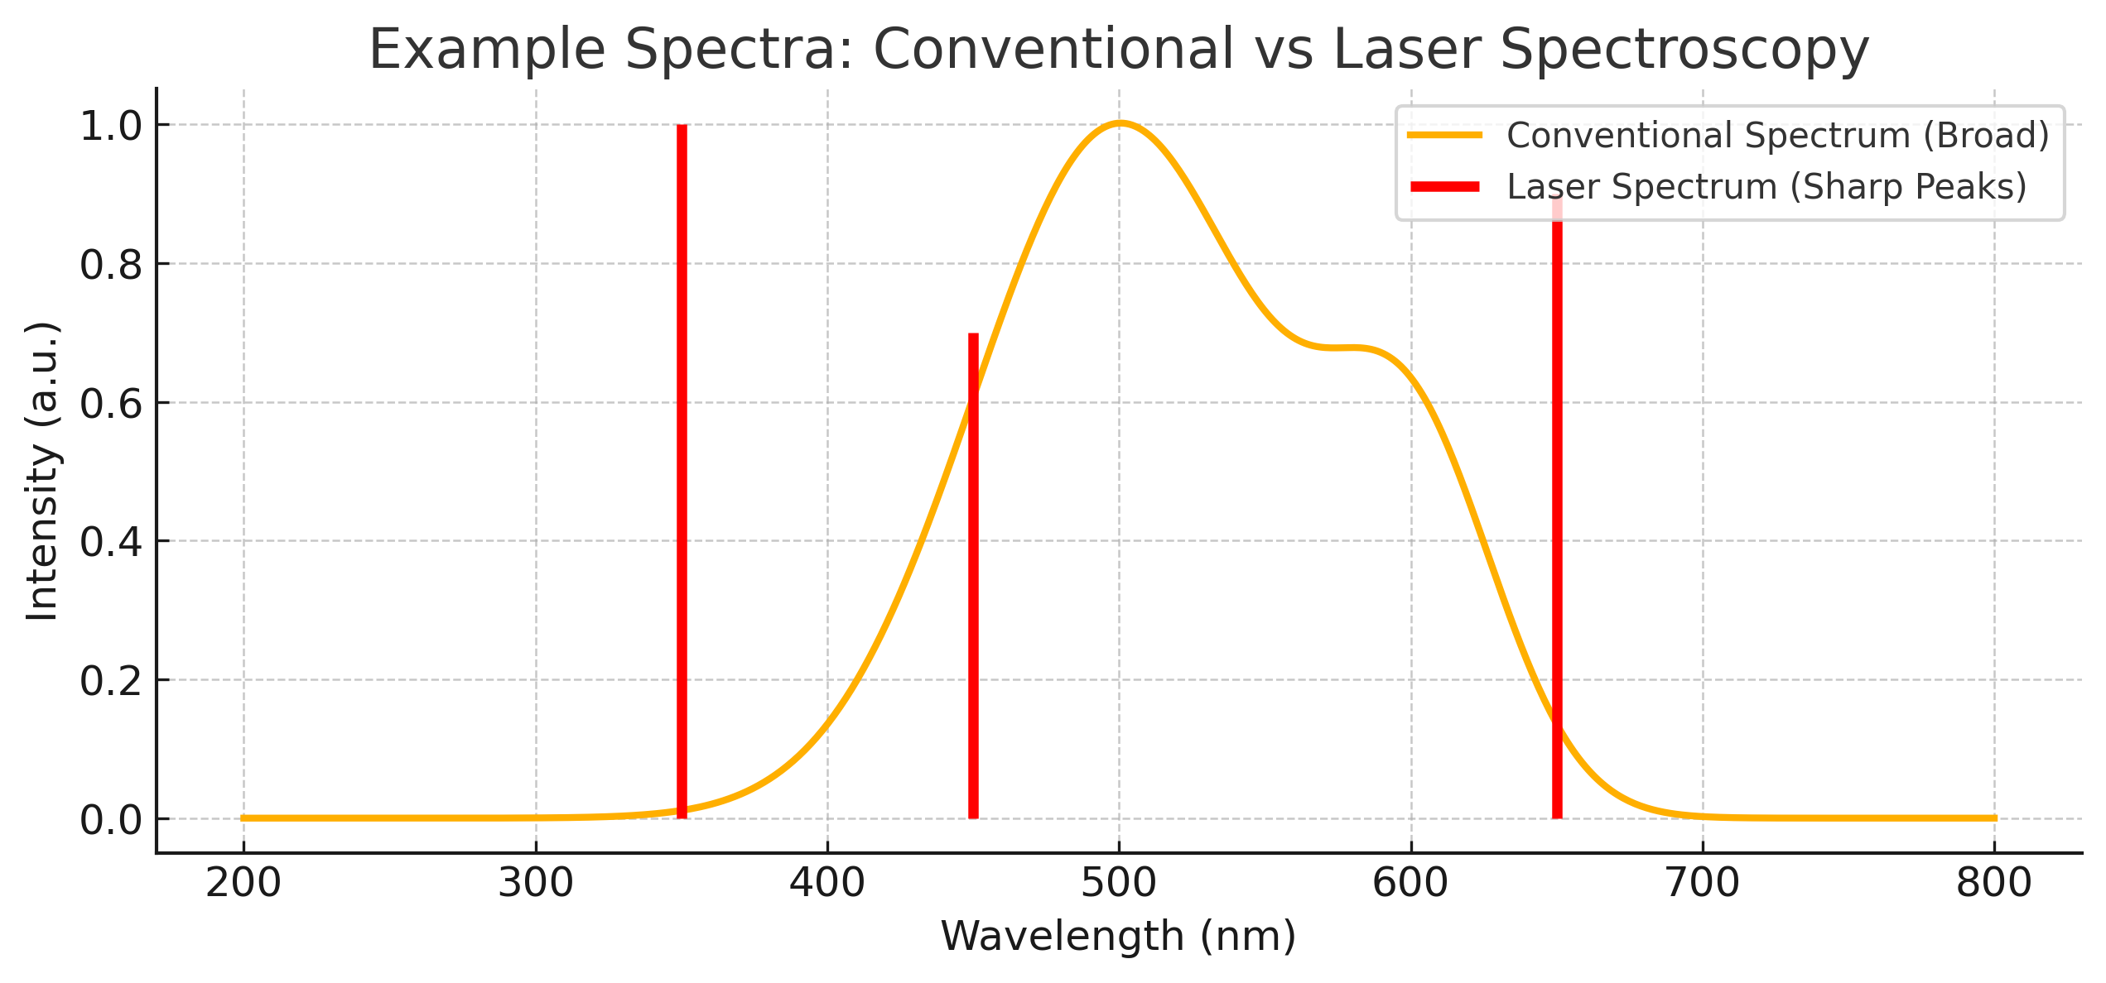
Conventional vs Laser Spectroscopy Setup Spectra
Conventional Spectroscopy Setup:
- Broad lamp source
- Monochromator/prism to select incident
wavelength
- Sample cell
- Detector (photodiode/PMT)
Laser Spectroscopy Setup:
- Laser (monochromatic, tunable)
- Sample cell (atoms/molecules)
- High-resolution detector
- Often lock-in detection for sensitivity

Slide 9
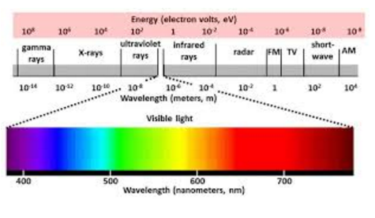
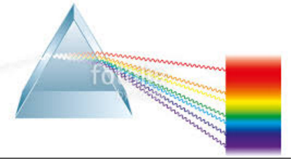
Spectrum of Electromagnetic Radiations
Lecture Prepared by Prof. Dr Muhammad Ashraf Gondal

Slide 10
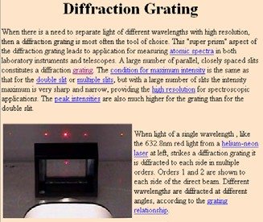
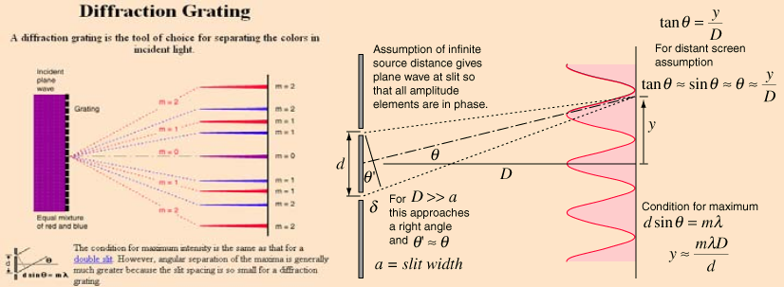


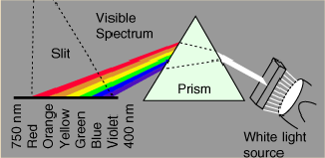


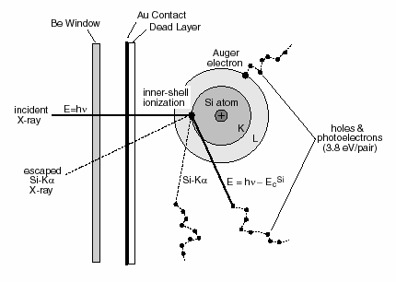
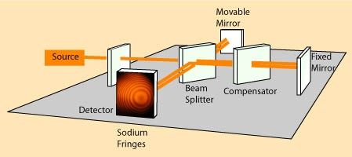
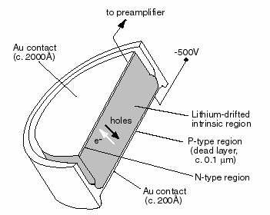
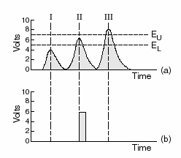
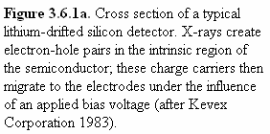
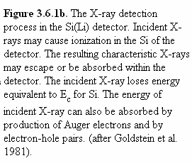

How can we analyze EM waves ?
Position € Wavelength
How can we analyze EM waves ?
Resolution depends on
d – number of groves per mm
Resolution
Prism vs. Grating
Lecture 2
Andrei Sirenko, NJIT
5
Lecture 2
Andrei Sirenko, NJIT
6
How can we analyze EM waves ?
Energy Dispersive Principle
http://www4.nau.edu/microanalysis/Microprobe/Course%20Overview.html
How can we analyze EM waves ?
Interferometry Principle
Andrei Sirenko, NJIT
7
Lecture 2
8
Lecture Prepared by Prof. Dr Muhammad Ashraf Gondal

Slide 11
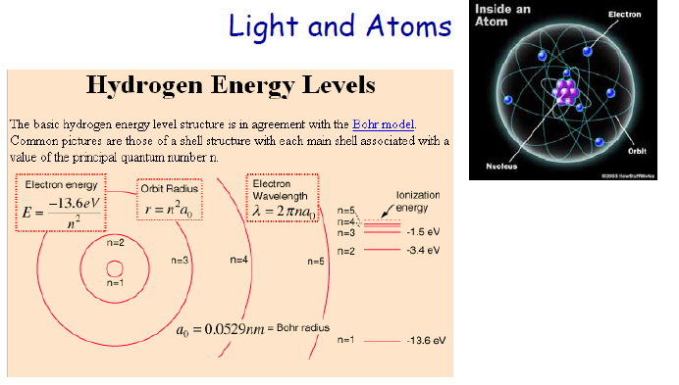
Lecture Prepared by Prof. Dr Muhammad Ashraf Gondal

Slide 12
Chap. 2.3 Absorption, Induced & Spontaneous Emission

Slide 13
Slide 1: Fundamental Light—Matter Interaction Processes
Scope: 3 quantum processes that exchange energy 𝐸 = ℎ𝜈 between radiation field and molecule/atom.
Relevance: determine intensity balance in black-body radiation, enable laser action when rates are manipulated.
Strategy for today’s derivations:
Precisely define each process.
Introduce Einstein coefficients 𝐴₂₁, 𝐵₁₂, 𝐵₂₁ and their relationship each other

Slide 14
Enforce thermal-equilibrium conditions → algebraic relations.
Interpret photon statistics per single electromagnetic (EM) mode.
Learning goal: move from qualitative pictures to fully quantitative formulas usable in spectroscopy and laser design.

Slide 15
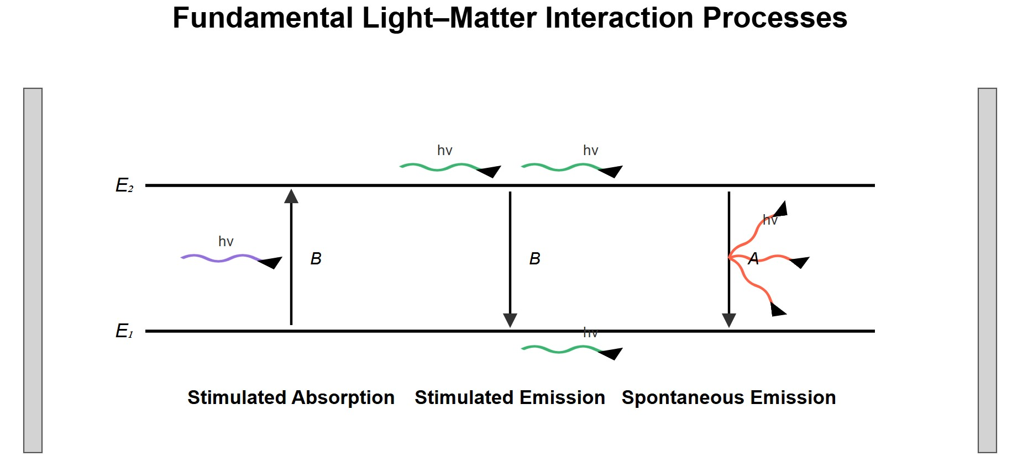
[IMAGE REQUIRED: Illustration showing a two-level atom inside a cavity. Arrows indicating (i) upward absorption, (ii) downward stimulated emission into same mode, (iii) downward spontaneous emission into many modes. Energy levels labeled 𝐸₁, 𝐸₂; photon wave fronts stylised.]

Slide 16
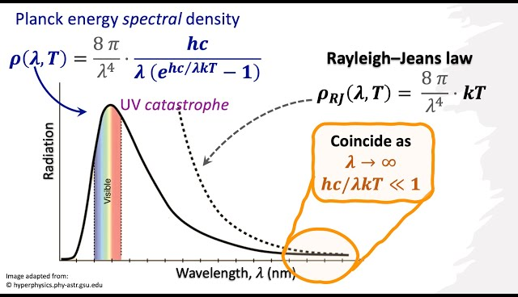

Slide 17
Slide 2: Quick Review — Thermal Radiation Field
A thermal EM field at abs. temp. 𝑇 is characterized solely by its spectral energy density 𝜌_{𝜈} (𝜈, 𝑇) (Energy per unit vol. per unit freq.).
Planck’s distribution (from cavity quantization + Bose-Einstein Statistics):
8𝜋ℎ𝜈³
1
𝜌_{𝜈} (𝜈, 𝑇) =
_{𝑐}3
exp(ℎ𝜈/𝑘𝑇) − 1
where
ℎ = 6.626 × 10⁻³⁴ J s – Planck constant.

Slide 18
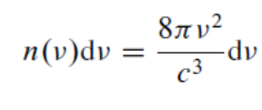
𝑐 = 2.998 × 10⁸ m s⁻¹ – vacuum speed of light.
𝑘 = 1.381 × 10⁻²³ J K⁻¹ – Boltzmann constant.
Every discrete EM mode of frequency 𝜈 then contains on average photons
1
𝑞‾(𝜈, 𝑇) =
exp(ℎ𝜈/𝑘𝑇) − 1
This mean occupancy induced/spontaneous rates.
The number of modes per unit volume within the
frequency interval dν is then
will later
be compared
with

Slide 19
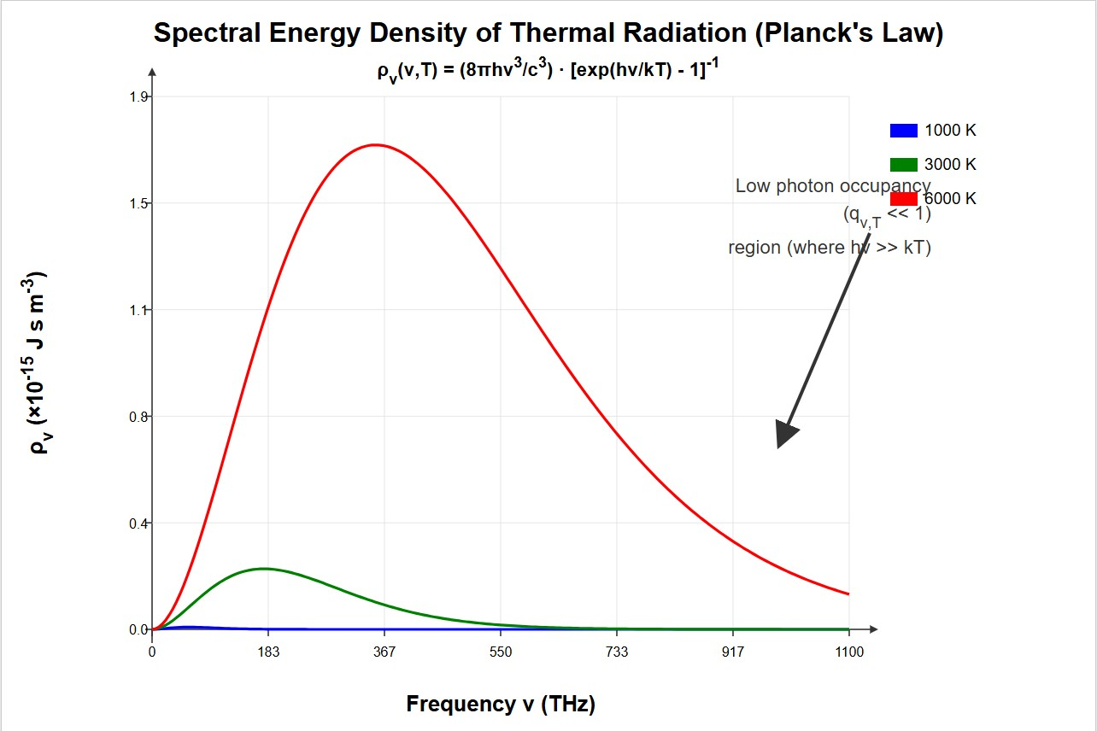
IMAGE REQUIRED: Plot of ^{𝜌}𝜈 vs. ^{𝜈} for several temperatures (e.g. 1000 K, 3000 K, 6000 K). Clearly mark low-photon‐occupancy region.]
--
repared by Dist. Prof. Dr. M.A. Gondal for Phys 608 Laser Spectroscopy course in KFUPM (Term 251)
[
-
P

Slide 20
Slide 3: Two-Level Atom/Molecule Model
Levels:
Lower state |1⟩ with energy 𝐸₁. Upper state |2⟩ with energy 𝐸₂ > 𝐸₁.
Transition frequency (Bohr condition) as proposed by Plank:
ℎ𝜈 = 𝐸₂ − 𝐸₁
𝜈 — exact resonant frequency, units: Hz.

Slide 21
Population symbols:
𝑁₁ ‒ number density (m⁻³) in |1⟩.
𝑁₂ ‒ number density (m⁻³) in |2⟩.
Assumption for derivations: homogeneous, isotropic radiation field; negligible collisions during radiative event (complete radiative isolation for a single transition).

Slide 22
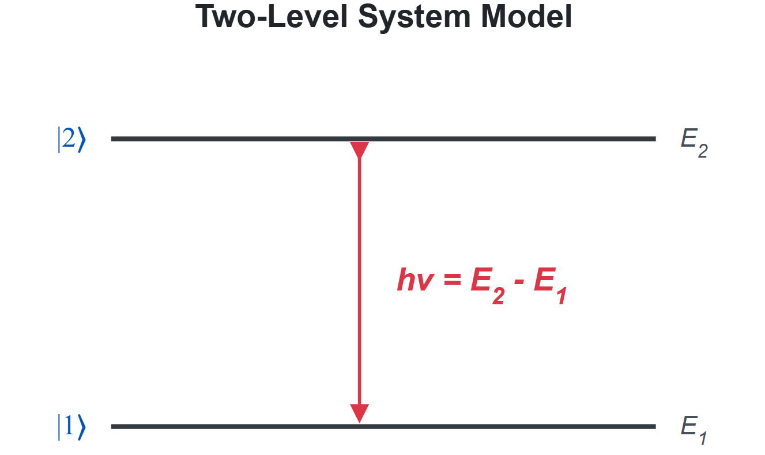
IMAGE REQUIRED: Energy-level diagram only, level spacing labeled, rrow showing ℎ𝜈.]
repared by Dist. Prof. Dr. M.A. Gondal for Phys 608 Laser Spectroscopy course in KFUPM (Term 251)
[
a
P

Slide 23
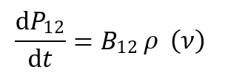
Slide 4: Process ① — Induced (Stimulated) Absorption
Microscopic description:
An incident photon in a specific EM mode is annihilated(absorbed).
Atom jumps |1⟩ → |2⟩.
Probability per molecule/atom, per second:

Slide 24
where
𝐵₁₂ – Einstein coefficient for induced absorption [m³ J⁻¹ s⁻²].
𝜌_{𝜈}(𝜈) – spectral energy density at 𝜈.
Proportionality reason: stronger field intensity ⇒ more incident photons ⇒ higher absorption rate.
Quantum origin of 𝑩_{𝟏𝟐}: determined by squared transition dipole matrix element (𝜇̂ electric-dipole operator, 𝐞 unit polarization vector)
𝐵₁₂ ∝ |⟨2|𝜇̂ ⋅ 𝐞|1⟩|²
_{e= elementary charge, μ = -er}

Slide 25
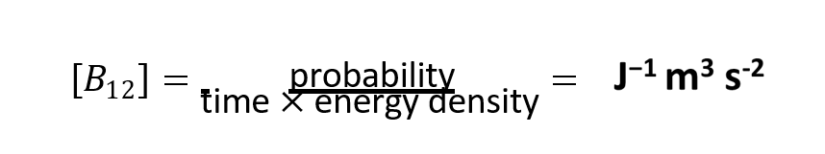
Slide 5: Einstein Coefficient 𝑩_{𝟏𝟐} — What Sets Its Numeric Value?
Dependence only on internal structure:
* Wavefunctions 𝜓₁(𝐫), 𝜓₂(𝐫) as predicted by quantum mechanics.
* Selection rules from parity and angular momentum.
Independence from external EM field provided field is weak enough not to perturb level energies (non-diabatic regime).
Units: ??????

Slide 26
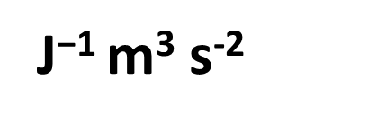
probability
^{[𝐵12] =} time × energy density ⁼
Experimental determination: absorbance measurement ⇒ fit of Beer–Lambert law gives 𝐵₁₂ after calibration of 𝜌_{𝜈}.
We will later link 𝐵₁₂ to measurable spontaneous coefficient 𝐴₂₁.

Slide 27
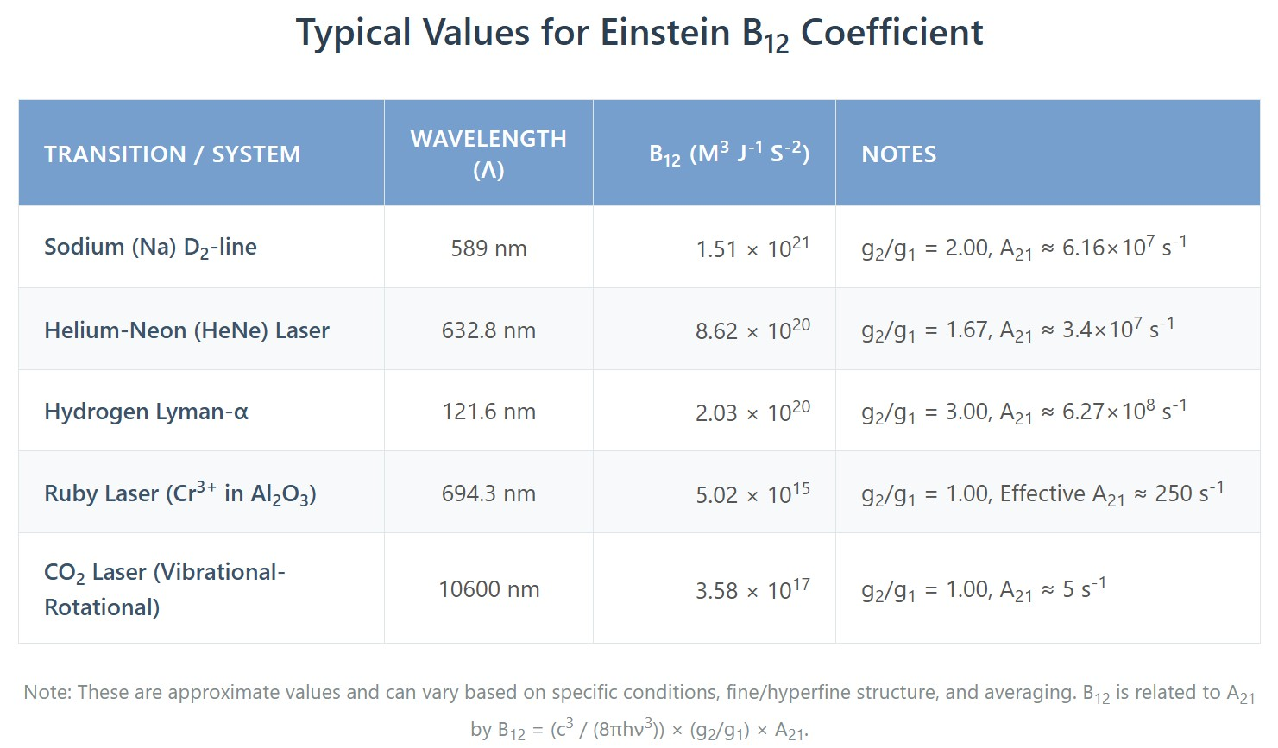
[IMAGE REQUIRED: Table listing typical 𝐵₁₂ values for Na D-line, HeNe
632.8 nm, etc.]
---
Prepared by Dist. Prof. Dr. M.A. Gondal for Phys 608 Laser Spectroscopy course in KFUPM (Term 251)

Slide 28
Slide 6: Process ② — Induced (Stimulated) Emission
Starting condition: atom already in excited state |2⟩.
Incident photon of the same mode (frequency) triggers ↓ downward transition
photon created is coherent with trigger.
Probability per molecule, per second:
ind
d𝑃₂₁
𝜌 (𝜈)
= 𝐵
d𝑡
21 𝜈
where 𝐵₂₁ – Einstein coefficient for induced emission.

Slide 29
Phase/Directionality property: emitted photon duplicates(clone) phase,
direction, polarization, and frequency → key for optical
Amplification in laser action.
Microscopic symmetry suggests 𝑩_{𝟏𝟐}
will be proven quantitatively later.
and 𝑩_{𝟐𝟏}
are closely related;
[IMAGE REQUIRED: Animation concept: incoming second photon, wavefront doubles amplitude.]
wave
stimulates

Slide 30
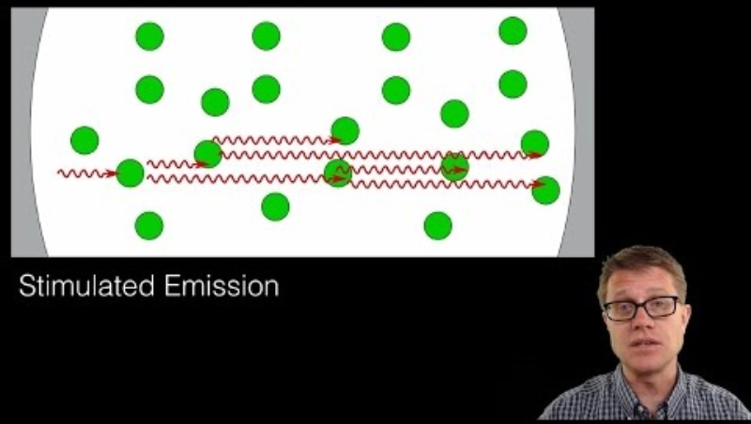

Slide 31
Slide 7: Process ③ — Spontaneous Emission
Occurs without any ext. field; vacuum fluctuations provide trigger.
Probability per molecule, per second (field-independent constant):
spon
d𝑃₂₁
= 𝐴
d𝑡
21
where 𝐴₂₁ – spontaneous emission coefficient [s⁻¹].
Photon characteristics:
Energy fixed at ℎ𝜈 for resonance transition only

Slide 32
2. Emitted into any mode with equal probability (isotropic for
non-preferred polarization/cavity).
Radiative lifetime 𝜏₂ of level |2⟩:
1
𝜏₂ = _{𝐴}
21
ignoring non-radiative decay channels.

Slide 33
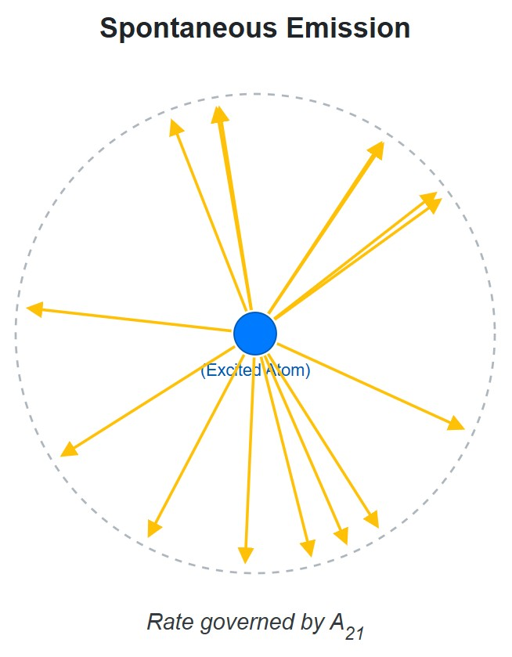
[IMAGE REQUIRED: with random arrows showing photon directions.]
Dr. M.A. Gondal for Phys 608 Laser Spectroscopy course in
---
Prepared by Dist. Prof.
KFUPM (Term 251)

Slide 34
Slide 8: Statistical Weights and Degeneracy
Angular momentum 𝐽_{i}
of level 𝑖 implies 𝑔_{i} = 2 𝐽_{i} + 1 degenerate
Zeeman sub-sublevels (without external field).
Degeneracy
enters both population statistics and transition
probabilities because dipole coupling may occur between multiple sublevel pairs.
In absence of external magnetic/electric fields, all sublevels are equally populated in thermal equilibrium.

Slide 35
Will explicitly see 𝑔₁ and 𝑔₂ in relation 𝐵₁₂ = (𝑔₂/𝑔₁)𝐵₂₁
𝑔₂ and 𝑔₁ are called degeneracies depends on total angular momentum “J”.
𝑔 = 2J + 1 of the level (state)
Here J is rotational quantum number for molecules

Slide 36
Slide 9: Boltzmann Population Distribution in Equilibrium
Total molecular number density:
𝑁 = ∑ 𝑁_{i}
𝑖
Population of level 𝑖:
𝑔_{i} exp(−𝐸_{i}/𝑘𝑇)
𝑁_{i} = 𝑁
where Z is partition function for normalization
𝑍

Slide 37
𝑍 = ∑ 𝑔_{i} exp(−𝐸_{i}/𝑘𝑇)
𝑖
normalizes probabilities.
For two-level subset(system):
^{𝑁2} = ^{𝑔2} exp ( − ^{𝐸2 − 𝐸1}) = ^{𝑔2} exp ( − ^{ℎ𝜈})
𝑁₁ 𝑔₁ 𝑔₁
𝑘𝑇 𝑘𝑇
crucial ratio used in Einstein-coefficient derivation.
Bar charts showing relative Boltzmann populations for different 𝑇…

Slide 38
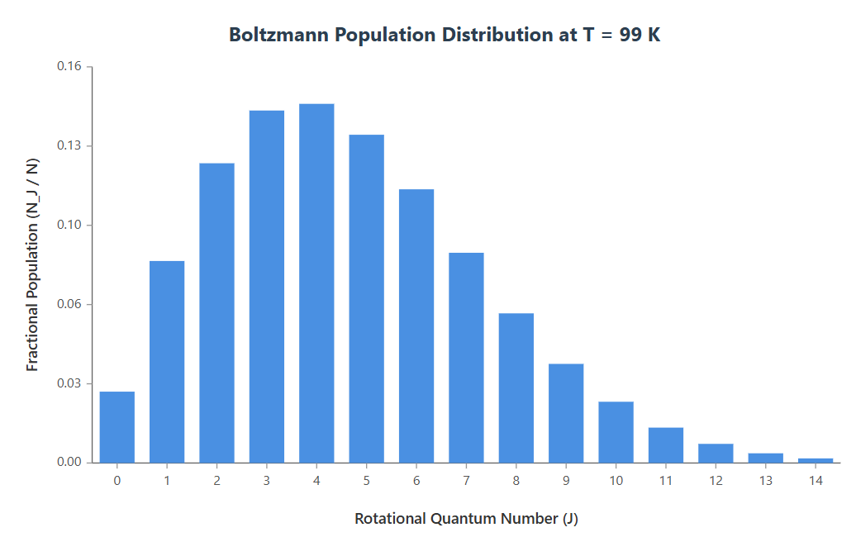
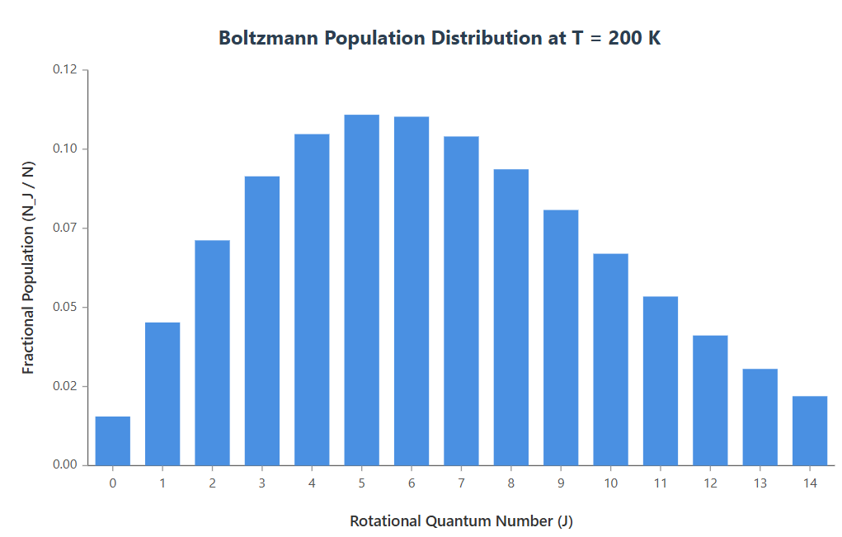
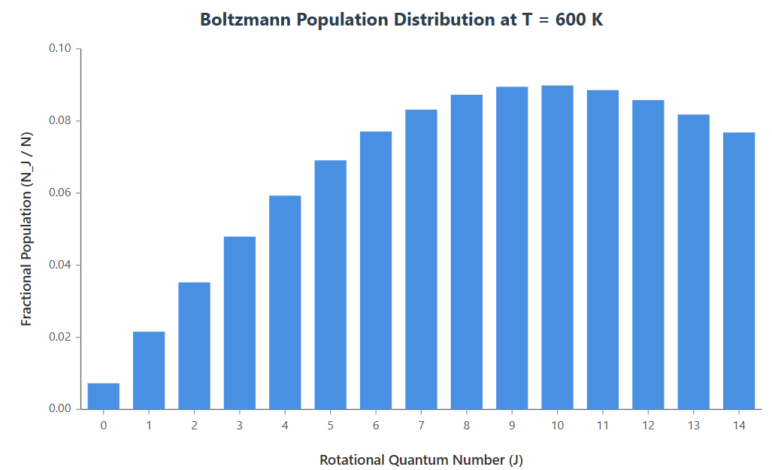
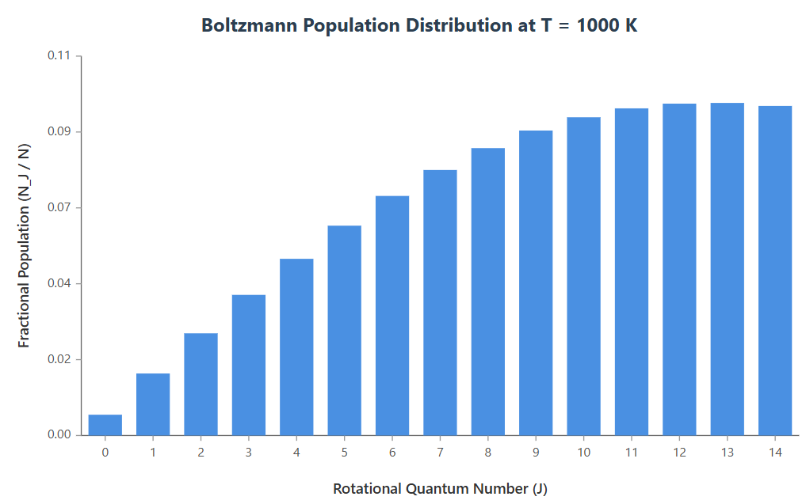
[IMAGE REQUIRED: Bar chart showing relativ
oltzmann populations for different 𝑇.]
e B
Prepared by Dist. Prof. Dr. M.A. Gondal for Phys 608 La
Spectroscopy course in KFUPM (Term 251)
ser

Slide 39
Slide 10: Imposing Detailed Balance: Photon Gain = Loss
At strict thermal equilibrium: energy density
𝜌_{𝜈} (𝜈)
is time-
independent. Therefore per unit volume:
absorption rate = total emission rate in same mode.
Photon loss (absorption):
^{𝑅}abs ^{= 𝑁}1 ^{𝐵}12 ^{𝜌}𝜈^{(𝜈)}
Photon gain (stimulated emission):
^{𝑅}ind.em ^{= 𝑁}2 ^{𝐵}21 ^{𝜌}𝜈^{(𝜈)}

Slide 40
Photon gain (spontaneous emission into all directions including
considered mode):
^{𝑅}spon.em ^{= 𝑁}2 ^{𝐴}21
Detailed balance condition:
^{𝑅}abs ^{= 𝑅}ind.em ^{+ 𝑅}spon.em
ensuring no net change in photon number for that mode.

Slide 41
Slide 11: Algebraic Solution for 𝝆_{𝝂}(𝝂)
Substitute explicit rates:
^{𝑁}1 ^{𝐵}12 ^{𝜌}𝜈 ^{= 𝑁}2^{(𝐵}21 ^{𝜌}𝜈 ^{+ 𝐴}21⁾
Isolate 𝜌_{𝜈}:
^{𝐴}21^{/𝐵}21
𝜌_{𝜈} =
^{𝑁}1 ^{𝐵}12
^{𝑁}2 ^{𝐵}21 ⁻ ¹
Replace population ratio using Boltzmann formula:

Slide 42
^{𝑁1} = ^{𝑔1} exp (^{ℎ𝜈})
𝑁₂ 𝑔₂
Final expression:
𝑘𝑇
^{𝐴}21^{/𝐵}21
𝜌_{𝜈}(𝜈) =
𝑔 𝐵
1
¹² exp(ℎ𝜈/𝑘𝑇) − 1
^{𝑔}2 ^{𝐵}21
Note: still unknown ratios 𝐵₁₂/𝐵₂₁ and 𝐴₂₁/𝐵₂₁ hiding inside.
---

Slide 43
Slide 12: Comparing with Planck Law to Extract
Coefficient Relations
Set our derived 𝜌_{𝜈} equal to Planck’s 𝜌_{𝜈}
Planck
for every 𝜈 and every 𝑇.
Two functions are equal only if their denominators and numerators match identically ⇒ yields two independent algebraic conditions.
Matching denominator exponential factors demands:
𝑔₂
𝐵₁₂ =
^{𝐵}21
𝑔
1

Slide 44
Matching numerators gives:
These two boxed statements are Einstein relations; no approximation made besides thermal equilibrium.
---
8𝜋ℎ𝜈³
_{𝑐}3
𝐴₂₁ =
^{𝐵}21

Slide 45
Slide 13: Physical Interpretation of 𝑩_{𝟏𝟐} = 𝑩_{𝟐𝟏} (𝒈_{𝟐}/𝒈_{𝟏})
If 𝑔₁ = 𝑔₂: induced absorption and induced emission have identical probability coefficients.
Unequal degeneracy: higher 𝑔₂ (more final states for absorption) naturally increases absorption probability.
Reciprocity principle backend: time reversal symmetry of QED matrix elements underlies equality means
The fundamental Hamiltonian describing the interaction between light and matter is Hermitian. This property, related to time-reversal symmetry, implies that the squared magnitude of the matrix element for a transition from an initial state to a final state (e.g.,
|⟨final|𝐻interaction|initial⟩|²) is the same as that for the time-reversed process (from final to initial, mediated by the same interaction).

Slide 46
Useful consequence: measuring either absorption cross-section or gain cross-section suffices to know the other.
Let's understand why?
The Einstein B coefficients are directly related to the concepts of absorption and gain cross-sections, often denoted by the Greek letter sigma (𝜎).
* The absorption cross-section, 𝜎_{abs} (or 𝜎₁₂), quantifies how effectively an atom in the lower state absorbs a photon. It's proportional to 𝐵12 (and also to a line shape function, 𝑔(𝜈), that describes the frequency profile of the transition). (see page 33 of my lecture notes)

Slide 47
Slide 14: Spontaneous vs. Induced Emission into a Single
Mode
Density of EM modes per unit volume(i.e. cube), per unit frequency interval:
8𝜋𝜈²
𝑛(𝜈) =
_{𝑐}3
• Divide equation 𝐴₂₁ = (8𝜋ℎ𝜈³/𝑐³)𝐵₂₁ by 𝑛(𝜈):
^{𝐴}21
= 𝐵₂₁ ℎ𝜈
𝑛(𝜈)

Slide 48
Interpretations:
∗
Left side = spontaneous per-mode probability, denote 𝐴₂₁.
Right side = induced probability when exactly one photon already present.
Therefore one photon in a mode causes stimulated emission at the same rate as vacuum causes spontaneous emission.

Slide 49
Slide 15: General Relation — Induced/Spontaneous Ratio
= Photon Number 𝒒
Energy density in a single mode:
𝜌_{𝜈} (𝜈) = 𝑞 ℎ𝜈
where 𝑞 = instantaneous photon count in that mode.
Induced emission rate per excited molecule:
𝑅_{ind} = 𝐵₂₁ 𝜌_{𝜈} = 𝐵₂₁ 𝑞 ℎ𝜈

Slide 50
Ratio to spontaneous rate:
^{𝑅}ind
𝐵₂₁ 𝑞 ℎ𝜈
= = 𝑞
Key takeaway: each additional photon multiplies induced rate linearly; spontaneous rate is constant.
^{𝑅}spon
∗
^{𝐴}21

Slide 51
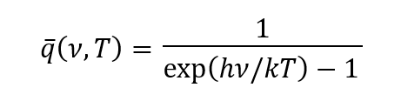
Slide 16: Practical Numbers — Thermal Field vs. Laser
Cavity
Visible light at 𝑇 = 3000 K (approx. tungsten bulb):
* ℎ𝜈/𝑘𝑇 ≈ 5 ⇒ 𝑞‾ (no of photons) ≈ 10⁻²
* Induced ≪ spontaneous per mode.
Same bulb but 10 cm away: actual 𝑞‾ ∼ 10⁻⁸
diluted by 4𝜋𝑟² geometry.
because intensity

Slide 52
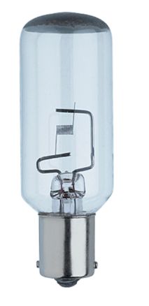
Example: Number of photons in Hg Lamp
High-pressure Hg lamp center, 𝜆 = 253.6 nm: 𝑞‾ ∼ 10⁻².
He–Ne laser single-mode cavity (1 mW, 1 % mirror transmission):
Stored photon number 𝑞 ∼ 10⁷.
Stimulated emission ~10⁷× spontaneous per same mode.

Slide 53
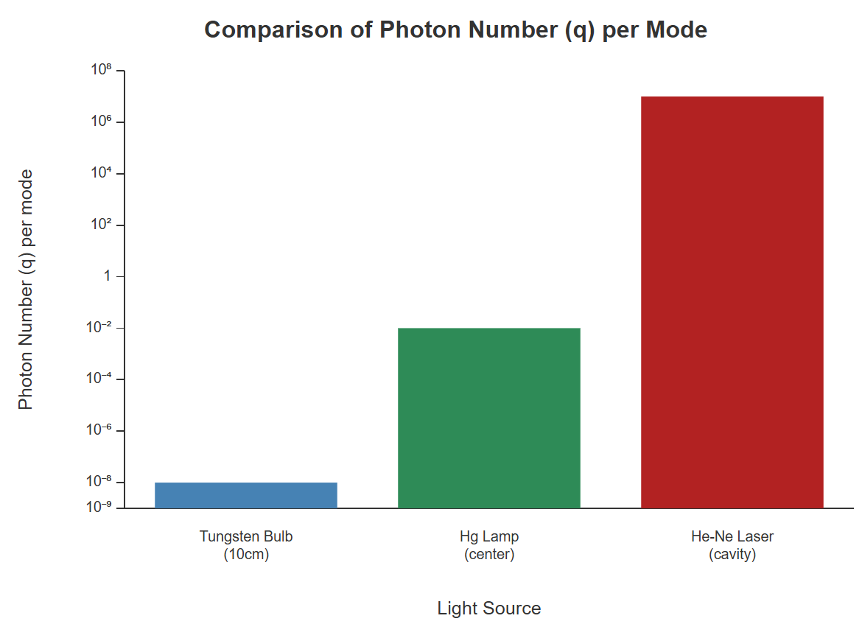
[IMAGE REQUIRED: Log-scale bar graph comparing 𝑞 for three situations: bulb, Hg lamp, laser.]
---
Prepared by Dist. Prof. Dr. M.A. Gondal for Phys 608 Laser Spectroscopy course in KFUPM (Term 25
1)

Slide 54
Slide 17: Independence of Einstein Coefficients from
Radiation Field
• 𝐴₂₁, 𝐵₁₂, 𝐵₂₁ depend only on:
Transition frequency 𝜈.
Dipole matrix elements (intrinsic to molecule/atom).
External field strength, direction, spectrum influence populations 𝑁₁, 𝑁₂ but not coefficients, provided field does not Stark-shift levels.

Slide 55
Hence Einstein relations (slides 12–14) remain valid for any 𝜌_{𝜈} (𝜈): thermal, laser, incoherent lamp, or even vacuum.

Slide 56
Slide 18: Reformulating with Angular Frequency 𝝎
Definition: 𝝎 = 𝟐𝝅𝝂
Mode density per unit 𝜔:
_{𝜔}2
𝑛(𝜔) =
_{𝜋}2_{𝑐}3
Spectral energy density per 𝜔:
_{𝜔}2
ℎ𝜔
^{𝜌𝜔(𝜔) = 𝑛(𝜔) ℎ𝜔 =} 𝜋²𝑐³ exp(ℎ𝜔/𝑘𝑇) − 1

Slide 57
Coefficient ratio becomes:
𝐴₂₁ ₌ ℏ𝜔
3
(ℏ = ℎ/2𝜋)
^{𝐵}21
𝜋𝑐³
Factor 2𝜋 distinction arises solely from change of variable 𝜈 ↔ 𝜔; physical predictions unchanged.

Slide 58
Slide 19: Example 1 — 100 W Tungsten Light Bulb
Parameters: filament 𝑻 ≈ 𝟐𝟖𝟎𝟎 K, observation point 𝒓 = 𝟎. 𝟏𝟎 m, wavelength 𝝀 = 𝟓𝟎𝟎 nm.
Step-by-step photon number per mode 𝒒:
Energy density at bulb surface from Stefan–Boltzmann law and geometric dilution.
Convert to 𝜌_{𝜈} at 𝜆 using Planck formula.
Divide by ℎ𝜈.

Slide 59
4. Divide by mode density 𝑛(𝜈).
Numerical outcome: 𝑞 ≈ 10⁻⁸.
Consequence: stimulated processes in molecular probe essentially zero; fluorescence remains spontaneous.

Slide 60
Slide 20: Example 2 — High-Pressure Hg Lamp
Mercury arc kernel 𝑇 ∼ 7000 K, strongest line 𝜆 = 253.6 nm.
Similar four-step evaluation gives no of photons q ∼ 10⁻².
Although lamp appears extremely bright to human eye, induced emission ≪ spontaneous per mode.
---

Slide 61
Slide 21: Example 3 — Single-Mode HeNe Laser Cavity
Output power 𝑃_{out} = 1 mW. Mirror transmission 𝑇 = 0.01.
Intracavity power: 𝑃_{cav} = 𝑃_{out}/𝑇 = 0.1 W.
Energy stored in mode:
^{𝑃}cav ^{𝐿}
𝑈 =
(𝐿 = cavity length)
𝑐
taking 𝐿 = 0.3 m ⇒ 𝑈 ≈ 1.0 × 10⁻¹⁰ J.
Photon count:

Slide 62
𝑈
𝑞 =
≈ 10⁷
ℎ𝜈
Stimulated emission overwhelms spontaneous (𝑞 ≫ 1); nevertheless, spontaneous into all other modes still supplies primary noise seed.

Slide 63
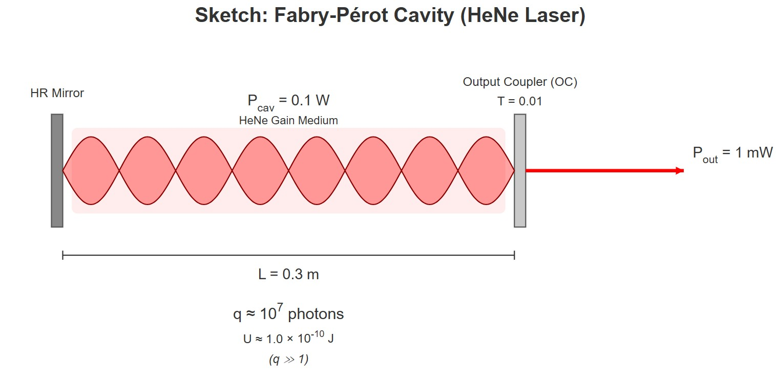
[IMAGE REQUIRED: Sketch of Fabry–Pérot cavity with standing-wave pattern and photon number indicated.]
Prepared by Dist. Prof. Dr. M.A. Gondal for Phys 608 Laser Spectroscopy course in KFUPM (Term 251)

Slide 64
Slide 22: Conceptual Bridge to Lasers
Laser gain medium engineered to invert populations (𝑁₂ > 𝑁₁).
Large 𝑞 accumulated in resonator → induced emission dominates →
exponential amplification.
Selective feedback (mirrors) confines energy to very few modes →
increases 𝑞 further without raising spontaneous emission.
Einstein-coefficient framework remains valid; only 𝑁₁, 𝑁₂
from Boltzmann distribution.
deviate

Slide 65
Slide 23: Key Take-Home Messages
Three elementary processes fully characterize linear light–matter interaction for a single transition.
Einstein
relations enforce self-consistency with black-body
radiation; no additional adjustable parameters.
Spontaneous emission sets fundamental noise floor; stimulated term scales with photon occupancy 𝑞.

Slide 66
Real-world bright thermal sources rarely reach 𝑞 ∼ 1; laser cavities routinely reach 𝑞 ≫ 1, enabling coherent amplification.
Mastery of 𝐴₂₁, 𝐵₁₂, 𝐵₂₁ is prerequisite for quantitative laser‐rate modeling, saturation spectroscopy, and fluorescence lifetime analysis.
---

Slide 67
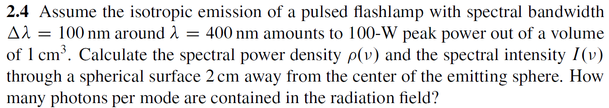
Chap. 2 Problems & Solutions

Slide 68
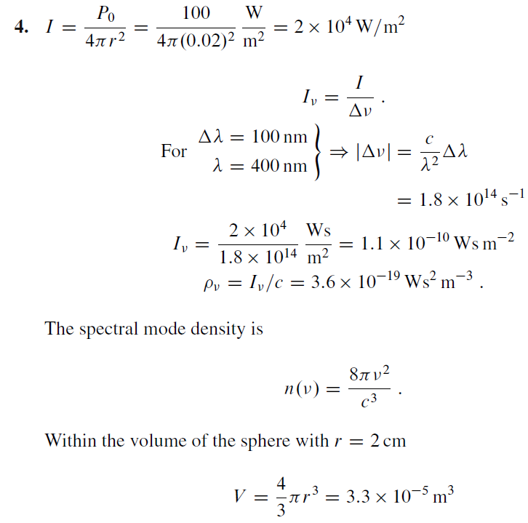
Chap. 2 Problems & Solutions

Slide 69
Chap. 2 Problems & Solutions

Slide 70
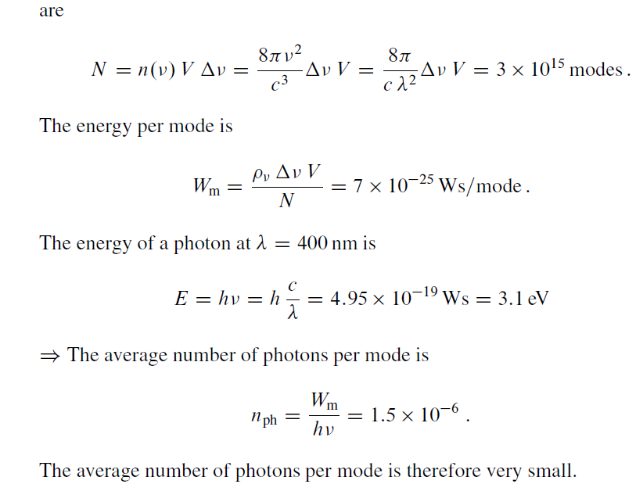
Chap. 2 Problems & Solutions

Slide 71
Chap. 2 Problems & Solutions

