Slide 1
Chap. 5.6 Linewidths of Single-Mode Lasers

Slide 2
Slide 1: Motivation – Why Does a Laser Have a
Linewidth at All?
Every real laser emits a spectrum with non-zero width, called the
linewidth Δ𝜈_{L}.
Ultranarrow linewidths are essential for:
  High-resolution spectroscopy (resolving isotope shifts, hyperfine splittings).

Slide 3
2. Optical frequency standards interferometric length metrology).
(atomic
clocks,
laser
3. Coherent manipulation of quantum states in quantum information.
Understanding the ultimate, fundamental lower limit on Δ𝜈_{L} reveals deep connections between:
  Quantum fluctuations of the electromagnetic field.
  Spontaneous emission of atoms.

Slide 4
3. Cavity photon statistics & phase diffusion.
Goal of this section: derive the Schawlow–Townes quantum limit, analyse the underlying noise mechanisms, and compare with experimentally achievable linewidths.

Slide 5
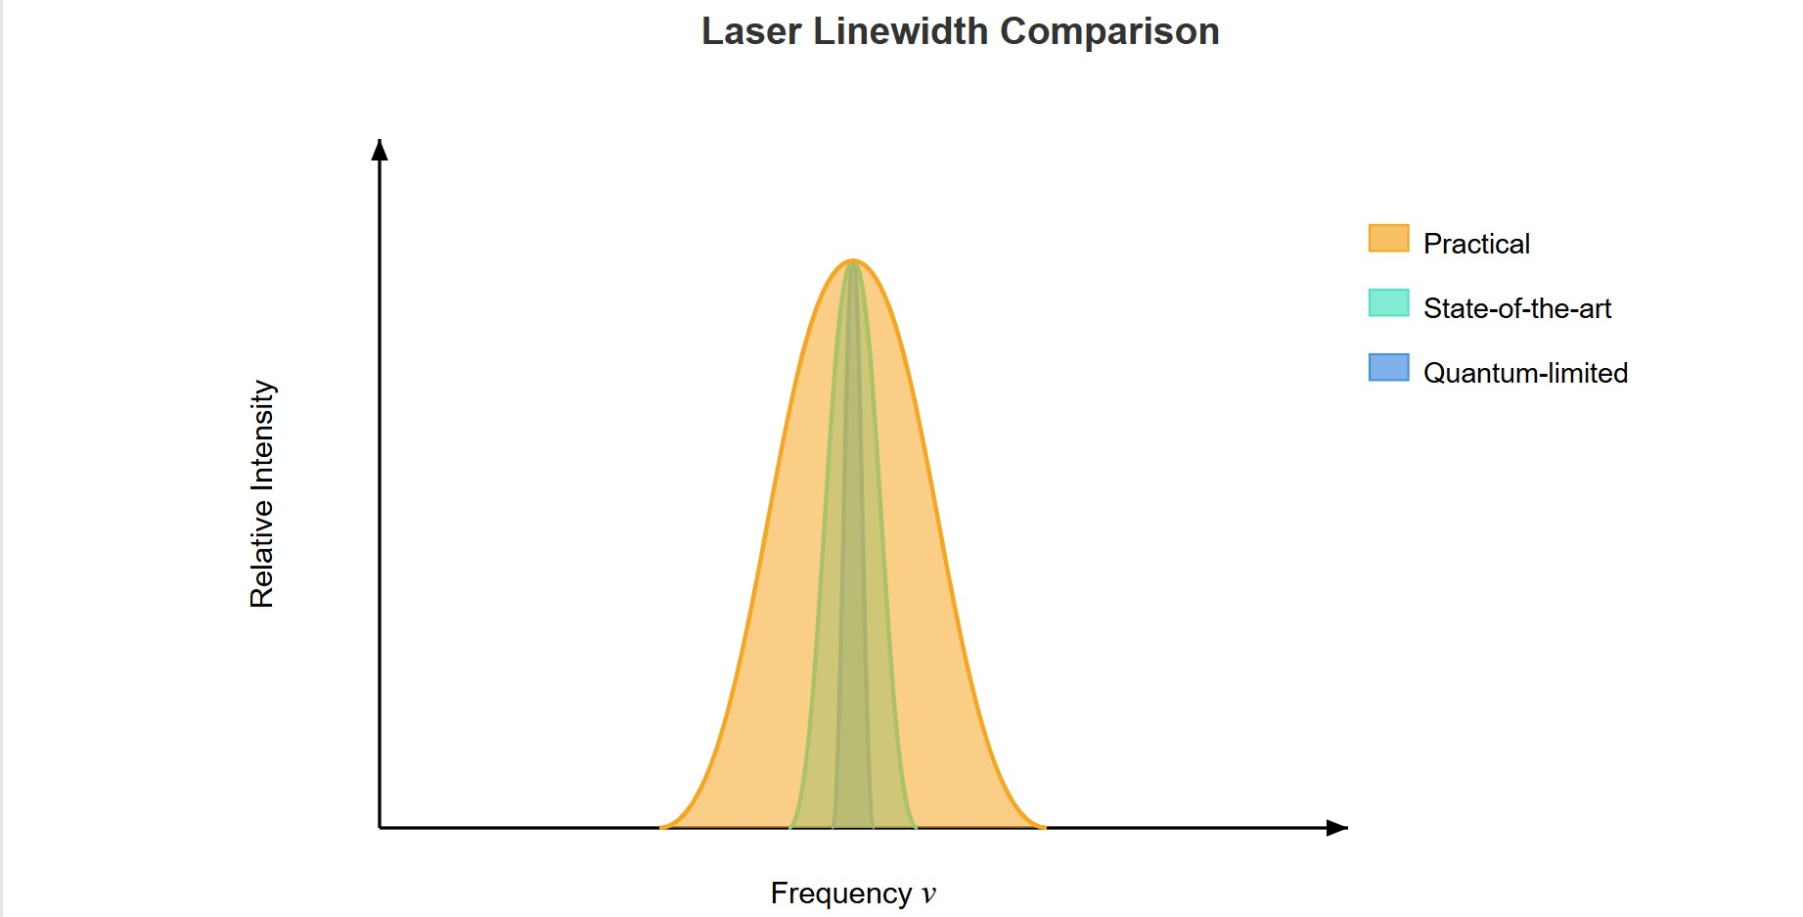
[IMAGE REQUIRED: A slide-style illustration showing three lasers with different linewidths represented by spectral peaks of different widths, annotated “practical”, “state-of-the-art”, and “quantum-limited”. Include an axis label Frequency v and Relative intensity.]
Prepared by Dist. Prof. Dr. M.A. Gondal for Phys 608 Laser Spectroscopy course in KFUPM (Term 251)

Slide 6
Slide 2: Basic Definitions – From Perfect
Monochromaticity to Finite Bandwidth
Ideal monochromatic wave (never realised in practice):
𝐸_{ideal}(𝑡) = 𝐸₀cos(2𝜋𝜈₀𝑡)
Real laser field must be written as
𝐸(𝑡) = 𝐴(𝑡) cos[2𝜋𝜈₀𝑡 + 𝜙(𝑡)]

Slide 7
where * 𝐴(𝑡) = slowly varying amplitude (in V m⁻¹). * 𝜙(𝑡) = slowly
varying phase (in rad).
Linewidth Δ𝜈_{L}: Full Width at Half Maximum (FWHM) of the power spectral density |𝐸(𝜈)|². Relates to coherence time 𝜏_{c} by
1
^{𝜏c ≈} 𝜋 Δ𝜈
L
Coherence length 𝐿_{c}: distance over which the field remains phase- correlated.

Slide 8
𝐿_{c} = 𝑐 𝜏_{c}
Narrower Δ𝜈_{L} ⇒ longer 𝐿_{c} (kilometres for Hz-level lasers).
---

Slide 9
Slide 3: Classification of Frequency Noise in Lasers
Technical (extrinsic) noise – originates outside quantum theory: * Fluctuations of cavity length 𝑑 (thermal expansion, vibrations). * Variations of refractive index 𝑛 (temperature, pressure, acoustic waves). * Power-supply and pump-intensity noise.
Fundamental (intrinsic) noise – cannot be eliminated even with “perfect” engineering: 1. Spontaneous emission into the lasing mode. 2. Photon-number (shot) noise leading to amplitude

Slide 10
fluctuations. 3. Phase diffusion generated by random birth times of photons.
Linewidth discussion below completely ignores technical noise and addresses only the intrinsic limit.

Slide 11
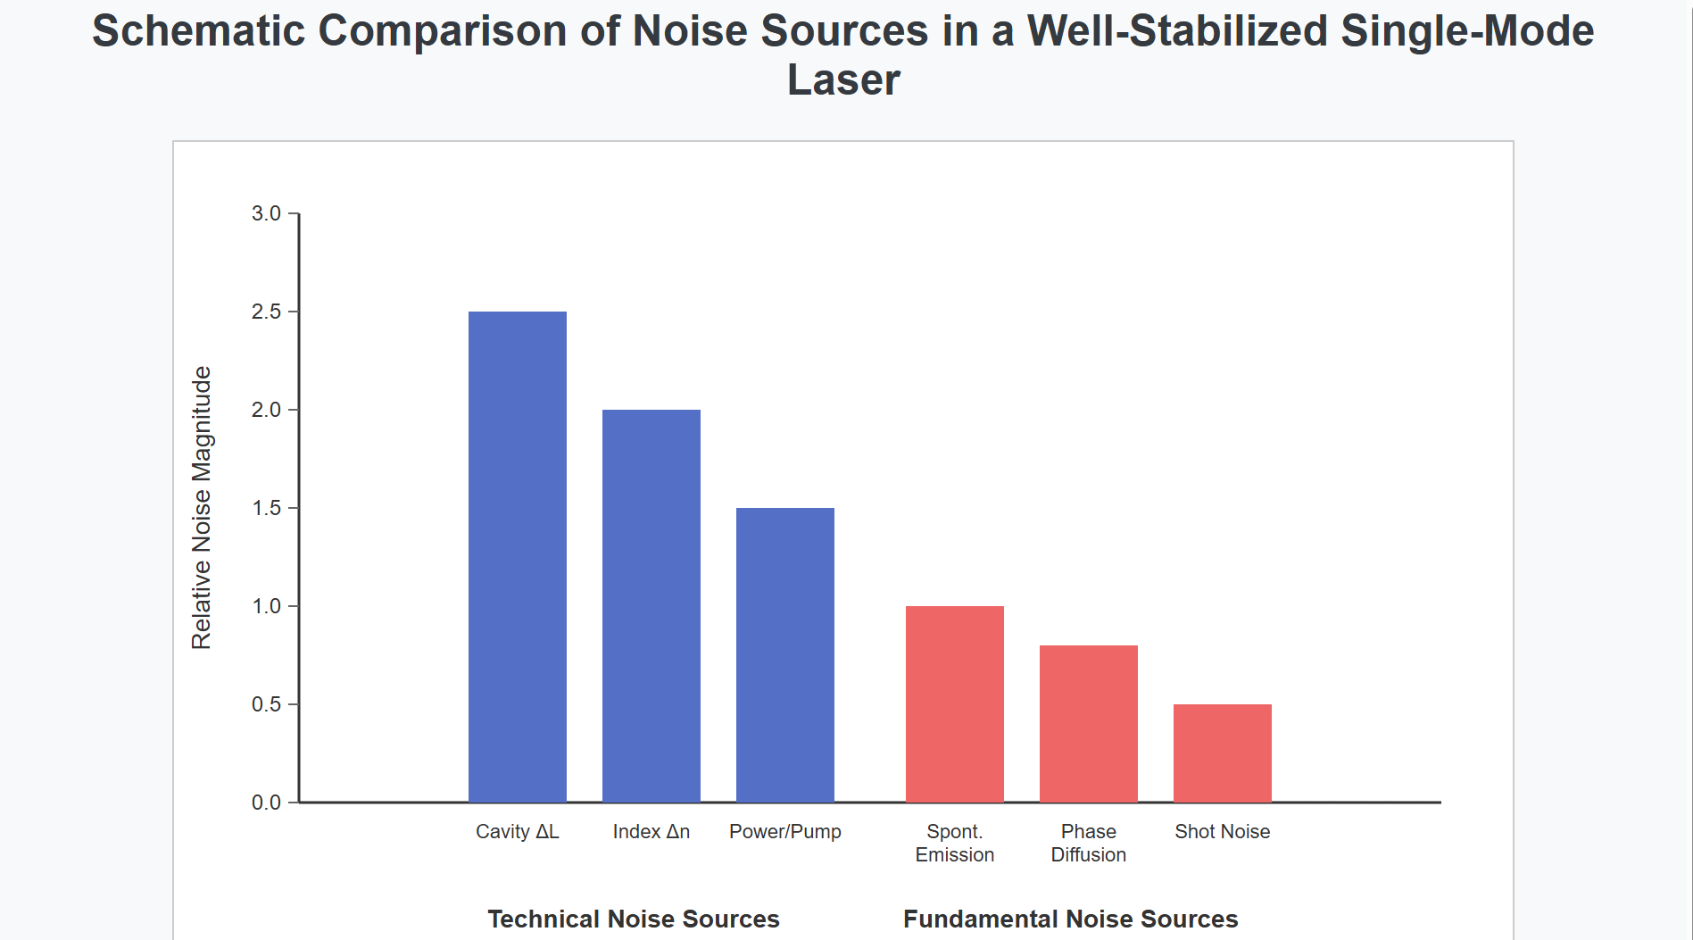
[IMAGE REQUIRED: Schematic bar chart comparing sizes of technical vs. fundamental noise sources for a typical well-stabilised single-mode laser.]
---
Prepared by Dist. Prof. Dr. M.A. Gondal for Phys 608 Laser Spectroscopy course in KFUPM (Term 251)

Slide 12
Slide 4: Spontaneous Emission – First Fundamental Noise
Source
Atom in upper laser level 𝐸_{i} decays to lower level 𝐸_{k} with probability per unit time 𝐴_{𝑖𝑘} (Einstein 𝐴-coefficient, units s⁻¹).
Total spontaneous power radiated from active volume 𝑉_{m} containing population density 𝑁_{i}:
𝑃_{𝑠𝑝} = 𝑁_{i} 𝑉_{m} 𝐴_{𝑖𝑘} ℎ𝜈_{L}
ℎ = Planck’s constant, 𝜈_{L} = laser frequency.

Slide 13
Photons
are emitted into all electromagnetic
modes
within
fluorescence bandwidth (Doppler width Δ𝜈_{D}).
Number
of spatial & polarisation modes
per unit
volume in
bandwidth Δ𝜈_{D}:
2
8𝜋𝜈_{L} Δ𝜈_{D}
^{𝒩}modes ≈
_{𝑐}3

Slide 14
Mean photon number per mode from spontaneous emission ≪ 1 ; therefore, initial optical field is dominated by vacuum fluctuations until laser reaches threshold.

Slide 15
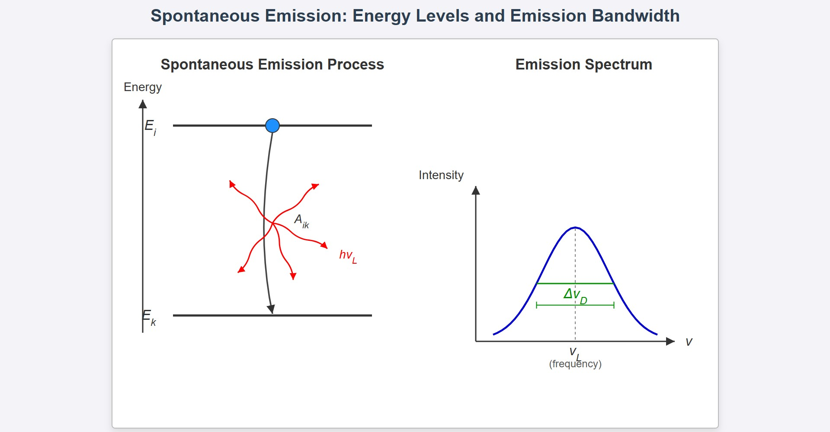
[IMAGE REQUIRED: Energy-level diagram with upper level 𝐸_{i}, lower level
𝐸_{k}, arrows showing spontaneous photons emitted into random directions, bandwidth indicated.]
---
Prepared by Dist. Prof. Dr. M.A. Gondal for Phys 608 Laser Spectroscopy course in KFUPM (Term 251)

Slide 16
Slide 5: Numerical Illustration – Spontaneous Photons in
a HeNe Laser
Stationary upper-level population density: 𝑁_{i} ≈ 10¹⁰ cm⁻³.
Einstein coefficient: 𝐴_{𝑖𝑘} ≈ 10⁸ s⁻¹.
Spontaneous photon rate per unit volume:
𝑅_{𝑠𝑝} = 𝑁_{i} 𝐴_{𝑖𝑘} = 10¹⁸ photons s⁻¹ cm⁻³
Modes in Doppler bandwidth at 𝜆 = 632.8 nm:

Slide 17
𝒩_{modes} ≈ 3 × 10⁸ modes cm⁻³
Photon flux into a single mode:
Φ = 𝑅_{𝑠𝑝}𝒩mds ≈ 3 × 10⁹ photons s − 1
Mean photon density in that mode:
𝛷
⟨𝑛_{𝑝ℎ}⟩ = _{𝑐} ≲ 0.1

Slide 18
Compare with ∼ 10⁷
photons per mode under 1 mW lasing →
spontaneous contribution is negligible to amplitude but crucial for phase.
---

Slide 19
Slide 6: Photon-Number (Shot) Noise and Amplitude
Stabilisation
Output power 𝑃 relates to average output photon rate:
𝑃
𝑛 =
ℎ𝜈_{L}
• 1 mW at ℎ𝜈_{L} ≈ 2 eV ⇒ 𝑛 ≈ 8 × 10¹⁵ s⁻¹.
Statistical
distribution of emitted photons in one-second
observation window obeys the Poisson law (for a coherent state):

Slide 20
_{𝑛}^{𝑛} _{𝑒}−𝑛
𝑝(𝑛) =
𝑛!
Relative root-mean-square fluctuation (shot noise):
√⟨(𝛥𝑛)²⟩ 1
= ≪ 1
𝑛
√𝑛
Gain saturation: if an instantaneous fluctuation causes 𝑛 to rise, population inversion is depleted, gain drops, and amplitude self- corrects.

Slide 21
Result: amplitude noise contributes little to Δ𝜈_{L}; dominant effect is
phase noise.
---

Slide 22
Slide 7: Geometric Picture – Amplitude–Phase
Representation
Complex electric-field phasor:
𝐄 = 𝐴 𝑒^{𝑖𝜙}
𝐴 limited to narrow annulus 𝛿𝐴 by saturation. * 𝜙 performs a random walk from 0 to 2𝜋.
Phase diffusion: incremental random “kicks” of 𝜙 each time a spontaneous photon enters the cavity mode.

Slide 23
No equivalent restoring force for phase → phase undergoes
unbounded Brownian motion; variance ⟨[𝜙(𝑡) − 𝜙(0)]²⟩ ∝ 𝑡.

Slide 24
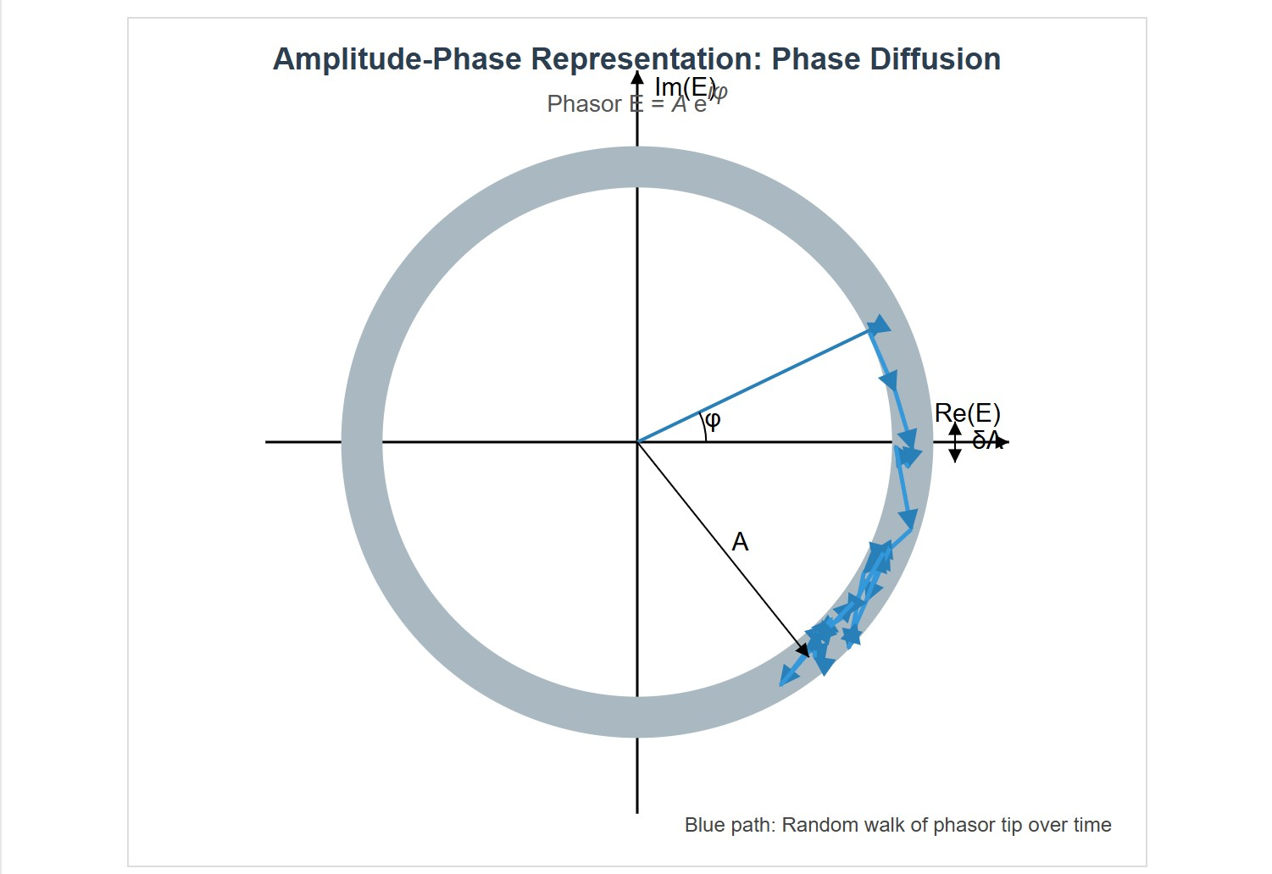
[IMAGE REQUIRED: Polar plot with a thin ring illustrating fixed amplitude, arrows indicating random angular diffusion of 𝜙 over time.]
---
Prepared by Dist. Prof. Dr. M.A. Gondal for Phys 608 Laser Spectroscopy course in KFUPM (Term 251)

Slide 25
Slide 8: Phase Diffusion Model – Deriving the Lorentzian
Spectrum
Assume small time increment 𝛿𝑡:
𝜙(𝑡 + 𝛿𝑡) = 𝜙(𝑡) + 𝛿𝜙
𝛿𝜙 is Gaussian with zero mean, variance 2 𝐷𝛿𝑡.
Phase-diffusion coefficient 𝐷 (units Hz):
1 d
𝐷 =
⟨[𝜙(𝑡) − 𝜙(0)]²⟩
2 d𝑡

Slide 26
Time-domain correlation function of field:
⟨𝐸∗(0)𝐸(𝑡)⟩ = 𝐴² 𝑒^{−𝐷|𝑡|}
Fourier transform of this exponential decay gives the Lorentzian power spectrum:
𝐸₀
2 _{𝐷}2
|𝐸(𝜈)|² =
(𝜈 − 𝜈₀)² + 𝐷²
FWHM of spectrum equals
Δ𝜈_{L} = 2 𝐷

Slide 27
By historical convention many texts quote half-width at half-maximum
𝐷; we shall use full width Δ𝜈_{L}.
---

Slide 28
Slide 9: Physical Origin of the Diffusion Coefficient 𝑫
Each spontaneously emitted photon adds uncertain phase 𝛿𝜙 ∼ 1/√𝑛.
Rate of such events ∝ spontaneous photon rate into mode 𝑁_{𝑠𝑝}.
Including cavity photon lifetime 𝜏_{c} and output coupling yields
^{𝑁}𝑠𝑝
1
𝐷 ∝
2𝑛 𝜏_{c}

Slide 29
Larger output power 𝑃_{L}
linewidth.
Smaller cavity bandwidth Δ𝜈_{c} (higher finesse) decreases fraction of spontaneous photons accepted, hence also reduces 𝐷.
---
⇒ larger 𝑛 ⇒ smaller 𝐷 ⇒ narrower

Slide 30
Slide 10: Cavity Properties – Definitions & Relations
Resonator half-width Δ𝜈_{c}
coupling:
determined by mirror losses & output
1
Δ𝜈_{c} = _{2𝜋𝜏}
c
where 𝜏_{c} = photon lifetime in the cavity.
Quality factor 𝑄:

Slide 31
𝜈_{L}
𝑄 =
2 Δ𝜈_{c}
Finesse ℱ:
Free Spectral Range
𝑐
ℱ =
=
Δ𝜈_{c}
2 𝑑 Δ𝜈_{c}
High 𝑄 or high ℱ ⇒ narrow Δ𝜈_{c}
photons, key to small Δ𝜈_{L}.
⇒ filters out most spontaneous

Slide 32
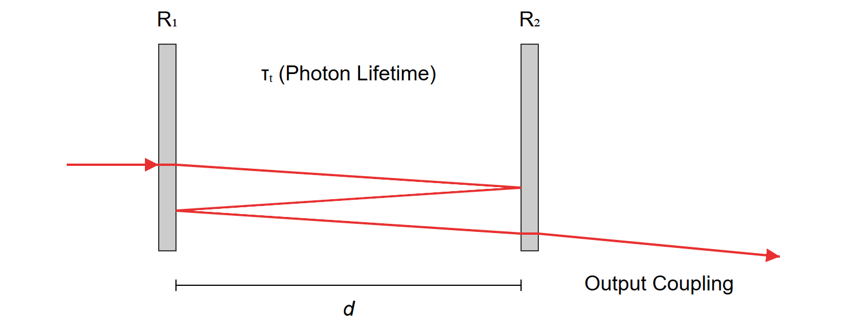
[IMAGE REQUIRED: Simple Fabry–Pérot cavity drawing with length 𝑑, reflectivities 𝑅₁, 𝑅₂, indicating 𝜏_{c}, photon paths, and output coupling.]
Prepared by Dist. Prof. Dr. M.A. Gondal for Phys 608 Laser Spectroscopy course in KFUPM (Term 251)

Slide 33
Slide 11: Step-by-Step Derivation of the Schawlow–
Townes Limit
Start from phase-diffusion width (half-width) 𝐷:
1 ℎ𝜈_{L}
𝐷 =
(Δ𝜈_{c})² (𝑁_{𝑠𝑝} + 𝑁_{𝑡ℎ} + 1)
4𝜋 𝑃_{L}
where

Slide 34
𝑁_{𝑠𝑝} = spontaneous photons s⁻¹
in lasing mode. * 𝑁_{𝑡ℎ}
= thermal
photons s⁻¹ (negligible at optical frequencies, 𝑁_{𝑡ℎ} ≪ 1). * “1” counts vacuum fluctuations.
Multiplying by 2 converts half-width to full linewidth:
𝜋ℎ𝜈_{L} (Δ𝜈_{c})² (𝑁_{𝑠𝑝} + 𝑁_{𝑡ℎ} + 1)
Δ𝜈_{L} = 2 𝐷 =
2 𝑃
L

Slide 35
Minimum possible value reached when exactly one spontaneous
photon per cavity lifetime initiates the stimulated chain (𝑁_{𝑠𝑝} = 1)
and 𝑁_{𝑡ℎ} ≈ 0.
This yields the celebrated Schawlow–Townes formula:
𝜋ℎ𝜈_{L}(Δ𝜈_{c})²
Δ𝜈_{ST} =
𝑃
L
Key insight: linewidth ∝ square of cavity width, inversely ∝ output power.

Slide 36
Slide 12: Practical Calculation Examples
HeNe laser (632.8 nm):
• 𝜈_{L} = 5 × 10¹⁴ Hz * Δ𝜈_{c} = 1 MHz * 𝑃_{L} = 1 mW
Δ𝜈_{L} ≈ 1.0 × 10⁻³ Hz
Argon-ion laser (488 nm):
• 𝜈_{L} = 6 × 10¹⁴ Hz * Δ𝜈_{c} = 3 MHz * 𝑃_{L} = 1 W
Δ𝜈_{L} ≈ 1.1 × 10⁻⁵ Hz

Slide 37
These values are many orders of magnitude narrower than technical noise can presently allow.

Slide 38
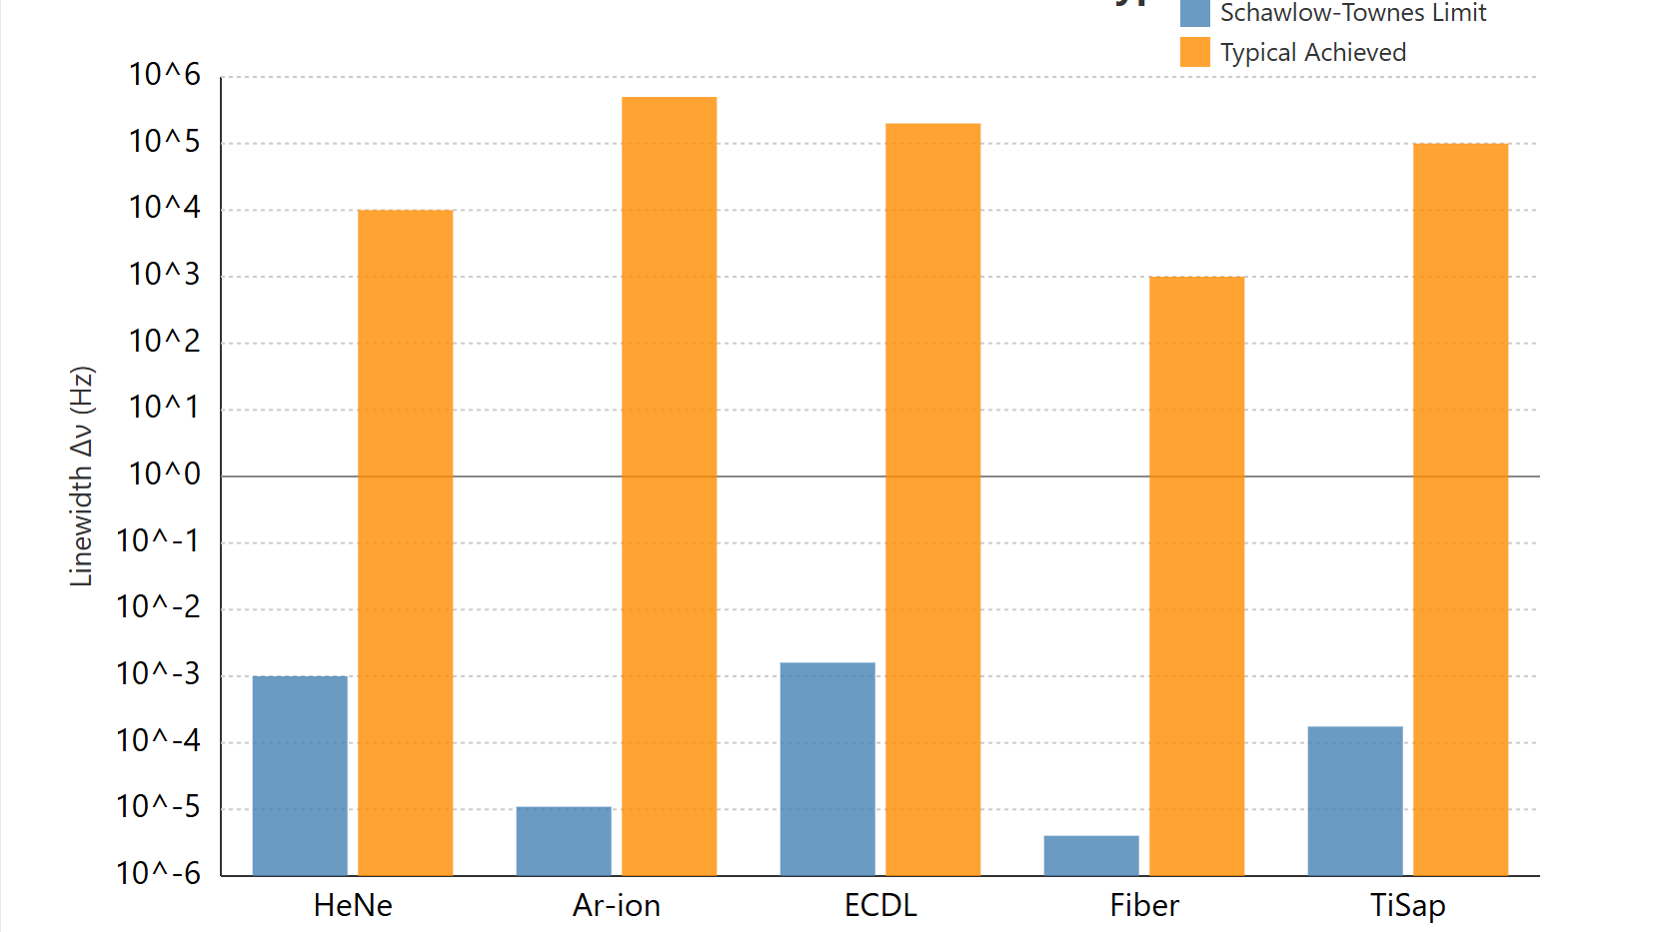
[IMAGE REQUIRED: Logarithmic bar graph showing theoretical ST limits
vs. typical achieved linewidths for various lasers.]
Prepared by Dist. Prof. Dr. M.A. Gondal for Phys 608 Laser Spectroscopy course in KFUPM (Term 251)

Slide 39
Slide 13: Experimental Reality – Comparison with
Achieved Linewidths
Typical good single-mode gas or dye lasers (moderate effort):
Δ𝜈_{L} ∼ 10⁴–10⁶ Hz
State-of-the-art
isolation):
ultra-stabilised systems (ULE cavities, vibration
Δ𝜈_{L} ≲ 1 Hz

Slide 40
Remaining gap between measured linewidth and ST limit arises from:
* Residual cavity-length fluctuations 𝑛𝑑. * Acoustic and electronic noise in servo loops. * Environmental temperature drifts inducing
index changes.
Research continues on techniques such as spectral hole burning, active cancellation, and cryogenic cavities to close the gap.
---

Slide 41
Slide 14: Linewidth vs. Frequency Stability – Do Not
Confuse!
Linewidth
diffusion.
Frequency stability: ability of the line centre 𝜈₀ to remain constant over time.
Example achievements:
Δ𝜈_{L}:
intrinsic spectral width due to random phase

Slide 42
𝛿𝜈
_{≲ 10}−15
𝜈
for dye lasers locked to molecular references.
𝛿𝜈
_{≲ 10}−16
𝜈
for cavity-stabilised HeNe or solid-state lasers.
Narrow linewidth is a necessary but not sufficient condition for excellent stability; active feedback & referencing are required.

Slide 43
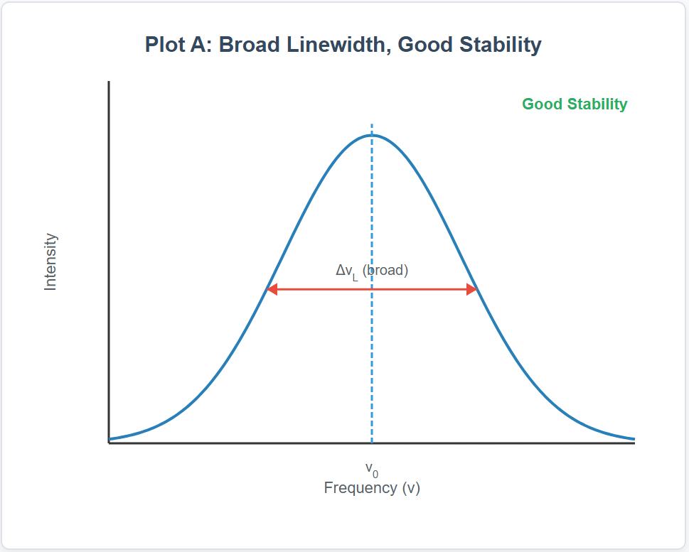
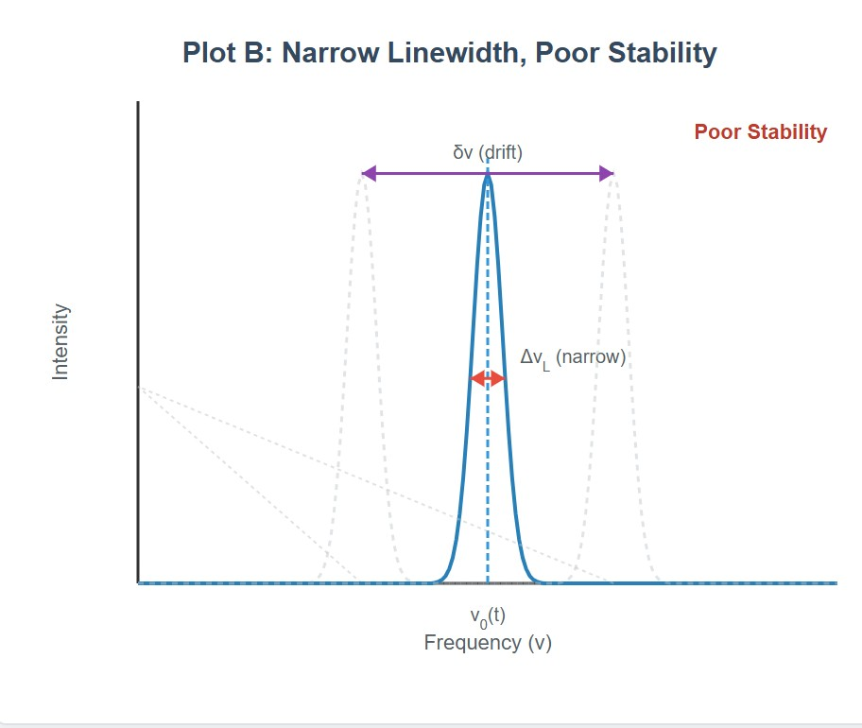
[IMAGE REQUIRED: Two separate spectral plots—one broad but
perfectly centered, one narrow but dri between linewidth and frequency stab
---
Prepared by Dist. Prof. Dr. M.A. Gondal for Phys 608 Laser Spectr
fting—highlighting the distinction ility.]
scopy course in KFUPM (Term 251)
o

Slide 44
Slide 15: Implications for Ultra-High-Resolution
Spectroscopy
Resolution limit of a spectroscopic measurement often set by probe- laser linewidth rather than sample linewidth.
Long coherence length enables interferometric techniques (e.g., gravitational-wave detectors use sub-Hz lasers).
Knowledge of ST limit guides engineering of:
Prepared by Dist. Prof. Dr. M.A. Gondal for Phys 608 Laser Spectroscopy course in KFUPM (Term 251)

Slide 45
Cavity finesse and mirror coatings. * Output coupling to balance power vs. linewidth. * Pump-noise suppression and thermal design.
Understanding phase noise foundation is critical for next-generation optical clocks targeting 10⁻¹⁸ fractional stability.
The
Schawlow–Townes framework remains a cornerstone for
designing, diagnosing, and pushing laser systems toward quantum- limited performance.
---
Prepared by Dist. Prof. Dr. M.A. Gondal for Phys 608 Laser Spectroscopy course in KFUPM (Term 251)

Slide 46
Prepared by Dist. Prof. Dr. M.A. Gondal for Phys 608 Laser Spectroscopy course in KFUPM (Term 251)

