Slide 1
Chap. 5.3 Spectral Characteristics of Laser Emission

Slide 2
Slide 1: Spectral Characteristics of Laser Emission —
Setting the Stage
Goal
of this block of slides: build a rigorous, step-by-step
understanding of how an active medium and an optical resonator together determine the exact set of frequencies emitted by a laser.
Key
ingredients that must be analysed separately and then
combined:
The spectral gain profile of the amplifying transition in the medium.

Slide 3
The discrete resonance spectrum (axial and transverse modes) of the passive optical cavity.
The non-linear, intensity-dependent phenomena that arise once oscillation starts (gain saturation, mode competition, spatial hole burning, mode pulling, …).
Strategy for the forthcoming slides:
Introduce mathematical description of the passive cavity.
Insert an active medium, derive modified eigenfrequencies.

Slide 4
Develop the laser threshold condition from first principles.
Examine line-narrowing effects, saturation physics, multimode behaviour, and the frequency shifts produced by dispersion in the gain medium.
  Conventions adopted throughout:
  𝑐: speed of light in vacuum [m s⁻¹].
  𝑑: physical mirror separation [m].

Slide 5
𝑛(𝜈): frequency-dependent refractive index of the active medium (dimensionless).
𝐿: length of the gain medium inside the cavity [m].
Axial mode index 𝑞 ∈ ℤ.
All symbols will be re-defined on the

Slide 6
Slide where they first appear.
CGS and SI units will be stated explicitly when needed.
---

Slide 7
Slide 2: Passive Fabry–Perot Resonator — Eigenfrequency
Review
Consider two perfectly parallel mirrors separated by distance 𝑑. For vacuum between the mirrors, the round-trip optical path length is 2 𝑑.
Standing-wave condition (electric field node at each mirror):
𝑐
2 𝑑 = 𝑞
^{𝜈}𝑞,vac

Slide 8
where
𝜈_{𝑞,vac}: eigenfrequency of the 𝑞-th axial mode in vacuum [Hz].
𝑞: integer mode number ( 0,1,2, … ).
Solve for the eigenfrequencies:
𝑞 𝑐
^{𝜈}𝑞,vac ⁼ _{2 𝑑}
Important derived quantity – Free Spectral Range (FSR):

Slide 9
𝑐
𝛿𝜈 =
^{𝜈}𝑞+1,vac ^{− 𝜈}𝑞,vac
=
2 𝑑
FSR is the constant spacing between adjacent axial modes of the passive cavity.
Passive cavity half-width (power) of each resonance, caused by mirror transmission 𝑇 and additional losses 𝛾, will be derived later when 𝐺(𝜈) is introduced.
---

Slide 10
Slide 3: Inserting an Active Medium — Effective Optical
Length
Whenever a dielectric slab of physical length 𝐿 and frequency- dependent index 𝑛(𝜈) is placed between the mirrors, the effective round-trip optical path length changes.
Replace the earlier geometric length 𝑑 by an effective length 𝑑∗(𝜈). Detailed derivation:
1. Segment outside the gain medium:

Slide 11
(𝑑 − 𝐿) in vacuum ⇒ optical length (𝑑 − 𝐿)
Segment inside the gain medium:
𝐿 gives optical length 𝑛(𝜈) 𝐿
Total optical length:
𝑑∗(𝜈) = (𝑑 − 𝐿) + 𝑛(𝜈) 𝐿
Rearranged form:
𝑑∗(𝜈) = 𝑑 + [𝑛(𝜈) − 1]𝐿
  The new eigenfrequency condition becomes:

Slide 12
𝑐
2 𝑑∗(𝜈) = 𝑞
^{𝜈}𝑞,act
where 𝜈_{𝑞,act} denotes the active-cavity eigenfrequency.

Slide 13
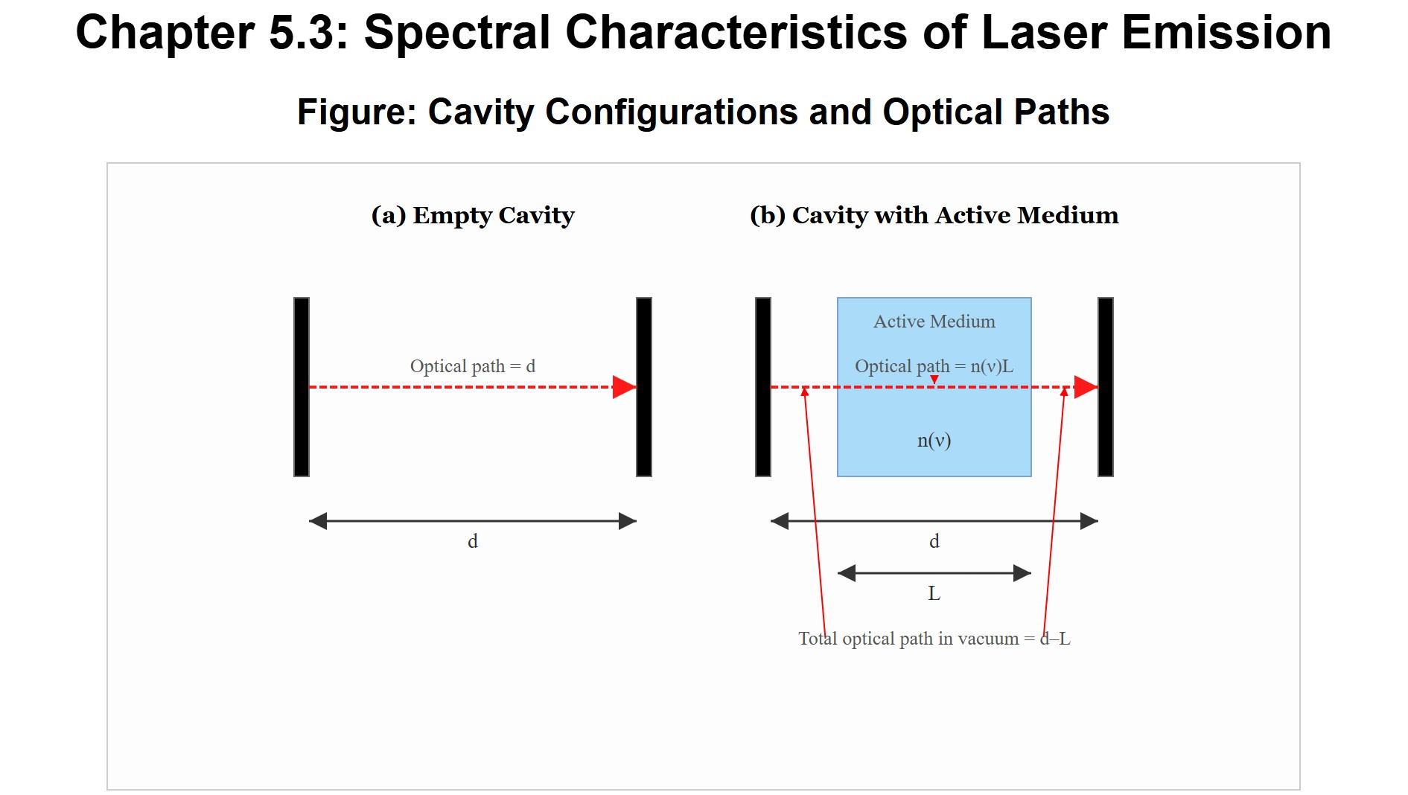
[IMAGE REQUIRED: Show side-by-side sketches of (a) empty cavity 𝑑; (b) cavity with active medium of length 𝐿; optical paths indicated; arrows marking 𝑑 − 𝐿 and 𝑛𝐿.]
---
Prepared by Dist. Prof. Dr. M.A. Gondal for Phys 608 Laser Spectroscopy course in KFUPM (Term 251)

Slide 14
Slide 4: Anomalous Dispersion and Its Spectroscopic
Importance
Within the gain bandwidth of an inverted transition, the real part of the refractive index exhibits anomalous dispersion:
𝑛(𝜈) decreases below unity on the low-frequency side ( 𝜈 < 𝜈₀ ).
𝑛(𝜈) increases above unity on the high-frequency side ( 𝜈 > 𝜈₀ ).
Physical reason:

Slide 15
Kramers–Kronig
relations link negative absorption (stimulated
emission) to a dispersive phase shift.
The sign change in 𝛼(𝜈) (gain instead of loss) forces a corresponding sign change in d𝑛/d𝜈.
Resulting pulling of the cavity modes:
Frequency of each mode is shifted towards 𝜈₀ compared with the passive value 𝜈_{𝑞,vac}.

Slide 16
Quantitative formula).
expression
derived
in later
slides
(mode
pulling

Slide 17
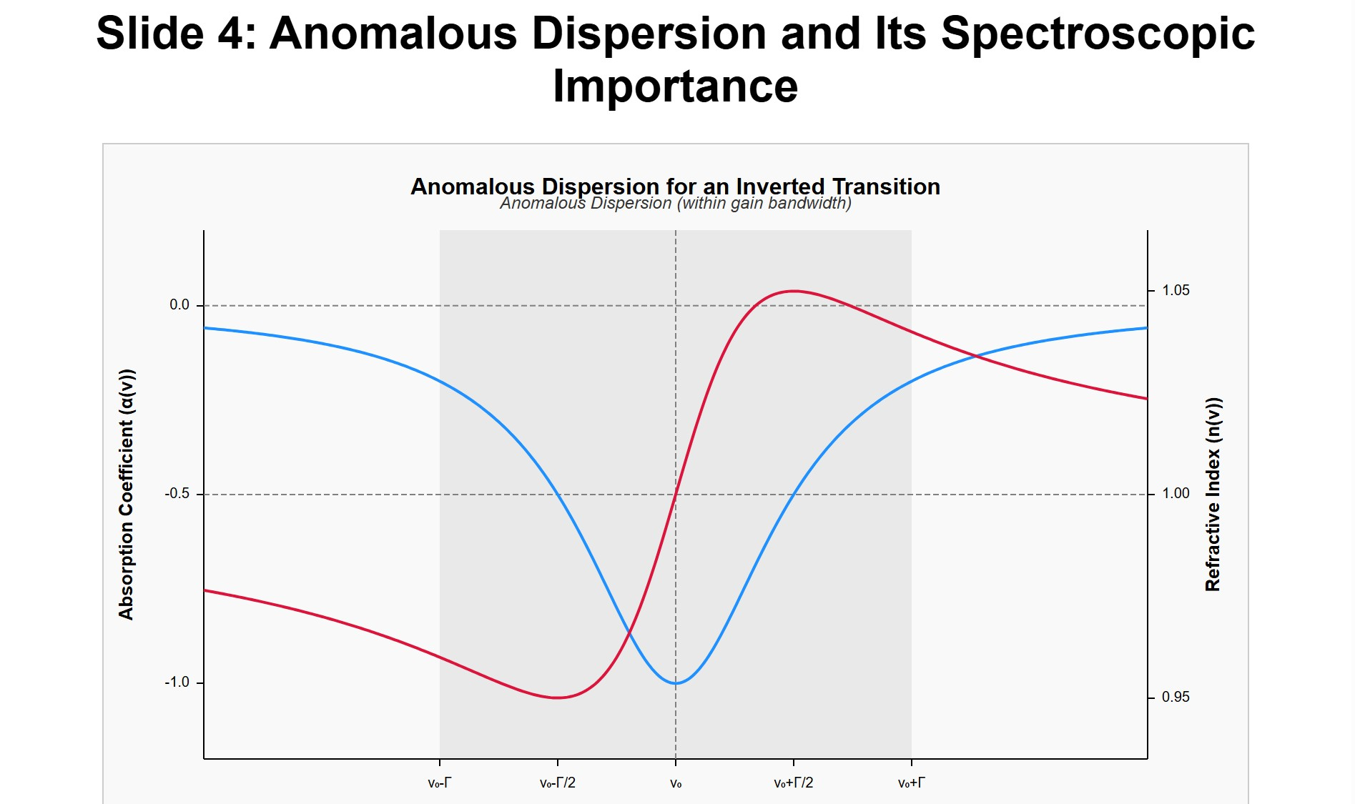
[IMAGE REQUIRED: Plot 𝛼(𝜈) (negative peak) and corresponding 𝑛(𝜈)
crossing unity; annotate “anomalous dispersion” region.]
Prepared by Dist. Prof. Dr. M.A. Gondal for Phys 608 Laser Spectroscopy course in KFUPM (Term 251)

Slide 18
Slide 5: Net Round-Trip Gain — Precise Definition
Define 𝐺(𝜈, 2 𝑑): amplitude (not intensity) gain factor for one round-trip of length 2 𝑑 inside the resonator.
𝐺(𝜈, 2 𝑑) = exp[−2𝛼(𝜈)𝐿 − 𝛾(𝜈)]
where
𝛼(𝜈) : small-signal absorption coefficient (negative if net gain) [m⁻¹].
𝐿 : length of the amplifying region [m].

Slide 19
𝛾(𝜈) : total passive loss factor per round-trip (dimensionless, 𝛾 > 0). Includes mirror transmission, scattering, diffraction, intracavity element losses.
The first term −2𝛼𝐿 appears twice because the light crosses the gain medium on the forward and backward paths.
Threshold condition:
𝐺(𝜈_{thr}, 2 𝑑) = 1
means “round-trip amplification equals all losses.”

Slide 20
Observe carefully:
𝐺 is frequency dependent through both 𝛼(𝜈) and 𝛾(𝜈).
The exponent is additive — changes in 𝛼 or 𝛾 shift the logarithm of 𝐺
linearly.
---

Slide 21
Slide 6: How a Probe Beam Reveals the Resonator
Transmission Spectrum
Thought experiment: send weak, broadband light with spectral intensity 𝐼₀(𝜈) into the cavity through mirror 𝑀₁.
Multiple internal reflections lead to constructive or destructive interference.

Slide 22
If amplification per pass is 𝐺(𝜈), mirror intensity transmission is 𝑇, reflectivity is 𝑅 ( 𝑅 + 𝑇 + scattering = 1 ), then total transmitted intensity follows an Airy-type formula extended by gain:
𝑇 ² 𝐺(𝜈)
𝐼_{T}(𝜈) = 𝐼₀(𝜈)
𝜙
[1 − 𝐺(𝜈)]² + 4 𝐺(𝜈) sin² (₂)
with
Phase advance per round-trip:

Slide 23
4𝜋 𝑑∗(𝜈) 𝜈
𝜙(𝜈) =
𝑐
Transmission maxima condition:
𝜙(𝜈) = 2𝜋𝑞
Exactly the active-cavity eigenfrequency condition derived earlier.
Important limit:

Slide 24
• As 𝐺(𝜈) → 1⁻
and 𝜙 satisfies the resonance condition, the
denominator tends to zero ⇒ 𝐼_{T}/𝐼₀ diverges ⇒ laser oscillation set- up.

Slide 25
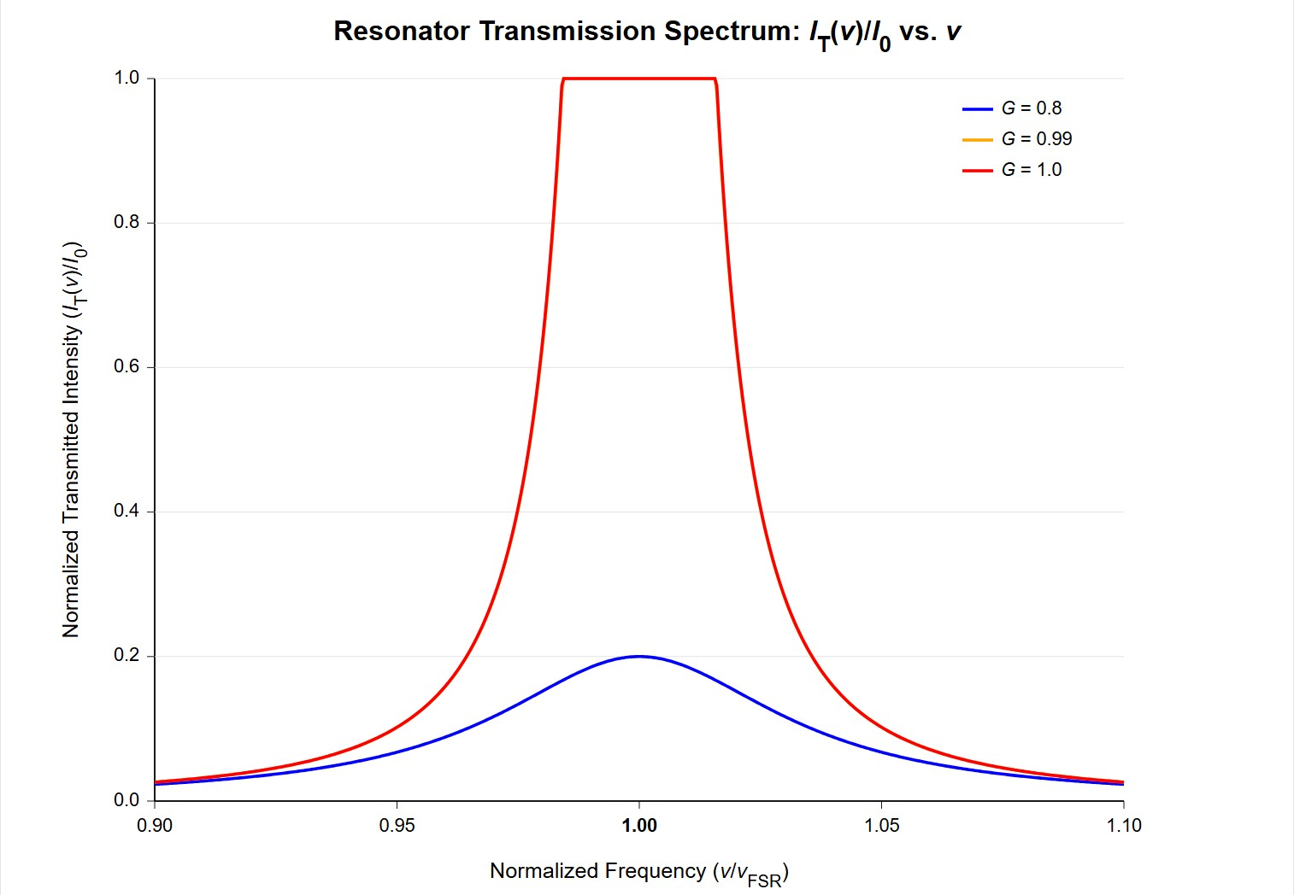
[IMAGE REQUIRED: Plot of 𝐼_{T}(𝜈) vs 𝜈 for three cases: (a) 𝐺 < 1, (b) 𝐺 = 0.99, (c) 𝐺 = 1.0; show narrowing and height growth of peaks.]
Prepared by Dist. Prof. Dr. M.A. Gondal for Phys 608 Laser Spectroscopy course in KFUPM (Term 251)

Slide 26
Slide 7: Graphical Visualization of the Threshold
Condition
Procedure often used in laboratory alignment:
Plot the unsaturated gain curve −2𝛼(𝜈)𝐿 (negative ordinate implies amplification) vs frequency.
On the same axis plot the frequency-dependent total losses 𝛾(𝜈).
Subtract point-wise to obtain the net gain

Slide 27
𝛥𝛼(𝜈) = −2𝛼(𝜈)𝐿 − 𝛾(𝜈)
Those frequencies where 𝛥𝛼(𝜈) > 0 satisfy 𝐺 > 1 and can lase.
  The contact points 𝛥𝛼(𝜈) = 0 mark the threshold.

Slide 28
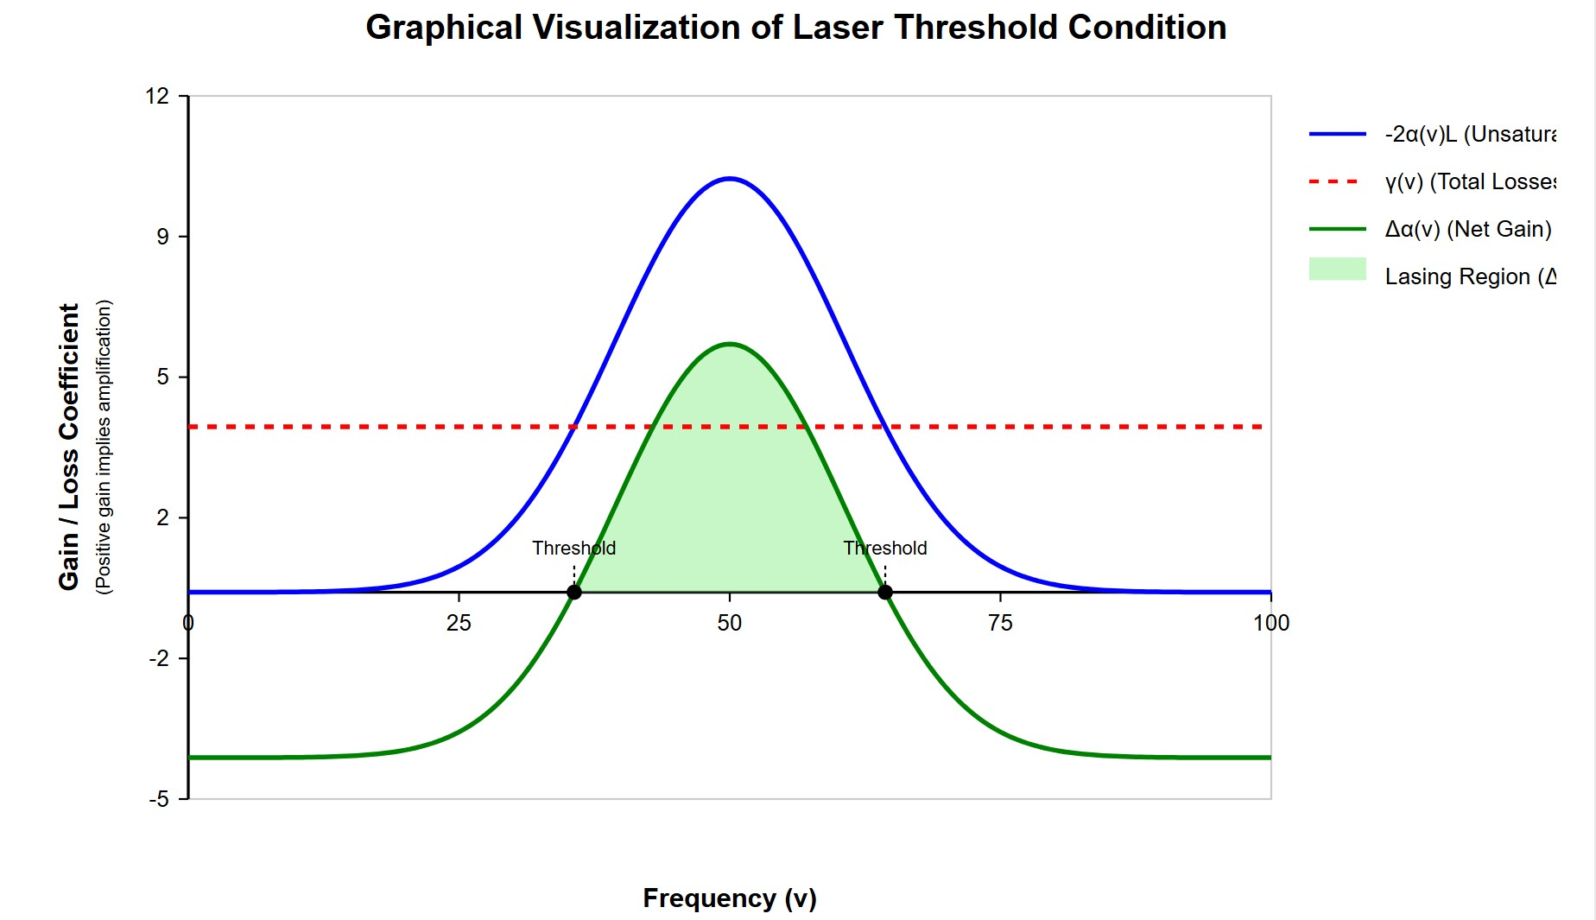
[IMAGE REQUIRED: Schematic similar to Fig. 5.24 – three curves (gain, loss, net gain); shades indicating regions where lasing is allowed.]
---
Prepared by Dist. Prof. Dr. M.A. Gondal for Phys 608 Laser Spectroscopy course in KFUPM (Term 251)

Slide 29
Slide 8: Case Study — Gas Laser With Doppler-Broadened
Gain (Example 5.9a, Part 1)
Given parameters (He-Ne-like):
Line-centre small-signal absorption coefficient
𝛼(𝜔₀) = −0.01 cm⁻¹
Gain cell length
𝐿 = 10 cm

Slide 30
Doppler FWHM (angular frequency)
𝛿𝜔_{D} = 1.3 × 10⁹ Hz × 2𝜋 = 8.17 × 10⁹ rad s⁻¹
Passive loss exponent per round-trip
𝛾 = 0.03
Doppler-broadened Gaussian profile for amplification coefficient:
2
𝜔 − 𝜔₀
−2𝛼(𝜔)𝐿 = −2 𝛼(𝜔₀) 𝐿 exp [− (
) ]
0.68 𝛿𝜔_{D}
Condition for positive net gain:

Slide 31
−2𝛼(𝜔)𝐿 > 𝛾
Insert numbers ⇒ determine the angular frequency interval satisfying the inequality.
---

Slide 32
Slide 9: Case Study — Gas Laser With Doppler-Broadened
Gain (Example 5.9a, Part 2)
Solve inequality numerically:
2
𝜔 − 𝜔₀
0.02 exp [− (
) ] > 0.03
0.68 𝛿𝜔_{D}
1. Rearrange:
𝜔 − 𝜔₀
2
) ] > 1.5
exp [− (
0.68 𝛿𝜔_{D}

Slide 33
2. Exponential on left cannot exceed 1 ⇒ the inequality has no solution
unless the prefactor −2𝛼(𝜔₀)𝐿 is > 0.03. But the given magnitude
  < 0.03 contradicts that.
    Interpretation:
    Pump power must be increased further until −2𝛼(𝜔₀)𝐿 = 0.03.
    After threshold, the valid frequency range broadens as the pump increases because unsaturated 𝛼(𝜔) becomes more negative.

Slide 34
Once −2𝛼(𝜔)𝐿 > 0.03 at line centre, approximate stimulated- emission bandwidth:
𝛿𝜔 ≈ 2𝜋 × 3 GHz
as quoted in the text.

Slide 35
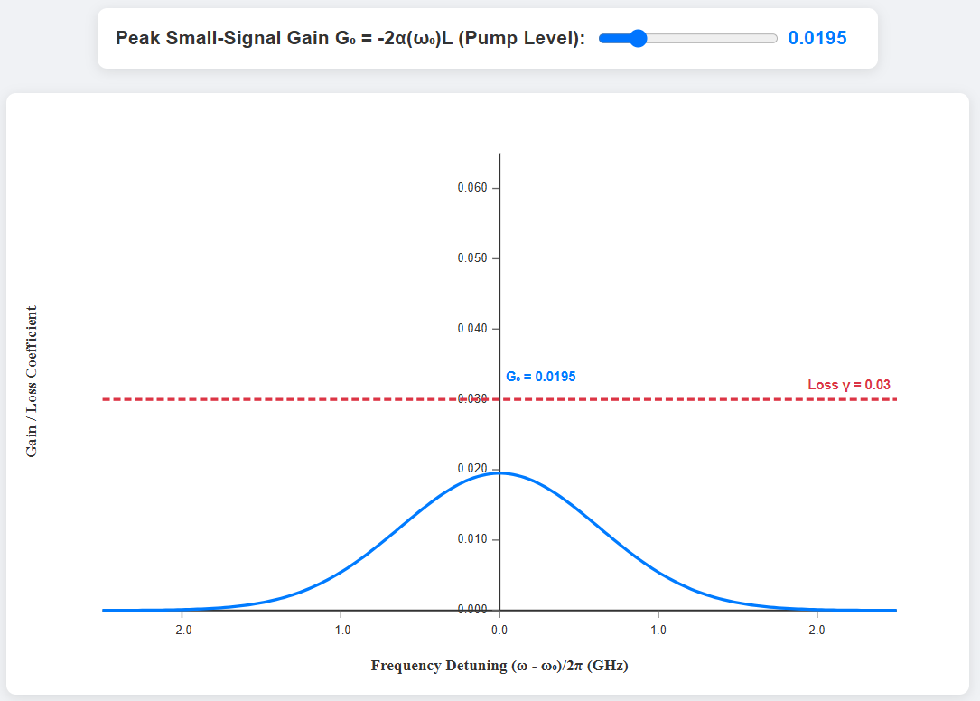
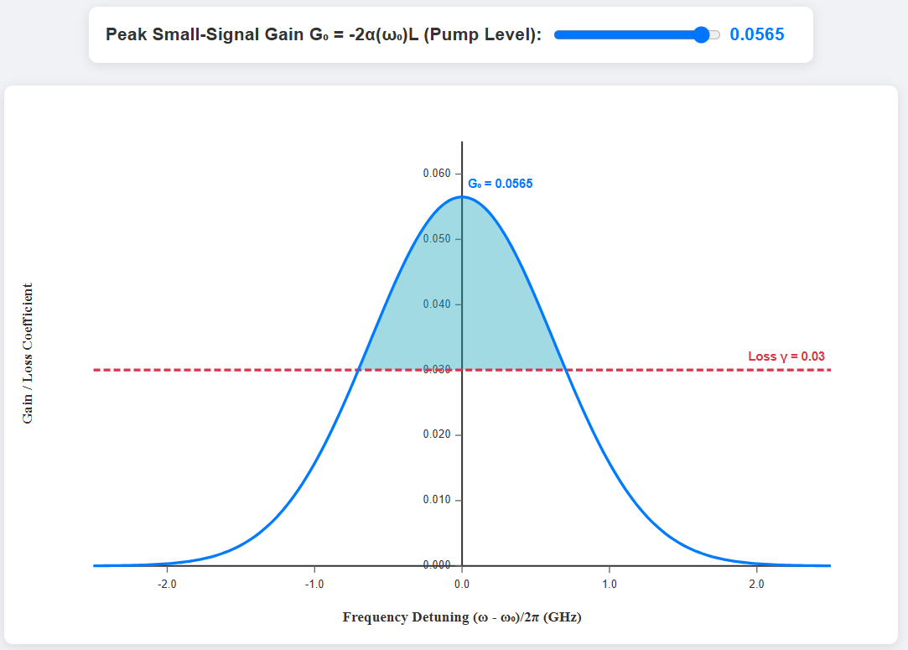
[IMAGE REQUIRED: Gaussian profile with shaded central region where gain exceeds losses; adjustable vertical offset representing pump power.]
---

Slide 36
Slide 10: Example 5.9a — Mode Counting in a 50 cm
Resonator
Mirror separation (physical length) 𝑑 = 50 cm = 0.5 m.
Passive cavity FSR:
𝑐 3.00 × 10⁸ m s⁻¹
𝛿𝜈 = =
= 3.00 × 10⁸ Hz = 300 MHz
2 𝑑 1.0 m
Amplification bandwidth supporting oscillation ≈ 3 GHz.
Number 𝑁_{axial} of axial modes inside the gain band:

Slide 37
3 GHz
^{𝑁axial =} 300 MHz ^{≈ 10}
These ten modes are potentially able to reach threshold; final number depends on saturation and competition effects elaborated in later slides.
---

Slide 38
Slide 11: Case Study — Solid-State / Dye Laser Broad Gain
(Example 5.9b)
Typical dye laser gain FWHM:
𝛥𝜈_{gain} ≈ 1 × 10¹³ Hz
Using same cavity length 𝑑 = 50 cm:
1 × 10¹³ Hz
^{𝑁axial =} 3.0 × 10⁸ Hz ^{≈ 3 × 10}
4
Crucial observation:

Slide 39
In broad-band media, the passive cavity mode spacing is extremely fine compared with the gain window.
Additional
intra-cavity wavelength-selective elements (gratings,
prisms, etalons) become essential for spectroscopy-grade single- mode operation.

Slide 40
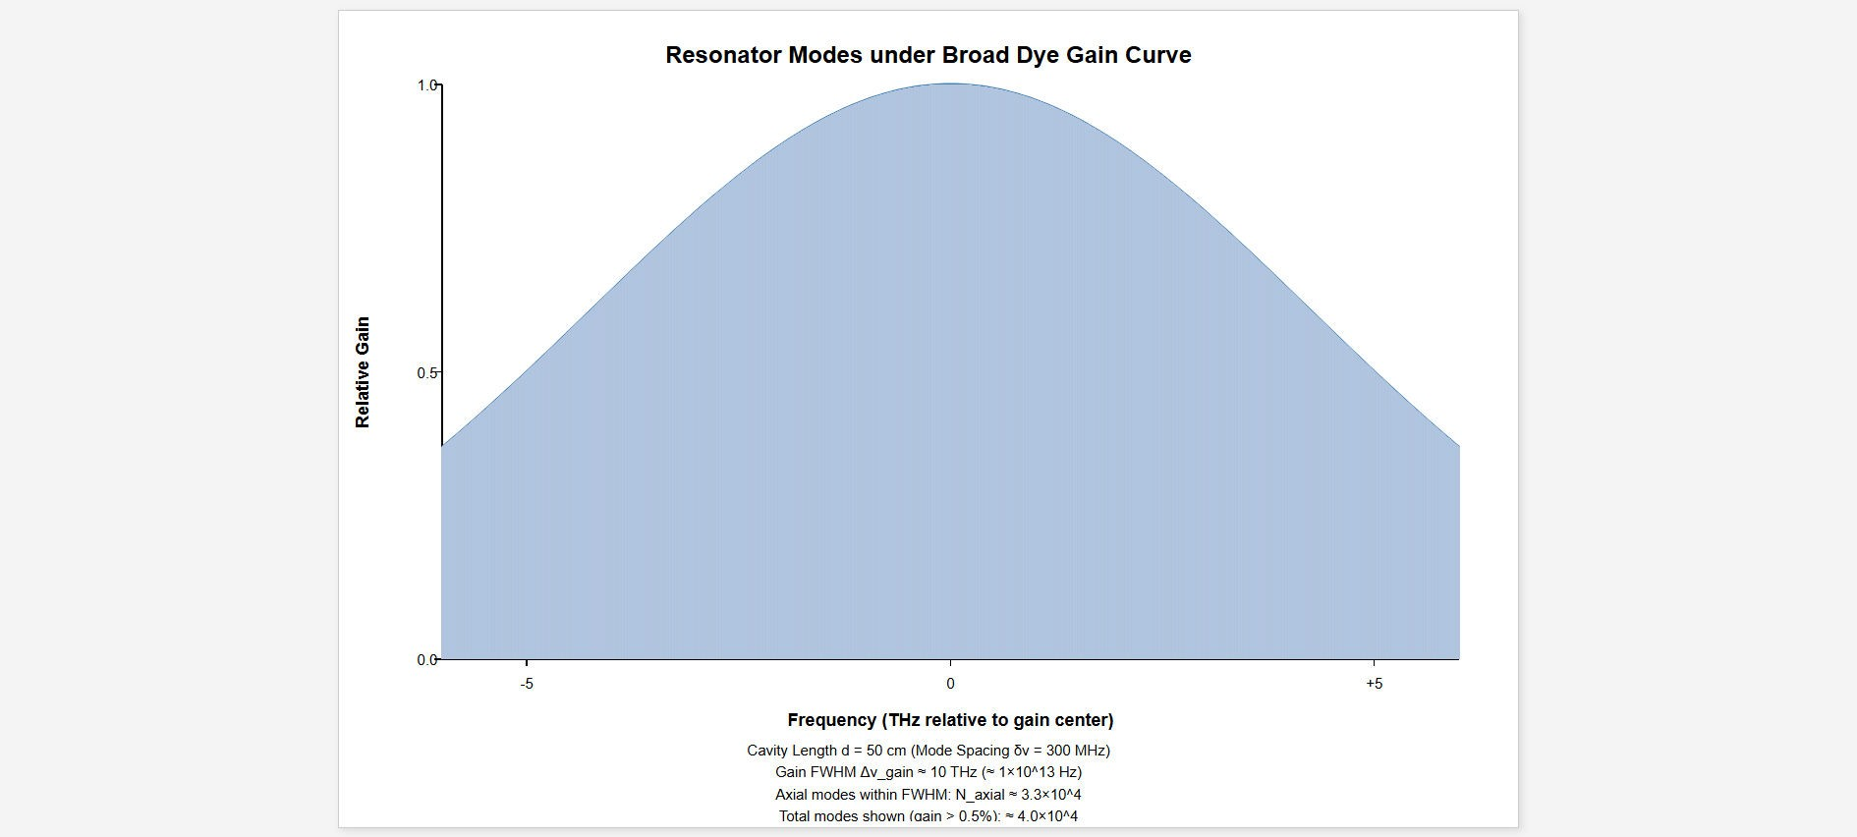
[IMAGE REQUIRED: Histogram illustrating density of resonator modes under a broad dye gain curve; 30 000 discrete lines packed under a smooth envelope.]

Slide 41
Slide 12: Passive vs Active Cavity Linewidth and the
Quality Factor
Define passive resonator finesse 𝐹_{𝑝} and linewidth 𝛥𝜈_{𝑝} (half-power width). For mirrors of amplitude reflectivity 𝑟 (𝑇 = 1 − 𝑟² − losses):
𝜋√𝑟
^{𝐹𝑝 =} 1 − 𝑟
𝛿𝜈
𝛥𝜈_{𝑝} =
𝐹
𝑝
When gain medium compensates losses and approaches threshold
𝐺 → 1⁻, effective finesse rises:

Slide 42
∗
2𝜋√𝐺(𝜈)
=
𝐹_{𝑎}
1 − 𝐺(𝜈)
Corresponding active-cavity linewidth:
𝛿𝜈
1 − 𝐺(𝜈)
𝛥𝜈 =
= 𝛿𝜈
𝑎
𝐹
∗
𝑎
2𝜋√𝐺(𝜈)
Limit behaviour:
• As 𝐺(𝜈) → 1, 𝐹_{𝑎} → ∞ and 𝛥𝜈_{𝑎} → 0.
∗

Slide 43
In practice quantum noise sets a lower bound on the achievable laser linewidth (see Sect. 5.6 — Schawlow-Townes limit).
---

Slide 44
Slide 13: Off-Resonance Regions — Why Threshold Is Not
Met
Between successive resonances, phase 𝜙 deviates from 2𝜋𝑞 by ≈ 𝜋.
For a Lorentzian resonance of half-width 𝛥𝜈_{𝑟} , loss factor 𝛽(𝜈)
increases approximately ten-fold at |𝜈 − 𝜈₀| ≃ 3 𝛥𝜈_{𝑟} .
Since the gain curve decays away from 𝜈₀, net gain quickly turns negative outside the immediate vicinity of each mode.

Slide 45
Conclusion: lasing occurs only in narrow frequency slots centred at cavity resonances; broad “valleys” remain non-lasing despite active medium present.
---

Slide 46
Slide 14: Introduction to Gain Saturation — The Basic
Concept
Population inversion 𝛥𝑁 ≡ 𝑁₂ − 𝑁₁ created by pumping.
Stimulated emission rate for one frequency component 𝜈:
𝑅_{stim}(𝜈) = 𝐵₂₁ 𝜌(𝜈) 𝑔(𝜈 − 𝜈₀) 𝑁₂
where
𝐵₂₁: Einstein 𝐵-coefficient.

Slide 47
𝜌(𝜈): spectral energy density [J m⁻³ Hz⁻¹].
𝑔(𝜈 − 𝜈₀): normalized line-shape function.
As intra-cavity intensity 𝐼 grows, 𝜌(𝜈) ∝ 𝐼
depletes 𝑁₂.
grows, hence 𝑅_{stim}
Under steady-state operation:
pump rate = stimulated emission rate
⇒ inversion is “pinned” to a smaller value 𝛥𝑁_{thr}.

Slide 48
This process is termed gain saturation. It introduces nonlinearity necessary for amplitude stability.
---

Slide 49
Slide 15: Homogeneous Broadening — Uniform
Saturation Across Frequency
For a homogeneously broadened line:
All atoms/molecules “see” every frequency component equally well.
Saturation of one laser mode reduces gain for the entire line profile.
Standard
saturation formula (derivation recalled from rate
equations):

Slide 50
𝛼₀(𝜈)
𝛼₀(𝜈)
𝛼
( )
𝜈 =
=
𝑠,hom
1 + 𝑆 1 + 𝐼/𝐼
𝑠
where
𝛼₀(𝜈): small-signal gain coefficient (before saturation).
𝐼_{𝑠}: saturation intensity, the intensity for which 𝑆 = 1.
𝑆 ≡ 𝐼/𝐼_{𝑠}: dimensionless saturation parameter.
Consequence:

Slide 51
Once one mode reaches high intensity, the gain for neighbouring modes drops as well ⇒ mode competition, often resulting in single- frequency output for perfectly homogeneous media.
---

Slide 52
Slide 16: Inhomogeneous Broadening — Selective
Saturation and Hole Burning
In inhomogeneous ensembles (Doppler, Stark, inhomogeneous crystal fields):
Individual molecules respond only to frequencies within their narrow homogeneous sub-profile 𝛥𝜈_{hom}.
A strong monochromatic field at 𝜈_{𝐿}
population distribution 𝛥𝑁(𝜈).
“burns a hole” in the overall

Slide 53
Calculated saturated gain coefficient:
√1 + 𝑆
𝛼₀(𝜈)
^{𝛼}𝑠,inh^{(𝜈) = 𝛼}0^{(𝜈)}
=
√1 + 𝐼/𝐼
1 + 𝑆
𝑠
Two competing trends with rising 𝐼:
Population depletion ⇒ gain ∝ 1/(1 + 𝑆).
Spectral hole broadening ⇒ effective molecules ∝ √1 + 𝑆. Net result given above.
number
of contributing

Slide 54
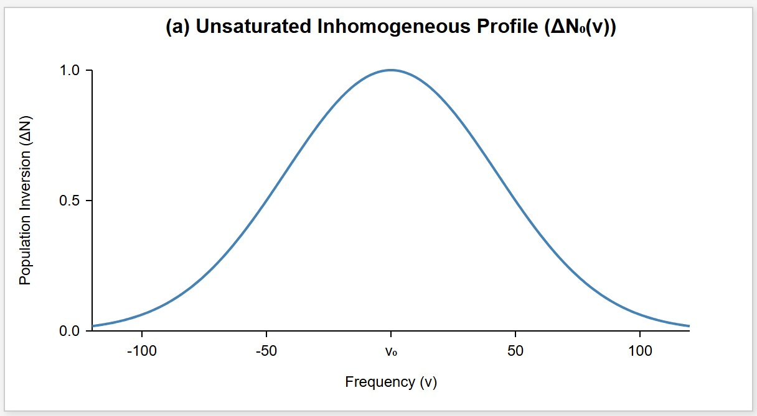
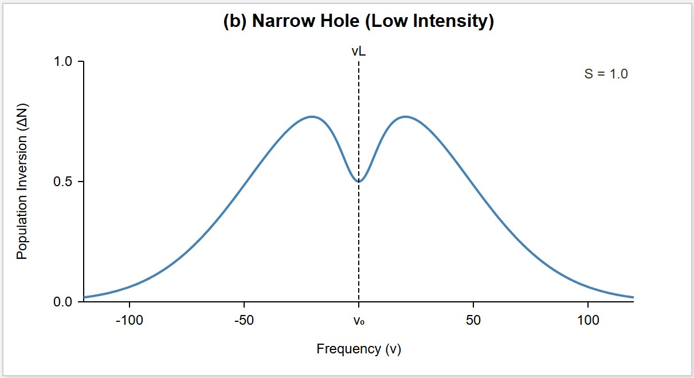
[IMAGE REQUIRED: Illustrate (a) unsaturated inhomogeneous Gaussian;
(b) narrow hole at low 𝐼; (c) wider h
---
o
le at high 𝐼. Axes labelled 𝜈 vs 𝛥𝑁.]

Slide 55
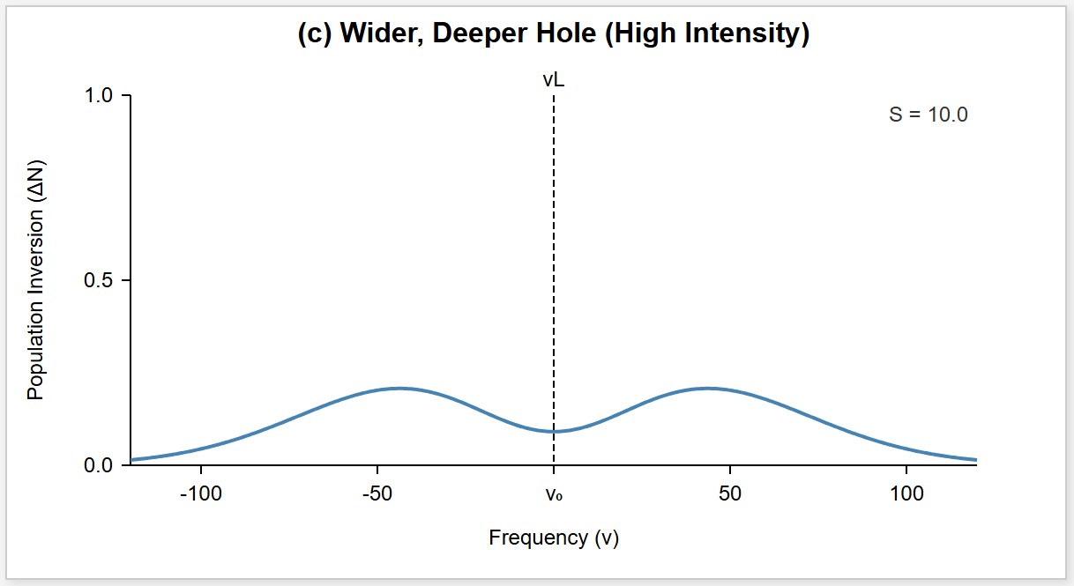
Prepared by Dist. Prof. Dr. M.A. Gondal for Phys 608 Laser Spectroscopy course in KFUPM (Term 251)

Slide 56
Slide 17: Spatial Hole Burning — Standing-Wave
Saturation Pattern
In a linear resonator the field is a standing wave:
𝐸(𝑧) = 𝐸₀ cos(2𝜋𝑧/𝜆)
nodes at mirrors, antinodes inside.
• Local intensity 𝐼(𝑧) ∝ |𝐸(𝑧)|² = 𝐸² cos²(2𝜋𝑧/𝜆).
0
Saturation therefore occurs only at the antinodes.

Slide 57
Nodes remain unsaturated ⇒ residual inversion.
Another mode shifted by 𝜆/4 can exploit these unsaturated regions
⇒ multiple modes may co-exist even in homogeneous media.

Slide 58
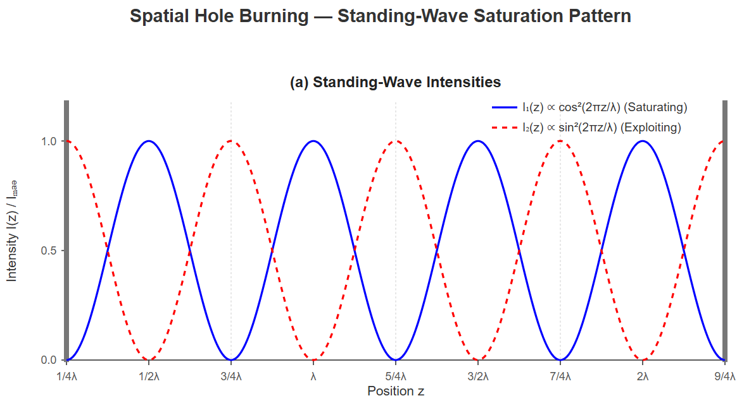
[IMAGE REQUIRED: (a) Two standing-wave patterns offset by 𝜆/4; (b) corresponding inversion profile with periodic troughs (holes).]
---
Prepared by Dist. Prof. Dr. M.A. Gondal for Phys 608 Laser Spectroscopy course in KFUPM (Term 251)

Slide 59
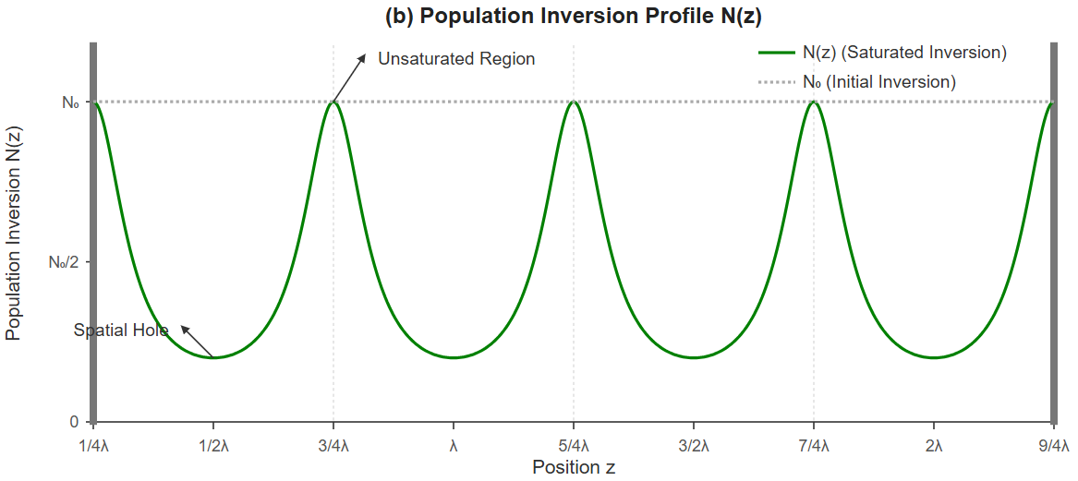

Slide 60
Slide 18: Quantitative Treatment of Spatial Hole-Burning
Mode Spacing
Suppose gain medium length 𝐿 is short and is located a distance 𝑎
from mirror 𝑀₁.
Condition for two standing waves of wavelengths 𝜆₁, 𝜆₂
maxima separated by 𝜆/𝑝:
to have
1
𝑚 𝜆₁ = 𝑎 = (𝑚 + _{𝑝}) 𝜆₂

Slide 61
where 𝑚 is an integer.
Convert to frequency ( 𝜈 = 𝑐/𝜆 ):
𝑚 𝑐
(𝑚 + 1/𝑝)𝑐
𝜈₁ =
,
𝜈₂ =
𝑎 𝑎
Spacing between spatial-hole-burning modes:
𝑐
𝛿𝜈_{sp} = 𝜈₂ − 𝜈₁ = _{𝑎 𝑝}
Expressed relative to axial FSR 𝛿𝜈 = 𝑐/(2 𝑑):

Slide 62
2 𝑑
𝛿𝜈_{sp} = _{𝑎 𝑝} 𝛿𝜈
If the homogeneous gain width < ² (𝑑/𝑎)𝛿𝜈, only one spatial-hole-
3
burning mode can survive.
---

Slide 63
Slide 19: Example 5.10 — Numerical Illustration of Spatial
Hole Burning
Given:
Cavity length 𝑑 = 100 cm.
Gain medium length 𝐿 = 0.1 cm.
Distance from mirror 𝑎 = 5 cm.
Desired separation index 𝑝 = 3.

Slide 64
Calculated quantities:
𝑐 3.00 × 10⁸
𝛿𝜈 =
=
Hz = 150 MHz
2 𝑑 2
2 𝑑 200 cm
𝛿𝜈_{sp} = _{𝑎 𝑝} 𝛿𝜈 = _{5 cm × 3} 150 MHz ≈ 2.0 GHz
Interpretation:

Slide 65
If the homogeneous width of the gain profile < 2.0 GHz, spatial hole burning will not allow more than one mode ⇒ single-mode operation feasible.
---

Slide 66
Slide 20: Eliminating Spatial Hole Burning — Ring Lasers
In a unidirectional ring cavity the field is purely travelling wave.
Intensity 𝐼 is uniform along the propagation axis ⇒ no nodes and antinodes.
Result:
Entire gain medium experiences the same saturation ⇒ no spatial holes.
Higher overall extraction efficiency; favoured in high-power lasers.

Slide 67
Practical ring implementations:
Four-mirror folded ring (bow-tie).
Fibre ring lasers.
Unidirection enforced with optical isolators or Faraday rotators.
---

Slide 68
Slide 21: Homogeneous vs Inhomogeneous —
Consequences for Multimode Operation
Homogeneous gain:
Strong mode competition through shared population.
Tends towards single-mode output if* spatial hole burning and technical noise can be suppressed.
Inhomogeneous gain:

Slide 69
Minimal competition; each mode taps a distinct sub-ensemble.
Many axial and transverse modes can oscillate simultaneously.
Real media are mixed; the ratio 𝛿𝜈/𝛥𝜈_{hom}
strength.
Transverse modes (TEM_{𝑚,𝑛}) complicate the spectrum because they have different longitudinal frequencies in non-confocal resonators.
---
dictates competition

Slide 70
Slide 22: Designing Cavities to Suppress Higher-Order
Transverse Modes
Key tools:
Choose mirror radii such that the resonator is stable only for TEM₀₀.
Insert intracavity apertures matched to the Gaussian beam waist.
Employ unstable or confocal resonator geometries when high power is needed but single transverse mode is tolerated.

Slide 71
Benefit: a Gaussian beam with minimal divergence, higher spatial coherence.
Spectral implication: still potentially multimode in frequency unless axial mode selection is also enforced.
---

Slide 72
Slide 23: Example 5.11 — HeNe Laser Detailed Mode
Count
Parameters recap:
• 𝜆 = 632.8 nm.
Doppler width 1.5 GHz (FWHM).
Cavity length 𝑑 = 1.0 m.
Axial mode spacing 𝛿𝜈 = 150 MHz.

Slide 73
Gain above threshold ≈ 1.2 GHz wide.
Potential axial modes 𝑁 ≈ 8.
Homogeneous linewidth contributions:
Natural width 20 MHz.
Pressure width ≈ 20 MHz.
Power broadening (example 𝐼/𝐼_{𝑠} = 10): increases to ≈ 100 MHz.

Slide 74
Since homogeneous width < 𝛿𝜈, modes do not overlap strongly ⇒ simultaneous oscillation of several independent modes yields stable multi-line spectrum (Fig. 5.27a).
---

Slide 75
Slide 24: Example 5.12 — Argon-Ion Laser Multimode
Dynamics
Key numerical data:
Doppler width 8–10 GHz.
Resonator length 𝑑 = 1.2 m ⇒ 𝛿𝜈 = 125 MHz.
Homogeneous width ≫ 𝛿𝜈 due to:
Electron–ion pressure broadening.

Slide 76
High intracavity power (10–100 W) ⇒ strong power broadening.
Resulting behaviour:
𝛥𝜈_{hom} ≫ 𝛿𝜈 ⇒ intense mode competition.
However, technical perturbations (cavity length jitter, discharge noise) constantly redistribute gain ⇒ observed spectrum fluctuates randomly (Fig. 5.27b).
---

Slide 77
Slide 25: Example 5.13 — Dye Laser Spectral Features
Liquid dye medium: gain FWHM of order 2 × 10¹³ Hz (≈ 20 nm at 600
nm).
With 𝑑 = 0.75 m, axial modes 𝑁 ∼ 10⁵.
Homogeneous profile dominates, yet refractive index fluctuations in the liquid cause mode coupling ⇒ time-dependent multimode emission.
Pulsed dye lasers:

Slide 78
Gain builds up in 𝜇s-scale; spectrum integrates over hopping—final
bandwidth ≈ 1 nm.
To obtain tunable single-mode operation:
Introduce diffraction grating, prism, or birefringent filter inside cavity (Sect. 5.4).

Slide 79
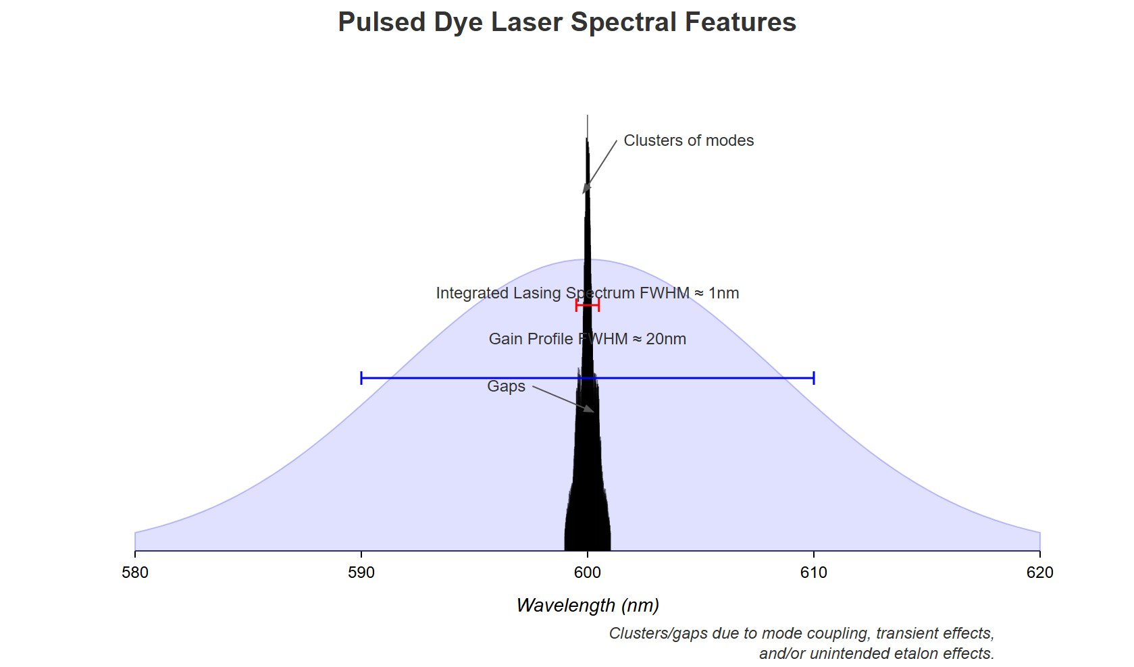
[IMAGE REQUIRED: Photographic spectrum of a pulsed dye laser showing clusters and gaps; annotate causes.]
---
Prepared by Dist. Prof. Dr. M.A. Gondal for Phys 608 Laser Spectroscopy course in KFUPM (Term 251)

Slide 80
Slide 26: Non-Uniform Intensity Distribution Within a
Multimode Band
Laser spectral density 𝐼_{𝐿} (𝜈, 𝑡) is not smooth — contains peaks and holes:
𝐼_{𝐿} (𝜔, 𝑡) = ∑ 𝐴_{𝑘} (𝑡) cos²[𝜔_{𝑘}𝑡 + 𝜙_{𝑘}(𝑡)]
𝑘
Time-averaged output:

Slide 81
1
𝑇
𝑇
∫ ∑ 𝐴_{𝑘} (𝑡) cos²[𝜔_{𝑘}𝑡 + 𝜙_{𝑘}(𝑡)] d𝑡
0 _{𝑘}
⟨𝐼(𝜔)⟩ =
For spectroscopic scanning, holes cause artificial features if the scanning time < 𝑇.
Experimental remedy:
• Wobble the cavity length 𝑑(𝑡) = 𝑑₀ + 𝛿𝑑 sin(2𝜋𝑓𝑡) with 𝑓 > 1/𝑇.
Rapidly modulates all 𝜔_{𝑘} ⇒ smoother averaged spectrum.
---

Slide 82
Slide 27: Mode Pulling — Concept Introduction
Even after mode selection, the exact frequency of a laser mode
differs from the passive cavity
resonance 𝜈_{𝑟}
because of the
frequency-dependent index 𝑛(𝜈).
This shift is called mode pulling.
Two intuitive viewpoints:
1. Cavity view: refractive index changes effective length 𝑑∗.

Slide 83
Gain medium view: phase of standing wave adjusted so that round- trip phase remains an integer multiple of 𝜋 in presence of dispersion.
  Quantitative derivation on next slide.
---

Slide 84
Slide 28: Mode Pulling — Mathematical Derivation Step-
by-Step
Passive cavity phase per round-trip:
2 𝑑
𝜙_{𝑝} = 2𝜋𝜈_{𝑝}
Active cavity phase:
= 𝑚𝜋, 𝑚 ∈ ℤ
𝑐
2 𝑑 𝑛(𝜈_{𝑎})
𝜙_{𝑎} = 2𝜋𝜈_{𝑎}
= 𝑚𝜋
𝑐

Slide 85
Expand 𝜙(𝜈) in Taylor series around 𝜈_{𝑝}:
∂𝜙
𝜙_{𝑎} ≈ 𝜙_{𝑝} + _{∂𝜈} |
(𝜈_{𝑎} − 𝜈_{𝑝}) + [𝜙_{𝑎}(𝜈_{𝑎}) − 𝜙_{𝑝}(𝜈_{𝑎})] = 𝑚𝜋
𝜈_{𝑝}
Setting 𝜙_{𝑝} = 𝑚𝜋 and rearranging yields:
∂𝜙
(𝜈_{𝑎} − 𝜈_{𝑝}) + [𝜙_{𝑎}(𝜈_{𝑎}) − 𝜙_{𝑝}(𝜈_{𝑎})] = 0
∂𝜈
identical to Eq. (5.72).
Need dispersion relation linking 𝑛(𝜈) to gain coefficient 𝛼(𝜈):

Slide 86
𝜈₀ − 𝜈 𝑐
𝑛(𝜈) = 1 +
𝛼(𝜈)
𝛥𝜈_{𝑚}
2𝜋𝜈
where
𝜈₀: centre frequency of gain line.
𝛥𝜈_{𝑚} = 𝛾/(2𝜋): homogeneous half-width.
After algebra (see next slide) obtain the mode-pulled frequency.
---

Slide 87
Slide 29: Mode Pulling — Final Formula and Limiting
Cases
Derived expression:
𝜈_{𝑟} 𝛥𝜈_{𝑚} + 𝜈₀ 𝛥𝜈_{𝑟}
𝜈 =
𝛥𝜈_{𝑚} + 𝛥𝜈_{𝑟}
𝑎
where

Slide 88
𝑐 𝛾
𝛥𝜈_{𝑟} = _{4𝜋𝑑}: passive cavity resonance half-width (determined by total losses 𝛾).
Interpretation:
Weighted average of cavity resonance 𝜈_{𝑟} and gain centre 𝜈₀.
Weighting factors are respective half-widths.
Gas lasers typical numbers:
• 𝛥𝜈_{𝑟} ∼ 1 MHz.

Slide 89
• 𝛥𝜈_{𝑚} ∼ 100 MHz.
Simplified form for 𝛥𝜈_{𝑟} ≪ 𝛥𝜈_{𝑚}:
𝛥𝜈_{𝑟}
+ (𝜈
𝜈 ≈ 𝜈
− 𝜈 )
𝑎
𝑟
𝛥𝜈_{𝑚}
0
𝑟
Mode pulled only slightly towards 𝜈₀.
Pulling magnitude proportional to detuning (𝜈₀ − 𝜈_{𝑟} ).
---

Slide 90
Slide 30: Practical Consequences of Mode Pulling
In line-centre operation (𝜈_{𝑟} ≈ 𝜈₀) pulling is negligible.
Near slope of gain curve:
Small cavity length drifts ⇒ large frequency drifts partially cancelled
by pulling.
Stabilization schemes exploit or compensate for this.
For precision spectroscopy:

Slide 91
Mode pulling introduces systematic error if laser is locked to cavity rather than atomic reference.
Correction requires knowledge of 𝛥𝜈_{𝑚}, 𝛥𝜈_{𝑟} , and detuning.
[IMAGE REQUIRED: Plot showing cavity resonance (vertical lines) and gain curve; arrows indicating mode shift towards centre as gain slope steepens.]
---

Slide 92
Slide 31: Summary of Key Quantitative Relationships
Passive cavity FSR:
𝑐
𝛿𝜈 =
2 𝑑
Round-trip gain factor:
𝐺(𝜈) = exp[−2𝛼(𝜈)𝐿 − 𝛾(𝜈)]
Active cavity linewidth:

Slide 93
1 − 𝐺
𝛥𝜈_{𝑎} = 𝛿𝜈
2𝜋√𝐺
Saturated gain coefficients:
Homogeneous:
𝛼₀
𝛼 =
𝑠
1 + 𝐼/𝐼
𝑠
Inhomogeneous:

Slide 94
𝛼₀
𝛼_{𝑠} =
√1 + 𝐼/𝐼_{𝑠}
Mode pulling:
𝜈_{𝑟} 𝛥𝜈_{𝑚} + 𝜈₀ 𝛥𝜈_{𝑟}
𝜈_{𝑎} =
𝛥𝜈_{𝑚} + 𝛥𝜈_{𝑟}
Each equation requires understanding of the definitions and units provided earlier; together they form the quantitative backbone for predicting and controlling laser spectra.

Slide 95
Slide 32: Concluding Remarks and Next Steps
The frequency composition of laser emission is not a simple direct mirror of the gain profile; it emerges from a rich interplay of:
Cavity resonance conditions.
Gain saturation (homogeneous vs inhomogeneous).
Spatial hole burning and transverse-mode structure.
Dispersive frequency shifts (mode pulling).

Slide 96
Experimental control levers:
Adjust cavity length 𝑑 and geometry.
Shape gain profile via temperature, pressure, and pumping.
Insert selective elements (etalons, gratings, birefringent filters).
  Subsequent chapters/slides will extend these concepts to:
  Linewidth narrowing mechanisms (Schawlow-Townes limit).
  Active frequency stabilization techniques.

Slide 97
Tunable and mode-locked laser systems.
Mastery of today’s material equips you to design, diagnose, and optimize laser sources for high-resolution spectroscopy and other precision applications.
---

