Slide 1
Chap. 5.1 Fundamentals of Lasers
Prepared by Dist. Prof. Dr. M.A. Gondal for Phys 608 Laser Spectroscopy course in KFUPM (Term 251)

Slide 2
Slide 1: Lasers in Spectroscopy — Why They Matter
Provide monochromatic radiation with linewidths far below
10⁻⁶ nm.
Deliver extremely high spectral radiance (power per unit area per unit solid angle per unit bandwidth) exceeding that of conventional lamps by > 10¹⁰.
Supply excellent spatial coherence →
diffraction-limited beams
enable long interaction lengths and tight focusing.
Prepared by Dist. Prof. Dr. M.A. Gondal for Phys 608 Laser Spectroscopy course in KFUPM (Term 251)

Slide 3
Allow precise control of frequency and phase → essential for
Doppler-free, saturation, and heterodyne techniques.
Offer tunability (via dye, Ti:sapphire, OPO, etc.) → access to virtually any atomic / molecular transition when combined with nonlinear optics.
Prepared by Dist. Prof. Dr. M.A. Gondal for Phys 608 Laser Spectroscopy course in KFUPM (Term 251)

Slide 4
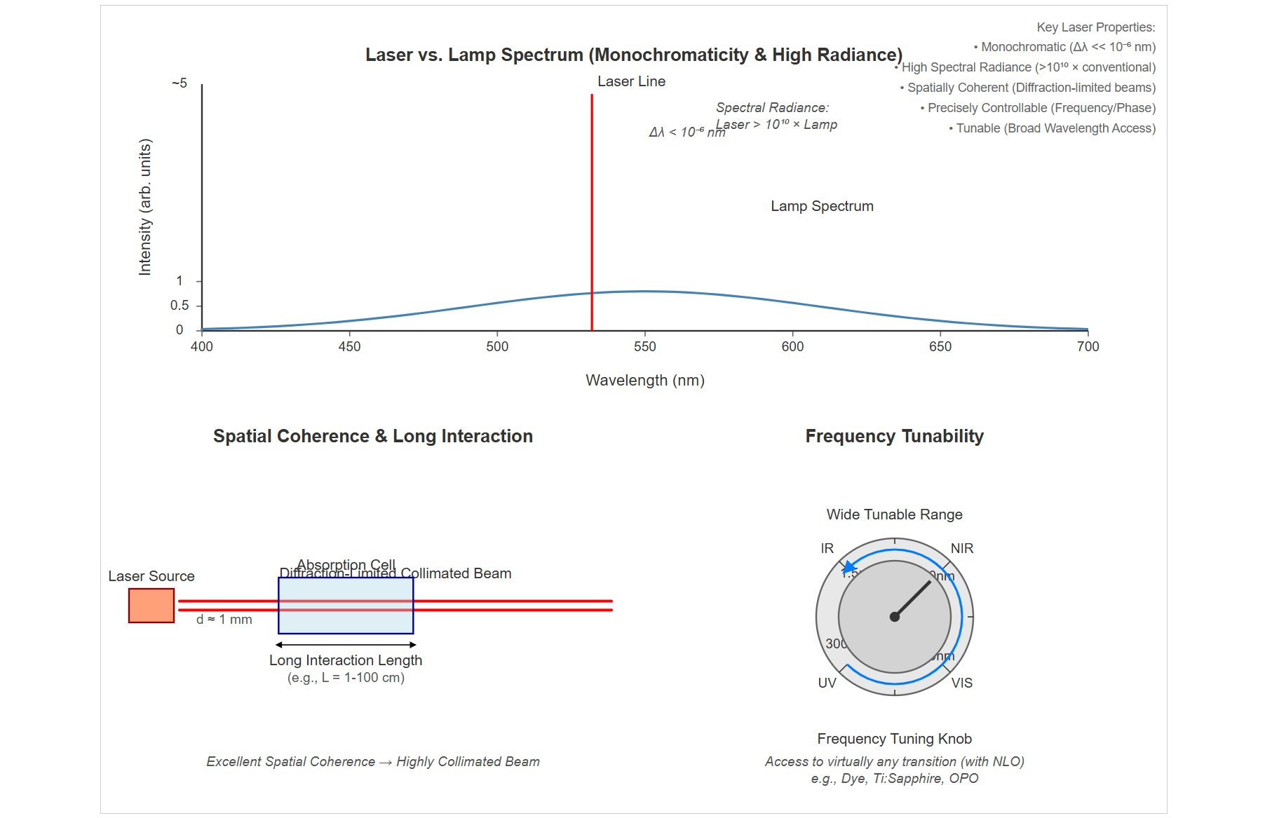
[IMAGE REQUIRED: Provide a montage-style Slide background showing (i) a narrow laser line versus a broad lamp spectrum, (ii) a highly collimated beam passing through an absorption cell, (iii) a frequency-tuning knob symbol, all labelled with quantitative scales.]
Prepared by Dist. Prof. Dr. M.A. Gondal for Phys 608 Laser Spectroscopy course in KFUPM (Term 251)

Slide 5
Slide 2: Minimum Ingredients of Any Laser
Active medium — material that can amplify light.
Contains discrete energy levels 𝐸_{i}, 𝐸_{k} of atoms, ions, molecules, or solid-state centers.
Energy pump — external energy source that drives population inversion.
Examples: electrical discharge, optical flashlamp, chemical reaction, another laser.

Slide 6
Optical resonator — typically two or more mirrors forming a Fabry– Pérot cavity of length 𝑑.
Provides feedback, selects longitudinal and transverse modes, and increases photon dwell time.

Slide 7
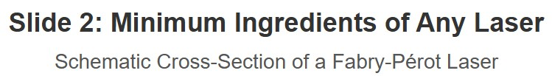
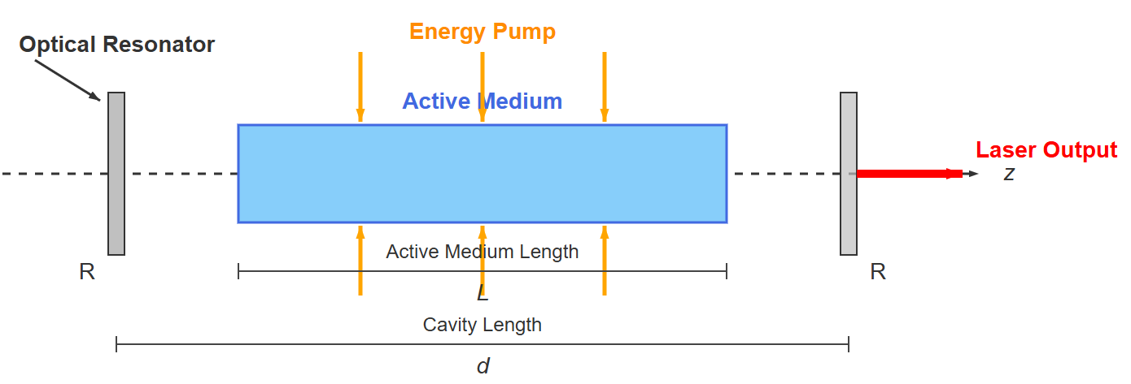
[IMAGE REQUIRED: Schematic cross-section of a Fabry–Pérot laser showing a gain rod between two mirrors, pump arrows into the rod, and
indication of the resonator axis 𝑧. Label mirror reflectivities 𝑅₁, 𝑅₂, cavity length 𝑑, and active medium length 𝐿.]

Slide 8
Slide 3: The Active Medium — Energy Levels and Gain
Thermal equilibrium: population follows Boltzmann law
𝑁_{eq}(𝐸) = 𝑁₀exp[−𝐸/(𝑘_{B}𝑇)]
𝑁₀: density [cm⁻³].
𝑘_{B}:
ground-state population *
Boltzmann
constant 1.38 × 10⁻²³ J K⁻¹. * 𝑇: absolute temperature [K].
Population inversion condition
𝑔_{k}
𝑁_{k} >
𝑁
𝑔
i
i

Slide 9
𝑔_{j}: degeneracy of level 𝑗.
With inversion, stimulated-emission rate exceeds absorption rate:
𝑊_{stim} = 𝑁_{k}𝐵_{𝑘𝑖}𝜌(𝜈) > 𝑁_{i}𝐵_{𝑖𝑘} 𝜌(𝜈)
𝐵_{𝑖𝑘} , 𝐵_{𝑘𝑖} : Einstein 𝐵-coefficients [m³ J⁻¹s⁻²]. * 𝜌(𝜈): spectral energy density [J m⁻³ Hz⁻¹].
Result:
passing electromagnetic wave is amplified instead of
attenuated.

Slide 10
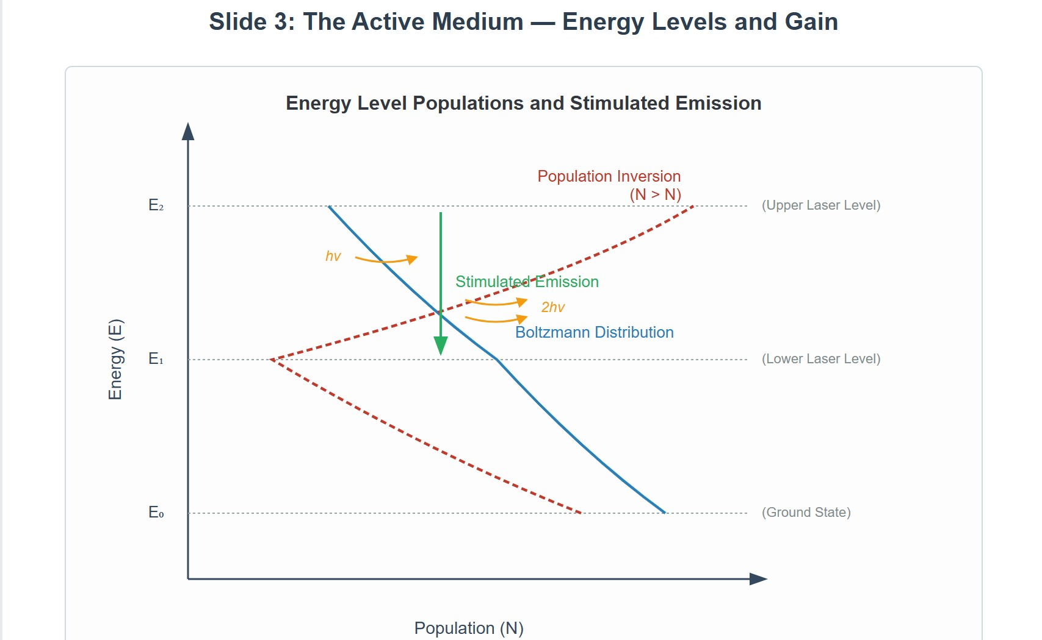
[IMAGE REQUIRED: Energy-level diagram comparing (i) Boltzmann distribution (decaying curve) with (ii) inverted distribution (dashed curve) for a three-level scheme, with arrows indicating stimulated emission.]
---
Prepared by Dist. Prof. Dr. M.A. Gondal for Phys 608 Laser Spectroscopy course in KFUPM (Term 251)

Slide 11
Slide 4: Energy-Pumping Mechanisms — Achieving
Inversion
Optical pumping with broadband flashlamp — used in ruby lasers.
Electrical discharge in low-pressure gas mixtures — He–Ne, Ar⁺, CO₂.
Chemical pumping — HF, DF, and excimer lasers.
Laser-pumped solid-state or dye media — Ti:sapphire pumped by frequency-doubled Nd:YAG.

Slide 12
Key design goal: deposit energy selectively into upper laser level while depleting lower level swiftly (short 𝜏_{eff}).
[IMAGE REQUIRED: Table-style graphic
listing pump types versus pump energy to specific
representative lasers, transition levels.]
---
with arrows from

Slide 13
Slide 5: Spontaneous vs. Stimulated Emission —
Microscopic View
Spontaneous emission probability per excited particle
^{𝐴}𝑘𝑖
_{[s}−1]
Stimulated emission probability density per excited particle
𝐵_{𝑘𝑖} 𝜌(𝜈) [s⁻¹]

Slide 14
Inversion increases 𝐵_{𝑘𝑖} 𝜌(𝜈) → overwhelmingly directs emission into
modes where 𝜌(𝜈) is large.
Optical resonator provides large 𝜌(𝜈) for its eigen-frequencies →
feedback loop.
Above threshold, stimulated processes dominate, making output highly directional and coherent.

Slide 15
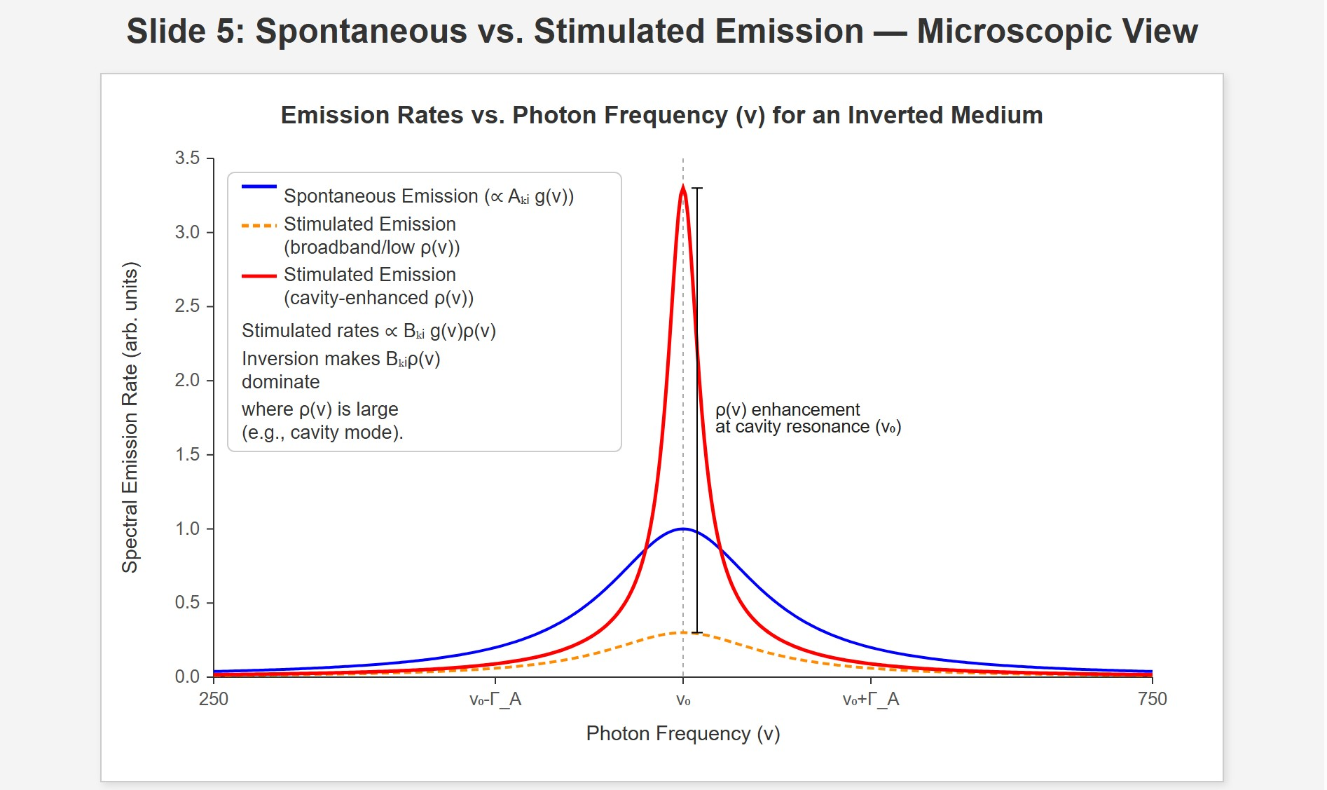
[IMAGE REQUIRED: Plot of emission rates versus photon frequency for an inverted medium inside and outside resonance, marking 𝜌(𝜈) enhancement due to cavity.]
---
Prepared by Dist. Prof. Dr. M.A. Gondal for Phys 608 Laser Spectroscopy course in KFUPM (Term 251)

Slide 16
Slide 6: Optical Resonator — Storage and Mode Selection
Two parallel mirrors form standing-wave cavity.
Allowed longitudinal modes satisfy
𝑞𝑐
𝜈_{q} = _{2𝑑} ,
𝑞 ∈ ℤ
Mirror radii and apertures set transverse mode pattern (TEM_{𝑚𝑛}).
Resonator
acts as frequency-selective filter with linewidth
determined by finesse ℱ.

Slide 17
High 𝑄-factor
energy stored
𝑄 = 2𝜋 ×
energy lost per cycle
enhances photon lifetime → greater amplification per pass.
Coupling mirror (partial reflector) allows controlled extraction of laser power.

Slide 18
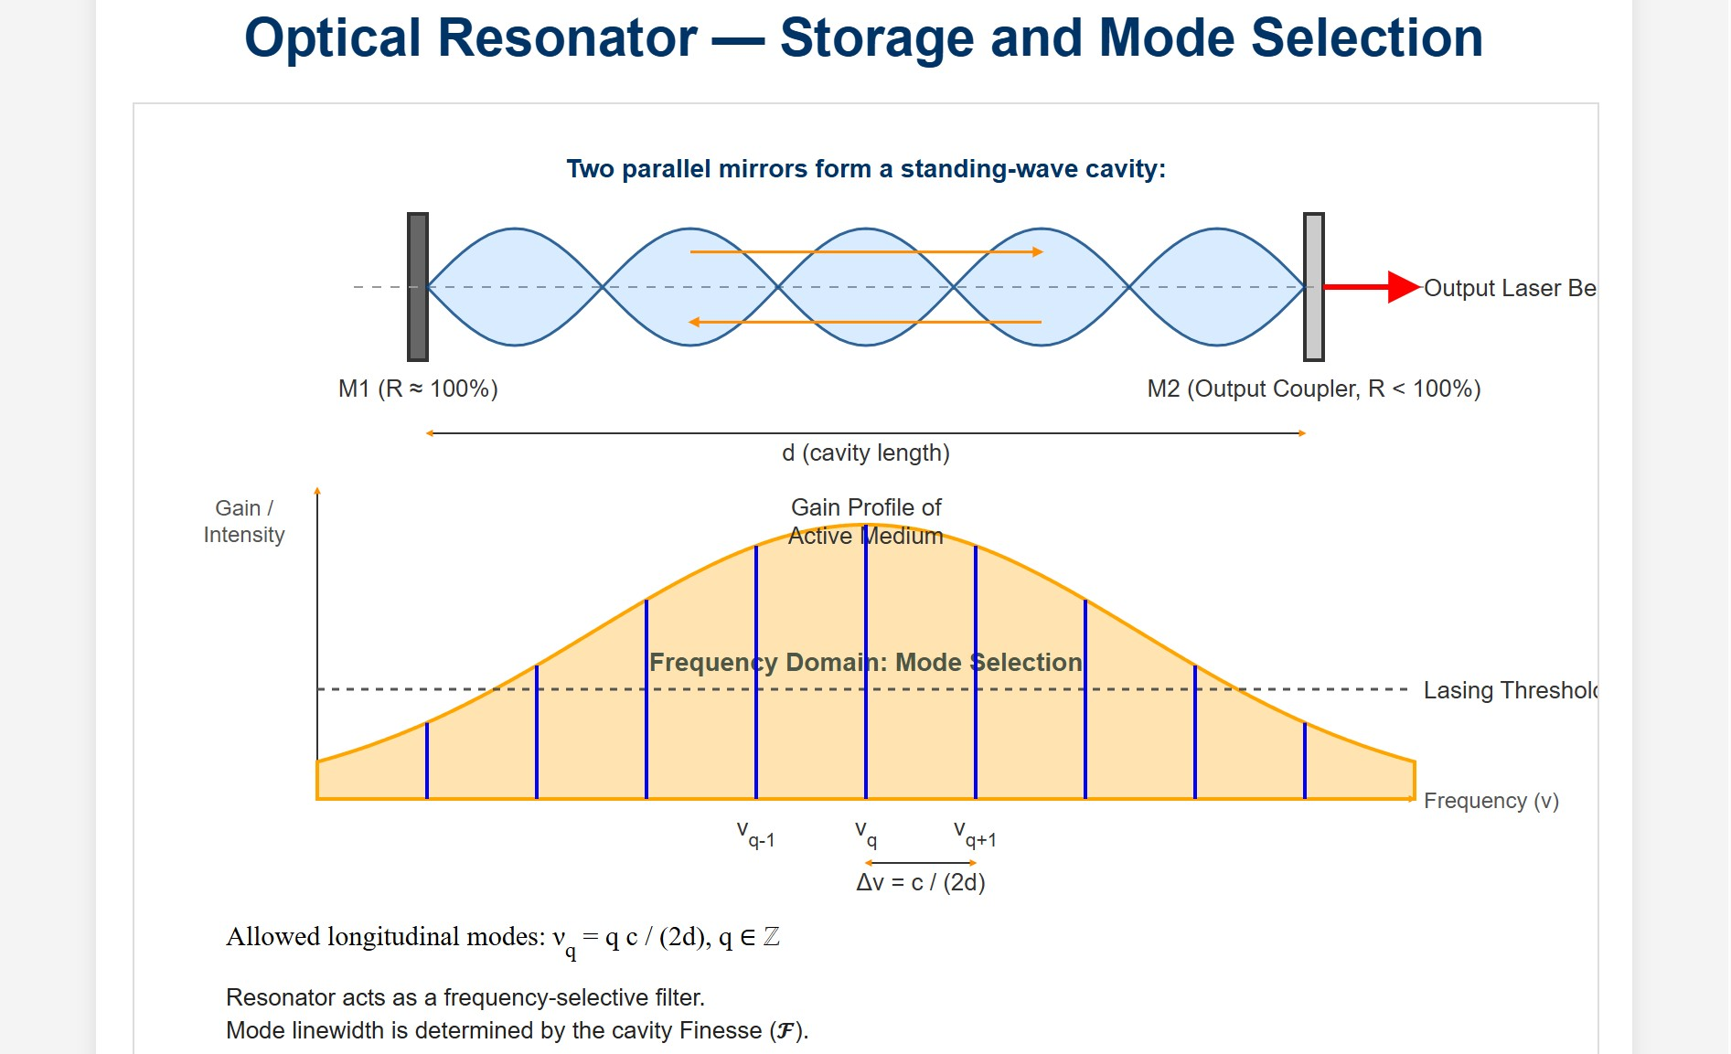
[IMAGE REQUIRED: Resonator diagram showing several longitudinal modes inside gain profile, with arrows indicating mirror reflectivity and output coupling.]
Prepared by Dist. Prof. Dr. M.A. Gondal for Phys 608 Laser Spectroscopy course in KFUPM (Term 251)

Slide 19
Slide 7: Propagation Through Gain Medium — Intensity
Evolution
Consider monochromatic beam frequency 𝜈 along 𝑧.
Differential intensity change
𝑑𝐼(𝜈, 𝑧)
= −𝛼(𝜈) 𝐼(𝜈, 𝑧)
𝑑𝑧
Solution over length 𝑧:
𝐼(𝜈, 𝑧) = 𝐼(𝜈, 0) exp[−𝛼(𝜈) 𝑧]

Slide 20
Absorption (or gain) coefficient
𝛼(𝜈) = [𝑁_{i} − (𝑔_{i}/𝑔_{k})𝑁_{k}] 𝜎(𝜈)
𝜎(𝜈): stimulated-transition cross-section [cm²].
If inversion satisfies
𝑁_{k} > (𝑔_{k}/𝑔_{i})𝑁_{i} ⇒ 𝛼(𝜈) < 0
→ beam is amplified.
---

Slide 21
Slide 8: Round-Trip Analysis — Defining Gain & Losses
Active medium length 𝐿; resonator length 𝑑 (possibly 𝑑 > 𝐿).
Pure gain over round-trip (no extraneous loss):
𝐺(𝜈) = exp[−2𝛼(𝜈)𝐿]
Real cavities have distributed losses summarised by dimensionless 𝛾.
Sources: mirror transmission (1 − 𝑅), scattering, diffraction clipping.
window absorption,

Slide 22
Exponential decay of intensity in empty resonator:
𝐼 = 𝐼₀ 𝑒^{−𝛾𝑦}
where 𝑦: number of round-trips.
Combined effect (single round-trip):
𝐼(𝜈, 2 𝑑) = 𝐼(𝜈, 0) exp[−2𝛼(𝜈)𝐿 − 𝛾]
---

Slide 23
Slide 9: Laser Threshold — Step-by-Step Derivation
Condition for Net Amplification
Net gain required:
−2𝐿𝛼(𝜈) > 𝛾
Substitute 𝛼(𝜈) expression:
2𝐿[𝑁_{k} − (𝑔_{k}/𝑔_{i}) 𝑁_{i}]𝜎(𝜈) > 𝛾
Define inversion density

Slide 24
𝑔_{i}
𝛥𝑁 = 𝑁
− 𝑁
k
𝑔
i
k
Threshold inversion
𝛾
^{𝛥𝑁thr =} 2 𝜎(𝜈) 𝐿
Laser oscillation possible only if
𝛥𝑁 > 𝛥𝑁_{thr}
All symbols: 𝛥𝑁 [cm⁻³], 𝜎 [cm²], 𝐿 [cm], 𝛾 [dimensionless].

Slide 25
Slide 10: Numerical Illustration — He–Ne Laser Example
Parameters:
• 𝐿 = 10 cm
𝛾 = 0.10 (10 % loss per round-trip)
• 𝜎 = 1.0 × 10⁻¹² cm²
Plug into threshold formula
0.10
^{𝛥𝑁thr =} 2 × 1.0 × 10⁻¹² × 10 ^{= 5 × 10}
9
cm
−3

Slide 26
Neon partial pressure 𝑝 = 0.2 mbar ⇒ total neon density
𝑁_{Ne} ≈ 5 × 10¹⁵ cm⁻³
Required inversion fraction
^{𝛥𝑁thr} ≈ 1 × 10⁻⁶
^{𝑁}Ne
→ remarkably small fraction suffices because gain cross-section is large and losses moderate.

Slide 27
Demonstrates practicality of continuous-wave operation in He–Ne gas discharge.
---

Slide 28
Slide 11: Frequency Dependence of Gain — Line Shape
Stimulated-transition cross-section relates to Einstein 𝐵-coefficient and homogeneous/inhomogeneous line profile 𝑔(𝜈 − 𝜈₀).
Unsaturated gain coefficient
ℎ𝜈
𝛼(𝜈) = 𝛥𝑁 𝜎_{𝑖𝑘} (𝜈) = 𝛥𝑁 ( c ) 𝐵_{𝑖𝑘} 𝑔(𝜈 − 𝜈₀)
Peak amplification at line centre 𝜈₀.
Homogeneous broadening → Lorentz profile, width 𝛤_{L}.

Slide 29
Inhomogeneous broadening (Doppler) → Gaussian profile, width
𝛥𝜈_{D}.

Slide 30
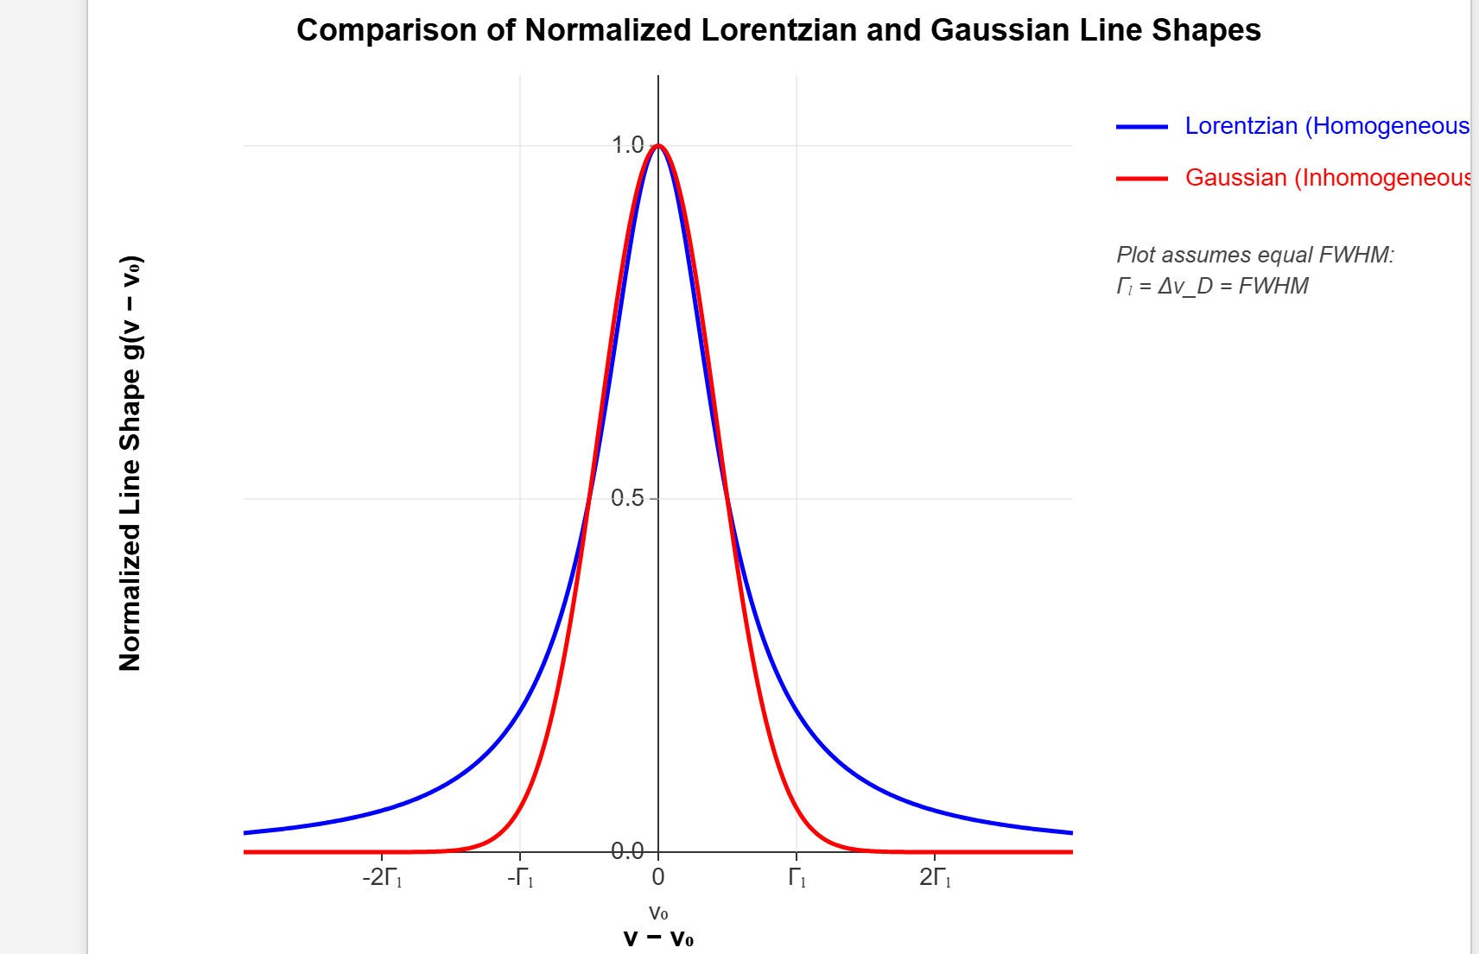
[IMAGE REQUIRED: Overlay plot of Lorentzian and Gaussian gain profiles, both normalized, indicating centre frequency 𝜈₀.]
Prepared by Dist. Prof. Dr. M.A. Gondal for Phys 608 Laser Spectroscopy course in KFUPM (Term 251)

Slide 31
Slide 12: Resonator Loss Factor 𝜸 — Frequency Behaviour
Mirror reflectivity depends on wavelength via coating design.
Diffraction losses vary with mode order → higher-order modes often suppressed.
Total 𝛾(𝜈) therefore has minima aligned with resonator eigen- frequencies.
Intersection of −2 𝐿𝛼(𝜈) and 𝛾(𝜈) curves dictates actual laser spectrum.

Slide 32
Single-mode operation requires cavity and gain bandwidth to support only one intersection.

Slide 33
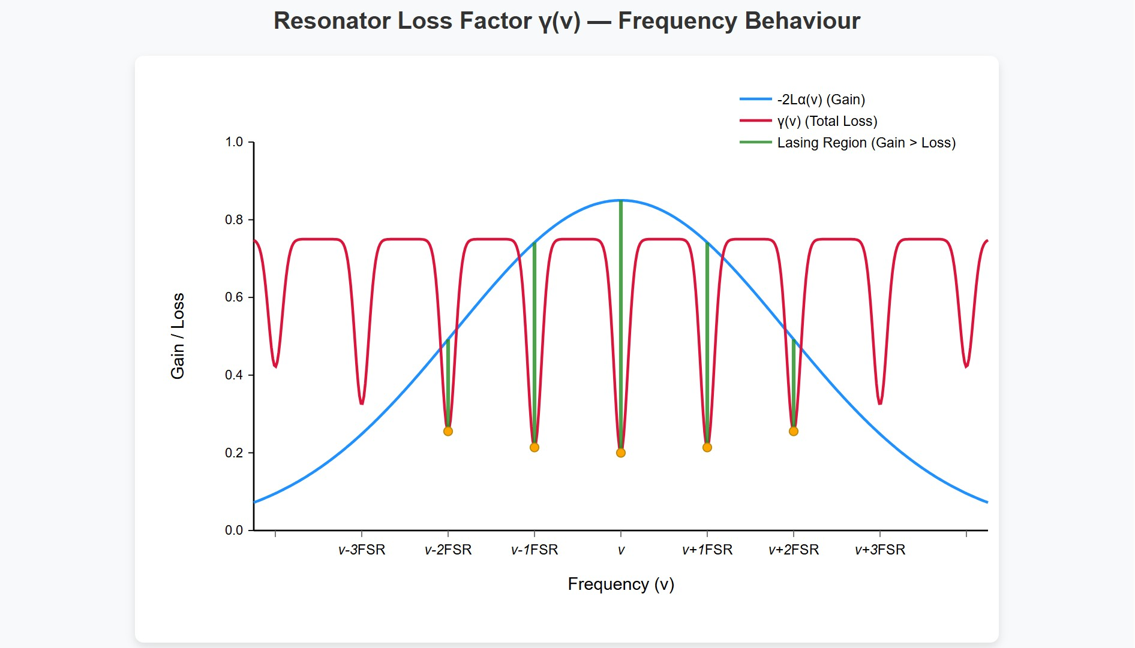
[IMAGE REQUIRED: Graph of net gain versus frequency with gain curve crossing loss curve at discrete mode frequencies.]
---
Prepared by Dist. Prof. Dr. M.A. Gondal for Phys 608 Laser Spectroscopy course in KFUPM (Term 251)

Slide 34
Slide 13: Enter Rate Equations — Tracking Populations &
Photons
Consider four-level system—simplest practical laser scheme.
Define:
𝑃: pump rate into level |2⟩ [atoms cm⁻³ s⁻¹].
𝑅_{i}: non-radiative relaxation rate out of level |𝑖⟩ [s⁻¹].
𝐴₂₁: spontaneous rate between |2⟩ and |1⟩ [s⁻¹].

Slide 35
𝑛: photon density inside cavity [photons cm⁻³].
Neglect quantum coherence → population-rate approximation valid for many cw lasers.

Slide 36
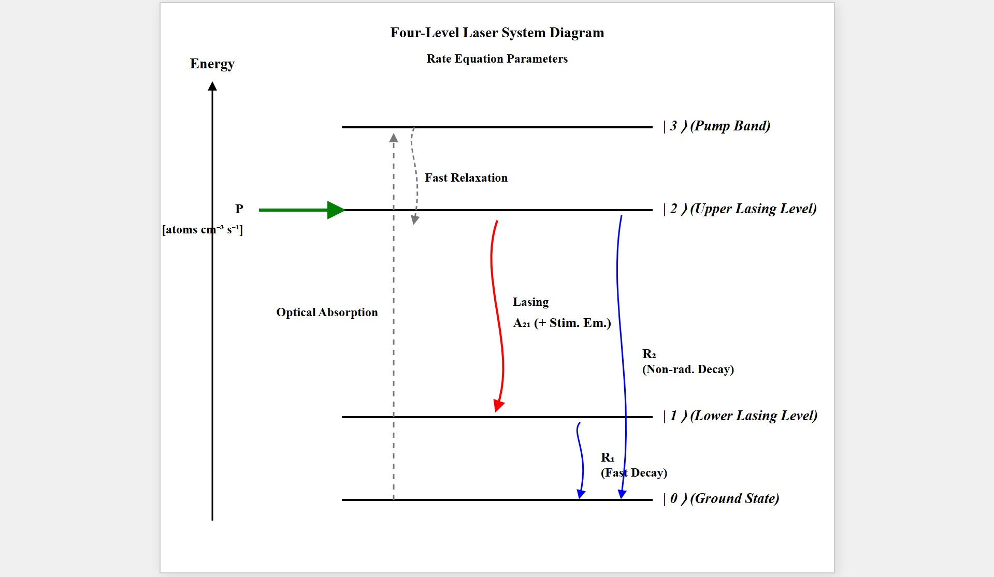
[IMAGE REQUIRED: Four-level diagram with pump arrow to |2⟩, lasing transition |2⟩ → |1⟩, fast decay |1⟩ → |0⟩.]
---
Prepared by Dist. Prof. Dr. M.A. Gondal for Phys 608 Laser Spectroscopy course in KFUPM (Term 251)

Slide 37
Slide 14: Complete Rate-Equation Set
Population of lower laser level |1⟩:
𝑑𝑁
1
= 𝑁 − 𝑁 )𝐵
(
𝑛ℎ𝜈 + 𝑁 𝐴 − 𝑁 𝑅
𝑑𝑡
2 1 21
2 21 1 1
Population of upper laser level |2⟩:
𝑑𝑁
2
( )
= 𝑃 − 𝑁 − 𝑁 𝐵
𝑛ℎ𝜈 − 𝑁 𝐴
− 𝑁 𝑅
𝑑𝑡
2
1 21
2 21
2 2
Photon density inside cavity:

Slide 38
𝑑𝑛
= −𝛽𝑛 + (𝑁₂ − 𝑁₁)𝐵₂₁𝑛ℎ𝜈
𝑑𝑡
𝛽 [s⁻¹]: photon loss rate due to mirror transmission + intracavity absorption.
Coupling
between matter and field explicitly visible
via (𝑁₂ −
𝑁₁)𝐵₂₁𝑛ℎ𝜈.
---

Slide 39
Slide 15: Relating 𝜷 to Cavity Loss 𝜸
One round-trip time
2 𝑑
𝑇 =
𝑐
Fractional energy loss per round-trip 𝛾.
Equate exponential decays:
𝑛(𝑡) = 𝑛(0)𝑒^{−𝛽𝑡}
𝐼 = 𝐼₀𝑒^{−𝛾𝑦}
with 𝑦 = 𝑡/𝑇

Slide 40
Hence
𝛾
𝑇 2 𝑑
𝑐
𝛽 =
= 𝛾
Convenient
link between macroscopic
loss
coefficient and
microscopic photon decay rate.
---

Slide 41
Slide 16: Steady-State Solutions — Pump Power Balance
• Stationary regime: 𝑑𝑁₁/𝑑𝑡 = 𝑑𝑁₂/𝑑𝑡 = 𝑑𝑛/𝑑𝑡 = 0.
Adding population equations yields pump–relaxation balance:
𝑃 = 𝑁₁𝑅₁ + 𝑁₂𝑅₂
Adding upper-level and photon equations gives:
𝑃 = 𝛽𝑛 + 𝑁₂(𝐴₂₁ + 𝑅₂)
Lower-level relaxation must satisfy

Slide 42
𝑁₁𝑅₁ = 𝛽𝑛 + 𝑁₂𝐴₂₁
Physical meaning: pump power splits into useful photon output and unavoidable relaxation losses.
---

Slide 43
Slide 17: Stationary Inversion Expression
Multiply first rate equation by 𝑅₂ and second by 𝑅₁, add:
(𝑅₁ − 𝐴₂₁) 𝑃
𝛥𝑁 =
stat
𝐵 𝑛ℎ𝜈(𝑅 + 𝑅 ) + 𝐴
𝑅 + 𝑅 𝑅
12 1 2 21 1 1 2
Continuous inversion requires
𝑅₁ > 𝐴₂₁
→ lower laser level must empty faster than it is refilled by spontaneous
decay.

Slide 44
In presence of strong field, stricter criterion
𝑅₁ > 𝐴₂₁ + 𝐵₂₁𝜌
ensuring inversion not quenched by stimulated emission into other modes.
---

Slide 45
Slide 18: Threshold Inversion via Rate Equations
Set 𝑑𝑛/𝑑𝑡 = 0 in photon rate equation:
(𝑁₂ − 𝑁₁)𝐵₂₁𝑛ℎ𝜈 = 𝛽𝑛
Solve for inversion:
𝛽
𝛥𝑁 =
𝐵₂₁ℎ𝜈
• Relate 𝛽 to 𝛾 and 𝜎 (using 𝜎 = ℎ𝜈⁄𝑐 𝐵₂₁):

Slide 46
𝛾
𝛥𝑁_{thr} = _{2𝐿𝜎}
Exactly identical to threshold derived from gain–loss balance →
confirms internal consistency of rate-equation approach.
---

Slide 47
Slide 19: He–Ne Laser — Detailed Power Budget Example
Given:
• 𝑁₂ = 1.0 × 10¹⁰ cm⁻³
• 𝐴₂₁ + 𝑅₂ = 2.0 × 10⁷ s⁻¹
Tube volume 𝑉 = 0.075 cm³ ( 𝐿 = 10 cm, diameter 1 mm ).
Incoherent loss rate (upper-level depletion):
𝑁₂(𝐴₂₁ + 𝑅₂)𝑉 = 1.5 × 10¹⁶ s⁻¹

Slide 48
Target output power 𝑃_{L} = 3 mW at 𝜆 = 633 nm → photon rate
𝑃_{L}
𝛽𝑛 =
= 1.0 × 10¹⁶ s⁻¹
ℎ𝑐/𝜆
Required pump rate
𝑃 = (1.5 + 1.0) × 10¹⁶ = 2.5 × 10¹⁶ s⁻¹
Fluorescence (isotropic spontaneous emission) is larger loss channel than mirror transmission in this design.
---

Slide 49
Slide 20: Key Takeaways Before Moving On
Population inversion is quantitative: 𝛥𝑁_{thr} links gain cross-section, medium length, and cavity loss.
Rate
equations provide intuitive bookkeeping of photons and
populations, predicting threshold and output power.
Lower-level depopulation speed is critical — designs favour four-level systems over three-level.

Slide 50
Resonator characteristics (losses, mode spacing) intertwine with gain profile to determine spectral output.
Mastery of these fundamentals is prerequisite for understanding single-mode operation, frequency stabilization, and tunable laser architectures in subsequent sections.

