Slide 1
Chap. 3.6 Saturation & Power Broadening

Slide 2
Slide 1: Saturation & Power Broadening – WHY WE CARE
Precise spectroscopy demands linewidths as narrow as possible.
High‐power lasers can unintentionally enlarge these widths.
Two closely related mechanisms are at play:
Saturation of the level populations (population equalisation).
Power (or saturation) broadening of the spectral profile.

Slide 3
We concentrate on a strictly homogeneous two-level absorber.
* Homogeneous = every absorber experiences the same natural width 𝛾.
Road-map of coming slides:
Build the two-level rate equation from scratch.
Derive the saturation parameter 𝑆 and discuss population depletion.
Extend the argument to frequency-dependent saturation 𝑆_{𝜔} and show how 𝛾 inflates to 𝛾_{s}.

Slide 4
Re-derive the same broadening with Rabi flopping to illuminate the underlying physics.
Conclude with experimentally relevant side-bands in a pump–probe arrangement.
---

Slide 5
Slide 2: Refresher – What Limits a Linewidth in the First
Place?
Line-shapes are affected by many unrelated physical processes.
Homogeneous sources: natural lifetime (1/𝜏), collisional de- phasing, transit-time, laser bandwidth, etc.
Inhomogeneous
sources: Doppler shifts, spatial field gradients,
unresolved hyperfine splittings, etc.

Slide 6
For the moment we suppress every inhomogeneous mechanism.
* Mathematically we keep a single Lorentzian function with half- width at half-maximum 𝛾/2.
Intense radiation alters a homogeneous line by:
Depleting the lower level more strongly at resonance than in the wings.
Driving coherent Rabi oscillations that smear out the response.

Slide 7
Outcome: an apparently wider Lorentzian with a reduced peak absorption.
---

Slide 8
Slide 3: Prototype Two-Level System
Two discrete, non-degenerate energy levels:
Lower level |1⟩, energy 𝐸₁.
Upper level |2⟩, energy 𝐸₂ (> 𝐸₁).
Transition angular frequency
𝐸₂ − 𝐸₁
𝜔₂₁ =
.
ℏ
Population variables (number of atoms per cm³)

Slide 9
𝑁₁(𝑡), 𝑁₂(𝑡).
Allowed processes:
Stimulated absorption |1⟩ → |2⟩.
Stimulated emission |2⟩ → |1⟩.
Spontaneous relaxation |2⟩ → |1⟩ (rate 𝑅₂).
Non-radiative depopulation of |1⟩ (rate 𝑅₁).
No other levels are involved; therefore
𝑁 = 𝑁₁ + 𝑁₂
remains
constant.

Slide 10
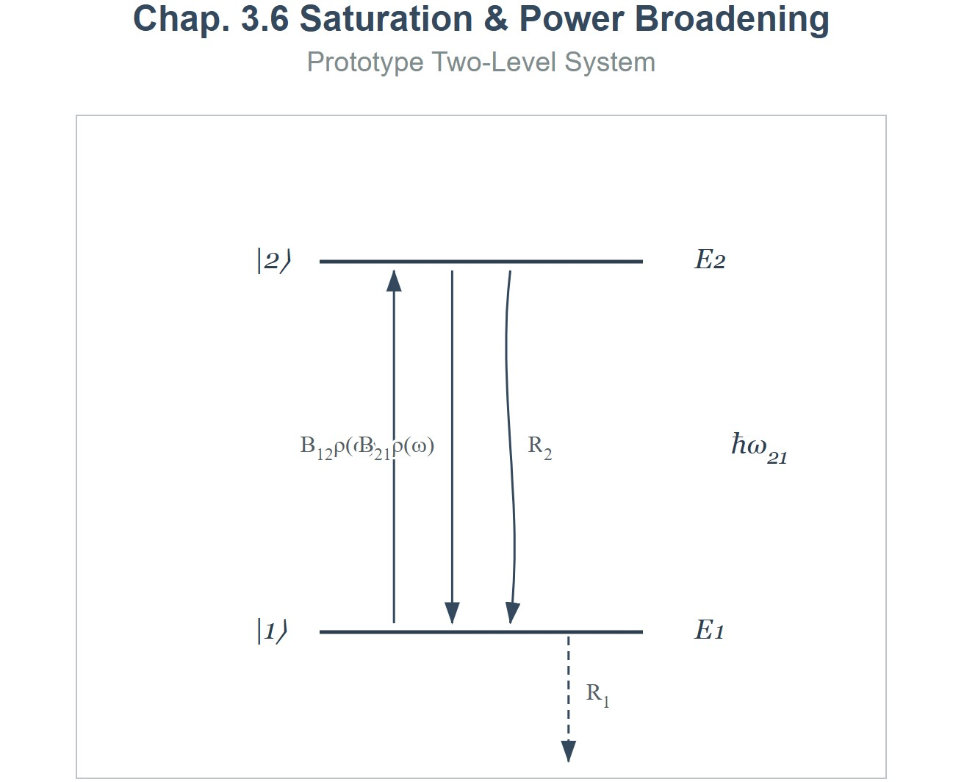
[IMAGE REQUIRED: Energy-level diagram showing |1⟩, |2⟩, upward arrow for absorption, downward arrows for spontaneous and stimulated emission, annotated with rates 𝐵₁₂𝜌(𝜔), 𝑅₂, 𝑅₁.]
Prepared by Dist. Prof. Dr. M.A. Gondal for Phys 608 Laser Spectroscopy course in KFUPM (Te
rm 251)

Slide 11
Slide 4: Building the Rate Equation – Step by Step
Stimulated absorption probability per atom per second:
^{𝒫}12
= 𝐵₁₂ 𝜌_{P}(𝜔),
𝐵₁₂: Einstein 𝐵 coefficient for absorption (units: s⁻¹ m³ J⁻¹).
𝜌_{P}(𝜔): spectral energy density of the pump field at frequency 𝜔
(units: J m⁻³ Hz⁻¹).
Define shorthand
Prepared by Dist. Prof. Dr. M.A. Gondal for Phys 608 Laser Spectroscopy course in KFUPM (Term 251)

Slide 12
𝑃 =
^{𝒫}12
(convenience symbol for pump rate).
Full differential balance (population gains counted positive):
d𝑁
1
= −𝑃𝑁₁ − 𝑅₁𝑁₁ + 𝑃𝑁₂ + 𝑅₂𝑁₂,
d𝑡
d𝑁
2
= +𝑃𝑁₁ + 𝑅₁𝑁₁ − 𝑃𝑁₂ − 𝑅₂𝑁₂.
d𝑡
Each term is individually interpretable:
−𝑃𝑁₁ → atoms leaving level 1 via absorption.
Prepared by Dist. Prof. Dr. M.A. Gondal for Phys 608 Laser Spectroscopy course in KFUPM (Term 251)

Slide 13
• +𝑃𝑁₂ → stimulated emission returns atoms to 1.
−𝑅₁𝑁₁ → non-radiative loss from 1.
• +𝑅₂𝑁₂ → spontaneous decay feeding 1.
---
Prepared by Dist. Prof. Dr. M.A. Gondal for Phys 608 Laser Spectroscopy course in KFUPM (Term 251)

Slide 14
Slide 5: Stationary Solution of the Rate Equations
Steady state condition
d𝑁_{i = 0}
(𝑖 = 1,2).
d𝑡
Enforce particle conservation
𝑁₁ + 𝑁₂ = 𝑁
(total density, constant).
Insert 𝑃 and solve algebraically for 𝑁₁:
(𝑃 + 𝑅₁)𝑁₁ = (𝑃 + 𝑅₂)(𝑁 − 𝑁₁).
Prepared by Dist. Prof. Dr. M.A. Gondal for Phys 608 Laser Spectroscopy course in KFUPM (Term 251)

Slide 15
Rearrangement yields
𝑃 + 𝑅₂
𝑁 = 𝑁
,
1
2 𝑃 + 𝑅₁ + 𝑅₂
𝑃 + 𝑅₁
𝑁 = 𝑁
.
2
2 𝑃 + 𝑅 + 𝑅
1 2
Important limiting cases:
𝑃 ≪ 𝑅_{i} (weak field) → returns thermal equilibrium populations.
Prepared by Dist. Prof. Dr. M.A. Gondal for Phys 608 Laser Spectroscopy course in KFUPM (Term 251)

Slide 16
• 𝑃 ≫ 𝑅_{i}
(very strong field) → 𝑁₁ = 𝑁₂ = 𝑁/2. Medium becomes
transparent because the populations equalise.
---
Prepared by Dist. Prof. Dr. M.A. Gondal for Phys 608 Laser Spectroscopy course in KFUPM (Term 251)

Slide 17
Slide 6: Introducing the Saturation Parameter 𝑺
Population difference (net absorbers)
𝛥𝑁 =
𝑁₁ − 𝑁₂.
Unsaturated difference ( 𝑃 = 0 )
𝑅₂ − 𝑅₁
𝛥𝑁₀
= 𝑁
𝑅 + 𝑅
.
1
2
Substitute steady-state populations:
Prepared by Dist. Prof. Dr. M.A. Gondal for Phys 608 Laser Spectroscopy course in KFUPM (Term 251)

Slide 18
𝛥𝑁₀
𝛥𝑁 =
.
1 +
2 𝑃
𝑅₁ + 𝑅₂
Define
2 𝑃
𝑅₁ + 𝑅₂
𝑃
= , 𝑅 =
𝑅
𝑅₁ + 𝑅₂
𝑆 =
.
2
𝑆 is the ratio “pumping rate per atom” ÷ “mean relaxation rate”.
Special case: only spontaneous decay from upper level
• 𝑅₁ = 0, 𝑅₂ = 𝐴₂₁.
Prepared by Dist. Prof. Dr. M.A. Gondal for Phys 608 Laser Spectroscopy course in KFUPM (Term 251)

Slide 19
Using intensity 𝐼(𝜔) and cross section 𝜎₁₂(𝜔):
𝜎₁₂(𝜔) 𝐼(𝜔)
2 𝜎₁₂(𝜔) 𝐼(𝜔)
𝑃 =
, 𝑆 =
.
ℏ𝜔
ℏ𝜔 𝐴₂₁
Prepared by Dist. Prof. Dr. M.A. Gondal for Phys 608 Laser Spectroscopy course in KFUPM (Term 251)

Slide 20
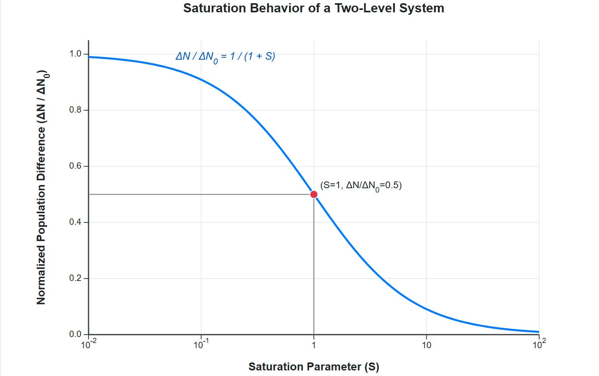
[IMAGE REQUIRED: Plot showing 𝛥𝑁/𝛥𝑁₀ vs 𝑆 on a log scale, highlighting the 1/(1 + 𝑆) decrease.]
Prepared by Dist. Prof. Dr. M.A. Gondal for Phys 608 Laser Spectroscopy course in KFUPM (Term 251)

Slide 21
Slide 7: Absorption Coefficient under Saturation
Microscopic absorption cross section 𝜎₁₂(𝜔) (units: m²).
Macroscopic coefficient
𝛼(𝜔) = 𝜎₁₂(𝜔) 𝛥𝑁.
Insert 𝛥𝑁 expression:
𝛼₀(𝜔)
𝛼(𝜔) =
,
1 + 𝑆
• 𝛼₀(𝜔) = 𝜎₁₂(𝜔) 𝛥𝑁₀ is the unsaturated value.

Slide 22
Consequences:
Peak absorption diminishes as 1/(1 + 𝑆).
In the limit 𝑆 → ∞, 𝛼 → 0: complete bleaching.

Slide 23
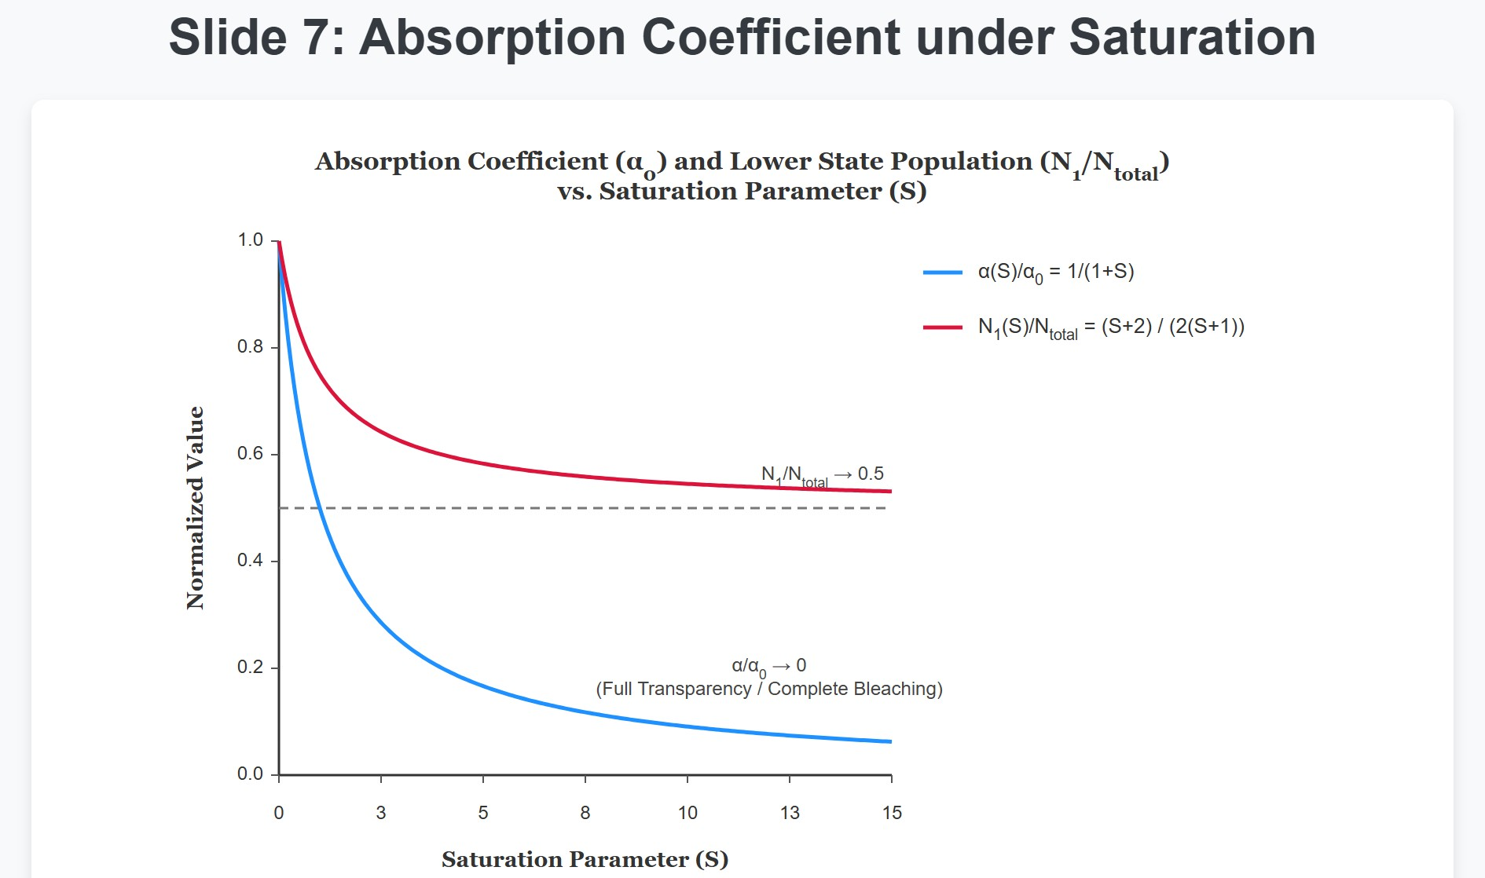
[IMAGE REQUIRED: Two curves on the same axes: (i) 𝛼 vs 𝑆, (ii) 𝑁₁ vs 𝑆; annotate the full transparency point.]
Prepared by Dist. Prof. Dr. M.A. Gondal for Phys 608 Laser Spectroscopy course in KFUPM (Term 251)

Slide 24
Slide 8: Saturation Broadening – Conceptual Jump
So far we treated a single frequency at a time. Real lasers have finite spectral width.
Saturation is strongest exactly at 𝜔₀
induced rate is highest there.
Wings of the Lorentzian are less saturated (smaller 𝑆_{𝜔}).
Result: central part flattens while the area (integrated oscillator
strength) stays conserved → line broadens outward.
(line centre) because the

Slide 25
Slide 9: Lorentzian Profile & Frequency-Dependent
Saturation
Unsaturated homogeneous line (natural plus collisional)
(𝛾/2)²
( )
= ,
𝐿 𝜔 − 𝜔
0
( )
2 2
𝜔 − 𝜔
( )
+ 𝛾/2
0
𝛾: full width at half maximum (FWHM).
Local saturation parameter

Slide 26
𝐵₁₂ 𝜌(𝜔)
𝑆_{𝜔} =
𝐿(𝜔 − 𝜔₀).
𝑅
Define peak value
𝑆₀ = 𝑆_{𝜔0} .
Frequency variation therefore reads
(𝛾/2)²
𝑆_{𝜔} = 𝑆₀
.
(
𝜔 − 𝜔
)
2
( )
2
+ 𝛾/2
0
• 𝑆_{𝜔} → 0 as |𝜔 − 𝜔₀| → ∞.

Slide 27
Slide 10: Deriving the Broadened Linewidth 𝜸_{s}
Power absorbed per unit volume per unit frequency
d𝑊₁₂(𝜔)
𝛥𝑁₀
= ℏ𝜔 𝑅
.
d𝑡
Substitute 𝑆_{𝜔} expression:
1 + 𝑆_{𝜔}
d𝑊₁₂(𝜔)
𝑆₀(𝛾/2)²
= ℏ𝜔 𝑅 𝛥𝑁₀
.
d𝑡
(𝜔 − 𝜔₀)² + (𝛾/2)² (1 + 𝑆₀)

Slide 28
The denominator has exactly the structure of a Lorentzian with an enlarged half-width
𝛾_{s} = 𝛾√ 1 + 𝑆₀ .
Physical meaning:
At 𝑆₀ = 1 the width grows by √2.
Scaling is ∝ √𝑃 for large 𝑃 because 𝑆₀ ∝ 𝑃.
---

Slide 29
Slide 11: Absorption Profile in the Saturated Regime
Saturated coefficient
(𝛾/2)²
( ) ( )
𝛼 𝜔 = 𝛼
𝜔
.
s
0 0
(
𝜔 − 𝜔
)
2
( )
2
+ 𝛾 /2
0
s
Alternate but equivalent form
𝛼₀(𝜔)
( )
.
𝛼 𝜔
=
s
1 + 𝑆
𝜔
Observations:

Slide 30
Peak reduction factor 1/(1 + 𝑆₀).
Area under 𝛼(𝜔) remains (nearly) constant – oscillator strength conservation.
Wings asymptotically merge with the unsaturated curve because
𝑆_{𝜔} → 0.
---

Slide 31
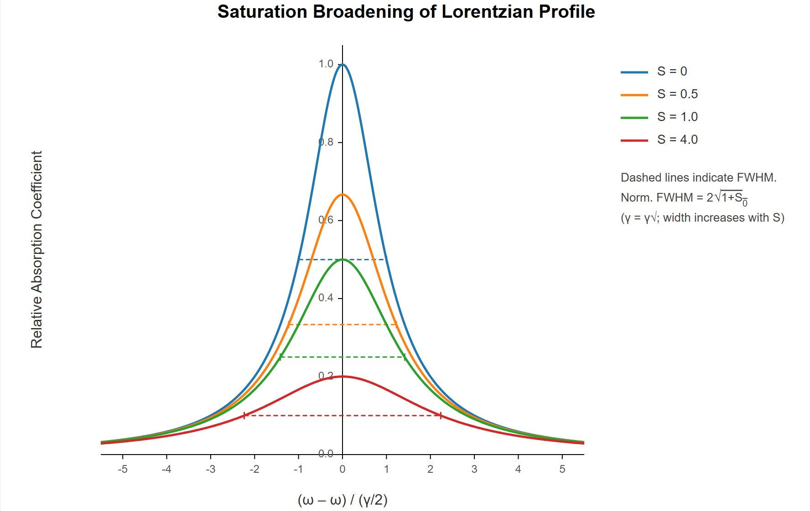
Slide 12: Visualising Saturation Broadening
[IMAGE REQUIRED: Overlaid Lorentzian curves for 𝑆₀ = 0, 0.5, 1, 4. Horizontal axis 𝜔 − 𝜔₀ in units of 𝛾/2; vertical axis relative absorption coefficient. Mark increasing 𝛾_{s}.]
Prepared by Dist. Prof. Dr. M.A. Gondal for Phys 608 Laser Spectroscopy course in KFUPM (Term 251)

Slide 32
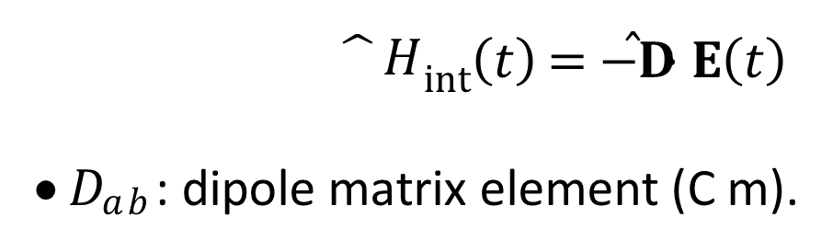
Slide 13: Power Broadening – An Alternative Microscopic
View
Treat the light classically: electric field
𝐸(𝑡) = 𝐸₀cos𝜔𝑡.
Quantum mechanical two-level interaction Hamiltonian
^{𝐷}𝑎𝑏 ^{𝐸}0
$\hat{}H$_{int}(𝑡) = −𝐃̂ ⋅ 𝐄(𝑡)
𝐷_{𝑎𝑏} : dipole matrix element (C m).
→ 𝛺_{R} =
,
ℏ

Slide 33
𝛺_{R}: Rabi flopping frequency (rad s⁻¹).
Population
of upper state |𝑏⟩ without
damping
exhibits
Rabi
oscillations between 0 and 1.
Intuition:
stronger field → faster flopping
→ broader
spectral
response (time–frequency uncertainty).
---

Slide 34
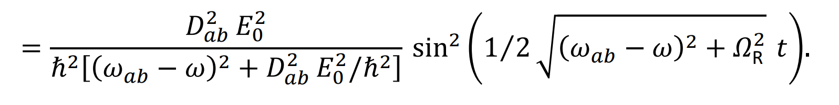
Slide 14: Exact Time-Dependent Excitation Probability
Probability amplitude 𝑏(𝑡) (rotating‐wave approximation):
|𝑏(𝑡)|²
At exact resonance 𝜔 = 𝜔_{𝑎𝑏} the sine term oscillates with frequency
𝛺_{R}.

Slide 35
Without
damping the spectrum would
develop
many
sharp
sidebands (Fourier series of a square wave).
---

Slide 36
Slide 15: Including Relaxation – Time Averaging
Exponential decay of coherence and population from both levels:
We introduce damping constant 𝛾 (s⁻¹).
Mean excitation probability obtained via weighted integral
∞
𝑃_{b}(𝜔) = ∫ 𝛾 e^{−𝛾𝑡} |𝑏(𝑡)|² d𝑡.
0
Result after algebra:

Slide 37
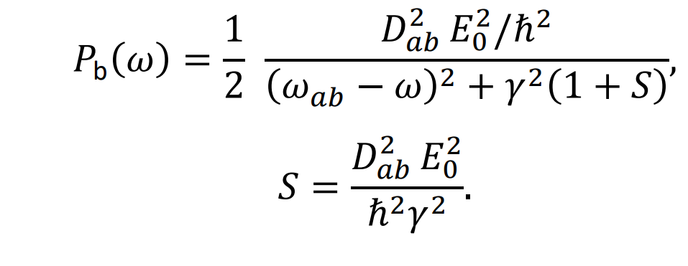
𝑆 again appears as the square of the field amplitude normalised to damping.
---

Slide 38
Slide 16: Identical Broadening Law from the Rabi Picture
Because 𝑃_{b}(𝜔) directly scales with the absorption line, we identify the same Lorentzian as before, but now with
𝛾_{s} = 𝛾√ 1 + 𝑆 .
Connection to the earlier definition:
Replace 𝐷² 𝐸²/ℏ² by 𝐵 𝐼/𝑐 (classical ↔ Einstein coefficients).
𝑎𝑏 0 12
• One recovers 𝑆 = 𝐵₁₂𝜌(𝜔₀)/𝑅 = 𝑆₀.

Slide 39
Conceptual bonus: we see that the broadening stems from the Fourier transform of damped Rabi oscillations.
---

Slide 40
Slide 17: Pump–Probe Scenario & Autler–Townes–Type
Sidebands
Strong “pump” laser exactly resonant: large 𝛺_{R}.
Weak tunable “probe” interrogates the modified absorption profile.
Populations and coherences are modulated at 𝛺_{R}; probe perceives sidebands at
𝜔 = 𝜔₀ ± 𝛺_{R}.

Slide 41
Requirement for clearly resolved doublet
𝛺_{R} > 𝛾_{s}.
Observed features:
Central dip (sometimes called “hole burning” or “Mollow triplet” in fluorescence context).
Two Lorentzian satellites each of width 𝛾_{s}.

Slide 42
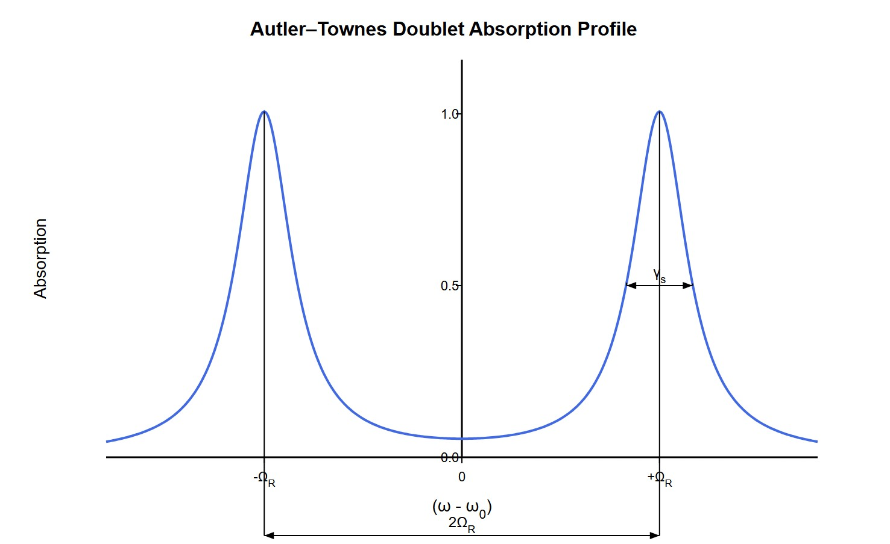
[IMAGE REQUIRED: Spectrum with central dip and two symmetric side peaks; annotate separation 2𝛺_{R} and individual widths 𝛾_{s}.]
Prepared by Dist. Prof. Dr. M.A. Gondal for Phys 608 Laser Spectroscopy course in KFUPM (Term 251)

Slide 43
Slide 18: Frequently Used Working Equations
Saturation parameter
2 𝑃
𝑅₁ + 𝑅₂
𝐵₁₂𝜌(𝜔₀)
2 2
^{𝐷}𝑎𝑏 ^{𝐸}0
𝑆 =
= =
.
𝑅
_{ℏ}2_{𝛾}2
Population difference
𝛥𝑁₀
𝛥𝑁 =
.
1 + 𝑆
Saturated absorption coefficient (homogeneous line)

Slide 44
𝛼₀(𝜔)
(𝛾/2)²
( )
𝛼 𝜔 =
,
𝑆 = 𝑆
.
s
1 + 𝑆
𝜔
0
(
𝜔 − 𝜔
)
2
( )
2
+ 𝛾/2
𝜔
0
Power-broadened half-width
𝛾_{s} = 𝛾√1 + 𝑆₀.
Rabi frequency (dipole interaction)
^{𝐷}𝑎𝑏 ^{𝐸}0
𝛺_{R} =
.
ℏ
---

