Slide 1
Chap. 3.5 Homogeneous
& Inhomogeneous Line Broadening

Slide 2
Slide 1: Scope & Learning Goals
Introduce
the two fundamental categories of spectral-line
broadening: homogeneous versus inhomogeneous.
Build an intuitive and quantitative understanding of how each mechanism modifies the observable frequency distribution of photons emitted or absorbed by atoms / molecules.

Slide 3
Develop the mathematical tools—especially the Lorentzian line shape and the Maxwell–Boltzmann Doppler profile—that let us predict and fit experimental spectra.
Examine the role of collisions, differentiating between
  amplitude-perturbing (inelastic) collisions,
  phase-perturbing (elastic) collisions, and
  velocity-changing collisions that redistribute molecular velocities.

Slide 4
Connect
these ideas to practical laser-spectroscopy techniques
(Doppler-limited, Doppler-free, and Dicke-narrowed regimes).
---

Slide 5
Slide 2: What Exactly Is a “Spectral Line”?
Core Concept
A spectral line is the distribution of detected photon frequencies
associated with a quantum transition 𝐸_{i} → 𝐸_{k}
identical particles.
Formal Probability Density
in an ensemble of
probability that a randomly chosen particle emits or absorbs a photon with frequency in [𝜔, 𝜔 + d𝜔].
𝑃_{𝑖𝑘} (𝜔) d𝜔 ≡

Slide 6
Essential Symbols (with SI Units)
𝐸_{i} — Energy of the initial quantum state (joule, J).
𝐸_{k} — Energy of the final quantum state (J).
𝜔 ≡ 2𝜋𝜈 — Angular frequency of the photon (radian s⁻¹).
𝑃_{𝑖𝑘} (𝜔) — Normalised probability density (s).
Normalisation condition:
∞
∫ 𝑃_{𝑖𝑘} (𝜔) d𝜔 = 1.
0

Slide 7
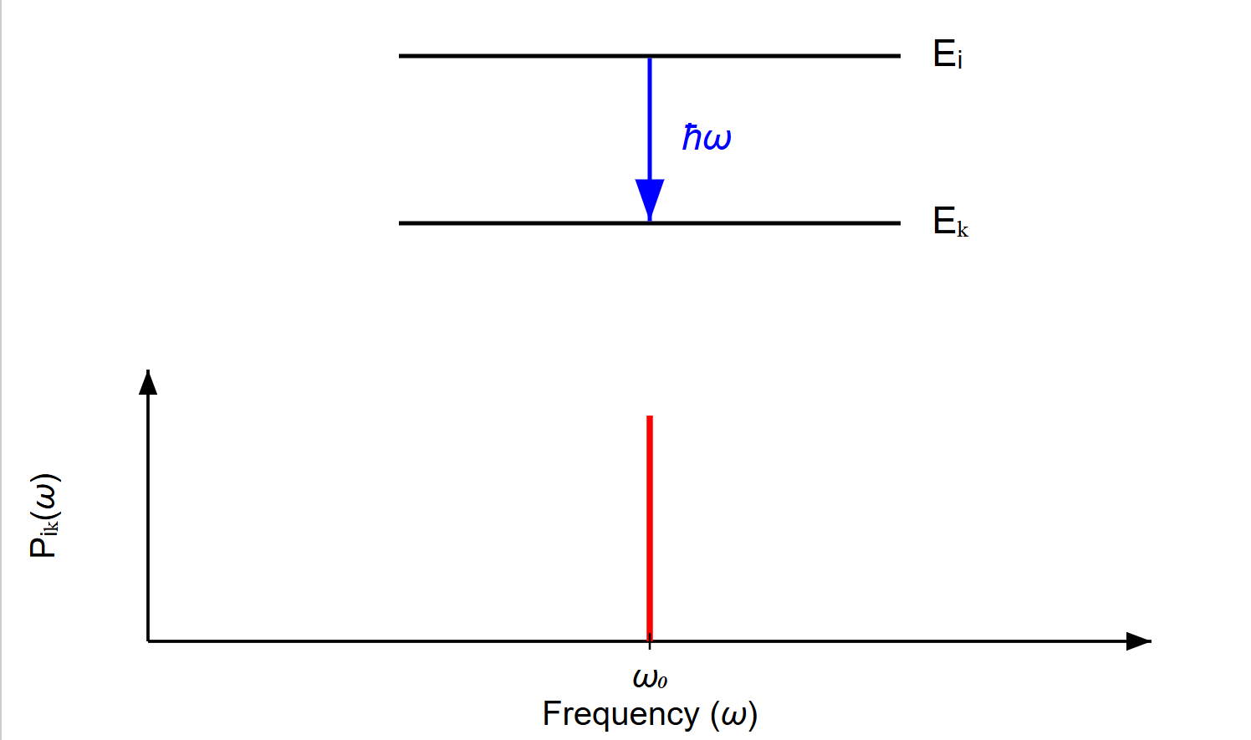
[IMAGE REQUIRED: Energy-level diagram showing 𝐸_{i} and 𝐸_{k} with an arrow labelled ℏ𝜔. Plot of an idealised narrow spectral line on a frequency axis underneath.]
---
Prepared by Dist. Prof. Dr. M.A. Gondal for Phys 608 Laser Spectroscopy course in KFUPM (Term 251)

Slide 8
Slide 3: Defining Homogeneous Broadening
Homogeneous means “the same for every member of the ensemble”.
Uniform Transition Probability
𝑃_{𝑖𝑘} (𝜔) identical for all particles initially in state 𝐸_{i}.
Typical Physical Origins
Natural
emission.
(radiative) lifetime
^{𝜏}sp
— stems from spontaneous

Slide 9
Collision-induced damping when collisions change amplitude or phase
without altering particle velocity.
Key Experimental Signature
Every particle exhibits the same line shape, so the observed macroscopic profile equals the single-particle profile.
Mathematical Prototype — The Lorentzian discussed on the next slide.

Slide 10
Slide 4: The Lorentzian Line Shape
Statement of the Model
For homogeneous broadening caused purely by the finite excited-state lifetime
𝑃_{𝑖𝑘} (𝜔)
= 𝐴_{𝑖𝑘} 𝐿(𝜔 − 𝜔₀).
Components & Definitions
1. 𝐴_{𝑖𝑘} — Einstein 𝐴-coefficient (s⁻¹); total spontaneous-emission rate.

Slide 11
2. 𝜔₀ — Central (resonant) angular frequency
𝐸_{k} − 𝐸_{i}
𝜔₀ =
.
ℏ
3. 𝐿(𝛥𝜔) — Normalised Lorentzian
1
1⁄2 𝛤
𝐿(𝛥𝜔) =
,
𝜋 (𝛥𝜔)² + (1⁄2 𝛤)²
where
• 𝛥𝜔 ≡ 𝜔 − 𝜔₀.

Slide 12
• 𝛤 ≡ 1/𝜏_{sp}
— Full width at half maximum (FWHM) in angular-
frequency units.
Visual Characteristics
Symmetric peak centred at 𝜔₀.
Long algebraic “wings” decreasing as 1/𝛥𝜔².

Slide 13
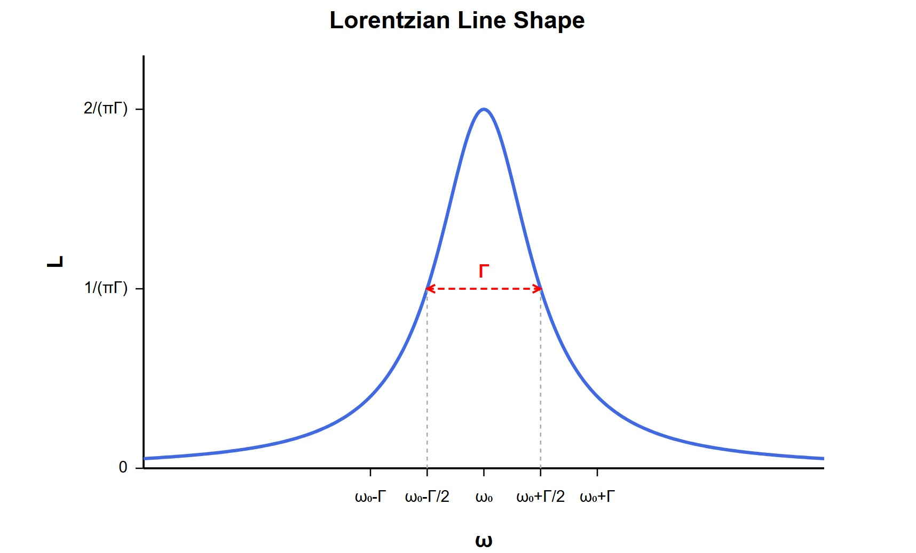
[IMAGE REQUIRED: Plot of a Lorentzian curve with labelled axes 𝜔 and
𝐿, marking FWHM 𝛤.]
Prepared by Dist. Prof. Dr. M.A. Gondal for Phys 608 Laser Spectroscopy course in KFUPM (Term 251)

Slide 14
Slide 5: Introducing Inhomogeneous Broadening
Inhomogeneous means “different subsets of the ensemble contribute different centre frequencies”.
Underlying Mechanism
Property that varies from particle to particle: here, centre frequency depends on velocity 𝐯.
Most Important Laboratory Example — Doppler Broadening.
Implication for Observed Line

Slide 15
Macroscopic profile is a convolution of the single-particle homogeneous line with the distribution of velocities.
4. Contrast to Homogeneous Case
No single, universal line shape per particle; instead, each velocity subclass sees a shifted resonance.
---

Slide 16
Slide 6: Doppler Broadening — Fundamental Kinematics
Doppler Shift for a Single Particle
𝜔 = 𝜔₀
+ 𝐤 ⋅ 𝐯,
where
𝐤 — Wave-vector of probe radiation, magnitude 𝑘 = 2𝜋/𝜆.
𝐯 — Particle velocity; choose 𝑣_{z} along 𝐤.
Velocity Distribution (Thermal Ensemble)

Slide 17
Maxwell–Boltzmann in 1-D:
2
𝑚𝑣_{z}
( )
𝑚
𝑓 𝑣
=
√
exp [ −
].
z
2𝜋𝑘 𝑇
2𝑘 𝑇
B B
𝑚 — Particle mass (kg).
𝑘_{B} — Boltzmann constant (J K⁻¹).
𝑇 — Absolute temperature (K).
Resulting Spectral Envelope

Slide 18
Convolution yields a Gaussian Doppler profile with FWHM
2 𝑘_{B}𝑇ln2
𝛥𝜔_{D} = 2 𝜔₀ √
.
𝑚𝑐²

Slide 19
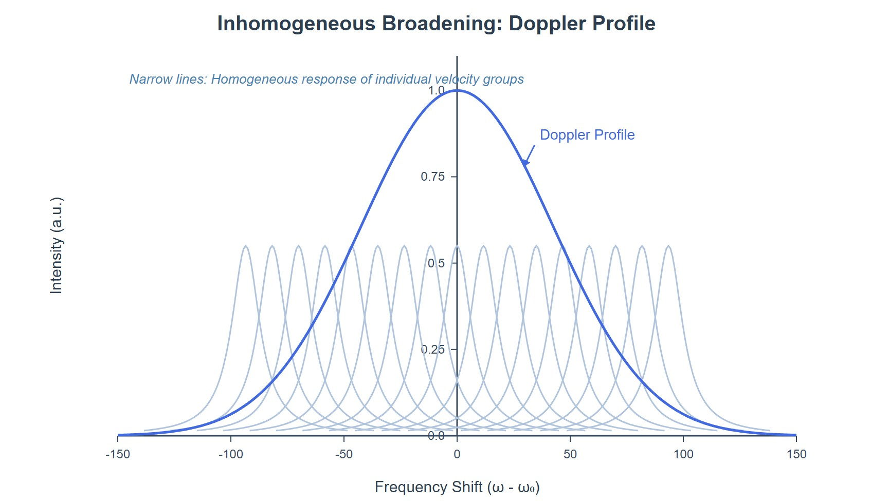
[IMAGE REQUIRED: Sketch showing a Gaussian envelope labelled
“Doppler profile” overlaid with many narrow Lorentzians.]
---
Prepared by Dist. Prof. Dr. M.A. Gondal for Phys 608 Laser Spectroscopy course in KFUPM (Term 251)

Slide 20
Slide 7: Velocity Sub-Grouping — “Homogeneous Islands”
Inside Doppler Sea
1. Conceptual Partition
Divide the velocity axis into slices of width
𝛿𝜔_{n}
𝛥𝑣_{z} =
,
𝑘
where 𝛿𝜔_{n} is the natural (homogeneous) linewidth.
2. Each Slice Behaves Homogeneously

Slide 21
All particles in slice centred at 𝑣_{z}
resonance
𝜔 = 𝜔₀ + 𝑘 𝑣_{z}.
Mathematical Viewpoint
Total profile = sum over Lorentzians of each subgroup, weighted by
𝑓(𝑣_{z}).
Experimental Relevance
share a common Doppler-shifted

Slide 22
saturation
Laser spectroscopists target individual spectroscopy) to “beat” Doppler broadening.
---
slices
(e.g.,

Slide 23
Slide 8: Collisional Broadening — Two Fundamental
Types
1. Inelastic (Amplitude-Perturbing) Collisions
Energy exchange between colliders.
Shortens excited-state lifetime 𝜏 → 𝜏′ < 𝜏.
Result: Increases homogeneous width 𝛤.
2. Elastic (Phase-Perturbing) Collisions

Slide 24
No energy exchange, velocity unchanged.
Introduce random phase jumps.
Lorentzian broadening.
Unified Outcome
Both mechanisms preserve the homogeneous nature:
Fourier
transform of interrupted oscillations
→ additional
collisions
→ broader Lorentzian.
𝑃_{𝑖𝑘} (𝜔)

Slide 25
[IMAGE REQUIRED: Cartoon comparing atomic dipole oscillation trains with/without phase interruptions.]
---

Slide 26
Slide 9: Velocity-Changing Collisions (VCC) — New
Complication
Physical Event
During collision, centre-of-mass momentum is redistributed → the
velocity component 𝑣_{z} shifts by 𝑢_{z}.
Transition Between Subgroups
Particle moves from slice
(𝑣_{z} ± 𝛥𝑣_{z}) → (𝑣_{z} + 𝑢_{z} ± 𝛥𝑣_{z}).

Slide 27
Resulting Frequency Jump
𝜔
Important Distinction
→ 𝜔 + 𝑘 𝑢_{z}.
This frequency shift is not the same as the line shift produced by pure phase-perturbing collisions.

Slide 28
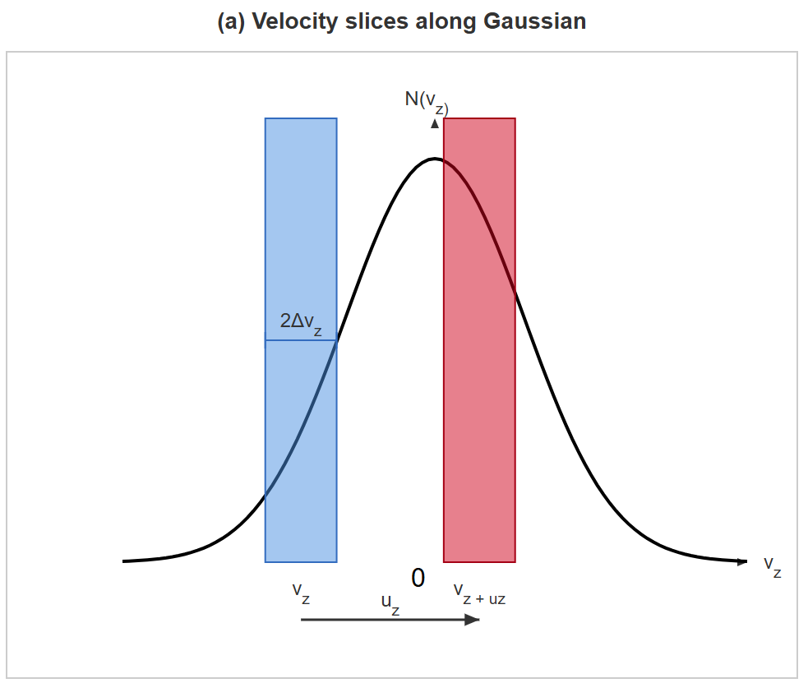
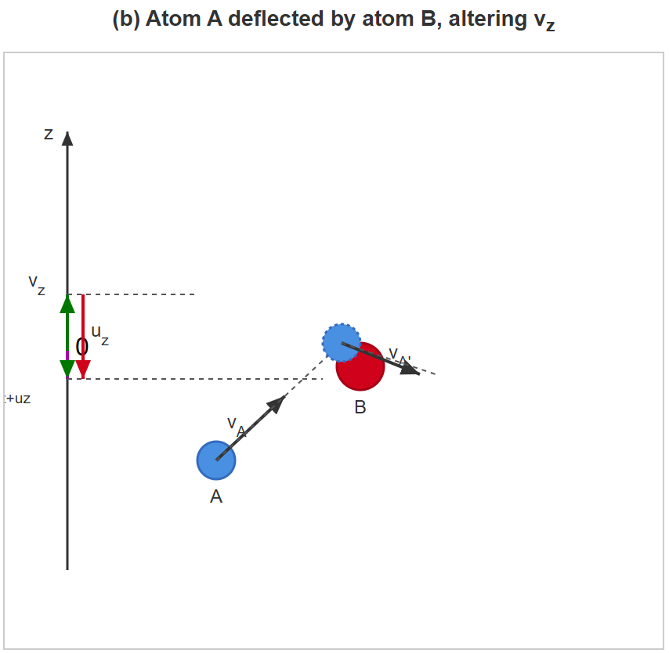
[IMAGE REQUIRED: Two-panel figure. (a) Velocity slices along Gaussian. (b) Arrow showing atom A deflected by atom B, altering 𝑣 .]
z
Prepared by Dist. Prof. Dr. M.A. Gondal for Phys 608 Laser Spectr
oscopy course in KFUPM (Term 251)

Slide 29
Slide 10: Collision Frequency vs Radiation Interaction
Time
Mean Free Time Between Collisions
𝛬
𝑇 = ,
𝑣
𝛬 — Mean free path (m).
𝑣 — Mean thermal speed (m s⁻¹).

Slide 30
Interaction Time with Laser Field
^{𝐿}beam
𝜏_{c} =
,
𝑣
𝐿_{beam} — Effective length of illuminated region (m).
Two Regimes
1. 𝑻 > 𝝉_{c} (Collisions Rare During Interaction)
Minimal mixing between velocity slices → negligible
broadening.
additional

Slide 31
2. 𝑻 ≪ 𝝉_{c} (Frequent Collisions)
Slices get re-populated, shortening effective resonance time → extra homogeneous broadening observed.
---

Slide 32
Slide 11: Spectroscopic Consequences
essentially unchanged.
Doppler-Free Methods (e.g., Saturation Spectroscopy)
VCC can blur the narrow “hole” or “peak” dug into a velocity subgroup, reducing resolution.
Line-Shape Diagnosis
1. Doppler-Limited (Conventional) Spectroscopy
Velocity-changing collisions average out; overall Doppler
width

Slide 33
Line-shape fitting or pump–probe timing can quantify VCC rates.
4. Practical Mitigation
Lower buffer-gas pressure or use atomic beams to reduce collision frequency.
---

Slide 34
Slide 12: Dicke Narrowing — When Collisions Reduce
Width
Key Requirement
𝛬 < 𝜆,
where 𝜆 = 2𝜋/𝑘 is the laser wavelength.
Physical Picture
Frequent velocity randomisation confines phase accumulation →
suppresses Doppler spread.

Slide 35
Observable Effect
Measured line becomes narrower than the naive Doppler width.
Applications
High-precision frequency standards in gas cells (e.g., Rb, Cs clocks).

Slide 36
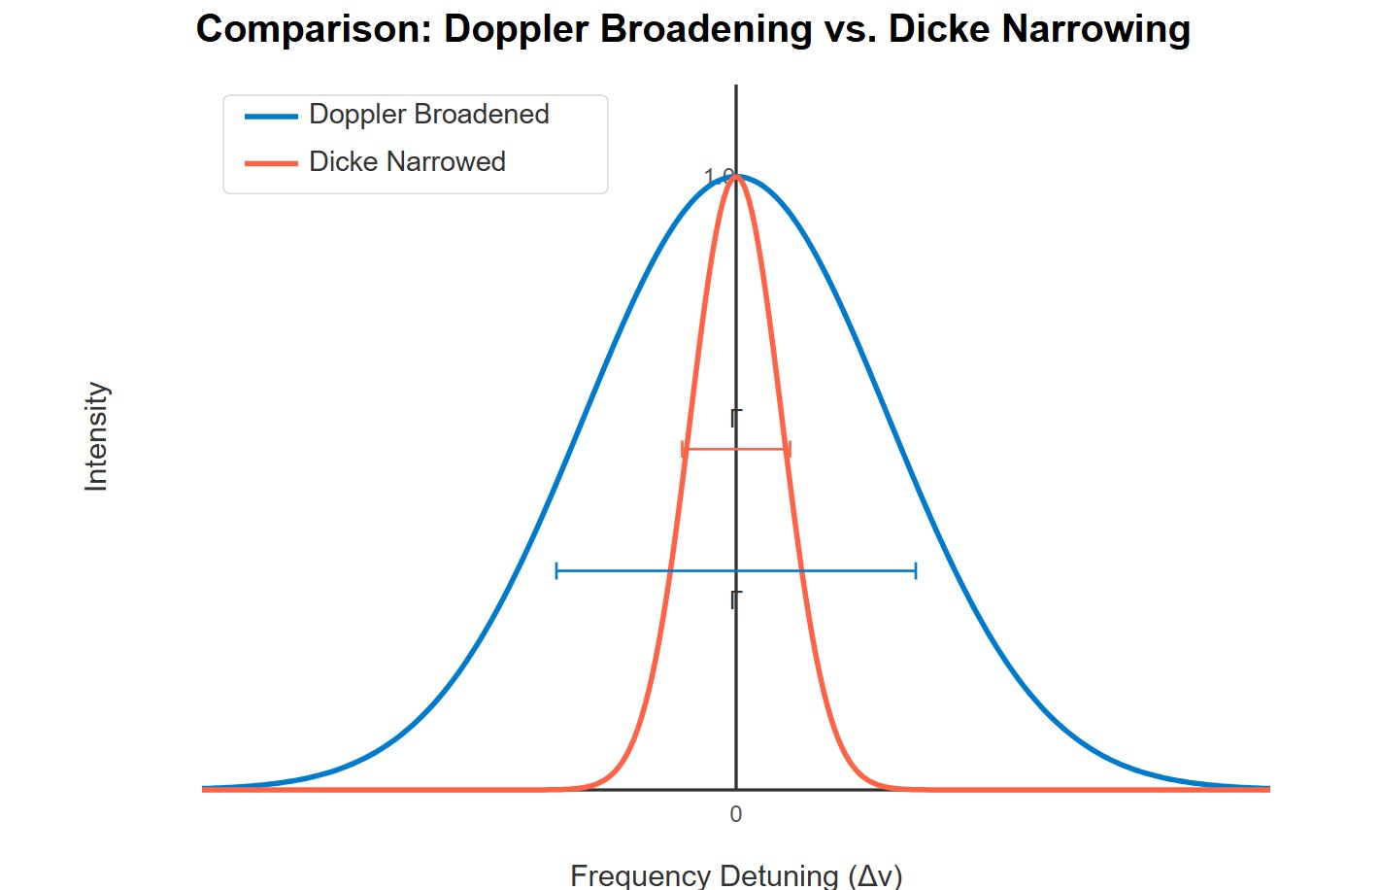
[IMAGE REQUIRED: Sketch comparing wide Gaussian (no Dicke) vs narrowed central peak (with Dicke).]
Prepared by Dist. Prof. Dr. M.A. Gondal for Phys 608 Laser Spectroscopy course in KFUPM (Term 251)

Slide 37
Slide 13: Summary & Next Steps
Recognised homogeneous mechanisms (natural, inelastic, elastic collisions) lead to Lorentzian profiles with width 𝛤.
Recognised inhomogeneous mechanism (thermal Doppler) leads to Gaussian profile with width 𝛥𝜔_{D}.
Velocity-changing collisions bridge the two pictures; their influence depends on 𝑇/𝜏_{c}.

Slide 38
In special high-pressure, short-path regimes, collisions can even narrow
lines (Dicke).
  Upcoming topic: Saturation Spectroscopy — exploiting population dynamics to circumvent Doppler broadening and directly measure
𝛤.
---

