Slide 1
Chap. 3.4 Transit-Time Broadening
Prepared by Dist. Prof. Dr. M.A. Gondal for Phys 608 Laser Spectroscopy course in KFUPM (Term 251)

Slide 2
Prepared by Dist. Prof. Dr. M.A. Gondal for Phys 608 Laser Spectroscopy course in KFUPM (Term 251)

Slide 3
Slide 1: Transit-Time Broadening — Why It Matters
Spectroscopic linewidth determines the achievable resolution and the minimum measurable frequency shift.
When a particle crosses a laser beam quickly, the interaction time 𝑇
can be far shorter than its spontaneous-emission lifetime 𝜏_{sp}.
In this short-interaction regime, the uncertainty principle associates the finite time window 𝑇 with an intrinsic frequency uncertainty: shorter 𝑇 → broader line.
Prepared by Dist. Prof. Dr. M.A. Gondal for Phys 608 Laser Spectroscopy course in KFUPM (Term 251)

Slide 4
Transit-time broadening therefore replaces natural (lifetime-limited) broadening as the dominant mechanism whenever
𝑑
𝑇 = ≪
𝜏_{sp},
|𝑣|
where 𝑑 = effective beam diameter [m], |𝑣| = speed of the particle perpendicular to the beam [m s⁻¹].
Prepared by Dist. Prof. Dr. M.A. Gondal for Phys 608 Laser Spectroscopy course in KFUPM (Term 251)

Slide 5
Understanding, predicting, and mitigating this effect is essential for high-precision laser spectroscopy, frequency standards, and Doppler-free techniques.
---
Prepared by Dist. Prof. Dr. M.A. Gondal for Phys 608 Laser Spectroscopy course in KFUPM (Term 251)

Slide 6
Slide 2: Computing The Transit Time 𝑻 — Step-by-Step
Assume a cylindrically symmetric laser beam of diameter 𝑑.
A particle with speed magnitude
|𝑣|
travels approximately
perpendicularly across the beam.
𝑇 =
𝑑
|𝑣|
Units consistency check:
Prepared by Dist. Prof. Dr. M.A. Gondal for Phys 608 Laser Spectroscopy course in KFUPM (Term 251)

Slide 7
m
= s → 𝑇 has units of seconds.
_{m s}−1
Practical importance: for thermally populated molecular beams, |𝑣| is typically hundreds of m s⁻¹; for ion beams, |𝑣| can reach 10⁶–10⁸ m s⁻¹.
Therefore,
even millimetre-scale beams can impose sub-
microsecond interaction times, orders of magnitude below most spontaneous lifetimes (µs – ms).
---
Prepared by Dist. Prof. Dr. M.A. Gondal for Phys 608 Laser Spectroscopy course in KFUPM (Term 251)

Slide 8
Slide 3: Numerical Illustration — Example 1 (Molecular
Beam)
Given thermal speed
|𝑣|
= 5.0 × 10⁴ cm s⁻¹ = 5.0 × 10² m s⁻¹,
and beam diameter
𝑑
Transit time:
= 0.10 cm
= 1.0 × 10⁻³ m.
Prepared by Dist. Prof. Dr. M.A. Gondal for Phys 608 Laser Spectroscopy course in KFUPM (Term 251)

Slide 9
1.0 × 10⁻³ m
𝑇 =
= 2.0 × 10⁻⁶ s
= 2 𝜇s.
5.0 × 10² m s⁻¹
Typical spontaneous lifetime for rovibrational levels:
^{𝜏}sp
∼ 1 ms
= 10⁻³ s.
Ratio 𝜏_{sp}/𝑇 ≈ 500 → transit-time broadening dominates by two orders of magnitude.
Prepared by Dist. Prof. Dr. M.A. Gondal for Phys 608 Laser Spectroscopy course in KFUPM (Term 251)

Slide 10
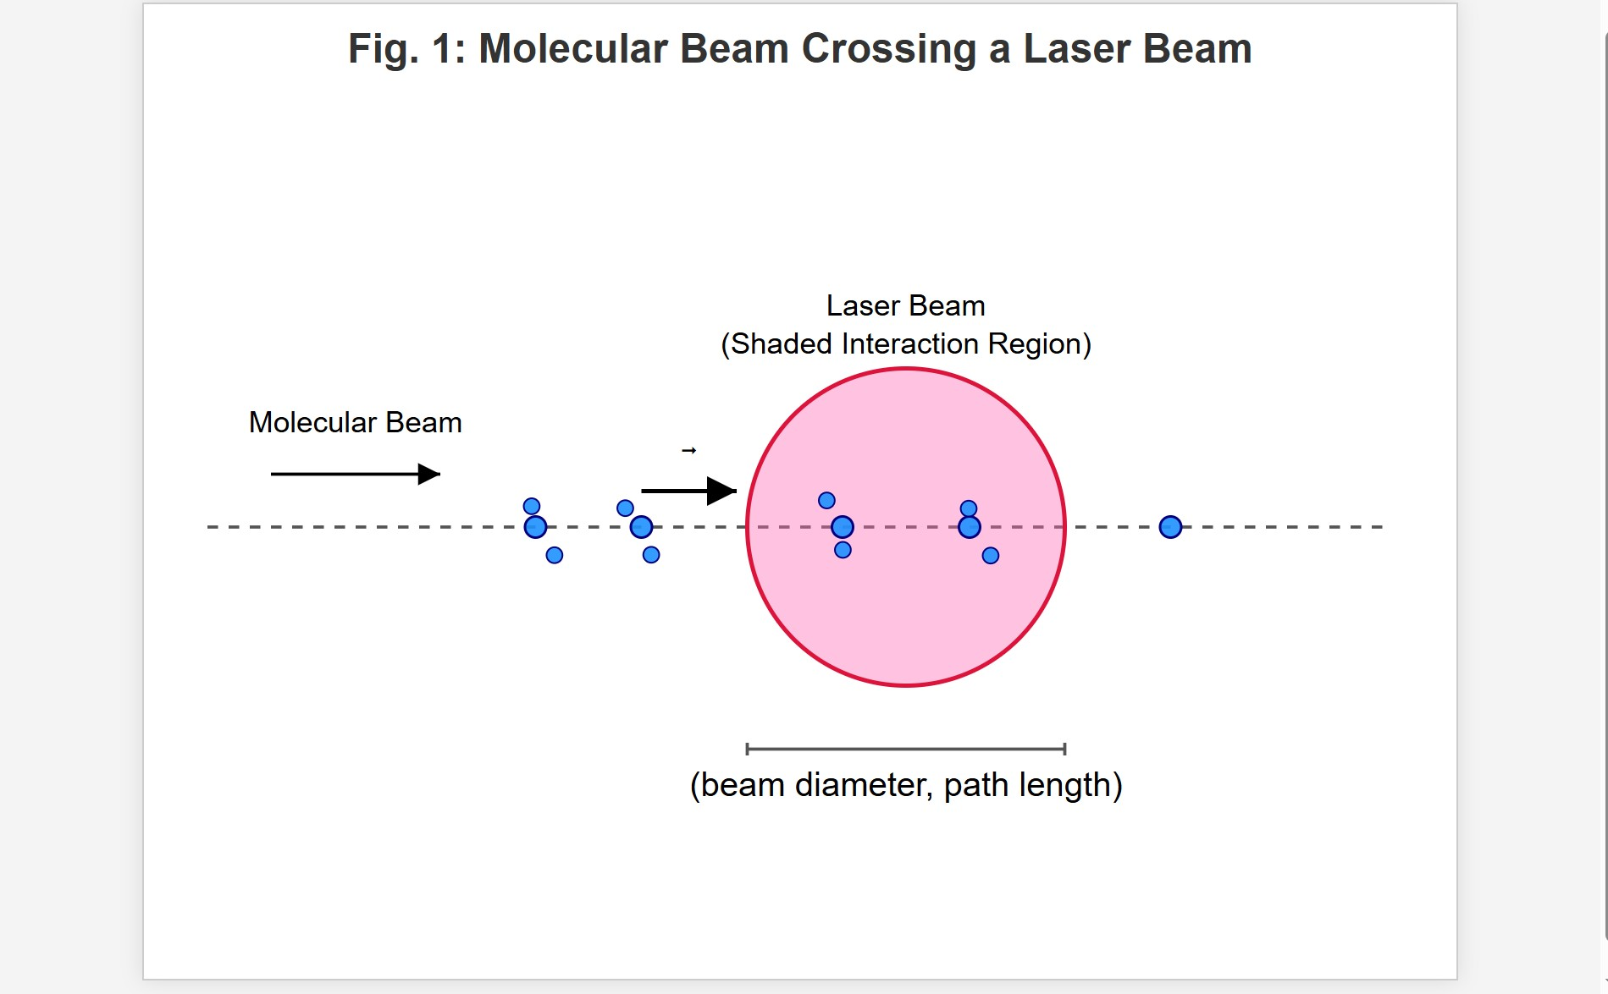
[IMAGE REQUIRED: Provide a schematic showing a molecular beam crossing a circular laser beam; include labels: diameter 𝑑, velocity vector 𝑣⃗, path length, and shaded interaction region.]
Prepared by Dist. Prof. Dr. M.A. Gondal for Phys 608 Laser Spectroscopy course in KFUPM (Term 251)

Slide 11
Slide 4: Numerical Illustration — Example 2 (Fast Ion
Beam)
Ion speed
𝑣 = 3.0 × 10⁸ cm s⁻¹ = 3.0 × 10⁶ m s⁻¹.
Beam diameter
𝑑 = 0.10 cm
= 1.0 × 10⁻³ m.
Transit time:

Slide 12
1.0 × 10⁻³
𝑇 =
= 3.3 × 10⁻¹⁰ s
= 0.33 ns.
3.0 × 10⁶
Many atomic excited states possess 𝜏_{sp} ≈ 10⁻⁸–10⁻⁷ s; here 𝑇 is still shorter, so even atomic lines are transit-time limited in fast-ion experiments.

Slide 13
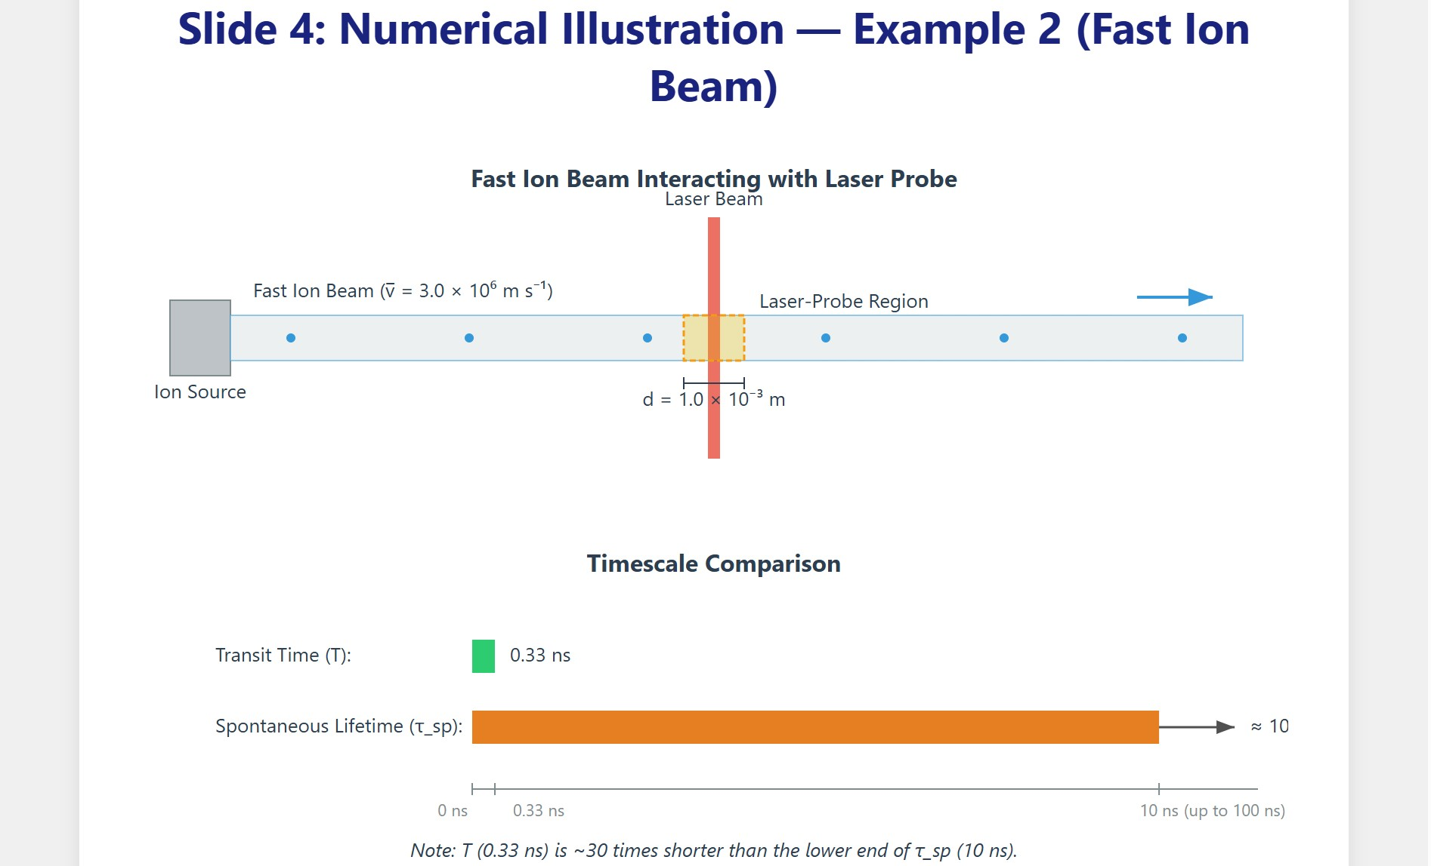
[IMAGE REQUIRED: Depict fast ion beam traversing small laser-probe region; include ultra-short interaction timeline vs spontaneous lifetime bar.]
Prepared by Dist. Prof. Dr. M.A. Gondal for Phys 608 Laser Spectroscopy course in KFUPM (Term 251)

Slide 14
Slide 5: Finite-Duration Oscillator Model — Physical
Analogy
Model an atom or molecule as a classical electric dipole (oscillator) with natural frequency 𝜔₀.
The dipole is excited and oscillates during a finite interval 0 ≤ 𝑡 ≤
𝑇.
Mathematically, position coordinate

Slide 15
{𝑥₀ cos(𝜔₀𝑡)
0 ≤ 𝑡 ≤ 𝑇,
𝑡 > 𝑇.
𝑥(𝑡)
=
0
The sudden shut-off at 𝑡 = 𝑇 emulates the particle leaving the laser field.
Goal: compute the emitted spectrum via the Fourier transform of
𝑥(𝑡).
---

Slide 16
Slide 6: Fourier Transform — Step-by-Step Integration
Define spectral amplitude
𝑇
1
= ∫ 𝑥₀ cos(𝜔₀𝑡) 𝑒^{−𝑖𝜔𝑡} 𝑑𝑡.
0
𝐴(𝜔)
√2𝜋
Express cosine via exponentials:
cos(𝜔₀𝑡)
= 1⁄2 (𝑒^{𝑖𝜔0𝑡} + 𝑒^{−𝑖𝜔0𝑡}).
Insert and integrate term-by-term:

Slide 17
𝑥₀
𝑇
∫
0
𝐴(𝜔)
=
_{[𝑒}𝑖(𝜔₀−𝜔)𝑡 _{+ 𝑒}−𝑖(𝜔₀+𝜔)𝑡_{]𝑑𝑡.}
2√2𝜋
Evaluate integrals of the form
𝑇
_{∫ 𝑒}𝑖𝛥𝜔 𝑡 _{𝑑𝑡}
0
𝑒
𝑖𝛥𝜔𝑇
− 1
, 𝛥𝜔 = 𝜔₀ − 𝜔 or − (𝜔₀ + 𝜔).
=
𝑖𝛥𝜔
Keep only the first term 𝛥𝜔 = 𝜔₀ − 𝜔 for |𝜔 − 𝜔₀| ≪ 𝜔₀ (rotating- wave approximation) and drop the second rapidly oscillating term.
---

Slide 18
Slide 7: Resulting Intensity Profile — Sinc^{𝟐} Function
After simplification,
𝑥₀
_{𝑒}𝑖(𝜔₀−𝜔)𝑇 ₋ ₁
𝐴(𝜔)
≈ .
2√2𝜋
𝑖(𝜔₀ − 𝜔)
Spectral intensity 𝐼(𝜔) = |𝐴(𝜔)|²:
sin²[(𝜔 − 𝜔₀) 𝑇/2]
𝐼(𝜔)
= 𝐶
,
(𝜔 − 𝜔 )²
0
2
where 𝐶 = 𝑥₀ /(8𝜋).

Slide 19
Key features of 𝐼(𝜔):
Central maximum at 𝜔 = 𝜔₀.
• Zeros whenever (𝜔 − 𝜔₀) 𝑇/2 = 𝑛𝜋, 𝑛 ∈ ℤ\{0}.
Side lobes characteristic of a finite rectangular time window (Fourier transform of a box).
Full halfwidth at half maximum (HWHM):
5.6
𝛿𝜔_{𝑇} = _{𝑇} .

Slide 20
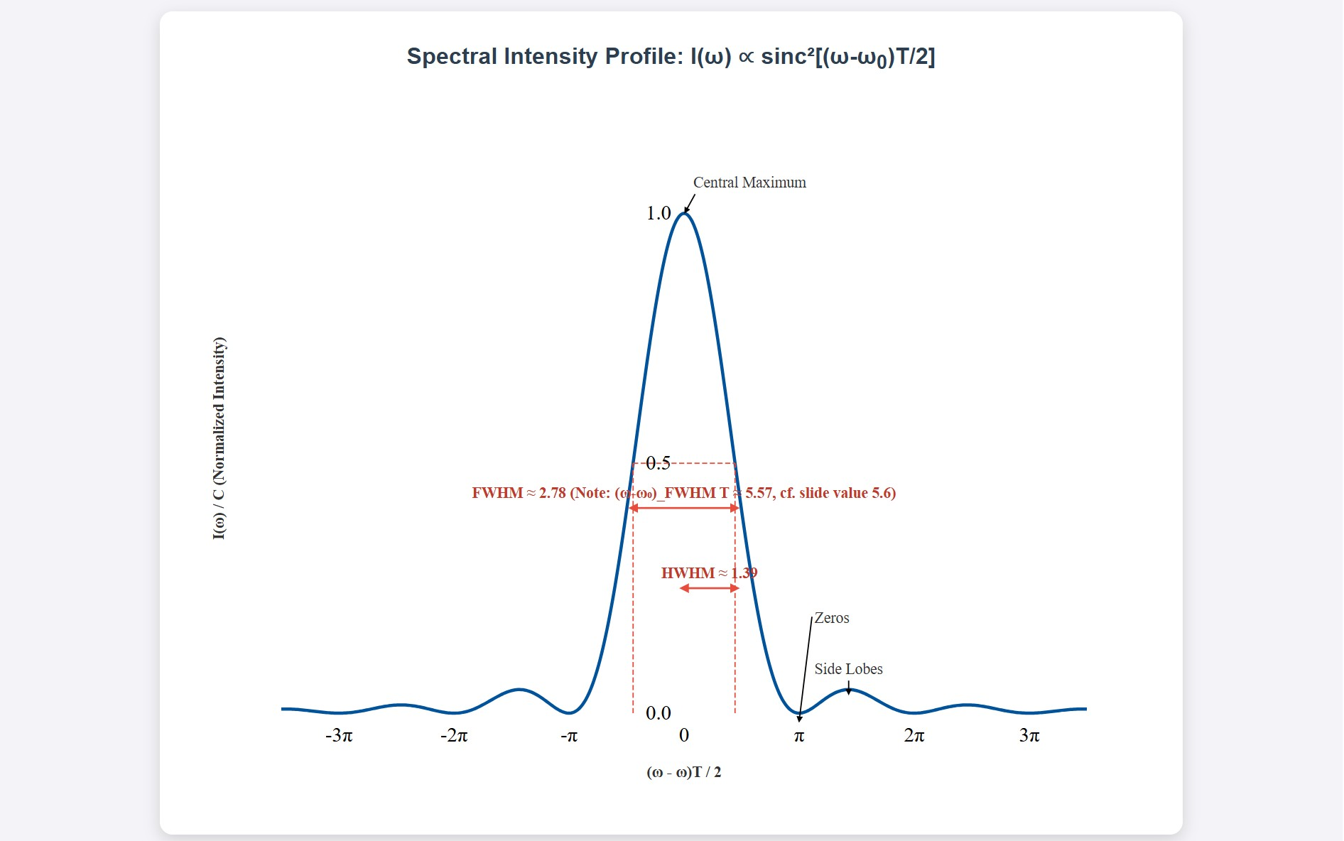
[IMAGE REQUIRED: Plot of sinc² function with annotated HWHM, side lobes, and zero crossings.]
Prepared by Dist. Prof. Dr. M.A. Gondal for Phys 608 Laser Spectroscopy course in KFUPM (Term 251)

Slide 21
Slide 8: Connecting Model to a Rectangular Laser Beam
Rectangular spatial intensity profile ⇒ particle experiences constant field amplitude while inside the beam.
Interaction time 𝑇 = 𝑑/|𝑣| effectively replaces the mathematical window length in the oscillator model.
Therefore
5.6 |𝑣|
^{𝛿𝜔}rect
≃
.
𝑑

Slide 22
Each symbol:
𝛿𝜔_{rect} = full width at half maximum (rad s⁻¹).
|𝑣| = particle speed (m s⁻¹).
𝑑 = beam diameter where intensity is uniform (m).
Implication: doubling the beam diameter halves the width; reducing the speed has the same effect.
---

Slide 23
Slide 9: Realistic Laser Beams — Gaussian Spatial Profile
Fundamental TEM₀₀ coordinate 𝑟.
Electric field amplitude:
𝐸(𝑟, 𝑡)
where
mode intensity varies as Gaussian in radial
2 2
= 𝐸₀ 𝑒^{−𝑟 /𝑤0} cos(𝜔𝑡),
𝑤₀ = beam waist radius (m) at which |𝐸| = 𝐸₀/𝑒.

Slide 24
Forced dipole amplitude proportional to field: 𝑥 = 𝛼𝐸 with 𝛼 = polarizability [C m² V⁻¹].
Gaussian spatial envelope maps onto Gaussian frequency envelope after transit-time Fourier transform.
Derived Gaussian line shape:
(𝜔 − 𝜔₀)² 𝑤²
𝐼(𝜔)
= 𝐼₀ exp [−
].
2 |𝑣|²

Slide 25
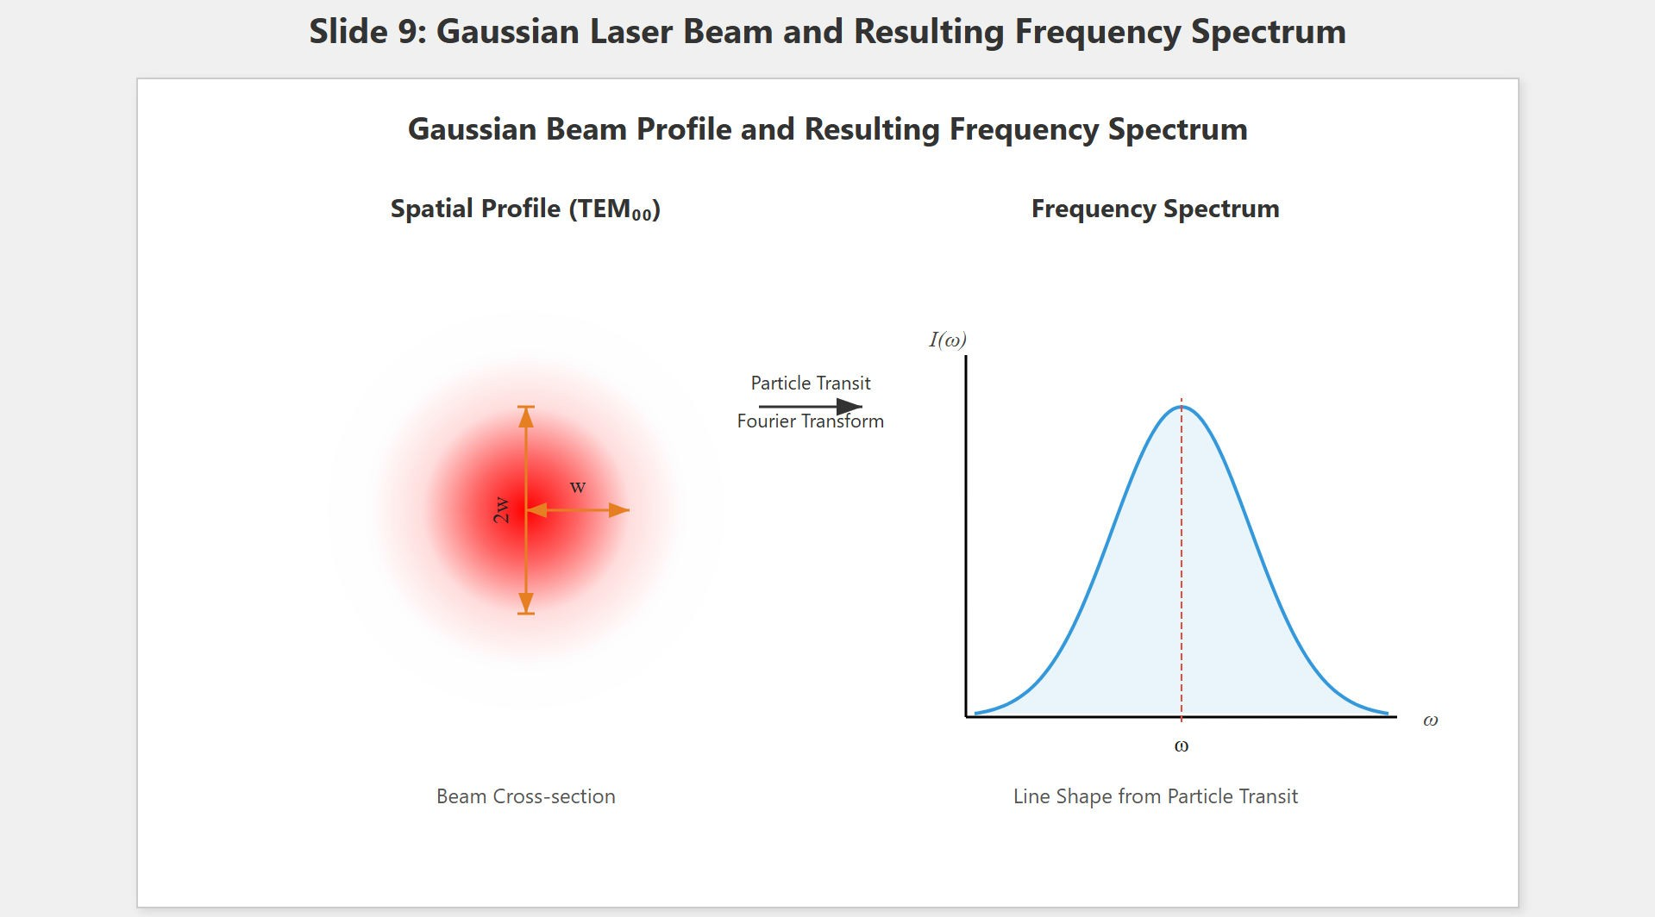
[IMAGE REQUIRED: Cross-section of Gaussian beam showing 2 𝑤₀
width, plus overlaid temporal Gaussian in frequency domain.]
Prepared by Dist. Prof. Dr. M.A. Gondal for Phys 608 Laser Spectroscopy course in KFUPM (Term 251)

Slide 26
Slide 10: Transit-Time Limited Width for Gaussian Beam
Full width at half maximum (FWHM) in angular frequency:
|𝑣|
= 2 √2ln2 ≈ 2.4 .
𝑤 𝑤
|𝑣|
𝛿𝜔_{𝑡}
Convert to ordinary frequency (Hz):
𝛿𝜔_{𝑡}
|𝑣|
≈ 0.4 𝑤
𝛿𝜈_{𝑡} =
2𝜋
Symbol definitions:

Slide 27
𝑤 = beam waist radius (m).
|𝑣| = particle speed (m s⁻¹).
Beam waist relates to wavelength 𝜆 and Rayleigh range 𝑅 (to be defined later):
𝑤 =
√
𝜆𝑅
.
2𝜋

Slide 28
Key
proportionalities:
reduce
width
by either
enlarging 𝑤 or
lowering |𝑣|.
---

Slide 29
Slide 11: How To Reduce Transit-Time Broadening
Strategy 1 — Increase beam diameter 2 𝑤:
Optical lenses can expand the waist.
Trade-off: lower intensity at fixed power.
Strategy 2 — Reduce particle velocity |𝑣|:
Cool translational motion (cryogenic beams, buffer-gas cooling).
Laser cooling provides dramatic velocity reduction.

Slide 30
Strategy 3 — Combine both: optical cavities support large spot sizes at high intensity.
Experimental verification: discussed in detail in Volume 2, Sections
2.3 & 9.2; record-narrow molecular lines achieved using both methods.

Slide 31
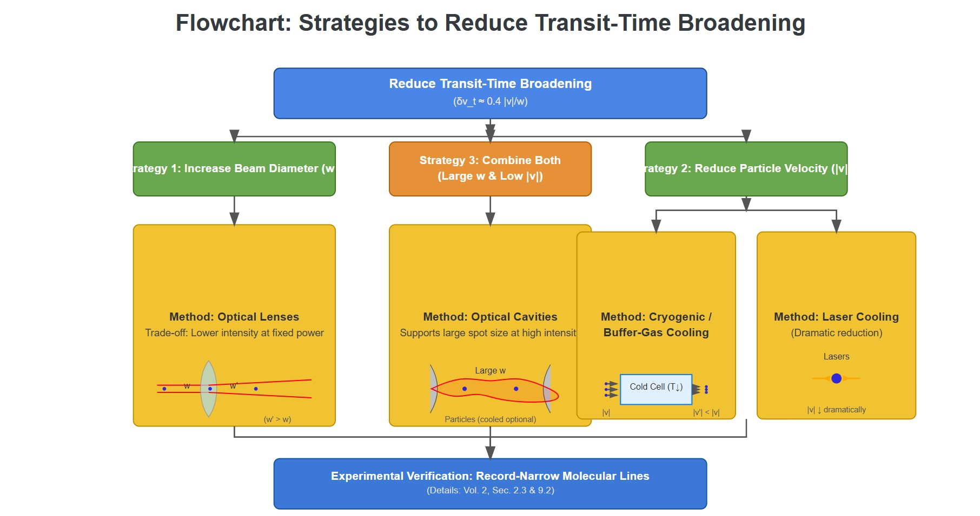
[IMAGE REQUIRED: Flowchart comparing manipulation of beam diameter and molecular velocity, with example experimental setups.]
Prepared by Dist. Prof. Dr. M.A. Gondal for Phys 608 Laser Spectroscopy course in KFUPM (Term 251)

Slide 32
Slide 12: Transit-Time Broadening vs Natural Width —
Example 3.6(a)
Species: nitrogen dioxide (NO₂).
Mean thermal velocity:
𝑣 = 600 m s⁻¹.
Focused laser beam waist:
𝑤 = 0.10 mm
= 1.0 × 10⁻⁴ m.

Slide 33
Transit-time width (Hz):
600
≈ 0.4 1.0 × 10⁻⁴
𝛿𝜈_{𝑡}
= 2.4 × 10⁶ Hz = 2.4 MHz.
Natural linewidth 𝛿𝜈_{𝑛} ≈ 10 kHz ⇒ transit-time broadening exceeds natural width by factor ∼ 240.
---

Slide 34
Slide 13: Transit-Time Broadening vs Natural Width —
Example 3.6(b)
Frequency standard transition: methane (CH₄) at
𝜆 = 3.39 𝜇m.
Mean molecular speed:
𝑣 = 7.0 × 10⁴ cm s⁻¹ = 700 m s⁻¹.
Desired limit: 𝛿𝜈_{𝑡} ≤ 10 kHz.

Slide 35
Required beam waist: solving 0.4
^{𝑣} = 10 kHz →
𝑤
𝑣
700
𝑤 = 0.4 = 0.4 ≈ 3.0 cm,
2𝜋 𝛿𝜈_{𝑡}
2𝜋 × 10⁴
so diameter 2 𝑤 ≈ 6 cm.
Practical implication: frequency-standard cells employ large-mode cavities to satisfy this requirement.

Slide 36
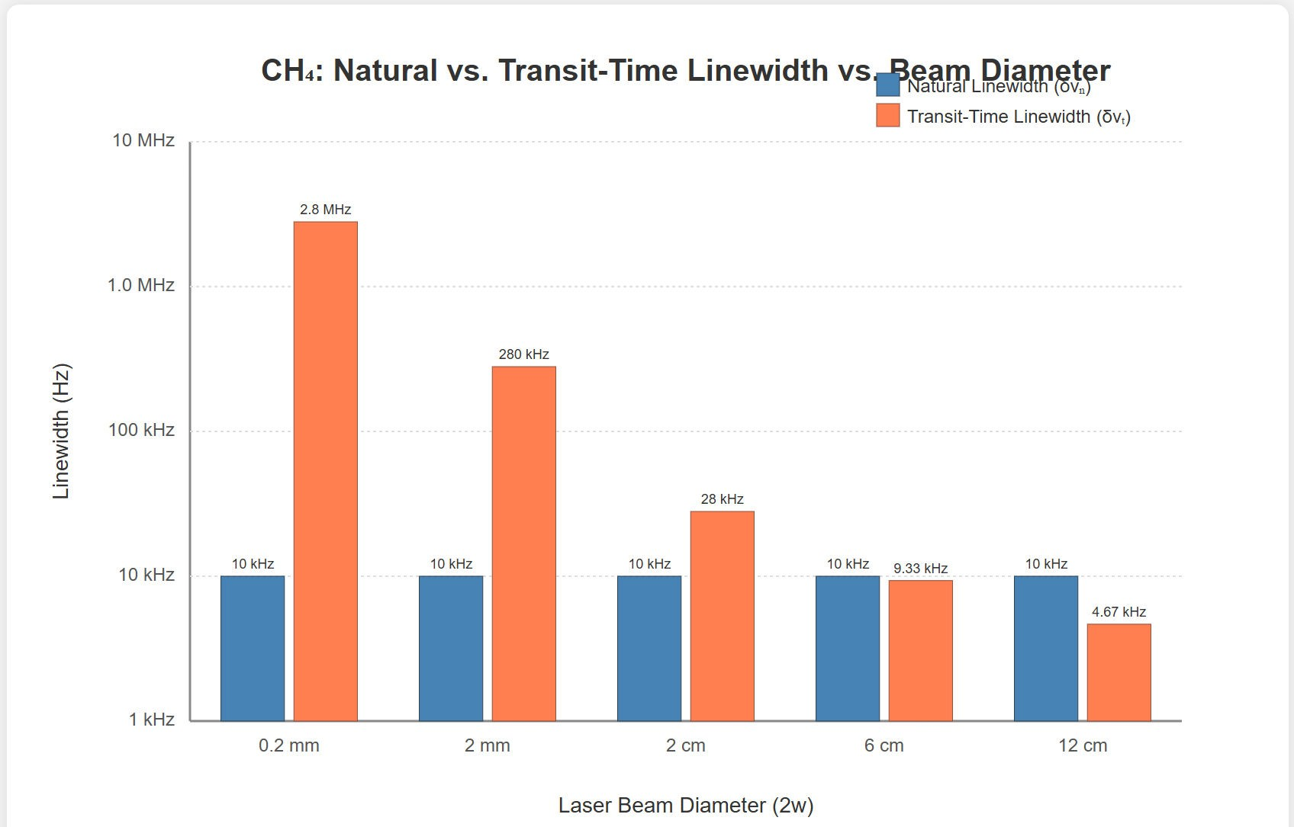
[IMAGE REQUIRED: Side-by-side bars: natural linewidth vs transit-time linewidth at varying beam diameters for CH₄.]
Prepared by Dist. Prof. Dr. M.A. Gondal for Phys 608 Laser Spectroscopy course in KFUPM (Term 251)

Slide 37
Slide 14: Beyond Plane Waves — Curved Phase Fronts in
Focused Beams
Real Gaussian beams possess spherical phase fronts with radius of curvature 𝑅(𝑧).
Atom moving radially (along 𝑟) experiences spatial phase variation.
Maximum longitudinal phase shift between center 𝑟 = 0 and edge
𝑟 = 𝑟₁:

Slide 38
2𝜋 𝑥
𝛥𝜙 =
,
𝜆
where 𝑥 = optical path difference.
Geometry of circle:
𝑟² = 𝑅² − (𝑅 − 𝑥)² ⇒ 𝑥 ≈ ^{𝑟}
2
for 𝑥 ≪ 𝑅.
2 𝑅
Therefore

Slide 39
𝑘 𝑟²
𝜔 𝑟²
𝛥𝜙 =
=
.
2 𝑅 2 𝑐 𝑅

Slide 40
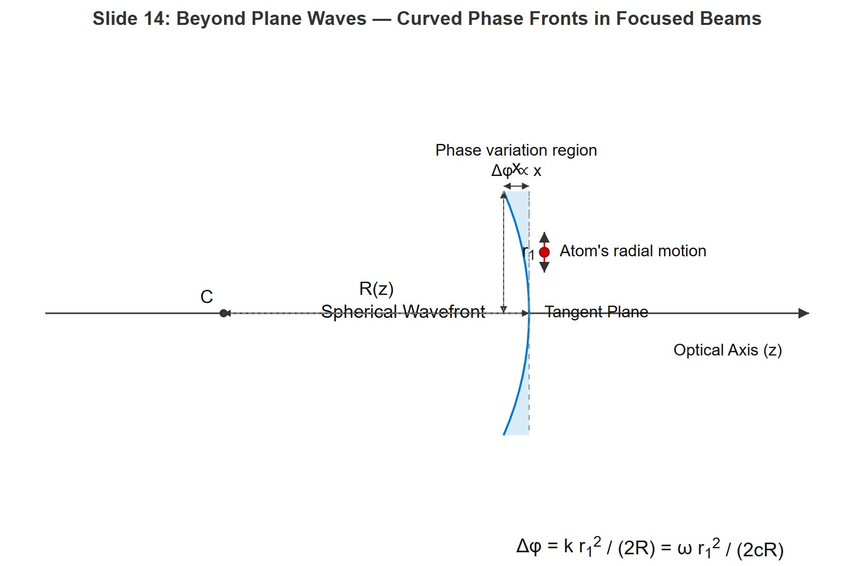
[IMAGE REQUIRED: Diagram of spherical wavefront with center of curvature, showing 𝑅, 𝑟, 𝑥, and phase shift region.]
Prepared by Dist. Prof. Dr. M.A. Gondal for Phys 608 Laser Spectroscopy course in KFUPM (Term 251)

Slide 41
Slide 15: Linewidth Including Wave-Front Curvature
Combined effect of transit time and phase curvature derived in Ref. [105]:
2 |𝑣|
𝜋 𝑤²
2
_{) ]}1/2.
𝛿𝜔 = √2ln2 [1 + (
𝑤
𝑅 𝜆
Define purely transit-time component
2 |𝑣|
𝛿𝜔_{𝑡𝑙} =
√2ln2.
𝑤

Slide 42
Introduce dimensionless phase-front parameter
𝜋 𝑤²
𝛥𝜙 = .
𝑅 𝜆
Compact form:
𝛿𝜔 = 𝛿𝜔_{𝑡𝑙} (1 + 𝛥𝜙²)^{1/2} .
Curvature adds in quadrature; significant only when 𝛥𝜙 ≳ 1.
---

Slide 43
Slide 16: Condition For Negligible Curvature Broadening
Require phase variation over 𝑟 = 𝑤 to be much less than 𝜋:
𝜋 𝑤²
𝛥𝜙 = ≪ 𝜋.
𝑅 𝜆
Simplifies to
_{𝑤}2
𝑅 ≫
.
𝜆
Interpretation:

Slide 44
Larger 𝑅 (flatter wavefronts) → smaller phase spread.
For
fixed 𝑅, widening the beam (𝑤 ↑) increases curvature
broadening — trade-off with earlier strategy.
Experimental design: choose focusing optics that place interaction region near beam waist but with sufficiently large 𝑅.

Slide 45
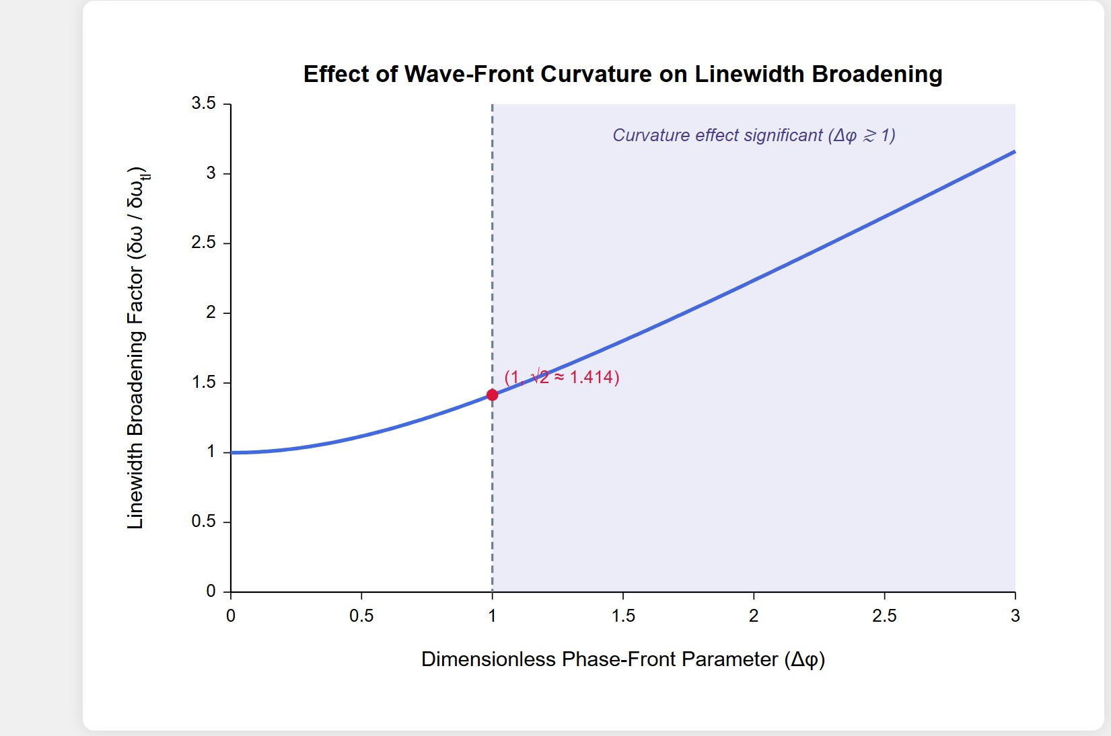
[IMAGE REQUIRED: Plot showing 𝛿𝜔/𝛿𝜔_{𝑡𝑙} versus 𝛥𝜙 with threshold region.]
Prepared by Dist. Prof. Dr. M.A. Gondal for Phys 608 Laser Spectroscopy course in KFUPM (Term 251)

Slide 46
Slide 17: Numerical Example 3.7 — Quantifying Curvature
Effects
Wavelength
𝜆 = 1.0 𝜇m.
Beam waist radius
𝑤 = 1.0 cm.
• Desired 𝛥𝜙 ≪ 2𝜋.

Slide 47
Compute required radius of curvature:
_{𝑤}2
(1.0 × 10⁻²)²
𝑅 ≫ =
= 1.0 × 10² m = 1.0 × 10⁴ cm.
𝜆
1.0 × 10⁻⁶
If 𝑅 = 5.0 × 10³ cm (focusing too strong), then
𝜋𝑤² 𝜋(1.0 × 10⁻²)²
𝛥𝜙 = = = 2𝜋,
𝑅𝜆
5.0 × 10³ × 1.0 × 10⁻⁶
leading to (1 + 𝛥𝜙²)^{1/2} ≈ 6.5 times additional linewidth!

Slide 48
Conclusion: for precision work, ensure 𝑅 well above 10⁴ cm or expand the beam to reduce 𝑤.

Slide 49
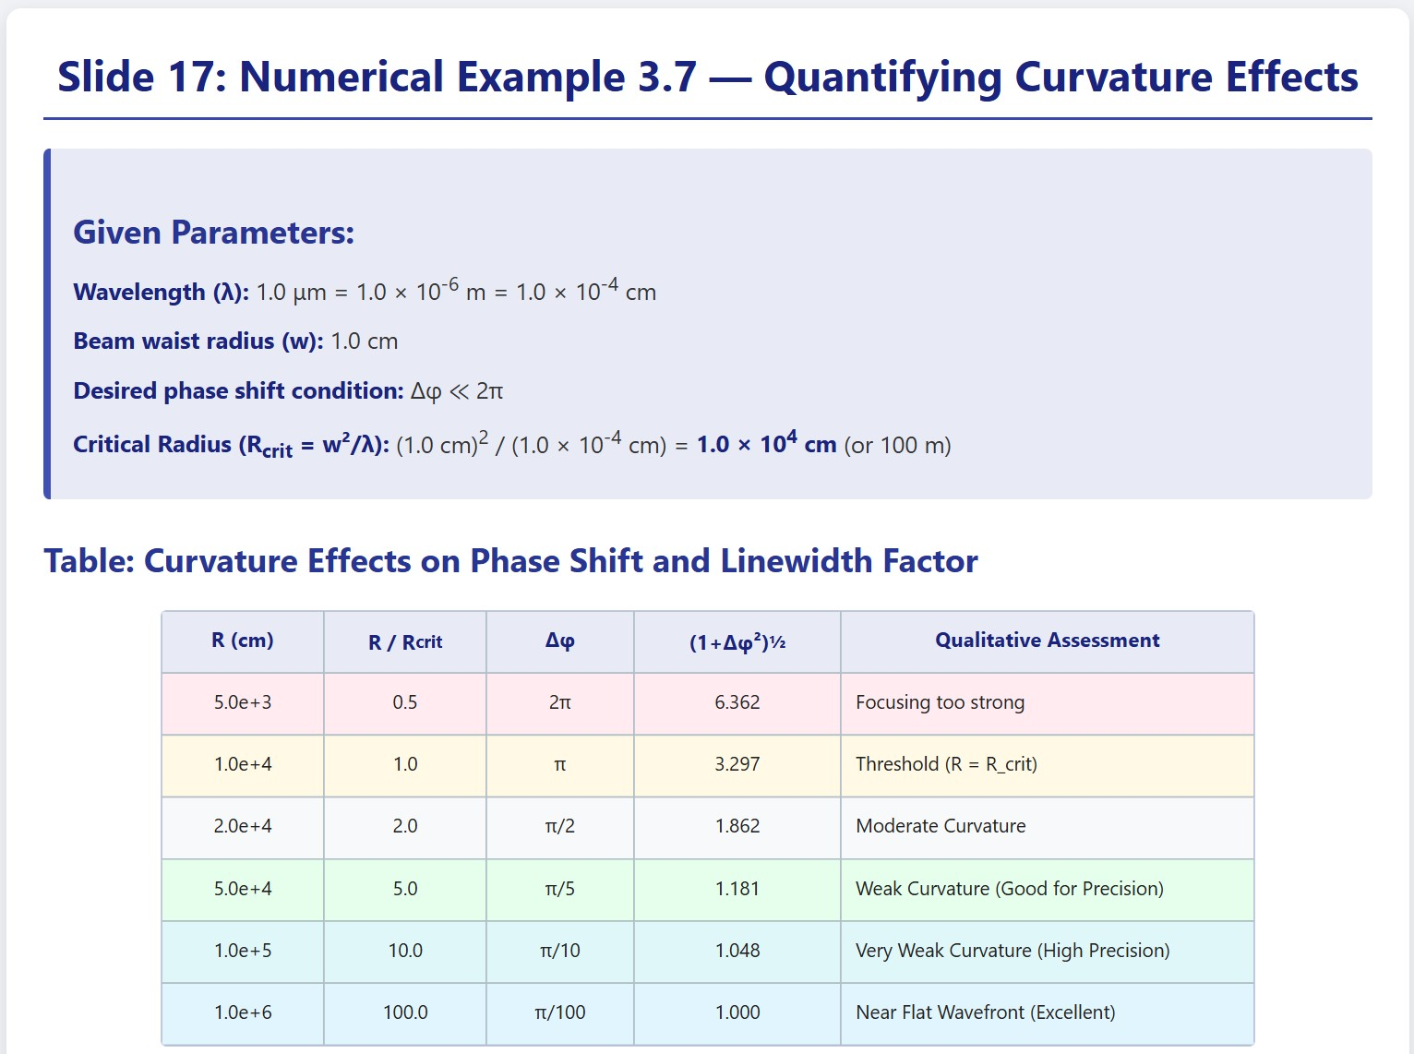
[IMAGE REQUIRED: Table comparing 𝑅, 𝛥𝜙, and resulting linewidth enhancement factors.]
Prepared by Dist. Prof. Dr. M.A. Gondal for Phys 608 Laser Spectroscopy course in KFUPM (Term 251)

Slide 50
Slide 18: Key Takeaways & Experimental Guidelines
Transit-time broadening scales linearly with |𝑣| and inversely with beam size: mitigate by cooling and/or beam expansion.
Gaussian beams give Gaussian line shapes; rectangular beams give sinc² profiles — choose geometry deliberately.
Wave-front curvature can substantially enlarge linewidth unless
𝑅 ≫ 𝑤²/𝜆.

Slide 51
Precision frequency standards (e.g., CH₄ at 3.39 µm) demand cm- scale waists or ultra-cold molecules to stay within natural linewidths.
Future frontier: laser cooling and optical trapping enable interaction times ≫ 𝜏_{sp}, effectively eliminating transit-time limits altogether.
---

