Slide 1
Chap. 3.2 Doppler Width

Slide 2
Slide 1: Spectral Lines – Why Widths Matter
A “spectral line” ideally marks a single, sharply-defined transition energy between two quantum states.
In real experiments each line possesses a finite width, i.e. light is emitted/absorbed over a band of angular frequencies 𝜔.
Width
carries information about underlying physical processes
(lifetimes, motion, collisions, external fields, …).

Slide 3
Goal of this unit: build a step-by-step, quantitative understanding of the Doppler contribution to the linewidth and place it in context with other mechanisms.

Slide 4
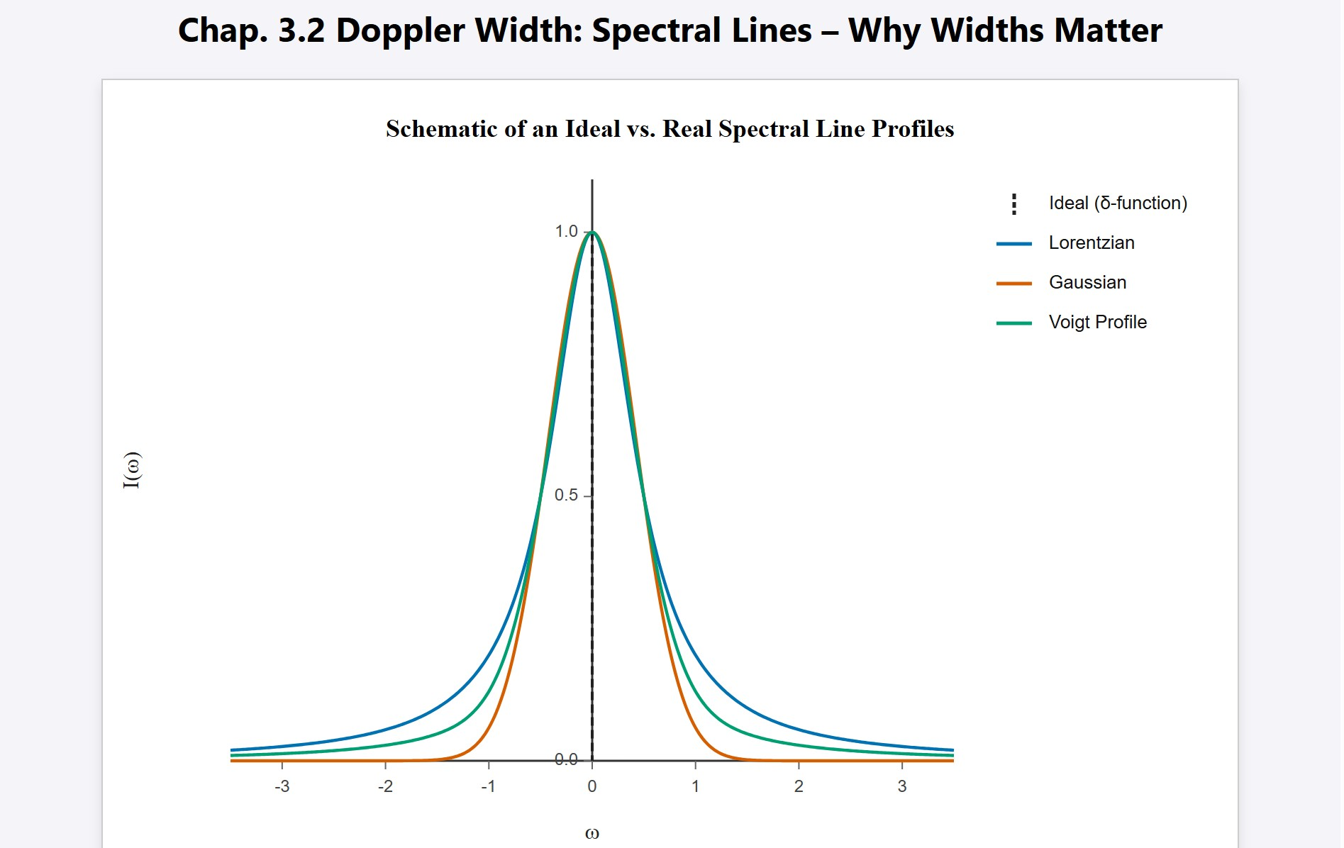
[IMAGE REQUIRED: Schematic of an ideal delta-function line versus real broadened profiles (Lorentzian, Gaussian, Voigt). Axes labeled 𝐼(𝜔) vs. 𝜔.]
Prepared by Dist. Prof. Dr. M.A. Gondal for Phys 608 Laser Spectroscopy course in KFUPM (Term 251)

Slide 5
Slide 2: Natural (Lifetime) Broadening Recap
Origin: finite excited-state lifetime 𝜏 gives an energy uncertainty
𝛥𝐸 ≈ ℏ/(2𝜏).
Resulting Lorentzian profile for emitted intensity
(𝛾/2)²
𝐼
( )
𝜔 = 𝐼
nat 0
( )
2
( )
2
𝜔 − 𝜔
+ 𝛾/2
0
𝛾 = 1/𝜏 – radiative decay rate (units: s⁻¹).
Full width at half maximum (FWHM):

Slide 6
𝛿𝜔_{𝑛} = 𝛾
Key point: Lorentzian wings decay slowly ∝ 1/(𝜔 − 𝜔₀)².
Unfortunately,
in gases the Lorentzian is rarely seen
directly
because larger effects obscure it.
---

Slide 7
Slide 3: Enter Thermal Motion – The Doppler Problem
Gas molecules at temperature 𝑇 move randomly; each molecule constitutes a moving source or absorber.
Motion along observer’s line of sight shifts the apparent frequency
via the Doppler effect.
Shift adds or subtracts from 𝜔₀ depending on velocity component
𝑣_{𝑧}.

Slide 8
Doppler
broadening: ensemble of many differently-moving
molecules ⇒ distribution of shifted frequencies ⇒ overall line broadening.

Slide 9
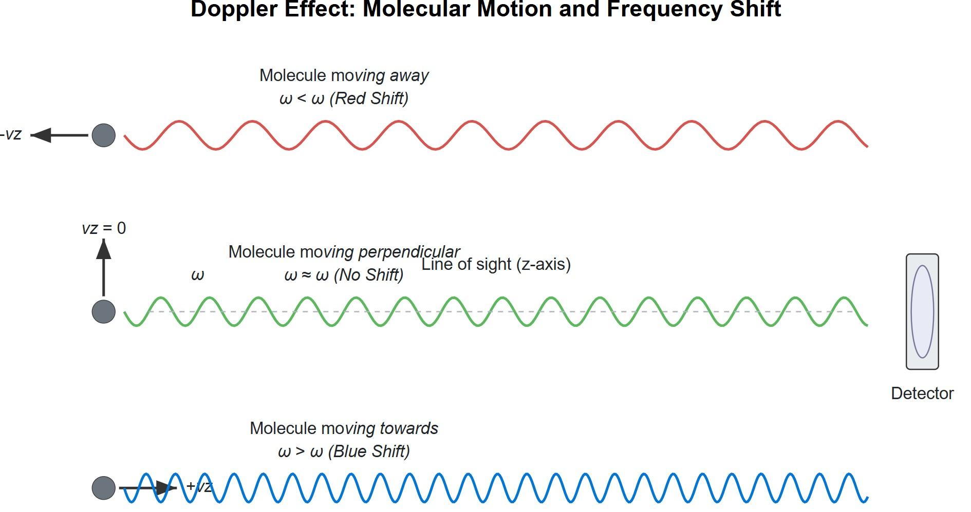
[IMAGE REQUIRED: Cartoon of molecules moving toward/away from detector, showing frequency shifts.]
---
Prepared by Dist. Prof. Dr. M.A. Gondal for Phys 608 Laser Spectroscopy course in KFUPM (Term 251)

Slide 10
Slide 4: Geometry & Notation for Doppler Shift
Choose laboratory 𝑧-axis along propagation direction of light.
• Wave vector 𝐤 = (0,0, 𝑘_{𝑧}).
• Magnitude 𝑘_{𝑧} = 2𝜋/𝜆 = 𝜔/𝑐.
• Molecular velocity 𝐯 = (𝑣_{𝑥}, 𝑣_{𝑦}, 𝑣_{𝑧}).
Component relevant for shift is 𝑣_{𝑧} because 𝐤 ⋅ 𝐯 = 𝑘_{𝑧} 𝑣_{𝑧}.

Slide 11
We treat speeds |𝑣_{𝑧}| ≪ 𝑐 → use linear Doppler approximation
(relativistic corrections deferred).
---

Slide 12
Slide 5: Doppler Shift for Spontaneous Emission
Consider a molecule that has just decayed and emitted a photon.
In molecule’s rest frame: photon angular frequency 𝜔₀.
For a laboratory observer:
𝜔_{𝑒} = 𝜔₀ + 𝐤 ⋅ 𝐯 = 𝜔₀ + 𝑘_{𝑧} 𝑣_{𝑧}.
𝑣_{𝑧} > 0: molecule moves toward observer ⇒ 𝜔_{𝑒} > 𝜔₀ (blue shift).
𝑣_{𝑧} < 0: molecule recedes ⇒ 𝜔_{𝑒} < 𝜔₀ (red shift).

Slide 13
Each value of 𝑣_{𝑧} thus maps to a unique emission frequency.

Slide 14
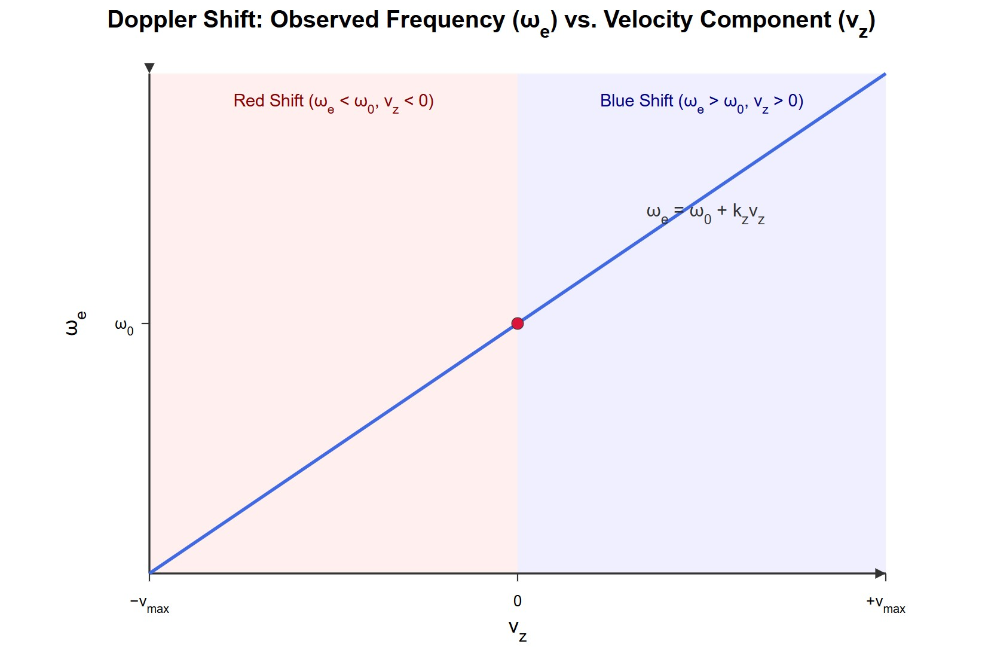
[IMAGE REQUIRED: Plot of 𝜔_{𝑒} vs 𝑣_{𝑧} showing linear relation; annotate blue/red shift regions.]
---
Prepared by Dist. Prof. Dr. M.A. Gondal for Phys 608 Laser Spectroscopy course in KFUPM (Term 251)

Slide 15
Slide 6: Doppler Shift for Absorption
Incident monochromatic plane wave in lab:
𝐸(𝐫, 𝑡) = 𝐸₀ exp(𝑖𝜔𝑡 − 𝑖𝐤 ⋅ 𝐫).
In molecule’s co-moving frame (velocity 𝐯): time and space transform so that the observed angular frequency becomes
𝜔′ = 𝜔 − 𝐤 ⋅ 𝐯.
Absorption occurs only when internal resonance condition met:
𝜔′ = 𝜔₀.

Slide 16
Solve for laboratory frequency 𝜔:
𝜔_{𝑎} = 𝜔₀ + 𝐤 ⋅ 𝐯.
Same linear dependence as emission case.
Explicit for chosen geometry 𝐤 = (0, 0, 𝑘_{𝑧}):
𝜔_{𝑎} = 𝜔₀ (1 + _{𝑐} ).
𝑣_{𝑧}
---

Slide 17
Slide 7: Validity & Higher-Order Doppler Effects
Linear approximation adequate until |𝑣_{𝑧}|/𝑐 ≈ 10⁻⁵.
Quadratic/relativistic Doppler adds terms ∝ (𝑣/𝑐)².
Important
in precision metrology (atomic clocks, Mössbauer
spectroscopy).
For the temperatures and masses addressed here (hundreds of kelvin, atomic masses), linear term dominates.
---

Slide 18
Slide 8: Maxwell–Boltzmann Velocity Distribution
At equilibrium the probability density for the 𝑧-component of velocity is
2
)].
𝑓(𝑣_{𝑧}) =
1
𝑣_{𝑧}
exp [− (
𝑣_{𝑝}√𝜋
𝑣_{𝑝}
2 𝑘𝑇
• 𝑣_{𝑝} = √ _{𝑚}
– most probable speed component magnitude.
• 𝑘 = 1.380 649 × 10⁻²³ J K⁻¹ – Boltzmann constant.

Slide 19
𝑚 – molecular mass (kg).
Number density of level 𝑖:
+∞
𝑁_{𝑖} = ∫
−∞
𝑛_{𝑖} (𝑣_{𝑧}) 𝑑𝑣_{𝑧}.

Slide 20
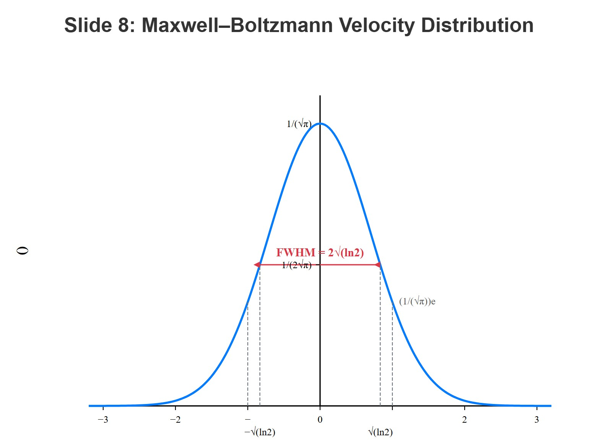
[IMAGE REQUIRED: Gaussian curve of 𝑓(𝑣_{𝑧}) with indicated 𝑣_{𝑝}, FWHM.]
Prepared by Dist. Prof. Dr. M.A. Gondal for Phys 608 Laser Spectroscopy course in KFUPM (Term 251)

Slide 21
Slide 9: Linking Velocity to Frequency
Relationship 𝑣_{𝑧} ↔ 𝜔 from absorption formula:
𝜔 − 𝜔₀
𝑣_{𝑧} = 𝑐
.
𝜔
0
Infinitesimal transformation:
𝑐
𝑑𝑣_{𝑧} = _{𝜔} 𝑑𝜔.
0

Slide 22
Substitute into velocity distribution to obtain frequency distribution of resonant molecules.
Each 𝜔 interval collects molecules whose 𝑣_{𝑧}
relation.
---
satisfy the above

Slide 23
Slide 10: Derivation of Gaussian Intensity Profile
Count of resonant molecules within (𝜔, 𝜔 + 𝑑𝜔):
𝑐
𝑛_{𝑖}(𝜔) 𝑑𝜔 = 𝑁_{𝑖}
exp[−(𝑐(𝜔 − 𝜔₀)⁄𝜔₀𝑣_{𝑝})²] 𝑑𝜔.
𝜔₀𝑣_{𝑝}√𝜋
Emitted/absorbed power 𝑃(𝜔) ∝ 𝑛_{𝑖}(𝜔) ⇒ same functional form for intensity:
𝐼(𝜔) = 𝐼₀exp[−(𝑐(𝜔 − 𝜔₀)⁄𝜔₀𝑣_{𝑝})²].

Slide 24
We have derived a Gaussian line shape (also called “normal”
distribution).

Slide 25
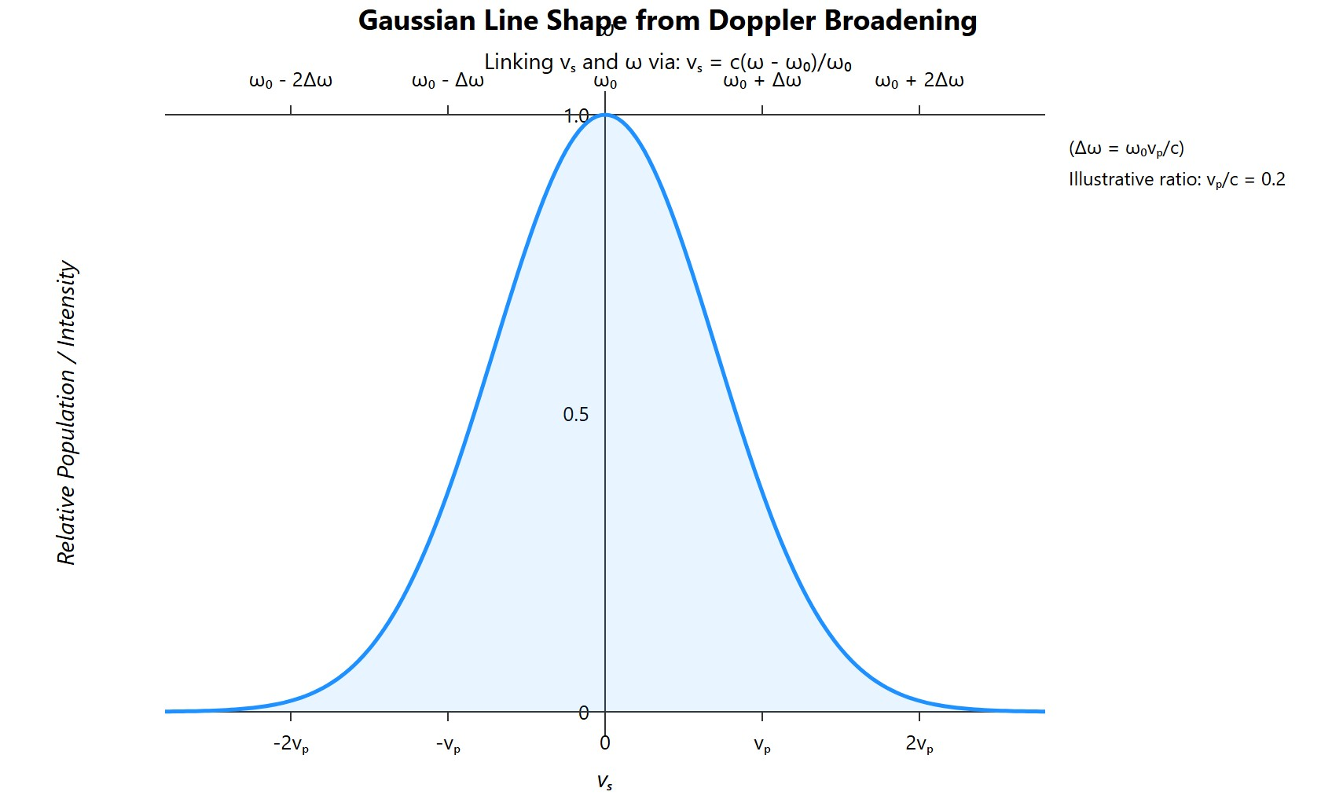
[IMAGE REQUIRED: Overlay of derived Gaussian on velocity-translated distribution.]
Prepared by Dist. Prof. Dr. M.A. Gondal for Phys 608 Laser Spectroscopy course in KFUPM (Term 251)

Slide 26
Slide 11: Extracting the Doppler Width
Define Doppler FWHM 𝛿𝜔_{𝐷}
drops to 1/2 of peak.
Solve
exp[−(𝑐𝛥𝜔⁄𝜔₀𝑣_{𝑝})²] = 1⁄2.
Rearranging yields
as frequency interval where intensity
𝜔₀𝑣_{𝑝}
𝛿𝜔_{𝐷} = 2√ln2
.
𝑐

Slide 27
• Substitute 𝑣_{𝑝} = √2 𝑘𝑇/𝑚:
𝜔₀ 8 𝑘𝑇ln2
𝛿𝜔_{𝐷} =
√
𝑐
.
𝑚
---

Slide 28
Slide 12: Mass & Temperature Dependence
Linear
in resonance
frequency 𝜔₀.
Higher-energy transitions
broaden more.
Scales as √𝑇. Heating a gas increases Doppler width.
Inversely ∝ √𝑚. Light atoms (H, He) show largest widths.
Expressed with molar quantities for convenience:
𝛿𝜔_{𝐷} = (2𝜔₀⁄𝑐)√2 𝑅𝑇ln2⁄𝑀,

Slide 29
• 𝑅 = 8.314 462 618 J mol⁻¹ K⁻¹ – gas constant.
𝑀 – molar mass (kg mol⁻¹).
Numeric form (convert to frequency 𝜈):
𝛿𝜈_{𝐷} = 7.16 × 10⁻⁷ 𝜈₀√𝑇⁄𝑀
[Hz].
---

Slide 30
Slide 13: Worked Example 1 – Lyman-α (Vacuum-UV)
Transition: 1 𝑠 → 2 𝑝 in atomic H.
• 𝜆 = 121.6 nm ⇒ 𝜈₀ = 2.47 × 10¹⁵ s⁻¹.
• Parameters: 𝑇 = 1000 K, 𝑀 = 1 g mol⁻¹.
Compute:
𝛿𝜈_{𝐷} = 7.16 × 10⁻⁷ (2.47 × 10¹⁵)√1000⁄1 = 5.6 × 10¹⁰ Hz.
Convert to wavelength width:

Slide 31
_{𝜆}2
−3
𝛿𝜆_{𝐷} = _{𝑐} 𝛿𝜈_{𝐷} = 2.8 × 10 nm.
---

Slide 32
Slide 14: Worked Example 2 – Sodium D Line (Visible)
Transition: 3 𝑠 → 3 𝑝 in Na.
• 𝜆 = 589.1 nm, 𝜈₀ = 5.10 × 10¹⁴ s⁻¹.
Cell at 𝑇 = 500 K. Molar mass 𝑀 = 23 g mol⁻¹.
Calculation:
𝛿𝜈_{𝐷} = 7.16 × 10⁻⁷ (5.10 × 10¹⁴)√500⁄23 = 1.7 × 10⁹ Hz.
𝛿𝜆_{𝐷} = 1.0 × 10⁻³ nm.

Slide 33
Slide 15: Worked Example 3 – CO_{𝟐} Infrared Vibration
Transition within rovibrational manifold of CO₂.
• 𝜆 = 10 𝜇m ⇒ 𝜈₀ = 3.0 × 10¹³ s⁻¹.
Room temperature 𝑇 = 300 K; 𝑀 = 44 g mol⁻¹.
Evaluate width:
𝛿𝜈_{𝐷} = 7.16 × 10⁻⁷ (3.0 × 10¹³)√300⁄44 = 5.6 × 10⁷ Hz.
𝛿𝜆_{𝐷} = 1.9 × 10⁻² nm.

Slide 34
Note dramatic decrease in 𝛿𝜈_{𝐷} as wavelength increases and mass becomes larger.
---

Slide 35
Slide 16: Gaussian vs. Lorentzian – Qualitative Contrast
Gaussian (Doppler): rapid wing decay ∝ exp[−(𝛥𝜔)²].
Lorentzian (natural/collisional): slow wing decay ∝ 1/(𝛥𝜔)².
Even when Doppler width overwhelms natural width near line center, far-wing measurements can reveal Lorentzian contribution.

Slide 36
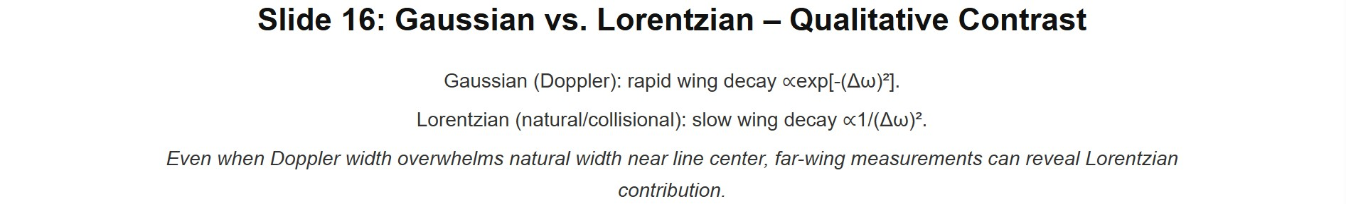
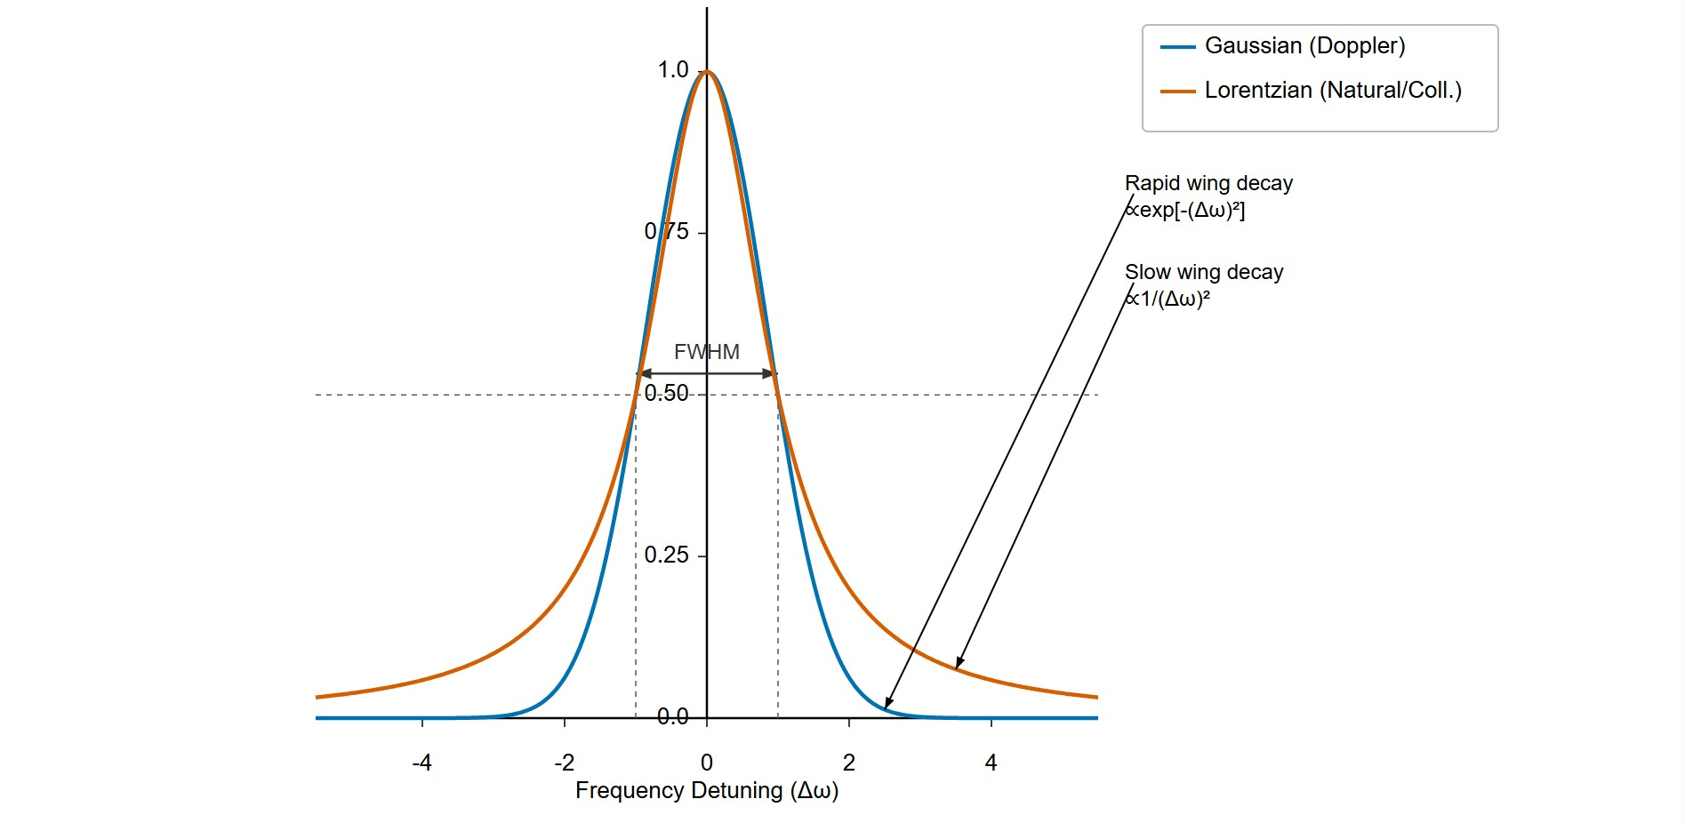
[IMAGE REQUIRED: Plot overlaying Gaussian and Lorentzian of equal FWHM, arrows on wing behavior.]
ared by Dist. Prof. Dr. M.A. Gondal for Phys 608 Laser Spectroscopy course in KFUPM (Term 251)
Prep

Slide 37
Slide 17: Why Pure Gaussian Is Not Exact
Real molecule with given 𝑣_{𝑧} still possesses finite lifetime ⇒ intrinsic Lorentzian response around its Doppler-shifted center.
Ensemble profile = convolution
Gaussian (motion) ∗ Lorentzian (lifetime).
Result called the Voigt profile.
Need Voigt to analyse high-resolution spectra (stellar atmospheres, laser diagnostics, pressure broadening studies).
Prepared by Dist. Prof. Dr. M.A. Gondal for Phys 608 Laser Spectroscopy course in KFUPM (Term 251)

Slide 38
Slide 18: Lorentzian Line Shape for a Single Velocity Class
Lifetime-limited response centred at 𝜔′ = 𝜔₀(1 + 𝑣_{𝑧}/𝑐):
𝛾/2𝜋
^{𝐿(𝜔 − 𝜔′) =} (𝜔 − 𝜔′)² + (𝛾/2)^{2.}
𝛾 – total homogeneous damping constant (includes
natural +
collisional).
Area
under 𝐿
equals 1;
ensures
energy
conservation
across
broadened line.
Prepared by Dist. Prof. Dr. M.A. Gondal for Phys 608 Laser Spectroscopy course in KFUPM (Term 251)

Slide 39
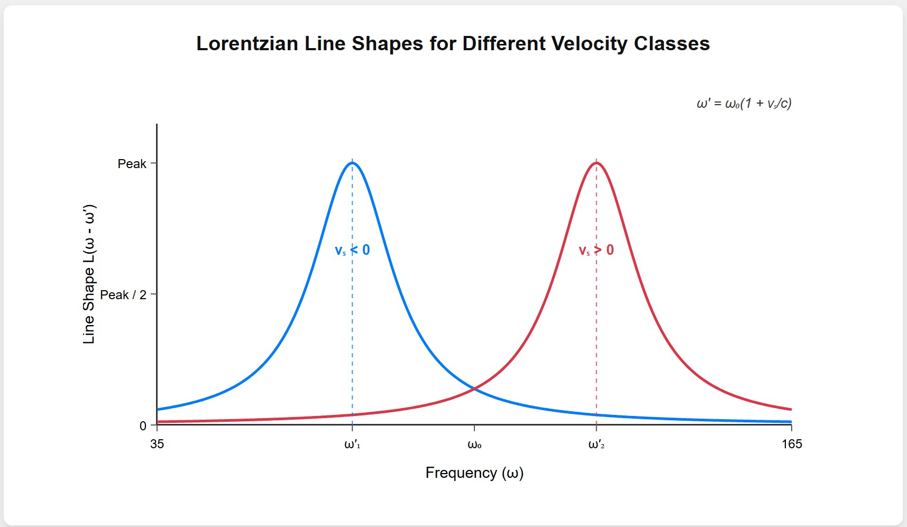
[: Lorentzian curves at two different 𝑣_{𝑧} values, horizontally displaced.]
---
Prepared by Dist. Prof. Dr. M.A. Gondal for Phys 608 Laser Spectroscopy course in KFUPM (Term 251)

Slide 40
Slide 19: Building the Voigt Profile – Convolution Integral
Let
𝐺(𝜔′) = Gaussian distribution from Doppler.
Observed intensity from all molecules:
( )
( )
′ ′
𝐼 ω = 𝐼
+∞
𝐿 ω − ω 𝑑ω . ]
0 ∫
′
𝐺(ω )
−∞
Insert explicit forms:

Slide 41
𝐼(ω) = ⍁{γ𝑁_{𝑖} 𝑐}{2 𝑣_{𝑝}π^{3
/2}ω_{0}^{2}} ∫ _{−∞}^{+∞} exp ! ├[ −├1( \𝑡𝑓𝑟𝑎𝑐{𝑐(ω′
− ω_{0})}{ω_{0} 𝑣_{𝑝}} ┤1)^{2} ┤] ⍁{ 𝑑ω′ } { (ω − ω′)^{2}
+ (γ/2)^{2} }. ]
Numerical evaluation often uses Faddeeva function 𝑤(𝑧).
---

Slide 42
Slide 20: Practical Uses of the Voigt Profile
Separate temperature (Gaussian width) from pressure or lifetime effects (Lorentzian width).
Essential in:
Stellar atmosphere diagnostics (extract 𝑇 & 𝑝 layers).
Gas
lasers & combustion monitoring (in-situ 𝑇, species
concentration).
Calibration of high-precision frequency references.

Slide 43
Accurate line-shape modelling improves trace-gas detection limits
and climate remote-sensing retrievals.

Slide 44
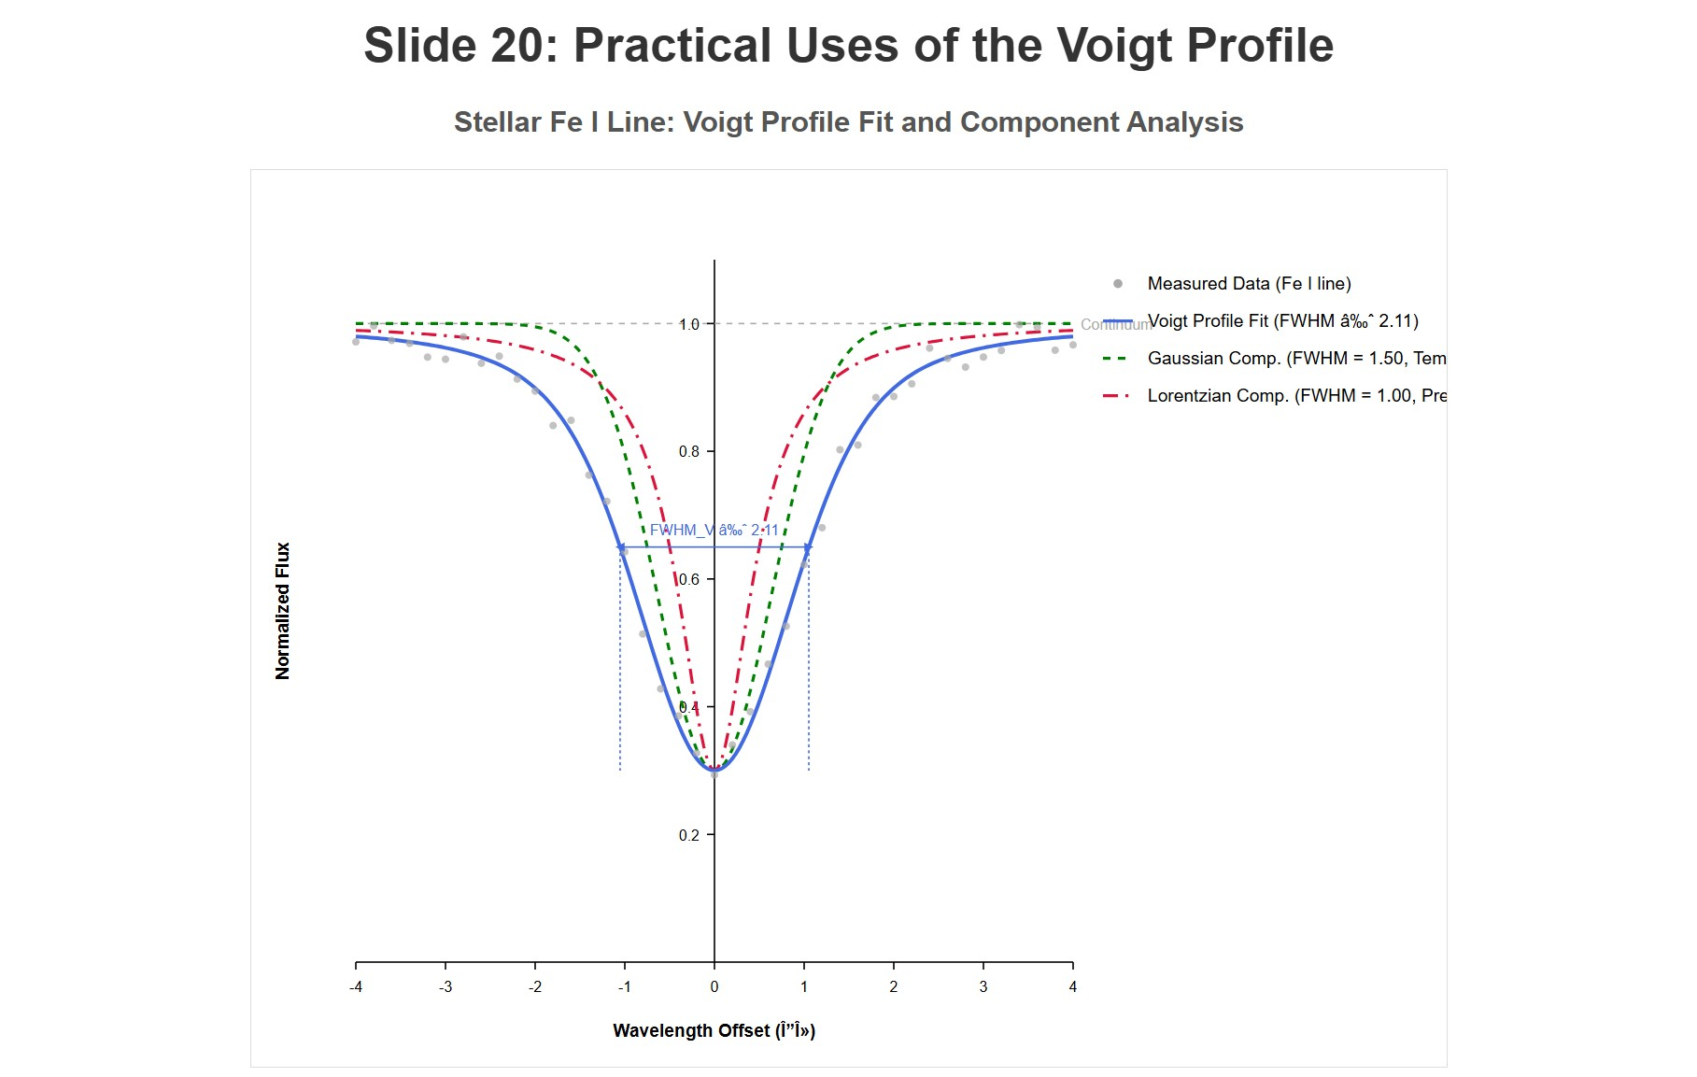
[IMAGE REQUIRED: Measured stellar Fe I line with Voigt fit; annotate Gaussian and Lorentzian contributions.]
Prepared by Dist. Prof. Dr. M.A. Gondal for Phys 608 Laser Spectroscopy course in KFUPM (Term 251)

Slide 45
Slide 21: Key Takeaways
Doppler broadening arises from Maxwellian velocity spread; yields
Gaussian FWHM
𝜔₀ 8 𝑘𝑇ln2
√
𝑐 𝑚
𝛿𝜔_{𝐷} =
.
Width grows with √𝑇 and shrinks with √𝑚.

Slide 46
Observed profile often a Voigt convolution of Gaussian (motion) and Lorentzian (homogeneous) components.
Accurate
determination of physical conditions demands
disentangling these mechanisms via line-shape analysis.

