Slide 1
Chap. 3.1 Natural Linewidth

Slide 2
Slide 1: Natural Linewidth — Why Study It?
Every real optical transition exhibits a finite spectral width; this width is called the natural linewidth.
The natural linewidth sets an ultimate resolution limit for high- precision laser spectroscopy, frequency metrology, and atomic clocks.

Slide 3
Understanding the microscopic origin of this width links quantum electrodynamics (spontaneous emission) with a simple classical analogue (damped harmonic oscillator).
We shall build the entire description step-by-step, defining every symbol, showing every algebraic move, and visualising each physical mechanism.

Slide 4
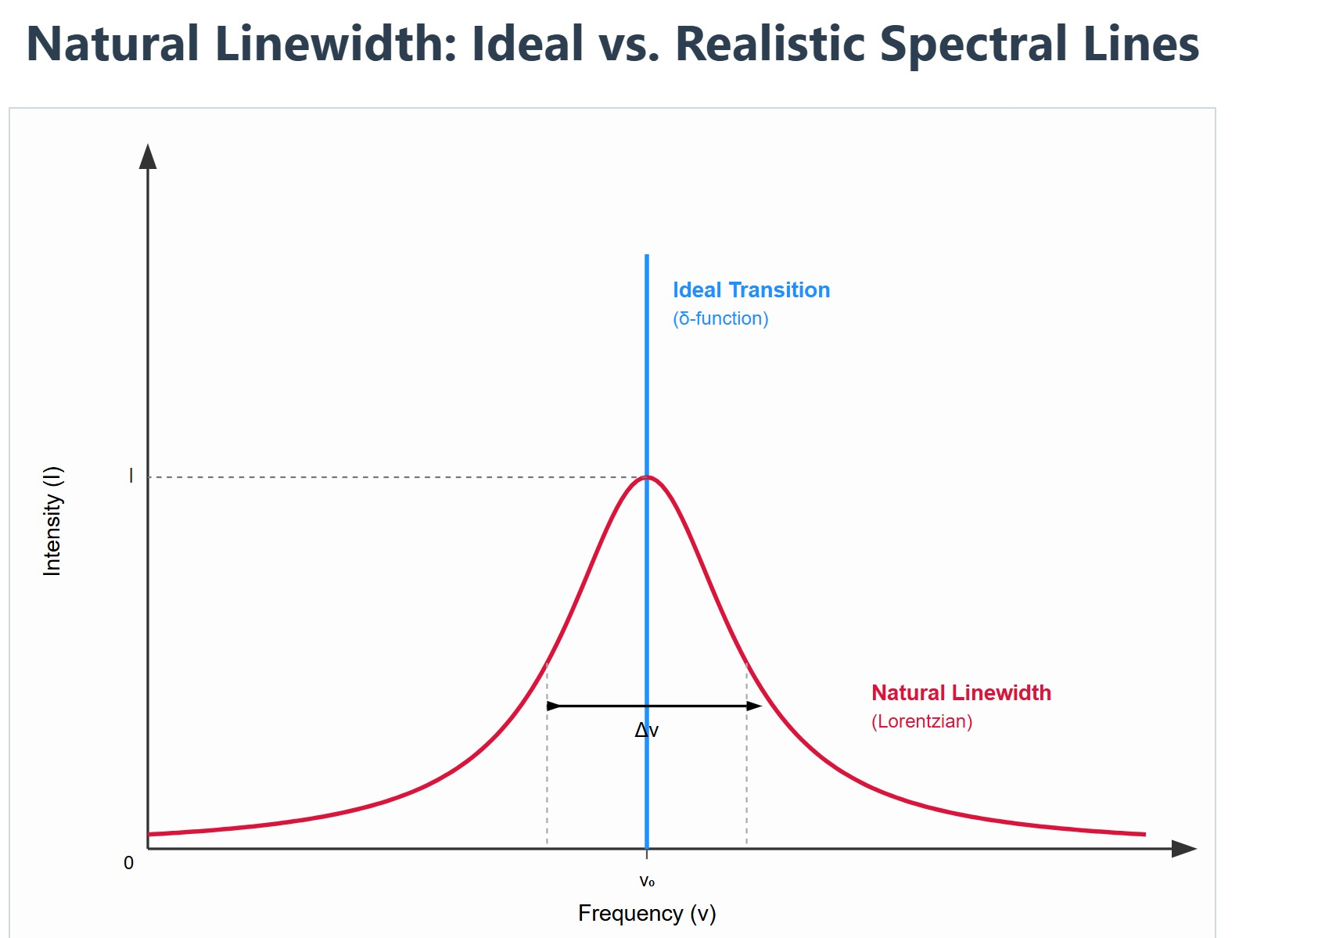
[IMAGE REQUIRED: Schematic comparing an ideal delta-function spectral line with a realistically broadened Lorentzian line, annotated with Δν and peak intensity.]
Prepared by Dist. Prof. Dr. M.A. Gondal for Phys 608 Laser Spectroscopy course in KFUPM (Term 251)

Slide 5
Slide 2: Spontaneous Emission ↔ Classical Damped
Oscillator Analogy
Quantum viewpoint: An excited atom in state ∣i⟩ of energy 𝐸_{i} can spontaneously emit a photon and fall to state ∣k⟩ of energy 𝐸_{k}.
Energy difference 𝐸_{i} − 𝐸_{k} = ℎ𝜈_{𝑖𝑘} = ℏ𝜔_{𝑖𝑘}.
Classical analogue: Treat the atom’s bound electron as a point charge of mass 𝑚 on a spring (restoring force constant 𝑘), losing energy to radiation.

Slide 6
Natural (undamped) angular frequency
𝑘/m
[rad s⁻¹]
𝜔₀ = √
Energy loss to the radiation field produces a friction-like term characterised by the damping constant 𝛾 [s⁻¹].
For real optical transitions 𝛾 ≪ 𝜔₀; the oscillator completes many cycles before noticeably decaying.

Slide 7
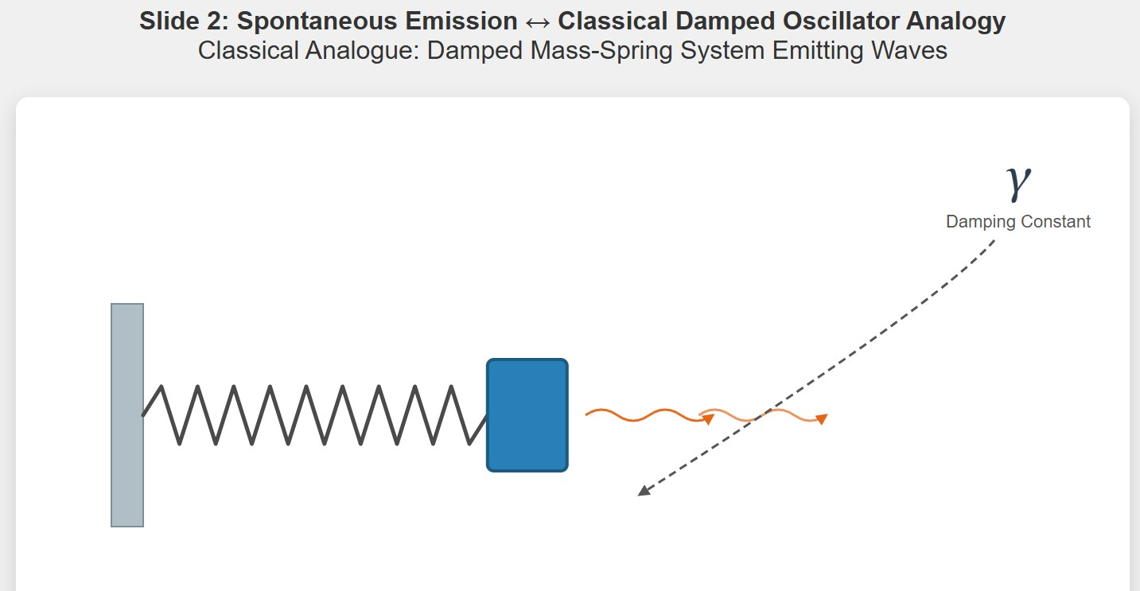
[IMAGE REQUIRED: Animated cartoon of a mass-spring oscillator emitting waves (wiggly arrows) that drain energy, with γ labelled.]
Prepared by Dist. Prof. Dr. M.A. Gondal for Phys 608 Laser Spectroscopy course in KFUPM (Term 251)

Slide 8
Slide 3: Equation of Motion — Full Differential Form
Newton’s second law for the damped oscillator gives
𝑥̈(𝑡) + 𝛾 𝑥̇(𝑡) + 𝜔₀ 𝑥(𝑡) = 0
𝑥(𝑡) : displacement of the charge from equilibrium [m].
2
• 𝑥̇(𝑡) = ^{𝑑𝑥} : velocity [m s⁻¹].
𝑑𝑡
2
• 𝑥̈(𝑡) = ^{𝑑𝑥} : acceleration [m s⁻²].
𝑑𝑡²
Physical interpretation of each term.

Slide 9
2
𝜔₀ 𝑥 : restoring force −𝑘𝑥.
𝛾𝑥̇ : radiative friction (proportional to velocity).
𝑥̈ : inertial response.
---

Slide 10
Slide 4: Exact Solution with Clear Initial Conditions
Choose initial displacement 𝑥(0) = 𝑥₀ and initial velocity 𝑥̇(0) = 0.
2
Characteristic equation 𝑟² + 𝛾𝑟 + 𝜔₀ = 0 yields roots
_{𝛾}2
𝛾 2
𝛾
2 4
√
2
± 𝑖𝜔.
𝑟 = −
± 𝑖 𝜔 −
≡ −
1,2
0
Define the damped oscillation frequency

Slide 11
_{𝛾}2
√
2
[rad s⁻¹].
𝜔 = 𝜔 −
0
4
The real-valued solution matching the initial conditions is
𝛾
𝑥(𝑡) = 𝑥₀ 𝑒^{−𝛾𝑡/2} [cos(𝜔𝑡) +
sin(𝜔𝑡)].
2𝜔

Slide 12
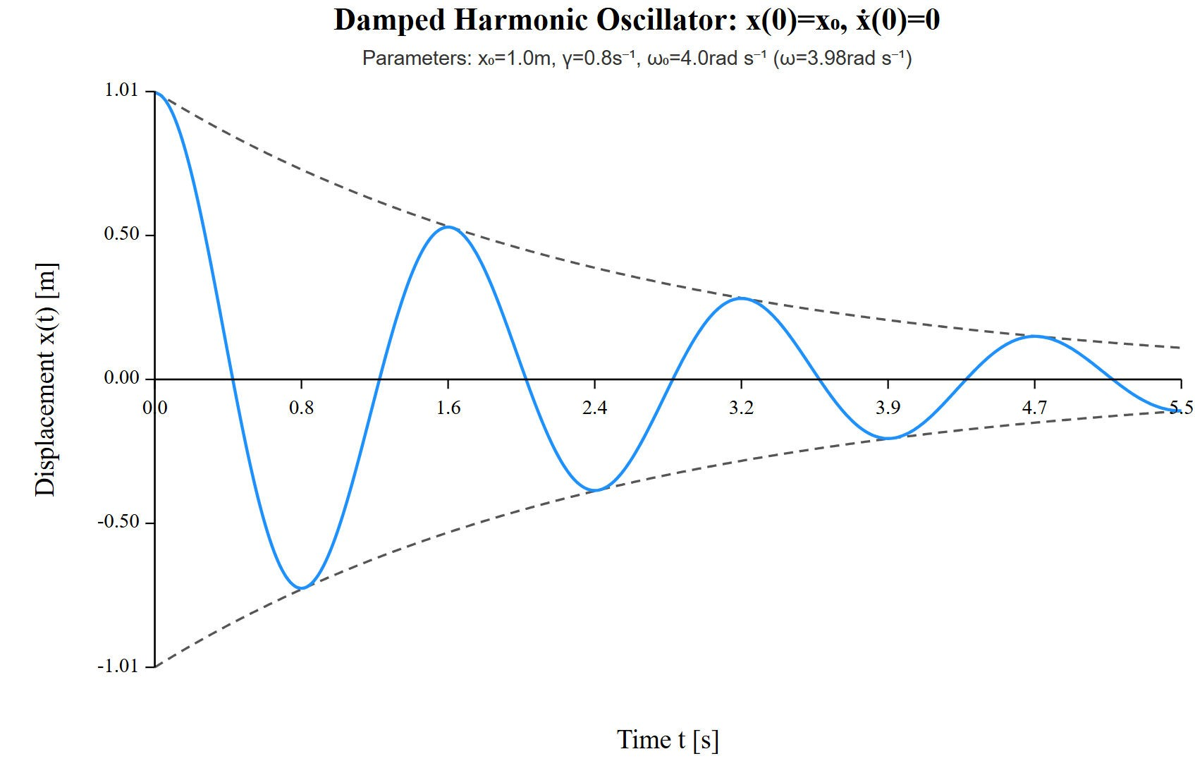
[IMAGE REQUIRED: Plot of 𝑥(𝑡) showing exponentially shrinking envelope and oscillations.]
Prepared by Dist. Prof. Dr. M.A. Gondal for Phys 608 Laser Spectroscopy course in KFUPM (Term 251)

Slide 13
Slide 5: Small-Damping Approximation and Atomic
Frequency Link
• Optical regime: 𝛾 ≪ 𝜔₀ ⇒ 𝜔 ≈ 𝜔₀.
𝛾
Term sin(𝜔𝑡) is of order 𝛾/𝜔 ; neglecting it introduces a relative
2𝜔
0
error < 10⁻⁷ for typical atoms.
Simplified, yet extremely accurate, motion becomes
𝑥(𝑡) = 𝑥₀ 𝑒^{−𝛾𝑡/2}cos(𝜔₀𝑡).

Slide 14
Identify atomic frequency
𝐸_{i} − 𝐸_{k}
𝜔₀ = 2𝜋𝜈₀ = 𝜔_{𝑖𝑘} =
𝜈₀ : optical frequency [Hz].
• ℏ = 1.054 571 817 × 10⁻³⁴ J s.
---
.
ℏ

Slide 15
Slide 6: Why a Frequency Distribution Appears
Constant-amplitude oscillation → single frequency.
Exponential decay multiplies the cosine; time truncation introduces a spread in frequency (Fourier theorem).
Goal: Determine the amplitude spectrum 𝐴(𝜔) such that
∞
1
__ ∫ 𝐴 (𝜔) 𝑒^{𝑖𝜔𝑡} 𝑑𝜔.
0
𝑥(𝑡) =
2√2𝜋
Key mathematical tool: Fourier transform of 𝑥(𝑡).

Slide 16
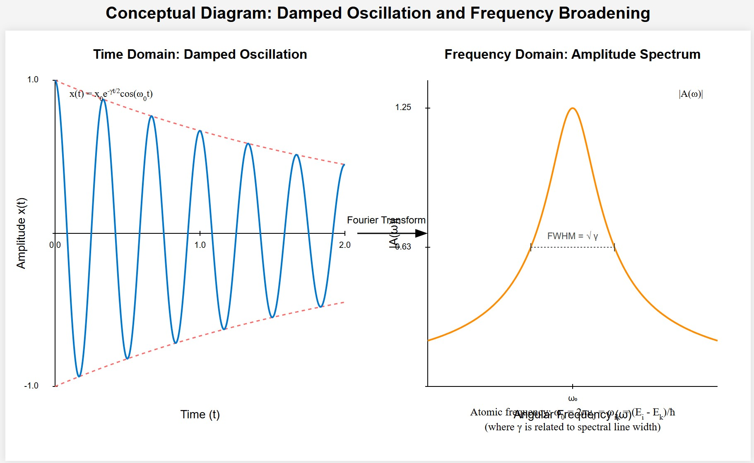
[IMAGE REQUIRED: Conceptual diagram showing time-domain decaying wave transforming into a broadened peak in frequency domain.]
Prepared by Dist. Prof. Dr. M.A. Gondal for Phys 608 Laser Spectroscopy course in KFUPM (Term 251)

Slide 17
Slide 7: Step-by-Step Evaluation of the Fourier Transform
Start with
+∞
1
𝐴(𝜔) =
∫ 𝑥 (𝑡) 𝑒^{−𝑖𝜔𝑡} 𝑑𝑡.
−∞
√2𝜋
Because 𝑥(𝑡 < 0) = 0, change lower limit to 0.
• Substitute 𝑥(𝑡) = 𝑥₀𝑒^{−𝛾𝑡/2}cos(𝜔₀𝑡).
1
𝑖𝜔₀𝑡 −𝑖𝜔₀𝑡
• Express cos(𝜔₀𝑡) = ₂ [𝑒 + 𝑒
] to integrate term-by-term.

Slide 18
𝑥₀
∞
𝐴(𝜔) =
___ ∫
0
_{𝑒}−𝛾𝑡/2 _{[𝑒}𝑖(𝜔₀−𝜔)𝑡 _{+ 𝑒}−𝑖(𝜔₀+𝜔)𝑡_{] 𝑑𝑡.}
2√2𝜋
Each exponential integral uses
∞
1
∫
0
_{𝑒}−(𝑎−𝑖𝑏)𝑡 _{𝑑𝑡 =}
(for 𝑎 > 0).
𝑎 − 𝑖𝑏
• Identify 𝑎 = 𝛾/2, 𝑏 = 𝜔 − 𝜔₀ or 𝑏 = 𝜔 + 𝜔₀.
---

Slide 19
Slide 8: Resulting Amplitude Spectrum
Carrying out the integrations yields
𝑥₀ 1 1
𝐴(𝜔) = [ +
].
𝑖(𝜔 − 𝜔₀) + 𝛾/2 𝑖(𝜔 + 𝜔₀) + 𝛾/2
√8𝜋
Physical meaning of each denominator term
First term: frequencies near 𝜔₀ (resonant part).
Second
term: anti-resonant component near
−𝜔₀;
negligible
around optical 𝜔 ≈ 𝜔₀.

Slide 20
We retain only the resonant denominator when |𝜔 − 𝜔₀| ≪ 𝜔₀.
---

Slide 21
Slide 9: Intensity Profile and Emergence of the Lorentzian
Spectral intensity 𝐼(𝜔) ∝ 𝐴(ω) 𝐴^{(ω} ∝ (Square of amplitude)
Near resonance, drop anti-resonant term to obtain
𝐶
( )
= .
𝐼 𝜔 − 𝜔
0
( )
2 2
𝜔 − 𝜔
( )
+ 𝛾/2
0
𝐶 : constant determined by chosen normalisation.
Functional form 1/(𝑥² + 𝑎²) is the Lorentzian.

Slide 22
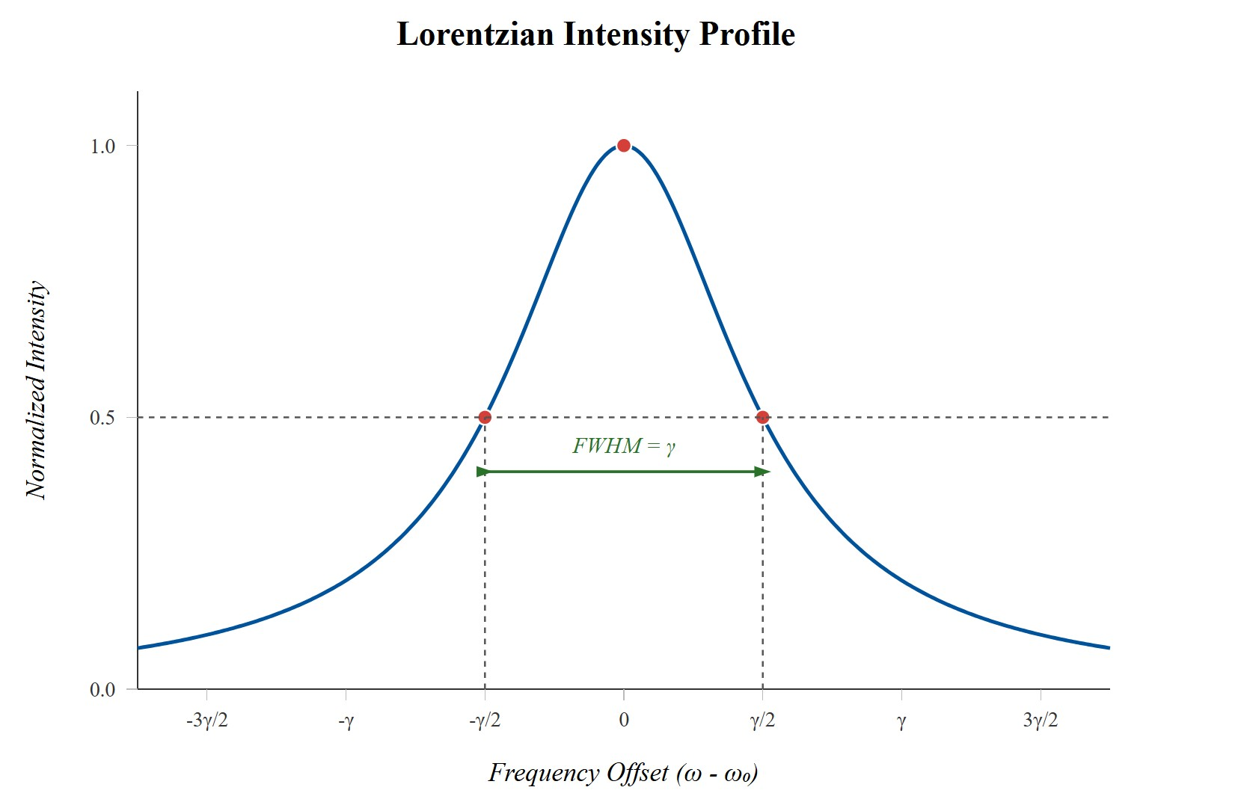
[IMAGE REQUIRED: Plot of Lorentzian vs. frequency offset, marking half-maximum points.]
Prepared by Dist. Prof. Dr. M.A. Gondal for Phys 608 Laser Spectroscopy course in KFUPM (Term 251)

Slide 23
Slide 10: Normalised Lorentzian — Definitions and FWHM
Total area under any spectral line is the integrated intensity
+∞
𝐼₀ = ∫ 𝐼 (𝜔) 𝑑𝜔.
−∞
Set
𝐼(𝜔 − 𝜔₀)
𝐿(𝜔 − 𝜔₀) =
,
𝐼
0
so that

Slide 24
+∞
∫ 𝐿 (𝜔 − 𝜔₀) 𝑑(𝜔 − 𝜔₀) = 1.
−∞
Substituting and integrating fixes
𝐼₀ 𝛾
𝐶 =
.
2𝜋
Final normalised profile
𝛾/(2𝜋)
(
)
.
𝐿 𝜔 − 𝜔
=
0
(
𝜔 − 𝜔
)
2
( )
2
+ 𝛾/2
0

Slide 25
Full width at half maximum (FWHM) in angular frequency
𝛾
or 𝛥𝜈_{nat} = _{2𝜋}.
𝛥𝜔_{nat} = 𝛾,
Width notation 𝛥𝜈 uses ordinary frequency [Hz].
---

Slide 26


Slide 11: Alternative Γ-Notation Common in Literature
Often in literature, the full halfwidth is denoted by
Define half-width parameter
Spectral profile written as
_{𝛤}2
𝑔(𝜔 − 𝜔_{𝑖𝑘}) = _{(𝜔}
− 𝜔)² + 𝛤^{2.}
𝑖𝑘
Peak value 𝑔(𝜔_{𝑖𝑘}) = 1 when normalised so that 𝐼(𝜔_{𝑖𝑘}) = 𝐼₀.

Slide 27
Dimensionless detuning parameter
𝜔_{𝑖𝑘} − 𝜔
𝜒 =
.
𝛤
Compact form
1
𝑔(𝜔 − 𝜔_{𝑖𝑘}) = _{1 + 𝜒2}.
Integrated area in this normalisation
+∞
∫ 𝐼 (𝜔) 𝑑𝜔 = 𝜋 𝐼₀ 𝛤.
−∞

Slide 28
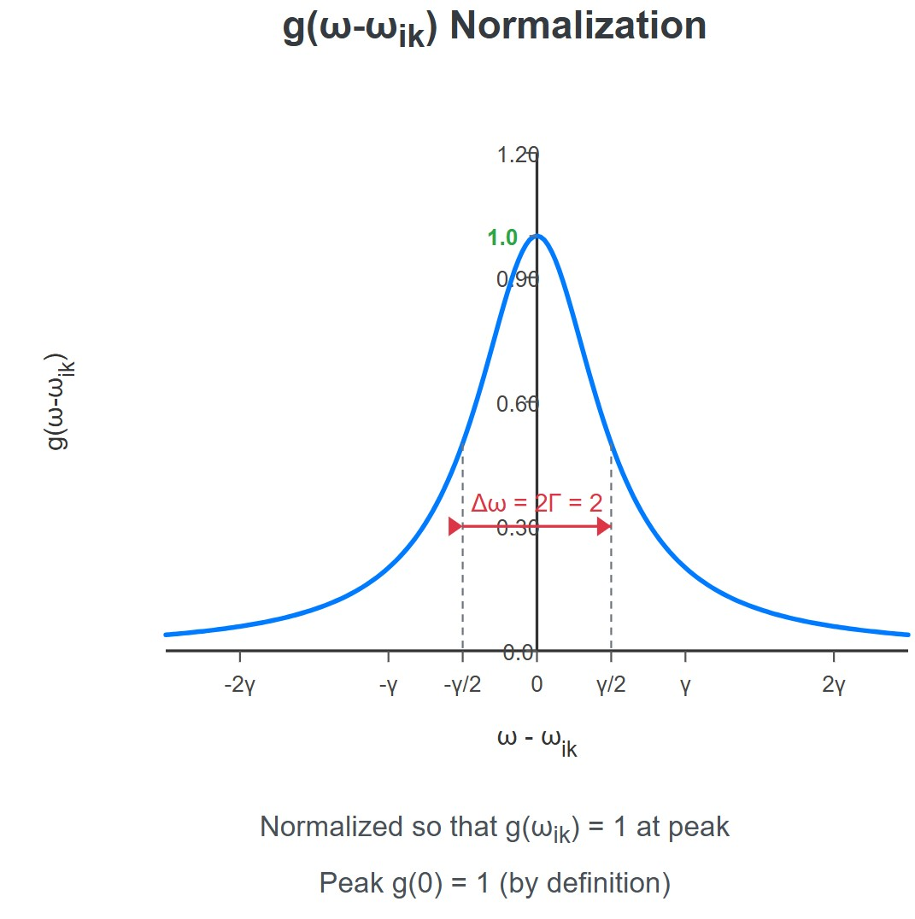
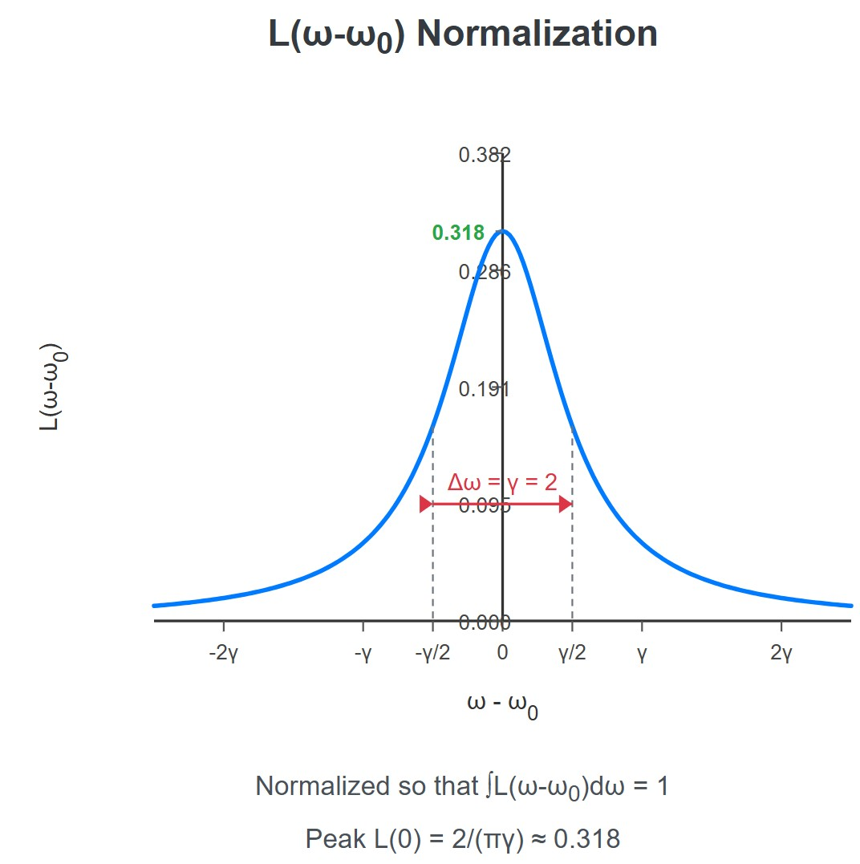
GE REQUIRED: Side-by-side comparison of 𝐿(𝜔) and 𝑔(𝜔) normalisations.]
[IMA
Prepared by Dist. Prof. Dr. M.A. Gondal for Phys 608 Laser Spectroscopy course in KFUPM (Term 251)

Slide 29
Slide 12: Energy Loss Rate Derived Directly From the
Equation of Motion
Multiply the motion equation by 𝑚𝑥(𝑡):
2 2
𝑚𝑥𝑥̈ + 𝑚𝜔₀ 𝑥𝑥̇ = −𝛾𝑚𝑥 .
Recognise left side as the total time derivative of mechanical energy
1
2
1
2
𝑚𝜔₀ 𝑥 (kinetic and potential energy)
𝑊(𝑡) =
𝑚𝑥̇ ² +
2 2
Therefore
Prepared by Dist. Prof. Dr. M.A. Gondal for Phys 608 Laser Spectroscopy course in KFUPM (Term 251)

Slide 30
𝑑𝑊
= −𝛾𝑚𝑥²(𝑡).
𝑑𝑡
• Insert 𝑥(𝑡) = 𝑥₀𝑒^{−𝛾𝑡/2}cos(𝜔₀𝑡) and discard 𝛾² terms (small).
𝑑𝑊
= −𝛾𝑚𝑥²𝑒^{−𝛾𝑡} sin²(𝜔 𝑡).
0 0
𝑑𝑡
Time-average over many optical cycles, using ⟨sin²⟩ = ¹
:
2
𝑑𝑊 𝛾
𝑃 ≡ ⟨
2 2 −𝛾𝑡
⟩ = − 𝑚𝑥₀ 𝜔₀𝑒 .
𝑑𝑡 2
Prepared by Dist. Prof. Dr. M.A. Gondal for Phys 608 Laser Spectroscopy course in KFUPM (Term 251)

Slide 31
Radiant power decays with the same time constant 𝜏 = 1/𝛾.
---
Prepared by Dist. Prof. Dr. M.A. Gondal for Phys 608 Laser Spectroscopy course in KFUPM (Term 251)

Slide 32
Slide 13: Connecting Damping Constant γ to Quantum
Lifetime τ
Quantum
spontaneous-emission rate for state ∣i⟩: Einstein 𝐴_{i}
coefficient [s⁻¹].
Mean lifetime
1
𝜏 =
.
i
𝐴
i
Identify 𝛾 = 𝐴_{i}.
Prepared by Dist. Prof. Dr. M.A. Gondal for Phys 608 Laser Spectroscopy course in KFUPM (Term 251)

Slide 33
Natural linewidth in frequency units
𝐴_{i} 1
2𝜋 2𝜋𝜏
𝛥𝜈_{nat} =
=
.
i
Any decrease in 𝜏_{i}
widens the line; longer-lived states generate
ultra-narrow features.
---
Prepared by Dist. Prof. Dr. M.A. Gondal for Phys 608 Laser Spectroscopy course in KFUPM (Term 251)

Slide 34
Slide 14: Uncertainty Principle Perspective
Energy-time uncertainty relation
ℏ
𝛥𝐸_{i} 𝛥𝑡 ≳ ₂.
For exponential decay 𝛥𝑡 ≡ 𝜏_{i}.
Hence
ℏ
𝛥𝐸_{i} ≈
.
𝜏
i
Prepared by Dist. Prof. Dr. M.A. Gondal for Phys 608 Laser Spectroscopy course in KFUPM (Term 251)

Slide 35
Frequency uncertainty (linewidth)
𝛥𝐸_{i} 1 ℏ 𝜏_{i}
𝛥𝜔 =
= .
If both upper and lower states are unstable (lifetimes 𝜏_{i}, 𝜏_{k}), total uncertainty adds in quadrature
1 1
₂ + ₂.
𝛥𝜔 = √
𝜏_{i} 𝜏_{k}
Prepared by Dist. Prof. Dr. M.A. Gondal for Phys 608 Laser Spectroscopy course in KFUPM (Term 251)

Slide 36
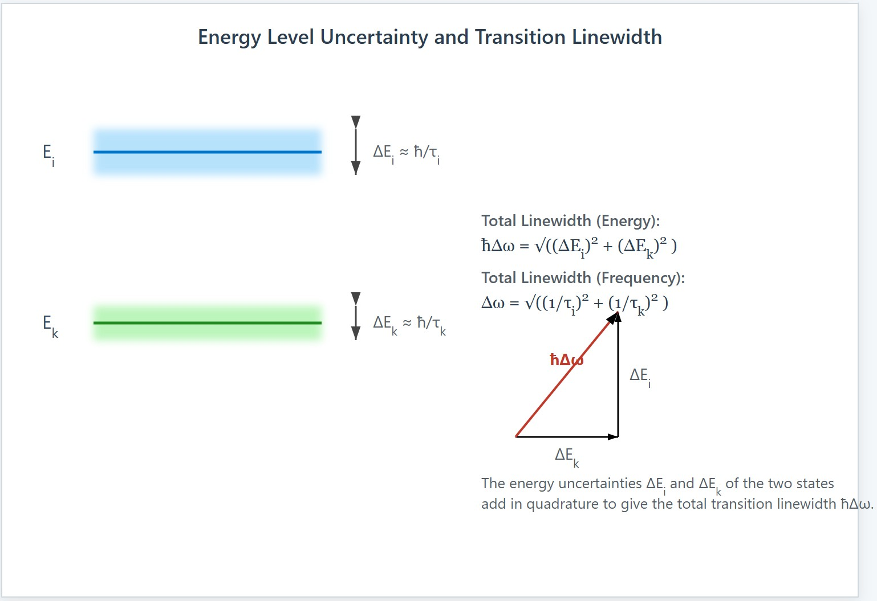
[IMAGE REQUIRED: Two energy levels with fuzzy widths, arrows indicating uncertainties adding.]
Prepared by Dist. Prof. Dr. M.A. Gondal for Phys 608 Laser Spectroscopy course in KFUPM (Term 251)

Slide 37
Slide 15: Power Emitted by an Ensemble of Atoms
𝑁_{i} : number density [m⁻³] of atoms in state ∣i⟩.
Radiant power for transition 𝑖 → 𝑘:
𝑑𝑊
𝑖𝑘
= 𝑁_{i} 𝐴_{𝑖𝑘} ℎ𝜔_{𝑖𝑘}.
𝑑𝑡
Detector of area 𝐴 at distance 𝑟 subtends solid angle 𝑑𝛺 = ^{𝐴} .
Assuming isotropic emission, power reaching detector
_{𝑟}2

Slide 38
𝐴
𝑃_{𝑖𝑘} = 𝑁_{i} 𝐴_{𝑖𝑘} ℎ𝜔_{𝑖𝑘} 𝛥𝑉 _{4𝜋𝑟2}.
Measuring 𝑃_{𝑖𝑘} allows determination of 𝑁_{i} provided 𝐴_{𝑖𝑘} is known.

Slide 39
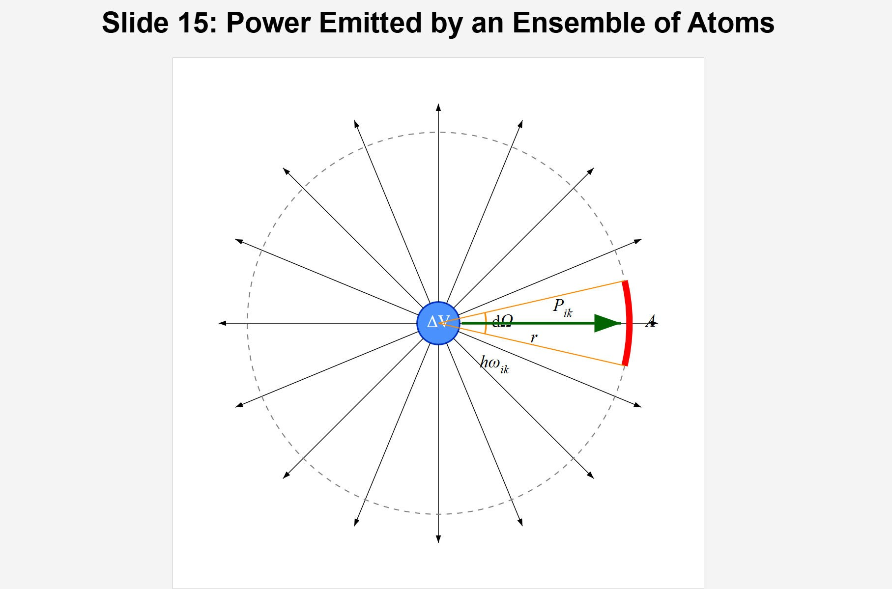
[IMAGE REQUIRED: Sphere depicting isotropic emission with detector patch highlighted.]
Prepared by Dist. Prof. Dr. M.A. Gondal for Phys 608 Laser Spectroscopy course in KFUPM (Term 251)

Slide 40
Slide 16: Absorption Geometry and Beer’s Law
Plane monochromatic wave enters sample of thickness 𝑧.
Intensity decrement over 𝑑𝑧:
𝑑𝐼 = −𝛼_{𝑖𝑘}(𝜔) 𝐼 𝑑𝑧.
Integrate from 0 to 𝑧:
𝐼(𝑧) = 𝐼₀ 𝑒^{−𝛼𝑖𝑘(𝜔) 𝑧}.
𝛼_{𝑖𝑘}(𝜔) : absorption coefficient [m⁻¹].

Slide 41
Expressed via cross-section 𝜎_{𝑖𝑘} (𝜔) and populations
𝑔_{i}
𝛼
( )
( )
𝑁 ].
𝜔 = 𝜎
𝜔 [𝑁 −
𝑖𝑘
𝑖𝑘
i
𝑔
k
k
For 𝑁_{k} ≪ 𝑁_{i} (ground state dominated): 𝛼_{𝑖𝑘} ≈ 𝜎_{𝑖𝑘} 𝑁_{i}.
---

Slide 42
Slide 17: Driven Damped Oscillator Yields Absorption
Profile
External electric field of light:
𝐸(𝑡) = 𝐸₀ 𝑒^{𝑖𝜔𝑡}.
Charge 𝑞 = 𝑒 experiences force 𝑞𝐸(𝑡).
Linear response theory (from Sect. 2.6) gives frequency-dependent absorption coefficient near resonance

Slide 43
𝑁𝑒²
𝛾
𝛼(𝜔) =
.
4𝜖₀𝑚𝑐 (𝜔 − 𝜔₀)² + (𝛾/2)²
Identical Lorentzian form and identical FWHM 𝛾 as emission case, confirming reciprocity.

Slide 44
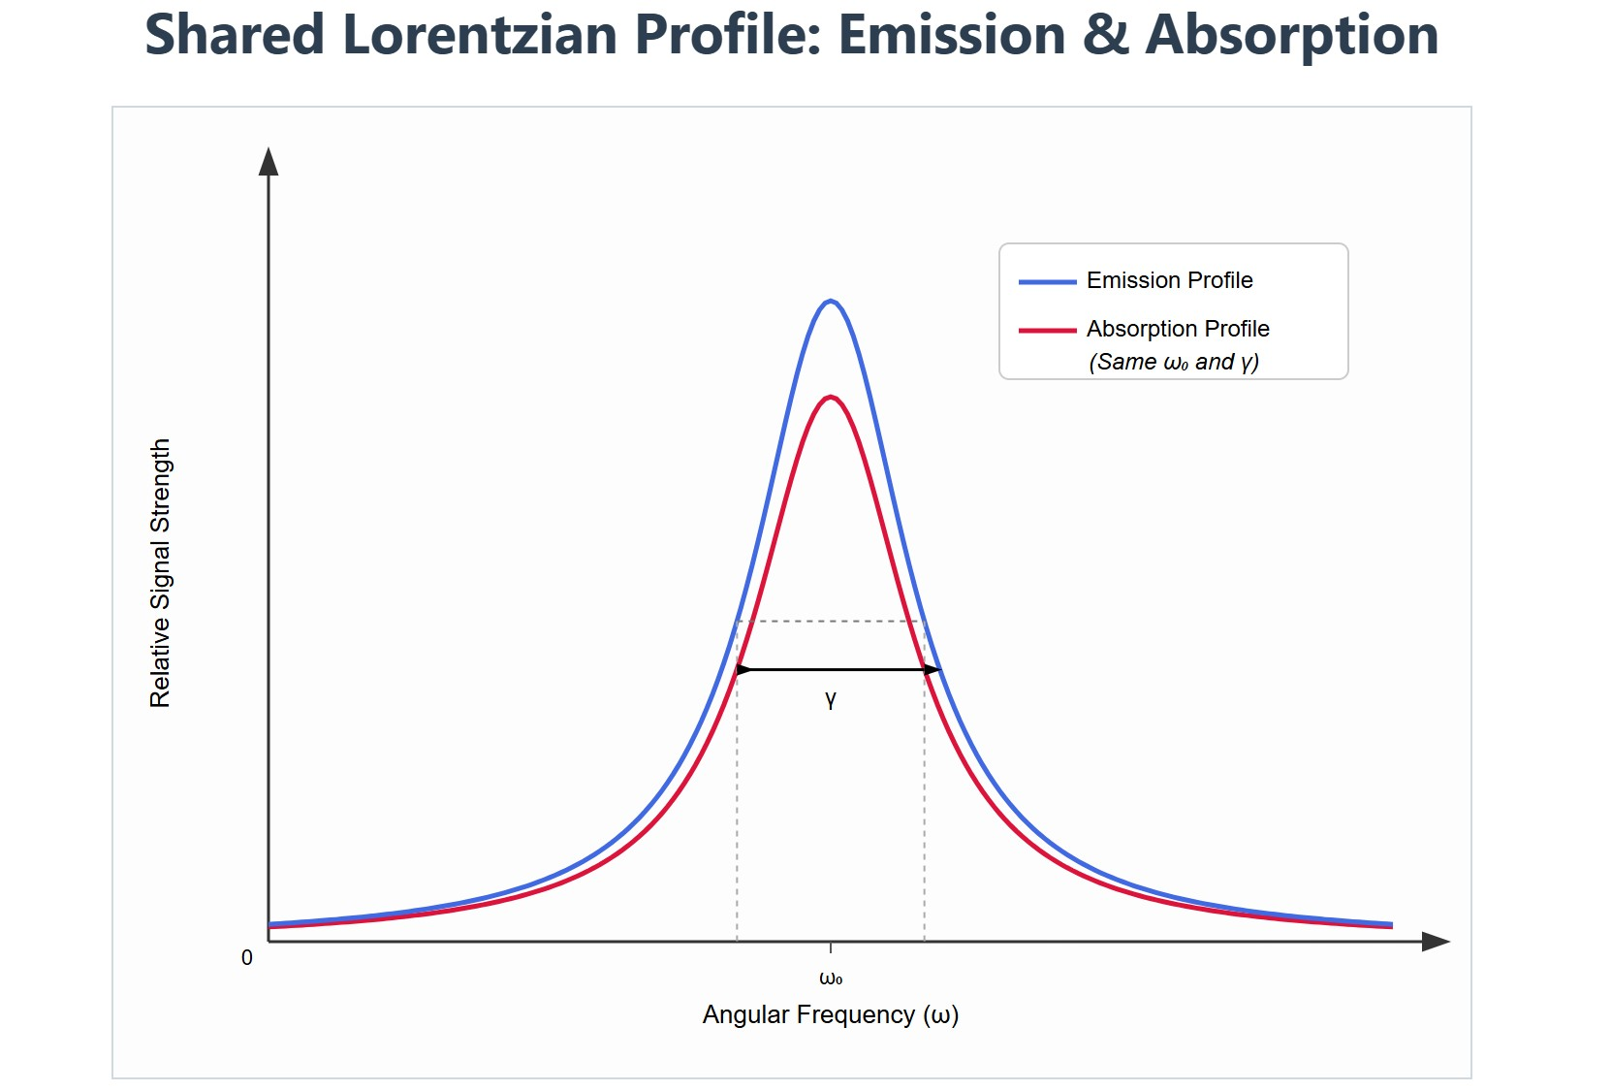
[IMAGE REQUIRED: Overlay of emission Lorentzian and absorption Lorentzian sharing same width.]
Prepared by Dist. Prof. Dr. M.A. Gondal for Phys 608 Laser Spectroscopy course in KFUPM (Term 251)

Slide 45
Slide 18: Dispersion — Variation of Refractive Index
Real part of the complex response gives refractive index increment
𝑁𝑒² 𝜔₀ − 𝜔
𝑛′(𝜔) = 1 +
.
4𝜖₀𝑚𝜔₀ (𝜔 − 𝜔₀)² + (𝛾/2)²
𝑛′(𝜔) exhibits steep slope near resonance (anomalous dispersion).
Relationship
between absorption peak and steep dispersion
mandated by Kramers-Kronig relations.

Slide 46
Such
dispersion
underlies
slow-light
and optical
switching
phenomena.

Slide 47
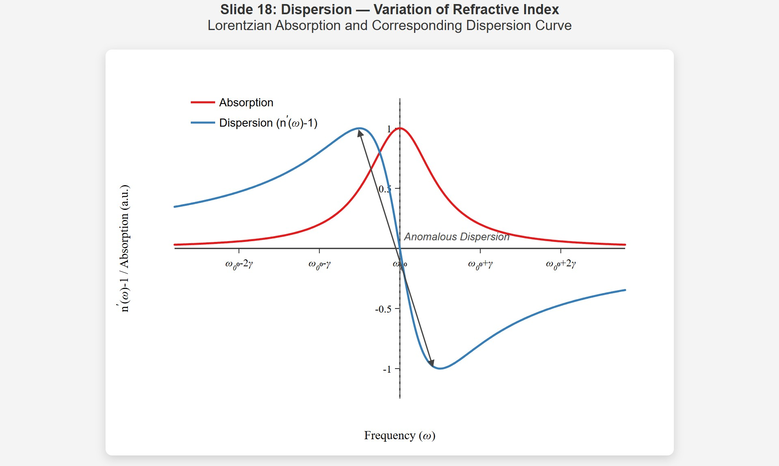
[IMAGE REQUIRED: Plot showing Lorentzian absorption and corresponding S-shaped dispersion curve.]
Prepared by Dist. Prof. Dr. M.A. Gondal for Phys 608 Laser Spectroscopy course in KFUPM (Term 251)

Slide 48

Slide 19: Practical Limitation — Role of Doppler
Broadening
Real gases at temperature 𝑇 have atoms moving with thermal velocities 𝑣 ∼ √𝑘_{B}𝑇/𝑚.
𝑣
Motion shifts resonance by Doppler frequency 𝛥𝜔_{D} = 𝜔_{0 𝑐}.
Result: convolution of natural Lorentzian with Gaussian velocity
distribution → Voigt profile.

Slide 49
Doppler effect and motion of gas molecules
https://de.pinterest.com/pin/322851867022866930/

Slide 50
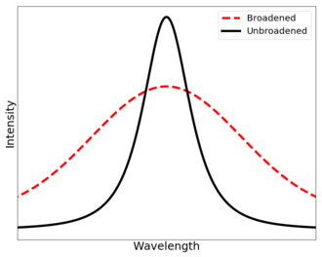
Doppler Broadend Line Profile

Slide 51
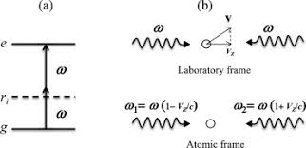
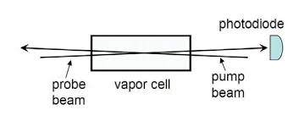
Doppler Free two photon Spectroscopy

Slide 52
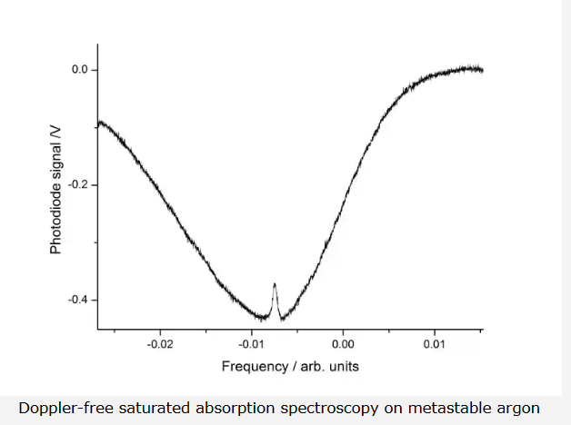
Natural profile derived here is observable only with Doppler-free spectroscopy (e.g., saturated absorption, two-photon spectroscopy).

Slide 53
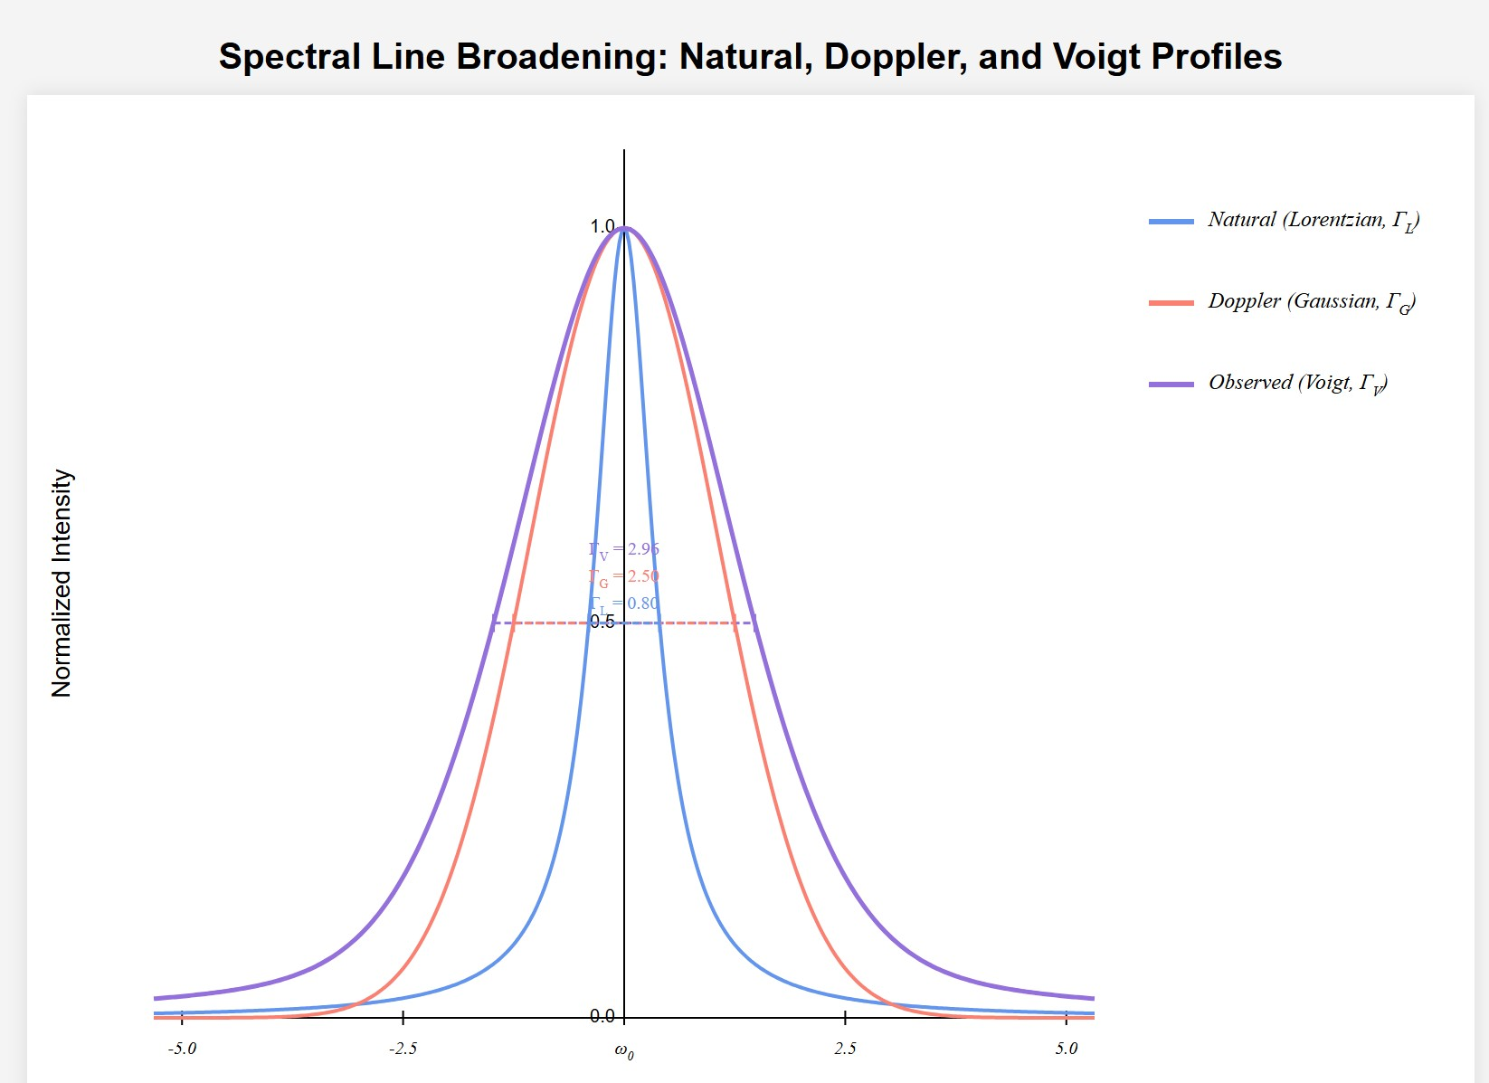
[IMAGE REQUIRED: Illustration of Gaussian Doppler width overlaying Lorentzian to produce Voigt curve.]
Prepared by Dist. Prof. Dr. M.A. Gondal for Phys 608 Laser Spectroscopy course in KFUPM (Term 251)

Slide 54
Slide 20: Example — Sodium D₁ Transition at 589 nm
Data
𝑐
14
• Wavelength 𝜆 = 589.1 nm ⇒ 𝜈₀ = _{𝜆} = 5.09 × 10 Hz.
• Lifetime 𝜏 = 16 ns = 16 × 10⁻⁹ s.
Natural linewidth
1 1
6
𝛥𝜈_{nat} = _{2𝜋𝜏} = _{2𝜋 × 16 × 10−9} = 9.95 × 10 Hz ≈ 10 MHz.

Slide 55
Number of optical cycles before amplitude decays by 1/𝑒:
𝑁_{cycles} = 𝜈₀ 𝜏 = (5.09 × 10¹⁴) × (16 × 10⁻⁹) ≈ 8.1 × 10⁶.
Confirms 𝛾 ≪ 𝜔₀ by over seven orders of magnitude.
---

Slide 56
Slide 21: Example — Ultra-Narrow Molecular and
Forbidden Lines
Vibrational states typical lifetime 𝜏 = 1 ms.
Natural width
1 1
𝛥𝜈_{nat} = _{2𝜋𝜏} = _{2𝜋 × 10−3} = 159 Hz ≈ 160 Hz.
Hydrogen 2s → 1s two-photon transition
Lifetime 𝜏 = 0.12 s.

Slide 57
Width
1
𝛥𝜈_{nat} = _{2𝜋 × 0.12} = 1.3 Hz.
narrow features are pivotal in
Such
testing
quantum
electrodynamics and probing fundamental constants.

Slide 58
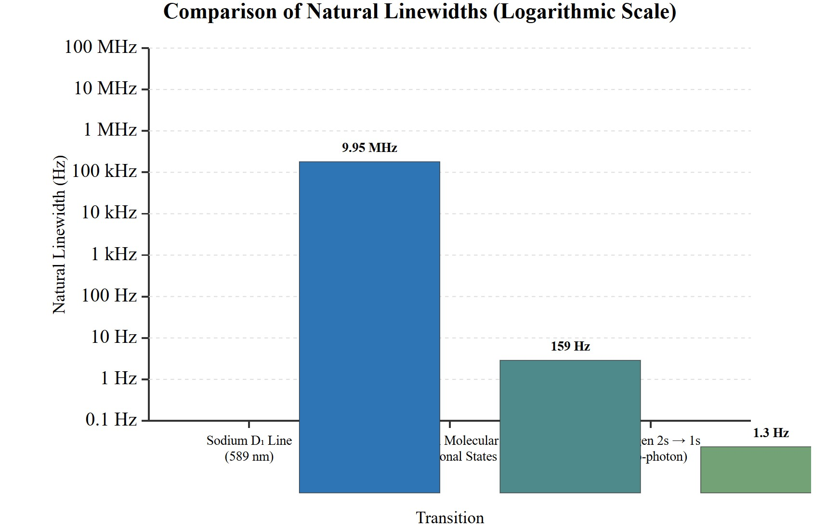
[IMAGE REQUIRED: Logarithmic bar chart comparing natural widths from MHz down to Hz for multiple transitions.]
Prepared by Dist. Prof. Dr. M.A. Gondal for Phys 608 Laser Spectroscopy course in KFUPM (Term 251)

Slide 59
Slide 22: Key Takeaways and Forward Look
Natural linewidth originates from spontaneous emission and is fully characterised by lifetime 𝜏.
Classical damped oscillator faithfully mirrors quantum behaviour for line-shape and width.
Lorentzian profile is universal for isolated, stationary emitters and absorbers.

Slide 60
Upcoming sections will incorporate motion (Doppler) and collisional effects to build the complete Voigt profile used in real-world spectroscopy.
---

