Slide 1
Chap. 3 Width & Profile of Spectral Lines
Prepared by Dist. Prof. Dr. M.A. Gondal for Phys 608 Laser Spectroscopy course in KFUPM (Term 251)

Slide 2
Slide 1: Spectral Lines—Why They Are Never Infinitely
Narrow
Spectroscopy detects discrete transitions between quantized energy levels of atoms, molecules, or ions.
Idealized picture: each transition produces a single frequency 𝜈₀ or wavelength 𝜆₀.
Real laboratory observation: intensity is distributed over a small but finite frequency interval 𝐼(𝜈).
Prepared by Dist. Prof. Dr. M.A. Gondal for Phys 608 Laser Spectroscopy course in KFUPM (Term 251)

Slide 3
Consequence: every “spectral line” possesses a measurable width
and a characteristic shape (profile), which information.
Understanding these widths is essential for:
carry rich physical
precision metrology (atomic clocks),
diagnostics of astrophysical and laboratory plasmas,
laser design and frequency stabilisation,
fundamental tests of quantum electrodynamics (QED).
Prepared by Dist. Prof. Dr. M.A. Gondal for Phys 608 Laser Spectroscopy course in KFUPM (Term 251)

Slide 4
Slide 2: Energy Levels & the Central (Resonance) Freq.
Two stationary states of a quantum system:
Upper (initial) state energy 𝐸_{i} (units: J).
Lower (final) state energy 𝐸_{k} (units: J).
Energy difference that must be supplied (absorption) or released (emission):
𝛥𝐸 =
𝐸_{i} − 𝐸_{k}
Prepared by Dist. Prof. Dr. M.A. Gondal for Phys 608 Laser Spectroscopy course in KFUPM (Term 251)

Slide 5
Planck–Einstein relation links energy to electromagnetic frequency:
𝛥𝐸
𝜈₀ =
ℎ
• ℎ = 6.626 070 15 × 10⁻³⁴ J s (defined constant).
𝜈₀ (Greek letter nu) is the central or resonance frequency in hertz (Hz).
Alternative angular-frequency notation eliminates factors 2𝜋:
ω₀ = 2π ν₀, units: rad s⁻¹
Prepared by Dist. Prof. Dr. M.A. Gondal for Phys 608 Laser Spectroscopy course in KFUPM (Term 251)

Slide 6
In spectroscopy literature, using 𝜔 is often more convenient for quantum-mechanical expressions involving phases 𝑒^{−𝑖𝜔𝑡}.
---
Prepared by Dist. Prof. Dr. M.A. Gondal for Phys 608 Laser Spectroscopy course in KFUPM (Term 251)

Slide 7
Slide 3: Definition of the Line Profile 𝑰(𝝂)
Units depend on detector: W cm⁻² Hz⁻¹, counts s⁻¹, etc.
Central maximum occurs at 𝜈 = 𝜈₀.
The complete functional dependence 𝐼(𝜈) in the vicinity of 𝜈₀ is called the line profile.
Experimentally recorded intensity as a function of frequency:
𝐼(𝜈)
Prepared by Dist. Prof. Dr. M.A. Gondal for Phys 608 Laser Spectroscopy course in KFUPM (Term 251)

Slide 8
Common analytical models (studied in later slides): Lorentzian, Gaussian, Voigt, etc.
The
profile encodes physical broadening mechanisms: natural
lifetime, Doppler shifts, collisions, external fields, instrumental resolution.
Prepared by Dist. Prof. Dr. M.A. Gondal for Phys 608 Laser Spectroscopy course in KFUPM (Term 251)

Slide 9
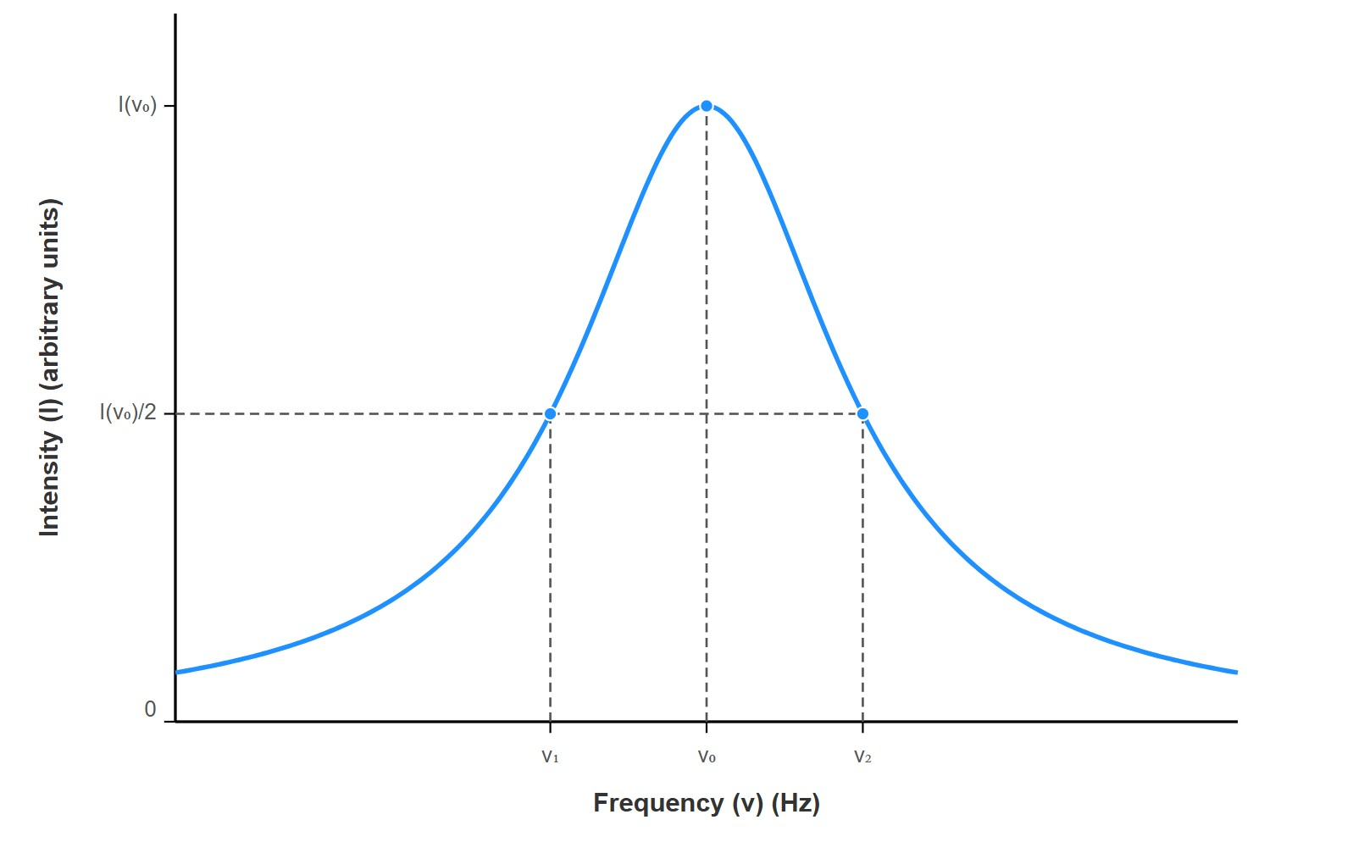
[IMAGE REQUIRED: Provide a labelled plot of intensity versus frequency. Show a symmetric peak centred at 𝜈0 , mark I(𝜈0 ), half-maximum level, and both frequencies 𝜈1 and 𝜈2 . Axes: horizontal—frequency (Hz), vertical—intensity (arbitrary units).]
Prepared by Dist. Prof. Dr. M.A. Gondal for Phys 608 Laser Spectroscopy course in KFUPM (Term 251)

Slide 10
Slide 4: Full Width at Half Maximum (FWHM) — Formal
Definition
Identify the two frequencies where the intensity drops to one-half of its peak value:
𝐼(𝜈₀)
𝐼(𝜈₁) 𝐼(𝜈₂)
= =
2
Full Width at Half Maximum (abbreviation: FWHM) is
𝛿𝜈 =
|𝜈₂ − 𝜈₁|

Slide 11
Often the symbol 𝛤 is also used for FWHM in quantum optics.
Half-width
at half-maximum (HWHM) equals 𝛿𝜈/2 but is less
common in optics.
The FWHM is the most practical single-number characterisation of a line’s breadth; it can be directly read off a plotted spectrum or fitted mathematically.
---

Slide 12
Slide 5: Converting FWHM Between Frequency, Angular
Frequency, and Wavelength
Frequency ↔ Angular Frequency
  Definition:
𝜔 = 2𝜋 𝜈
  Therefore for small differentials or finite widths:
𝛿𝜔 = 2𝜋 𝛿𝜈

Slide 13
2. Frequency ↔ Wavelength
Dispersion relation of light in vacuum:
𝑐 = 𝜈 𝜆
• 𝑐 = 2.997 924 58 × 10⁸ m s⁻¹.
Differentiate both sides with respect to the variables to relate small changes:
0 = 𝜆 𝛿𝜈 + 𝜈 𝛿𝜆
Solve for 𝛿𝜆:

Slide 14
𝑐
𝛿𝜆 = − 𝛿𝜈
_{𝜈}2
Negative sign: an increase in frequency corresponds to a decrease in wavelength; the magnitude is what matters for widths.
Magnitude of wavelength FWHM:
𝑐
|𝛿𝜆| = |𝛿𝜈|
_{𝜈}2
Typical laboratory usage: 𝜆 in nm or Å; 𝜈 in THz; 𝛿𝜆 often lies in picometres (pm) range for optical transitions.

Slide 15
Slide 6: Unit-Independent Relative Halfwidths
Define relative (dimensionless) width for any variable 𝑥:
𝛿𝑥
| |
𝑥
Starting with 𝑥 = 𝜈 and using earlier conversions we prove:
𝛿𝜈 𝛿𝜔 𝛿𝜆
| | = | | = | |
𝜈 𝜔 𝜆
Derivation example for 𝜈 → 𝜔:

Slide 16
𝛿𝜔
2𝜋 𝛿𝜈
𝛿𝜈
= =
𝜔 2𝜋 𝜈 𝜈
Derivation example for 𝜈 → 𝜆 (use 𝜈 = 𝑐/𝜆):
𝛿𝜈 𝛿𝜆 𝛿𝜈
𝛿𝜆
= − ⇒ | | = |
|
𝜈 𝜆 𝜈
𝜆
Practical
importance: once relative width is known in any
representation, it is immediately known in all others—extremely convenient for comparing microwave, infrared, visible, and ultraviolet spectroscopy results on a common footing.

Slide 17
Slide 7: Kernel and Wings—Anatomy of a Spectral Line
Kernel (core):
Frequency interval 𝜈₁ ≤ 𝜈 ≤ 𝜈₂.
Contains half of the maximum intensity and is typically dominated by the most probable physical broadening process (e.g., Doppler in gases).
Wings:
• Regions 𝜈 < 𝜈₁ and 𝜈 > 𝜈₂.

Slide 18
Intensity
falls rapidly but never to exact zero; wings carry
fingerprints of additional physical mechanisms such as collisional broadening or quantum interference.
Wing behaviour determines:
  laser gain bandwidth,
  radiation transport in stellar atmospheres,
  accuracy limits of atmospheric remote sensing.

Slide 19
For precise modelling, wings often require different mathematical treatment (e.g., Lorentzian tails).

Slide 20
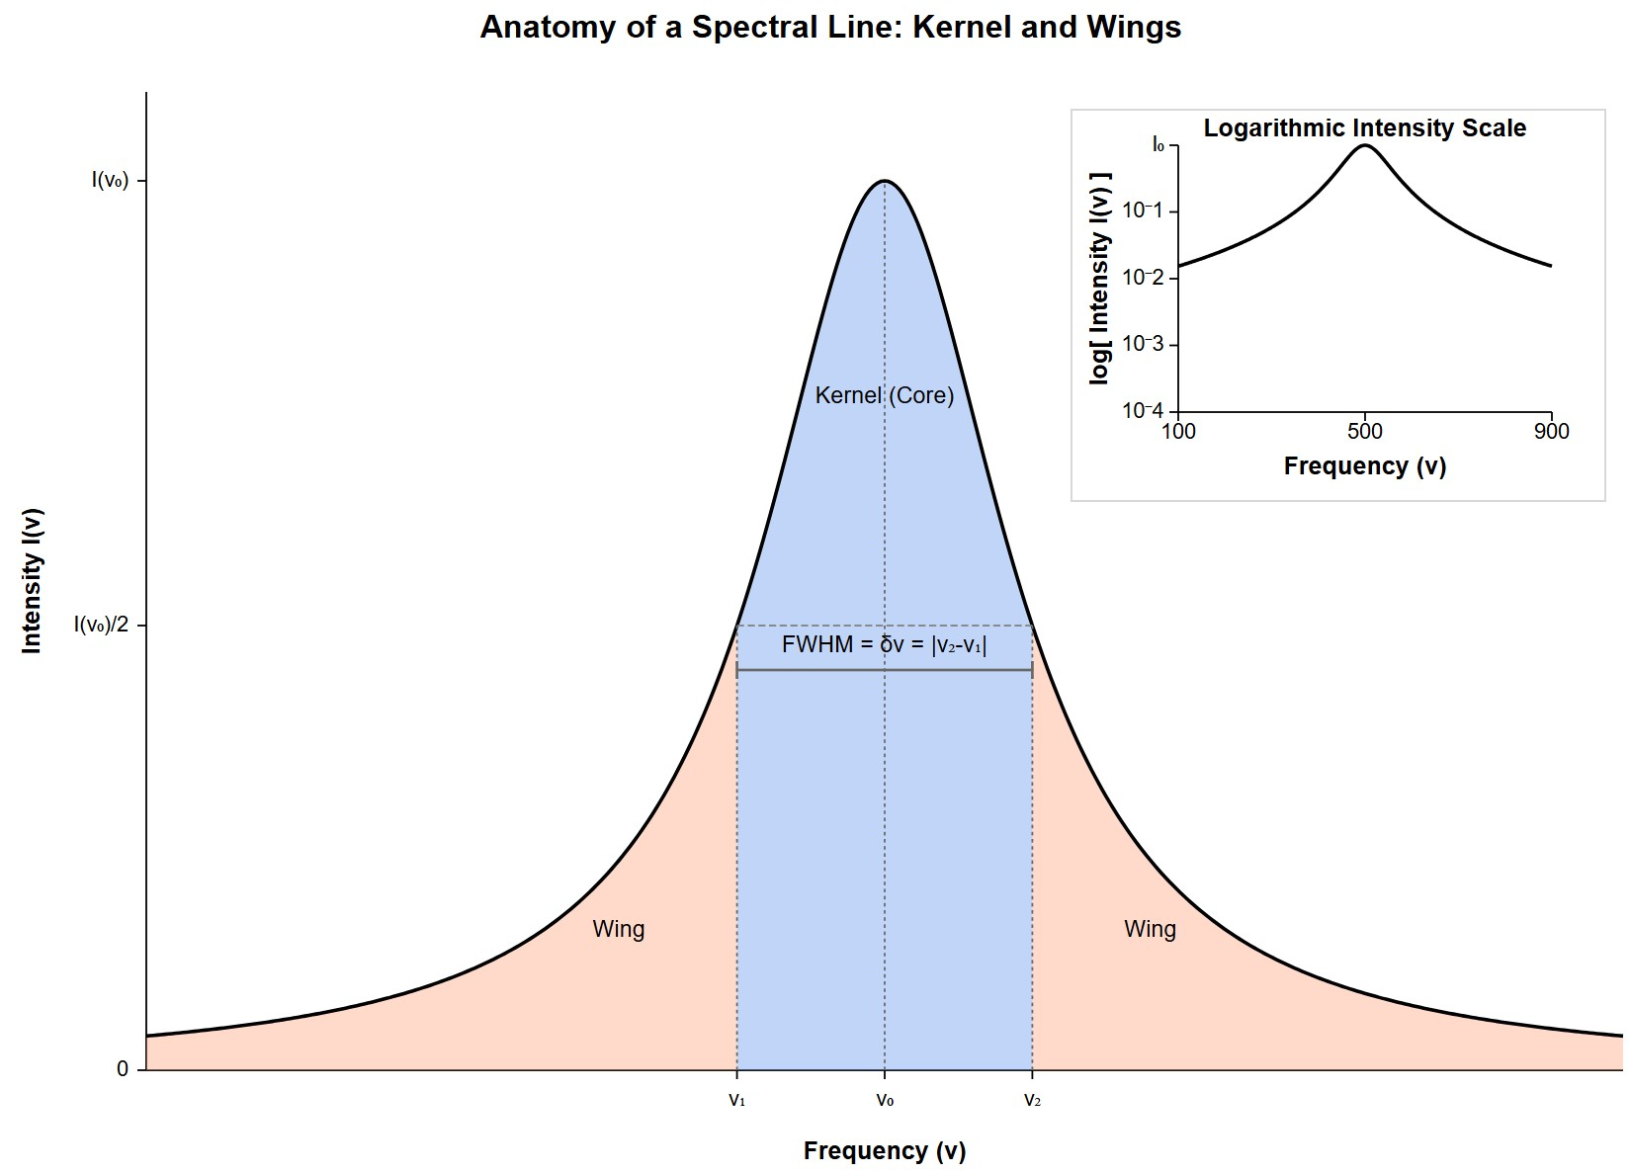
[IMAGE REQUIRED: Intensity versus frequency plot with coloured shading: central kernel region shaded differently, wings labelled, half-maximum level marked. Include logarithmic inset to highlight slow wing decay.]
---
Prepared by Dist. Prof. Dr. M.A. Gondal for Phys 608 Laser Spectroscopy course in KFUPM (Term 251)

Slide 21
Slide 8: Overview of Broadening Mechanisms (Context for
Later Sections)
Natural (lifetime) broadening—finite excited-state lifetime via the energy–time uncertainty principle.
Doppler
(thermal motion) broadening—Doppler shifts of
emitting/absorbing particles; Gaussian shape.
Collisional (pressure) broadening—perturbations due to collisions; Lorentzian shape, dependent on gas pressure.
particle

Slide 22
Stark,
Zeeman, and other field-induced broadenings—external
electric or magnetic fields split/shift levels.
Instrumental broadening—limited resolution of spectrographs or interferometers; must be deconvolved to recover intrinsic profile.
---

Slide 23
Slide 9: Typical Orders of Magnitude—Why Widths
Matter
Natural linewidth of a typical allowed optical transition:
𝛤_{nat} ∼ 10⁷ Hz (≈ few MHz).
Doppler width for sodium D line (𝜆₀ = 589 nm) at 300 K:
• 𝛿𝜈_{𝐷} ≈ 1.5 GHz.
Collisional width in air at 1 atm for the same transition:

Slide 24
𝛤_{coll} ∼ 100 MHz.
Ultra-high resolution spectrometers (Fabry–Pérot, Fourier transform interferometers) can resolve 𝛿𝜈 down to ≲ 1 MHz under favourable conditions.
Context: laser cooling and atomic clocks require lines narrowed to Hz or sub-Hz, demanding extreme suppression of all broadening sources.
---

Slide 25
Slide 10: Why Spectroscopists Prefer Angular Frequency 𝝎
The Schrödinger equation contains the phase factor 𝑒^{−𝑖𝜔𝑡}, making
𝜔 the natural variable in quantum dynamics.
Fourier transforms and time–frequency uncertainty relations appear cleaner without extra 2𝜋 factors:
1 1
2 4𝜋
𝛥𝜔 𝛥𝑡 ≥
vs. 𝛥𝜈 𝛥𝑡 ≥

Slide 26
Perturbation-theory matrix elements often involve denominators
𝜔₀ − 𝜔, again avoiding 2𝜋.
In plotting, spectroscopists may stick to 𝜈 (Hz) for intuitive frequency scale, but algebraic derivations almost always adopt 𝜔.
Conversion is straightforward; always keep track of units (rad s⁻¹ vs. Hz).
---

Slide 27
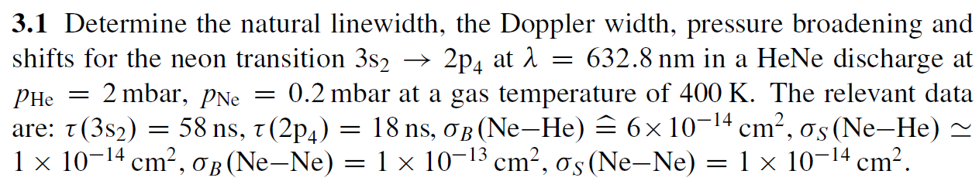
Chap. 3 Problems & Solutions

Slide 28
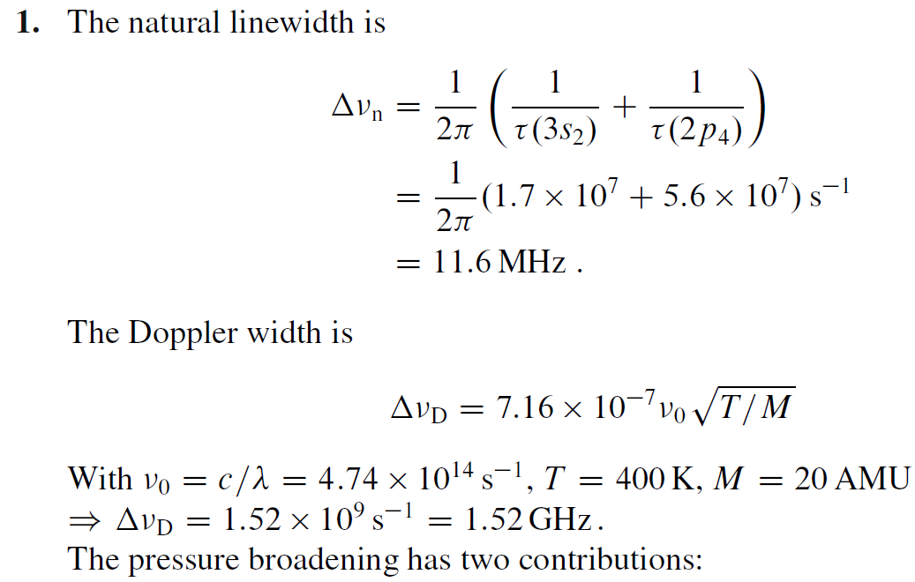
Chap. 3 Problems & Solutions

Slide 29
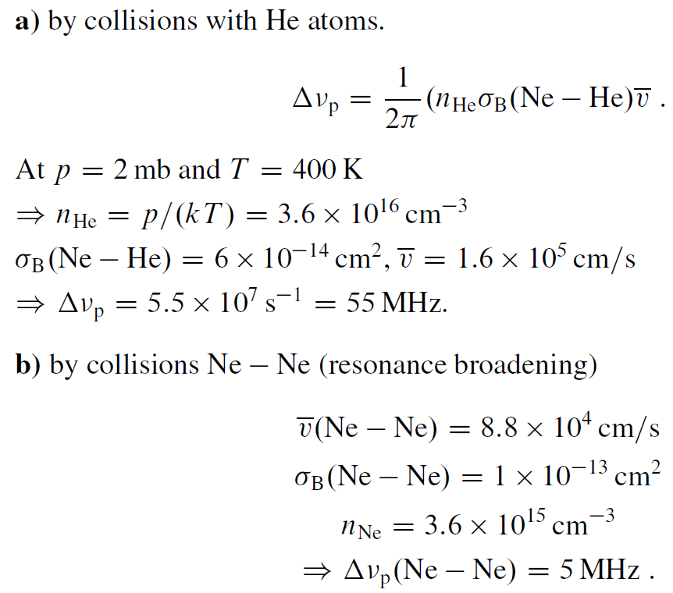
Chap. 3 Problems & Solutions

Slide 30
Chap. 3 Problems & Solutions

Slide 31
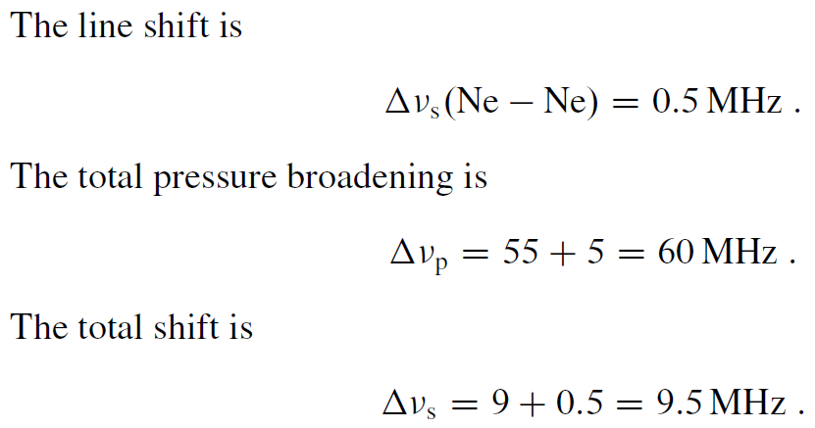
Chap. 3 Problems & Solutions

