Slide 1
Chap. 2.6 Absorption
& Dispersion

Slide 2
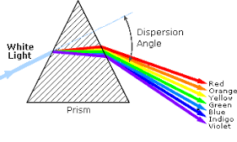
Slide 1: Absorption & Dispersion — What/Why?
Why Study These Two Phenomena?
Absorption alters light amplitude (amount of light) of an optical wave as it propagates through matter.
Dispersion alters phase velocity, changing how different frequency components separate in time and space. Think Prism: White light, which is a superposition of many colors, enters the prism, and because the refractive index (and thus phase velocity) is different for red light versus blue light, these colors travel at slightly different speeds and bend by different amounts, separating into the familiar rainbow.
For laser pulses, which are often composed of a band of frequencies, this means
the pulse can spread out or become chirped as it travels through a dispersive medium.

Slide 3
Together they determine the shape, delay, and intensity of laser pulses in gases, liquids, and solids – critical for spectroscopy, telecommunications, and laser design.
A transparent, quantitative link exists between both effects through the complex refractive index 𝑛; unveiling this link is the goal of the following derivation.
The refractive index (n) of a medium is the ratio of the speed of light in a vacuum (c) to the speed of light in that medium (v).
The formula is: n = c / v

Slide 4
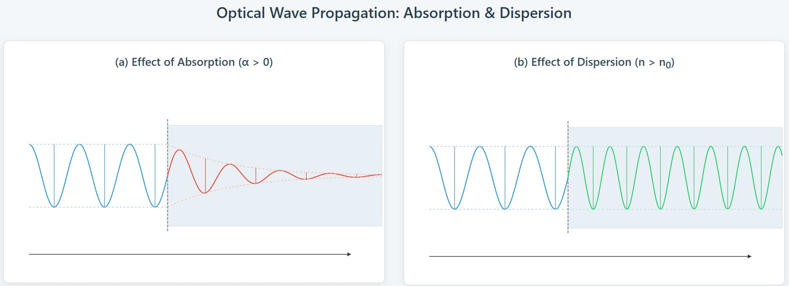
[IMAGE REQUIRED: Schematic comparing an initial monochromatic light beam entering a material and showing (a) shrinking amplitude envelope vs. distance and (b) advancing phase fronts with a changed slope illustrating reduced phase velocity.]
---
ligt
Here the velocity or phase of light wave is changed due
refractive index change of the material
Here amplitude of light wave is attenuated due to absorption

Slide 5
Introduction to Dispersion Spectroscopy
Dispersion spectroscopy is based on frequency-dependent changes in refractive index.
Unlike absorption, it measures phase shifts or refractive index variations.
Produces derivative-like signals centered on resonance.

Slide 6
General Experimental Setup
Key components:
• Tunable narrowband laser source
• Sample medium (gas cell, plasma, flame, solid)
• Interferometric or polarimetric detection
• Balanced photodetectors
• Lock-in detection with modulation

Slide 7
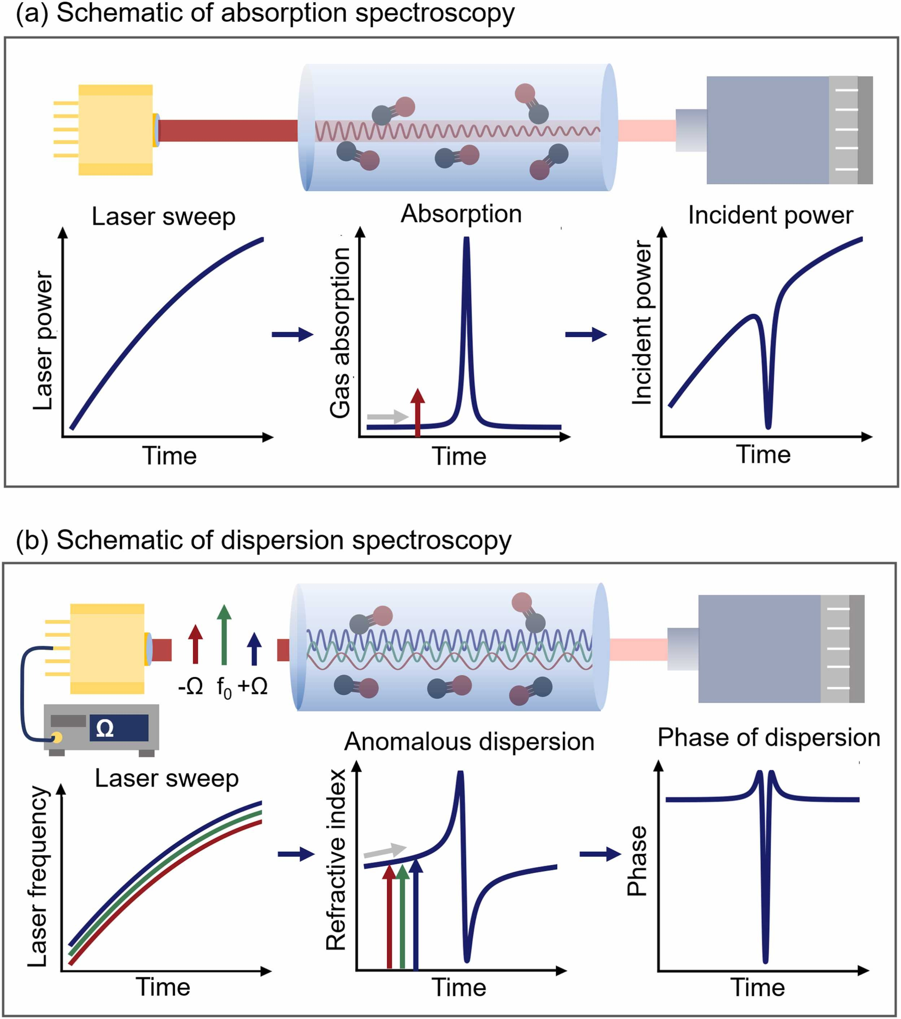
Phase dispersion is a general term for the variation of phase velocity with frequency.
Anomalous dispersion is a specific case of dispersion where the refractive index behaves unusually.
Both are described using the refractive index n(ω), which relates directly to both phase velocity and group velocity.
Anomalous dispersion occurs when the refractive index of a material decreases with increasing frequency (or decreasing wavelength) of light, which is the opposite of the usual (normal) behavior.
Normal Dispersion:
In normal dispersion, the refractive index increases with frequency. This is common in most transparent materials over most visible wavelengths.

Slide 8
Setup Schematic
Typical arrangement:
Laser → Sample cell → Interferometer/Polarizer → Detector → Lock-in Amplifier
Produces dispersion signal with zero-crossing at resonance.

Slide 9
Applications of Dispersion spectroscopy
• Environmental Monitoring
• Laser Frequency Stabilization
• Combustion and Plasma Diagnostics
• Biomedical Imaging
• Semiconductor and Material Characterization

Slide 10
Applications
Environmental : Trace Gas Detection
Detects pollutants (NO, SO₂, CH₄, CO₂) with high sensitivity.
• Important in atmospheric chemistry and industrial emissions.
• Dispersion signals are robust against broadband absorption.
Laser Frequency Stabilization
Dispersion provides a zero-crossing lock point.
• Used for stabilizing diode lasers to atomic/molecular transitions.
• Example: Rubidium and iodine frequency standards.
Combustion & Plasma Diagnostics
Measures refractive index variations in flames and plasmas.
Determines temperature, species concentration, and flow.
Used in fusion plasma density measurements.
Biomedical
Optical Coherence Tomography (OCT) uses dispersion.
Provides depth-resolved imaging in tissues.
Non-invasive diagnostic tool
Solid-State Characterization
Measures bandgap and excitonic resonances in semiconductors.
Determines refractive index dispersion.
Important for optoelectronic device design.

Slide 11
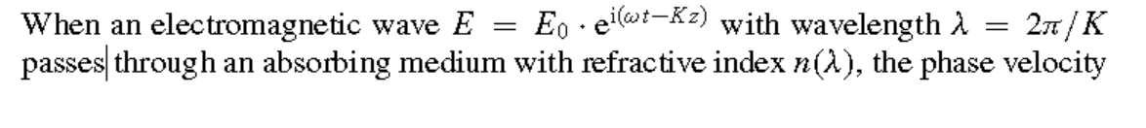
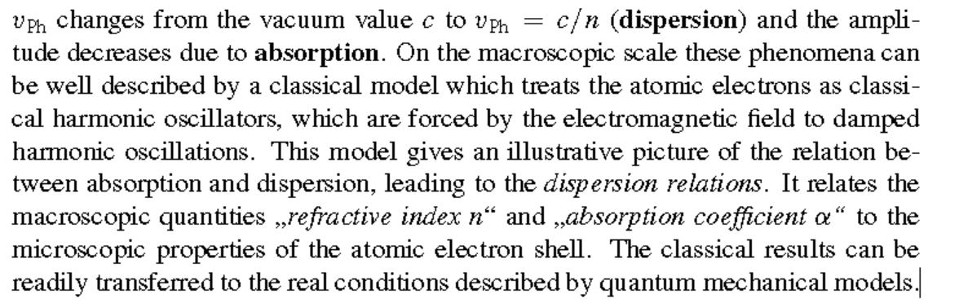
Electromagnetic Wave — interaction with matter (electrons)

Slide 12

Why Matter Primarily Responds to Electric Fields (E) and Not Magnetic Fields(H)
1. Most materials (especially dielectrics) interact with the electric field component of an EM wave more strongly than with the magnetic field.
⚡ Polarization:
The electric field exerts forces on charged particles (electrons and nuclei), causing displacement of bound charges → this creates electric dipoles.
These dipoles oscillate with the field, and this polarization is frequency-dependent, leading to dispersion.
🔍 Microscopic Picture: Electrons bound in atoms act like damped harmonic oscillators driven by 𝐸⃗(𝑡) This leads to a frequency-dependent dielectric function 𝜀(𝜔), which directly determines the refractive index 𝑛(𝜔).
🔹 2. Refractive Index Depends on 𝜀(𝜔) Not 𝜇(𝜔) (usually)
For most non-magnetic materials: The magnetic permeability 𝜇≈𝜇₀​ is nearly constant over a wide range of frequencies. But the electric permittivity 𝜀(𝜔) varies significantly with frequency — this variation is what causes dispersion. So the refractive index:
​is mainly governed by 𝜀(𝜔) which comes from the material's response to 𝐸, not 𝐻.
🔹 3. Magnetic Effects: are Weak at Optical Frequencies . The magnetic field 𝐻⃗ also interacts with matter, but this interaction is much weaker — especially at optical and higher frequencies. Most materials are non-magnetic (relative permeability 𝜇𝑟≈1) in the visible, UV, and near-IR range. So magnetic dispersion is negligible in most optical applications.

Slide 13
Electromagnetic Wave — Interaction with matter(electrons)
Linear polarization E field vector along x axis and perpendicular to Z
2𝜋 𝜔
−1
𝐾₀ = _{𝜆} = _{𝑐} : free-space wavenumber [rad m
].
0
Phase fronts advance at the vacuum phase velocity(dispersion
𝜔
8
−1
𝑣 = = 𝑐 = 2.997 924 58 × 10 m s
.
ph,vac
𝐾
0
Energy flow per unit area is given by the time-averaged Poynting vector ⟨𝐒⟩ = 1⁄2 𝜖₀𝑐𝐸₀ = Intensity Of Electric Field
𝜖₀ = permittivity = 8.85x10 ⁻¹²
factor of 1/2 arises from the time averaging of the squared sinusoidal field
2

Slide 14
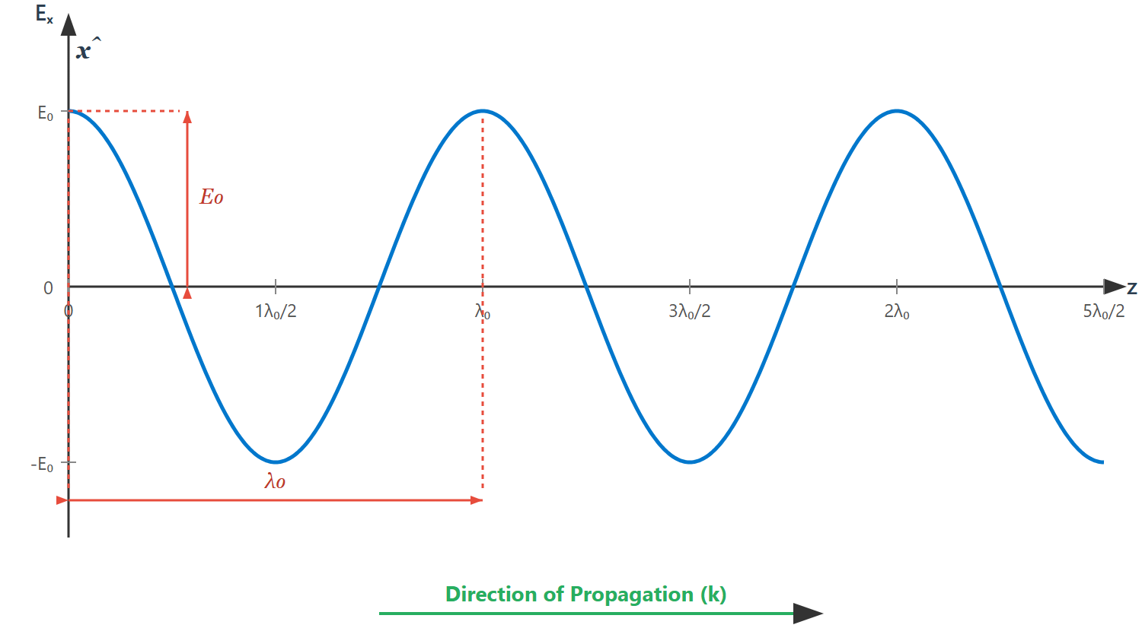
provides a visual representation of the electric field component 𝐸_{x} of our plane wave, plotted as a function of the propagation distance 𝑧, at a fixed instant in time (say, 𝑡=0).
[IMAGE REQUIRED: Plot of electric field versus 𝑧 at fixed 𝑡 showing wave crests separated by 𝜆₀.]
---
Prepared by Dist. Prof. Dr. M.A. Gondal for Phys 608 Laser Spectroscopy course in KFUPM (Term 251)

Slide 15
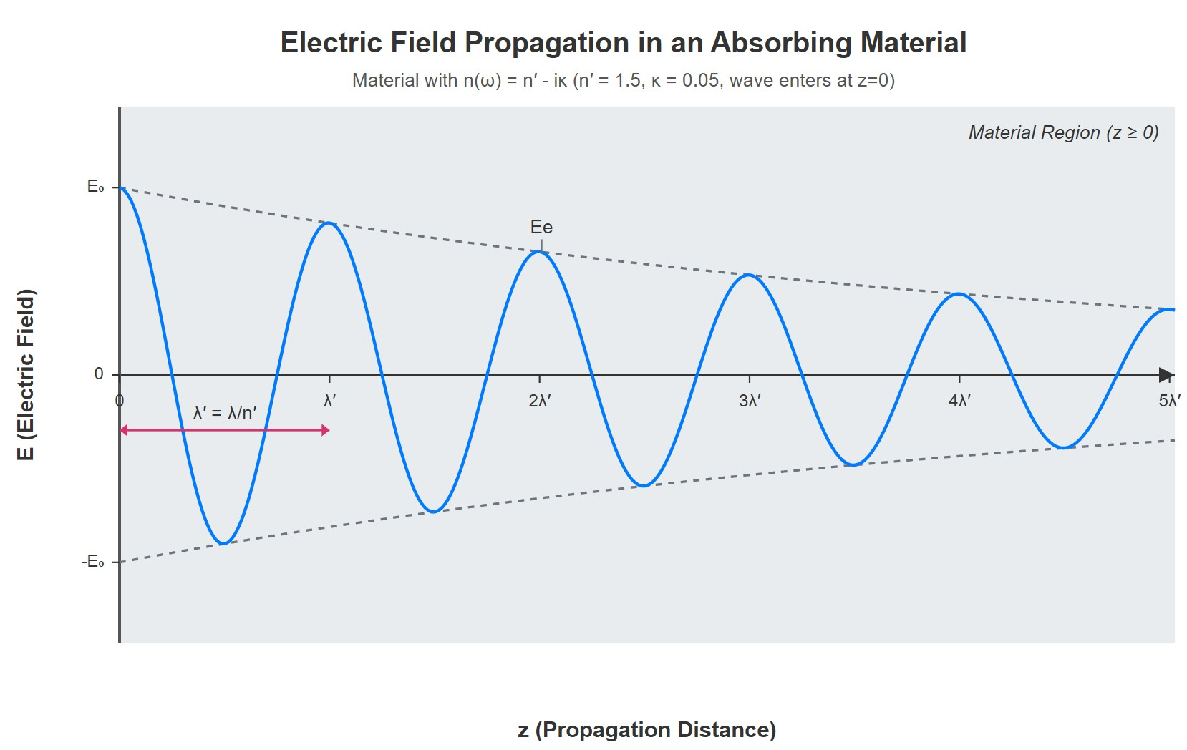
[IMAGE REQUIRED: Same wave as previous slide but inside material, showing decaying envelope and contracted wavelength 𝜆₀/𝑛′.]
this single plot effectively shows both consequences of a complex 𝑛: the amplitude decay due to 𝜅 and the wavelength (and phase velocity) change due to 𝑛′. The wave is oscillating, getting weaker as it propagates, and its spatial period is modified by the medium.
This is precisely what our equation 𝐸(𝑧,𝑡)=𝐸₀𝑒^{−𝜅𝐾0𝑧} 𝑒 ^{𝑖(𝜔𝑡−𝑛′𝐾0𝑧}
Prepared by Dist. Prof. Dr. M.A. Gondal for Phys 608 Laser Spectroscopy course in KFUPM (Term 251)
\

Slide 16
Slide 4: Microscopic Picture — Classical Electron Oscillators Model
The Foced Damped Harmonic Oscillator
𝑚 𝑥̈ (𝑡) + 𝑏 𝑥̇(𝑡) + 𝐷 𝑥(𝑡) = 𝑞 𝐸₀ 𝑒 ^{𝑖𝜔𝑡}.
𝑚𝑎 = 𝐹_{driving}−𝐹_{damping}−𝐹_{restoring} (Newtons law motion)
𝑏 𝑥̇(𝑡) represents the damping force, which is proportional to the velocity and opposes the motion. Its units would be Newton-seconds per meter or kilograms per second and _{g}
F_{restoring} = - Dx(t) (like (–kx) Hooks law in spring case)
𝐹_{driving} = 𝑞 𝐸₀ 𝑒 ^{𝑖𝜔𝑡} and ma= 𝑚 𝑥̈ (𝑡)

Slide 17
• 𝑚: electron mass 9.109 × 10⁻³¹ kg.
• 𝑏:
phenomenological damping constant
(energy
loss
due to
radiation & collisions).
2
𝐷: spring constant ⇒ 𝜔₀ = 𝐷/𝑚.
𝑞 = −𝑒: electron charge magnitude 1.602 × 10⁻¹⁹ C.
Assumptions:
Linear response (displacements 𝑥 small).
External field uniform over atomic dimension.
Damping 𝑏 independent of 𝑥.

Slide 18
Slide 5: Solving for the Steady-State Oscillation
Complex-Amplitude Ansatz (guess)
Seek a particular solution of the form
𝑥(𝑡) = 𝑥₀ 𝑒 ^{𝑖𝜔𝑡}
Substitute into the motion equation. Each time derivative multiplies
𝑥₀ by 𝑖𝜔.
𝑚(−𝜔²)𝑥₀ + 𝑏(𝑖𝜔)𝑥₀ + 𝐷 𝑥₀ = 𝑞𝐸₀.

Slide 19
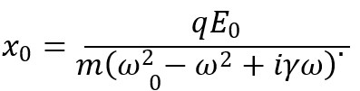
Rearrange and isolate 𝑥₀. Introduce convenient parameters
𝑏
𝑚
𝐷
𝑚
𝛾 ≡
,
2
𝜔₀ ≡
.
Obtain
Physical interpretation: Here the complex amplitude 𝑥₀ of the electron's oscillation in terms of the driving field amplitude 𝐸₀, the electron's charge 𝑞 and mass 𝑚, driving frequency 𝜔, the natural resonant frequency 𝜔₀, and the damping rate 𝛾.
Denominator magnitude minimum when 𝜔 ≈ 𝜔₀ ⇒ at resonance.
the denominator's magnitude is at a minimum, the magnitude of 𝑥₀ (the amplitude of oscillation) will be at a maximum. This phenomenon is called resonance
Imaginary term 𝑖𝛾𝜔 introduces phase lag and energy dissipation. There will be a phase difference, or phase lag (or lead, depending on the sign of 𝜔₀²−𝜔²), between the driving force and the electron's response. This phase lag is frequency-dependent and is largest near resonance. If you plot the phase of 𝑥₀ versus 𝜔, you'll see it change significantly around 𝜔₀.

Slide 20
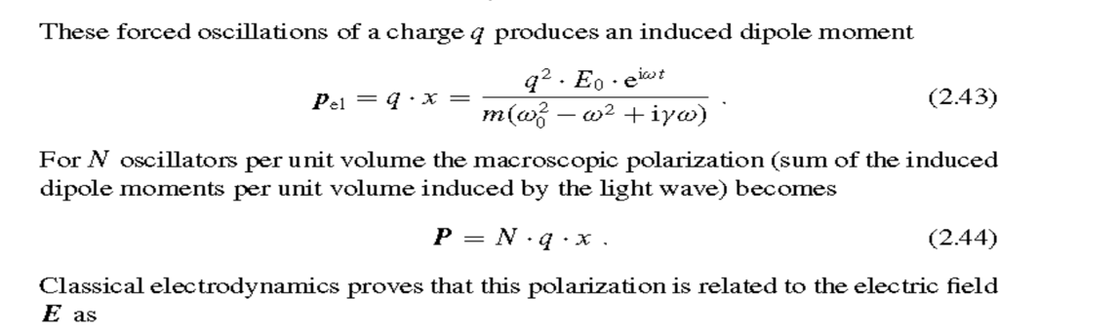
Elctric Dipole Moment and Polarization

Slide 21
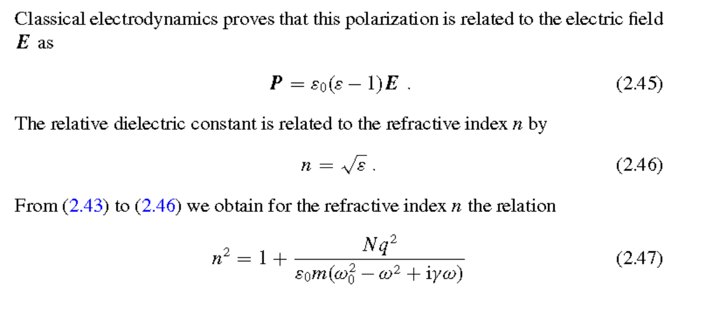

Slide 22
Slide 3: Entering a Material — New Macroscopic
Parameters to understand absorption and Dispersion
Definition of the Complex Refractive Index
Inside matter the wave number changes to
𝐾 = 𝑛 𝐾₀ ^{where K}₀ ^{= free space wavenumber for n}₀
Refractive index (n) is, in general, frequency dependent and complex:
𝑛(𝜔) = 𝑛′(𝜔) − 𝑖 𝜅(𝜔)
𝐾=𝑛𝐾₀=(𝑛′−𝑖𝜅)𝐾₀
𝜅(𝜔) (kappa of omega): This is the imaginary part of the complex refractive index, also known as the extinction coefficient or attenuation index. As we will see, this part is responsible for the absorption of light in the medium.

Slide 23
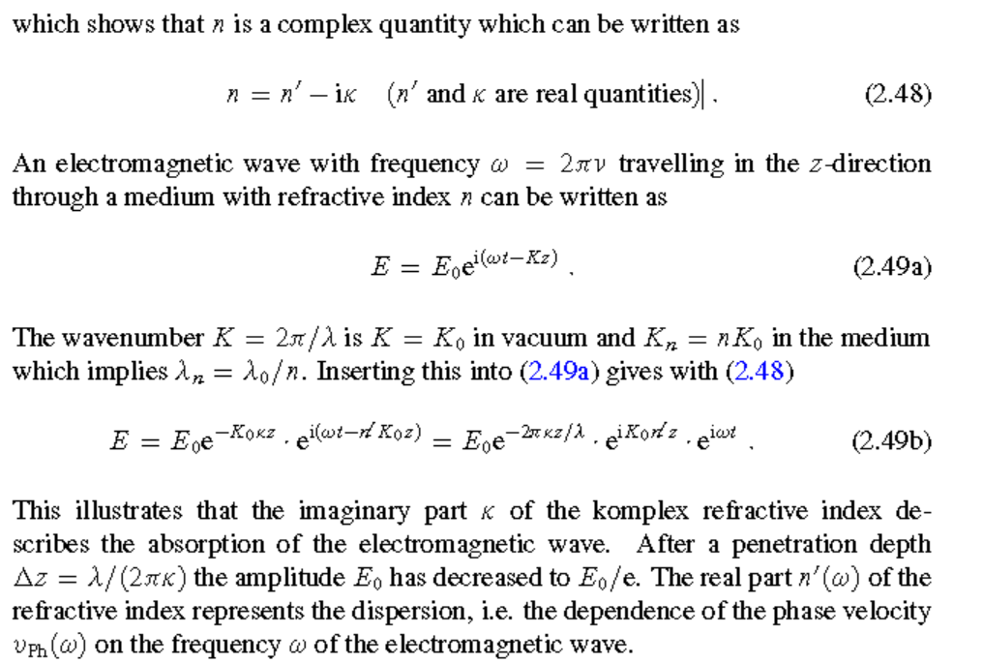

Slide 24
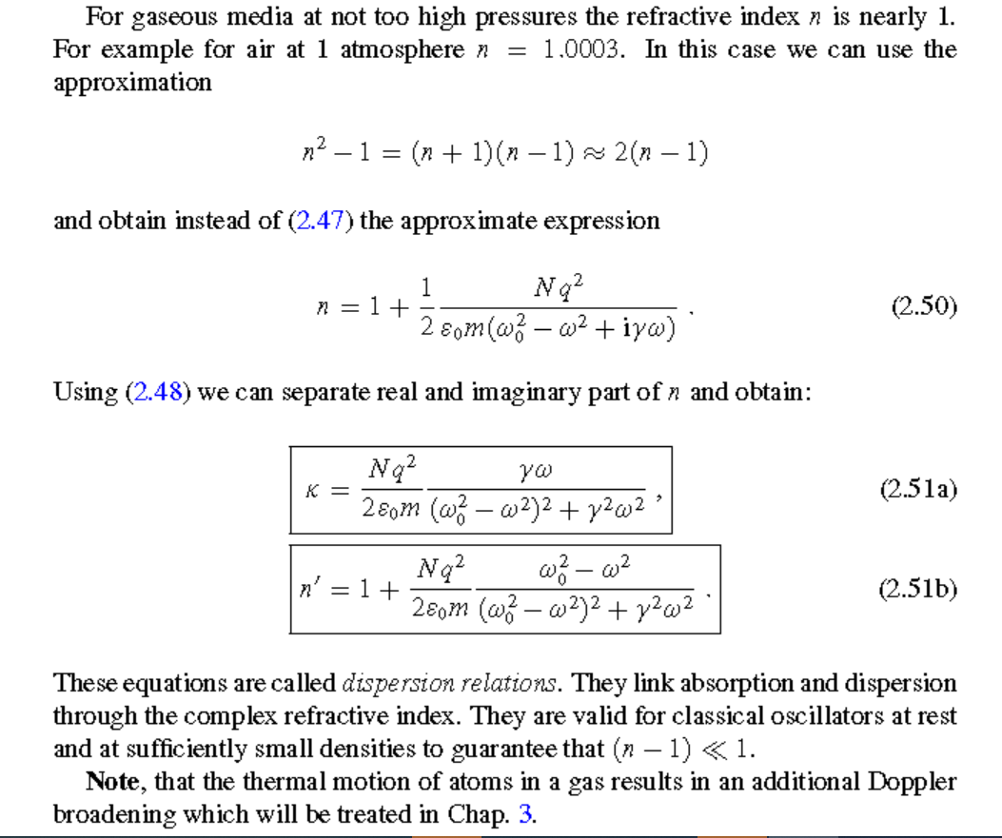
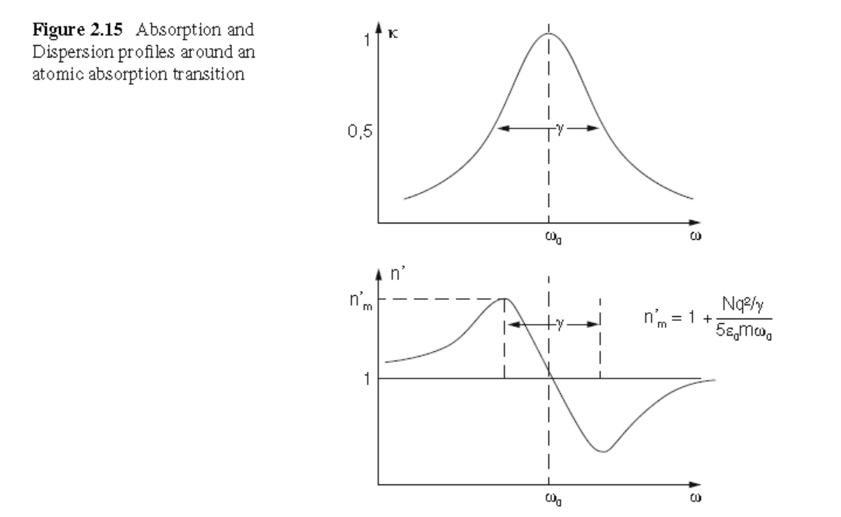
Here γ is the Full Width at Half Maximum(FWHM)

Slide 25
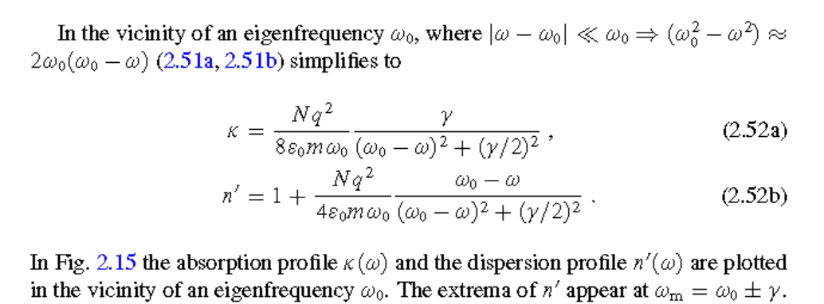

Slide 26
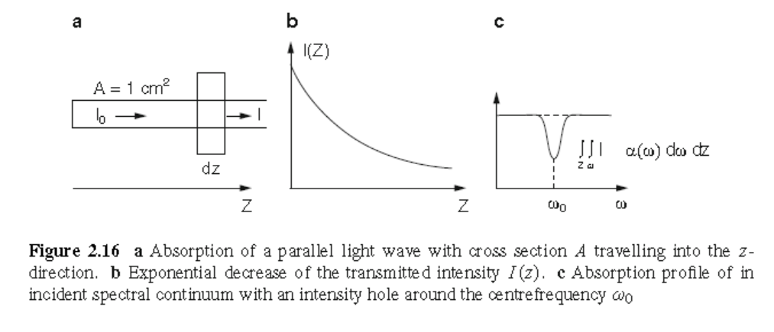
Absorption and Kappa Relationship

Slide 27
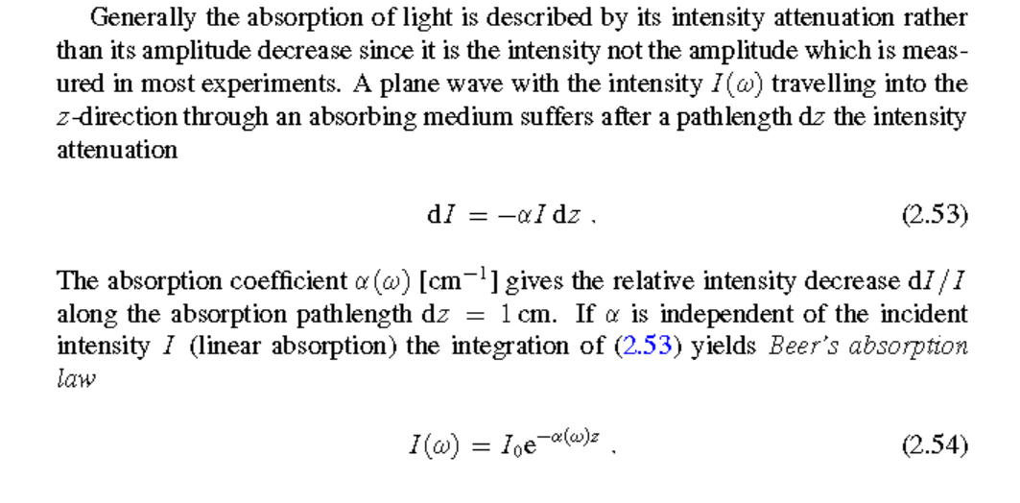
Absorption and Kappa Relationship

Slide 28
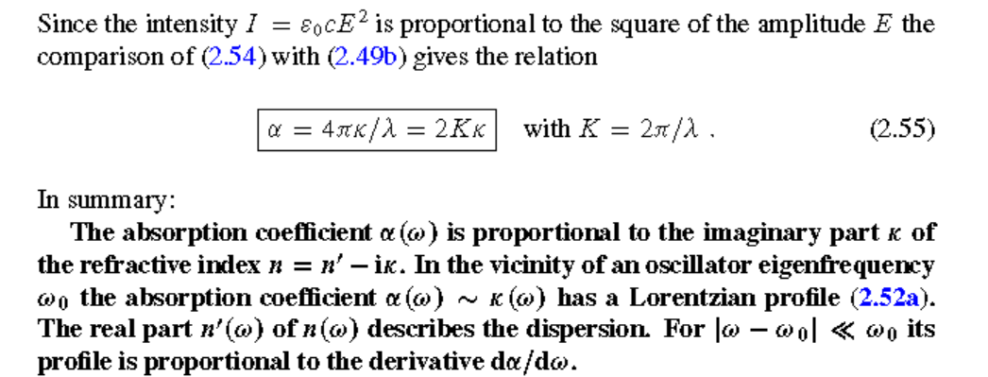
Absoption and Kapa Relationship

Slide 29
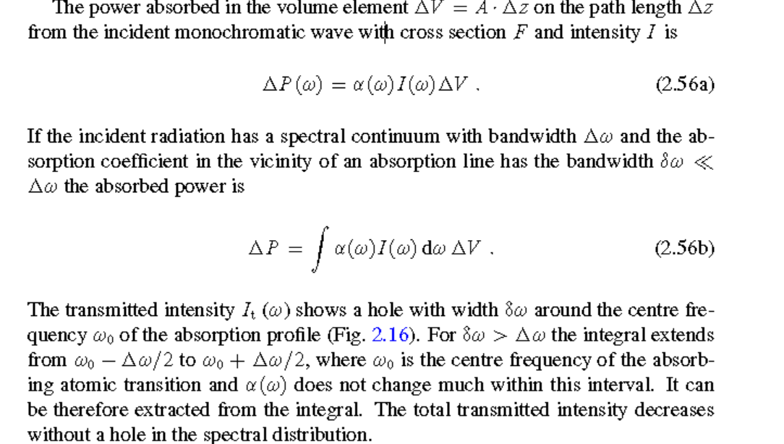
Absorbed Power

Slide 30
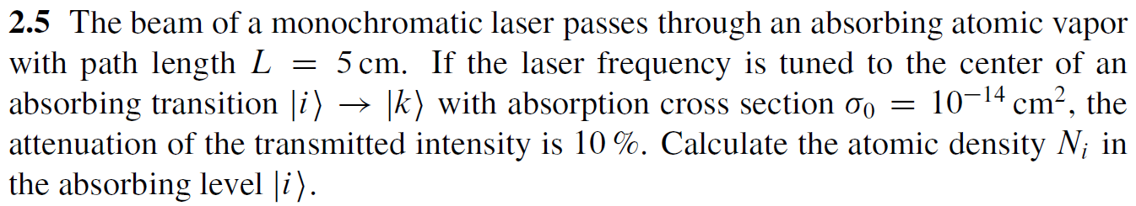
Chap. 2 Problems & Solutions

Slide 31
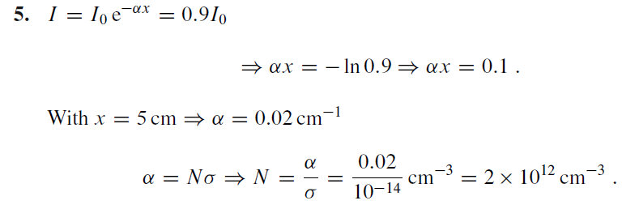
Chap. 2 Problems & Solutions

Slide 32
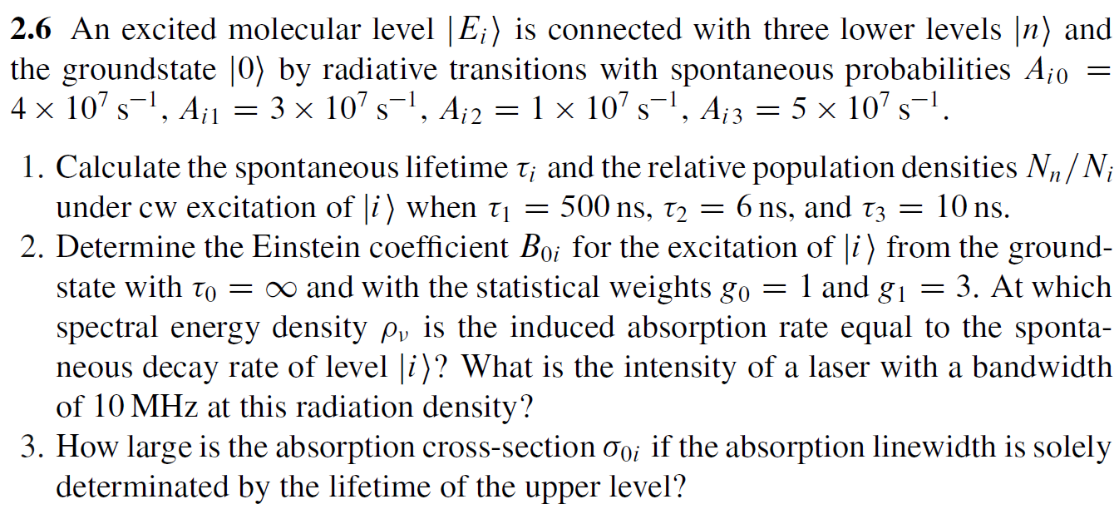
Chap. 2 Problems & Solutions

Slide 33
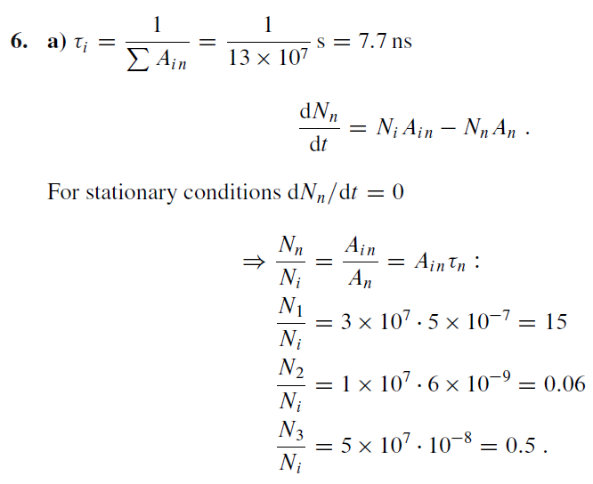
Chap. 2 Problems & Solutions

Slide 34
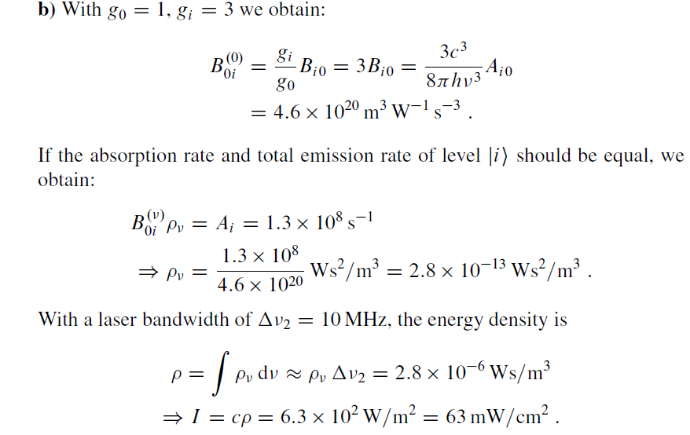
Chap. 2 Problems & Solutions

Slide 35
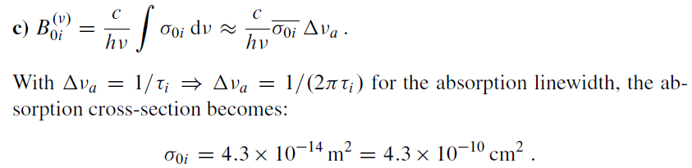
Chap. 2 Problems & Solutions

Slide 36
Why Matter Primarily Responds to Electric Fields (E) and Not Magnetic Fields(H)
1. Most materials (especially dielectrics) interact with the electric field component of an EM wave more strongly than with the magnetic field.
⚡ Polarization:
The electric field exerts forces on charged particles (electrons and nuclei), causing displacement of bound charges → this creates electric dipoles.
These dipoles oscillate with the field, and this polarization is frequency-dependent, leading to dispersion.
🔍 Microscopic Picture: Electrons bound in atoms act like damped harmonic oscillators driven by 𝐸⃗(𝑡)E(t).This leads to a frequency-dependent dielectric function 𝜀(𝜔)ε(ω), which directly determines the refractive index 𝑛(𝜔)n(ω).
🔹 2. Refractive Index Depends on 𝜀(𝜔) Not 𝜇(𝜔) (usually)
For most non-magnetic materials: The magnetic permeability 𝜇≈𝜇₀​ is nearly constant over a wide range of frequencies. But the electric permittivity 𝜀(𝜔)ε varies significantly with frequency — this variation is what causes dispersion. So the refractive index:
​is mainly governed by 𝜀(𝜔) which comes from the material's response to 𝐸⃗E, not 𝐻⃗H.
🔹 3. Magnetic Effects: are Weak at Optical Frequencies . The magnetic field 𝐻⃗ also interacts with matter, but this interaction is much weaker — especially at optical and higher frequencies. Most materials are non-magnetic (relative permeability 𝜇𝑟≈1μr ​≈1) in the visible, UV, and near-IR range. So magnetic dispersion is negligible in most optical applications.

Slide 37
Slide 3: Entering a Material — New Macroscopic
Parameters to understand absorption and Dispersion
Definition of the Complex Refractive Index
Inside matter the wave number changes to
𝐾 = 𝑛 𝐾₀ ^{where K}₀ ^{= free space wavenumber for n}₀
Refractive index (n) is, in general, frequency dependent and complex:
𝑛(𝜔) = 𝑛′(𝜔) − 𝑖 𝜅(𝜔)
𝐾=𝑛𝐾₀=(𝑛′−𝑖𝜅)𝐾₀
𝜅(𝜔) (kappa of omega): This is the imaginary part of the complex refractive index, also known as the extinction coefficient or attenuation index. As we will see, this part is responsible for the absorption of light in the medium.

Slide 38
𝑛′ (real part) governs phase propagation ⇒ dispersion.
𝜅 (imaginary part) governs exponential attenuation ⇒ absorption.
The field now reads
_{𝐄(𝑧, 𝑡) = 𝐸0 𝑒}−𝜅𝐾₀𝑧 _{𝑒} 𝑖(𝜔𝑡−𝑛′𝐾₀𝑧) _{𝐱̂.}
• Intensity decays as 𝐼(𝑧) = 𝐼₀ 𝑒^{−2𝜅𝐾0𝑧}. (Bear Lambert law)
Two distinct effects due to the material:
𝑒^{−𝜅𝐾0 𝑧}: This is a real exponential decay factor. Since 𝜅, 𝐾₀, and 𝑧 are positive for a forward-propagating wave in an absorbing medium, this term causes the amplitude of the wave 𝐸₀ to decrease exponentially as it travels deeper into the material (increasing 𝑧). This is the mathematical description of absorption.
𝑒 ^{𝑖(𝜔𝑡−𝑛′𝐾0 𝑧):} This is the oscillatory part. Notice that the wavenumber in the phase is now 𝑛′𝐾₀, not just 𝐾₀. This means the wavelength inside the medium is 𝜆₀ / 𝑛′, and the phase velocity is 𝑐/𝑛′.
This term describes the phase evolution and is responsible for Dispersion if 𝑛′ varies with 𝜔.

Slide 39
Slide 5: Solving for the Steady-State Oscillation
Complex-Amplitude Ansatz (guess)
Seek a particular solution of the form
𝑥(𝑡) = 𝑥₀ 𝑒 ^{𝑖𝜔𝑡}
Substitute into the motion equation. Each time derivative multiplies
𝑥₀ by 𝑖𝜔.
𝑚(−𝜔²)𝑥₀ + 𝑏(𝑖𝜔)𝑥₀ + 𝐷 𝑥₀ = 𝑞𝐸₀.

Slide 40
More Explanation
The damped harmonic oscillator equation for an atom subjected to an oscillatory electric field is a second-order differential equation.
It describes the motion of an electron bound to an atom, where the restoring force is modeled as a spring force, and damping arises
from energy dissipation, such as radiation damping.
The equation is: m(d²x/dt²) + b(dx/dt) + Dx = eE₀cos(ωt)
where:
m: is the mass of the electron.
x: is the displacement of the electron from its equilibrium position.
b: is the damping coefficient, related to the rate of energy dissipation.
D: is the spring constant, related to the restoring force.
e: is the elementary charge of the electron.
E₀: is the amplitude of the electric field.
ω: is the angular frequency of the electric field.
This equation represents the damped harmonic oscillator driven by an external force (the oscillatory electric field).
The term `m(d²x/dt²) ` represents the electron's acceleration, b(dx/dt) represents the damping force, kx represents the restoring force,
and eE₀cos(ωt) is the driving force due to the electric field. The solution to this equation will describe the oscillatory motion
of the electron, including the effects of damping and the driving force.

Slide 41
• 𝑚: electron mass 9.109 × 10⁻³¹ kg.
• 𝑏:
phenomenological damping constant
(energy
loss
due to
radiation & collisions).
2
𝐷: spring constant ⇒ 𝜔₀ = 𝐷/𝑚.
𝑞 = −𝑒: electron charge magnitude 1.602 × 10⁻¹⁹ C.
Assumptions:
Linear response (displacements 𝑥 small).
External field uniform over atomic dimension.
Damping 𝑏 independent of 𝑥.

Slide 42
Slide 6: From Single Electron to Macroscopic Polarization
Building the Polarization Vector 𝐏
Instantaneous dipole moment for one oscillator(electron)
𝑝_{el}(𝑡) = 𝑞 𝑥(𝑡) = 𝑞 𝑥₀ 𝑒 ^{𝑖𝜔𝑡}
Number density of identical oscillators: 𝑁 [m⁻³]
Macroscopic polarization (dipole moment per unit volume):
𝐏(𝑡) = 𝑁 𝑞 𝑥₀ 𝑒 ^{𝑖𝜔𝑡} 𝐱̂.
Pls note that here macroscopic P(t) is arising due to microscopic model

Slide 43
Linear-response definition links 𝐏 to the field:
𝐏 = 𝜖₀ 𝜒(𝜔) 𝐄
𝜒(𝜔) = 𝜀_{𝑟} − 1: electric susceptibility.
Electric susceptibility χ_{e} is a measure of how much a material becomes polarized in response to an applied electric field 𝐄
𝜀_{𝑟} = 𝜀/𝜖₀: relative dielectric constant.
Recall relation between refractive index and dielectric constant (in non-magnetic media, 𝝁_{𝑟} ≈ 1):
𝑛²(𝜔) = 𝜀_{𝑟}(𝜔) = 1 + 𝜒(𝜔).
---

Slide 44
Slide 7: Deriving the Complex Refractive Index
Algebraic Connection to Oscillator Parameters
Combine previous expressions, substitute 𝐏 and 𝑥₀.
2
𝑁𝑞
𝑛²(𝜔) = 1 +
.
2
𝜖₀𝑚(𝜔₀ − 𝜔² + 𝑖𝛾𝜔)
It's a monumental result! It gives us the square of the complex refractive index, 𝑛², directly in terms of: “ 𝑁:”number density of oscillators * 𝑞: charge of the electron * 𝜀₀: permittivity of free space * 𝑚: mass of the electron * 𝜔₀: natural resonant frequency of the oscillators * 𝜔: frequency of the incident light * 𝛾: damping rate of the oscillators
Note the complex denominator → 𝑛 is complex. Explicitly write
𝑛(𝜔) = 𝑛′(𝜔) − 𝑖 𝜅(𝜔).
Complex Refractive Index: 𝑛(𝜔)=𝑛′(𝜔)−𝑖𝜅(𝜔) plotted in the complex plane.

Slide 45
Important observation:
Real part 𝑛′ ↔ even function of 𝜔 − 𝜔₀.
describes the symmetry of the dispersive part of the refractive index around the resonance
Imaginary strength.
part 𝜅
↔ odd around 𝜔₀
and controls absorption

Slide 46

Slide 8: Wave Propagation with a Complex 𝒏
Separating Phase and Amplitude Evolution
Write the field again emphasizing individual factors:
𝐄(𝑧, 𝑡) = 𝐸₀ 𝑒^{−𝜅𝐾0𝑧} exp[𝑖(𝜔𝑡 − 𝑛′𝐾₀𝑧)]𝐱̂.
𝑒^{−𝜅𝐾0𝑧}: is the amplitude attenuation factor.
exp[𝑖(𝜔𝑡−𝑛′𝐾0𝑧)]: is the phase evolution factor.
Phase velocity inside the medium
Always 𝑛′≥1 and 𝜅≥0 (kappa is greater than or equal to 0) for absorption (not gain).

Slide 47
Intensity attenuation length 𝐿_{1/𝑒} defined at z= 𝐿_{1/𝑒} where
𝐸₀
1
𝜆₀
𝐸(𝑧 = 𝐿_{1/𝑒}) = _{𝑒}
⇒ 𝐿 =
= .
𝜅𝐾 2𝜋𝜅
1/𝑒
0
Power loss is intrinsically tied to the same microscopic parameters that set dispersion; this reciprocity becomes clearer on next slides.
---

Slide 48
Slide 9: Simplification for Dilute Gases ( 𝒏 − 𝟏 ≪ 𝟏 )
Linearizing 𝒏^{𝟐} around Unity
For most gases at low pressure, 𝑛′ ≈ 1.000 − 1.005.
Expand
𝑛² − 1 = (𝑛 + 1)(𝑛 − 1) ≈ 2(𝑛 − 1)
since 𝑛 ≃ 1.
Drop terms of order (𝑛 − 1)². The refractive index becomes

Slide 49
1
𝑁𝑞²
𝑛(𝜔) = 1 +
.
2
2𝜖₀𝑚 𝜔₀ − 𝜔² + 𝑖𝛾𝜔
Advantage:
multiplying numerator and
real and imaginary
parts
now follow
directly by
denominator
with
the complex
conjugate of the denominator.
---

Slide 50
Slide 10: Explicit Expressions — Dispersion Relations
Isolating 𝜿(𝝎) and 𝒏′(𝝎)
2 2
Multiply by the complex conjugate 𝜔₀ − 𝜔 − 𝑖𝛾𝜔 in numerator &
denominator.
𝑁𝑞²
𝛾𝜔
𝜅(𝜔) =
.
2
2𝜖₀𝑚 (𝜔₀ − 𝜔²)² + 𝛾²𝜔²
𝑁𝑞²
_{𝜔}2
𝑛′(𝜔) = 1 +
.
2
2𝜖₀𝑚 (𝜔₀ − 𝜔²)² + 𝛾²𝜔²

Slide 51
These two coupled formulas are called the (classical) dispersion relations.
Key insight: same denominator ⇒ absorption peak and dispersion inflection share identical spectral width 𝛾.

Slide 52
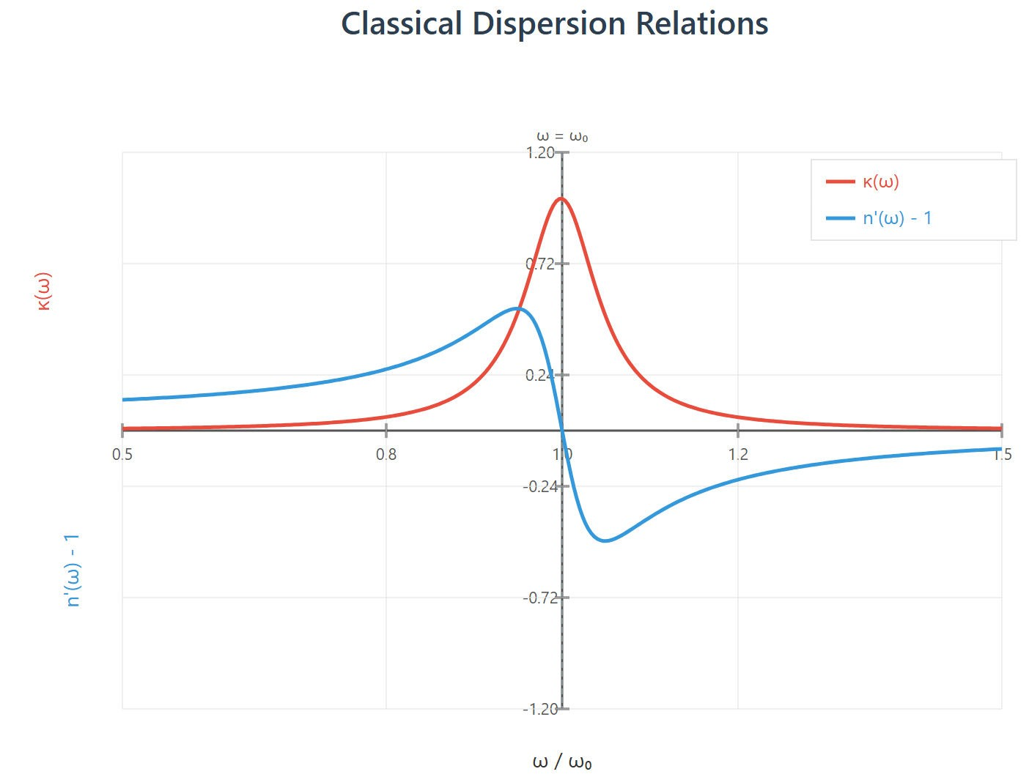
MAGE REQUIRED: Overlaid plots of 𝜅(𝜔) and 𝑛′(𝜔) vs. 𝜔 illustrating peak and dispersive S-shape.]
--
repared by Dist. Prof. Dr. M.A. Gondal for Phys 608 Laser Spectroscopy course in KFUPM (Term
[I
-
P
251)

Slide 53
Slide 11: Near-Resonance Approximation |𝝎 − 𝝎_{𝟎}| ≪ 𝝎_{𝟎}
Lorentzian Absorption and Derivative-Like Dispersion
2 2
• Expand 𝜔₀ − 𝜔 ≈ 2𝜔₀(𝜔₀ − 𝜔).
Insert into previous relations; obtain compact Lorentzian forms
𝑁𝑞²
𝛾
𝜅(𝜔) =
.
8𝜖₀𝑚𝜔₀ (𝜔 − 𝜔₀)² + (𝛾⁄2)²
𝑁𝑞² 𝜔 − 𝜔₀
𝑛′(𝜔) = 1 +
.
4𝜖₀𝑚𝜔₀ (𝜔 − 𝜔₀)² + (𝛾⁄2)²

Slide 54
Observations:
𝜅(𝜔) is symmetric, peaks at 𝜔₀.
𝑛′(𝜔) is antisymmetric, crosses 𝑛′ = 1 at 𝜔₀.
Extremal dispersion slopes at 𝜔_{𝑚} = 𝜔₀ ± 𝛾/2.
---

Slide 55
Slide 12: Connecting Absorption Coefficient 𝜶 to 𝜿
Intensity Versus Field Amplitude
Time-averaged intensity for a plane wave
1
2
𝐼 =
𝜖₀𝑐 |𝐸|².
Propagating field contains factor 𝑒^{−2𝜅𝐾0𝑧}
amplitude).
Define absorption coefficient 𝛼 [m⁻¹]:
for intensity (square of

Slide 56
𝑑𝐼
= −𝛼 𝐼
⇒ 𝐼(𝑧) = 𝐼₀ 𝑒^{−𝛼𝑧}.
𝑑𝑧
Direct comparison yields
4𝜋
𝛼(𝜔) = 2 𝐾₀ 𝜅(𝜔) = _{𝜆} 𝜅(𝜔).
0
Therefore 𝛼(𝜔) inherits the Lorentzian profile of 𝜅(𝜔).
---

Slide 57
Slide 13: Beer–Lambert Law — Practical Measurement
Implementing 𝜶 in Experiments
Given a sample length 𝐿:
^{𝐼}trans^{(𝜔) = 𝐼}inc^{(𝜔) 𝑒−𝛼(𝜔)𝐿.}
Taking natural logarithm gives linear relation for data fitting:
ln[𝐼_{inc}⁄𝐼_{trans}] = 𝛼(𝜔)𝐿.
Advantages:

Slide 58
Directly extract 𝛼(𝜔) from slope.
Works for broadband or tunable-laser measurements.
Limitation: assumes linear absorption ⇒ valid only at low intensities (no saturation).
---

Slide 59
Slide 14: Power Absorbed in a Finite Volume Element
From Coefficient to Energy Dissipation
Consider small slab 𝛥𝑧 of cross-section area 𝐴 (volume 𝛥𝑉 = 𝐴 𝛥𝑧).
Power removed from the beam within 𝛥𝑉:
𝛥𝑃(𝜔) = 𝛼(𝜔) 𝐼(𝜔) 𝛥𝑉.
For a broadband continuum 𝐼(𝜔) and a narrow atomic line 𝛼(𝜔):

Slide 60
∞
𝛥𝑃 = (∫ 𝛼 (𝜔) 𝐼(𝜔) 𝑑𝜔) 𝛥𝑉.
−∞
If 𝐼(𝜔) varies slowly across the line, treat it as constant and pull outside integral.
Applications: quantify heat load in gas cells, determine oscillator strengths.
---

Slide 61
Slide 15: Spectral “Hole” Burning Illustration
What Happens to the Transmitted Spectrum?
Narrow absorption line (𝛿𝜔) imprints a dip in an otherwise flat input continuum.
Depth and width of the “hole” directly reflect 𝛼(𝜔).
For extremely wide continuum (𝛥𝜔 ≫ 𝛿𝜔) total transmitted power hardly changes, but spectral shape is modified.

Slide 62
Conversely, if 𝛿𝜔 ≫ 𝛥𝜔 the continuum is uniformly attenuated—no visible hole.
Next 3 Slides – 3 plots:
input flat spectrum,
output with narrow hole,
output when continuum narrower than absorption line showing uniform attenuation.

Slide 63
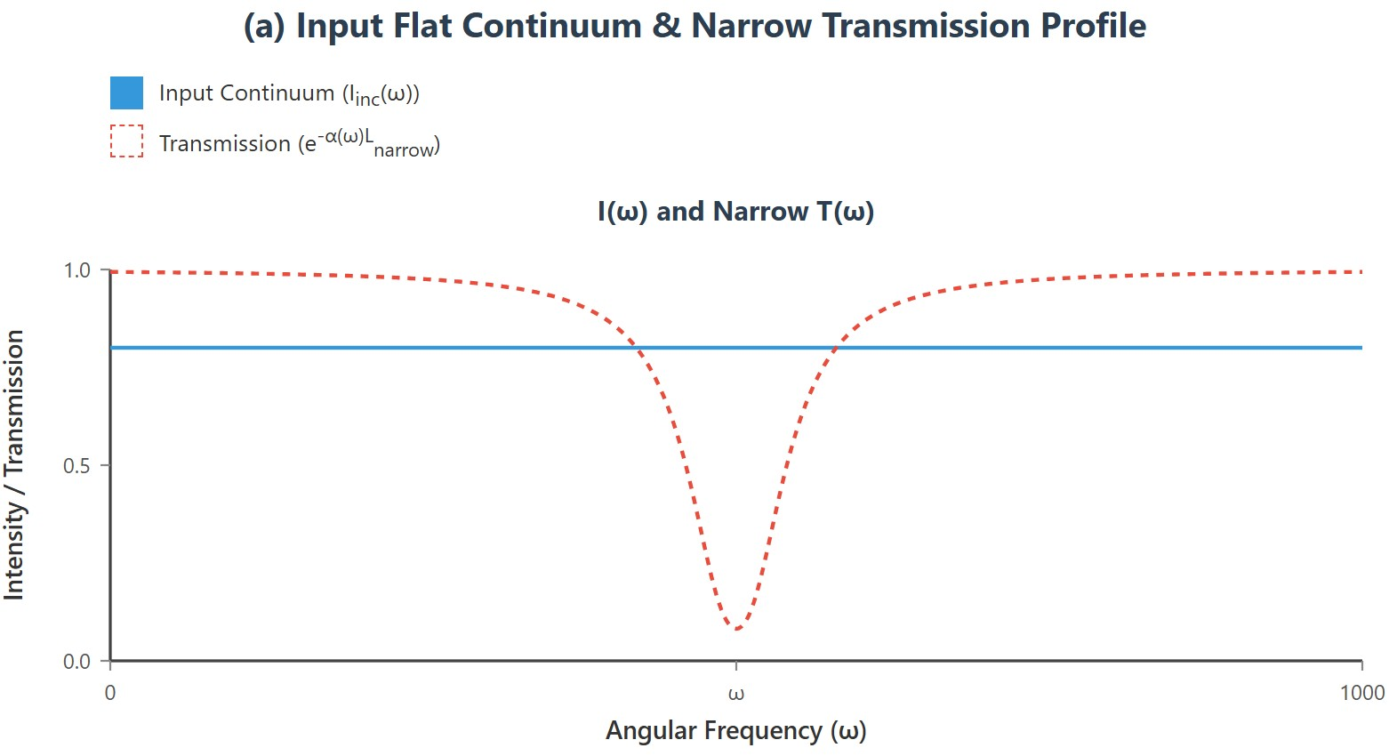
[IMAGE REQUIRED: Three plots: (a) input flat spectrum, (b) output with narrow hole, (c) output when continuum narrower than absorption line showing uniform attenuation.]
---
Prepared by Dist. Prof. Dr. M.A. Gondal for Phys 608 Laser Spectroscopy course in KFUPM (Term 251)

Slide 64
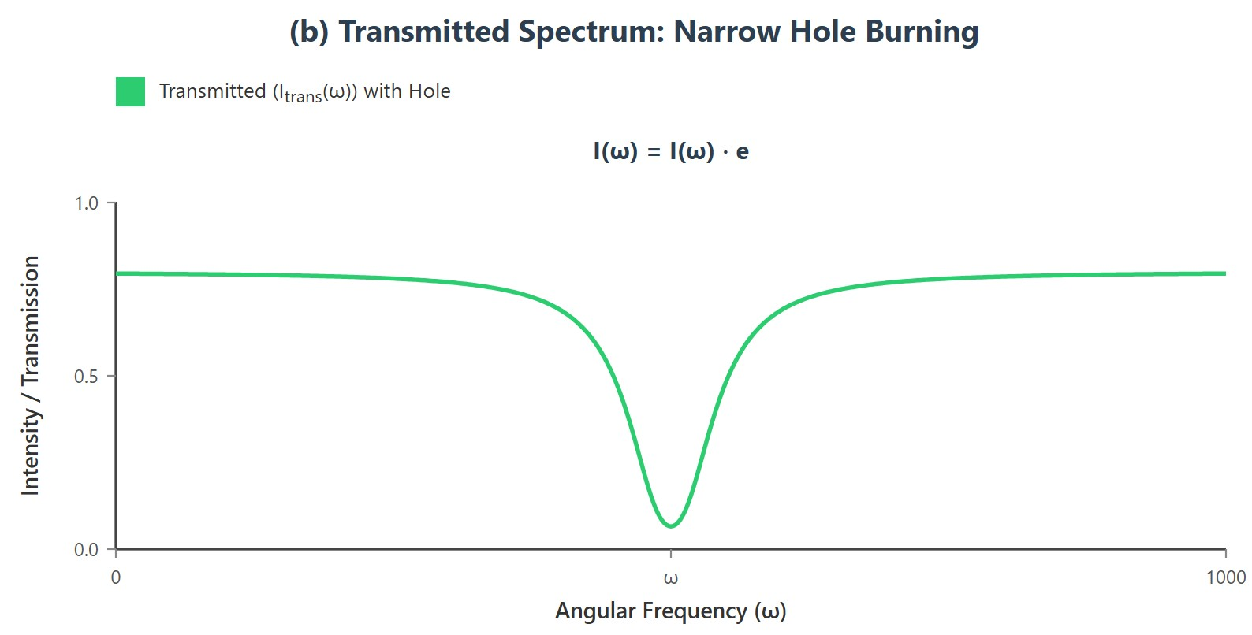
Prepared by Dist. Prof. Dr. M.A. Gondal for Phys 608 Laser Spectroscopy course in KFUPM (Term 251)

Slide 65
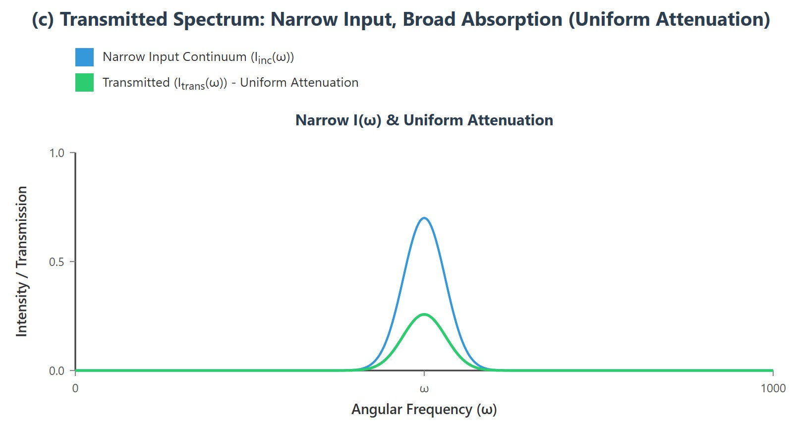
Prepared by Dist. Prof. Dr. M.A. Gondal for Phys 608 Laser Spectroscopy course in KFUPM (Term 251)

Slide 66
Slide 16: Physical Origin of Damping Constant 𝜸
Where Does the Energy Go?
Radiative
damping: oscillating charge re-emits electromagnetic
radiation; classical Larmor formula predicts
2
𝑒²𝜔₀
^{𝛾}rad ⁼
.
6𝜋𝜖 𝑚𝑐
3
0
Collisional damping: in gases, electron momentum transferred to neighboring atoms/molecules during collisions.

Slide 67
Intrinsic (natural) linewidth in quantum picture relates to excited- state lifetime 𝜏: 𝛾 = 1/𝜏.
In condensed matter, additional damping from phonon coupling, inhomogeneous broadening, impurity scattering.
---

Slide 68
Slide 17: Limitations of the Classical Oscillator Model
When and Why Does It Fail?
Cannot predict discrete allowed transition frequencies; 𝜔₀ must be inserted from experiment or quantum theory.
Ignores
Doppler broadening due to thermal motion (Gaussian
convolution of the Lorentzian profile).
Neglects saturation and stimulated emission at high laser intensities (non-linear optics).

Slide 69
Does not account for selection rules, polarization dependence, or multi-level interference effects.
---

Slide 70
Slide 18: Road Map Beyond — Toward Quantum
Dispersion Theory
Preparing for Chapter 3 and Beyond
Replace classical oscillator with quantum two-level system; derive susceptibility via density-matrix formalism.
Introduce Doppler effect and Voigt profile for gaseous absorbers.
Examine Kramers–Kronig relations, rigorously connecting 𝑛′(𝜔) and
𝜅(𝜔) through causality.

Slide 71
Explore
non-linear extensions: saturation
spectroscopy,
electromagnetically induced transparency, slow light.
---
---

Slide 72
Chap. 2 Problems & Solutions

Slide 73
Chap. 2 Problems & Solutions

Slide 74
Chap. 2 Problems & Solutions

Slide 75
Chap. 2 Problems & Solutions

Slide 76
Chap. 2 Problems & Solutions

Slide 77
Chap. 2 Problems & Solutions

