Slide 1
Chapter 18
Temperature, Heat and First law of thermodynamics

Slide 2
Lecture 01

Slide 3
Zeroth Law of thermodynamics
Heat flows from hot body to cold body until both bodies acquire the thermal equilibrium
A
B
A
B
Heat
Hot
Cold
Thermal Equilibrium
Temperature: It is a physical quantity that measures the direction of heat flow.
Direction of heat flow is from higher temperature to lower temperature. Body with thermal equilibrium are at same temperature.
A
B
If bodies:
A and B are in thermal equilibrium
and
B and C are in thermal equilibrium
then
A and C must be in thermal equilibrium
Thermal Equilibrium
B
C
Thermal Equilibrium
A
C
This is zeroth law of thermodynamics
Thermal Equilibrium

Slide 4
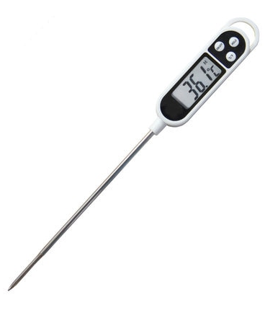
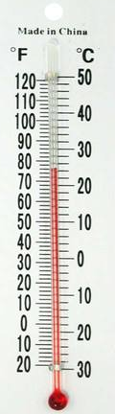
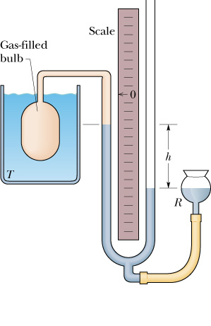
Temperature Sensor
Temperature can be sensed by:
Expansion of solid,
Expansion of liquid
Expansion of gas
Increase in resistance
A
Gas thermometer
Electrical Resistance thermometer
Liquid thermometer

Slide 5
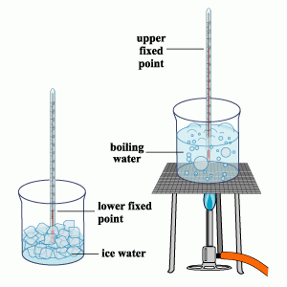
Scale of temperature
Scientifically is measured in K (Kelvin) scale.
But before Kelvin two more popular scales were used, which are still common in our day to day life. They are:
Degree Celsius (⁰C) and Degree Fahrenheit (⁰F) .
Degree Celsius (⁰C) and Degree Fahrenheit (⁰F) are based in freezing and boiling point of water
USA and UK ------- ⁰F
Rest of the world ------ ⁰C

Slide 6
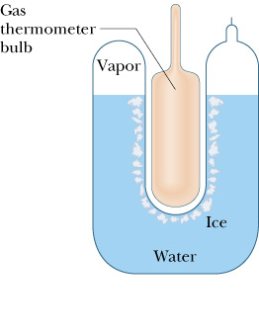
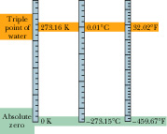
18-5: Temperature and its measurement
Triple point of water as a reference point:
Liquid water , solid ice and water vapor coexist together at T₃=273.16 K
Kelvin scale is a scientific scale and it is based on the triple point of water.

Slide 7
Conversion of different units of temperature
100
212
373
Boiling water
C
F
K
For the change of temperature
Freezing Water
0
32
273
⁰C
⁰F
K

Slide 8
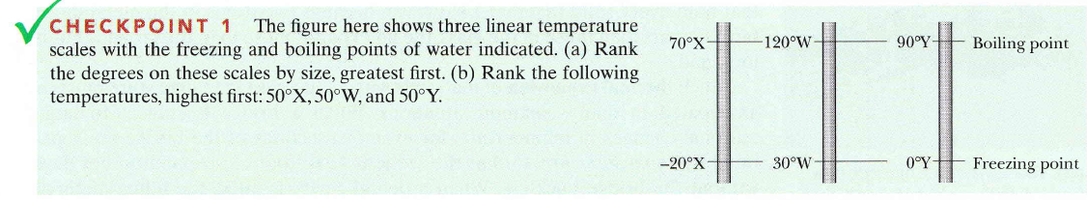
1. (a) all tie; (b) 50'X,50'Y,50"W

Slide 9
T72-Q11.
Helium condenses into the liquid phase at approximately 4 K. What temperature in degrees Fahrenheit, does this correspond to? (Ans: -452)
Ch18:P7:
On a linear X temperature scale, water freezes at -125⁰X and boils at 375⁰X. On a linear Y temperature scale, water freezes at -70⁰Y and boils at -30⁰Y. A temperature of 50⁰Y correspond to what temperature of X scale.
T041: Q#1
It is recommended to use a new temperature scale called Z . On Z scale, the boiling point of water is 65.0 degrees Z and the freezing point is -15.0 degrees Z. To what temperature on the Fahrenheit scale would a temperature of -100 degrees correspond? [Note: both scales are linear]
(Ans: -159 Degrees Fahrenheit)
T103-Q10.
The melting point of sulfur is 444.6 °C and is 586.1 F° below its boiling point. Determine the boiling point of sulfur in degrees Celsius.
A) 770.2 ºC

Slide 10
Ch18:P7:
On a linear X temperature scale, water freezes at -125⁰X and boils at 375⁰X. On a linear Y temperature scale, water freezes at -70⁰Y and boils at -30⁰Y. A temperature of 50⁰Y correspond to what temperature of X scale.

Slide 11
T103-Q10.
The melting point of sulfur is 444.6 °C and is 586.1 F° below its boiling point. Determine the boiling point of sulfur in degrees Celsius.
A) 770.2 ºC

Slide 12
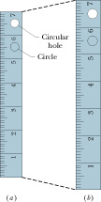
18-6: Linear Expansion
T+ΔT
T
α = coefficient of linear expansion
Its unit is K⁻¹
L
L+ΔL

Slide 13
Surface Expansion
A
A₀
T₀
T
γ = coefficient of surface expansion = 2α
Its unit is K⁻¹

Slide 14
Volume Expansion
T+ΔT
T
V
V+ΔV
β = coefficient of volume expansion
Its unit is K⁻¹
You can prove this

Slide 15
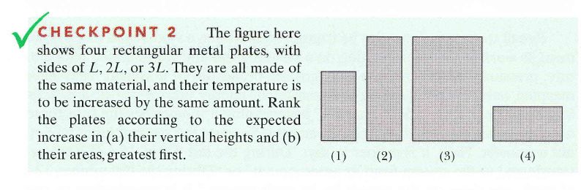
(a) 2 and3 tie, then 1, then 4; (b) 3, 2,then 1 and 4tie

Slide 16
T72Q10.
A square hole 8.00 cm along each side is cut in a sheet of metal. If the temperature of the sheet is increased by 50 K, the area of the hole increases by 0.11 cm². Find the coefficient of linear expansion α of the metal
(Ans:17.2 x10^{-6 o}C ⁻¹)

Slide 17
T012-Q2:
A steel washer (ring) has an inner diameter of 4.000 cm and an outer diameter of 4.500 cm at 20 deg C. To what temperature must the washer be heated to just fit over a rod that is 4.010 cm in diameter?
(Coefficient of linear expansion of steel, alpha, = 11x10⁻⁶ /⁰C )
(Ans: 247 deg C )
T062:Q10.
A metal rod has a length of 7.30 m at 15 °C and a length of 7.40 m at 95 °C. What is the temperature of the rod when its length is 7.21 m?
(Ans: -57 °C)
°Ch18-Q13.
At 20 °C, a brass cube has an edge length of 30cm. What is the increase in the cube’s surface area when it is heated from 20°C to 75°C?
° ° Ch18-Q14.
At 20 °C, a rod is exactly 20.05 cm long on a steel ruler. Both the rod and the ruler are placed in an oven at 270 ⁰C and the rod is now measured 20.11 cm. What is the coefficient of linear expansion of which the material is made? α_{steel} = 1.1x10⁻⁵/⁰C

Slide 18
T81-Q9.
The volume of 1.00 kg water is 958.38 mm³ at a temperature of 10.0 °C and 999.73 mm³ at temperature of 100.0 °C. Calculate coefficient of volume expansion for water in that range of temperature.
(Ans: 4.79 × 10⁻⁴/ C°)
T071: Q9.
A glass flask with volume 250 cm³ is filled with mercury at 25 ⁰C. How much mercury overflows when the temperature of the system is raised to 105 ºC (the coefficient of linear expansion of glass is 4.0 ×10⁻⁶ K⁻¹ and coefficient of volume expansion of mercury is 1.82 ×10⁻⁴ K⁻¹).
(Ans: 3.4 cm³)
T011: Q#1)
The coefficient of linear expansion of gold is 14.20 x10⁻⁶/K. If the density of gold is 19.30 g/cm³ at 20 degrees Celsius, the density of gold at 90 degrees Celsius will be:
(Ans: 19.34 g/cm³)

Slide 19
T071: Q9.
A glass flask with volume 250 cm³ is filled with mercury at 25 ⁰C. How much mercury overflows when the temperature of the system is raised to 105 ºC (the coefficient of linear expansion of glass is 4.0 ×10⁻⁶ K⁻¹ and coefficient of volume expansion of mercury is 1.82 ×10⁻⁴ K⁻¹).
(Ans: 3.4 cm³)

Slide 20
Lecture 02

Slide 21
18-7: Temperature (T) and heat(Q)
Everybody exchange heat (Q) with its environment
Q
T_{e}
T_{s}
If the temperature of a body (T_{s}) is lower than the temperature of the environment (T_{e}), heat flow inwards and is called heat gain
Q
Q
Q
Q
T_{e}
If the temperature of a body (T_{s}) is higher than the temperature of the environment (T_{e}), heat flow outwards and is called heat loss
T_{s}
Q
Q
Q
But, if Ts=T_{e} , the system is called to be in thermal equilibrium with its environment
Heat Gain = Heat Loss

Slide 22
18-8: Heat Capacity
For a fixed mass of body more heat is required to create more temperature difference
Heat capacity
Unit: J/⁰C
Heat capacity:
Amount of heat required to raise the temperature of a body by 1⁰C or 1K
One Calorie (cal) is amount of heat required to raise temperature of one gram of water from 14.5°C to 15.5 °C
1 cal = 4.1868 Joules (J)

Slide 23
Specific Heat Capacity
More heat is required to create more temperature difference
More heat is required to warm more mass
Specific heat capacity
Unit: J/Kg ⁰C
Specific heat capacity: Amount of heat required to raise the temperature of 1 Kg object by 1⁰C or 1K
Specific Heat Capacity of water = 4190 J/kg⁰C

Slide 24
Molar Heat Capacity
More heat is required to create more temperature difference
More heat is required to warm more molecules
n = # of moles
Molar heat capacity
Unit: J/mole ⁰C
Molar heat capacity: Amount of heat required to raise the temperature of 1 mole object by 1⁰C or 1K

Slide 25
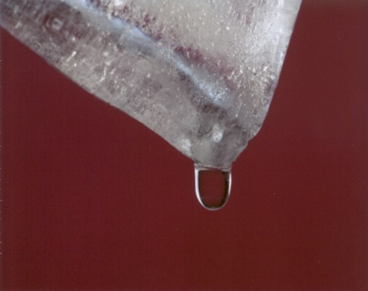
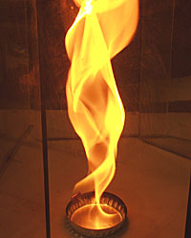
Latent heat of Fusion (L_{f})
Heat required to change solid state to Liquid state (melt)
Melting Ice at –0 C
Unit: J/Kg
Latent heat of fusion: Amount of heat required to melt 1kg object.
Heat is used to change the state but not to increase the temperature
Latent Heat of fusion L_{f}: for water L_{f}=333 kJ/kg

Slide 26
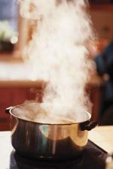
Latent heat of Vaporization (L_{v})
Heat required to change Liquid state to Gas state (vaporize)
Boiling water at 100 C
Unit: J/Kg
Latent heat of vaporization: Amount of heat required to vaporize 1kg object.
Heat is used to change the state but not to increase the temperature
Latent Heat of vaporization L_{v}: for water L_{v}=2256 kJ/kg

Slide 27
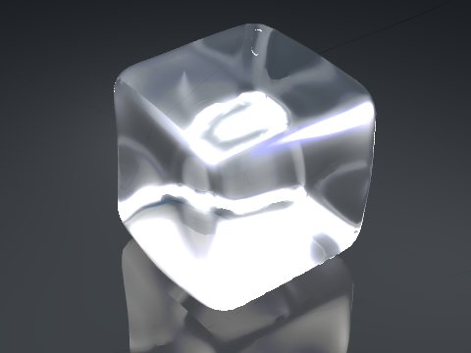
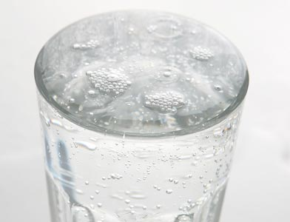
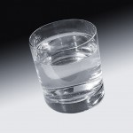
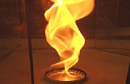































Heat Gain and Heat Lost
Vapor 100 C
Ice at –T_{i} C
water at –0 C
Warm water at T_{w} C
mL_{v}
Melting Ice at –0 C
mL_{f}
m_{w}c_{w}(T_{w}-0)
m_{i}c_{i}(0-(-T_{i}))
m_{w}c_{w}(100-T_{w})
Boiling water at 100 C
For water
Temperature Change
L_{v}=2256 kJ/kg
State Change
L_{f}=333 kJ/kg
c =4190 J/kg⁰C
1 cal = 4.1868 Joules (J)

Slide 28
Isolated System:
The system without any exchange of heat to surrounding
Isolated from surroundings
B
A
Net Exchange of heat between A and B = 0
or
Heat gain by B= Heat lost by A

Slide 29
T122-Q12:
Two different solid objects have the same mass and temperature. Equal quantities of energy are absorbed as heat by each. Their final temperatures may be different because the samples have different:
A) Coefficients of thermal expansion
B) Latent heat of fusion
C) Specific heats
D) volumes
E) thermal conductivities
T52-Q#8.
500 g of steam at 100 ºC lose 1.180×10⁶ J of heat. Calculate the final temperature? Heat of vaporization of water is 2.256 ×10⁶ J/kg, heat of fusion is 333 kJ/kg, and the specific heat of water = 4.19 kJ/kg K.
(Ans:75 ºC )
T61-Q11.
100 g of ice at 0 °C is mixed with 100 g of water at 70 °C, what is the final temperature of the mixture?
(0 ºC)

Slide 30
T61-Q11.
100 g of ice at 0 °C is mixed with 100 g of water at 70 °C, what is the final temperature of the mixture?
(0 ºC)

Slide 31
T81-Q11.
How much ice at -20.0 °C must be mixed with 0.25 kg of water, initially at 20.0 °C to obtain a final temperature of mixture of 0.0°C with all ice melted. (c_{ice} = 2220 J/kg K)
(Ans: 56 g)
T72-Q13.
A 15 g ice cube at 0 °C is placed in an aluminum cup whose initial temperature is 70 ºC. The system comes to an equilibrium temperature of 20 °C. What is the mass of the cup? (cAl = 900 J/kg.K; Lfusion-ice= 333 kJ/kg.K) (Ans: 140 g)
T12-Q5)
Liquid nitrogen boils at temperature of -196 degrees Celsius when the pressure is one atmosphere. A silver coin of mass 1.5x10⁻² Kg and temperature 25 degrees Celsiusis dropped into the liquid. What mass of nitrogen boils off as the coin cools to – 196 degrees Celsius. [Take the specific heat of silver = 235 J/Kg/K and latent heat of vaporization for liquid nitrogen is 2.0x10⁵ J/Kg.
(Ans: 3.90 g)

Slide 32
Lecture 03

Slide 33
18-9: Heat and Work
F
Working system: gas confined to a cylinder fitted with movable piston in thermal contact with a heat reservoir to exchange heat Q:
V_{i}
dx
Insulator
V_{f}
Conductor
valve
Work done by system = +ve
P
Work done on the system = -ve
V
Area under
the curve
P
V

Slide 34
















Negative and Positive Work
F
V_{i}
dx
Insulator
V_{f}
Positive Work: Area under the curve with increasing volume
ΔV Positive
Conductor
i
valve
P
f
Net work: Area between the curve
V
Negative Work: Area under the cure with decreasing volume
ΔV Negative

Slide 35
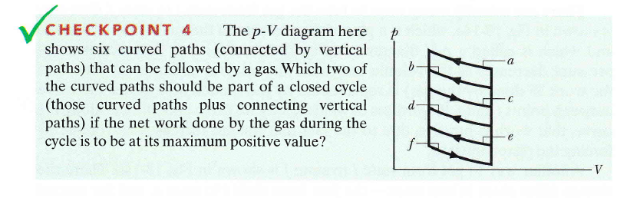
Checkpoint
Answer: c to e

Slide 36
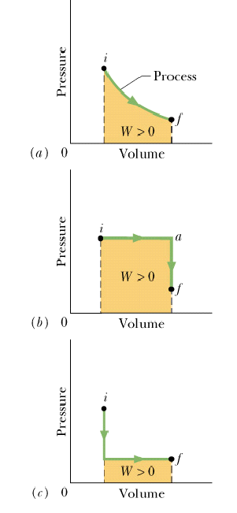
Work done (W) = Area under the curve
There are many different ways to reach from initial state i to final state f.
f
i
Volume is increased (work done W) from i to f by decreasing the pressure.
i
f
Volume is increased (work done W) from i to a by keeping the pressure constant by supplying heat Q. Then pressure is released to by loosing the heat (Q)
i
f
Pressure is decreased by loosing the heat (Q) and then the volume is increased (work done W) to f.
Therefore, Q and W depends on the path taken from i to f

Slide 37
18-10: First law of thermodynamics
Internal Energy (ΔE) = Δ Q - Δ W
But the quantity (Q – W) doesn’t depends on the path from i to f. This quantity is called internal energy of the system (E).
Change in internal energy
First law of thermodynamics is the conversation of Energy!

Slide 38
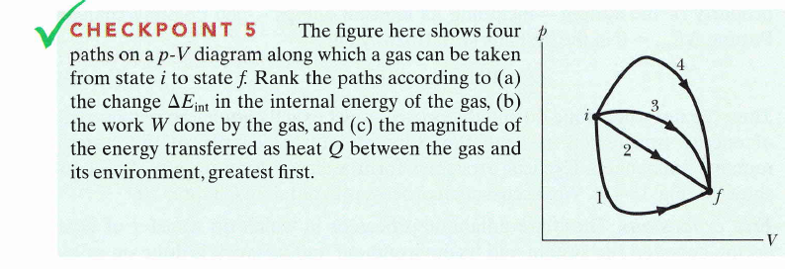
Checkpoint
Ans:
ΔE = all same
W = area under the curve: 4,3,2,1
Q = W+ ΔE : 4,3,2,1

Slide 39
18-11: Special case of first law of thermodynamics
First law of thermodynamics
Adiabatic Process: (Q=0)
Process in which no exchange of heat takes place
2. Constant Volume (iso-choric) Process: (dV=0)
0

Slide 40
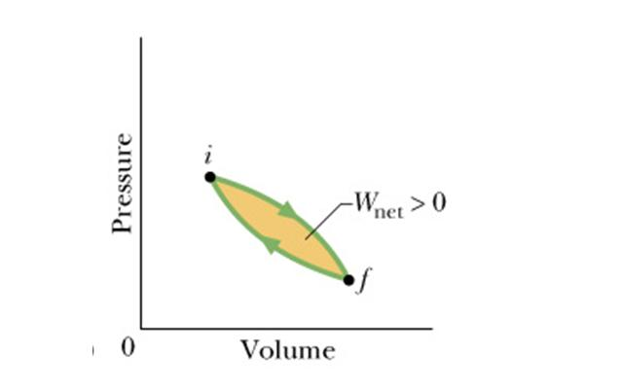
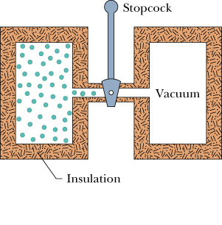
18-11: Special case of first law of thermodynamics
First law of thermodynamics
3. Cyclic Process (ΔE =0)
4. Free Expansion (Q =0, W=0 )

Slide 41
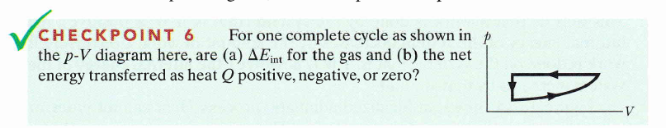
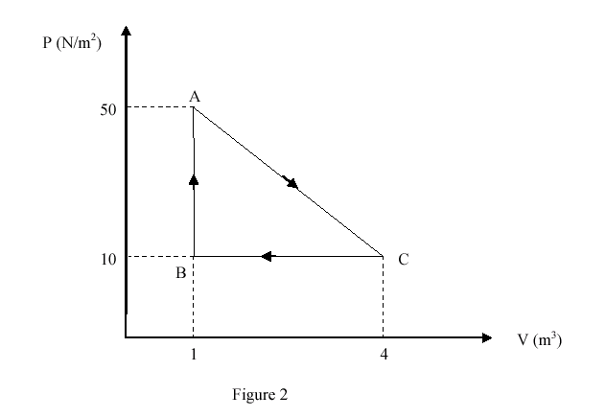
T31-Q#3)
Gas within a closed chamber undergoes the cycle shown in Fig. 2. Calculate the net heat added to the system in a complete cycle.
(Ans: 60 J)

Slide 42
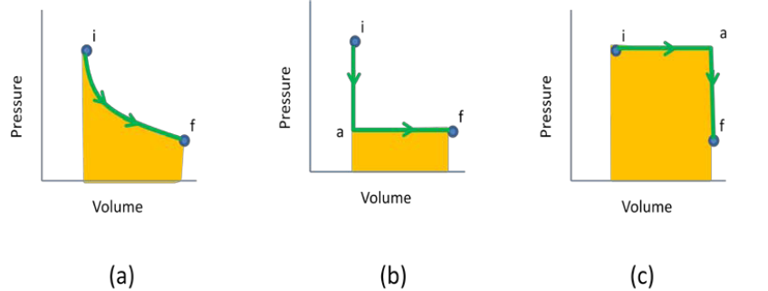
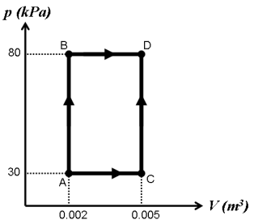
T102-Q12.
Which of the following statements is FALSE regarding the processes connecting the same points i and f shown in the three diagrams in Figure 1?
A) Change in internal energy is different in all three processes
B) Work is different in all three processes
C) Heat energy transfer is different in all three processes
D) The first law of thermodynamics can be applied to the three processes
E) The work is positive in all three processes
T92-Q16.
In the p-V diagram shown in Figure 1, 150 J of heat is added to the system in process AB, and 600 J
of heat is added to the system in process BD. What is the total heat added in process ACD?
A) 600 J

Slide 43
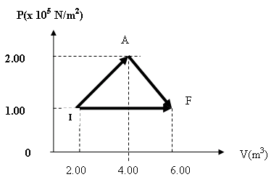
T81-Q12.
A gas expands from a volume of 2.00 m³ to a volume of 6.00 m³ along two different paths as shown in Fig 2. The heat added to the gas along path IAF equals 1.68 × 10⁶ J. Find the heat added during path IF.
(Ans: 1.48 × 10⁶ J)
Ch18-Book’s Question:
When a system is taken from state i to state f along path iaf in figure, Q = 50cal and W =20 Cal. Along path ibf, Q = 36 cal.
what is W along path ibf? (6 cal
If W = -13 cal for the return path f to i, what is Q for this path?
if E_{int, i} = 10 cal what is E_{f}?
If E_{int}, _{b} = 22 cal, what is Q for
(d) path ib and (e) path bf?.
Ans: (a) 6 Cal (b) -43 cal (c) 40 cal (d) 18 cal (e) 18 cal
a
f
pressure
i
b
volume

Slide 44
Lecture 04

Slide 45
18-12:Heat Transfer
Heat can be transferred through three different ways
Conduction 2. Convection 3. Radiation
Conduction: Heat is transferred through molecules without the transfer of molecule. Example: Heating a metal rod
T_{C}
T_{H}
A
L
k is coefficient of thermal conductivity

Slide 46
Heat Transfer
Conduction through composite slab
T_{H}
T_{x}
T_{c}
Q/t
Q/t
Thermal Resistance (R)

Slide 47
Checkpoint
T62-Q12.
The Figure shows five slabs of different materials with equal thickness and same cross sectional area, placed side by side. Heat flows from left to right and steady state temperatures are given at the interfaces. Which slab has largest thermal conductivity?
(Ans: 3)
1
2
3
4
5
28°C 24°C 17°C 14 °C 5°C -2 °C
Rank the thermal conductivity of the slabs from highest to lowest

Slide 48
Convection and Radiation
Convection: The transferred heat is carried out by the molecules themselves.
Example: Heating of water, and heating of house
Radiation: Heat is transferred without any medium
Example: Heat coming from sun to earth.
A
σ= stephan Boltzmann constant = 5.67x10⁻⁸ W/m².K⁴
A = Area of the surface
T = Temperature of the Surface in K
ε = Emissivity, whose value varies from 0 to 1.
If the body absorbs all the radiation that falls on it, is called black body.
Emissivity is 1 for ideal black body.

Slide 49
Q1.
If an object has a temperature of -180 degrees C, how much power per square meter does it emit?
4.24 Wm⁻²
Q2.
What is the temperature of a surface that emits 0.0000000043 W per square meter?
0.525 K
Q3.
5.0 x 10 ⁻⁹ W per square meter strikes a field of grass with an average albedo (emissivity) of 0.6. How much energy is reflected? How much is absorbed?
3 x 10⁻⁹ reflected; 2 x 10⁻⁹ absorbed
Q4.
5.0 x 10 ⁻⁹ W per square meter strikes a field of grass of area 10 m² with an average emissivity of 0.6 for 5.0s. Find the final temperature of the glass.

Slide 50
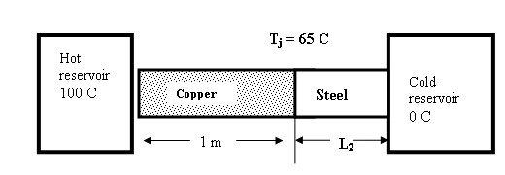
T81-Q10. An isolated rod is in thermal contact with hot reservoir at one end and with cold reservoir at other end ( Fig. 1). The rod consists of a 1.00 m section of copper joined by a section of length L₂ of steel. Both rods have the same cross section area of 4.00 cm². The temperature of copper-steel junction Tj is 65 °C. Find L₂. ( k_{steel} = 14 W/m.K; k_{cu} = 401 W/m.K)
( Ans: 0.065 m)
72-Q14. Two cylindrical copper rods with different length L1 and L2 and different diameters D1 and D2. are connected across two heat reservoirs with temperatures TL= 0 °C and TH=100 °C. In the steady state the heat conduction rate through the rod L1 is half of that through L2. If L1=40 cm and D2.= 1.2 D1 , the length L2 is: (κcopper = 385 W/m.K)
(Ans: 29 cm)
Q#12. The temperature of one side of 8.0-mm thick glass window is maintained at 45 ºC while the other side is maintained at 25 ºC. If the area of the window is 2.0 m², how much energy is transferred through the window in 5 hours? The thermal conductivity of glass is 1.0 W/m·K.
(Ans: 90 ×10⁶ J )

Slide 51
T-111-Ch18
Q9. At 20 ºC, an aluminum cube has an edge length of 25 cm. What is the increase in the cube’s total surface area when it is heated from 20 ºC to 75 ºC. The coefficient of linear expansion of aluminum is 23 × 10⁻⁶/C°.
A) 9.5 cm²

Slide 52
T-111-Ch18
Q10. A 0.0400-kg ice cube at 0.00 °C is placed in an insulated box that contains 0.0750 kg of water at 100 °C. What is the equilibrium temperature reached by this closed system?
A) 37.6 °C

Slide 53
T-111-Ch18
Q 11. A wall has a thickness of 0.61 m and a thermal conductivity of 2.1 W/(m∙ C °). The temperature on one face of the wall is 3.2 °C, and 20.0 °C on the opposite face. How much heat is transferred in one hour through each square meter of the wall?
A) 2.1 × 10⁵ J

Slide 54
T-111-Ch18
Q 12. A system containing an ideal gas at a constant pressure of 1.22 × 10⁵Pa gains 2140 J of heat. During the process, the internal energy of the system increases by 2320 J. What is the change in the volume of the gas?
A) –1.48 × 10 ^{–3} m

Slide 55
T-103-Ch18
Q10. The melting point of sulfur is 444.6 °C and is 586.1 F° below its boiling point. Determine the boiling point of sulfur in degrees Celsius.
A) 770.2 ºC
Q11. An iron tank is completely filled with 2.80 m3 of water when both the tank and the water are at a temperature of 32.0 °C. When the tank and the water have cooled to 18.0 °C, what additional volume of water can be put into the tank? [alpha iron = 12.0 × 10-6/ C, Beta water = 4.79 × 10-4/ C]
A) 17.4 × 10-3 m3
Q12. A 100-g ice cube at 0.0 °C is placed in 650 g of water at 18 °C. If the system is isolated, what is the final temperature?
A) 5.0 °C
Q13. A copper rod has a length of 60 cm. One end is maintained at 80 °C and the other end is at 20 °C. In steady state, what is the temperature of the rod at a point which is 20 cm from the hot end?
[kcopper = 401 W/m.K]
A) 60 oC

Slide 56
Q10. The melting point of sulfur is 444.6 °C and is 586.1 F° below its boiling point. Determine the boiling point of sulfur in degrees Celsius.
A) 770.2 ºC

Slide 57
T-102-Ch18
Q9. One end of a cylindrical rod of length 50.0 cm and area of cross-section 11.5 cm² is placed in a steam bath at 100 oC whereas the other end is inserted into an ice bath at 0 oC. If 500 g of ice melts in 30.0 min, what is the rod made up of:
A) Copper: (k = 402 W/m.K)
Q10. 1.00 kg of steam at 100 ºC is mixed with 1.00 Kg of ice at 0 ºC. Assuming the system is isolated, the final temperature of the mixture is:
A) 100 ºC
Q11. When the average temperature of the earth increased by 1.00 Co, commonly known as global warming, the volume of the ocean due to expansion will be increased by: (Coefficient of volume expansion for water = 2.07 x 10-4/Co)
A) 0.021 %
Q12. Which of the following statements is FALSE regarding the processes connecting the same points i and f shown in the three diagrams in Figure 1?
A) Change in internal energy is different in all three processes
B) Work is different in all three processes
C) Heat energy transfer is different in all three processes
D) The first law of thermodynamics can be applied to the three processes
E) The work is positive in all three processes

Slide 58
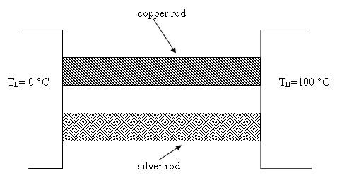
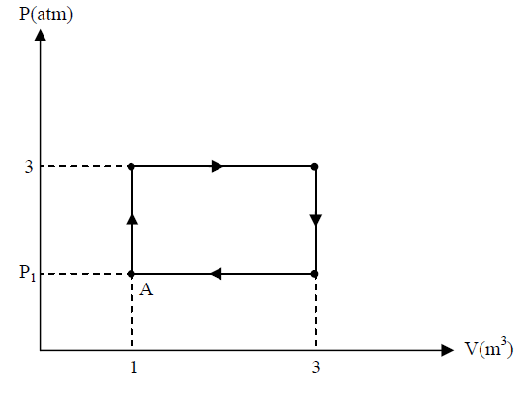
T-101-Ch18
Q9. Consider a steel ball of radius 10 cm at 20 0C. What is the magnitude of the change in its volume when the temperature is lowered to −20 0C? [The coefficient of linear expansion of steel = 11.7 × 10−6 /C0].
A) 5.9 × 10-6 m3
Q10. Two metal rods, one silver and the other copper, each are 5.00 cm long and have a square cross-section, 2.00 cm on a side. As shown in Figure 1 both rods are connected in parallel between a steam chamber at a temperature of 100°C, at one end, and an ice water bath, with a temperature of 0°C, at the other. How much heat flows through the two rods in1.00 minute? [The thermal conductivity of silver is 417 W/(m·K), and that of copper is 395 W/(m·K)].
A) 39.0 kJ
Q11. A 200-g thermally insulated metal container has 100 g of water, both in thermal equilibrium at 22.0°C. A 21-g ice cube, at 0 °C, is dropped into the water, and when thermal equilibrium is reached the temperature is 15.0 °C. The specific heat for the metal is:
A) 3.86 kJ/kg·K
Q12. A 30.0 moles of an ideal gas starting at point A is carried around the cycle shown in Figure 2. In the process the gas does 3.00 × 105 J of work. Find the gas temperature at point A.
A) 617 K

Slide 59
T-92-Ch18
Q12. Two containers A and B, each having 1.0 kg of water, are initially at 20 oC. Container A is heated by 10 K, while container B is heated by 10 Fo. Then, they are mixed. What is the final temperature?
A) 27.8 °C
Q13.A steel gas tank of volume 0.0700 m3 is filled completely with gasoline. The temperature of the tank increased from 20.0 to 50.0 oC. How much gasoline has spilled out of the tank? For steel, the coefficient of linear expansion is 12.0×10-6 (oC)-1. For gasoline, the coefficient of volume expansion is 9.50×10-4 (oC)-1.
A) 1.92×10-3 m3
Q14.
You take a block of ice at 0 °C and add heat to it at a steady rate. It takes time t to completely convert
the block of ice to steam at 100 °C. What do you have at time t/2?
A) A mixture of water and steam at 100 °C.
B) All ice at 0 °C.
C) Water at a temperature between 0 °C and 100 °C.
D) A mixture of ice and water at 0 °C.
E) All steam at 100 °C.

Slide 60
T-92-Ch18
Q15.
One end of an insulated metal rod is maintained at 100 oC, and the other end is maintained at 0.00 oC by an ice-water mixture. The rod is 60.0 cm long and has a cross sectional area of 1.25 cm2. The heat conducted by the rod melts 8.50 g of ice in 10.0 min. What is the thermal conductivity of the rod?
A) 226 W/m.K
Q16.
In the p-V diagram shown in Figure 1, 150 J of heat is added to the system in process AB, and 600 J
of heat is added to the system in process BD. What is the total heat added in process ACD?
A) 600 J

Slide 61

T-91-Ch18
Q10. Which one of the following statements is TRUE?
A) Temperatures which differ by 10° on the Celsius scale must differ by 18° on the Fahrenheit scale
B) Temperatures differing by 25° on the Fahrenheit scale must differ by 45° on the Celsius scale
C) 40 K corresponds to –40 °C
D) water at 96 °C is warmer than water at 212 °F
E) 0 °F corresponds to –32 °C
Q11. Two steel rods are each 1.000 m long at 20.0 °C. Their ends are 1.00 mm apart as shown in Fig. 2. To what common temperature should they be heated so that their ends touch at point A? The coefficient of linear expansion of steel is 11.0 × 10-6 (°C)-1.
A) 111 °C
Q12. Fifty grams of ice at 0 °C is placed in a thermos bottle containing 100 g of water at 6.0°C. What quantity of ice will melt? The heat of fusion of water is 333 kJ/kg and the specific heat of water is 4190 J/kg ⋅ K.
A) 7.5 g

Slide 62
T-91-Ch16
Q13. In a certain process a gas ends in its original thermodynamic state. Of the following,
which is possible as the net result of the process?
A) The gas absorbs 50 J of energy as heat and does 50 J of work.
B) It is adiabatic and the gas does 50 J of work.
C) The gas does no work but absorbs 50 J of energy as heat.
D) The gas does no work but rejects 50 J of energy as heat.
E) The gas rejects 50 J of heat and does 50 J of work.
Q14. Heat flows through a slab. It takes 1.0 minute to transfer 600 J of thermal energy across the slab. If the slab thickness is doubled, its cross-sectional area is halved, and the temperature difference across it is doubled, how long will it take to transfer the same amount
of thermal energy?
A) 120 s

Slide 63
T-82-Ch18
Q9. A student uses a metallic measuring rod that is exactly equal to 1.00 m long on a summer day having temperature of 45.0 oC. What is length of the rod on a winter day when the temperature is −5.00 oC. (the coefficient of linear expansion of the metal = 5.20 × 10-4 K-1).
A) 0.974 m
Q10. 500 g of water at 100 oC is converted to steam at 100 oC by boiling it at a constant pressure of 1.01 × 105 Pa. The change in volume of the water-vapor system is 0.83 m3. Calculate the change in internal energy of the water during this process.
A) 1.04×106 J
Q11. A copper block of mass 400 g at 80.0 oC is dropped into an insulated bucket containing ice at 0 oC. All the ice has melted and did not evaporate. Calculate the amount of melted ice. (Specific heat for copper is 386 J/kg.K). Neglect the heat gained by the bucket.
A) 37.1 g

Slide 64
T-82-Ch18
Q12.
Which of the following statements is WRONG?
A) If work is done on a system, the internal energy of the system decreases in an adiabatic process.
B) In an adiabatic process, transfer of energy as heat is zero.
C) In a constant-volume process, the internal energy of the system increases if heat is added.
D) In a cyclic process, the change in internal energy of the system is zero.
E) Heat energy can be transferred only between bodies having different temperatures.
Q13.
On a hot summer day, the amount of thermal energy transferred to a classroom from the outside through a 3.0 m2 glass window is 3.0 ×105 J every minute. The thickness of the glass window is 1.5 cm. If the outside temperature is 45 oC, calculate the temperature inside the classroom. (kglass = 1.2 W/m.K).
A) 24 oC

Slide 65
T-81-Ch18
Q9. The volume of 1.00 kg water is 958.38 mm³ at a temperature of 10.0 °C and 999.73 mm³ at temperature of 100.0 °C. Calculate coefficient of volume expansion for water in that range of temperature.
(Ans: 4.79 × 10⁻⁴/ C°)
Q10. An isolated rod is in thermal contact with hot reservoir at one end and with cold reservoir at other end ( Fig. 1). The rod consists of a 1.00 m section of copper joined by a section of length L₂ of steel. Both rods have the same cross section area of 4.00 cm². The temperature of copper-steel junction Tj is 65 °C. Find L₂. ( k_{steel} = 14 W/m.K; k_{cu} = 401 W/m.K)
( Ans: 0.065 m)
Q11.How much ice at -20.0 °C must be mixed with 0.25 kg of water, initially at 20.0 °C to obtain a final temperature of mixture of 0.0°C with all ice melted. (c_{ice} = 2220 J/kg K) (Ans: 56 g)
Q12. A gas expands from a volume of 2.00 m³ to a volume of 6.00 m³ along two different paths as shown in Fig 2. The heat added to the gas along path IAF equals 1.68 × 10⁶ J. Find the heat added during path IF.
(Ans: 1.48 × 10⁶ J)

Slide 66
T-72-Ch18
Q10. A square hole 8.00 cm along each side is cut in a sheet of metal. If the temperature of the sheet is increased by 50 K, the area of the hole increases by 0.11 cm2. Find the coefficient of linear expansion α of the metal
(Ans:17.2 x10^{-6 o}C -1)
Q11. Helium condenses into the liquid phase at approximately 4 K. What temperature in degrees Fahrenheit, does this correspond to?
(Ans: -452)
Q12. A gas is compressed from 600 cm3 to 200 cm3 at a constant pressure of 400 kPa. At the same time, 100 J of heat energy is transferred out of gas. What is change in the internal energy of the gas during this process?
(A) 60 J
Q13. A 15 g ice cube at 0 °C is placed in an aluminum cup whose initial temperature is 70 oC. The system comes to an equilibrium temperature of 20 °C. What is the mass of the cup? (cAl = 900 J/kg.K; Lfusion-ice= 333 kJ/kg.K)
(Ans: 140 g)
Q14. Two cylindrical copper rods with different length L1 and L2 and different diameters D1 and D2. are connected across two heat reservoirs with temperatures TL= 0 °C and TH=100 °C. In the steady state the heat conduction rate through the rod L1 is half of that through L2. If L1=40 cm and D2.= 1.2 D1 , the length L2 is: (κcopper = 385 W/m.K)
(Ans: 29 cm)

Slide 67
T-71-Ch18
Q9.
A glass flask with volume 250 cm³ is filled with mercury at 25 ⁰C. How much mercury overflows when the temperature of the system is raised to 105 ºC (the coefficient of linear expansion of glass is 4.0 ×10⁻⁶ K⁻¹ and coefficient of volume expansion of mercury is 1.82 ×10⁻⁴ K⁻¹).
(Ans: 3.4 cm³)
Q10.
How much ice at -10.0 ºC must be added to 4.0 kg of water at 20.0 ºC to cause the resulting mixture to be liquid water at 0 ºC ? ( c_{ice} = 2220 J/kg.K)
(Ans: 0.94 kg)
Q11.
One end of a steel bar is welded to one end of a copper bar. Both bars have the same length and cross sectional area. The free end of the steel bar is maintained at 100 ºC and free end of the copper bar is maintained at 0.0 ºC. Find the temperature of the junction at steady state.(k _{steel} = 50.2 W/m.K; k_{copper} = 385 W/m.K) (Ans: 11.5 °)

Slide 68
T-62-Ch16
Q10. A metal rod has a length of 7.30 m at 15 °C and a length of 7.40 m at 95 °C. What is the temperature of the rod when its length is 7.21 m?
(Ans: -57 °C)
Q11. 100 g of ice at 0 °C is mixed with 100 g of water at 70 °C, what is the final temperature of the mixture?
(0 ºC)
Q12. The Figure shows five slabs of different materials with equal thickness and same cross sectional area, placed side by side. Heat flows from left to right and steady state temperatures are given at the interfaces. Which slab has largest thermal conductivity? (Ans: 3)
Q13. A temperature difference of 25 K is equal to:
(Ans: a difference of 45 on the Fahrenheit Scale.)

Slide 69
T-61-Ch18
Q9. A steel rod is 4.000 cm in diameter at 35 ºC. A brass ring has an inner diameter of 3.992 cm at 35 ºC. At what common temperature will the brass ring slide onto steal rod? α_{steel}= 11 x 10⁻ ⁶ / K⁻¹ ; α_{brassl}= 19 x 10⁻ ⁶ / K⁻¹
( Ans 286 ⁰C )
Q10. What mass of steam initially at 100 ºC should be mixed with 160 g of ice at 0 ºC in a thermally insulated container to produce liquid water at 40 ºC.
(Ans: 32 g )
Q11. A 20-kg block of copper is dropped and falls 122 m. Calculate the raise in the temperature of the block if all the potential energy lost in the fall is converted to heat. [The specific heat of copper = 386 J/kg.K]
(Ans: 3.1 K)
Q12. The following figure shows a steel bar 15 cm long welded end to end to a copper bar 30 cm long. Each bar has a square cross section of 2.2 cm² on a side. The free end of steel is maintained at 100 ºC and the free end of copper is maintained at 0.0 ºC. Find the temperature at the junction of the two bars? Ksteel= 50.2 W/m.K; Kcopper =385 W/m.K] (Ans: 21 °C)

Slide 70
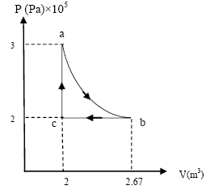
T-52-Ch18
Q#6. A 2.0-cm diameter cylinder contains 50 mL of water at 10.0 ºC. What is the change in the water level when the temperature rises to 80 ºC? Ignore the change in the volume of the tube. The coefficient of volume expansion of water is 2.1×10⁻⁴ /ºC, and 1 mL = 1 cm³.
(Ans: 0.23 cm )
Q#7. Consider one mole of a monatomic gas taken through the cycle shown in the figure 2. Find the change in internal energy of the system for the adiabatic process a → b.
(Ans: –100 kJ)
Q#8. 500 g of steam at 100 ºC lose 1.180×10⁶ J of heat. Calculate the final temperature? Heat of vaporization of water is 2.256 ×10⁶ J/kg, heat of fusion is 333 kJ/kg, and the specific heat of water = 4.19 kJ/kg K.
(Ans:75 ºC )
Q#12. The temperature of one side of 8.0-mm thick glass window is maintained at 45 ºC while the other side is maintained at 25 ºC. If the area of the window is 2.0 m², how much energy is transferred through the window in 5 hours? The thermal conductivity of glass is 1.0 W/m·K. (Ans: 90 ×10⁶ J )

Slide 71
T-51-Ch18
Q#9- 500 g of water at 100 ºC is converted to steam at 100 ºC by heating at constant pressure of 1.01×10⁵ Pa. The volume of the water is 0.5×10⁻³ m³ and the volume of steam is 0.83 m³. Calculate the change in the internal energy of the system.
(Ans: 1044 kJ )
Q#10 What mass of steam initially at 100 ºC that can be mixed with 160 g of ice at 0 ºC in a thermally insulated container to produce liquid water at 40 ºC.
(Ans: 32 g)
Q#12. The figure 1 below shows an aluminum and iron rods joint together. The rods have the same cross section and their sides are insulated. In the steady state, find the temperature T₃ at the far end of the iron rod. The thermal conductivity of aluminum is 235W/mK and for iron is 14 W/mK.(Ans:302 ºC)

