Slide 1
Chapter 38
Photons and Matter Waves
Learning Objectives
38.01 Explain the absorption and emission of light in terms
of quantized energy and photons.
38.02 For photon absorption and emission, apply the
relationships between energy, power, intensity, rate of
photons, the Planck constant, the associated frequency,
and the associated wavelength.

Slide 2
Chapter 38
Photons and Matter Waves
In this chapter we will explore
the strange reality of quantum mechanics.

Slide 3
The Photon, the Quantum of Light
Quantum physics:
Study of the microscopic world
Many physical quantities found only in certain minimum (elementary) amounts, or integer multiples of those elementary amounts
These quantities are "quantized“
Electromagnetic radiation (light) is also quantized, with quanta called photons. This means that light is divided into integer number of elementary packets (photons).

Slide 4
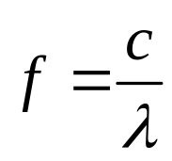

The Photon, the Quantum of Light
Frequency and wavelength still can be any value according to the classical idea, not quantized:
where c is the speed of light 3x10⁸ m/s
However, given light of a particular frequency, the total energy of that radiation is quantized with an elementary amount (quantum) of energy E given by:
Planck constant
The energy of light with frequency f must be an integer multiple of hf.
Photon emission and Photon absorption

Slide 5
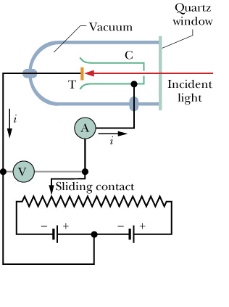
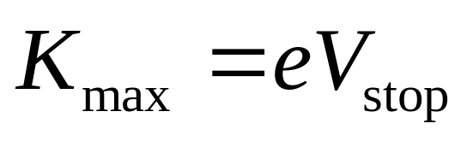
The Photoelectric Effect
When short-wavelength light illuminates a clean metal surface, electrons are ejected from the metal. These photoelectrons produce a photocurrent.
First Photoelectric Experiment:
Photoelectrons stopped by stopping voltage, V_{stop}. The kinetic energy of the most energetic photoelectrons is
K_{max} does not depend on the intensity of the light!
→ single photon ejects each electron

Slide 6
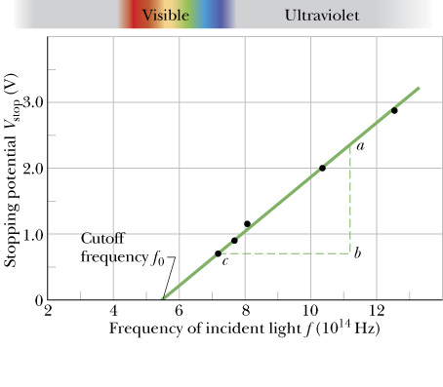
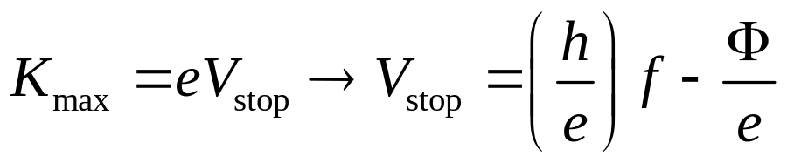
The Photoelectric Effect
Second Photoelectric Experiment:
-Photoelectric effect does not occur if the frequency is below the cutoff frequency f₀, no matter how bright the light!
→ single photon with energy greater than work function Φ ejects each electron

Slide 7
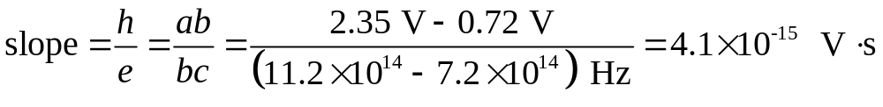
The Photoelectric Effect
Photoelectric Equation
The previous two experiments can be summarized by the following equation, which also expresses energy conservation:
Using
equation for a straight line with slope h/e and intercept –Φ/e
Multiplying this result by e:
(38-6)

Slide 8
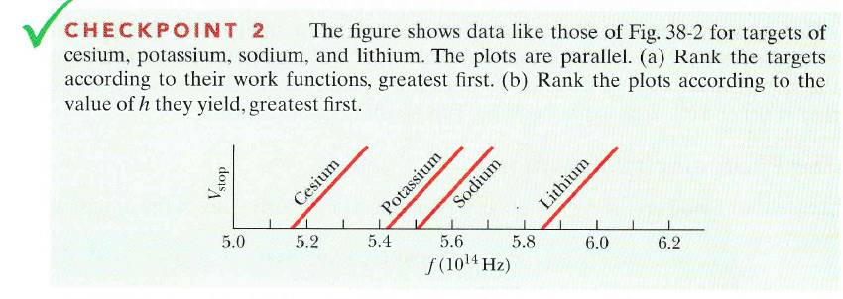
L,S,P,C (according to the intercept)
All tie

Slide 9

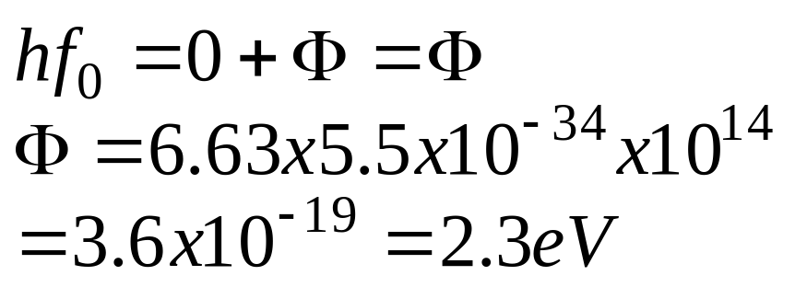
K_{max}=0 at cutoff frequency

Slide 10
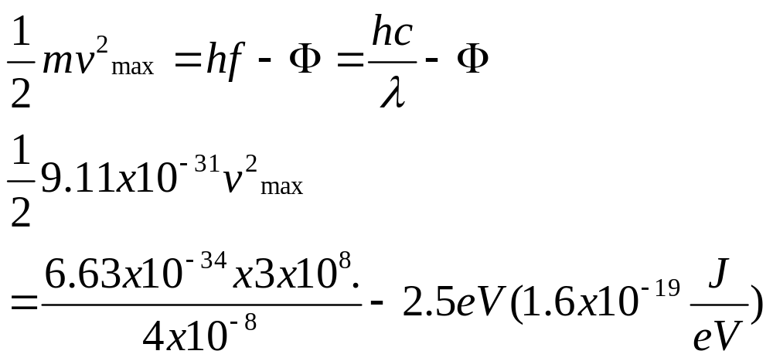
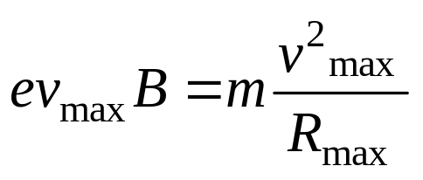
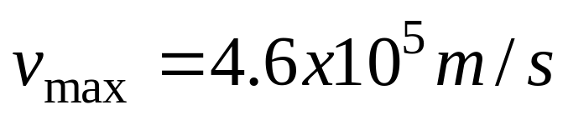
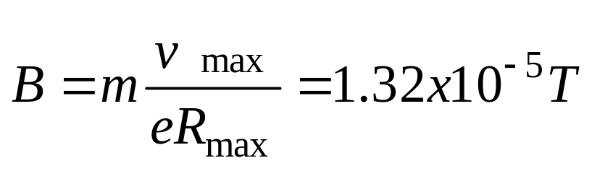
Find the strength of the transverse magnetic field required to bend all the photoelectrons within a circle of radius 20 cm when light of wavelength 4000 A is incident on barium emitter. The work function of barium is 2.5 eV

Slide 11
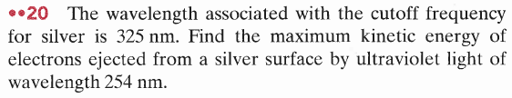
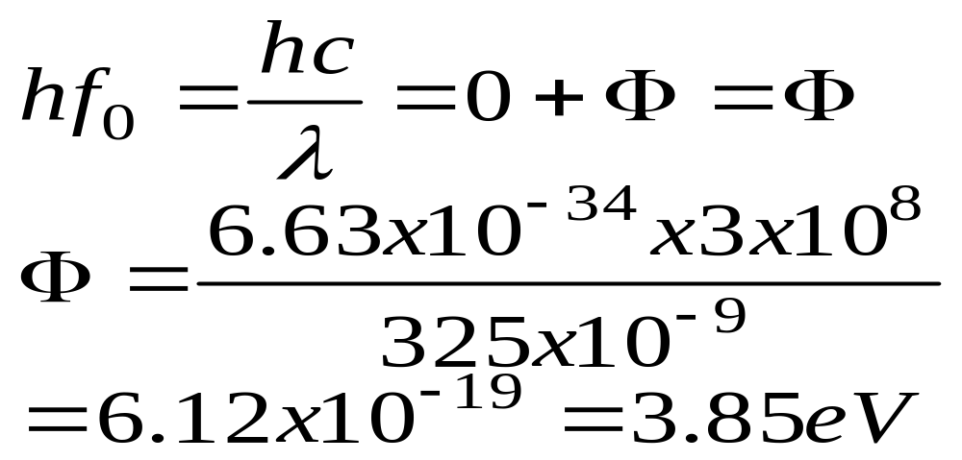
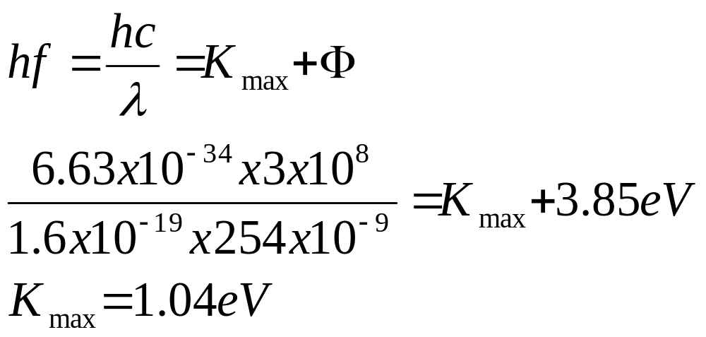

Slide 12
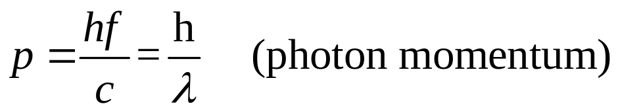
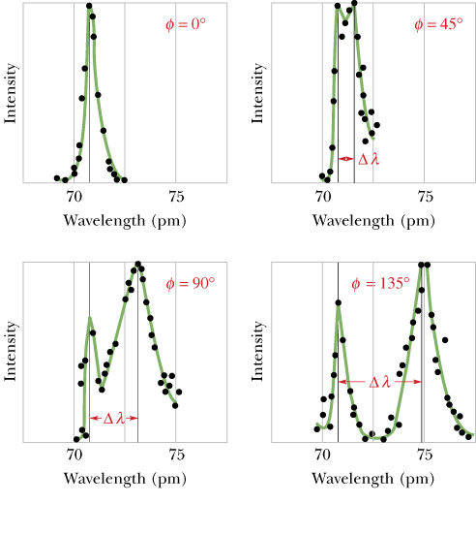
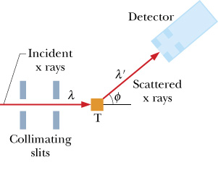
Photons Have Momentum

Slide 13
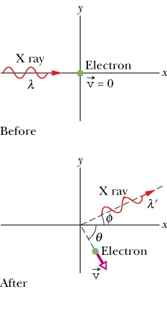

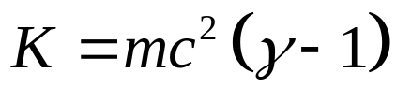
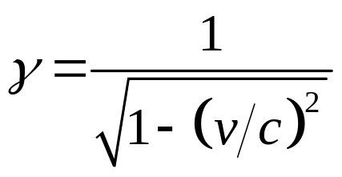
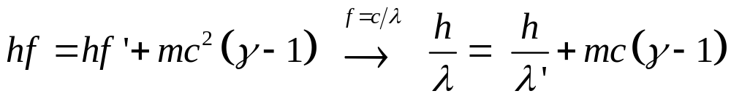

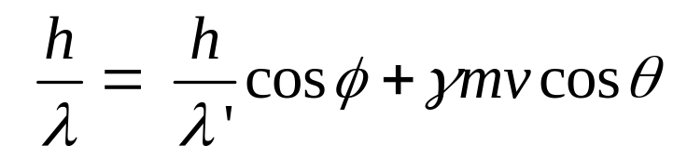
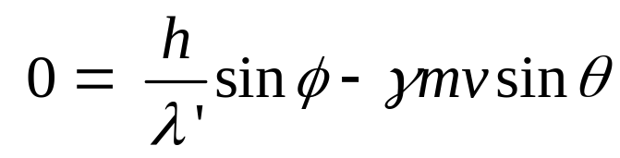
Photons Have Momentum, Compton shift
Conservation of energy
Since electrons may recoil at speeds approaching c we must use the relativistic expression for K:
where γ is the Lorentz factor
Substituting K in the energy conservation equation
Electron momentum
Conservation of momentum along x:
Conservation of momentum along y:

Slide 14

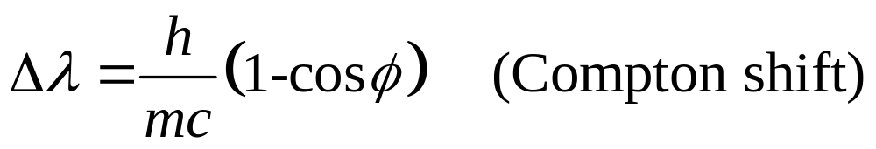
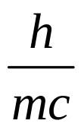
Photons Have Momentum, Compton shift
Want to find wavelength shift:
Conservation of energy and momentum provide 3 equations for 5 unknowns (λ, λ’, v, φ, and θ ), which allows us to eliminate 2 unknowns, v and θ.
λ, λ’, and φ can be readily measured in the Compton experiment.
is the Compton wavelength and depends on 1/m of the scattering particle.
Loose end: Compton effect can be due to scattering from electrons bound loosely to atoms (m = m_{e}→ peak at θ ≠ 0) or electrons bound tightly to atoms
(m ≈ m_{atom} >>m_{e} → peak at θ ≈ 0).

Slide 15
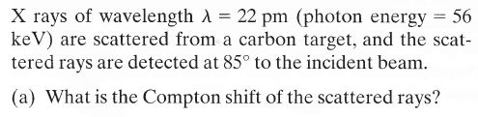


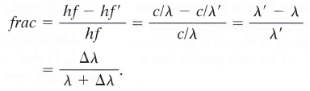



Slide 16
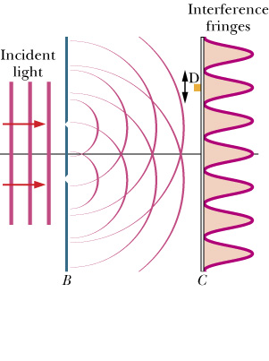
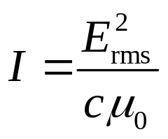
Light as a Probability Wave
How can light act both as a wave and as a particle (photon)?
Standard Version: Photons sent through double slit. Photons detected (1 click at a time) more often where the classical intensity:
Detector
clicks
is maximum.
The probability per unit time interval that a photon will be detected in any small volume centered on a given point is proportional to E² at that point.
Light is not only an electromagnetic wave but also a probability wave for detecting photons.

Slide 17
Light as a Probability Wave
Single Photon Version: Photons sent through double slit one at a time. First experiment by Taylor in 1909.
We cannot predict where the photon will arrive on the screen.
We can predict the probability of the photon hitting different parts of the screen. This probability pattern is just the two-slit interference
The wave traveling from the source to the screen is a probability wave, which produces a pattern of "probability fringes" at the screen.

Slide 18
Light as a Probability Wave
Conclusions :
1. Light is generated at source as photons.
2. Light is absorbed at detector as photons.
3. Light travels between source and detector as a probability wave.

Slide 19
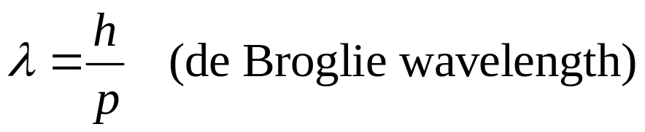
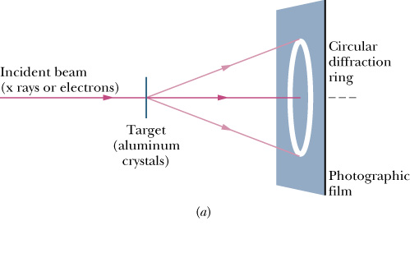
Electrons and Matter Waves
If electromagnetic waves (light) can behave like particles (photons), can particles behave like waves?
where p is the momentum of the particle
Electrons
θ
p, n and various atoms
Recently for I₂,C₆₀ and C₇₀
Electron and neutron diffraction

Slide 20
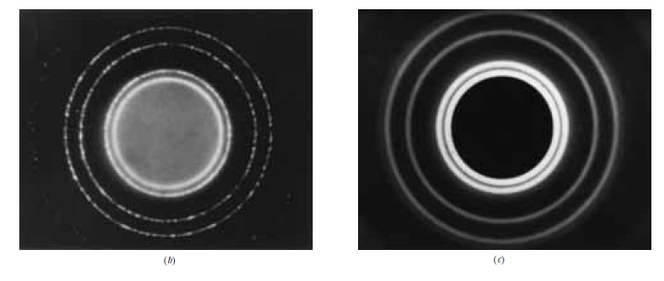
X-ray
electrons

Slide 21
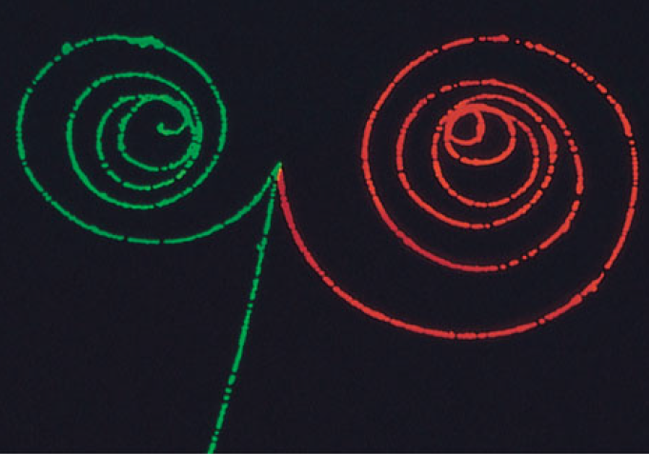
Waves and Particles
Lawrence Berkeley Laboratory/Science Photo Library/Photo Researchers, Inc.

Slide 22
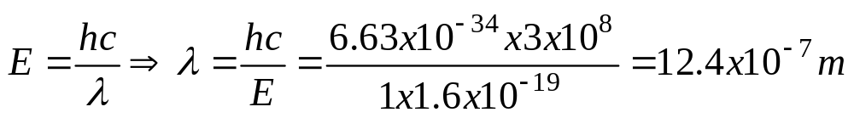
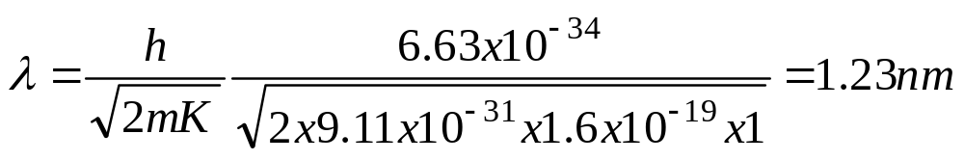
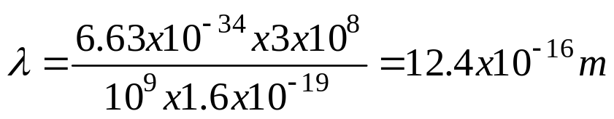

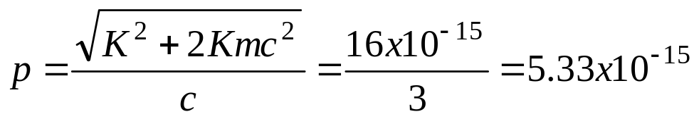
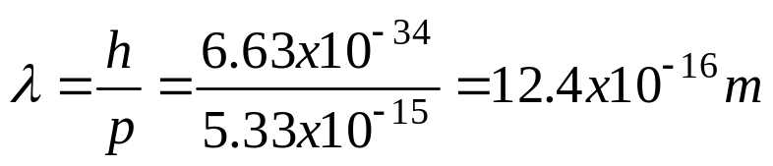
What is the wavelength of a photon with energy 1eV and 1 GeV and electron with energy 1 eV and 1 GeV
for 1eV
for 1GeV

Slide 23

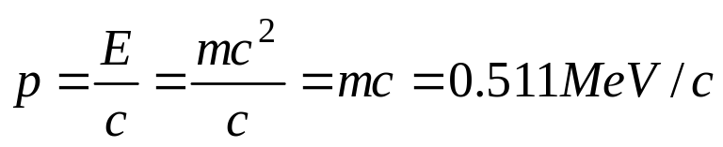
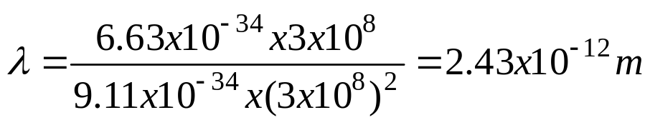
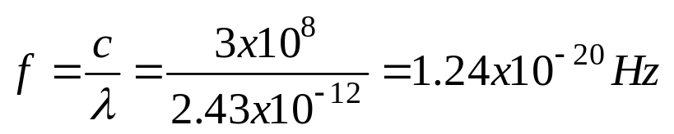

Slide 24

Schrödinger’s Equation
For light E(x, y, z, t) characterizes its wavelike nature, for matter the wave function Ψ(x, y, z, t) characterizes its wavelike nature.
Like any wave, Ψ(x, y, z, t) has an amplitude and a phase (it can be shifted in time and/or position), which can be conveniently represented using a complex number a+ib where a and b are real numbers and i² = -1.
In the situations that we will discuss, the space and time variables can be grouped separately:
Wave function
where ω=2πf is the angular frequency of the matter wave.

Slide 25
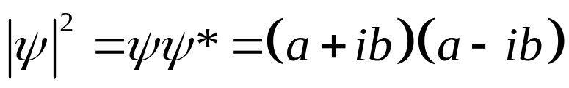
Schrödinger’s Equation
What does the wave function mean?
The probability that a particle will be detected there in a specified period of time is proportional to Iψ|², where Iψ| is the absolute value (amplitude) of the wave function at the detector’s location.
The probability per unit time interval of detecting a particle in a small volume centered on a given point in a matter wave is proportional to the value Iψ|² at that point.
Since ψ is typically complex, we obtain Iψ|² by multiplying ψ by its complex conjugate ψ* . To find ψ* we replace the imaginary number i in ψ with –i wherever it occurs.

Slide 26
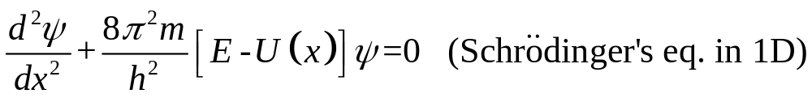

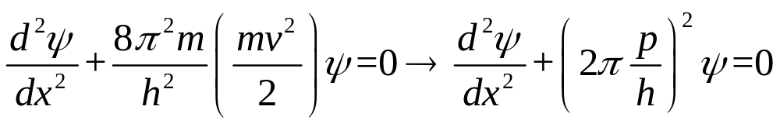
Schrödinger’s Equation
How do we find (calculate) the wave function?
Light waves are described by Maxwell’s equations, Sound waves by Newtonian mechanics, and matter waves by Schrödinger’s equation.
For a particle traveling in the x direction through a region in which forces on the particle cause it to have a potential energy U(x), Schrödinger’s equation reduces to:

Slide 27
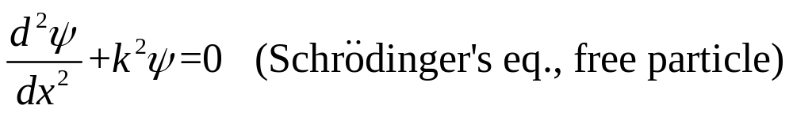

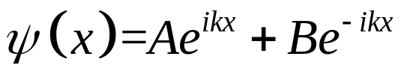
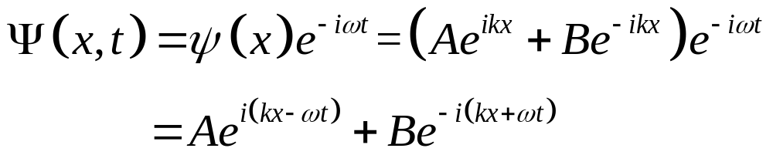
Schrödinger’s Equation
since λ=h/p, we can replace the p/h with 1/λ, which in turn is related to the angular wave number k=2π/λ.
The most general solution is:
Leading to:

Slide 28
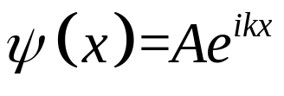
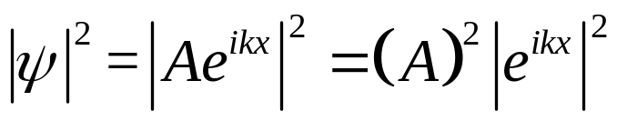



Finding the Probability Density Iψ|²
Choose arbitrary constant B=0 and let A= ψ₀

Slide 29


Heisenberg’s Uncertainty Principle
the momentum (p or k) in the x-direction was exactly defined, but the particle’s position along the x-direction was completely unknown. This is an example of an important principle formulated by Heisenberg:
Measured values cannot be assigned to the position r and the momentum p of a particle simultaneously with unlimited precision.

Slide 30



Slide 31





Slide 32

Barrier Tunneling
As a puck slides uphill, kinetic energy K is converted to gravitational potential energy U. If the puck reaches the top its potential energy is U_{b}. The puck can only pass over the top if its initial mechanical energy E> U_{b}. Otherwise the puck eventually stops its climb up the left side of the hill and slides back. For example, if U_{b} = 20 J and E = 10 J, the puck will not pass over the hill, which acts as a potential barrier.

Slide 33




Barrier Tunneling
What about an electron approaching an electrostatic potential barrier?
Due to the nature of quantum mechanics, even if E< U_{b} there is a nonzero transmission probability (transmission coefficient T) that the electron will get through (tunnel) to the other side of the electrostatic potential barrier!

Slide 34


The Scanning Tunneling Microscope (STM)
As the tip is scanned laterally across the surface, the tip is moved up or down to keep the tunneling current (tip to surface distance L) constant. As a result, the tip maps out the contours of the surface with resolution on the scale of 1 nm instead of >300 nm for optical microscopes!

Slide 35


Slide 36




Slide 37




Suggested Problems (CH: 38)

Slide 38



