Slide 1
Chapter 33
Electromagnetic Waves
Learning Objectives
33.01 In the electromagnetic spectrum, identify the relative wavelengths (longer or shorter) of AM radio, FM radio, television, infrared light, visible light, ultraviolet light, x rays, and gamma rays.
33.02 Describe the transmission of an electromagnetic wave
by an LC oscillator and an antenna.
33.03 For a transmitter with an LC oscillator, apply the
relationships between the oscillator’s inductance L,
capacitance C, and angular frequency v, and the
emitted wave’s frequency f and wavelength l.
33.04 Identify the speed of an electromagnetic wave in
vacuum (and approximately in air).
33.05 Identify that electromagnetic waves do not require a
medium and can travel through vacuum.

Slide 2
Chapter 33
Electromagnetic Waves
Learning Objectives
33.06 Apply the relationship between the speed of an electromagnetic wave, the straight-line distance traveled by the wave, and the time required for the travel.
33.07 Apply the relationships between an electromagnetic wave’s frequency f, wavelength l, period T, angular frequency v, and speed c.
33.08 Identify that an electromagnetic wave consists of an
electric component and a magnetic component that are
(a) perpendicular to the direction of travel, (b) perpendicular to each other, and (c) sinusoidal waves with the same
frequency and phase.
33.09 Apply the sinusoidal equations for the electric and
magnetic components of an EM wave, written as functions
of position and time.

Slide 3
Chapter 33
Electromagnetic Waves
In this chapter
We
-introduce fundamental concepts and
-explore the properties of electromagnetic waves

Slide 4
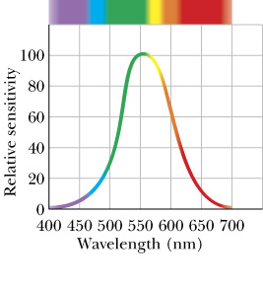
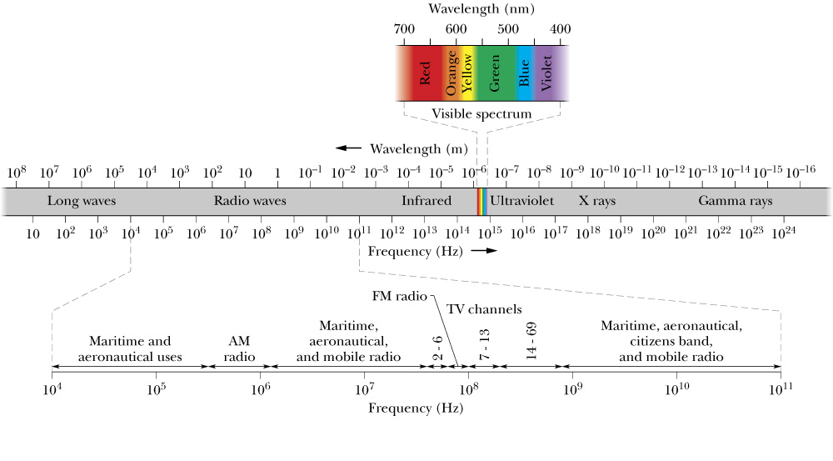
Maxwell’s Rainbow
Fig. 33-2

Slide 5
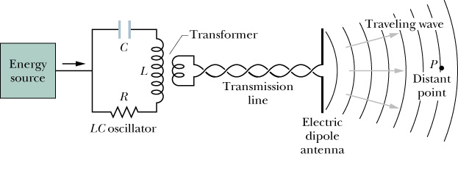
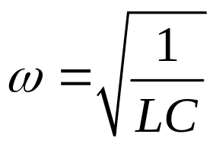
The Traveling Electromagnetic (EM) Wave, Qualitatively
An LC oscillator causes currents to flow sinusoidally, which in turn produces oscillating electric and magnetic fields, which then propagate through space as EM waves.
Oscillation Frequency:

Slide 6

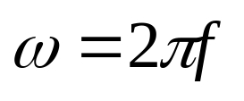
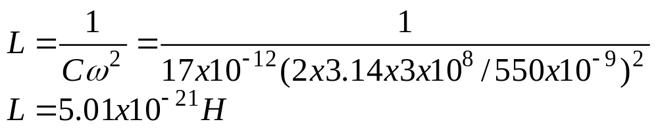
Oscillation Frequency:

Slide 7
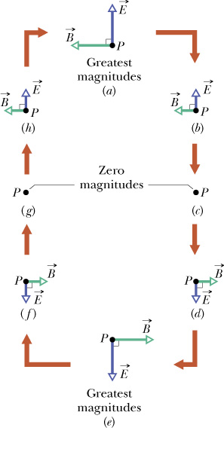
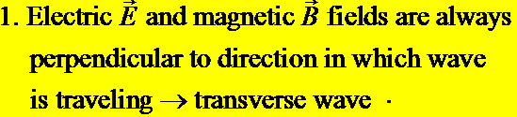


The Traveling Electromagnetic (EM) Wave, Qualitatively
Variation in E and B at the distant Point P

Slide 8
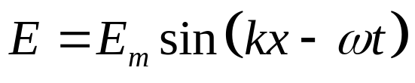
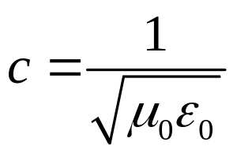
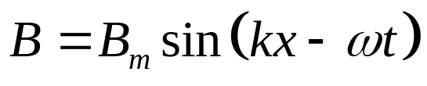
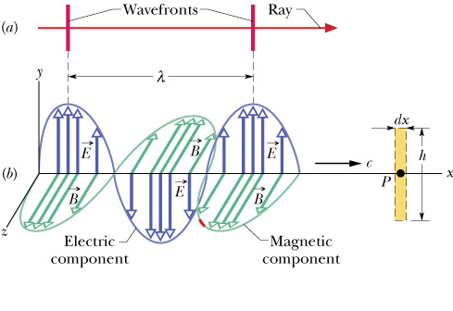
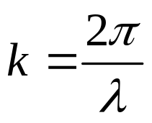
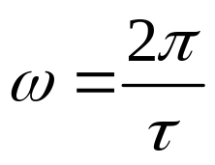


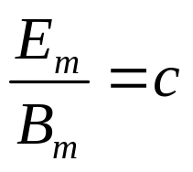
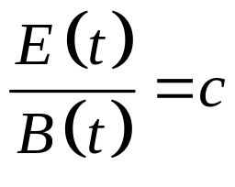
Mathematical Description of Traveling EM Waves
Electric Field:
Wave Speed:
Magnetic Field:
Wavenumber:
EM Wave Simulation
Angular frequency:
Vacuum Permittivity:
Vacuum Permeability:
Amplitude Ratio:
Magnitude Ratio:

Slide 9
For which one of the following properties do visible light and ultraviolet waves have the same value?
a) wavelength
b) frequency
c) speed
d) energy
e) period

Slide 10
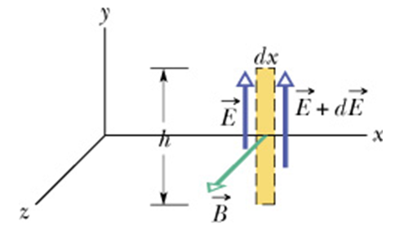
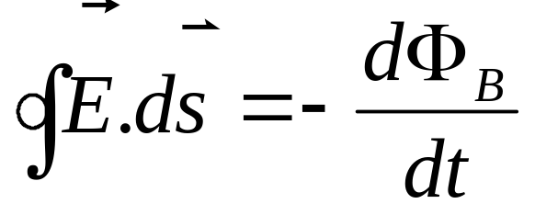
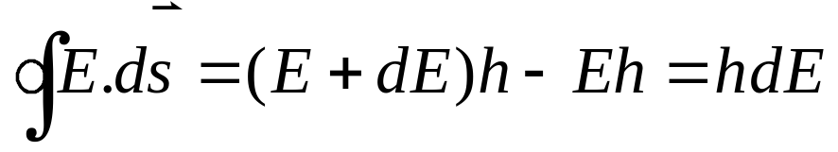
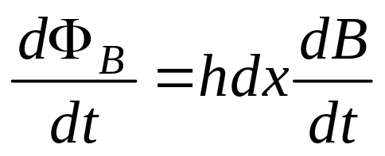
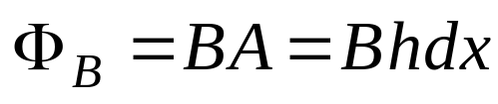
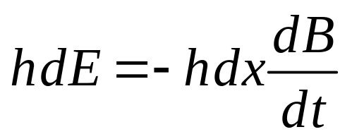
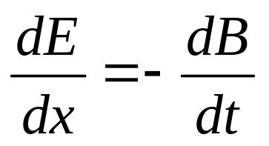
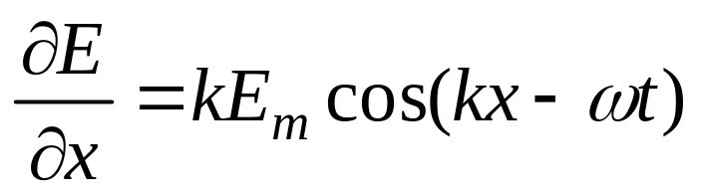
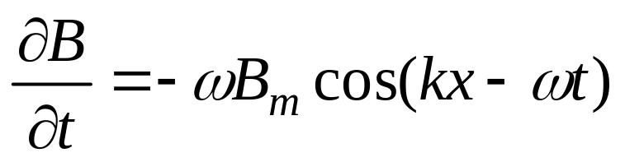
Traveling EM Waves, Quantitatvely

Slide 11
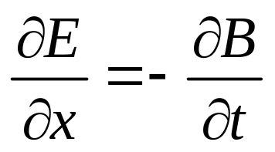
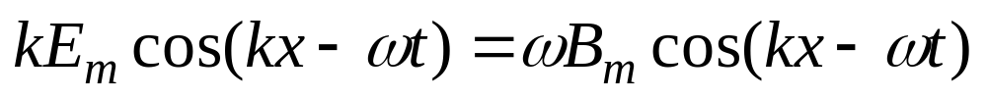
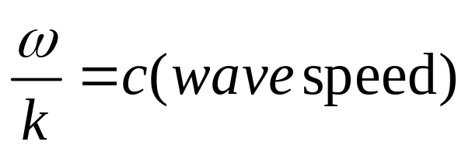
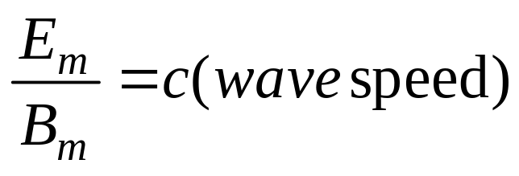

Slide 12
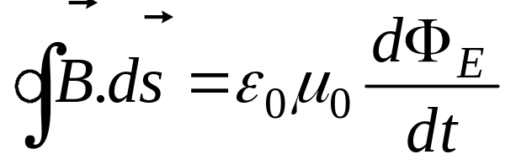
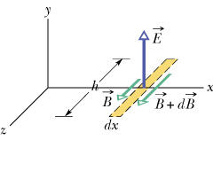
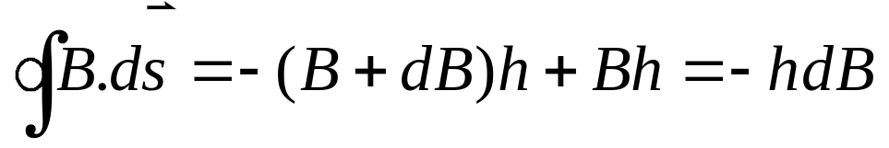
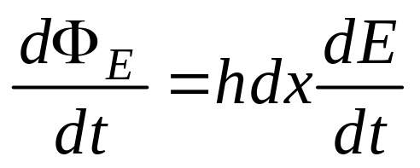
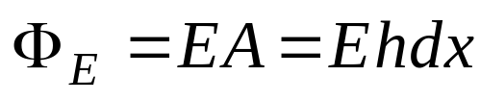
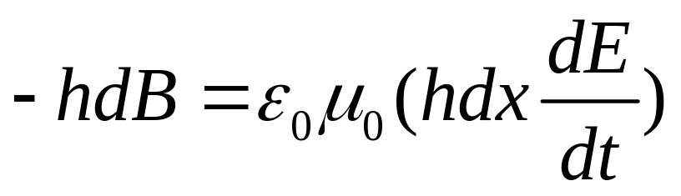
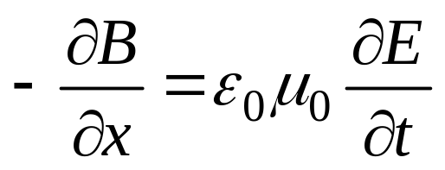
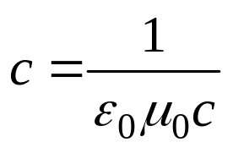
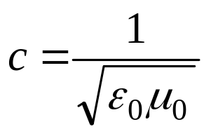
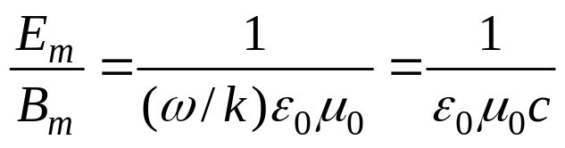
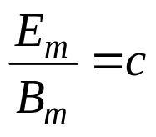

Slide 13


What is the wavelength of the electromagnetic wave emitted by the oscillator–antenna system if L= 0.253 mH and C = 25.0 pF?

Slide 14
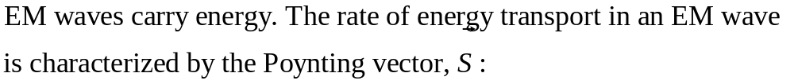
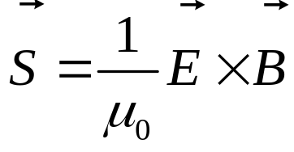
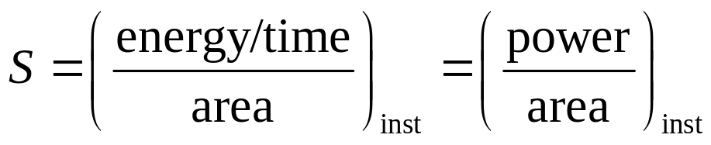
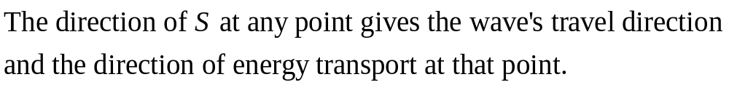
Energy Transports and the Poynting Vector
Poynting Vector:
The magnitude of S is related to the rate at which energy is transported by a wave across a unit area at any instant (inst). The unit for S is (W/m²).

Slide 15
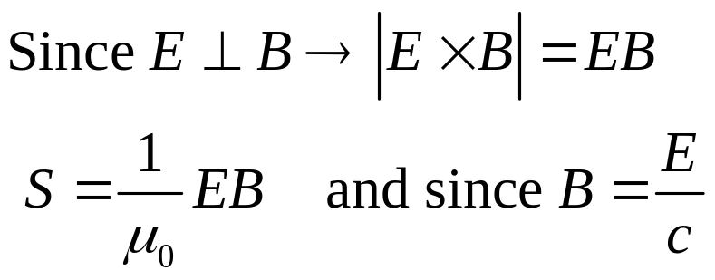

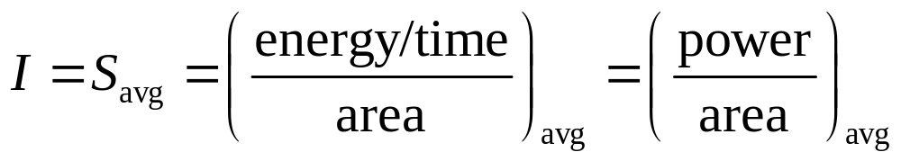
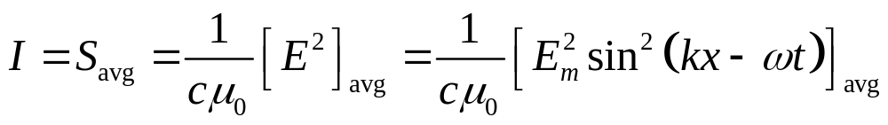
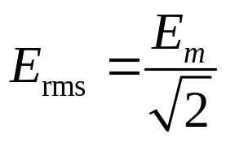
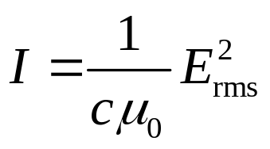
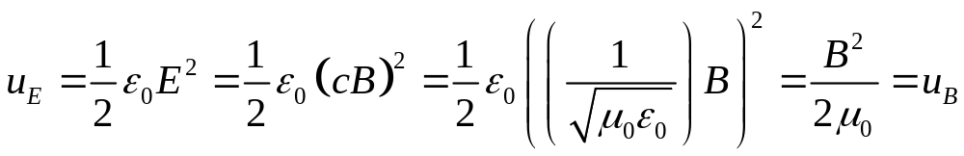
Instantaneous
energy flow rate:
S is a function of time. The time-averaged value for S, S_{avg} is also called the intensity I of the wave.

Slide 16


Variation of Intensity with Distance
Consider a point source S that is emitting EM waves isotopically (equally in all directions) at a rate P_{S}. Assume that the energy of waves is conserved as they spread from source.
How does the intensity (power/area) change with distance r?

Slide 17


Slide 18

Polarization
The polarization of light describes how the electric field in the EM wave oscillates.
Vertically plane polarized in y-direction( the plan containing E vector is the plane of oscillation)
in England VHF TV antennas in England are oriented vertically
in US are horizontal
Direction of E oscillation ( to represent polarization)

Slide 19

Polarized Light
Unpolarized or randomly polarized light has its instantaneous polarization direction vary randomly with time.
Travelling out of the page
One can produce unpolarized light by the addition (superposition) of two perpendicularly polarized waves with randomly varying amplitudes.

Slide 20

Polarizing Sheet
We can transfer unpolarized light into polarized by passing through polarizing sheet.
I₀
I
Polaroid
Only the electric field component along the polarizing direction of polarizing sheet is passed (transmitted); the perpendicular component is blocked (absorbed).

Slide 21







Intensity of Transmitted Polarized Light
Intensity of transmitted light,
unpolarized incident light:
Since only the component of the incident electric field E parallel to the polarizing axis is transmitted.
Intensity of transmitted light,
polarized incident light:
For unpolarized light, θ varies randomly in time:

Slide 22

Overlapping Polarizing Sheets

Slide 23
Complete the following statement: The polarization direction of an electromagnetic wave is determined by
a) the direction the wave is traveling.
b) the frequency of the electromagnetic radiation.
c) the direction of the magnetic field component.
d) the wavelength of the electromagnetic radiation.
e) the direction of the electric field component.

Slide 24
When unpolarized light is incident on a sheet of polarizing material with a transmission axis oriented vertically, what percentage of the light is transmitted through the material?
a) ten percent
b) twenty-five percent
c) fifty percent
d) seventy-five percent
e) zero percent

Slide 25



Slide 26




Reflection and Refraction
Although light waves spread as they move from a source, often we can approximate its travel as being a straight line → geometrical optics.
What happens when a narrow beam of light encounters a glass surface?
Law of Reflection
Reflection:
Snell’s Law
Refraction:
n is the index of refraction of the material.

Slide 27

Refractive index

Slide 28

Reflection and Refraction
For light going from n₁ to n₂:
n₂ = n₁ → θ₂ = θ₁
n₂ > n₁ → θ₂<θ₁, light bent toward normal
n₂ < n₁ → θ₂ > θ₁, light bent away from normal

Slide 29

a

Slide 30


Chromatic Dispersion
The index of refraction n encountered by light in any medium except vacuum depends on the wavelength of the light. So if light consisting of different wavelengths enters a material, the different wavelengths will be refracted differently → chromatic dispersion.
n_{2,blue}>n_{2,red}
Chromatic dispersion can be good (e.g., used to analyze wavelength composition of light) or bad (e.g., chromatic aberration in lenses).

Slide 31

The angle is 180⁰

Slide 32



Total Internal Reflection
For light that travels from a medium with a larger index of refraction to a medium with a smaller index of refraction n₁>n₂ → θ₂>θ₁, as θ₁ increases, θ₂ will reach 90º (the largest possible angle for refraction) before θ₁ does.
n₂
n₁
Critical Angle:
Total internal reflection can be used, for example, to guide/contain light along an optical fiber.

Slide 33


Total Internal Reflection
An endoscope used to inspect an artery.

Slide 34


Critical Angle:

Slide 35




Polarization by Reflection
Applications
Perfect window: since parallel polarization is not reflected, all of it is transmitted
Polarizer: only the perpendicular component is reflected, so one can select only this component of the incident polarization
Brewster’s Law
Brewster Angle:

Slide 36


Brewster Angle:
b) yes

Slide 37




Slide 38




Suggested Problems (CH: 33)

Slide 39




Suggested Problems (CH: 33)

Slide 40


