Slide 1
Chapter 32
Maxwell Equations; Magnetism of Matter

Slide 2
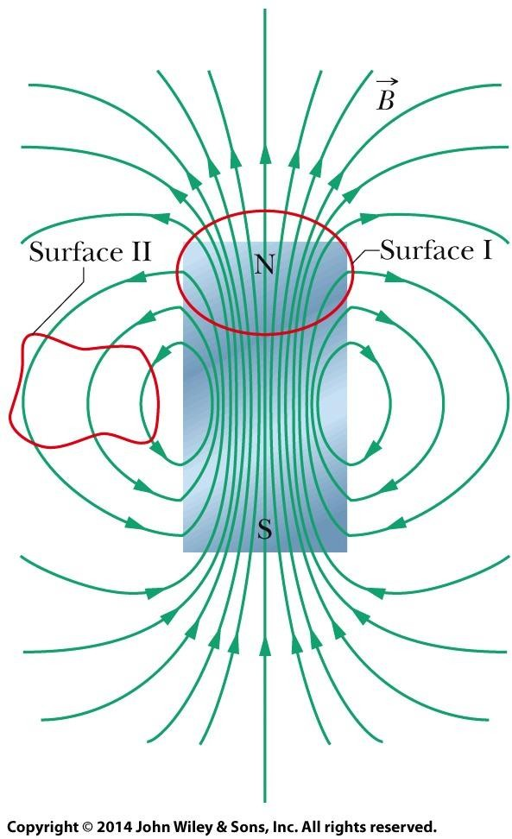

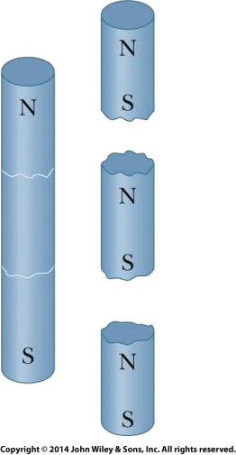


32-1 Gauss’ Law for Magnetic Fields
Gauss’ law for magnetic fields is a formal way of saying that magnetic monopoles do not exist. The law asserts that the net magnetic flux Φ_{B} through any closed Gaussian surface is zero:
Contrast this with Gauss’ law for electric fields,
The field lines for the magnetic field B of a short bar magnet. The red curves represent cross sections of closed, three-dimensional Gaussian surfaces.
If you break a magnet, each fragment becomes a separate magnet, with its own north and south poles.
Gauss’ law for magnetic fields says that there can be no net magnetic flux through the surface because there can be no net “magnetic charge” (individual magnetic poles) enclosed by the surface.

Slide 3
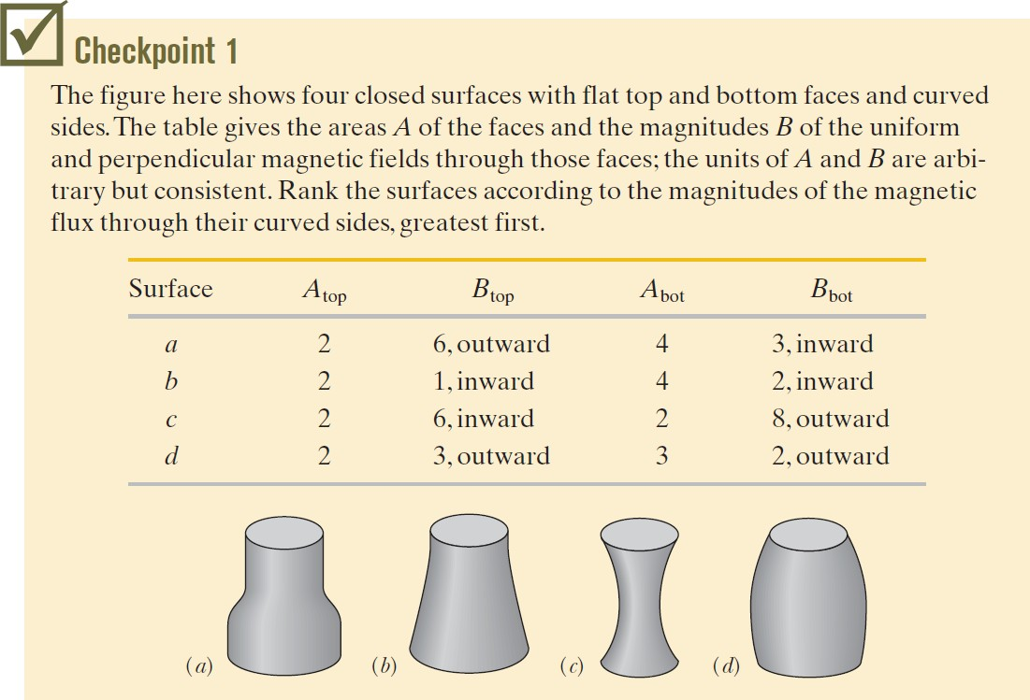

Slide 4
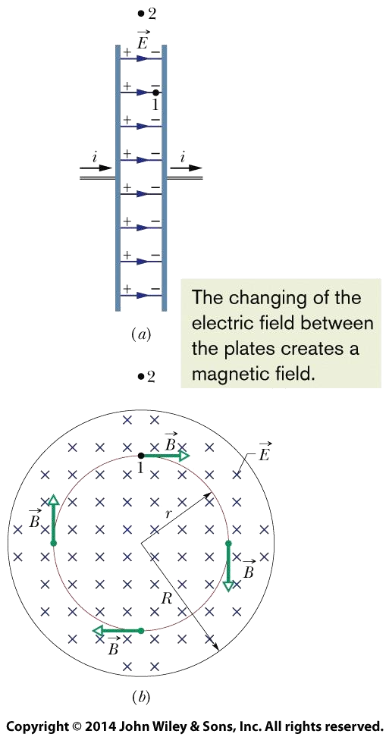

32-2 Induced Magnetic Fields
A changing electric flux induces a magnetic field B. Maxwell’s
Law,
Relates the magnetic field induced along a closed loop to the
changing electric flux ϕ_{E} through the loop.
Charging a Capacitor.
As an example of this sort of induction, we consider the charging of a parallel-plate capacitor with circular plates. The charge on our capacitor is being increased at a steady rate by a constant current i in the connecting wires. Then the electric field magnitude between the plates must also be increasing at a steady rate.

Slide 5
32-2 Induced Magnetic Fields
A changing electric flux induces a magnetic field B. Maxwell’s
Law,
Relates the magnetic field induced along a closed loop to the
changing electric flux ϕ_{E} through the loop.
Charging a Capacitor (continued)
Figure (b) is a view of the right-hand plate of Fig. (a) from between the plates. The electric field is directed into the page. Let us consider a circular loop through point 1 in Figs.(a) and (b), a loop that is concentric with the capacitor plates and has a radius smaller than that of the plates. Because the electric field through the loop is changing, the electric flux through the loop must also be changing. According to the above equation, this changing electric flux induces a magnetic field around the loop.

Slide 6

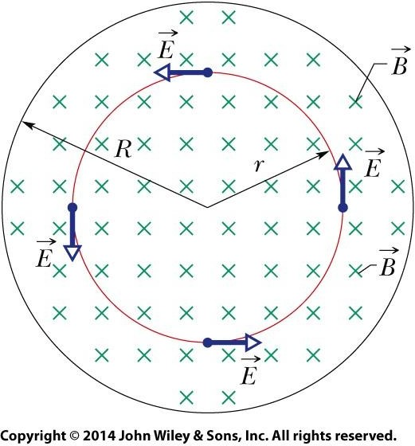


32-2 Induced Magnetic Fields
Ampere-Maxwell Law
Ampere’s law,
gives the magnetic field generated by a current i_{enc} encircled by a closed loop.
Thus, the two equations (the other being Maxwell’s Law) that specify the magnetic field B produced by means other than a magnetic material (that is, by a current and by a changing electric field) give the field in exactly the same
form. We can combine the two equations into the single equation:
When there is a current but no change in electric flux (such as with a wire carrying a constant current), the first term on the right side of Eq. is zero, and so the Eq. reduces to Ampere’s law. When there is a change in electric flux but no current (such as inside or outside the gap of a charging capacitor), the second term on the right side of Eq. is zero, and so Eq. reduces to Maxwell’s law of induction.

Slide 7
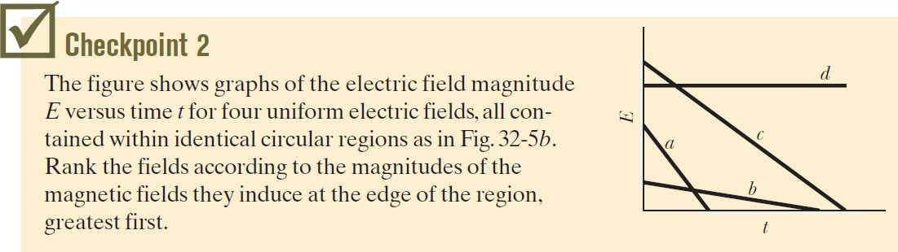

Slide 8
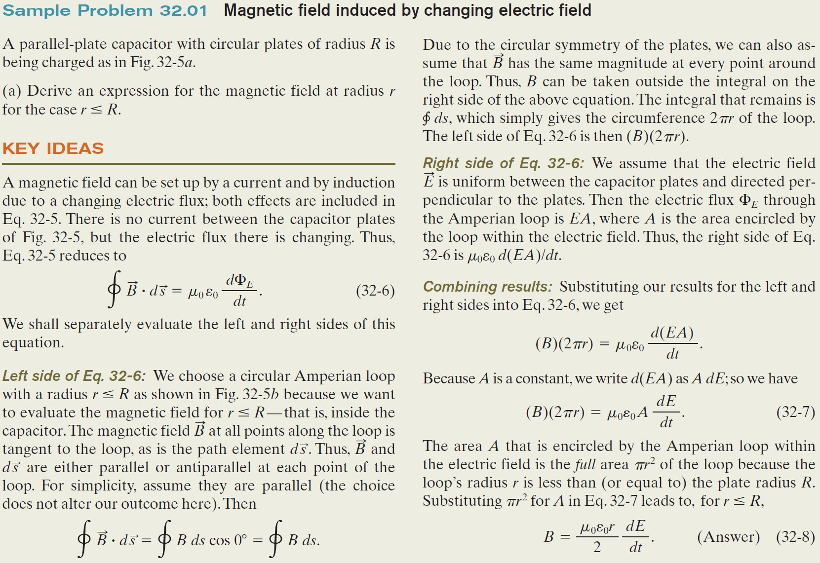

Slide 9
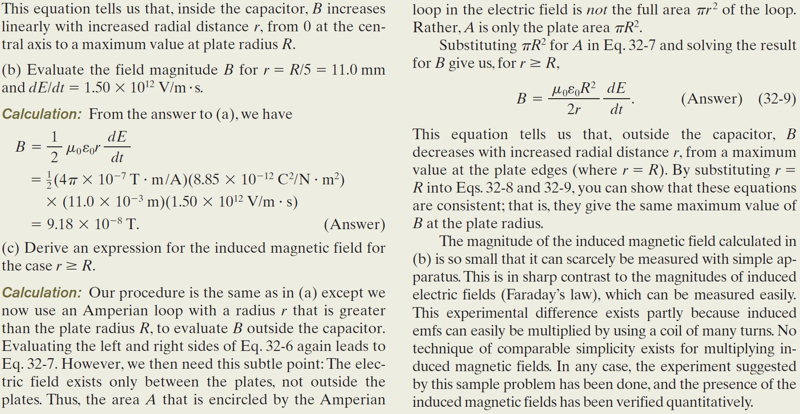

Slide 10

Chapter 32
Maxwell Equations; Magnetism of Matter

Slide 11


32-3 Displacement Current
If you compare the two terms on the right side of Eq. (Ampere-Maxwell Law), you will see that the product ε₀(dϕ_{E}/dt) must have the dimension of a current. In fact, that product has been treated as being a fictitious current called the displacement current i_{d}:
Ampere-Maxwell law
Ampere-Maxwell Law then becomes,
where i_{d,enc} is the displacement current encircled by the integration loop.

Slide 12
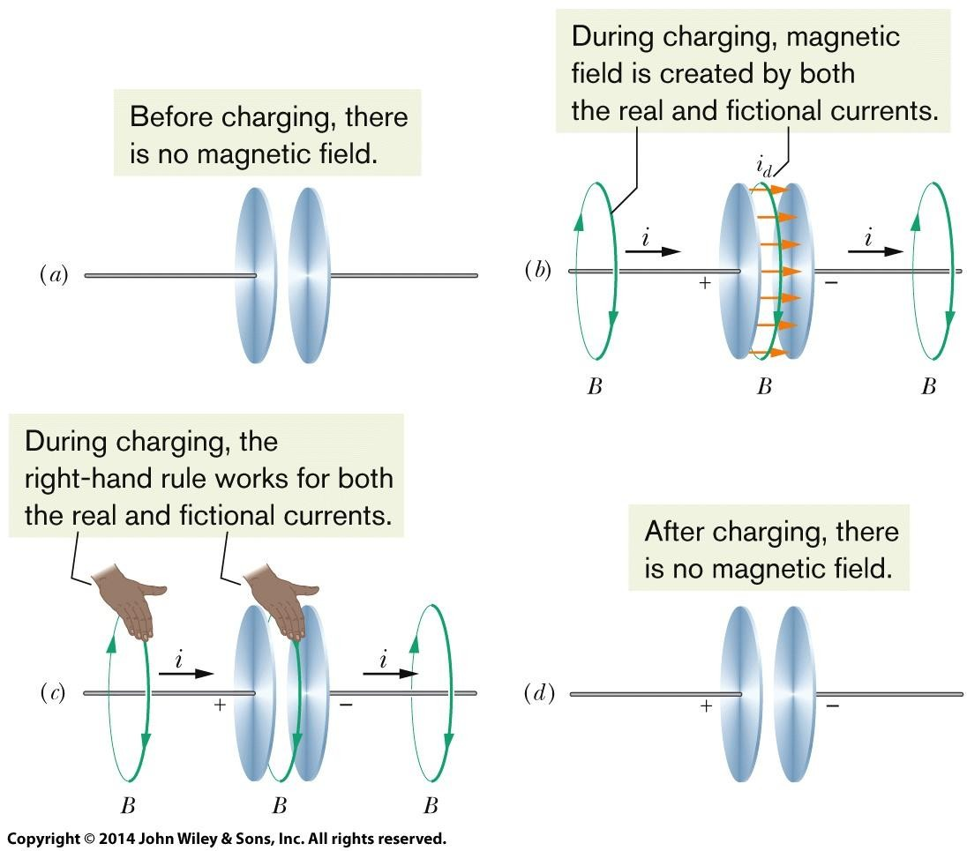


32-3 Displacement Current
Finding the Induced Magnetic Field:
In Chapter 29 we found the direction of the magnetic field produced by a real current i by using the right-hand rule. We can apply the same rule to find the direction of an induced magnetic field produced by a fictitious displacement current i_{d}, as is shown in the center of Fig. (c) for a capacitor.
Then, as done previously, the magnitude of the magnetic field at a point inside the capacitor at radius r from the center is
(a) Before and (d) after the plates are charged, there is no magnetic field. (b) During the charging, magnetic field is created by both the real current and the (fictional) (c) displacement current. (c) The same right-hand rule works for both currents to give the direction of the magnetic field.
the magnitude of the magnetic field at a point outside the capacitor at radius r is

Slide 13
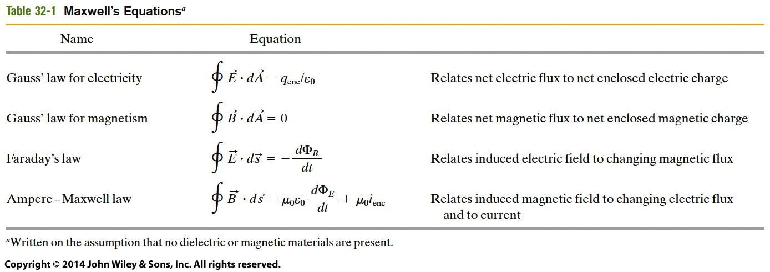
32-3 Displacement Current
The four fundamental equations of electromagnetism, called Maxwell’s
equations and are displayed in Table 32-1.
These four equations explain a diverse range of phenomena, from why a compass needle points north to why a car starts when you turn the ignition key. They are the basis for the functioning of such electromagnetic devices as electric motors, television transmitters and receivers, telephones, scanners, radar, and microwave ovens.

Slide 14
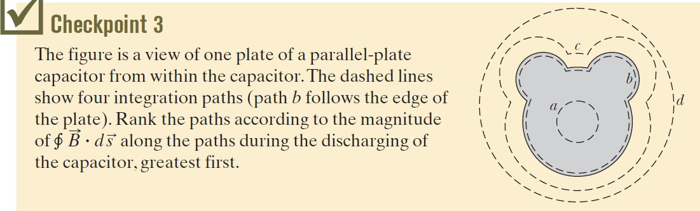

Slide 15
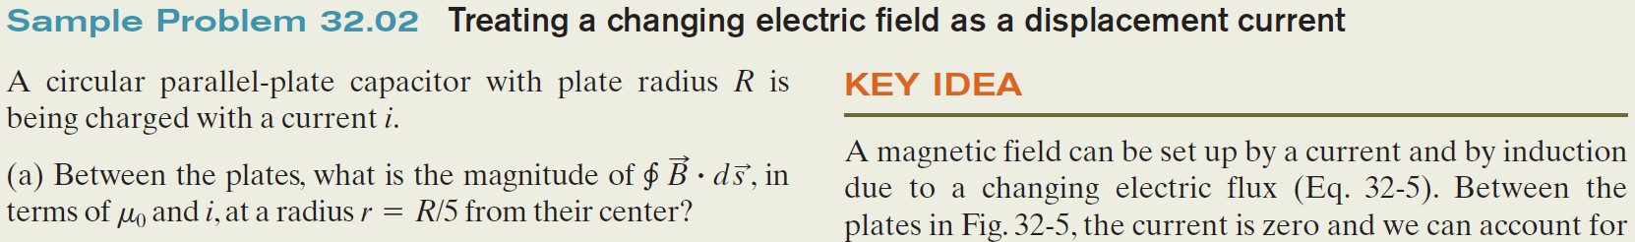
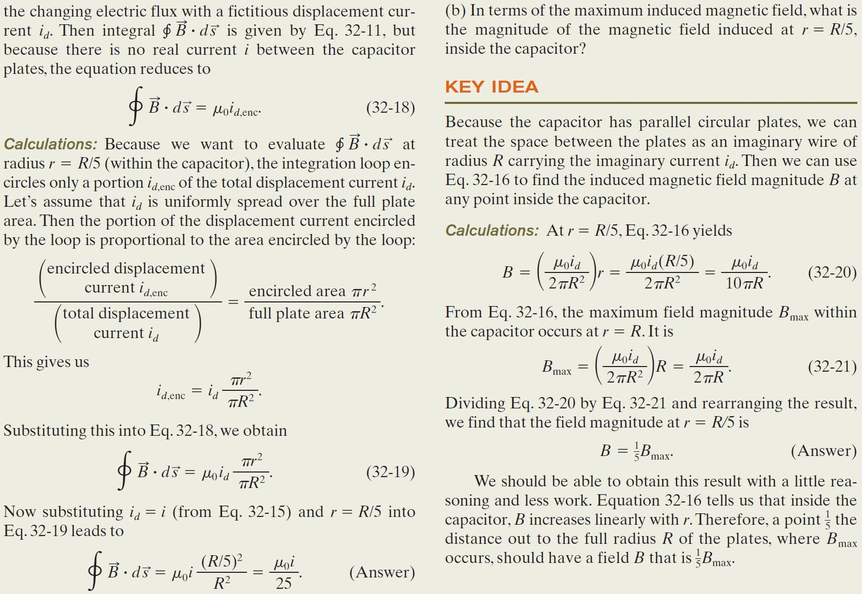

Slide 16
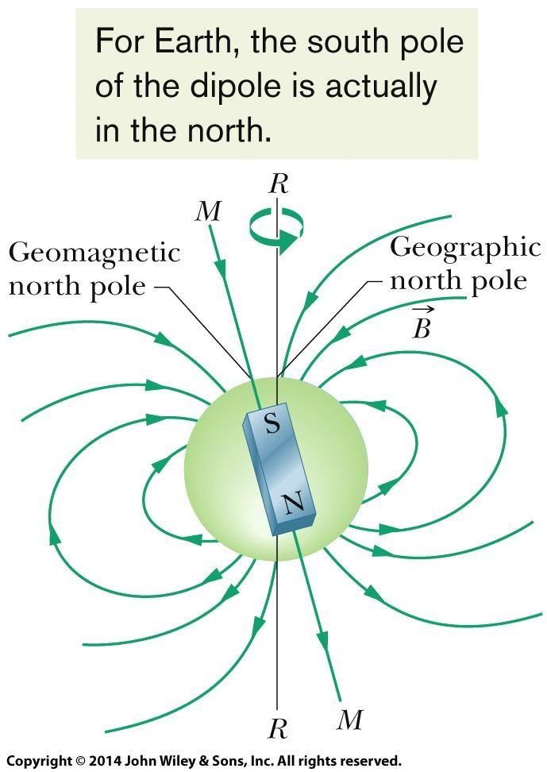
32-4 Magnets
The Magnetism of Earth
Earth is a huge magnet; for points near Earth’s surface, its magnetic field can be approximated as the field of a huge bar magnet — a magnetic dipole
— that straddles the center of the planet. Figure shown here is an idealized symmetric depiction of the dipole field, without the distortion caused by passing charged particles from the Sun.
The direction of the magnetic field at any location on Earth’s surface is commonly specified in terms of two angles. The field declination is the angle (left or right) between geographic north (which is toward 90° latitude) and the horizontal component of the field.
The field inclination is the angle (up or down)
between a horizontal plane and the field’s direction.
Earth’s magnetic field represented as a dipole field. The dipole axis MM makes an angle of 11.5° with Earth’s rotational axis RR. The south pole of the dipole is in Earth’s Northern Hemisphere.

Slide 17
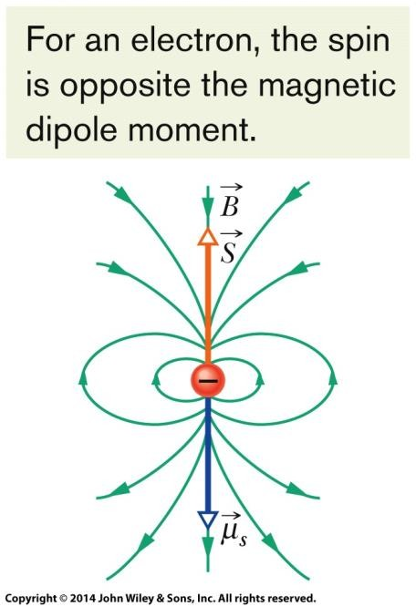




32-5 Magnetism and Electrons
Spin Magnetic Dipole Moment. An electron has an intrinsic angular momentum called its spin angular momentum (or just spin) S; associated with this spin is an intrinsic spin magnetic dipole moment μ_{s}. (By intrinsic, we mean that S and μ_{s} are basic characteristics of an electron, like its mass and electric charge.) Vectors S and μ_{s} are related by
in which e is the elementary charge (1.60 × 10⁻¹⁹ C) and m is the mass of an electron (9.11 × 10⁻³¹ kg). The minus sign means that μ_{s} and S are oppositely directed.
For a measurement along a z axis, the component S_{z} can have only the values given by
for m_{s}= ±½
where μ_{B} is the Bohr magneton:
Similarly,

Slide 18

32-5 Magnetism and Electrons
Spin Magnetic Dipole Moment. An electron has an intrinsic angular momentum called its spin angular momentum (or just spin) S; associated with this spin is an intrinsic spin magnetic dipole moment μ_{s}. (By intrinsic, we mean that S and μ_{s} are basic characteristics of an electron, like its mass and electric charge.) Vectors S and μ_{s} are related by
Energy. When an electron is placed in an external magnetic field B_{ext}, an energy U can be associated with the orientation of the electron’s spin magnetic dipole moment μ_{s} just as an energy can be associated with the orientation of the magnetic dipole moment μ of a current loop placed in B. The orientation energy for the electron is
where the z axis is taken to be in the direction of B_{ext}.

Slide 19

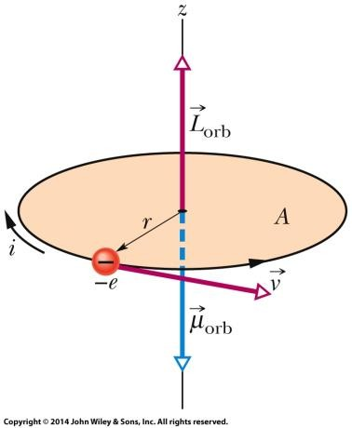


32-5 Magnetism and Electrons
Orbital Magnetic Dipole Moment. When it is in an atom, an electron has an
additional angular momentum called its orbital angular momentum L_{orb}. Associated with L_{orb} is an orbital magnetic dipole moment μ_{orb} the two are related by
The minus sign means that μ_{orb} and L_{orb} have opposite directions. Orbital angular momentum is quantized and can have only measured values given by
for m_{l}=0, ±1, ±2, …, ±(limit integer)
The associated magnetic dipole moment is given by
An electron moving at constant speed v in a circular path of radius r that encloses an area A.
The energy U associated with the orientation of the orbital magnetic dipole moment
in an external magnetic field B_{ext} is

Slide 20

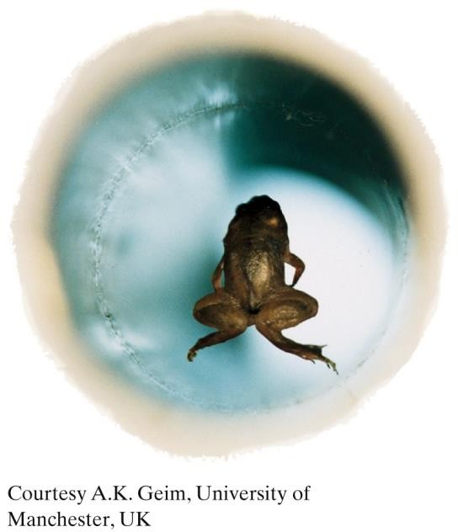
32-6 Diamagnetism
Levitating Frog: The frog in the figure is diamagnetic (as is any other animal). When the frog was placed in the diverging magnetic field near the top end of a vertical current- carrying solenoid, every atom in the frog was repelled upward, away from the region of stronger magnetic field at that end of the solenoid. The frog moved upward into weaker and weaker magnetic field until the upward magnetic force balanced the gravitational force on it, and there it hung in midair. The frog is not in discomfort because every atom is subject to the same forces and thus there is no force variation within the frog.

Slide 21
Chapter 32
Maxwell Equations; Magnetism of Matter

Slide 22
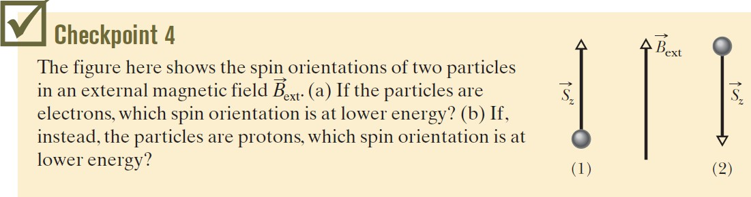

Slide 23
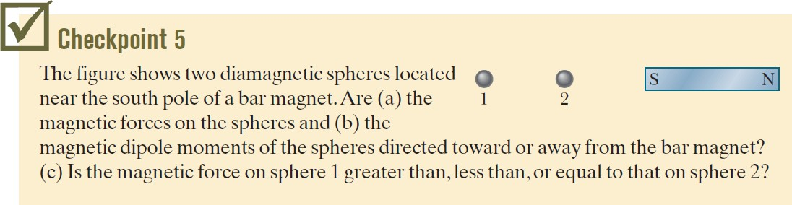

Slide 24


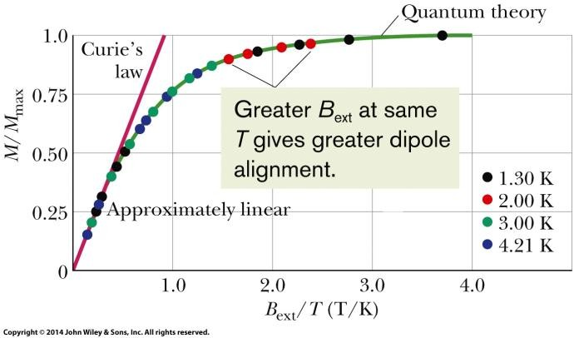

32-7 Paramagnetism
Paramagnetic materials have atoms with a permanent magnetic dipole moment but the moments are randomly oriented, with no net moment, unless the material is in an external magnetic field B_{ext}, where the dipoles tend to align with that field. The extent of alignment within a volume V is measured as the magnetization M,
given by
Complete alignment (saturation) of all N dipoles in the volume gives a maximum value M_{max} = Nμ/V.
At low values of the ratio B_{ext} /T,
where T is the temperature (in kelvins) and C is a material’s Curie constant.
In a nonuniform external field, a paramagnetic material is attracted to the region of greater magnetic field.

Slide 25
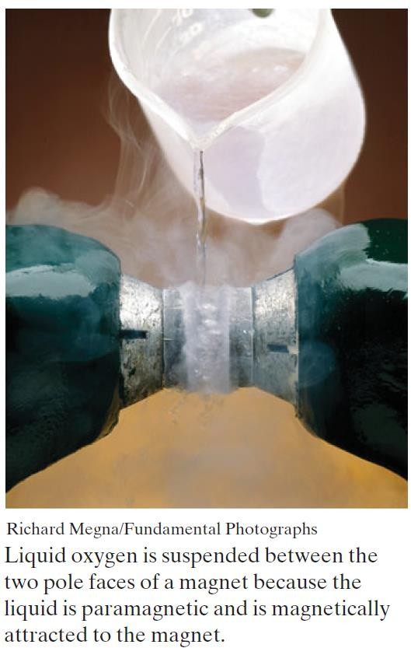

Slide 26
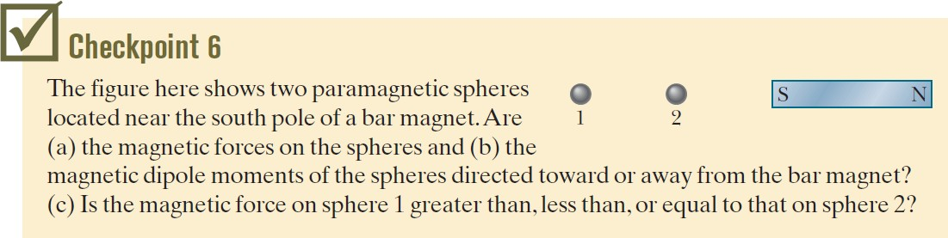

Slide 27
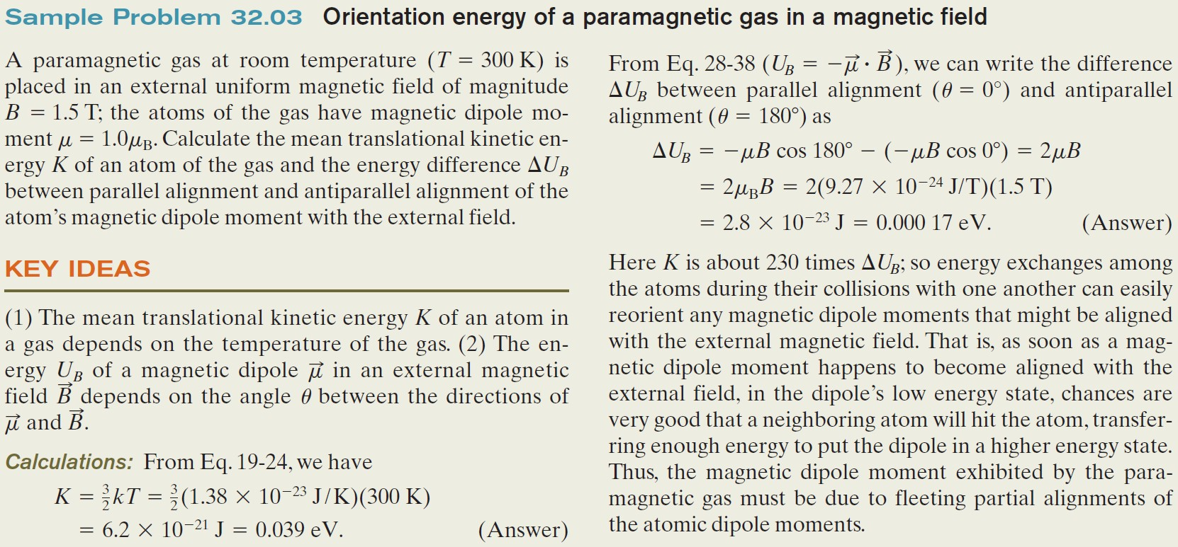

Slide 28
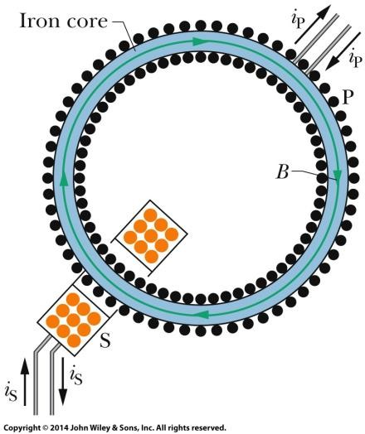

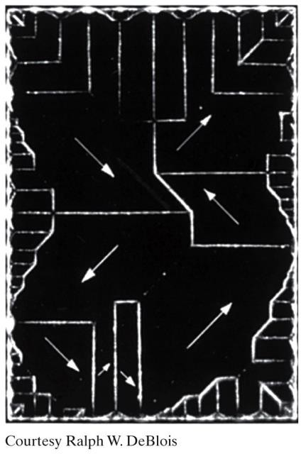
32-8 Ferromagnetism
The magnetic dipole moments in a ferromagnetic material can be aligned by an external magnetic field and then, after the external field is removed, remain partially aligned in regions know as magnetic domains.
A photograph of domain patterns within a single crystal of nickel; white lines reveal the boundaries of the domains. The white arrows superimposed on the photograph show the orientations of the magnetic dipoles within the
A Rowland ring. A primary coil P has a core made of the ferromagnetic material to be studied (here iron). The core is
magnetized by a current i_{P} sent
through coil P. (The turns of the coil are represented by dots.) The extent to which the core is magnetized determines the total magnetic field B within coil P. Field
domains and thus the orientations of the net magnetic dipoles of the domains. The crystal as a whole is unmagnetized if the net magnetic field (the vector sum over all the domains) is zero.
B can be measured by means of a secondary coil S.

Slide 29
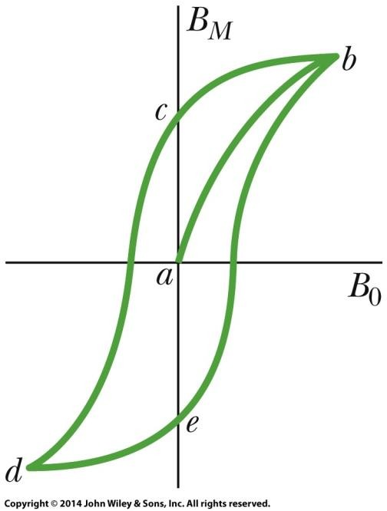
32-8 Ferromagnetism
The lack of retraceability shown in the Figure is called hysteresis, and the curve bcdeb is called a hysteresis loop. Note that at points c and e the iron core is magnetized, even though there is no current in the toroid windings; this is the familiar phenomenon of permanent magnetism.
Hysteresis can be understood through the concept of magnetic domains. Evidently the motions of the domain boundaries and the reorientations of the domain directions are not totally reversible. When the applied magnetic field B0 is increased and then decreased back to its initial value, the domains do not return completely to their original configuration but retain some “memory” of their alignment after the initial increase. This memory of magnetic materials is essential for the magnetic storage of information.

Slide 30
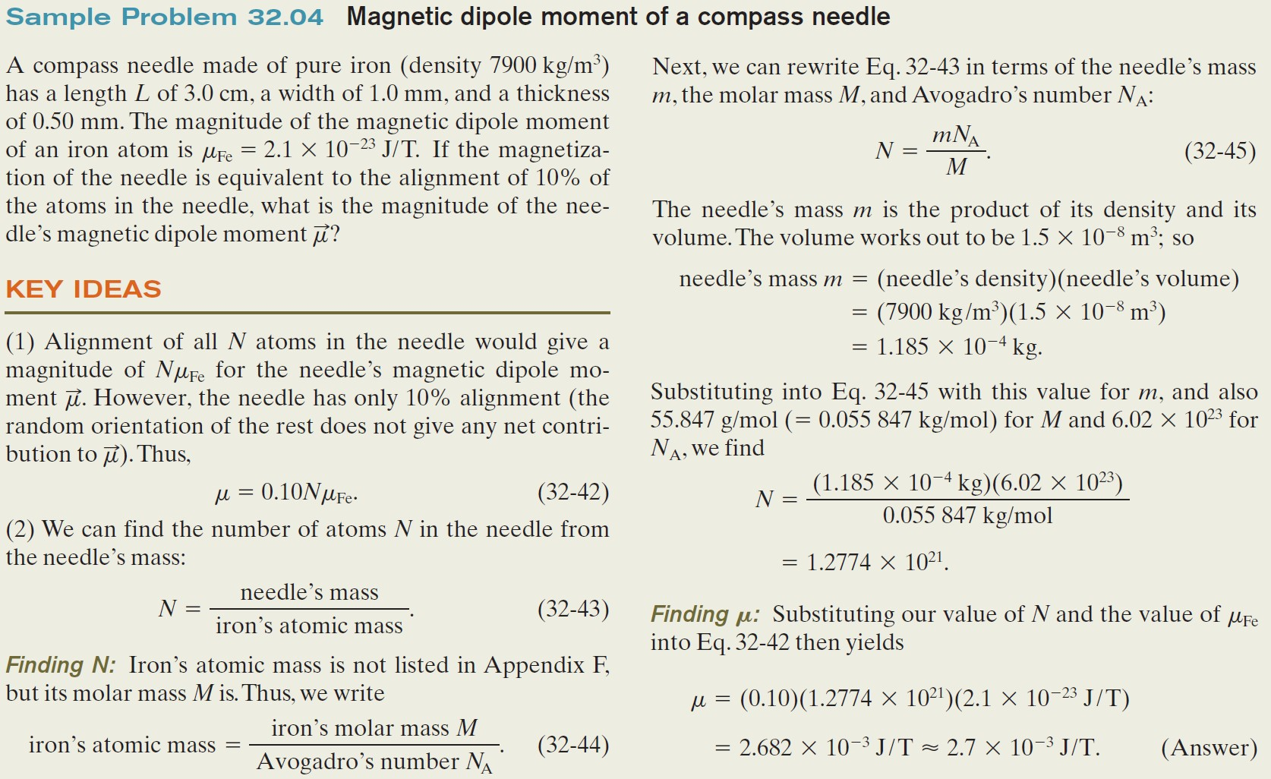

Slide 31



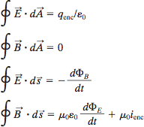

32 Summary
Gauss’ Law for Magnetic Fields
Gauss’ law for magnetic fields,
Displacement Current
We define the fictitious displacement current due to a changing electric field as
Eq. 32-10
Equation 32-5 then becomes
Eq. 32-11
Maxwell’s Equations
Four equations are as follows:
Eq. 32-1
Maxwell’s Extension of
Ampere’s Law
A changing electric field induces a magnetic field given by,
Eq. 32-3
Maxwell’s law and Ampere’s law can be written as the single equation
Eq. 32-5

Slide 32




32 Summary
Spin Magnetic Dipole Moment
Spin angular momentum of electron is associated with spin magnetic dipole momentum through,
Eq. 32-22
For a measurement along a z axis, the component S_{z} can have only the values given by
Similarly,
Eq. 32-24 &26
Where the Bohr magneton is
Eq. 32-25
The energy U
Orbital Magnetic Dipole Momentum
Angular momentum of an electron is associated with orbital magnetic dipole momentum as
Eq. 32-28
Orbital angular momentum is
quantized,
Eq. 32-29
The associated magnetic dipole moment is given by
Eq. 32-30&31
The energy U
Eq. 32-32
Eq. 32-23
Eq. 32-27

Slide 33

32 Summary
Diamagnetism
Diamagnetic materials exhibit magnetism only when placed in an external magnetic field; there they form magnetic dipoles directed opposite the external field. In a nonuniform field, they are repelled from the region of greater magnetic field.
Paramagnetism
Paramagnetic materials have atoms with a permanent magnetic dipole moment but the moments are randomly oriented unless the material is in an external magnetic field. The extent of alignment within a volume V is measured as the magnetization M, given by
Eq. 32-28
Complete alignment (saturation) of all N dipoles in the volume gives a maximum value M_{max} = Nμ/V. At low values of the ratio B_{ext} /T,
Eq. 32-39
Ferromagnetism
The magnetic dipole moments in a ferromagnetic material can be aligned by an external magnetic field and then, after the external field is removed, remain partially aligned in regions (domains). Alignment is eliminated at temperatures above a material’s Curie temperature. In a nonuniform external field, a ferromagnetic material is attracted to the region of greater magnetic field.

Slide 34

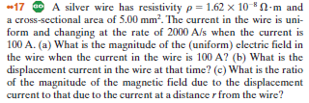

Suggested Problems (CH: 32)

Slide 35

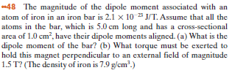

Suggested Problems (CH: 32)

