Slide 1
Phys 204 Course Description-T261
PHYS 204 Nuclear Instrumentation (3-0-3)
Inductance; magnetic properties of matter, electromagnetic oscillations and waves; geometrical and physical optics. Relativity, introduction to quantum physics, atomic physics, solids, nuclear physics, particle physics and cosmology.
(Prerequisites: PHYS 102, MATH 102)
Course Objectives:
Teach the students Maxwell’s equations, how they relate Syllabus to Gauss’s, Faraday’s, Ampere’s laws.
Teach the students the major laws in geometrical and wave optics.
Introduce Einstein’s two postulates of special relativity and their major consequences.
Motivate the need of quantum physics.
Introduce Schrodinger’s equation in one dimension and Heisenberg uncertainty principle.
Introduce the hydrogen atom and its quantized energy levels.
Textbooks:
Fundamentals of Physics, by Halliday, Resnick and Walker, Eleventh Edition, John Wiley & Sons, Inc (2018).
List Recommended Textbooks and Reference Material (Journals, Reports, etc)
Physics for Scientists and Engineers by Serway (Latest Edition), The Physics Teacher, Physics Today, Scientific American
. List Electronic Materials, Web Sites, Facebook, Twitter, etc.
•http://hyperphysics.phy-astr.gsu.edu/hbase/hframe.html.
•YouTube

Slide 2
Schedule of Assessment Tasks for Students During the Semester
 | Assessment Task* | Week Due | Proportion
1 | Class work (Assignments) | Weekly | 10%
2 | Quizzes | Weekly | 20%
3 | First Major Exam | 6 | 20%
4 | Second Major Exam | 12 | 20%
5 | Final Exam | 16 | 30%
Lecture Schedule
Week | Chapter | Topics | Omitted Sections
1 | 30 | Induction and Inductance: Faradays Law of Induction, Inductance, RL Circuits, Energy stored in B, Mutual inductance.
2 | 31 | Electromagnetic Oscillations and Alternating Current: LC Oscillations, RLC Circuits, Series RLC Circuits. | Forced oscillation, transformers
3 | 32 | Maxwell's Equations: Magnetism of Matter: Gauss’ Law for magnetic field, Maxwell’s equations, Magnetic Materials.
4 | 33 | Electromagnetic Waves: EM Waves (Qualitative and Quantitative Analysis), Energy Transport, energy transport and the Poynting vectors, Polarization, Total Internal Refraction. | radiation pressure
5 | 34 | Images: Plane and spherical Mirrors, Spherical Refracting Surfaces and thin lenses. | spherical lenses, three proofs
6 | 35 | Interference: Light as a wave and diffraction, Young’s Interference experiment, Intensity in Double Slit Interference.
7 | 36 | Diffraction: Diffraction & Wave Theory of Light, Diffraction by Double Slit, Diffraction Gratings.
8 | 37 | Relativity: The postulates, Measuring and event, Relativity of Time and Length, Lorentz Transformation, Doppler Effect for Light
9 | 38 | Photons and Matter Waves: Photon, The Quantum of Light, Photons Have Momentum (Schrodinger's equation)
10 | 39 | More About Matter Waves: Energy of Trapped Electron, Two- and Three-Dimensional Trap, The Hydrogen Atom. | two and three D electron trap,
11 | 40 | All About Atoms: Properties of Atoms, Pauli Exclusion Principle, Lasers
12 | 41 | Conduction of Electricity in Solids: Electronic Properties, Metals, Semiconductors
13 | 42 | Nuclear Physics: Some Nuclear Properties, Radioactive Decay, β Decay | Measuring radiation dosage, nuclear models
14 | 43 | Energy from the Nucleus: Energy from the Nucleus
15 | 44 | Quark, Leptons and the Big Bang
Attendance Policy:
PHYS 204 course is offered in person. Class attendance and participation are required.
A DN grade shall be given to the student who has more than 12 unexcused absences in lectures.

Slide 3
Chapter 30
Induction and Inductance
Learning Objectives
30.01 Identify that the amount of magnetic field piercing a surface (not skimming along the surface) is the magnetic flux through the surface. 30.02 Identify that an area vector for a flat surface is a vector that is perpendicular to the surface and that has a magnitude equal to the area of the surface.
30.03 Identify that any surface can be divided into area elements (patch elements) that are each small enough and flat enough for an area vector to be assigned to it, with the vector perpendicular to the element and having a magnitude equal to the area of the element.
30.04 Calculate the magnetic flux through a surface by integrating the dot product of the magnetic field vector and the area vector (for patch elements) over the surface, in magnitude-angle notation and unit-vector notation.
30.05 Identify that a current is induced in a conducting loop while the number of magnetic field lines intercepted by the loop is changing.

Slide 4
Chapter 30
Induction and Inductance
Learning Objectives
30.06 Identify that an induced current in a conducting loop
is driven by an induced emf.
30.07 Apply Faraday’s law, which is the relationship between
an induced emf in a conducting loop and the rate at which
magnetic flux through the loop changes.
30.08 Extend Faraday’s law from a loop to a coil with multiple
loops.
30.09 Identify the three general ways in which the magnetic
flux through a coil can change.
30.10 Use a right-hand rule for Lenz’s law to determine
the direction of induced emf and induced current in a conducting loop.
30.11 Identify that when a magnetic flux through a loop changes, the induced current in the loop sets up a magnetic field to oppose that change.
30.12 If an emf is induced in a conducting loop containing
a battery, determine the net emf and calculate the corresponding current in the loop.

Slide 5
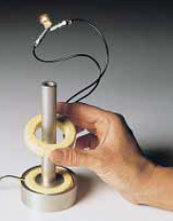
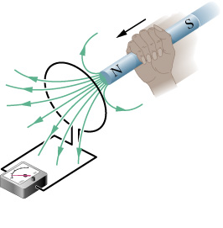
Chapter 30
Induction and Inductance
First Faraday Experiment
Current produced called induced current
Emf appeared called induced emf

Slide 6
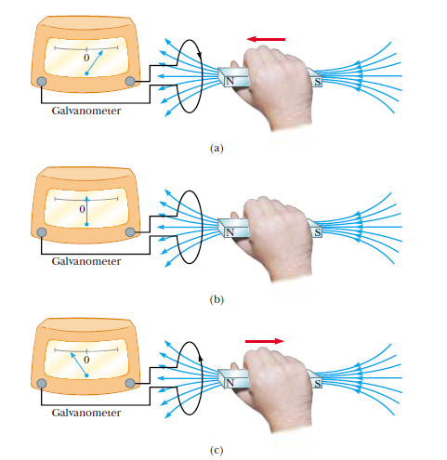

Slide 7
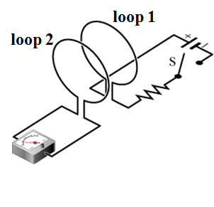
Second Faraday Experiment
closing
Current passing in loop 1
Magnetic field
Induce sudden current in loop 2
Opening
Induce sudden current in opposite direction
Current and emf appear only if something changes!!!!

Slide 8
Farady’s Law of Induction
Important is the rate of changing of the number of magnetic lines
not the actual number
No magnetic field lines
No induced current means
No change of magnetic field lines

Slide 9
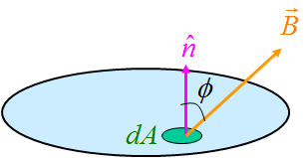


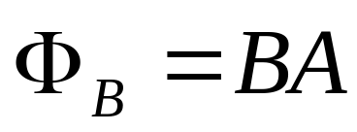
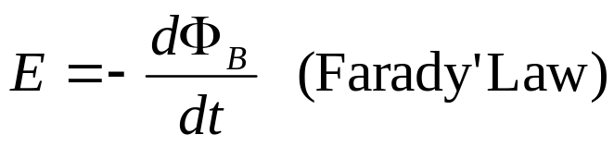
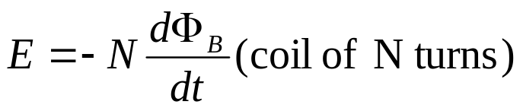
Calculation of emf produced by induction
B ┴ A , B is uniform
SI unit for magnetic flux is Weber (Wb)
1Wb=1T.m²
emf induced

Slide 10
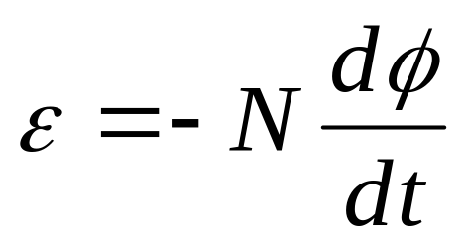
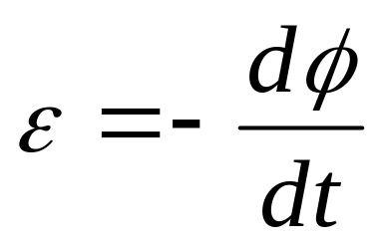
Faraday’s law
N
S
Faradays law: The rate of change of flux through a coil is equal to the emf generated in the coilc
Emf generated in the coil
If the coil have N turns

Slide 11
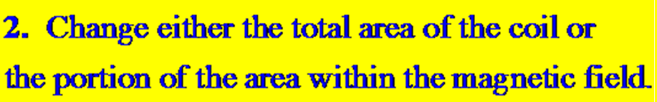

Methods of changing the magnetic flux

Slide 12
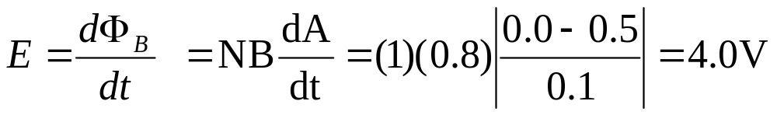
A circular wire loop of area 0.5 m² is perpendicular to a magnetic field of 0.8 T. If the coil is removed completely from the field in 0.1 s, calculate the average magnitude of the emf induced in the loop.
Answer

Slide 13
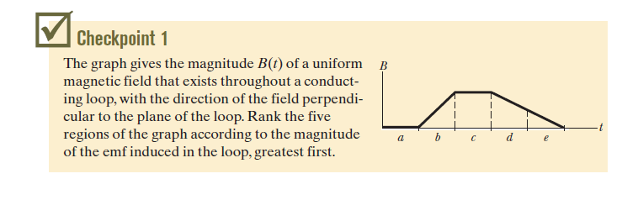
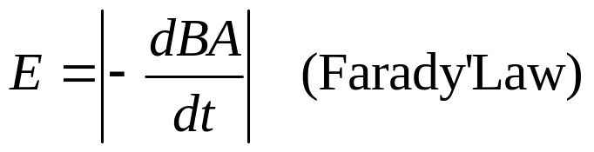

Slide 14
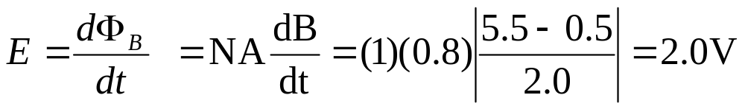
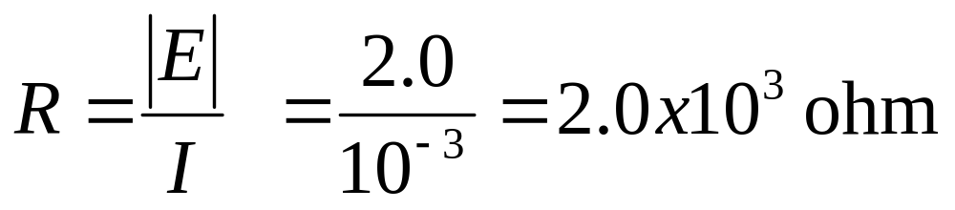
A single turn plane loop of wire of cross sectional area 0.8 m² is perpendicular to a magnetic field that increases uniformly in magnitude from 0.5 T to 5.5 T in 2.0 seconds. What is the resistance of the wire if the induced current has a value of 1.0 mA?
Answer

Slide 15

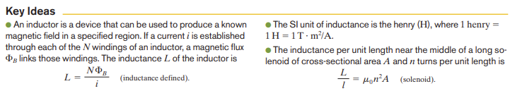
Inductor and Magnetic Field
A capacitor is used to produce a desired electric field. We considered the parallel-plate arrangement as a basic type of capacitor and it stores electrical energy. Similarly, an inductor (L) can be used to produce a desired magnetic field and store magnetic energy.
• Inductor stores energy in a magnetic field
• Opposes changes in current
B_{circular-coil} = μ₀ n I (solenoid) n=no of turns/length, I= current
Magnetic Flux: Φ_{B} = B.A = BAcosθ
Flux Linkage: NΦ_{B}
Inductance, L = NΦ_{B} / I

Slide 16
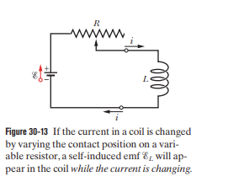
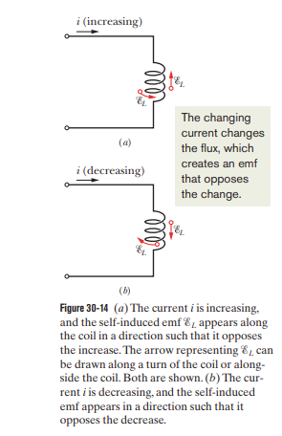
Current Change → Flux Change → Induced emf
Faraday's Law:
ε = −N(dΦ_{B}/dt)
L = NΦ_{B} / I
ε_{L} = - d/dt (NΦ_{B} )
Self-Induced emf in the inductor(coil, solenoid or toroid) :
ε = −L(dI/dt)
Direction of EMF can be determined by Lenz s law
Self-Inductance

Slide 17
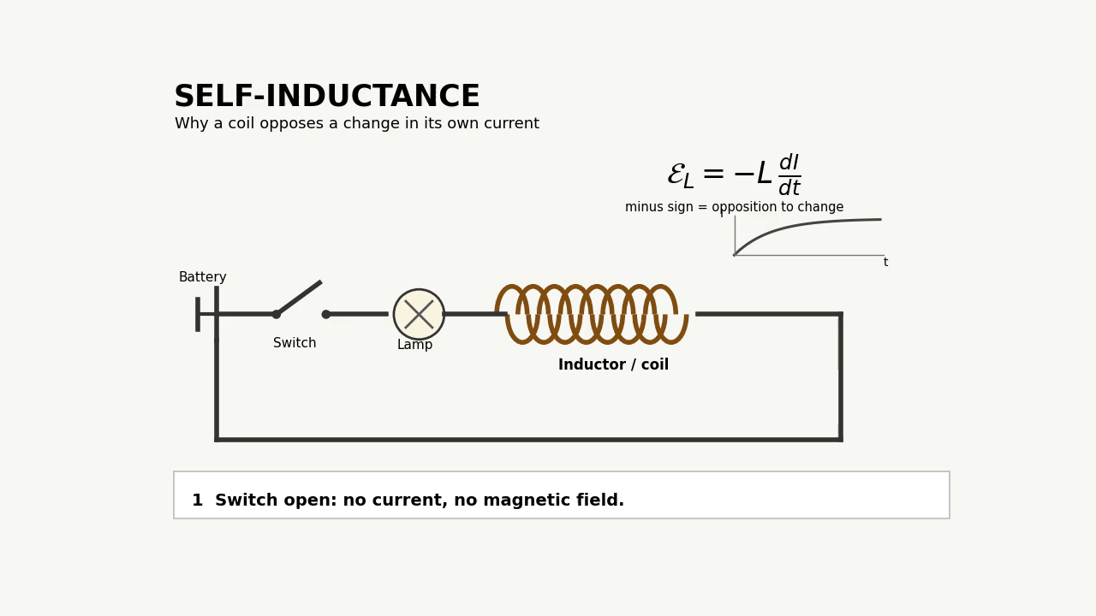

Slide 18
Energy Stored in an Inductor
Energy Stored:
U = ½LI²
Summary
• B = μ₀ n I n= N/length
• Φ_{B} = BA cosθ
• L = NΦ_{B}/I
• ε = −L(dI/dt)
• U_{L} = ½LI²
U_{c} = ½ CV²

Slide 19
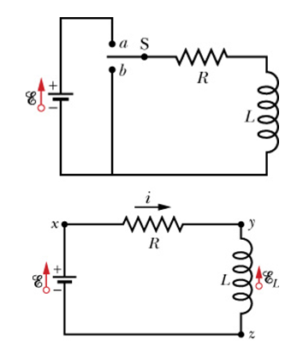



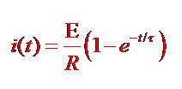

RL Circuits

Slide 20
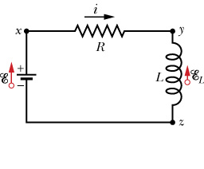


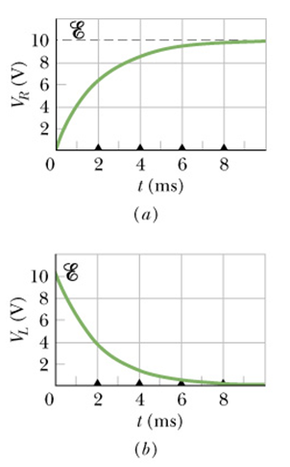

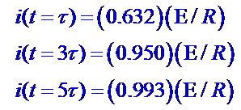

at t = 0, I_{R}= 0 and V_{R} =0
E - V_{R} _ V_{L} = 0 so E= V_{L}
at t = infinity, I_{R}= maximum
I_{L} = 0 , V_{L} = 0 so L is shortcircuited

Slide 21
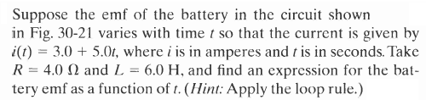



Answer

Slide 22




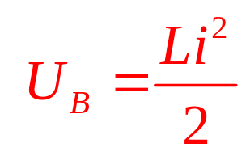
Energy Stored in a Magnetic Field
emf
emf
Magnetic Energy

Slide 23
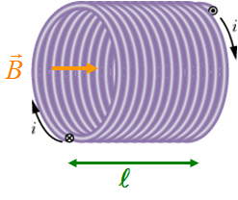





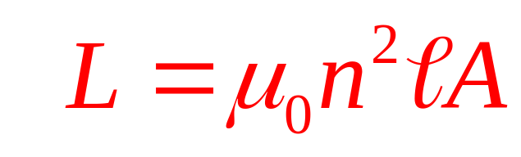


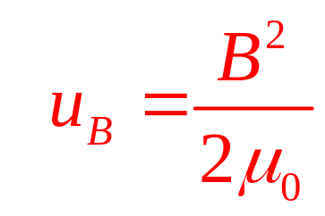
Energy Density of a Magnetic Field
Inductance of A solenoid
Magnetic Energy Density

Slide 24




Slide 25
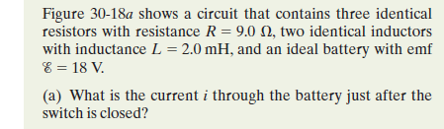
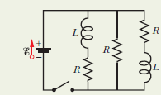
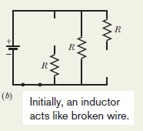
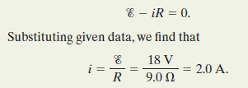

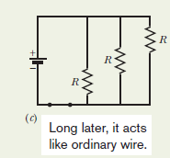
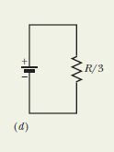


Slide 26
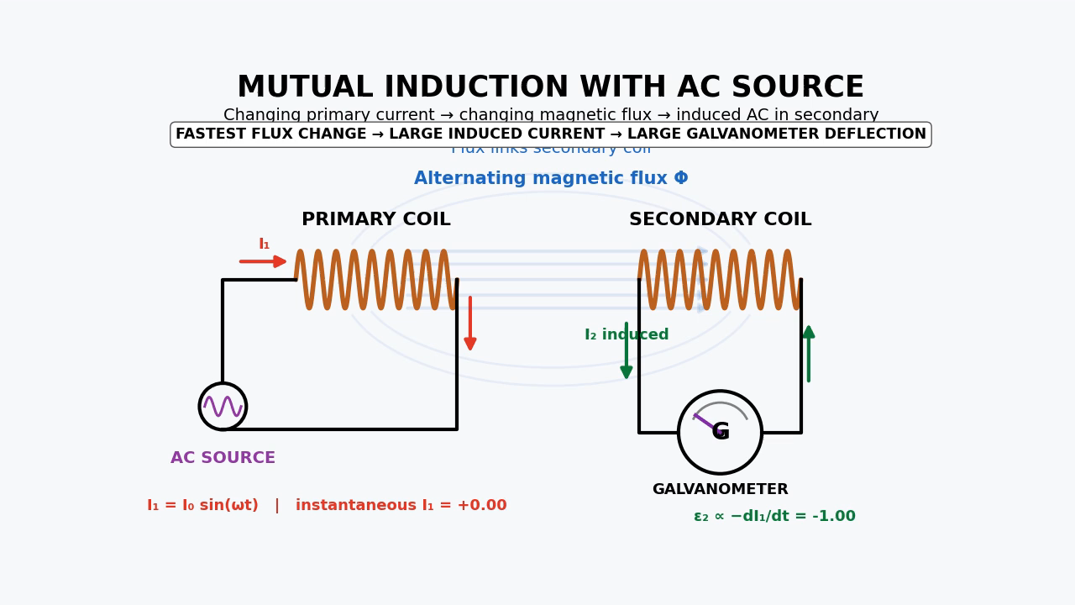
Mutual Induction

Slide 27
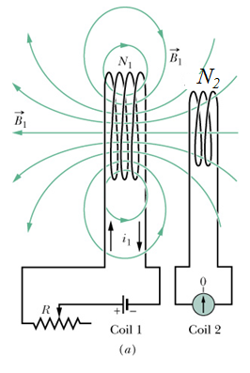
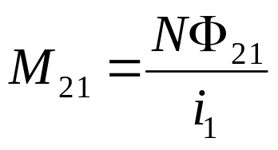

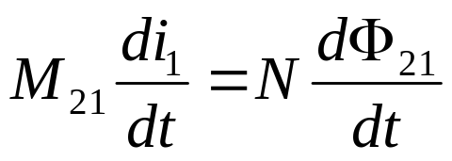

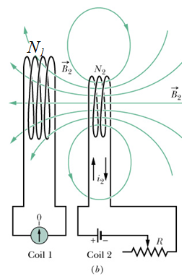
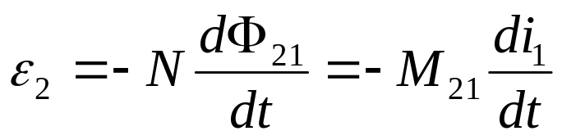
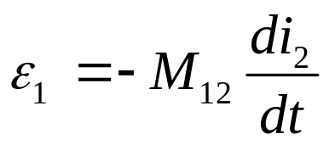


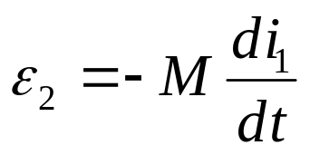

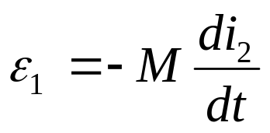
Mutual Induction

Slide 28
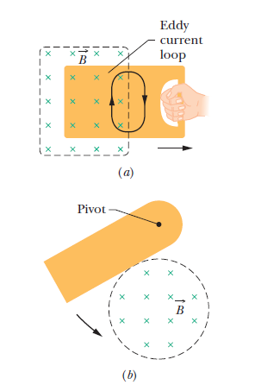
Eddy Current
Each time the plate enters and leaves the field, a portion of its mechanical energy is transferred to its thermal energy. After several swings, no mechanical energy remains and the warmed-up plate just hangs from its pivot.

Slide 29
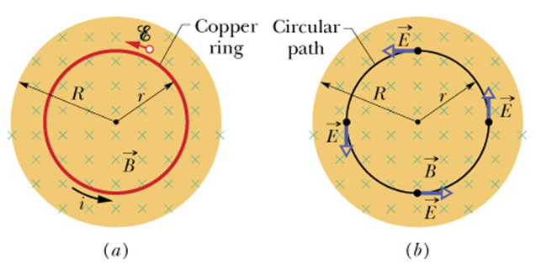
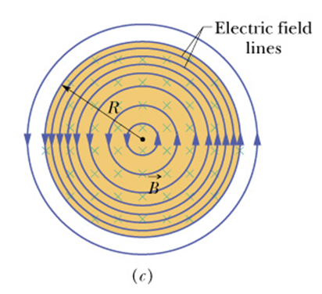
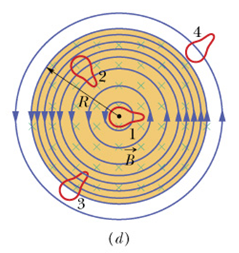
Induced Electric Fields
B(in) is increasing steadily (e.g. by increasing the current of electro magnet)
Net B will change
induced I counterclockwise
Copper ring of radius r in a magnetic field B(in)
Emf is induced and exist even after removal
Electric field lines
Paths 1 and 2 (equal emf)
Path 3 (smaller emf)
Path 4 (No emf)

Slide 30





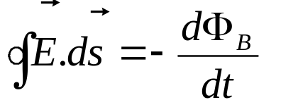
Faraday’s Law (reformulation)
Consider a particle of charge q_{o} moving in a circular path
In general, for closed path

Slide 31








Inductors and Inductance
L is Inductance
Inductance of a solenoid

Slide 32





Self-Induction
Self-induced emf
The magnitude of the current will not affect the magnitude of emf
Only the rate of change of the current causes the change of emf

Slide 33



Answer
a) Decreasing
b) Inductance

Slide 34

Lenz’s Law ( direction of induced current in a loop)
An induced current has direction such that magnetic filed due to current opposes change in magnetic flux that induces current

Slide 35

Lenz’s Law ( direction of induced current in a loop)
The fingers are in the current's direction; the thumb is in the induced field's direction.
B _{ind} is opposite to B
B _{ind} and B in the same direction

Slide 36

A plane loop of wire consisting of a single turn, of cross- sectional area 0.20 m² , is perpendicular to a magnetic field that increases uniformly in magnitude from 0.25 T to 3.25 T in a time of 2.0 s. What is the resistance of the coil if the induced current has a value of 2.0 A?
Answer

Slide 37


Slide 38








Induction and Energy Transfer

Slide 39



F₂ and F₃ cancel each other
Applied force F = F₁=iL x B
=iLBsin90=iLB
The power delivered by the applied force is
Comparing eqs. 1 and 2, work done by external agent is converted into thermal energy on the loop wires

Slide 40


In the arrangement shown in the figure, a conducting bar moves to the right. Assume that R=10.0Ω , L= 0.5 m, and that a uniform 3.5 T magnetic field is directed into the page. Neglect the mass of the bar, find the power dissipated in the resistor such that the bar moves to the right with a constant speed of 4.0 m/s?
Answer

Slide 41

A conducting rod of length 1.2 m is moving with a speed of 10 m/s as shown in the figure. If the magnetic field is 0.55 T into the page, calculate the potential difference between the ends of the rod.
Answer

Slide 42

C and D tie, then A and B tie

Slide 43

A rectangular loop of wire is placed midway between two long straight parallel conductors as shown in figure (11). The conductors carry currents i₁ and i₂ as indicated. If i₁ is increasing and i₂ is constant, then the direction of the induced current in the loop is:
Answer
Counterclockwise

Slide 44
Eddy Current
Each time the plate enters and leaves the field, a portion of its mechanical energy is transferred to its thermal energy. After several swings, no mechanical energy remains and the warmed-up plate just hangsfrom its pivot.

Slide 45
Induced Electric Fields
B(in) is increasing steadily (e.g. by increasing the current of electro magnet)
Net B will change
induced I counterclockwise
Copper ring of radius r in a magnetic field B(in)
Emf is induced and exist even after removal
Electric field lines
Paths 1 and 2 (equal emf)
Path 3 (smaller emf)
Path 4 (No emf)

Slide 46
Faraday’s Law (reformulation)
Consider a particle of charge q_{o} moving in a circular path
In general, for closed path

Slide 47





Suggested Problems (CH: 30)

Slide 48


Suggested Problems (CH: 30)

Slide 49



