Slide 1
KING FAHD UNIVERSITY OF PETROLEUM AND MINERALS
PYP 001
Fall 2012 (Term 121)
Chapter 6
The Periodic Table

Slide 2
6.1: Development of the Periodic Table
The Modern Perodic Table and Perodic Trends
Each square of the table includes:
Element’s name.
Chemical symbol.
Atomic number.
Atomic mass.
Each horizontal raw of periodic is called period.
Each Vertical column is called group ( have similar chemical and physical properties).
Number of “p” and “e” Atomic number increase across periods and down a group.

Slide 3
6.1: Development of the Periodic Table
Cont. The Modern Perodic Table and Periodic Trends
Atomic Radius: is the distance from the nucleus to the outermost electrons of an atom.
Atomic Radius decreases across a period.
Atomic Radius increases down a group.
Ionization Energy: the energy required to completely remove electron from a neutral atom in the gaseous state.
Ionization Energy increases from left to Right across a period.
Ionization Energy decreases moving down a group.
down a group.

Slide 4
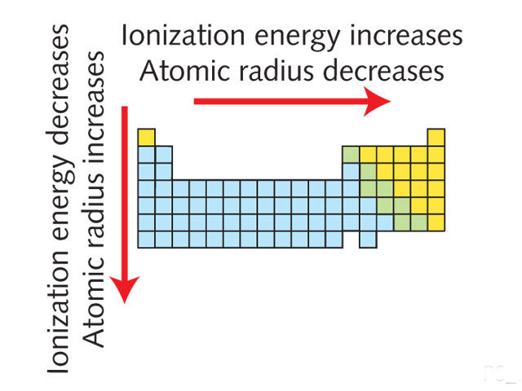

Slide 5
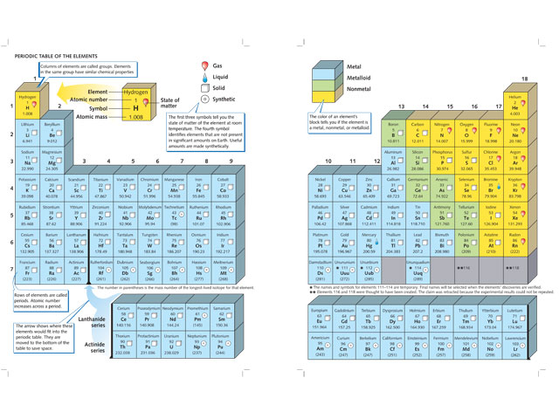
Periodic Table

Slide 6
6.2: Types of Elements.
Metals:
( most of P.T elements, found to the left of the zigzag line in the P.T)
Properties: ( Figure 6.6) Page 97
Shiny, ( reflects light)
Malleable,(can be folded and reshaped)
Solid at Room Temp, melts at High Temperature ( except “Hg”)
Good conductors of heat and electricity,
Ductile. ( can be drawn into thin wires)

Slide 7
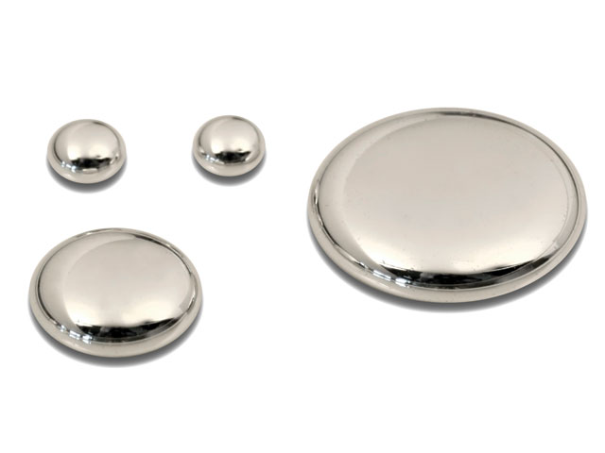
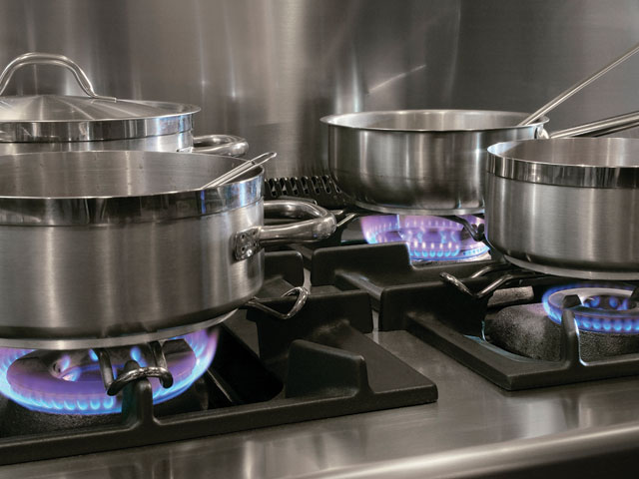
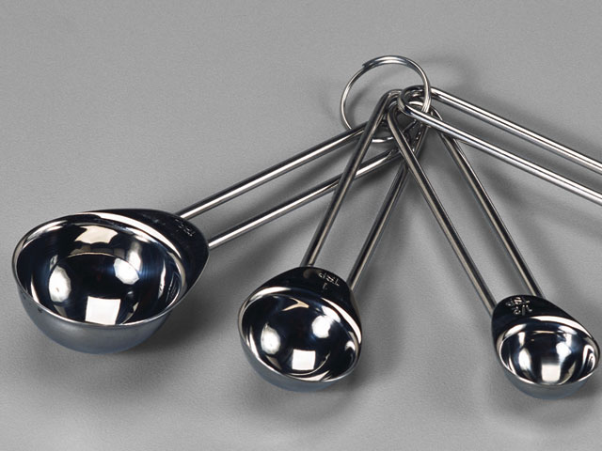
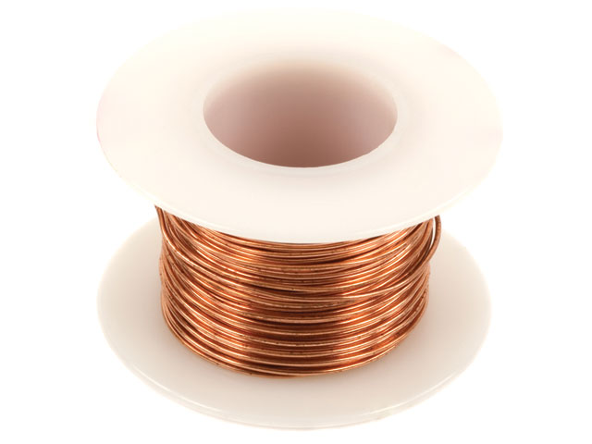
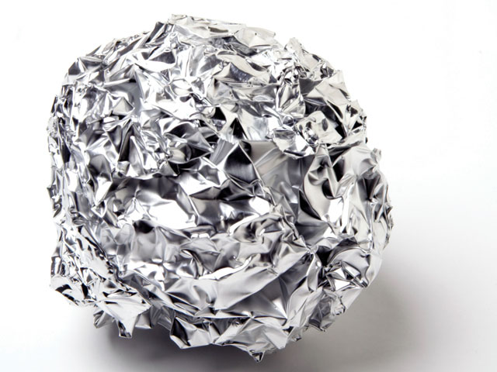
Chromium (Cr)
Copper (Cu)
Aluminum (Al)

Slide 8
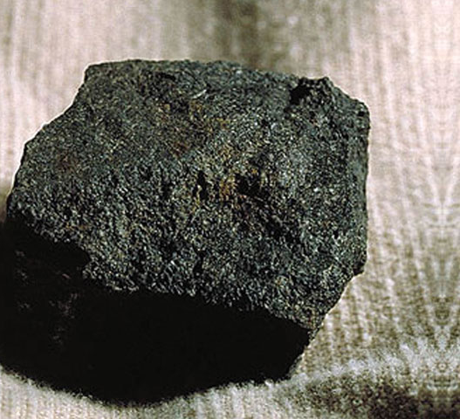
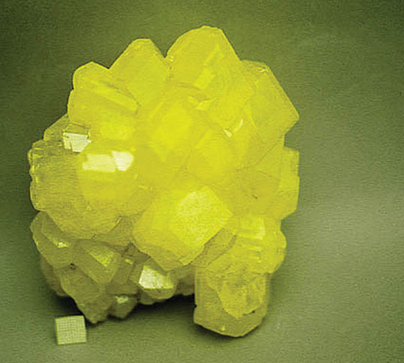
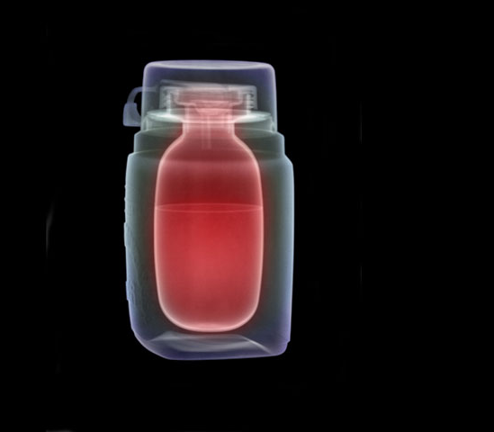
6.2: Types of Elements.
Nonmetals:
Found to the right of the P.T ( except “H” )
More than ½ of the nonmetals are gases at room Temp.
Properties ( opposite to metals) :
Not shiny (dull),
Brittle (shatter),
Poor conductors of heat and electricity.

Slide 9
6.2: Types of Elements.
Metalloids:
7 elements located between the metals and nonmetals.
Has properties of both metal and nonmetals.
All are solids
Under certain conditions they produce semiconductors.

Slide 10
6.3: Groups of Elements.
Elements of the same group: :
They share certain properties because they have the same number of valence electrons.
They are likely to transfer or share electrons with other elements in a group have the same number of valence electrons “Reactive Elements.
They behave in similar way to obtain a complete set of valence electrons. ”

Slide 11
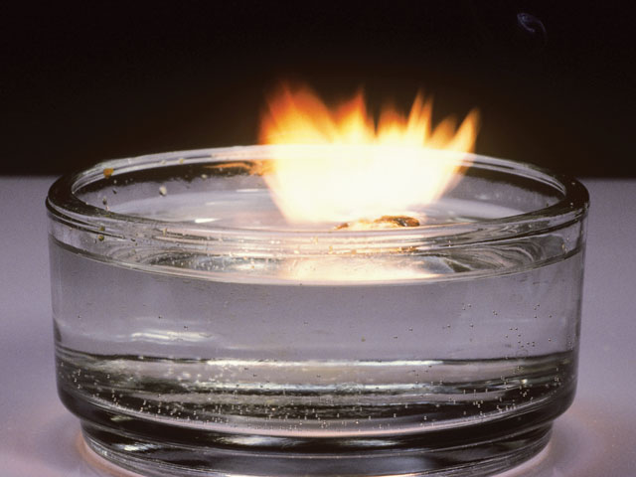
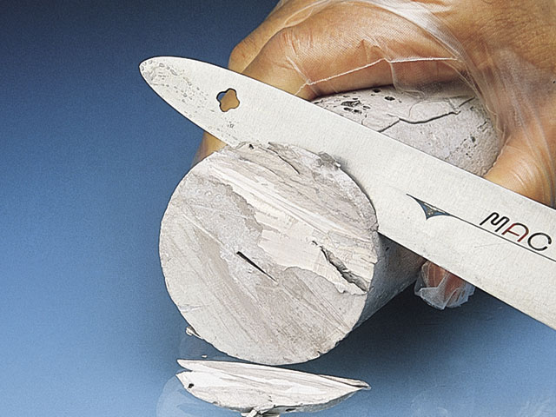
6.3: Groups of Elements.
Group 1: Alkali Metals
Soft
Silver in color.
Shiny
Low density
One valence “e”.
So reactive ( cant found in nature uncombined). Saved in oil sealed containers.
Useful uses: salt, long life batteries, clocks, firework, photocells ..etc

Slide 12
6.3: Groups of Elements.
Group 17: Halogen Family
Made of 5 nonmetals.
Have 7 valence electrons.
Very reactive.
Dangerous to Human if found uncombined.
Many of their compounds are extremely useful.
Exist as diatomic molecules: F₂, Cl₂, Br₂, I₂ and At₂.
The only group in which elements exist in 3 states of matter at room Temp , ( check Fig 6.17 page 104).

Slide 13
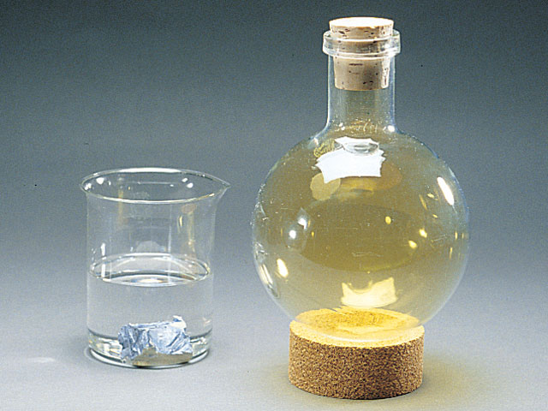
6.3: Groups of Elements.
Cont , Group 17: Halogen Family
Fluorine ( F):
Greenish – Yellow gas.
Never found uncombined in nature.
The most reactive element.
Used in : toothpaste, nonstick coating.
Chlorine (Cl) :
Greenish – Yellow gas.
Never found uncombined in nature.
The name came from Greek word “ chloros”
Best known compound is NaCl.
Used to make drinking water safe, also to treat swimming pools,
Used in industrial processes such as production of papers, plastic, dyes and antiseptics.

Slide 14
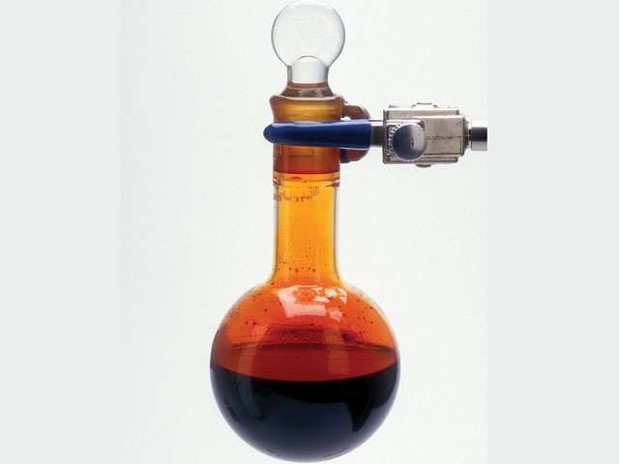
6.3: Groups of Elements.
Cont , Group 17: Halogen Family
Bromine( Br):
Reddish- Brown liquid ( at room Temp) with strong odor.
The name came from Greek word “ bromos” – (stench)
The only nonmetal that is liquid under normal conditions
Causes painful burns.
Used in dyes (paints), disinfectants and photographic chemicals.

Slide 15
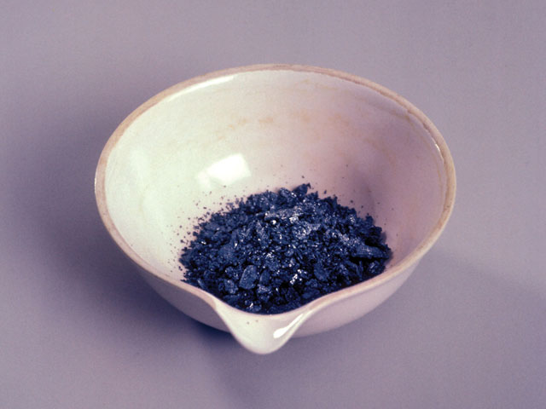
6.3: Groups of Elements.
Cont , Group 17: Halogen Family
Iodine ( I) :
Dark -gray solid .with light metallic luster.
Used in human diet ( small amounts) added to table salt.
Astatine (As):
Radioactive halogen,
Unstable and decay quickly.

Slide 16
6.3: Groups of Elements.
Group 18: Noble Gases:
All of them are gases at room Temp.
Generally they are not reactive .
They have a complete set of valence electrons.
He has 2 valence electrons, the rest have 8 valence electrons.
Present in the atmosphere.
He: is the second most abundant gas in Universe. ( either from atmosphere of natural gas).
Ne: more common than He, Used in lights.

Slide 17
6.3: Groups of Elements.
Cont , Group 18: Noble Gases
Hydrogen( H ):
The only element that dose not fit into any other group of the P.T.
Located in the upper-left corner.
The most abundant element in the universe.
Stars use H to produce energy.
Colorless, odorless gas.
very flammable.
It combines with other elements to form compounds like :
Water (H₂O), table sugar (C₁₂H₂₂O₁₁) and ammonia ( NH₃)
Liquid H is used as fuel to lift rockets into space.

Slide 18
Summary:
6.1: Development of the Periodic Table
The modern periodic table is arranged in horizontal rows call periods and vertical columns called groups.
According to the periodic law, chemical elements display a repeating pattern of properties when arranged in order of increasing atomic number.
6.2: Types of Elements
Metal elements are generally shiny, malleable, ductile, and good conductors of heat and electricity.
Nonmetal elements are usually dull, brittle and poor conductors of heat and electricity.
Metalloids exhibit some properties of metals and some properties of nonmetals.
.

Slide 19
Cont . Summary:
6.3: Groups of Elements:
The Alkali metals, or Group 1 elements have one valence electron to give up and are very reactive as a result..
Halogens ( Group 17) are the most reactive nonmetals because they need only one electron to become stable.
The noble gases ( group 18) are the least reactive elements because they have complete valance levels of electrons,

