Slide 1
Waves - I
Chapter 16

Slide 2
16-1 Transverse Waves
displacement at any given time and position
16.04 Given a displacement function for a traverse wave, calculate the time between two given displacements.
16.05 Sketch a graph of a transverse wave as a function of position, identifying amplitude y_{m} wavelength λ, where the slope is greatest, where it is zero, and where the string elements have positive velocity, negative velocity, and zero velocity.
Learning Objectives
16.01 Identify the three main types of waves.
16.02 Distinguish between transverse waves and longitudinal waves.
16.03 Given a displacement function for a traverse wave, determine amplitude y_{m}, angular wave number k, angular frequency ω, phase constant ϕ, and direction of travel, and calculate the phase kx ± t + ϕ and the

Slide 3
16.06 Given a graph of displacement versus time for a transverse wave, determine amplitude y_{m} and period T.
16.07 Describe the effect on a transverse wave of changing phase constant ϕ.
16.08 Apply the relation between the wave speed v, the distance traveled by the wave, and the time required for that travel.
16.09 Apply the relationships between wave speed v, angular frequency ω, angular wave number k, wavelength λ, period T, and frequency f.

Slide 4
16.10 Describe the motion of a string element as a transverse wave moves through its location, and identify when its transverse speed is zero and when it is maximum.
16.11 Calculate the transverse velocity u(t) of a string
element as a transverse wave moves through its location.
16.12 Calculate the transverse acceleration a(t) of a
string element as a transverse wave moves through its
location.
16.13 Given a graph of displacement, transverse velocity, or transverse acceleration, determine the phase constant ϕ.

Slide 5
16-1 Transverse Waves
Types of Waves
Mechanical Waves: They are governed by Newton’s laws, and they can exist only within a material medium, such as water, air, and rock. Examples: water waves, sound waves, and seismic waves.
Electromagnetic waves: These waves require no material medium to exist. Light waves from stars, for example, travel through the vacuum of space to reach us. All electromagnetic waves travel through a vacuum at the same speed c = 299 792 458 m/s.
Matter waves: These waves are associated with electrons, protons, and other fundamental particles, and even atoms and molecules. Because we commonly think of these particles as constituting matter, such waves are called matter waves.

Slide 6
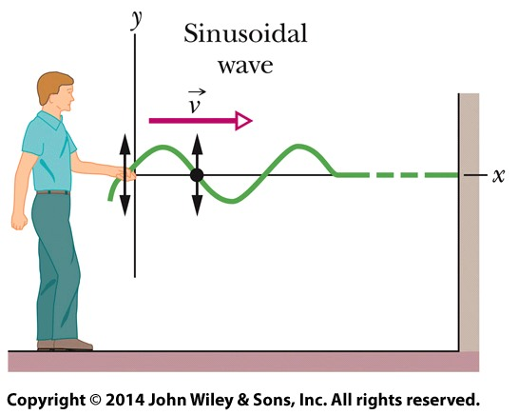
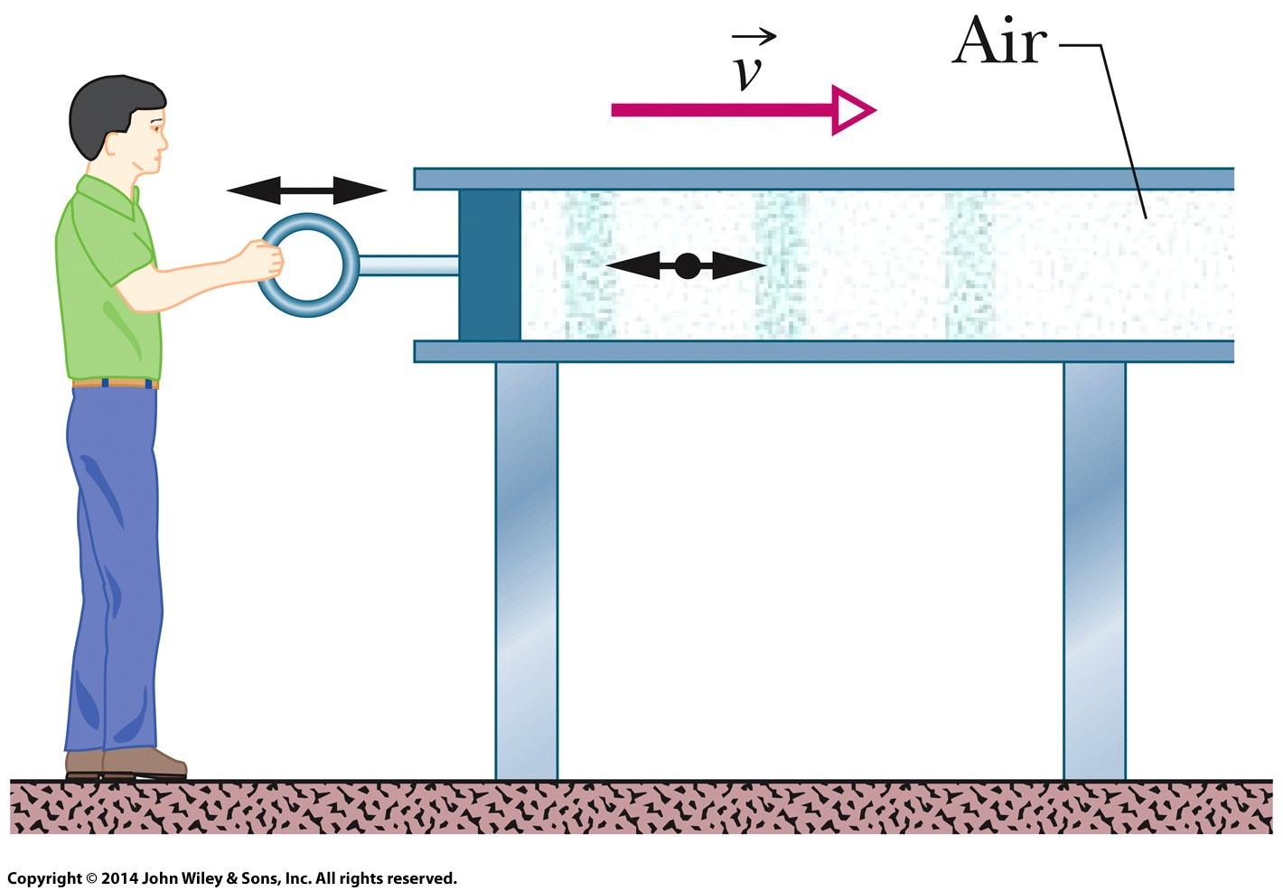
16-1 Transverse Waves
Transverse and Longitudinal Waves
A sinusoidal wave is sent along the string (Figure (a)). A typical string element moves up and down continuously as the wave passes. This is transverse wave.
A sound wave is set up in an air- filled pipe by moving a piston back and forth (Figure (b)). Because the oscillations of an element of the air (represented by the dot) are parallel to the direction in which the wave travels, the wave is a longitudinal wave.
(a) Transverse Wave
(b) Longitudinal Wave

Slide 7
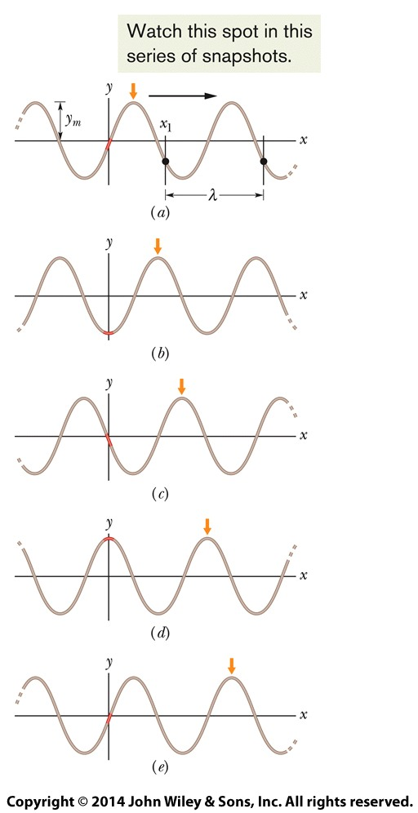
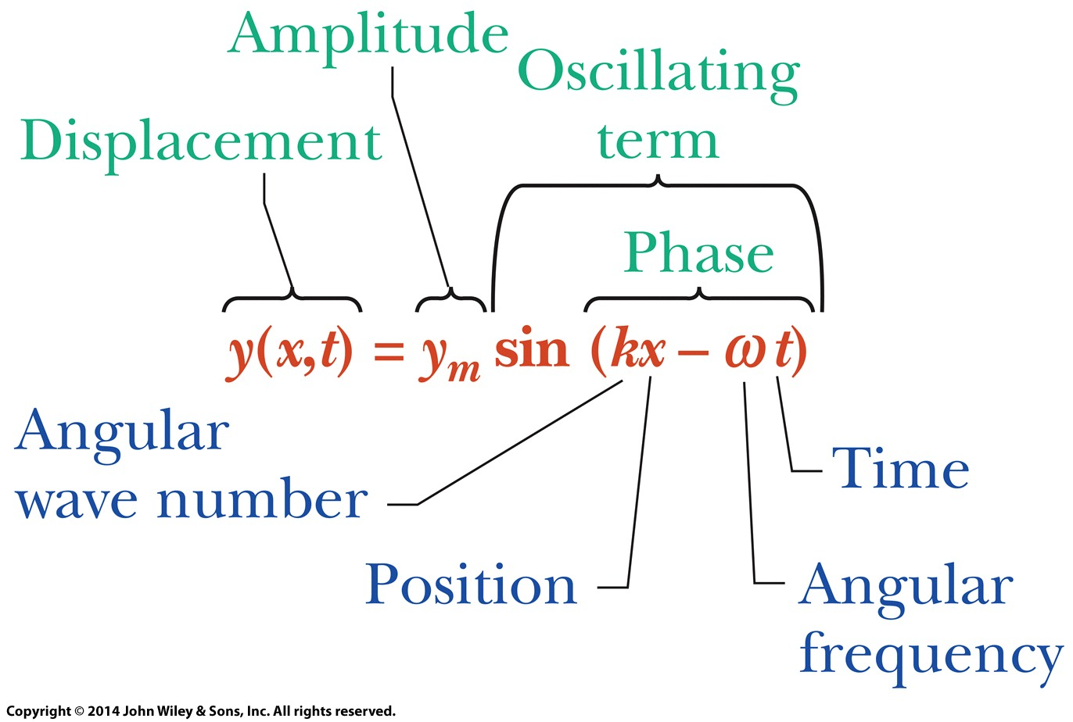
16-1 Transverse Waves
Sinusoidal Function
Five “snapshots” (y vs x each at a constant time) of a string wave traveling in the positive direction along an x axis. The amplitude y_{m} is indicated. A typical wavelength λ, measured from an arbitrary position x₁, is also indicated.
The sine function describes
the shape of the wave

Slide 8
16-1 Transverse Waves
Period, Wave Number, Angular Frequency and Frequency

Slide 9
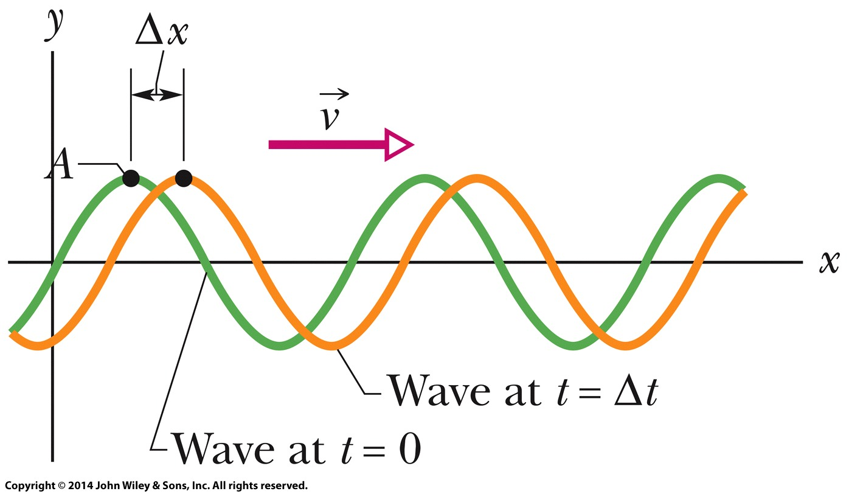
16-1 Transverse Waves
The Speed of a Traveling Wave
Two snapshots of the wave: at time t=0, and then at time t=Δt. As the wave moves to the right at velocity ν, the entire curve shifts a distance Δx during Δt.

Slide 10
16-2 Wave Speed on a Stretched String
Learning Objectives
16.14 Calculate the linear density μ of a uniform string in terms of the total mass and total length.
16.15 Apply the relationship between wave speed ν, tension τ, and linear density μ.

Slide 11
16-2 Wave Speed on a Stretched String
Learning Objectives
The speed of a wave on a stretched string is set by properties of the string (i.e. linear density), not properties of the wave such as frequency or amplitude. Tau is the tension (in N) in the string.
(linear density)

Slide 12
16-3 Energy and Power of a Wave Traveling along a String
Learning Objective
16.16 Calculate the average rate at which energy is transported by a transverse wave.

Slide 13
16-3 Energy and Power of a Wave Traveling along a String
When we set up a wave on a stretched string, we provide energy for the motion of the string. As the wave moves away from us, it transports that energy as both kinetic energy and elastic potential energy.
The Rate of Energy Transmission The kinetic energy dK associated with a string element of mass dm is given by
where u is the transverse speed of the oscillating string element

Slide 14
16-3 Energy and Power of a Wave Traveling along a String
The average power of, or average rate at which energy is transmitted by, a sinusoidal wave on a stretched string is given by
The factors μ and ν in this equation depend on the material and tension of the string. The factors ω and y_{m} depend on the process that generates the wave.

Slide 15
16-4 The Wave Equation
Learning Objective
16.17 For the equation giving a string-element displacement as a function of position x and time t, apply the relationship between the second derivative with respect to x and the second derivative with respect to t.

Slide 16
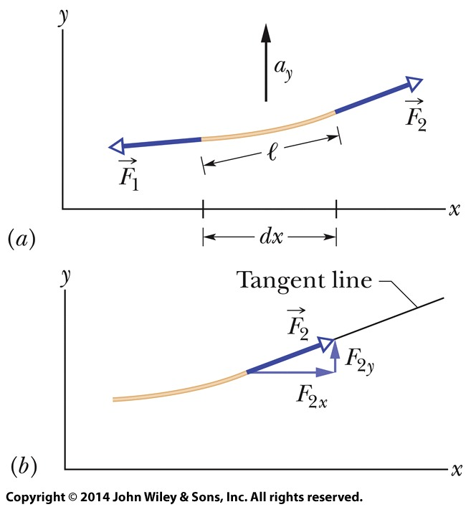
16-4 The Wave Equation
By applying Newton’s second law to the element’s motion, we can derive a general differential equation, called the wave equation, that governs the travel of waves of any type.
A string element as a sinusoidal transverse wave travels on a stretched string. Forces and act at the left and right ends, producing acceleration with a vertical component a_{y} .
The force at the element’s right end is directed along a tangent to the element’s right side.

Slide 17
16-4 The Wave Equation
This is the general differential equation that governs the travel of waves of all types. Here the waves travel along an x axis and oscillate parallel to the y axis, and they move with speed v, in either the positive x direction or the negative x direction.

Slide 18
16-5 Interference of Waves
Learning Objectives
16.20 Describe how the phase difference between two transverse waves (with the same amplitude and wavelength) can result in fully constructive interference, fully destructive interference, and intermediate interference.
16.21 With the phase difference between two interfering waves expressed in terms of wavelengths, quickly determine the type of interference the waves have.
16.18 Apply the principle of superposition to show that two overlapping waves add algebraically to give a resultant (or net) wave.
16.19 For two transverse waves with the same amplitude and wavelength and that travel together, find the displacement equation for the resultant wave and calculate the amplitude in terms of the individual wave amplitude and the phase difference.

Slide 19
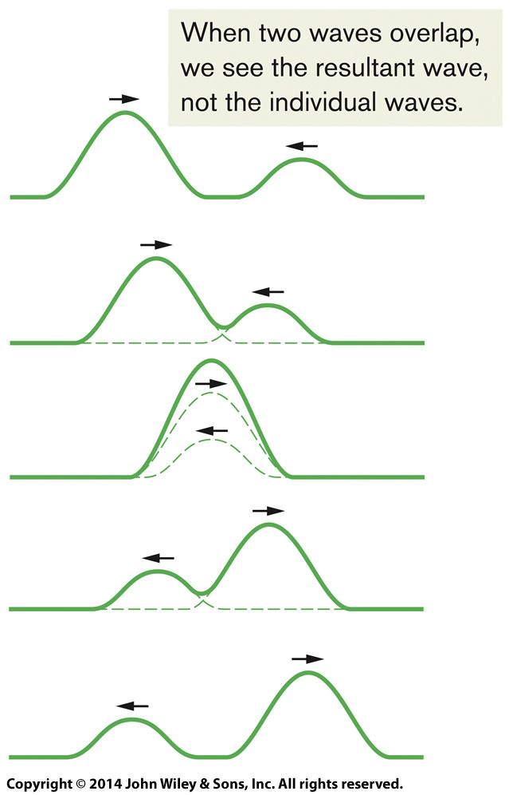
16-5 Interference of Waves
Principle of Superposition of waves
Let y₁(x, t) and y₂(x, t) be the displacements that the string would experience if each wave traveled alone. The displacement of the string when the waves overlap is then the algebraic sum
This summation of displacements along the string means that

Slide 20
16-5 Interference of Waves
The resultant wave due to the interference of two sinusoidal transverse waves, is also a sinusoidal transverse wave, with an amplitude and an oscillating term.

Slide 21
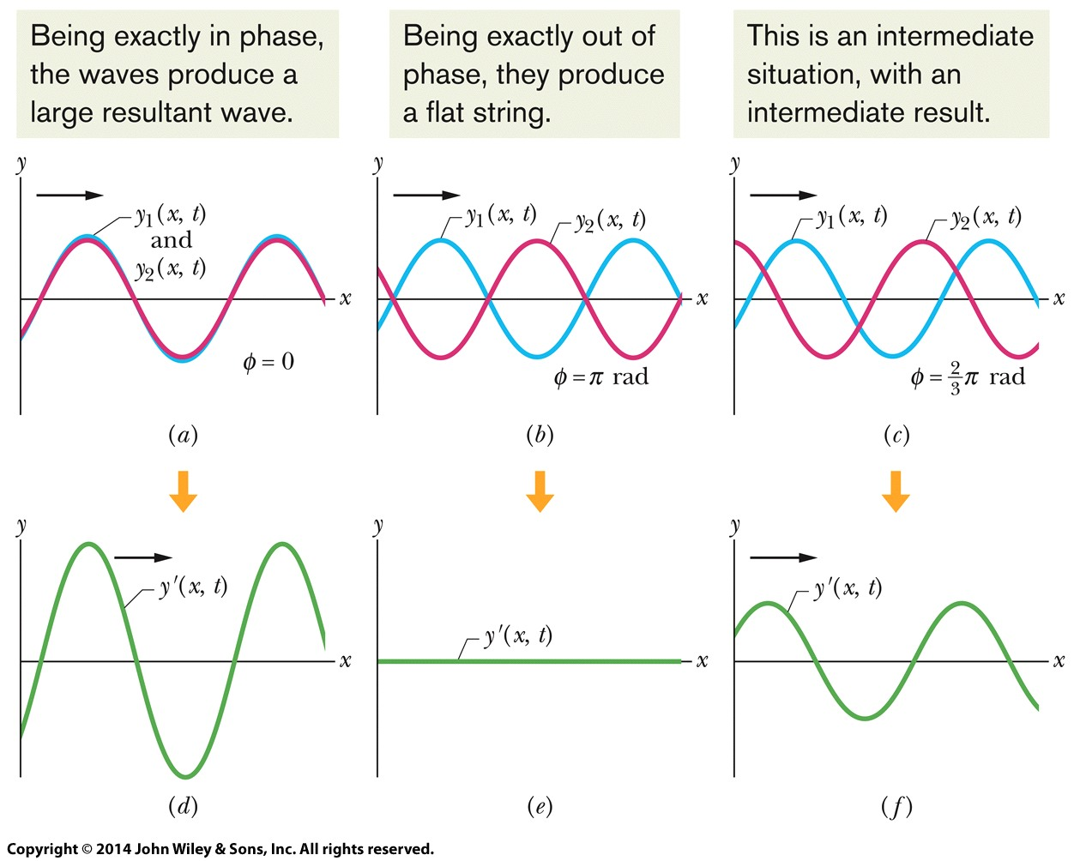
16-5 Interference of Waves
Constructive and Destructive Interference
Two identical sinusoidal waves, y₁(x, t) and y₂(x, t), travel along a string in the positive direction of an x axis. They interfere to give a resultant wave y’(x, t). The resultant wave is what is actually seen on the string. The phase difference Φ between the two interfering waves is (a) 0 rad or 0º, (b) π rad or 180º, and (c) 2/3 π rad or 120º. The corresponding resultant waves are shown in (d), (e), and ( f ).

Slide 22
16-6 Phasors
Learning Objectives
16.22 Using sketches, explain how a phasor can represent the oscillations of a string element as a wave travels through its location.
16.23 Sketch a phasor diagram for two overlapping waves traveling together on a string, indicating their amplitudes and phase difference on the sketch.
16.24 By using phasors, find the resultant wave of two transverse waves traveling together along a string, calculating the amplitude and phase and writing out the displacement equation, and then displaying all three phasors in a phasor diagram that shows the amplitudes, the leading or lagging, and the relative phases.

Slide 23
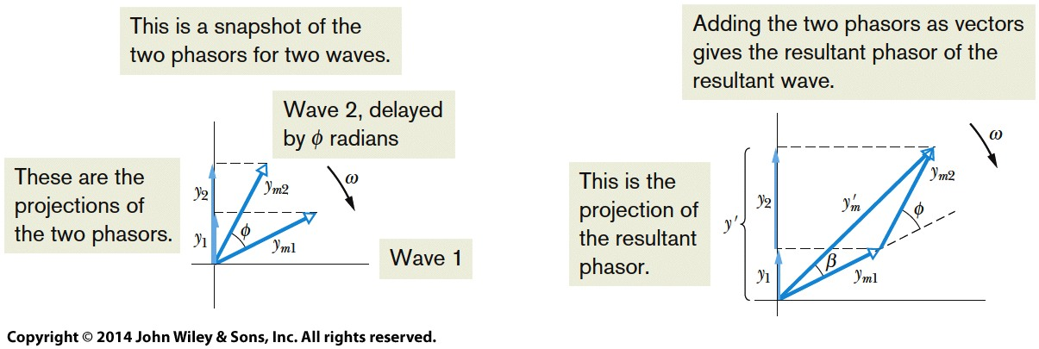
16-6 Phasors
A phasor is a vector that rotates around its tail, which is pivoted at the origin of a coordinate system. The magnitude of the vector is equal to the amplitude y_{m} of the wave that it represents.
(a)
(b)
(a) A second phasor, also of angular speed ω but of magnitude y_{m2} and rotating at a constant angle β from the first phasor, represents a second wave, with a phase constant Φ. (b) The resultant wave is represented by the vector sum y’_{m} of the two phasors.

Slide 24
16-7 Standing Waves and Resonance
Learning Objectives
calculate the amplitude in terms of
the individual wave amplitude.
16.27 Describe the SHM of a string element at an antinode of a standing wave.
16.25 For two overlapping waves (same amplitude and wavelength) that are traveling in opposite directions, sketch snapshots of the resultant wave, indicating nodes and antinodes.
16.26 For two overlapping waves (same amplitude and wavelength) that are traveling in opposite directions, find the displacement equation for the resultant wave and

Slide 25
16.28 For a string element at an antinode of a standing wave, write equations for the displacement, transverse velocity, and transverse acceleration as functions of time.
16.29 Distinguish between “hard” and “soft” reflections of string waves at a boundary.
16.30 Describe resonance on a string tied taut between two supports, and sketch the first several standing wave patterns, indicating nodes and antinodes.
16.31 In terms of string length, determine the wavelengths required for the first several harmonics on a string under tension.
16.32 For any given harmonic, apply the relationship between frequency, wave speed, and string length.

Slide 26
16-7 Standing Waves and Resonance
Standing Waves
The interference of two identical sinusoidal waves moving in opposite directions produces standing waves. For a string with fixed ends, the standing wave is given by
Stroboscopic photographs reveal (imperfect) standing wave patterns on a string being made to oscillate by an oscillator at the left end. The patterns occur at certain frequencies of oscillation.

Slide 27
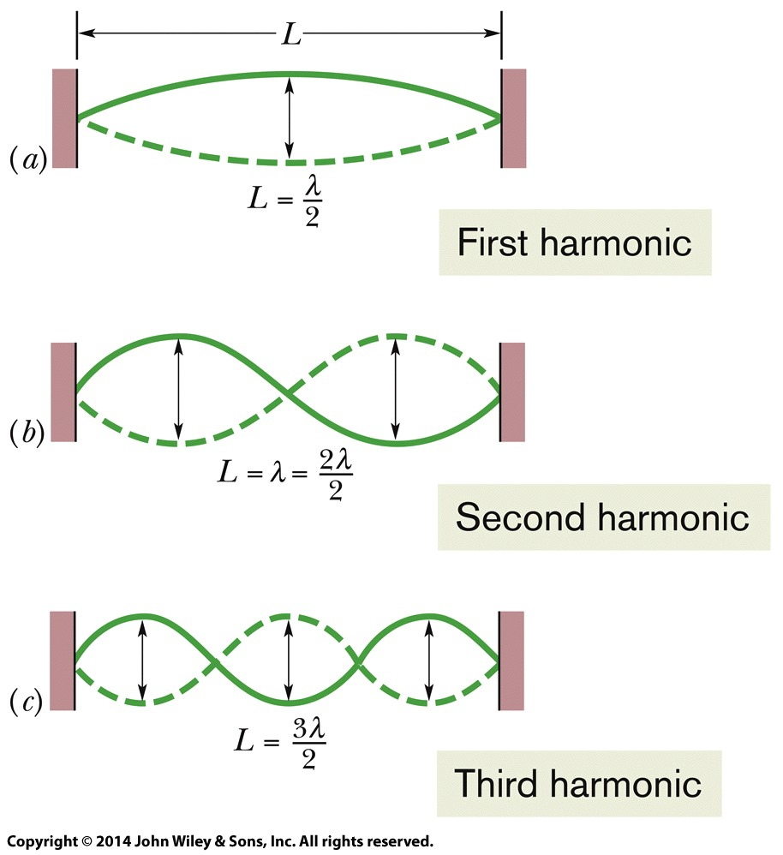
16-7 Standing Waves and Resonance
Harmonics
Standing waves on a string can be set up by reflection of traveling waves from the ends of the string. If an end is fixed, it must be the position of a node. This limits the frequencies at which standing waves will occur on a given string. Each possible frequency is a resonant frequency, and the corresponding standing wave pattern is an oscillation mode. For a stretched string of length L with fixed ends, the resonant frequencies are

Slide 28
16 Summary
Waves
Transverse Waves
Longitudinal Waves
Wave Speed
Angular velocity/ Angular wave number
Eq. (16-13)
Sinusoidal Waves
Wave moving in positive direction (vector)
Traveling Waves
A functional form for traveling waves
Eq. (16-2)
Eq. (16-17)

Slide 29
16 Summary
Powers
Average Power is given by
Standing Waves
The interference of two identical sinusoidal waves moving in opposite directions produces standing waves.
Eq. (16-33)
Eq. (16-60)
Interference of Waves
Two sinusoidal waves on the same string exhibit interference
Resonance
For a stretched string of length L with fixed ends, the resonant frequencies are
Eq. (16-51)
Eq. (16-66)

