Slide 1
CHAPTER 7-1
LEAST-SQUARES
FIT TO A POLYNOMIAL

Slide 2
7.1 DETERMINANT SOLUTION
So far we have discussed fitting a straight line to a group of data points.
However, suppose our data (Xi' Yi) were not consistent with a straight line fit.
We might construct a more complex function with extra parameters and try varying the parameters of this function to fit the data more closely.
A very useful function for such a fit is a power-series polynomial
where the dependent variable Y is expressed as a sum of power series of the
independent variable X with coefficients a₁, a₂, a₃, a₄, and so forth.
For problems in which the fitting function is linear in the parameters, the method of least squares is readily extended to any number of terms m, limited only by our ability to solve m linear equations in m unknowns and by the precision with which calculations can be made.
We can rewrite Equation (7.1) as
where the index k runs from 1 to m.
In fact, we can generalize the method even further by writing Equation (7.2) as
where the functions f_{k}(x) could be the powers of x as in Equation (7.2) ,
f₁(x) = 1, f₂(x) = x , f₃(x) = x², and so forth, or they could be other functions of
x as long as they do not involve the parameters a₁ , a₂ , a₃ , and so forth.

Slide 4
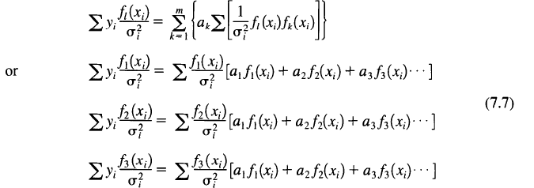
With this definition, the probability function of Equation (6.8) can be written as
and Equation (6.9) for χ² becomes
The method of least squares requires that we minimize χ² , our measure of the
goodness of fit to the data, with respect to the parameters at> a2' a3, and so
forth.
The minimum is determined by taking partial derivatives with respect to each parameter in the expression for χ² of Equation (7.5), and setting them to zero:
Thus, we obtain a set of m coupled linear equations for the m parameters ai' with the index I running from 1 to m:
and so forth.

Slide 6
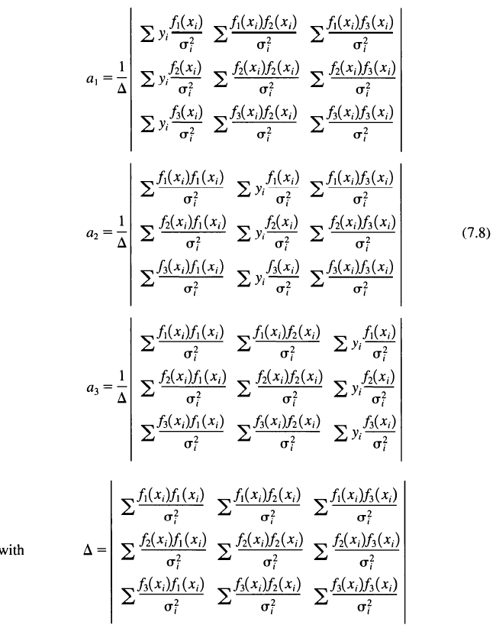
The solutions can be found by the method of determinants, as in Chapter 6.
We shall display the full solution for the particular case of m = 3:
We note that, as in the straight-line fits in Chapter 6, the denominatorΔ is a function only of the independent variable x and the uncertainties σ _{i} in the dependent variable, and is not a function of the dependent variable y_{i} Itself.

Slide 8
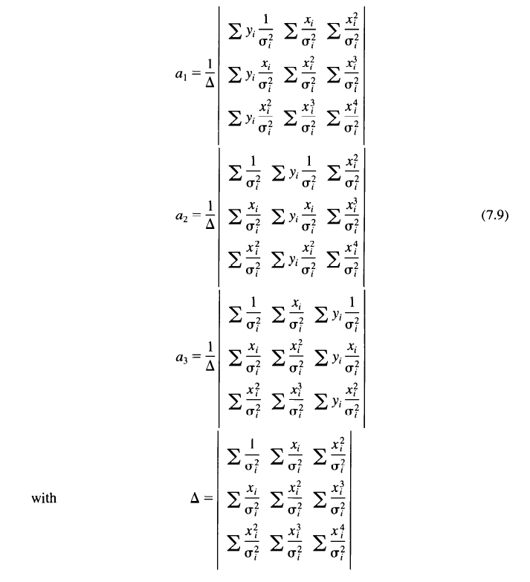
For the special case of a quadratic power series in x, y(xi) = a₁ + a₂x_{i} + a₃x_{i}² , we have f₁(x_{i}) = 1, f₂(x_{i}) = x_{i} , and f₃(x_{i}) = x_{i}², so that Equations (7.8) become

Slide 10
Example 7.1.
A student plans to use a thermocouple to monitor temperatures and mus first calibrate it against a thermometer.
The thermocouple consists of a junction of a copper wire and a constantan wire.
In order to measure the junction voltage with high precision, she connects the sample junction in series with a reference junction that is held at 0°C in an ice water bath.
The data, therefore, will be valid only for calibrating the relative variation of the junction voltage with temperature.
The absolute voltage must be determined in a separate experiment by measuring it at one specific temperature.
The student measures the difference in output voltage between the two junctions for a temperature variation in the sample junction from 0 to 100°C in steps of 5° C.
The measurements are made on the 3-m V scale of the voltmeter, and fluctuations of the needle indicate that the uncertainties in the measurements are approximately 0.05 m V for all readings.
Data from the experiment are listed in Table 7.1 and are plotted in Figure 7.1.
To a first approximation, the variation of V with T is linear, but close inspection of the graph reveals a slight curvature.
Theoretically, we expect a good fit to these data with a quadratic curve of the form V = a₁ + a₂ T + a₃ T².

Slide 12
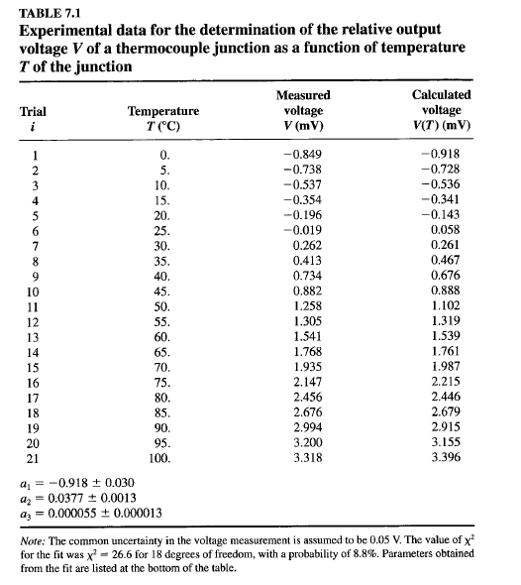

Slide 13
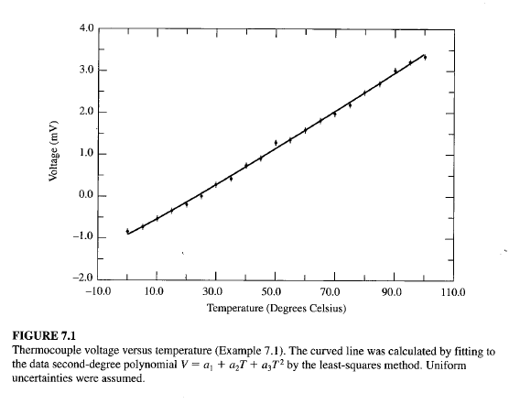

Slide 14
The parameters for the fit to the data of Example 7.1 have been obtained by
evaluating the sums and determinants of Equations (7.9).
For a second-degree polynomial with 21 data points, Equation (7.5) becomes
The values of χ² and the parameters a₁, a₂ and a₃ determined from the fit are
listed in Table 7.1, as are the calculated values of V(T_{i} ) = y(x_{i}).
The calculated values of V are also represented by the solid line on the graph of Figure 7.1.
We obtain χ² = 26.6 for this fit, or χ_{ν}² = χ²/v = 1.5, where the number of degrees of freedom v is related to the number of events N and the number of free parameters m by ν = N - m.
The probability for obtaining χ² this high or higher can be determined from the χ² -probability distribution (see Table C.4) and is about 8.8%, indicating a
reasonable fit to the data.
As an alternative to calculating χ² from the fit, we could extend Equation (6.15) to three parameters and calculate the average uncertainty in the temperature readings to obtain
which is just the value of the uncertainty that would make χ_{ν}² = 1.
For Example 7.1, we obtain for an estimate of the variance,
suggesting, perhaps, that the student slightly underestimated the
uncertainty in her measurements of V.

Slide 16
7.2 MATRIX SOLUTION
The techniques of least-squares fitting fall under the generalname of regrerssion analysis.
Because we have been considering only problems in which the fItting function
is linear in the parameters a_{k} we are considering only linear regression or
multiple linear regression, usually shortened to multiple regression.
In Chapter 8 we deal with techniques for handling problems with fitting functions that are not linear in the parameters.
Matrix Equations
We have not yet determined the uncertainties in the three parameters we obtained when we fitted the second-order equation to the data of Example 7.1.
We could find the uncertainties by extending the method used for the linear fits of Examples 6.1 and 6.2.
However, the algebra becomes even more tedious as the number of terms in the fitted equation increases, and in fact, our method only yielded estimates of the variances σ_{k}² and not of the covariances σ_{kl}² which are often important for fitted parameters.
Rather than pursue the determinant method, we shall discuss immediately
the more elegant and general matrix method for solving the multiple regression problem.
Some of the properties of matrices are discussed in Appendix B.

Slide 18
Equations (7.7) can be expressed in matrix form as the equivalence between a
row matrix β and the product of a row matrix a with a symmetric matrix α, all
of order m:
The elements of the row matrix β are defined by
those of the symmetric matrix α by
and the elements of the row matrix a are the parameters of the fit.
For m = 3, the matrices may be written as

Slide 20
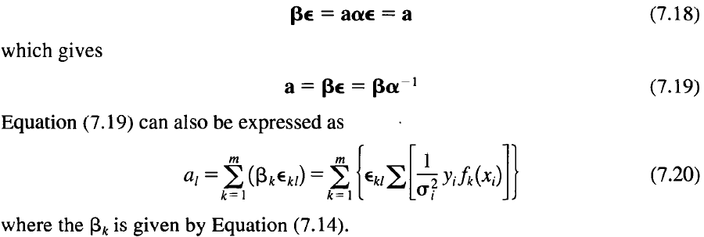
To solve for the parameter matrix a we multiply both sides of Equation (7.13) on the right by the inverse e of the matrix α, defined such that αε = αα⁻¹ = 1, the unity matrix.
We obtain
The solution of Equation (7.19) requires that the matrix α be inverted.
This generally is not a simple procedure, except for matrices of very low order, but computer routines are readily available.
The inversion of a matrix is discussed in Appendix B.
The symmetric matrix α is called the curvature matrix because of its relationship
to the curvature of the χ² function in parameter space.
The relationship becomes apparent when we take the second derivatives of χ² with respect to the parameters.
From Equation (7.6), we have for the partial derivative of χ² with respect to any arbitrary parameter a_{i}

Slide 22
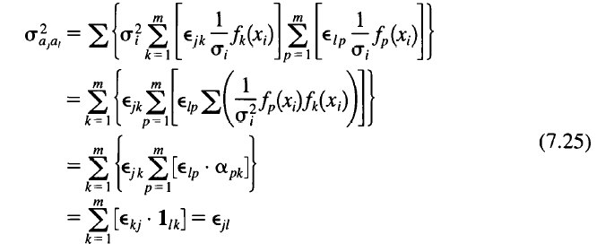
Estimation of Errors
The variance σ²_{al} of any parameter a_{i} is the sum of the variances of each of the data points σ _{i} multiplied by the square of the effect that each data point has on the determination of the parameter a_{l} [see Equation (6.19)].
Similarly, the covariance of two parameters a_{j} and a_{l} is given by
(which also gives the variance for j = l), where we have assumed that there are
no correlations between uncertainties in the measured variables y_{i} .
Taking the derivatives in Equation (7.23) of al with respect to y_{i} we obtain
and, substituting into Equation (7.23), we obtain for the weighted sum of the
squares of the derivatives,
where we have switched the order of the sums over the dummy indices i, k,
and l and have used the fact that because the curvature matrix α is symmetric,
its inverse ε must also be symmetric, so that ε_{kj} = ε_{jk} .
The elements of the unity matrix, which result from the summed products of the elements of a with its inverse ε, are represented by 1_{jk} .
The inverse matrix ε = α⁻¹is called the error matrix or the covariance matrix
because its elements are the variances and covariance of the fitted parameters
σ²_{ajal} = ε_{jl}

Slide 24
Example 7.2.
The matrix method is illustrated by a straight-line fit V = a₁ + a₂ T to a selection of data from Example 7.1.
To show clearly each step of the calculation, we have selected just six points spaced at 25° intervals between 0 and 100° and have assumed a common uncertainty in the dependent variable σ_{V} = 0.05 mV.
The data are listed in the columns 2 and 3 of Table 7.2a.
We begin by calculating each of the fitting functions f₁ = 1 and f₂ = x at each
value of the independent variable T.
These are listed in columns 4 and 5 of Table 7.2a.
For each measured value of x, the values of β_{k} the elements of the column matrix β, and of α _{lk} the elements of the symmetric matrix α, are calculated according to Equations (7.14) and (7.15).
The individual terms in the calculation of β₁ and β₂ are listed in columns 6 and 7 of Table 7.2a and the individual terms in the calculation of α _{lk} are listed in columns 8 through 10. (We assume symmetry in α)
The resulting matrices are displayed in Table 7.2h.
The symmetric matrix α is inverted to obtain the variance matrix ε with elements ε_{kl} , shown in Table 7.2b, and the product matrix of the fitted parameters α= βε is calculated and displayed in Table 7.2b.
The calculated values of the fitted variable V for each value of the independent variable T are listed in the last column of Table 7.2a.
Program 7.1. M U L TR EG R (Appendix E) Least-squares fitting with matrices.
Multiple regression problems are usually solved by computer.
The program M U L T REG R calls a set of routines for fitting any function that is linear in the parameters a₁, a₂ , .. , a_{m} to a set of N data points.
Branches in the program on the character variable PAE permit selection of the fitting function for each example in this chapter, with PAE = ‘P' for the power series in x, PAE = 'A' for all terms of a fourth-order Legendre polynomial, or PAE = 'E' for only the even terms in the Legendre polynomial.
The program uses several program units in addition to those referred to in Chapter 6.

Slide 26
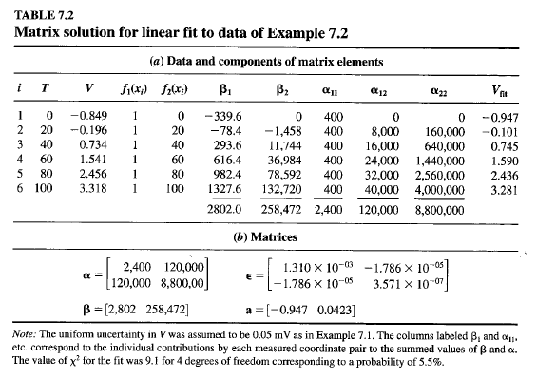

Slide 27
Program 7.2. FITFu Nc7 (Appendix E) Fitting functions and X2 calculation.
In general, every fitting problem requires such a routine.
The function POWERFu NC calculates the individual terms in a power function of any order in x for Example 7.2, or Legendre polynomials for Example 7.3.
Program 7.3. MAKEAB7 (Appendix E) Form the arrays for the matrices a and p.
Program B.1. MATRIX (Appendix E) Matrix products and inversion.
When we use the matrix method to fit a polynomial function to a data sample, the resulting parameters must be identical to those calculated by the determinant method, but we also obtain the full error matrix.
The error matrix obtained by fitting a second-degree polynomial to the complete data sample of Example 7.1 is listed in Table 7.3.
The error matrix can be used to estimate the uncertainty in a calculated result, including the effects of the correlations of the errors.
As an example, let us suppose that we wish to find the predicted value of the voltage V and its uncertainty for a temperature of exactly 80°C.
We should calculate
using the parameters determined by the fit to the data.

Slide 29
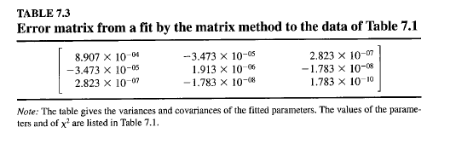

Slide 30
The uncertainty in the calculated value of V, which results from the uncertainty in the parameters, is given by Equation (3.13),
where ElZ and so on are the covariant terms in the symmetric error matrix.
If we used only the diagonal terms in the error matrix, our result w~uld be ~ = (2:45 ± 0.14) V.
However, the off-diagonal terms are mainly negatIve, and lllcludlllg them reduces the uncertainty by almost a factor of 10 to 0.015, so that we should
quote V = (2.45 ± 0.02) v.
Linear Least-Squares Fitting with a Spreadsheet
Table 7.4 illustrates the use of a spreadsheet (without taking advantage of the
spreadsheet's built-in least-squares fitting routine) to fit a straight line to the data of Example 7.2 by the matrix method.
We entered the data in columns labeled T, V, and (Tv and calculated component terms to be summed for 131' 132' and au, a12' and a 22 in the labeled columns using the indicated equations.
We summed each a clo' l- umn to form the elements of the square matrix a, and the 13 columns to form the lllear matrix 13.

Slide 31
The spreadsheet's matrix-handling routines were applied to invert t~e a-matrix to form the E-matrix, and to multiply E by 13 to find the parameter matnx
a.
Uncertainties in the parameters were calculated from the square roots of the diagonal terms in the E-matrix.
Although we used absolute cell addresses to illustrate the procedure, we could have simplified the calculation by naming the arrays of cells and using the array-handling capabilities of the spreadsheet.
It may seem inefficient to write a program to solve such a simple problem,
which most spreadsheets can handle with ease.
However, there are advantages.
First, it would be relatively easy to expand the program to fit more parameters, or to fit a series of functions more complicated than simple powers of the independent variable.
A second advantage is that the solution provides the full error matrix.
While most fitting programs should provide the uncertainties in the fitted pa~ameters, the covariances may not be available.
In some problems, they are essentIal.
We used Quatro Pro for this example, but the procedure with Excel is similar.

Slide 32
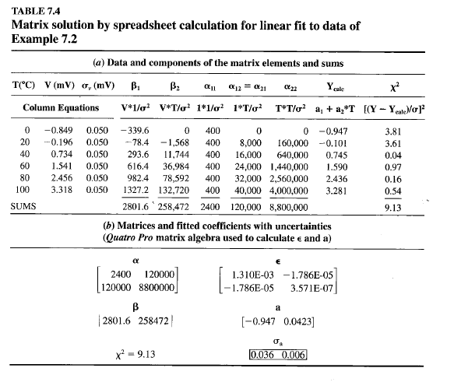

Slide 33
7.3 INDEPENDENT PARAMETERS
3.81
3.61
0.04
0.97
0.16
0.54
9.13
Suppose we take the data of Example 6.1 or Example 6.2 and fit to them the quadratic
polynomial function y = a] + a2x + a3x2 as we did for Example 7.1. We
should expect to find a rather small and possibly meaningless result for the coefficient
a3 of the quadratic term, but, because a3 was not set equal to zero by definition,
as in the analysis of Chapter 6, we might also find that the values of a] and a2 have
changed, sometimes considerably, from the values obtained in the linear fit. In general,
the polynomial fitting procedure that we have considered will yield values for
the coefficients that depend on the degree of the polynomial fitted to the data.
This interdependence arises from the fact that we have specified our coordinate
system without regard to the region of parameter space from which our data
points are extracted. The value of a] represents the intercept on the ordinal axis, the
coefficient az represents the slope at this same point, and other coefficients represent
higher orders of curvature at this same intercept point. If the data are not clustered
about this intercept point, its location might be highly dependent on the
polynomial used to fit the data.
We might be able to extract more meaningful information about the data if we
were to determine instead coefficients a;, a2' a3, and so forth, which represent the

Slide 34
average value, the average slope, the average curvature, and so forth, of the data.
Such coefficients would be independent of our choice of coordinate system and
would represent physical characteristics of the data that are independent of the degree
of the fitted polynomial.
Orthogonal Polynomials
We want to fit the data to a function that is similar to that of Equation (7.1) but that
yields the desired independence of the coefficients. The appropriate function to use
is the sum of orthogonal polynomials, 1 which has the form
y(x) = al + aix - 13) + a3(x - )'1) (x - )'2) (7.28)
+ a4(x - 81)(x - 82) (x - 83) + ...
Following the development of Section 7.1, we must minimize X 2 to determine the coefficients
aI' a2, a3, a4, and so on, with the further criterion that the addition of higherorder
terms to the polynomial will not affect the evaluation of lower-order terms. This
criterion will be used to determine the extra parameters 13, )'1' )'2, and so on.
The goodness-of-fit parameter X2 is defined as
X2 == L [~i]2 = L [:T [Yi - Y(Xi)J2] (7.29)
Setting the derivatives of X2 with respect to each ofthe m coefficients aI' a2, and so
forth to 0 yields m simultaneous equations
LYi = Nal + a2L(xi -13) + a3L(xi - )'1) (xi - )'2)
+ a4L(xi - 81) (Xi - 82) (Xi - 83) + ...
L XiYi = alLxi + a2Lxi(xi - 13) + a3LxJxi - )'1) (Xi - )'2)
+ a3LxJxi - 81)(Xi - 82)(Xi - 83) + ...
LXTYi = alLxT + a2LxT(xi -13) + a3LxT(xi - )'1) (Xi - )'2)
+ a4LxT(xi - 81) (Xi - 82) (Xi - 83) + ...
LxfYi = al Lxf + a2Lxf(xi - 13) + a3 Lxf(xi - )'1) (Xi - "/2)
+ a4Lxf(xi - 81) (Xi - 82) (Xi - 83) + ...
where we have omitted a factor of cry in the denominator for clarity.
(7.30)
(7.31)
(7.32)
(7.33)
lAny polynomial such as that of Equation (7.1) can be rewritten as a sum of orthogonal polynomials
y=a+ i[bjjj(x.)]
j~l
with the orthogonal property that L[fj(X;)fk(X;)] = 0 for j * k

Slide 35
Additional Parameters
Let us examine Equation (7.30). If we restrict ourselves to a zeroth-degree polynomial,
that is, to only one coefficient aj, all the other coefficients are equal to 0 by definition.
The coefficient aj, therefore, is specified completely by the first term on the
right-hand side of Equation (7.30):
1
al = 'it L Yi = Y (7.34)
If we restrict ourselves to a first-degree polynomial, the coefficient a2 of the second
term of Equation (7.30) is not O. However, if ar is to be independent of the value of
a2, the second term itself must be O. Hence, the requirement that
leads to the value for 13,
(7.35)
and a2 can be determined directly from Equation (7.31) by substituting the values of
al and 13 with higher-order coefficients (a3, a4, etc.) set to O.
Similarly, if we consider a quadratic function, the third term of Equation
(7.30) must be 0 even when the coefficient a3 is not O. This constraint leads to a quadratic
equation in )'1 and "12 that is not sufficient to specify either parameter. We
have the additional constraint, however, that the coefficient a2 must be specified
completely by Equations (7.30) and (7.31). Thus, the third term in both Equations
(7.30) and (7.31) must be 0 regardless of the value ofthe coefficient a3, and we have
two simultaneous quadratic equations for the parameters )'1 and )'2,
and
Similarly, the coefficient a3 must be determined completely by Equation (7.32) (and
the predetermined values of al and a2), and this constraint yields three simultaneous
equations for the parameters 81, 82, and 83:
L (Xi - 81) (Xi - 82) (Xi - 83) = 0
L XJXi - 81) (Xi - 82) (Xi - 83) = 0
LXT (Xi - 81) (Xi - 82) (Xi - 83) = 0
(7.37)
The extrapolation to higher order is straightforward. (Note that these additional parameters
are functions only of the independent variable Xi')
Estimates of the Coefficients
Once the parameters 13,)',8, and so on have been determined by the constraint equations,
estimates of the coefficients aj, a2, and so on can be found from the resulting

Slide 36
n + 1 simultaneous equations. The value for the first coefficient al is specified completely
by minimizing X2 with respect to al in Equation (7.30) and is given in Equation
(7.34). The value of the second coefficient a2 is determined by minimizing X2
with respect to both al and a2 in Equations (7.30) and (7.31) and substituting the
value of al from Equation (7.34) into Equation (7.31). Similarly, the value of a3 can
be determined from Equation (7.32) after substituting the values of al and a2 determined
from Equations (7.30) and (7.31). Each succeeding equation yields a value for
the next higher-order coefficient.
Note that the value determined for any coefficient is thus independent of the
value specified for any higher-order coefficient, but is not independent of the value
of lower-order coefficients. The parameters, representing our best estimates of the
coefficients, are given by
and so forth.
Simplification
1 _
al =NLYi=Y
LYi(Xi -13)
L(Xi -13)2
LyJXi - 1'1) (Xi - 1'2)
L [(Xi - 1'1) (xi - 1'2)]2
L yJXi - ( 1) (Xi - ( 2) (Xi - ( 3)
L [(Xi - 8J) (Xi - ( 2) (Xi - (3)]2
(7.38)
For the general case of arbitrarily chosen data points (Xi' Yi), this procedure is cumbersome
even with computer techniques because it requires the solution of coupled,
nonlinear equations. There is, however, a special type of data for which the calculations
can be considerably simplified, namely, data that meet the following two criteria:
(1) the independent variables Xi are equally spaced, and (2) the uncertainties
are constant, O'i = 0', and can therefore be ignored.
Consider the experiments of Examples 6.1 (measurement of temperature versus
position) and 7.1 (voltage versus temperature). Those data satisfy the required
conditions and, therefore, we could use a simplified method of independent parameters
to obtain a fit. The resulting values ofthe coefficients for these particul~ experiments
might not have any great physical significance (that is, aJ = T the
average temperature of the data points in Example 6.1 is not a particularly useful
number), but by using this technique of fitting orthogonal polynomials we could try
fitting higher-degree polynomials without changing the values of the coefficients already
calculated for a straight-line or quadratic fit. The experiment of Example 6.2
(the decay of a radioactive state) fulfills only the first of the two criteria, because the
X data points are equally spaced but the uncertainties are statistical, so that we can-

Slide 37
not ignore the factor of O'T that belongs in the denominators of the fitting Equations
(7.30) through (7.33).
For an experiment similar to that of Example 7.1, where we have made N
measurements of equally spaced values of the independent variable X ranging from
Xl to XN in steps of d,
d =Xi+1 +Xi
and the uncertainties are due to instrumental errors with a common standard deviation
O'i = 0', Equations (7.35) through (7.37) reduce to
1 1 13 = N LXi = X = 2 (Xi - xn)
I' = 13 ± )~ L(Xi -13)2 = 13 ± d) 112 (N2 - 1) (7.39) _
A more comprehensive list of parameters for orthogonal polynomials can be found
in Anderson and Houseman (1942).
Table 7.5 shows coefficients aj, a2, a3, and a4 as well as the values of X2 and
the x2-probability obtained when we fit the data of Example 7.1, by the standard
least-squares method and by the independent parameter method of Equation (7.39).
We have made separate fits with first-, second-, and third-degree polynomials
(m = 2, 3, and 4). As expected, adding extra terms does not change the values of the
lower-order coefficients obtained by the independent parameter method and therefore
we display them only once in Table 7.5. There is a marked improvement in X2
in going from the two-parameter (linear) fits to three-parameter (quadratic) fits.
Unless a theoretical reason dictates that our data should follow a cubic distribution,
there is no justification in making a four-parameter (cubic) fit to these data, because
the value of X2 for m = 3 is satisfactory (26.6 for 18 degrees of freedom,
TABLE 7.5
Values of X2 and parameters obtained by fitting the data of Example 7.1 by
the standard least-squares method and by the method of independent
parameters, as a function of the number of parameters m of the fit
Standard least squares
Independent
m 2 3 4 parameters
X2 43.5 (0.12%) 26.6(8.8%) 24.9(9.4%)
a l -1.01 ± 0.02 (-0.92 ± 0.03) (-0.89 ± 0.03) 1.15
a2 (4.31 ± 0.04)10-2 (3.8 ± 0.1)10-2 (3.4 ± 0.3)10-2 4.31 X 10-2
a3 (5.5 ± 1.3)10-5 (1.5 ± 0.8)10-4 5.49 X 10-5
a4 (-6.5 ± 5.1)10-7 6.51 X 10-7
Note: The values of X' are the same for both methods. The numbers in parentheses correspond to the X' probability
for the fit with 21-m degrees of freedom.

Slide 38
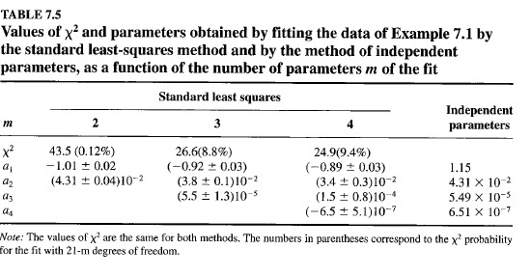

Slide 39
corresponding to P = 8.8%), and adding more terms does not improve the fit. If a
cubic function had been predicted by theoretical considerations, we should be obligated
to say that our data are not sensitive to the presence of a cubic term.
Legendre Polynomials
Although the method of fitting to orthogonal polynomials outlined in the previous
section can be tedious, there are predefined sets of orthogonal polynomials that are
often useful in fitting data. One important set is the Legendre polynomials
where x = cos e and the terms PL(X) in the function are given by
Po(x) = 1
Pl(X) = x
P2(x) = Vz(3x2 - 1)
P3(x) = Y2 (5x3 - 3x)
and higher-order terms can be determined from the recursion relation
1
PL(x) = L [(2L - 1)XPL- 1(X) - (L - l)PL-ix)]
(7.40)
(7.41)
(7.42)
Legendre polynomials are orthogonal when averaged over all values of x = cos e:
iI [P ( )P ( ) d = {2/(2L + 1) for L = M (7.43)
-I L x M X X 0 for L *" M
Example 7.3. Let us consider an experiment in which l3C is bombarded by 4.5-Me V
protons. In the subsequent reaction, some of the protons are captured by the l3C nucleus,
which then decays by gamma emission, producing gamma rays with energies up
to 11 MeV. A measurement of the angular distribution of the emitted gamma rays gives
information about the angular momentum states of the energy levels in the residual nucleus
14N.
Table 7.6 lists simulated data for this experiment. Gamma ray counts were
recorded at 17 angles from 0 to 160°. Columns 1 through 4 list the angles at which the
measurements were made, the cosine of the angle (x = cos e), the measured number
of counts (Ci), and the uncertainties (J c, in the counts. The uncertainties are assumed to
be purely statistical. These data are plotted in Figure 7.2 as a function of the angle e.
There appears to be symmetry around e = 90°, and consideration of the reaction
process predicts that the data should be described by a fourth-order Legendre polynomial
with only even terms:
(7.44)
Let us apply the matrix method of least squares of Section 7.2 to this problem to
fit the series of Legendre polynomials of Equation (7.41) to these data. We shall first
fit a fourth-order Legendre polynomial that includes both odd and even terms. The fitting
function is of the form
(7.45)
which is linear in the fitting parameters, the coefficients ai.

Slide 40
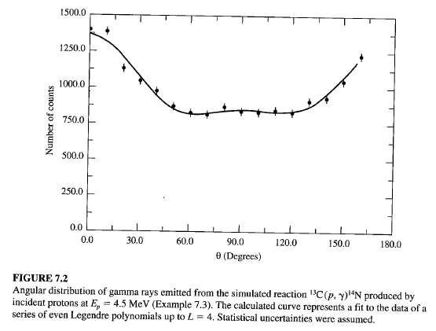

Slide 41
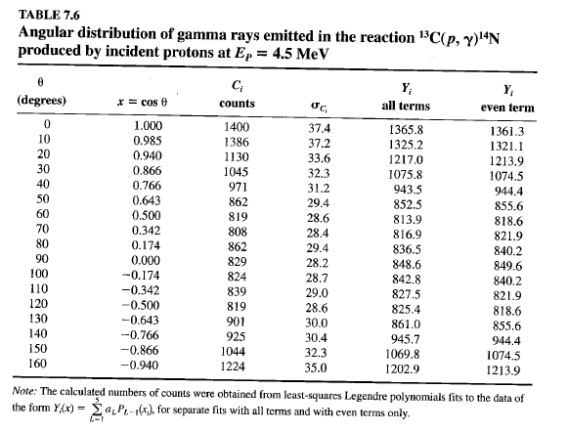

Slide 42
Computer fits Routines used for fitting a series of Legendre polynomials to these data
are included in Program 7.1. The procedure LEGPOLY in the program unit
FITFu Nc7 calculates the terms of the Legendre polynomials through tenth order.
The procedure is selected through a branch on the variable PAE in the function Funct
with PAE = 'A' for all terms to order n = m - 1, or PAE = 'E' to fit with just the
even terms. Note that the index k of the term in the fitting function, in general, does
not correspond to the order L of the Legendre polynomial.
The efficiency of the calculation (and therefore the speed of the linear regression
calculation) could be improved in a number of ways. The simplest change would be
to calculate the functions once at each value of the independent variable and store
the calculated values in an array.
Parameters obtained by fitting a series in Legendre polynomials for terms up
to L = 4 are listed in Table 7.7. Separate fits were made with all terms and with only
the even terms in the series. As expected, the coefficients ofterms involving odd orders
are comparable to their uncertainties and negligible compared to those involving
even poynomials. The full error matrix for the fit with even terms is listed in
Table 7.8.
In view of the strong theoretical argument that only even Legendre polynomials
are required for this reaction, it would be appropriate to fit a series that includes
only the even terms. The parameters obtained in this fit are also displayed in Table
7.7, and the numbers of counts calculated from these parameters are listed. The function
calculated with even terms is illustrated as a curve on the data of Figure 7.2.
Because we are fitting with orthogonal functions, we might have expected to
obtain identical values for the coefficient ao from both fits. (We expect the higherorder
even coefficients to change because the presence or absence of lower-order
coefficients must affect the higher coefficients.) The fact that there is some dependence
of ao on higher-order terms is a result of the fact that a given experiment does
not sample uniformly the entire range of the Legendre polynomial, so the orthogonality
relation Equation (7.43) is not satisfied by a finite data set. This is in contrast
to the situation in the previous section, where we set up orthogonal functions based
on the data themselves. Nevertheless, it is generally good practice to use orthogonal

Slide 43
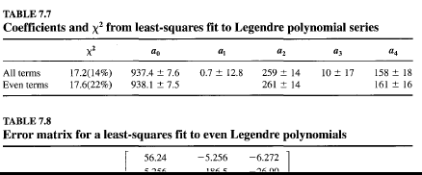

Slide 44
fitting functions whenever possible to minimize both the correlations between coefficients
and the dependence of higher coefficients on the presence of lower ones.
The values of X2 and the x2-probability for the two fits are also given in Table
7.7. We note that X2 for the three-parameter fit is necessarily higher than that for the
five-parameter fit, but X2 per degree of freedom is smaller and the x2-probability is
higher.
7.4 NONLINEAR FUNCTIONS
In all the procedures developed so far we have assumed that the fitting function was
linear in the coefficients. By that we mean that the function can be expressed as a
sum of separate terms each multiplied by a single coefficient. How can we fit data
with a function that is not linear in the coefficients? For example, suppose we have
measured the distribution of decay times of an unstable state and that the distribution
can be represented by the normalized function pet) = (1/T)e- tlT, where T is the
mean lifetime of the state. Can we find the parameter T by the least-squares method?
The method of least squares does not yield a straightforward analytical solution for
such functions. In Chapter 8 we investigate methods of searching parameter space
for values of the coefficients that will minimize the goodness-of-fit criterion X2.
Here we consider approximate solutions to such problems using linear-regression
techniques.
Linearization
It is possible to transform some functions into linear functions. For example, if we
were to fit an exponential decay problem of the form
Y = ae-bx (7.46)
where a and b are the unknown parameters, it would seem reasonable to take logarithms
of both sides and to fit the resulting straight line equation
In Y = In a - bx (7.47)
The method of least squares minimizes the value of X 2 with respect to each of
the coefficients In a and In b where X2 is given by
X2 = L {a~t [In Yi + In a - bxJ2
} (7.48)
where we must use weighted uncertainties a; instead of ai to account for the transformation
of the dependent variable:
,_ d(1nYi) _ I
ai-~ai-~ai (7.49)
The importance of weighting the uncertainties is illustrated in Figure 7.3, which
shows the function of Equation (7.46) graphed both on a linear and on a logarithmic
However, on the logarithmic scale, they appear to decrease with increasing Yi and
are very large for very small In Yi' If we were to ignore this effect in fitting Equation
(7.47), we would overemphasize the uncertainties for small values of Yi'
In general, if we fit the functionf(y) rather than y, the uncertainties ai in the
measured quantities must be modified by
a' = df(y) a· (7.50)
I dYi I
Errors in the Parameters
If we modify the fitting function so that instead of fitting the data points Yi with
the coefficient a, b, ... , we fit modified data points Y; = fey;) with coefficients a',
b', ... , then our estimates of the errors in the coefficients will pertain to the uncertainties
in the modified coefficients a', b', ... , rather than to the desired coefficients
a, b, .... If the relationship between the two sets of coefficients is defined to be
(7.51)
then the correspondence between the uncertainties a~, a~, ... in the modified coefficients
and the uncertainties am ab, ... in the desired coefficients is obtained in a
manner similar to that for a; and ai in Equation (7.50):
, _ dfa (a) , _ dfb(b)
aa - ~ aa ab - ---;n;- ab (7.52)

Slide 45
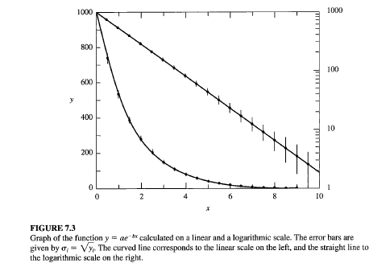

Slide 46
Thus, if the modified coefficient is a' = In a, the estimated error in a is determined
from the estimated error in a', according to Equation (7.52) withfa = In a:
, _ d(1na) _ aa
aa - ~ aa ---;; (7.53)
Values of X2 for testing the goodness of fit should be determined from the
original uncertainties of the data ai and from the unmodified equation, although
Equation (7.48) should give approximately equivalent results when weighted with
the modified uncertainties a;.
In Example 6.2, we considered an experiment to check the decrease in the
number of counts C as a function of distance r from a radiative source. We expected
a relation of the form
C(r) = b/r2 (7.54) .
and therefore changed the independent variable to x = lIr and fitted a straight line
to the C versus x data. Because uncertainties were assigned only to the dependent
variable C, the fit was not distorted by that transformation.
Suppose, instead, that our objective had been to determine the exponent a in
the expression for C:
C(r) = br-a
Taking logarithms of both sides, we obtain the linear equation
In(C) = In(b) - a In r
or
Ci=b'-ar'
(7.55)
(7.56)
with C' = In C, r' = In T, and b' = In b. The uncertainties a' in C' would be given
by Equation (7.49) as
a' = a/C
and we could find the exponent a by fitting a straight line to Equation (7.56) using
these weighted uncertainties.
Although the method of taking logarithms of an exponential or a power function
to produce a function that is linear in the parameters may be convenient for
quick estimates, with fast computers it is generally better to solve such problems by
one of the approximation methods developed for fitting nonlinear functions. These
methods will be explored in Chapter 8.

