Slide 1
CHAPTER – 1
UNCERTAINTIES
IN
MEASUREMENTS

Slide 2
1.1 MEASURING ERRORS
For all physical experiments, errors and uncertainties exist., that makes an experiment different from true value.
The errors and uncertainties must be reduced by improved experimental techniques and repeated measurements, and those errors remaining must always be estimated to establish the validity of our results.
Error: defined as "the difference between an observed or calculated value and the true value.
" Usually we do not know the "true" value; otherwise there would be no reason for performing the experiment.
We may know approximately what it should be, however, either from earlier experiments or from theoretical predictions.
illegitimate errors : errors that originate from mistakes or blunders in measurement or computation.
Fortunately, these errors are usually apparent either as obviously incorrect data points or as results that are not reasonably close to expected values.
They are classified as and generally can be corrected by carefully repeating the operations
We are interested in uncertainties introduced by random fluctuations in our measurements, and systematic errors that limit the precision and accuracy of our results in more or less well-defined ways.
The uncertainties are referred as the errors in our results, and the procedure for estimating them is called error analysis.

Slide 3
1.1 MEASURING ERRORS
Error: "the difference between an observed or calculated value and the true value.
The errors and uncertainties must be reduced by improved experimental techniques and repeated measurements.
" Usually we do not know the "true" value; otherwise there would be no reason for performing the experiment. True value may be known approximately either from earlier experiments or from theoretical predictions.
illegitimate errors : errors that originate from mistakes or blunders in measurement or computation. these errors are usually apparent either as obviously incorrect data points or as results that are not reasonably close to expected values. can be corrected by carefully repeating the erroneous operations
We are interested in uncertainties introduced by random fluctuations in our measurements, and systematic errors that limit the precision and accuracy of our results in more or less well-defined ways.
The uncertainties are referred as the errors in our results, and the procedure for estimating them is called error analysis.

Slide 4
1.1 MEASURING ERRORS
Errors : the difference between an observed or calculated value and true values in physical experiment. Errors must be estimated to establish the validity of our results
The errors and uncertainties must be minimized by improving experimental techniques and repeating measurements.
True value: generally unknown, may be known approximately from earlier experiments or from theoretical predictions.
Illegitimate errors : errors that originate from mistakes or blunders in measurement or computation. They are incorrect data points or as results not reasonably close to expected values. They can be corrected by carefully repeating the operations.
Uncertainties are referred as the errors and the procedure for estimating them is called error analysis.
Uncertainties :introduced by random fluctuations and systematic errors may limit the precision and accuracy of our results .
Systematic Errors: Errors due to faulty calibration of equipment or from bias on the part of the observer. can be estimated from an analysis of the experimental conditions and techniques. Systematic Errors cannot be studied by statistical analysis.
Reduction of systematic errors : major part of the planning of an experiment.

Slide 6
Accuracy Versus Precision
Accuracy of an experiment: how close the result of the experiment is to the true value;
Precision: how well the result has been determined, without reference to its agreement with the true value.
Precision is a measure of the reproducibility of the results.
Two sets of measurements in Figure 1.1 where the straight line on each graph shows the expected relation between the dependent variable y and the independent variable x.
In both graphs, the scatter of the data points is a reflection of uncertainties in the measurements, consistent with the error bars on the points.
The data in Figure 1.1(a) have been measured to a high degree of precision as illustrated by the small error bars, and are in excellent agreement with the expected variation of y with x, but are clearly inaccurate, deviating from the line by a constant offset.
the data points in Figure 1.1 (b) are rather imprecise as illustrated by the large error bars, but are scattered about the predicted distribution.
Accuracy and precision must be considered simultaneously for any experiment.
To determine a result with high precision and high inaccuracy is a waste of time and energy
Conversely, a result cannot be extremely accurate if the precision is low.
uncertainty or error in a result is referred to the precision with which that result has been determined.
Absolute precision : magnitude of the uncertainty in the result expressed in the same units as the result;
Relative precision: the magnitude of uncertainty expressed in terms of a fraction of the value of the result.

Slide 7
Accuracy Versus Precision
Accuracy of an experiment is a measure of how close the result of the experiment is to the true value;
Precision is a measure of how well the result has been determined, without reference to its agreement with the true value.
The precision is a measure of the reproducibility of the result in a given experiment.
Two sets of measurements in Figure 1.1 where the straight line on each graph shows the expected relation between the dependent variable y and the independent variable x.
In both graphs, the scatter of the data points is a reflection of uncertainties in the measurements, consistent with the error bars on the points.
The data in Figure 1.1(a) have been measured to a high degree of precision as illustrated by the small error bars, and are in excellent agreement with the expected variation of y with x, but are clearly inaccurate, deviating from the line by a constant offset.
On the other hand, the data points in Figure 1.1 (b) are rather imprecise as illustrated by the large error bars, but are scattered about the predicted distribution.
Accuracy and precision must consider simultaneously for any experiment.
It would be a waste of time and energy to determine a result with high precision if we knew that the result would be highly inaccurate.
Conversely, a result cannot be considered to be extremely accurate if the precision is low.
In general, when we quote the uncertainty or error in an experimental result, we are referring to the precision with which that result has been determined.
Absolute precision indicates the magnitude of the uncertainty in the result in the same units as the result;
Relative precision indicates the uncertainty in terms of a fraction of the value of the result

Slide 9
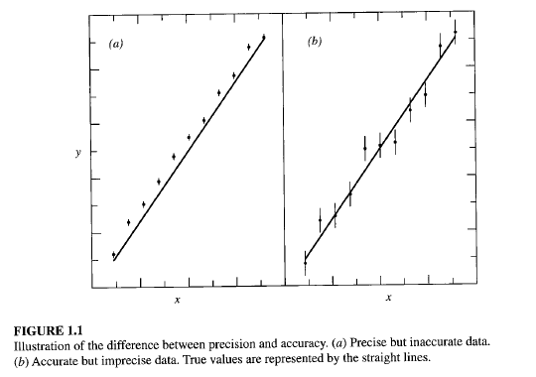

Slide 10
Systematic Errors
They may result from faulty calibration of equipment or from bias on the part of the observer. They must be estimated from an analysis of the experimental conditions and Techniques.
Errors of this type are not easy to detect and not easily studied by statistical analysis.
A major part of the planning of an experiment should be devoted to understanding
and reducing sources of systematic errors.
EXAMPLE 1.1
A student measures a table top with a steel meter stick and finds that the average of his measurements yields a result of (1.982 ± O.OOl) m for the length of the table.
He subsequently learns that the meter stick was calibrated at 25°C and has an expansion coefficient of 0.0005 °e-l.
Because his measurements were made at a room temperature of 20°C, they are systematically too small.
To correct for this effect, he multiplies his results by 1 + 0.0005 X (20 - 25) = 0.9975 so that his new determination of the length is l.977 m.
When the student repeats the experiment, he discovers a second systematic error, his technique for reading the meter stick was faulty in that he did not always read the divisions from directly above.
By experimentation he determines that this consistently resulted in a reading that was 2 mm short. The corrected result is l.979 m.
In this example, the first result was given with a fairly high precision, approximately
1 part in 2000.
The corrections to this result were meant to improve the accuracy by compensating for known sources of deviation of the first result from the best estimate possible.
These corrections did not improve the precision at all, but did in fact worsen it, because the corrections were themselves only estimates of the exact corrections.
Before quoting his final result, the student must reexamine his error analysis and take account of any additional uncertainties that may have been introduced by these corrections.

Slide 11
EXAMPLE 1.1
A student measures a table top with a steel meter stick and finds that the average of his measurements yields a result of (1.982 ± 0.001) m for the length of the table.
Meter stick was calibrated at 25°C and has an expansion coefficient of 0.0005 °e⁻¹.
The measurements were made at a room temperature of 20°C, they are systematically too small.
To correct, he multiplies his results by 1 + 0.0005 X (20 - 25) = 0.9975 so that his new determination of the length is 1.977 m.
When the student repeats the experiment, he discovers a second systematic error, his technique for reading the meter stick was faulty in that he did not always read the divisions from directly above.
By experimentation he determines that this consistently resulted in a reading that was 2 mm short. The corrected result is l.979 m.
In this example, the first result was given with a fairly high precision, approx. 1 part in 2000.
The corrections to this result were meant to improve the accuracy by compensating for known sources of deviation of the first result from the best estimate possible.
These corrections did not improve the precision at all, but did in fact worsen it, because the corrections were themselves only estimates of the exact corrections.
Before quoting his final result, the student must reexamine his error analysis and take account of any additional uncertainties that may have been introduced by these corrections.

Slide 13
Random Errors
The precision of an experiment depends upon random errors, caused by fluctuations in observations that yield different results each time the experiment is repeated, and thus require repeated experimentation to yield precise results.
A given accuracy implies an equivalent precision and, therefore, also depends to some extent on random errors.
The problem of reducing random errors is essentially one of improving the experimental method and refining the techniques, as well as simply repeating the experiment.
If the random errors result from instrumental uncertainties, they may be reduced by using more reliable and more precise measuring instruments.
If the random errors result from statistical fluctuations in a limited number of measurements, they may be reduced by making more measurements.
There are practical limits to these improvements.
In the measurement of the length of the table of Example 1.1, the student might attempt to improve the precision of his measurements by using a magnifying glass to read the scale, or he might attempt to reduce statistical fluctuations in his measurements by repeating the measurement several times.
In neither case would it be useful to reduce the random errors much below the systematic errors, such as those introduced by the calibration of the meter stick or the correction for his initial faulty reading of the scale.
The limits imposed by systematic errors are important considerations in planning and performing experiments.

Slide 14
Random Errors
The precision of an experiment depends upon random errors.
Random errors : caused by fluctuations in observations that yield different results each time the experiment is repeated.
Random error minimization requires repeated experimentation to yield precise results.
A given accuracy implies an equivalent precision and, therefore, also depends to some extent on random errors.
Reducing random errors: requires improving the experimental method and techniques, as well as repeating the experiment.
Random errors resulting from instrumental uncertainties: may be reduced by using more reliable and more precise measuring instruments.
Random errors resulting from statistical fluctuations in a limited number of measurements: they may be reduced by making more measurements.
There are practical limits to these improvements.
In the measurement of the length of the table of Example 1.1, the student might attempt to improve the precision of his measurements by using a magnifying glass to read the scale, or he might attempt to reduce statistical fluctuations in his measurements by repeating the measurement several times.
It would not be useful to reduce the random errors much below the systematic errors, such as those introduced by the calibration of the meter stick or the correction for his initial faulty reading of the scale.
The limits imposed by systematic errors are important considerations in planning and performing experiments.

Slide 16
Significant Figures and Roundoff
The precision of an experimental result is implied by the number of digits recorded in the result, although generally the uncertainty should be quoted specifically as well. The number of significant figures in a result is defined as follows:
1. The leftmost nonzero digit is the most significant digit.
2. If there is no decimal point, the rightmost nonzero digit is the least significant digit.
3. If there is a decimal point, the rightmost digit is the least significant digit, even if it is a O.
4. All digits between the least and most significant digits are counted as significant digits.
For example, the following numbers each have four significant digits: 1234, 123,400, 123.4, 1001, 1000., 10.10,0.0001010, 100.0.
If there is no decimal point, there are ambiguities when the rightmost digit is O.
Thus, the number 1010 is considered to have only three significant digits even though the last digit might be physically significant.
To avoid ambiguity, it is better to supply decimal points or to write such numbers in scientific notation, that is, as an argument in decimal notation multiplied by the appropriate power of 10.
Thus, our example of 1010 would be written as 1010. or 1.010 X 10³ if all four digits are significant.
When quoting an experimental result, the number of significant figures should be approximately one more than that dictated by the experimental precision.
The reason for including the extra digit is to avoid errors that might be caused by rounding errors in later calculations.
If the result of the measurement of Example 1.1 is L = 1.979 m with an uncertainty of 0.012 m, this result could be quoted as L = (1.979 ± 0.012) m.
However, if the first digit of the uncertainty is large, such as 0.082 m, then we should probably quote L = (1.98 ± 0.08) m.
In other words, we let the uncertainty define the precision to which we quote our result.
When insignificant digits are dropped from a number, the last digit retained should be rounded off for the best accuracy.

Slide 17
Significant Figures and Roundoff
The precision of an experimental result is given by the number of digits recorded in the result, although generally the uncertainty should be quoted specifically as well.
The number of significant figures in a result is defined as follows:
1. The leftmost nonzero digit is the most significant digit.
2. If there is no decimal point, the rightmost nonzero digit is the least significant digit.
3. If there is a decimal point, the rightmost digit is the least significant digit, even if it is a 0.
4. All digits between the least and most significant digits are counted as significant digits.
For example, the following numbers each have four significant digits: 1234, 123,400, 123.4, 1001, 1000., 10.10,0.0001010, 100.0.
If there is no decimal point, there are ambiguities when the rightmost digit is 0.
Thus, the number 1010 is considered to have only three significant digits even though the last digit might be physically significant.
To avoid ambiguity, it is better to supply decimal points or to write such numbers in scientific notation, that is, as an argument in decimal notation multiplied by the appropriate power of 10.
Thus, our example of 1010 would be written as 1010. or 1.010 X 10³ if all four digits are significant.
When quoting an experimental result, the number of significant figures should be approximately one more than that dictated by the experimental precision.
The reason for including the extra digit is to avoid errors that might be caused by rounding errors in later calculations.
If the result of the measurement of Example 1.1 is L = 1.979 m with an uncertainty of 0.012 m, this result could be quoted as L = (1.979 ± 0.012) m.
However, if the first digit of the uncertainty is large, such as 0.082 m, then we should probably quote L = (1.98 ± 0.08) m.
In other words, we let the uncertainty define the precision to which we quote our result.

Slide 18
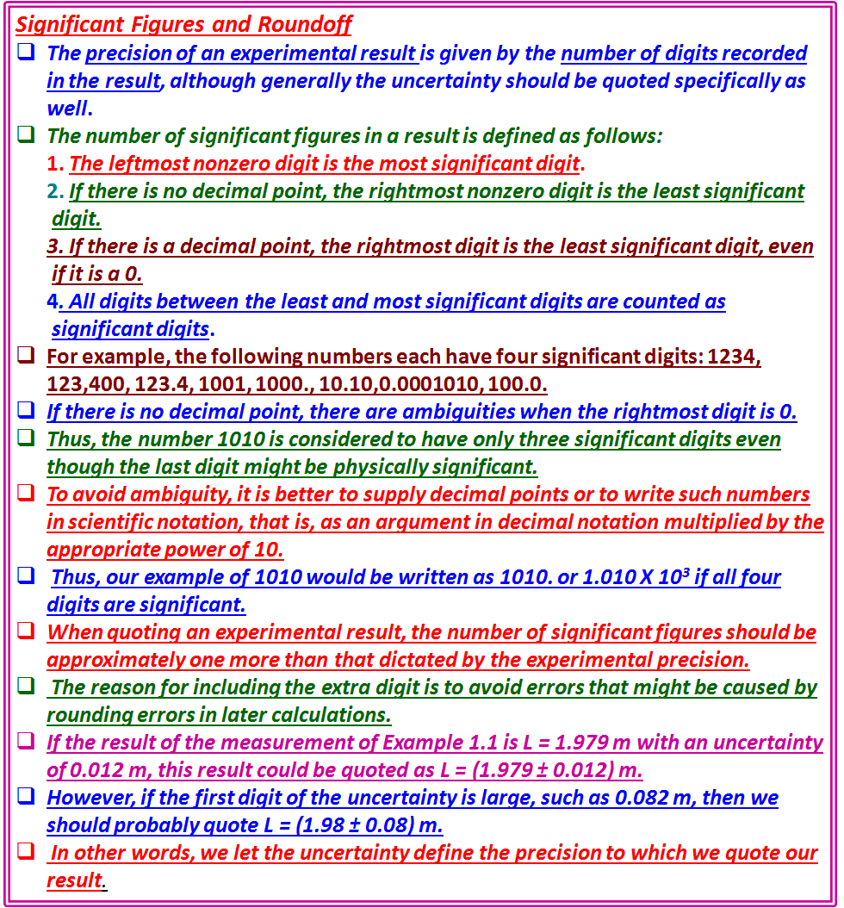

Slide 19
To round off a number to fewer significant digits than were specified originally, we truncate the number as desired and treat the excess digits as a decimal fraction. Then:
1. If the fraction is greater than 1/2, increment the new least significant digit.
2. If the fraction is less than 1/2, do not increment.
3. If the fraction equals 1/2, increment the least significant digit only if it is odd.
The reason for rule 3 is that a fractional value of 1/2 may result from a previous rounding up of a fraction that was slightly less than 1/2 or a rounding down of a fraction that was slightly greater than 1/2.
For example, 1.249 and 1.251 both round to three significant figures as 1.25.
If we were to round again to two significant figures, both would yield the same value, either 1.2 or 1.3, depending on our convention.
Choosing to round up if the resulting last digit is odd and to round down if the resulting last digit is even, reduces systematic errors that would otherwise be introduced into the average of a group of such numbers.
Note that it is generally advisable to retain all available digits in intermediate calculations and round only the final results.
1.2 UNCERTAINTIES
Uncertainties in experimental results can be separated into two categories:
those that result from fluctuations in measurements,
and those associated with the theoretical description of our result.
For example, if we measure the length of a rectangular table along one edge, we know that any uncertainties, aside from systematic errors, are associated with the fluctuations of our measurements from trial to trial.
With an infinite number of measurements we might be able to estimate the length very precisely, but with a finite number of trials there will be a finite uncertainty.

Slide 20
Round off
When insignificant digits are dropped from a number, the last digit retained should be rounded off for the best accuracy.
To round off a number to fewer significant digits than were specified originally, we truncate the number as desired and treat the excess digits as a decimal fraction. Then:
1. If the fraction is greater than 1/2, increment the new least significant digit.
2. If the fraction is less than 1/2, do not increment.
3. If the fraction equals 1/2, increment the least significant digit only if it is odd.
The reason for rule 3 is that a fractional value of 1/2 may result from a previous rounding up of a fraction that was slightly less than 1/2 or a rounding down of a fraction that was slightly greater than 1/2.
For example, 1.249 and 1.251 both round to three significant figures as 1.25.
If we were to round again to two significant figures, both would yield the same value, either 1.2 or 1.3, depending on our convention.
Choosing to round up if the resulting last digit is odd and to round down if the resulting last digit is even, reduces systematic errors that would otherwise be introduced into the average of a group of such numbers.
Note that it is generally advisable to retain all available digits in intermediate calculations and round only the final results.

Slide 22
If we were to measure the length of the table at equally spaced positions across the table, the measurements would show additional fluctuations corresponding to irregularities in the table itself, and our result could be expressed as the mean length.
If, however, we were to describe the shape of an oval table, we would be faced with uncertainties both in the measurement of position of the edge of the table at various points and in the form of the equation to be used to describe the shape, whether it be circular, elliptical, or whatever.
Thus, we shall be concerned in the following chapters with a comparison of the distribution of measured data points with the distribution predicted on the basis of a theoretical model.
This comparison will help to indicate whether our method of extracting the results is valid or needs modification.
The term error suggests a deviation of the result from some "true" value.
Usually we cannot know what the true value is, and can only estimate the errors inherent in the experiment.
If we repeat an experiment, the results may well differ from those of the first attempt. We express this difference as a discrepancy between the two results.
Discrepancies arise because we can determine a result only with a given uncertainty.
For example, when we compare different measurements of a standard physical constant, or compare our result with the accepted value, we should refer to
the differences as discrepancies, not errors or uncertainties.
Because, in general, we shall not be able to quote the actual error in a result,
we must develop a consistent method for determining and quoting the
estimated error.

Slide 23
1.2 UNCERTAINTIES
Uncertainties in experimental results can be separated into two categories:
1) those that result from fluctuations in measurements,
2) those associated with the theoretical description of our result.
if we measure the length of a rectangular table along one edge, we know that any uncertainties, aside from systematic errors, are associated with the fluctuations of our measurements from trial to trial.
With an infinite number of measurements we might be able to estimate the length very precisely, but with a finite number of trials there will be a finite uncertainty.
If we were to measure the length of the table at equally spaced positions across the table, the measurements would show additional fluctuations corresponding to irregularities in the table itself, and our result could be expressed as the mean length.
If, however, we were to describe the shape of an oval table,
1) we would be faced with uncertainties both in the measurement of position of the edge of the table at various points
2) in the form of the equation to be used to describe the shape, whether it be circular, elliptical, or whatever.
Thus, we shall be concerned in the following chapters with a comparison of the distribution of measured data points with the distribution predicted on the basis of a theoretical model.
This comparison will help to indicate whether our method of extracting the results is valid or needs modification.

Slide 25
A study of the distribution of the results of repeated measurements of the same
quantity can lead to an understanding of these errors so that the quoted error is a measure of the spread of the distribution.
However, for some experiments it may not be feasible to repeat the measurements and experimenters must therefore attempt to estimate the errors based on an understanding of the apparatus and their own skill in using it.
For example, if the student of Example 1.1 could make only a single measurement
of the length of the table, he should examine his meter stick and the table, and try to estimate how well he could determine the length.
His estimate should be consistent with the result expected from a study of repeated measurements; that is, to quote an estimate for the standard error, he should try to estimate a range into which he would expect repeated measurements to fall about seven times out of ten.
Thus, he might conclude that with a fine steel meter stick and a well-defined table edge, he could measure to about ± 1 mm or ±O.OOI m. He should resist the temptation to increase this error estimate, "just to be sure."
We must also realize that the model from which we calculate theoretical parameters to describe the results of our experiment may not be the correct model.
we shall discuss hypothetical parameters and probable distributions of errors pertaining to the "true" states of affairs, and we shall discuss methods of making experimental estimates of these parameters and the uncertainties associated with these determinations.

Slide 26
Error suggests a deviation of the result from some "true" value.
Usually we cannot know what the true value is, and can only estimate the errors inherent in the experiment.
If we repeat an experiment, the results may well differ from those of the first attempt. This difference is called a discrepancy between the two results.
Discrepancies arise because we can determine a result only with a given uncertainty.
We compare different measurements of a standard physical constant, or compare our result with the accepted value, the differences is referred as discrepancies, and not errors or uncertainties.
We shall not be able to quote the actual error in a result, we must develop a consistent method for determining and quoting the estimated error.
A study of the distribution of the results of repeated measurements of the same
quantity can lead to an understanding of these errors so that the quoted error is a measure of the spread of the distribution.
However, for some experiments it may not be feasible to repeat the measurements and experimenters must therefore attempt to estimate the errors based on an understanding of the apparatus and their own skill in using it.
if the student of Example 1.1 could make only a single measurement of the length of the table, he should examine his meter stick and the table, and try to estimate how well he could determine the length.
His estimate should be consistent with the result expected from a study of repeated measurements; that is, to quote an estimate for the standard error, he should try to estimate a range into which he would expect repeated measurements to fall about seven times out of ten.
Thus, he might conclude that with a fine steel meter stick and a well-defined table edge, he could measure to about ± 1 mm or ±0.001 m. He should resist the temptation to increase this error estimate, "just to be sure."
We must also realize that the model from which we calculate theoretical parameters to describe the results of our experiment may not be the correct model.
We shall discuss hypothetical parameters and probable distributions of errors pertaining to the "true" states of affairs, and we shall discuss methods of making experimental estimates of these parameters and the uncertainties associated with these determinations.

Slide 27
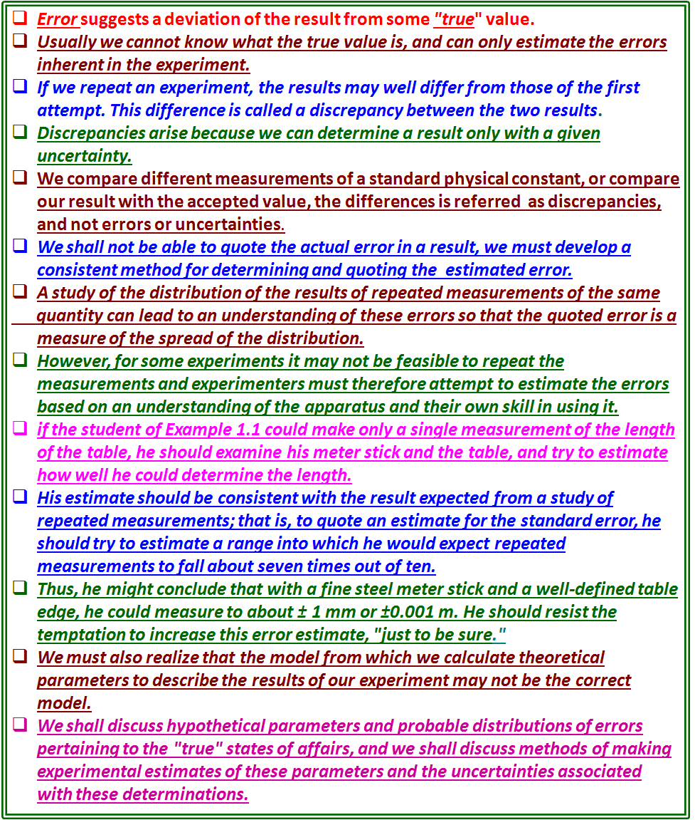

Slide 28
Minimizing Uncertainties and Best Results
Our preoccupation with error analysis is not confined just to the determination of the precision of our results.
In general, we shall be interested in obtaining the maximum amount of useful information from the data on hand without being able either to repeat the experiment with better equipment or to reduce the statistical uncertainties by making more measurements.
We shall be concerned, therefore, with the problem of extracting from the data the best estimates of theoretical parameters and of the random errors, and we shall want to understand the effect of these errors on our results, so that we can determine what confidence we can place in our final results.
It is reasonable to expect that the most reliable results we can calculate from a given set of data will be those for which the estimated errors are the smallest.
Thus, our development of techniques of error analysis will help to determine the optimum estimates of parameters to describe the data.
It must be noted, however, that even our best efforts will yield only estimates of the quantities investigated.

Slide 29
Minimizing Uncertainties and Best Results
In error analysis we are not confined just to the determination of the precision of our results.
We shall be interested in obtaining the maximum amount of useful information from the data on hand without being able either to repeat the experiment with better equipment or to reduce the statistical uncertainties by making more measurements.
We shall be interested in the problem of extracting from the data the best estimates of theoretical parameters and of the random errors, and the effect of these errors on our results, so that we can determine what confidence we can place in our final results.
It is reasonable to expect that the most reliable results we can calculate from a given set of data will be those for which the estimated errors are the smallest.
Thus, techniques of error analysis will help to determine the optimum estimates of parameters to describe the data.
It must be noted, however, that even our best efforts will yield only estimates of the quantities investigated.

Slide 31
1.3 PARENT AND SAMPLE DISTRIBUTIONS
If we make a measurement x_{i} in of a quantity x, we expect our observation to approximate the quantity, but we do not expect the experimental data point to be exactly equal to the quantity.
If we make another measurement, we expect to observe a discrepancy between the two measurements because of random errors, and we do not expect either determination to be exactly correct, that is, equal to x. As we make more and more measurements, a pattern will emerge from the data.
Some of the measurements will be too large, some will be too small. On the average, however, we expect them to be distributed around the correct value, assuming we can neglect or correct for systematic errors.
If we could make an infinite number of measurements, then we could describe exactly the distribution of the data points.
This is not possible in practice, but we can hypothesize the existence of such a distribution that determines the probability of getting any particular observation in a single measurement.
This distribution is called the parent distribution.
Similarly, we can hypothesize that the measurements we have made are samples from the parent distribution and they form the sample distribution.
In the limit of an infinite number of measurements, the sample distribution becomes the parent distribution.

Slide 32
1.3 PARENT AND SAMPLE DISTRIBUTIONS
If we make a measurement x_{i} in of a quantity x, we expect our observation to approximate the quantity, but we do not expect the experimental data point to be exactly equal to the quantity.
If we make another measurement, we expect to observe a discrepancy between the two measurements because of random errors, and we do not expect either determination to be exactly correct, that is, equal to x.
As we make more and more measurements, a pattern will emerge from the data.
Some of the measurements will be too large, some will be too small.
On the average, however, we expect them to be distributed around the correct value, assuming we can neglect or correct for systematic errors.
If we could make an infinite number of measurements, then we could describe exactly the distribution of the data points called the parent distribution.
This is not possible in practice, but we can hypothesize the existence of such a distribution that determines the probability of getting any particular observation in a single measurement.
This distribution is called the parent distribution.
Similarly, we can hypothesize that the measurements we have made are samples from the parent distribution and they form the sample distribution.
In the limit of an infinite number of measurements, the sample distribution becomes the parent distribution.
It is convenient to think in terms of a probability density function p(x), normalized to unit area (i.e., so that the integral of the entire curve is equal to 1) and defined such that in the limit of a very large number N of observations, the number ,)..N of observations of the variable x between x and x + Δx is given by M = Np(x) Δ x.
The solid and dashed curves in Figure 1.2 have been scaled in this way so that the ordinate values correspond directly to the numbers of observations expected in any range Δ x from a 50-event sample and the area under each curve corresponds to the total area of the histogram.

Slide 33
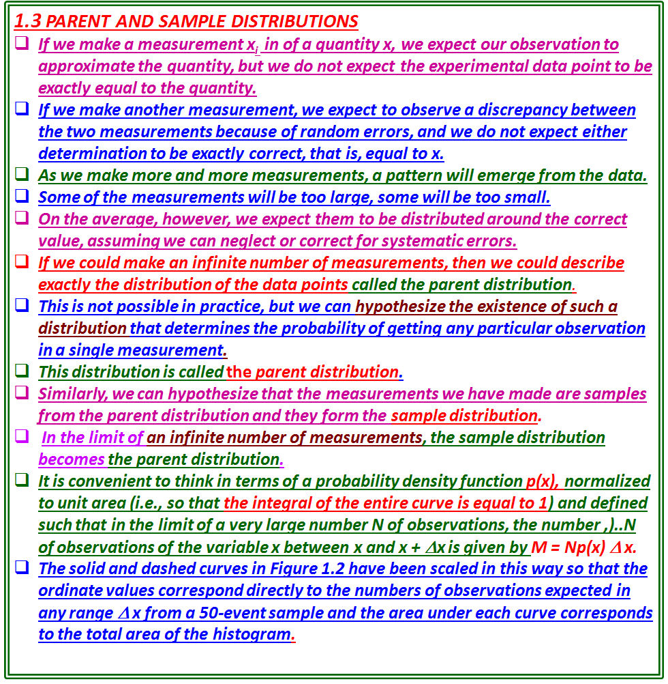

Slide 34
EXAMPLE 1.2
In a physics laboratory experiment, students drop a ball 50 times and record the time it takes for the ball to fall 2.00 m.
One set of observations, corrected for systematic errors, ranges from about 0.59 s to 0.70 s, and some of the observations are identical.
Figure 1.2 shows a histogram or frequency plot of these measurements. The height of a data bar represents the number of measurements that fall between the two values indicated by the upper and lower limits of the bar on the abscissa of the plot. (See Appendix D.)
If the distribution results from random errors in measurement, then it is very likely that it can be described in terms of the Gaussian or normal error distribution the familiar bell-shaped curve of statistical analysis, which we shall discuss in Chapter 2.
A Gaussian curve, based on the mean and standard deviation of these measurements, is plotted as the solid line in Figure 1.2.
This curve summarizes the data of the sample distribution in terms of the Gaussian model and provides an estimate of the parent distribution.
The measured data and the curve derived from them clearly do not agree exactly.
The coarseness of the experimental histogram distinguishes it at once from the smooth theoretical Gaussian curve.
We might imagine that, if the students were to make a great many measurements or combine several sets of measurements so that they could plot the histogram in finer and finer bins, under ideal circumstances the histogram would eventually approach a smooth Gaussian curve.
If they were to calculate the parameters from such a large sample, they could determine the parent distribution represented by the dotted curve in Figure 1.2.

Slide 35
EXAMPLE 1.2
A students drop a ball 50 times and record the time it takes for the ball to fall 2.00 m.
One set of observations, corrected for systematic errors, ranges from about 0.59 s to 0.70 s, and some of the observations are identical.
Figure 1.2 shows a histogram or frequency plot of these measurements.
The height of a data bar represents the number of measurements that fall between the two values indicated by the upper and lower limits of the bar on the abscissa of the plot. (See Appendix D.)
If the distribution results due to random errors in measurement, then it can be described in terms of the Gaussian or normal error distribution -the familiar bell-shaped curve of statistical analysis( Chapter 2).
A Gaussian curve, based on the mean and standard deviation of these measurements, is plotted as the solid line in Figure 1.2.
This curve summarizes the data of the sample distribution in terms of the Gaussian model and provides an estimate of the parent distribution.
The measured data and the curve derived from them clearly do not agree exactly.
The coarseness of the experimental histogram distinguishes it at once from the smooth theoretical Gaussian curve.
If the students were to make a great many measurements or combine several sets of measurements so that they could plot the histogram in finer and finer bins, under ideal circumstances the histogram would eventually approach a smooth Gaussian curve.
If they were to calculate the parameters from such a large sample, they could determine the parent distribution represented by the dotted curve in Figure 1.2.

Slide 37
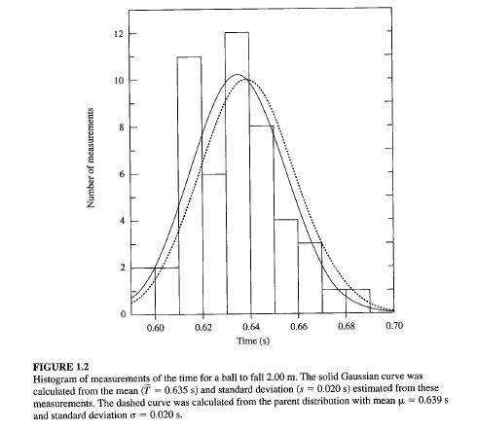

Slide 38
It is convenient to think in terms of a probability density function p(x), normalized to unit area (i.e., so that the integral of the entire curve is equal to 1) and defined such that in the limit of a very large number N of observations, the number ,)..N of observations of the variable x between x and x + Δx is given by M = Np(x) Δ x.
The solid and dashed curves in Figure 1.2 have been scaled in this way so that the ordinate values correspond directly to the numbers of observations expected in any range Δ x from a 50-event sample and the area under each curve corresponds to the total area of the histogram.
Notation
A number of parameters of the parent distribution have been defined by convention.
We use Greek letters to denote them, and Latin letters to denote experimental estimates of them.
In order to determine the parameters of the parent distribution, we assume that the results of experiments asymptotically approach the parent quantities as the number of measurements approaches infinity; that is, the parameters of the experimental distribution equal the parameters of the parent distribution in the limit of an infinite number of measurements.
If we specify that there are N observations in a given experiment, then we can denote this by (parent parameter) = lim (experimental parameter) N->∞ .
If we make N measurements and label them x₁, x₂, x₃, and so forth, up to a final measurement x_{N} , then we can identify the sum of all these measurements as

Slide 39
Notation
Greek letters to denote parameters of the parent distribution , and Latin letters to denote experimental estimates of them.
We assume that the results of experiments asymptotically approach the parent quantities as the number of measurements approaches infinity;
the parameters of the experimental distribution equal the parameters of the parent distribution in the limit of an infinite number of measurements.
If we specify that there are N observations in a given experiment, then we can denote this by (parent parameter) = lim (experimental parameter) N->∞ .
If we make N measurements and label them x₁, x₂, x₃, and so forth, up to a final measurement x_{N} , then we can identify the sum of all these measurements as
where the left-hand side is interpreted as the sum of the observations x_{i} over the index i from i = 1 to i = N inclusive.
Because we shall be making frequent use of the sum over N measurements of various quantities, we simplify the notation by omitting the index whenever we are considering a sum where the index i runs from 1 to N;

Slide 41
where the left-hand side is interpreted as the sum of the observations x_{i} over the index i from i = 1 to i = N inclusive.
Because we shall be making frequent use of the sum over N measurements of various quantities, we simplify the notation by omitting the index whenever we are considering a sum where the index i runs from 1 to N;
Mean, Median, and Mode
The of the experimental distribution is given as the sum of N determinations x_{i} of the quantity x divided by the number of determinations
Mean μ of the parent population is defined as the limit
The mean is therefore equivalent to the centroid or average value of the quantity x.
Median μ _{1/2} of the parent population μ _{1/2} is defined as that value for which, in the limit of an infinite number of determinations x_{i} half the observations will be less than the median and half will be greater.
In terms of the parent distribution, this means that the probability is 50% that any measurement x_{i} will be larger or smaller than the median

Slide 42
Mean, Median, and Mode
The of the experimental distribution is given as the sum of N determinations x_{i} of the quantity x divided by the number of determinations
Mean μ of the parent population is defined as the limit
; mean is therefore equivalent to the centroid or average value of the quantity x.
Median μ _{1/2} of the parent population μ _{1/2} is defined as that value for which, in the limit of an infinite number of determinations x_{i} half the observations will be less than the median and half will be greater.
The probability is 50% that any measurement x_{i} will be larger or smaller than the median μ _{1/2}
so that the median line cuts the area of the probability density distribution in half.
Mode, or most probable value μ_{max}, of the parent population is that value for which the parent distribution has the greatest value.
In any given experimental measurement, this value is the one that is most likely to be observed.
In the limit of a large number of observations, this value will probably occur most often
The relationship of the mean, median, and most probable value to one another is illustrated in Figure 1.3.
For a symmetrical distribution these parameters would all be equal by the symmetry of their definitions.
For an asymmetric distribution such as that of Figure 1.3, the median generally falls between the most probable value and the mean.
The most probable value corresponds to the peak of the distribution, and the areas on either side of the median are equal.

Slide 44
so that the median line cuts the area of the probability density distribution in half.
The mode, or most probable value μ_{max}, of the parent population is that value for which the parent distribution has the greatest value.
In any given experimental measurement, this value is the one that is most likely to be observed.
In the limit of a large number of observations, this value will probably occur most often
The relationship of the mean, median, and most probable value to one another is illustrated in Figure 1.3.
For a symmetrical distribution these parameters would all be equal by the symmetry of their definitions.
For an asymmetric distribution such as that of Figure 1.3, the median generally falls between the most probable value and the mean.
The most probable value corresponds to the peak of the distribution, and the areas on either side of the median are equal.

Slide 45
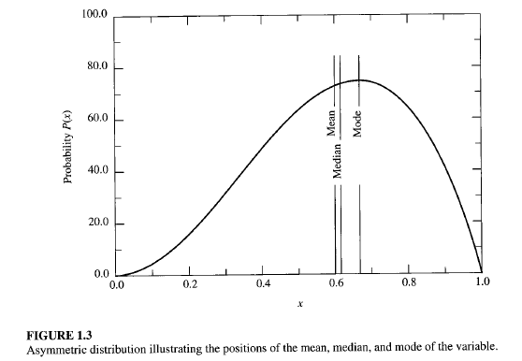

Slide 46
Deviations
The deviation di of any measurement x_{i} from the mean μ of the parent distribution is defined as the difference between x_{i} and μ :
If μ is the true value of the quantity, then d_{i} is also the true error in x_{i} .
The average of the deviations d must vanish by virtue of the definition of the
mean in Equation (1.2):
The average deviation α, therefore, is defined as the average of the absolute values of the deviations:
The average deviation is a measure of the dispersion of the expected observations about the mean.
A parameter that is a more appropriate measure of the dispersion of the observations is the standard deviation σ.
The variance σ² is defined as the limit of the average of the squares of the deviations from the mean μ:
and the standard deviation σ is the square root of the variance.
Note that the second form of Equation (1.8) is often described as "the average of the squares minus the square of the average.
The standard deviation is the root mean square of the deviations, and is associated with the second moment of the data about the mean.

Slide 47
Deviations
The deviation d_{i} of any measurement x_{i} from the mean μ of the parent distribution is defined as the difference between x_{i} and μ :
If μ is the true value of the quantity, then d_{i} is also the true error in x_{i} .
The average of the deviations d must vanish by virtue of the definition of the
mean in Equation (1.2):
The average deviation α, therefore, is defined as the average of the absolute values of the deviations:
The average deviation α is a measure of the dispersion of the expected observations about the meanμ.
Standard deviation σ is a measure of the dispersion of the observations about the the mean μ.
The variance σ² is defined as the limit of the average of the squares of the deviations from the mean μ:
and the standard deviation σ is the square root of the variance.
Note that the second form of Equation (1.8) is often described as "the average of the squares minus the square of the average.
The standard deviation is the root mean square of the deviations, and is associated with the second moment of the data about the mean.

Slide 49
The corresponding expression for the variance s² of the sample population is given by
where the factor N - 1, rather than N, is required in the denominator to
account for the fact that the parameter 'x has been determined from the data
and not independently.
We note that the symbol σ(instead of s) is often used to represent the best estimate of the standard deviation of the parent distribution determined from a sample distribution.
Significance
We wish to describe our distribution in terms of just the mean and standard deviation.
The mean may not be exactly equal to the datum in question if the parent distribution is not symmetrical about the mean, but it should have the same characteristics.
The mean is one of the parameters that specifies the probability distribution: It has the same units as the "true“ value and, we shall consider it to be the best estimate of the "true" value under the prevailing experimental conditions.
The variance s² and the standard deviation s characterize the uncertainties associated with our experimental attempts to determine the "true" values.
For a given number of observations, the uncertainty in determining the mean of the parent distribution is proportional to the standard deviation of that distribution.
The standard deviation s is, therefore, an appropriate measure of the uncertainty due to fluctuations in the observations in our attempt to determine the "true" value.
The distribution resulting from purely statistical errors can be described well by the two parameters, the mean and the standard deviation,
At distances of a few standard deviations from the mean of an experimental distribution, nonstatistical errors may dominate.
Then it may be preferable to describe the spread of the distribution in terms of the average deviation, rather than the standard deviation, because the latter tends to deemphasize measurements that are far from the mean.
There are also distributions for which the variance does not exist. The average deviation or some other quantity must be used as a parameter to indicate the spread of the distribution in such cases.

Slide 50
The corresponding expression for the variance s² of the sample population is given by
where the factor N - 1, rather than N, is required in the denominator to account
for the fact that the parameter x has been determined from the data and not
independently.
Symbol σ (instead of s) is often used to represent the best estimate of the standard deviation of the parent distribution determined from a sample distribution.
Significance
We need to describe our distribution in terms of just the mean and standard deviation.
The mean may not be equal to exact reference point of the parent distribution, if it is not symmetrical about the mean, but it should have the same characteristics.
The mean is one of the parameters that specifies the probability distribution:
It has the same units as the "true“ value and, we shall consider it to be the best estimate of the "true" value under the prevailing experimental conditions.
The variance s² and the standard deviation s characterize the uncertainties associated with our experimental attempts to determine the "true" values.
For a given number of observations, the uncertainty in determining the mean of the parent distribution is proportional to the standard deviation of that distribution.
The standard deviation s is, therefore, an appropriate measure of the uncertainty due to fluctuations in the observations in our attempt to determine the "true" value.
The distribution resulting from purely statistical errors can be described well by the two parameters, the mean and the standard deviation,
At distances of a few standard deviations from the mean of an experimental distribution, nonstatistical errors may dominate.
Then it may be preferable to describe the spread of the distribution in terms of the average deviation, rather than the standard deviation, because the latter tends to deemphasize measurements that are far from the mean.
There are also distributions for which the variance does not exist.
The average deviation or some other quantity must be used as a parameter to indicate the spread of the distribution in such cases.

Slide 52
In the following sections, however, we shall be concerned mainly with distributions that result from statistical errors and for which the variance exists.
1.4 MEAN AND STANDARD DEVIATION OF DISTRIBUTIONS
We can define the mean μ and the standard deviation σ in terms of the distribution p (x) of the parent population.
The probability density p(x) is defined such that in the limit of a very large number of observations, the fraction dN of observations of the variable x that yield values between x and x + dx is given by dN = Np (x) dx.
The mean μ is the expectation value < x> of x, and the variance σ is the expectation
value <( x - μ)²> of the square of deviations of x from μ.
The expectation value <f(x)> of any function of x is defined as the weighted average of f(x), over all possible values of the variable x, with each value of f(x) weighted by the probability density distribution p (x).
Discrete Distributions
If the probability function is a discrete function P(x) of the observed value x, we replace
the sum over the individual observations ∑x_{i} in Equation (1.2) by a sum over
the values of the possible observations multiplied by the number of times these observations are expected to occur.
If there are n possible different observable values of the quantity x, which we denote by x_{j} (where the index j runs from 1 to n with no two values of x_{j} equal), we should expect from a total of N observations to obtain each observable NP(x_{j}) times.

Slide 53
1.4 MEAN AND STANDARD DEVIATION OF DISTRIBUTIONS
In the following , we shall be concerned mainly with distributions that result from statistical errors and for which the variance exists
The mean μ and the standard deviation σ can be defined in terms of the distribution p (x) of the parent population.
The probability density p(x) is defined such that in the limit of a very large number of observations, the fraction dN of observations of the variable x that yield values between x and x + dx is given by dN = Np (x) dx.
The mean μ is the expectation value < x> of x, and the variance σ is the expectation value <( x - μ)²> of the square of deviations of x from μ.
The expectation value <f(x)> of any function of x is defined as the weighted average of f(x), over all possible values of the variable x, with each value of f(x) weighted by the probability density distribution p (x).
Discrete Distributions
If the probability function is a discrete function P(x) of the observed value x, we replace the sum over the individual observations ∑x_{i} in Equation (1.2) by a sum over the values of the possible observations multiplied by the number of times these observations are expected to occur.
If there are n possible different observable values of the quantity x, which we denote by x_{j} (where the index j runs from 1 to n with no two values of x_{j} equal), we should expect from a total of N observations to obtain each observable NP(x_{j}) times.

Slide 55
The mean can then be expressed as
Similarly, the variance σ in Equation (1.8) can be expressed in terms of the probability function P(x):
In general, the expectation value of any function of f(x) is given by
Continuous Distributions
If the probability density function is a continuous smoothly varying function p(x) of the observed value x, we replace the sum over the individual observations by an integral over all values of x multiplied by the probability p(x).
The mean μ becomes the first moment of the parent distribution
and the variance σ² becomes the second central product moment
The expectation value of any function of x is

Slide 56
The mean can then be expressed as
Similarly, the variance σ in Equation (1.8) can be expressed in terms of the probability function P(x):
In general, the expectation value of any function of f(x) is given by
Continuous Distributions
If the probability density function is a continuous smoothly varying function p(x) of the observed value x, we replace the sum over the individual observations by an integral over all values of x multiplied by the probability p(x).
The mean μ becomes the first moment of the parent distribution
the variance σ² becomes the second central product moment
The expectation value of any function of x is:

Slide 58
What is the connection between the probability distribution of the parent population and an experimental sample we obtain?
We have already seen that the uncertainties of the experimental conditions preclude a determination of the "true“ values themselves.
As a matter of fact, there are three levels of abstraction between the data and the information we seek:
From. our experimental data points we can determine a sample frequency distribution that describes the way in which these particular data points are distributed over the range of possible data points. We use x to denote the mean of the data and s² to denote the sample variance. The shape and magnitude of the sample distribution vary from sample to sample.
2. From the parameters of the sample probability distribution we can estimate the parameters of the probability distribution of the parent population of possible observations. Our best estimate for the mean μ is the mean of the sample distribution x, and the best estimate for the variance σ² is the sample variance s². Even the shape of this parent distribution must be estimated or assumed.
3. From the estimated parameters of the parent distribution we estimate the results sought. In general, we shall assume that the estimated parameters of the parent distribution are equivalent to the "true" values, but the estimated parent distribution is a function of the experimental conditions as well as the "true" values, and these may not necessarily be separable.

Slide 59
Relation between the probability distribution of the parent population and an experimental sample?
the uncertainties of the experimental conditions preclude a determination of the "true“ values themselves.
Three levels of abstraction between the data and the information we seek:
From experimental data points we can determine a sample frequency distribution that describes the way in which these particular data points are distributed over the range of possible data points. We use x _{avg} to denote the mean of the data and s² to denote the sample variance. The shape and magnitude of the sample distribution vary from sample to sample.
2. From the parameters of the sample probability distribution we can estimate the parameters of the probability distribution of the parent population of possible observations. Our best estimate for the mean μ is the mean of the sample distribution x, and the best estimate for the variance σ² is the sample variance s². Even the shape of this parent distribution must be estimated or assumed.
3. From the estimated parameters of the parent distribution we estimate the results sought. In general, we shall assume that the estimated parameters of the parent distribution are equivalent to the "true" values, but the estimated parent distribution is a function of the experimental conditions as well as the "true" values, and these may not necessarily be separable.

Slide 61
Let us refer again to Figure 1.2, which shows a histogram of time interval measurements and two Gaussian curves, a solid curve based on the parameters Average T = 0.635 s and s = 0.020 s, which were determined experimentally from the data displayed in the histogram, and a dotted curve based on the parameters μ = 0.639 s and σ= 0.020 s of the parent distribution. (Although, in general we don't know the properties of the parent distribution, they could have been estimated to high precision in another experiment involving many more measurements.)
Comparing the two curves, we observe a slight difference between the experimental mean T and the "true" meanμ, and between sand σ.
By considering the data to be a sample from the parent population with the values of the observations distributed according to the parent population, we can estimate the shape and dispersion of the parent distribution to obtain useful information on the precision and reliability of our results.
Thus, we consider the sample mean T to be our best estimate from the data of the mean μ, and we consider the sample variance s² to be our best estimate from the data of the variance σ², from which we can estimate the uncertainty in our estimate of μ·

Slide 62
Let us refer again to Figure 1.2, which shows a histogram of time interval measurements and two Gaussian curves, a solid curve based on the parameters Average T = 0.635 s and s = 0.020 s, which were determined experimentally from the data displayed in the histogram, and a dotted curve based on the parameters μ = 0.639 s and σ= 0.020 s of the parent distribution. (Although, in general we don't know the properties of the parent distribution, they could have been estimated to high precision in another experiment involving many more measurements.)
Comparing the two curves, we observe a slight difference between the experimental mean T and the "true" mean μ, and between s and σ.
By considering the data to be a sample from the parent population with the values of the observations distributed according to the parent population, we can estimate the shape and dispersion of the parent distribution to obtain useful information on the precision and reliability of our results.
Thus, we consider the sample mean T to be our best estimate from the data of the mean μ, and we consider the sample variance s² to be our best estimate from the data of the variance σ², from which we can estimate the uncertainty in our estimate of μ·

Slide 64
