Slide 1
Volleyball
P E 102

Slide 2
The Brief History of the Game of Volleyball
Mr. William G. Morgan, Physical Director Y M C A in Holyoke, Massachusetts (USA) invented the game in 1895.
Originally the sport was called ‘mintonette’ and was played by middle aged businessmen who found the game basketball too strenuous.
It was Professor A.T. Halsted, who after viewing the game, suggested that its name be changed to volleyball, since the basic idea of play was to volley the ball back and forth over the net.

Slide 3
Characteristics of the Game
Volleyball is a game played by two teams each having six players on a 9-meter square court, the two courts separated by a net (height 2.43 meters for men and 2.24 meters for women).
Three are called front row players and three are called back row players.
The object of the game is to send the ball over the net in a way that the opponent is unable to return it without committing a fault.
The team has three hits for returning the ball (in addition to the block contact).

Slide 4
Characteristics of the Game
The ball is put in play with a service by the right back player: hit by the server over the net to opponents.
The rally continues until the players commit a fault, ball is grounded on the playing court, goes “out”; a team fails to return it properly.
In volleyball, the team winning a rally scores a point. When the receiving team wins a rally, it gains a point and the right to serve, and its players rotate one position clockwise.

Slide 5
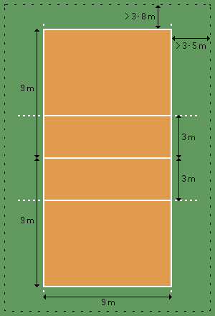
PLAYING AREA DIMENSIONS
The playing court is a rectangle measuring
18 x 9m,
surrounded by a free zone which is a minimum of 3 m wide on all sides.
The free playing space is the space above the playing area which is free from any obstructions.
The free playing space shall measure a minimum of 7 m in height from the playing surface.

Slide 6
PLAYING AREA DIMENSIONS
LINES ON THE COURT: All lines are 5 cm wide. They must be of a light color which is different from the color of the floor and from any other lines.
Service zone: The service zone is a 9 m wide area behind each end line. It is laterally limited by two short lines, each 15 cm long, drawn 20 cm behind the end line as an extension of the sidelines. Both short lines are included in the width of the service zone.
Substitution zone: The substitution zone is limited by the extension of both attack lines up to the scorer's table.

Slide 7
PLAYING AREA DIMENSIONS
Libero Replacement Zone The Libero Replacement Zone is part of the free zone on the side of the team benches, limited by the extension of the attack line up to the end line.
Warm-up area For FIVB, World and Official Competitions, the warm-up areas, sized approximately 3 x 3 m, are located in both of the bench-side corners, outside the free zone.
Penalty area A penalty area, sized approximately 1 x 1 m and equipped with two chairs, they may be limited by a 5 cm wide red line.

Slide 8
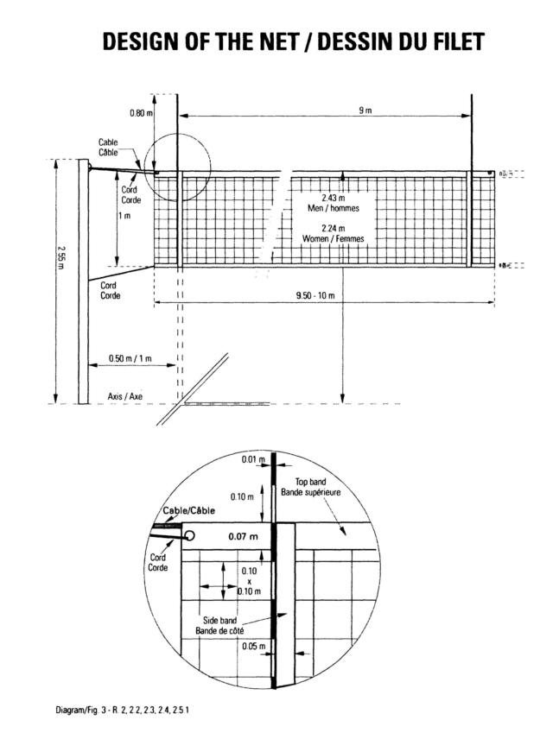
PLAYING AREA DIMENSIONS
HEIGHT OF THE NET Placed vertically over the centre line there is a net whose top is set at the height of 2.43 m for men and 2.24 m for women. Its height is measured from the centre of the playing court.
STRUCTURE The net is 1 m wide and 9.50 to 10 meters long (with 25 to 50 cm on each side of the side bands), made of 10 cm square black mesh.
At its top a horizontal band, 7 cm wide, made of two-fold white canvas, is sewn along its full length. Each extreme end of the band has a hole, through which passes a cord, fastening the band to the posts for keeping its top taut. Within the band, a flexible cable fastens the net to the posts and keeps its top taut.

Slide 9
PLAYING AREA DIMENSIONS
At the bottom of the net there is another horizontal band, 5cm wide, similar to the top band, through which is threaded a rope. This rope fastens the net to the posts and keeps its lower part taut.
SIDE BANDS Two white bands are fastened vertically to the net and placed directly above each sideline. 1.3.2, They are 5 cm wide and 1 m long, and are considered as part of the net.
ANTENNAE An antenna is a flexible rod, 1.80 m long and 10 mm in diameter, made of fiberglass or similar material. An antenna is fastened at the outer edge of each side band. The top 80 cm of each antenna extends above the net and is marked with 10 cm stripes of contrasting color, preferably red and white. The antennae are considered as part of the net and laterally delimit the crossing space.

Slide 10
BALLS:
The ball shall be spherical, made of a flexible leather or synthetic leather case with a bladder inside made of rubber or a similar material. Its colour may be a uniform light colour, or a combination of colours. Synthetic leather material and colour combinations of balls used in International Official competitions should comply with FIVB standards.
Circumference is 65-67 cm
Weight is 260-280 g.
Inside pressure shall be 0.30 to 0. 325 kg/cm2

Slide 11
TEAMS
A team may consist of up to 12 players, one coach, one assistant coach, one trainer and one medical doctor. For FIVB, World and Official Competitions, the medical doctor must be accredited beforehand by the FIVB. For FIVB and World Competitions for Seniors, a team may consist of a maximum of fourteen (14) players (a maximum of twelve (12) regular players).
EQUIPMENT A player's equipment consists of a jersey, shorts, socks (the uniform) and sport shoes. The colour and the design for the jerseys, shorts and socks must be uniform for the team (except for the Libero). The uniforms must be clean.
Players' jerseys must be numbered from 1 to 18.

Slide 12
Rally and completed rally
A rally is the sequence of playing actions from the moment of the service hit by the server until the ball is out of play. A completed rally is the sequence of playing actions which results in the award of a point.
If the serving team wins a rally, it scores a point and continues to serve; if the receiving team wins a rally, it scores a point and it must serve next.

Slide 13
TO WIN A SET
A set (except the deciding, 5th set) is won by the team which first scores 25 points with a minimum lead of two points. In the case of a 24-24 tie, play is continued until a two-point lead is achieved (26-24; 27-25; …).
TO WIN THE MATCH The match is won by the team that wins three sets. In the case of a 2-2 tie, the deciding set (the 5th) is played to 15 points with a minimum lead of 2 points.

Slide 14
DEFAULT AND INCOMPLETE TEAM
If a team refuses to play after being summoned to do so, it is declared in default and forfeits the match with the result 0-3 for the match and 0-25 for each set.
A team that, without justifiable reason, does not appear on the playing court on time is declared in default with the same result.
THE TOSS Before the match, the first referee carries out a toss to decide upon the first service and the sides of the court in the first set.
If a deciding set is to be played, a new toss will be carried out. The toss is taken in the presence of the two team captains.
The winner of the toss chooses: EITHER the right to serve or to receive the service, OR the side of the court. The loser takes the remaining choice.

Slide 15
TEAM STARTING LINE-UP
There must always be six players per team in play. The team's starting line-up indicates the rotational order of the players on the court. This order must be maintained throughout the set.
POSITIONS At the moment the ball is hit by the server, each team must be positioned within its own court in the rotational order (except the server).
The positions of the players are numbered as follows: the three players along the net are front-row players and occupy positions 4 (front-left), 3 (front-centre) and 2 (front-right); the other three are back-row players occupying positions 5 (back-left), 6 (back-centre) and 1 (back-right).
The positions of players are determined and controlled according to the positions of their feet contacting the ground. After the service hit, the players may move around and occupy any position on their court, and the free zone.

Slide 16
POSITIONAL FAULT
The team commits a positional fault, if any player is not in his/her correct position at the moment the ball is hit by the server.
A positional fault leads to the following consequences: the team is sanctioned with a point and service to the opponent, players' positions are rectified.
ROTATIONAL FAULT: A rotational fault is committed when the SERVICE is not made according to the rotational order. It leads to the following consequences: the team is sanctioned with a point and service to the opponent; the players' rotational order is rectified.

Slide 17
TEAM HITS
A hit is any contact with the ball by a player in play. The team is entitled to a maximum of three hits (in addition to blocking, for returning the ball. If more are used, the team commits the fault of: "FOUR HITS".
CONSECUTIVE CONTACTS: A player may not hit the ball two times consecutively.
ASSISTED HIT: Within the playing area, a player is not permitted to take support from a team-mate or any structure/object in order to hit the ball. However, a player who is about to commit a fault (touch the net or cross the centre line, etc.) may be stopped or held back by a team-mate.

Slide 18
CHARACTERISTICS OF THE HIT
The ball may touch any part of the body.
The ball must not be caught and/or thrown. It can rebound in any direction.
The ball may touch various parts of the body, provided that the contacts take place simultaneously.
Exceptions: at blocking, consecutive contacts may be made by one or more blocker(s) provided that the contacts occur during one action; at the first hit of the team, the ball may contact various parts of the body consecutively provided that the contacts occur during one action.

Slide 19
FAULTS IN PLAYING THE BALL
FOUR HITS: a team hits the ball four times before returning it.
ASSISTED HIT: a player takes support from a team-mate or any structure/object in order to hit the ball within the playing area.
CATCH: the ball is caught and/or thrown; it does not rebound from the hit
DOUBLE CONTACT: a player hits the ball twice in succession or the ball contacts various parts of his/her body in succession.

Slide 20
PLAYER AT THE NET
REACHING BEYOND THE NET In blocking, a blocker may touch the ball beyond the net, provided that he/she does not interfere with the opponent’s play before or during the latter's attack hit.
After an attack hit, a player is permitted to pass his/her hand beyond the net, provided that the contact has been made within his/her own playing space.
PENETRATION UNDER THE NET It is permitted to penetrate into the opponent’s space under the net, provided that this does not interfere with the opponent’s play.
Penetration into the opponent's court, beyond the centre line: to touch the opponent's court with a foot (feet) is permitted, provided that some part of the penetrating foot (feet) remains either in contact with or directly above the centre line;

Slide 21
PLAYER AT THE NET
to touch the opponent’s court with any part of the body above the feet is permitted provided that it does not interfere with the opponent’s play.
A player may enter the opponent's court after the ball goes out of play.
CONTACT WITH THE NET: Contact with the net by a player is not a fault, unless it interferes with the play. Players may touch the post, ropes, or any other object outside the antennae, including the net itself, provided that it does not interfere with play. When the ball is driven into the net, causing it to touch an opponent, no fault is committed

Slide 22
PLAYER'S FAULTS AT THE NET
A player touches the ball or an opponent in the opponent's space before or during the opponent’s attack hit.
A player interferes with the opponent's play while penetrating into the opponent’s space under the net.
A player’s foot (feet) penetrates completely into the opponent's court.
A player interferes with the opponent’s play by (amongst others): - touching the top band of the net or the top 80 cm of the antenna during his/her action of playing the ball, or - taking support from the net simultaneously with playing the ball, or - creating an advantage over the opponent, or making actions which hinder an opponent’s legitimate attempt to play the ball.

Slide 23
SERVICE
The service is the act of putting the ball into play, by the back right player, placed in the service zone.
EXECUTION OF THE SERVICE The ball shall be hit with one hand or any part of the arm after being tossed or released from the hand(s).
Only one toss or release of the ball is allowed. Dribbling or moving the ball in the hands is permitted.
At the moment of the service hit or take-off for a jump service, the server must not touch the court (the end line included) or the floor outside the service zone.
The server must hit the ball within 8 seconds after the first referee whistles for service.

Slide 24
SCREENING
The players of the serving team must not prevent their opponent, through individual or collective screening, from seeing the server or the flight path of the ball.
A player or group of players, of the serving team makes a screen by waving arms, jumping or moving sideways, during the execution of the service, or by standing grouped to hide the flight path of the ball.

Slide 25
ATTACK HIT
CHARACTERISTICS OF THE ATTACK HIT All actions which direct the ball towards the opponent, with the exception of service and block, are considered as attack hits. During an attack hit, tipping is permitted only if the ball is cleanly hit, and not caught or thrown.
An attack hit is completed at the moment the ball completely crosses the vertical plane of the net or is touched by an opponent.
RESTRICTIONS OF THE ATTACK HIT A front-row player may complete an attack hit at any height, provided that the contact with the ball has been made within the player's own playing space.

Slide 26
ATTACK HIT
A back-row player may complete an attack hit at any height from behind the front zone: at his/her take-off, the player's foot (feet) must neither have touched nor crossed over the attack line; after his/her hit, the player may land within the front zone.
A back-row player may also complete an attack hit from the front zone, if at the moment of the contact part of the ball is lower than the top of the net.
No player is permitted to complete an attack hit on the OPPONENT’S service, when the ball is in the front zone and entirely higher than the top of the net.

Slide 27
BLOCKING
Blocking is the action of players close to the net to intercept the ball coming from the opponent by reaching higher than the top of the net, regardless of the height of the ball contact. Only front-row players are permitted to complete a block, but at the moment of contact with the ball, part of the body must be higher than the top of the net.
BLOCKING WITHIN THE OPPONENT'S SPACE In blocking, the player may place his/her hands and arms beyond the net provided that this action does not interfere with the opponent’s play. Thus, it is not permitted to touch the ball beyond the net until an opponent has executed an attack hit.

Slide 28
BLOCKING
BLOCK AND TEAM HITS A block contact is not counted as a team hit. Consequently, after a block contact, a team is entitled to three hits to return the ball.
BLOCKING THE SERVICE To block an opponent's service is forbidden.
BLOCKING FAULTS The blocker touches the ball in the OPPONENT’S space either before or simultaneously with the opponent’s attack hit.
A back-row player or a Libero completes a block or participates in a completed block.
A Libero attempts an individual or collective block.

Slide 29
REGULAR GAME INTERRUPTIONS
Regular game interruptions are TIME-OUTS and SUBSTITUTIONS.
TIME-OUTS AND TECHNICAL TIME-OUTS All time-outs that are requested last for 30 seconds.
For FIVB, World and Official Competitions, in sets 1-4, two additional 60-seconds “Technical Time-Outs” are applied automatically when the leading team reaches the 8th and 16th points.
In the deciding (5th) set, there are no "Technical Time-Outs"; only two time-outs of 30 seconds duration may be requested by each team.
During all time-outs, the players in play must go to the free zone near their bench.

Slide 30
SUBSTITUTION OF PLAYERS
A substitution is the act by which a player, other than the Libero or his/her replacement player, after being recorded by the scorer, enters the game to occupy the position of another player, who must leave the court at that moment. Substitution requires the referee's authorization.
LIMITATION OF SUBSTITUTIONS Six substitutions is the maximum permitted per team per set.
One or more players may be substituted at the same time. A player of the starting line-up, may leave the game, but only once in a set, and re-enter, but only once in a set, and only to his/her previous position in the line-up. A substitute player may enter the game in place of a player of the starting line-up, but only once per set, and he/she can only be substituted by the same starting player.

Slide 31
EXCEPTIONAL GAME INTERRUPTIONS
INJURY Should a serious accident occur while the ball is in play, the referee must stop the game immediately and permit medical assistance to enter the court. The rally is then replayed
If an injured player cannot be substituted, legally or exceptionally, the player is given a 3-minute recovery time, but not more than once for the same player in the match.
SET INTERVALS An interval is the time between sets. All set intervals last three minutes. During this period of time, the change of courts and line-up registrations of the teams on the score sheet are made.
LIBERO PLAYER A specialized defensive player.

Slide 32
LIBERO PLAYER
A specialized defensive player.
EQUIPMENT The Libero players must wear a uniform (or jacket/bib for the re-designated Libero) whose jerseys at least must contrast in colour with that of the other members of the team. The Libero uniform may have a different design, but it must be numbered like the rest of the team members.
ACTIONS INVOLVING THE LIBERO: The playing actions:
The Libero is allowed to replace any player in a back row position.
He/she is restricted to perform as a back row player and is not allowed to complete an attack hit from anywhere (including playing court and free zone) if at the moment of the contact, the ball is entirely higher than the top of the net.
He/she may not serve, block or attempt to block. A player may not complete an attack hit from higher than the top of the net, if the ball is coming from an overhand finger pass by a Libero in his/her front zone. The ball may be freely attacked if the Libero makes the same action from outside his/her front zone.

Slide 33
MISCONDUCT LEADING TO SANCTIONS
Incorrect conduct by a team member towards officials, opponent, team-mates or spectators is classified in three categories according to the seriousness of the offence.
Rude conduct: action contrary to good manners or moral principles, or any action expressing contempt.
Offensive conduct: defamatory or insulting words or gestures.
Aggression: actual physical attack or aggressive or threatening behavior.
SANCTION SCALE According to the judgment of the first referee and depending on the seriousness of the offence, the sanctions to be applied and recorded on the score sheet are: Penalty, Expulsion or Disqualification.

Slide 34
SANCTION CARDS
Warning: verbal or hand signal, no card
Penalty: yellow card; any team member is penalized with a point and service to the opponent.
Expulsion: red card; sanctioned by expulsion shall not play for the rest of the set and must remain seated in the penalty area with no other consequences.
Disqualification: yellow + red card (jointly); A team member who is sanctioned by disqualification must leave the Competition Control Area for the rest of the match with no other consequences.

Slide 35
REFEREEING CORPS
COMPOSITION The refereeing corps for a match is composed of the following officials: -
-the first referee
- the second referee
- the scorer
- four (two) line judges

