Slide 1
Chapter 17 Multivariable Calculus
17.1) Partial Derivatives
17.4) Higher-Order Partial Derivatives
17.6) Maxima and Minima for Functions of Two Variables

Slide 2
17.1 Partial Derivatives
Definitions: A function of two independent variables, denoted by $z=f(x,y)$, is a correspondence which assigns a unique value of z for each ordered pair of real numbers $(x,y)$. The variables x and y are called independent variables and $z$ is called the dependent variable.
The set of all ordered pairs $(x,y)$ such that $f(x,y)$ is real number is called the domain of $f$ and the set of all values of $f(x,y)$ is called the range of$f$.
Definition. Let $z=f(x,y)$ be a function of two variables. The partial derivatives of $f$with respect to$x$, denoted by $f_{x}$, is a function defined as:
$f_{x}(x,y)=\lim_{h→0} \frac{f(x+h,y)−f(x,y)}{h}$,
provided that the limit exists. Similarly, we define $f_{y}$ as
$$f_{y}(x,y)=\lim_{h→0} \frac{f(x,y+h)−f(x,y)}{h}$$
To find
treat y as a constant, and differentiate f with respect to x in the
usual way. To find
treat x as a constant, and differentiate f with
respect to y in the usual way.

Slide 3
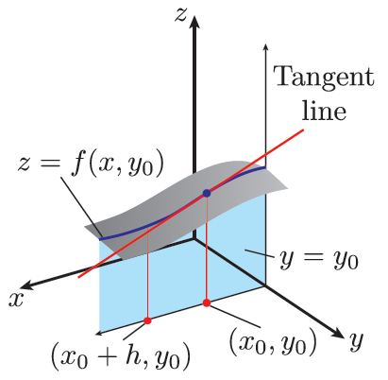
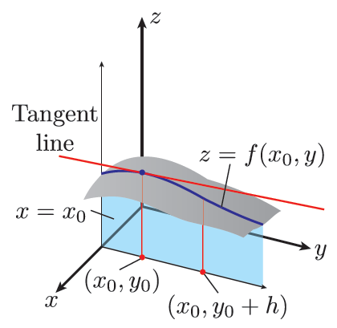
Remark: the partial derivative $f_{x}(x_{0},y_{0})$ at $(x_{0},y_{0})$ is the slope of the line tangent to the surface $z=f(x,y)$ at $(x_{0},y_{0},z_{0})$ and parallel to the xz- plane. It represents the rate of change of z respect to $x$ when $y$is held fixed. Similarly $f_{y}$ represents the rate of change of z respect to y when x is held fixed.

Slide 4
Example 1 – Finding Partial Derivatives
If
Find
and
Solution: We treat y as a constant and differentiate f with
respect to
We now treat x as a constant and differentiate f with respect
to
We evaluate then
and

Slide 5
Example 2: Consider the function$f(x,y)=3x^{2}−5xy+y^{2}$. Find $f_{x}(2,1)$ and $f_{y}(1,1)$.
Notation: If $z=f(x,y),$ then
$$f_{x}\left(x,y\right)=\frac{∂}{∂x}\left[\left.f(x,y\right)\right]=\frac{∂z}{∂x}=z_{x}=$$
$$6x−5y+0$$
$$f_{x}\left(2,1\right)=12−5=7$$
$$f_{y}\left(x,y\right)=\frac{∂}{∂y}\left[\left.f(x,y\right)\right]=\frac{∂z}{∂y}=z_{y}=$$
$$0−5x+2y$$
$$f_{y}(1,1)\text{=−5+2=−3}$$

Slide 6
Example 3 – Partial Derivatives of a Function of Three Variables
If
Solution: We treat y and z as constants and differentiate f with
respect to
We treat x and z as constants and differentiate f with respect
to
We treat x and y as constants and differentiate f with respect
to

Slide 7
Example 4: Find $f_{x}$and $f_{y}$ for each of the following functions:
1. $z=x^{2}y+y^{2}x+\ln{x}y$ 2. $f(x,y)=x^{y}+ye^{x}$
3. $z=\ln{(}x^{2}+y^{2})$ 4. $z=\sin{x}y+e^{x−y}$.
Solution
$1. z=x^{2}y+y^{2}x+\ln{x}y$
$f_{x}=2xy+$ $y^{2}+\frac{1}{xy}\left(y\right)=$
$$2xy+ y^{2}+\frac{1}{x}$$
$$f_{y}=x^{2}+2yx+\frac{1}{xy}\left(x\right)=$$
$$x^{2}+2yx+\frac{1}{y}$$
2. $f(x,y)=x^{y}+ye^{x}$
$f_{x}=y$ $x^{y−1}+y(e^{x}$)
$$f_{y}=x^{y}lnx+e^{x}$$
3. $z=\ln{(}x^{2}+y^{2})$
$$f_{x}=\frac{1}{x^{2}+y^{2}}\left(2x\right)=$$
$$\frac{2x}{x^{2}+y^{2}}$$
$f_{y}=$ $\frac{1}{x^{2}+y^{2}}\left(2y\right)=$
$$\frac{2y}{x^{2}+y^{2}}$$

Slide 8
Example 5 – Partial Derivatives of a Function of Four Variables
If
Solution: Using the quotient rule, we have
Rewriting
and using the power rule
Letting

Slide 9
Example 6: (Three variables) If $f(x,y,z)=xy+yz+xyz$, find $f_{x}$, $f_{y}$ and $f_{z}$.
Solution
$$f_{x}=y+0+yz=y+yz$$
$f_{y}=x+z+xz$
$$f_{z}=0+y+xy=y+xz$$
Example 7: (four variables)
If $w=f(x,y,z,t)=xy^{2}+yzt^{3}+\sin{(}xy+zt)$ find $f_{x}$, $f_{y}$ , $f_{z}$and $f_{t}$.

Slide 10
17.4 Higher-Order Partial Derivatives
If we can differentiate
we obtain second-order
partial derivatives of f. Symbolically,
$$f_{xx}=\frac{∂}{∂x}\left(\frac{∂f}{∂x}\right)=\frac{∂^{2}f}{∂x^{2}}=\frac{∂^{2}z}{∂x^{2}}$$
$$f_{yy}=\frac{∂}{∂y}\left(\frac{∂f}{∂y}\right)=\frac{∂^{2}f}{∂y^{2}}=\frac{∂^{2}z}{∂y^{2}}$$
$$f_{xy}={\left(f_{x}\right)}_{y}=\frac{∂}{∂y}\left(\frac{∂f}{∂x}\right)=\frac{∂^{2}f}{∂y∂x}=\frac{∂^{2}z}{∂y∂x}$$
$$f_{yx}={\left(f_{y}\right)}_{x}=\frac{∂}{∂x}\left(\frac{∂f}{∂y}\right)=\frac{∂^{2}f}{∂x∂y}=\frac{∂^{2}z}{∂x∂y}$$
In terms of

Slide 11
Example 1 – Second-Order Partial Derivatives
Find the four second-order partial derivates of
Solution: Since
we have
and
Also, since
we have
and

Slide 12
Example 2 Find the four second partial derivatives at $(1,1)$ for the function $f(x,y)=\sqrt{x^{2}+y^{2}}$
Solution:
$$f_{x}=\frac{x}{\sqrt{x^{2}+y^{2}}} ;{ }$$
$$f_{y}=\frac{y}{\sqrt{x^{2}+y^{2}}}$$
$$f_{xy}=\frac{\sqrt{x^{2}+y^{2}}(0)−x\frac{2y}{2\sqrt{x^{2}+y^{2}}}}{{\left(\sqrt{x^{2}+y^{2}}\right)}^{2}}=$$
$$\frac{\frac{−xy}{\sqrt{x^{2}+y^{2}}}}{{\left(\sqrt{x^{2}+y^{2}}\right)}^{2}}=$$
$$−\frac{xy}{{\left(x^{2}+y^{2}\right)}^{\frac{3}{2}}};$$
$$f_{xy}\left(1,1\right)=−\frac{1}{2^{\frac{3}{2}}}=−\frac{1}{2\sqrt{2}}$$

Slide 13
REMARK: $If z=f\left(x,y\right)is continuous then f_{xy}=f_{yx}$
$f_{yx}(1,1)=$ $−\frac{1}{2\sqrt{2}}$
$$f_{xx}=\frac{\sqrt{x^{2}+y^{2}}(1)−x\frac{2x}{2\sqrt{x^{2}+y^{2}}}}{{\left(\sqrt{x^{2}+y^{2}}\right)}^{2}}=$$
$$\frac{\sqrt{x^{2}+y^{2}}−\frac{x^{2}}{\sqrt{x^{2}+y^{2}}}}{{\left(\sqrt{x^{2}+y^{2}}\right)}^{2}}=$$
$$\frac{y^{2}}{{\left(x^{2}+y^{2}\right)}^{\frac{3}{2}}};$$
$$f_{xx}\left(1,1\right)=\frac{1}{2\sqrt{2}}$$
$$f_{yy}=\frac{\sqrt{x^{2}+y^{2}}(1)−y\frac{2y}{2\sqrt{x^{2}+y^{2}}}}{{\left(\sqrt{x^{2}+y^{2}}\right)}^{2}}=$$
$$\frac{\sqrt{x^{2}+y^{2}}−\frac{y^{2}}{\sqrt{x^{2}+y^{2}}}}{{\left(\sqrt{x^{2}+y^{2}}\right)}^{2}}=$$
$$\frac{x^{2}}{{\left(x^{2}+y^{2}\right)}^{\frac{3}{2}}};$$
$$f_{yy}\left(1,1\right)=\frac{1}{2\sqrt{2}}$$

Slide 14
Example 3: Find the four 2nd partial derivatives of $z=f(x,y)=x^{2}+y^{2}+\sin{x}y$
Example 4: If $f(x,y)=y^{2}e^{x}+\ln{(}xy)$ find $f_{xyy} \text{and} f_{yxx}$.

Slide 15
17.6 Maxima and Minima for Functions of Two Variables
In this section we need to optimize functions of two variables. Let $z=f(x,y)$ be function of two variables with continuous partial derivatives. Then
Definition 1: A point $\left(x_{0},y_{0}\right)$ for which $f_{x}(x_{0}y_{0})=0=f_{y}(x_{0}y_{0})$ is called a critical point.
Definition 2: The function $f$ has a relative maximum at a point $(x_{0},y_{0})$ if $f(x_{o},y_{0})≥f(x,y)$ for all $(x,y)$ in a small neighborhood of $(x_{0},y_{0})$. Similarly, it has a relative minimum at a point $(x_{0},y_{0})$ if $f(x_{0},y_{0})≤f(x,y)$ for all $(x,y)$ in a small neighborhood of $(x_{0},y_{0})$.
Rule # 1: to find critical points, solve the two equation $f_{x}=0$ and $f_{y}=0$for x and y.

Slide 16
Example 1: Consider the function $f(x,y)=x^{2}+y^{2}+1$. The first partial derivatives are
$$f_{x}=2x=0→x=0$$
$$f_{y}=2y=0→y=0$$
Thus the point $(x_{0},y_{0})=(0,0)$ is a critical point. (Since the value of the function is always greater than or equal to 1, we see that the function has relative minimum at $(0,0)$.
Example 2 – Finding Critical Points
Find the critical points of the following functions.
Solution: Since
we solve the system
This gives
Thus,
Is the only critical point.

Slide 17
Example 3
Solution:
From the first equation above,
Substituting for k in the second
equation above gives
Hence, either l = 0 or
The critical points are (0, 0) and
c.
Solution: Solving the system
gives the critical point (25, 75, 175).

Slide 18
Example 4 Find the critical points of the following functions.
$$f(x,y)=2x^{2}+y^{2}−2xy+5x−3y+1.$$
Solution:
$$f_{x}(x,y)=4x−2y+5$$
$$f_{y}(x,y)=2y−2x−3.$$
we solve the system
$$\left\{\begin{aligned}4x−2y+5=0 \\ −2x+2y−3=0\end{aligned}\right.$$
$$x=–{1} and y=\frac{1}{2}.$$
This gives
$$(−1, \frac{1}{2})$$
Is the only critical point.

Slide 19
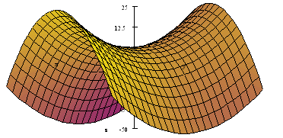
Rule # 2: Second Derivative Test for Functions of Two Variables
Let $(x_{0},y_{0})$ be critical point to the function $z=f(x,y)$. We define the number
$$D(x_{0},y_{0})=f_{xx}(x_{0},y_{0})f_{yy}(x_{0},y_{0})−{\left[\left.f_{xy}(x_{0},y_{0}\right)\right]}^{2}$$
Case 1: If $D>0$we look at $f_{xx}(x_{0},y_{0})$.
If $f_{xx}(x_{0},y_{0})>0$, then f has a local minimum at $(x_{0},y_{0})$
If $f_{xx}(x_{0},y_{0})<0$, then f has a local maximum at $(x_{0},y_{0})$.
Case 2: If $D<0$, then f has no extrema at $(x_{0},y_{0})$. (Saddle point)
Case 3: If $D=0⇒$ no conclusion.

Slide 20
Example 5: Find critical points and the local extrema:
$$f(x,y)=1+x^{2}+y^{2}$$
The first partial derivatives are
$$f_{x}=2x=0→x=0$$
$$f_{y}=2y=0→y=0$$
Thus the point $(x_{0},y_{0})=(0,0)$ is a critical point.
The second partial derivatives are:
$$f_{xx}=2,$$
$$f_{yy}=2$$
and $f_{xy}=0$ .
$$D=(2)(2)−0=4>0,$$
and since $f_{xx}=2>0$,
we have local minimum at (0,0) is $f\left(0,0\right)=1$.

Slide 21
Example 6: Find critical points and the local extrema:
$$f(x,y)=x^{3}+y^{3}−xy$$
$$f_{x}\left(x,y\right)=3x^{2}−y,$$
$$fy(x,y)=3y^{2}−x$$
$$\left\{\begin{aligned}f_{x}=0 \\ f_{y}=0\end{aligned}\right.$$
$$\left\{\begin{aligned}3x^{2}−y=0 \\ 3y^{2}−x=0\end{aligned}\right.$$
$\left(0, 0\right) and (\frac{1}{3}, \frac{1}{3}).$ Are the critical points
$$f_{xx}(x,y)=6x$$
$$f_{yy}(x,y=6y$$
$$f_{xy}(x,y)=−1$$
$$D\left(x,y\right)=(6x) (6y)−(−1)^{2}=36xy−1$$
$$D (\frac{1}{3}, \frac{1}{3})=3>0 \text{and}$$
$$f_{xx}(\frac{1}{3}, \frac{1}{3})=2>0,$$
there is a relative minimum at $\left(\frac{1}{3}, \frac{1}{3}\right) is f\left(\frac{1}{3}, \frac{1}{3}\right)=−\frac{1}{27}.$
$$D\left(0, 0\right) = −1 < 0$$
Saddle point at $\left(0, 0\right)$

Slide 22
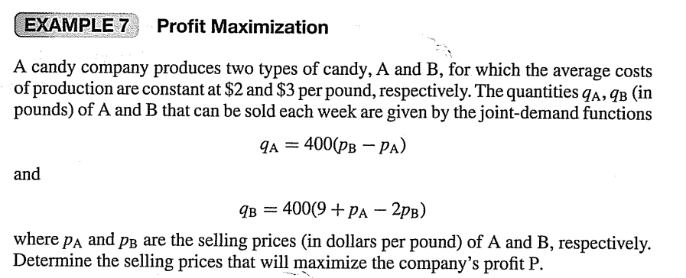

Slide 24
Example 8: A company wishes to make an open rectangular box of volume$500cm^{3}$. Find the dimensions of the box which will minimize the amount of material used.
Solution:
Let x, y, and z denote the dimensions of the box and let S be the surface area of the sides.
Then$S=xy+2xz+2yz.$
We need to minimize the surface area S.
Since $xyz=500$, then $z=\frac{500}{xy}$. Substituting in S we get:
$$xy+2x\frac{500}{xy}+2y\frac{500}{xy}=$$
$$yx+\frac{1000}{y}+\frac{1000}{x}$$
$$S=xy+2xz+2yz=$$
$S=xy+\frac{1000}{y}+\frac{1000}{x}$.
$$S_{x}=y−\frac{1000}{x^{2}}$$
$$S_{y}=x−\frac{1000}{y^{2}}$$
$$\left\{\begin{aligned}y−\frac{1000}{x^{2}}=0 \\ x−\frac{1000}{y^{2}}=0\end{aligned}\right.$$
$$\left\{\begin{aligned}S_{x}=0 \\ S_{y}=0\end{aligned}\right.$$
we get one critical point $(10,10)$.
$D(10,10)={\left[\frac{2000}{x^{3}}⋅\frac{2000}{y^{3}}−(1)^{2}\right]}_{(10,10)}=3>0$,
$S_{xx}(10,10)=\frac{2000}{x^{3}}=2>0$,
we have minimum value surface area at $(10,10)$.
That is, the dimension of the box which requires the least amount of material is a square base of $10×10$ and height 5 cm.

Slide 25
Example 9 – Applying the Second-Derivative Test
Examine
for relative maxima or minima by using the
second-derivative test.
Solution: First we find critical points
Solving
gives critical points
Now,
Thus,
Since
there is no relative extremum at
Also, since
there is a relative
minimum at
At this point, the value of the function is

Slide 26
Example 10 – Finding Relative Extrema
Examine
For relative extrema
Solution: If we set
and
then we have
that is,
Thus,
is the only critical point.
At
Hence,
and the second-derivative test gives no information.
However, for all
we have
We conclude that f has a relative (and absolute) minimum at

Slide 27
Example 11 – Profit Maximization
A candy company produces two types of candy, A and B, for which the
average costs of production are constant at
per pound,
respectively. The quantities
(in pounds) of A and B that can be
sold each week are given by the joint-demand functions
are the selling
prices (in dollars per pound) of A and B, respectively. Determine the selling prices that will maximize the company’s profit P.

Slide 28
HW The weekly loss from selling x computers and y printers is given by
$L(x,y)=1000+3x^{2}−2xy−8y+y^{2}$. Find the number of computers and printers to be sold in order to minimize the loss. (Answer: x = 2 and y = 6)

