Slide 1
17.6 Maxima and Minima for Functions of Two Variables
In this section we need to optimize functions of two variables. Let $z=f(x,y)$ be function of two variables with continuous partial derivatives. Then
Definition 1: A point $\left(x_{0},y_{0}\right)$ for which $f_{x}(x_{0}y_{0})=0=f_{y}(x_{0}y_{0})$ is called a critical point.
Definition 2: The function $f$ has a relative maximum at a point $(x_{0},y_{0})$ if $f(x_{o},y_{0})≥f(x,y)$ for all $(x,y)$ in a small neighborhood of $(x_{0},y_{0})$. Similarly, it has a relative minimum at a point $(x_{0},y_{0})$ if $f(x_{0},y_{0})≤f(x,y)$ for all $(x,y)$ in a small neighborhood of $(x_{0},y_{0})$.
Rule # 1: to find critical points, solve the two equation $f_{x}=0$ and $f_{y}=0$for x and y.

Slide 2
Example 1: Consider the function $f(x,y)=x^{2}+y^{2}+1$. The first partial derivatives are
$$f_{x}=2x=0→x=0$$
$$f_{y}=2y=0→y=0$$
Thus the point $(x_{0},y_{0})=(0,0)$ is a critical point. (Since the value of the function is always greater than or equal to 1, we see that the function has relative minimum at $(0,0)$.
Example 2 – Finding Critical Points
Find the critical points of the following functions.
Solution: Since
we solve the system
This gives
Thus,
Is the only critical point.

Slide 3
Example 3
Solution:
From the first equation above,
Substituting for k in the second
equation above gives
Hence, either l = 0 or
The critical points are (0, 0) and
c.
Solution: Solving the system
gives the critical point (25, 75, 175).

Slide 4
Example 4 Find the critical points of the following functions.
$$f(x,y)=2x^{2}+y^{2}−2xy+5x−3y+1.$$
Solution:
$$f_{x}(x,y)=4x−2y+5$$
$$f_{y}(x,y)=2y−2x−3.$$
we solve the system
$$\left\{\begin{aligned}4x−2y+5=0 \\ −2x+2y−3=0\end{aligned}\right.$$
$$x=–{1} and y=\frac{1}{2}.$$
This gives
$$(−1, \frac{1}{2})$$
Is the only critical point.

Slide 5
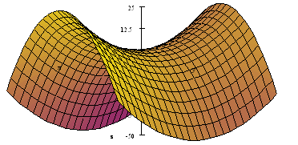
Rule # 2: Second Derivative Test for Functions of Two Variables
Let $(x_{0},y_{0})$ be critical point to the function $z=f(x,y)$. We define the number
$$D(x_{0},y_{0})=f_{xx}(x_{0},y_{0})f_{yy}(x_{0},y_{0})−{\left[\left.f_{xy}(x_{0},y_{0}\right)\right]}^{2}$$
Case 1: If $D>0$we look at $f_{xx}(x_{0},y_{0})$.
If $f_{xx}(x_{0},y_{0})>0$, then f has a local minimum at $(x_{0},y_{0})$
If $f_{xx}(x_{0},y_{0})<0$, then f has a local maximum at $(x_{0},y_{0})$.
Case 2: If $D<0$, then f has no extrema at $(x_{0},y_{0})$. (Saddle point)
Case 3: If $D=0⇒$ no conclusion.

Slide 6
Example 5: Find critical points and the local extrema:
$$f(x,y)=1+x^{2}+y^{2}$$
The first partial derivatives are
$$f_{x}=2x=0→x=0$$
$$f_{y}=2y=0→y=0$$
Thus the point $(x_{0},y_{0})=(0,0)$ is a critical point.
The second partial derivatives are:
$$f_{xx}=2,$$
$$f_{yy}=2$$
and $f_{xy}=0$ .
$$D=(2)(2)−0=4>0,$$
and since $f_{xx}=2>0$,
we have local minimum at (0,0) is $f\left(0,0\right)=1$.

Slide 7
Example 6: Find critical points and the local extrema:
$$f(x,y)=x^{3}+y^{3}−xy$$
$$f_{x}\left(x,y\right)=3x^{2}−y,$$
$$fy(x,y)=3y^{2}−x$$
$$\left\{\begin{aligned}f_{x}=0 \\ f_{y}=0\end{aligned}\right.$$
$$\left\{\begin{aligned}3x^{2}−y=0 \\ 3y^{2}−x=0\end{aligned}\right.$$
$\left(0, 0\right) and (\frac{1}{3}, \frac{1}{3}).$ Are the critical points
$$f_{xx}(x,y)=6x$$
$$f_{yy}(x,y=6y$$
$$f_{xy}(x,y)=−1$$
$$D\left(x,y\right)=(6x) (6y)−(−1)^{2}=36xy−1$$
$$D (\frac{1}{3}, \frac{1}{3})=3>0 \text{and}$$
$$f_{xx}(\frac{1}{3}, \frac{1}{3})=2>0,$$
there is a relative minimum at $\left(\frac{1}{3}, \frac{1}{3}\right) is f\left(\frac{1}{3}, \frac{1}{3}\right)=−\frac{1}{27}.$
$$D\left(0, 0\right) = −1 < 0$$
Saddle point at $\left(0, 0\right)$

Slide 8
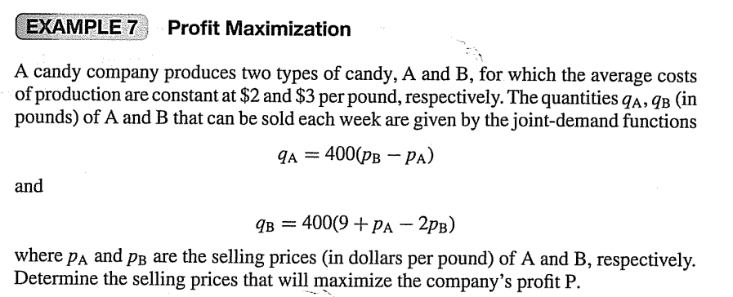

Slide 10
Example 8: A company wishes to make an open rectangular box of volume$500cm^{3}$. Find the dimensions of the box which will minimize the amount of material used.
Solution:
Let x, y, and z denote the dimensions of the box and let S be the surface area of the sides.
Then$S=xy+2xz+2yz.$
We need to minimize the surface area S.
Since $xyz=500$, then $z=\frac{500}{xy}$. Substituting in S we get:
$$xy+2x\frac{500}{xy}+2y\frac{500}{xy}=$$
$$yx+\frac{1000}{y}+\frac{1000}{x}$$
$$S=xy+2xz+2yz=$$
$S=xy+\frac{1000}{y}+\frac{1000}{x}$.
$$S_{x}=y−\frac{1000}{x^{2}}$$
$$S_{y}=x−\frac{1000}{y^{2}}$$
$$\left\{\begin{aligned}y−\frac{1000}{x^{2}}=0 \\ x−\frac{1000}{y^{2}}=0\end{aligned}\right.$$
$$\left\{\begin{aligned}S_{x}=0 \\ S_{y}=0\end{aligned}\right.$$
we get one critical point $(10,10)$.
$D(10,10)={\left[\frac{2000}{x^{3}}⋅\frac{2000}{y^{3}}−(1)^{2}\right]}_{(10,10)}=3>0$,
$S_{xx}(10,10)=\frac{2000}{x^{3}}=2>0$,
we have minimum value surface area at $(10,10)$.
That is, the dimension of the box which requires the least amount of material is a square base of $10×10$ and height 5 cm.

Slide 11
Example 9 – Applying the Second-Derivative Test
Examine
for relative maxima or minima by using the
second-derivative test.
Solution: First we find critical points
Solving
gives critical points
Now,
Thus,
Since
there is no relative extremum at
Also, since
there is a relative
minimum at
At this point, the value of the function is

Slide 12
Example 10 – Finding Relative Extrema
Examine
For relative extrema
Solution: If we set
and
then we have
that is,
Thus,
is the only critical point.
At
Hence,
and the second-derivative test gives no information.
However, for all
we have
We conclude that f has a relative (and absolute) minimum at

Slide 13
Example 11 – Profit Maximization
A candy company produces two types of candy, A and B, for which the
average costs of production are constant at
per pound,
respectively. The quantities
(in pounds) of A and B that can be
sold each week are given by the joint-demand functions
are the selling
prices (in dollars per pound) of A and B, respectively. Determine the selling prices that will maximize the company’s profit P.

Slide 14
HW The weekly loss from selling x computers and y printers is given by
$L(x,y)=1000+3x^{2}−2xy−8y+y^{2}$. Find the number of computers and printers to be sold in order to minimize the loss. (Answer: x = 2 and y = 6)

