Slide 1
17.4 Higher-Order Partial Derivatives
If we can differentiate
we obtain second-order
partial derivatives of f. Symbolically,
$$f_{xx}=\frac{∂}{∂x}\left(\frac{∂f}{∂x}\right)=\frac{∂^{2}f}{∂x^{2}}=\frac{∂^{2}z}{∂x^{2}}$$
$$f_{yy}=\frac{∂}{∂y}\left(\frac{∂f}{∂y}\right)=\frac{∂^{2}f}{∂y^{2}}=\frac{∂^{2}z}{∂y^{2}}$$
$$f_{xy}={\left(f_{x}\right)}_{y}=\frac{∂}{∂y}\left(\frac{∂f}{∂x}\right)=\frac{∂^{2}f}{∂y∂x}=\frac{∂^{2}z}{∂y∂x}$$
$$f_{yx}={\left(f_{y}\right)}_{x}=\frac{∂}{∂x}\left(\frac{∂f}{∂y}\right)=\frac{∂^{2}f}{∂x∂y}=\frac{∂^{2}z}{∂x∂y}$$
In terms of

Slide 2
Example 1 – Second-Order Partial Derivatives
Find the four second-order partial derivates of
Solution: Since
we have
and
Also, since
we have
and

Slide 3
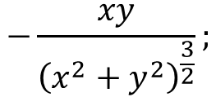
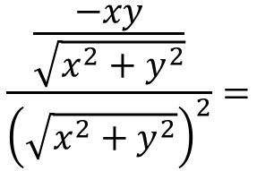
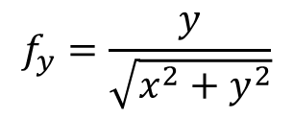
Example 2 Find the four second partial derivatives at $(1,1)$ for the function $f(x,y)=\sqrt{x^{2}+y^{2}}$
Solution:
$$f_{x}=\frac{x}{\sqrt{x^{2}+y^{2}}} ;{ }$$
$$f_{y}=\frac{y}{\sqrt{x^{2}+y^{2}}}$$
$$f_{xy}=\frac{\sqrt{x^{2}+y^{2}}(0)−x\frac{2y}{2\sqrt{x^{2}+y^{2}}}}{{\left(\sqrt{x^{2}+y^{2}}\right)}^{2}}=$$
$$\frac{\frac{−xy}{\sqrt{x^{2}+y^{2}}}}{{\left(\sqrt{x^{2}+y^{2}}\right)}^{2}}=$$
$$−\frac{xy}{{\left(x^{2}+y^{2}\right)}^{\frac{3}{2}}};$$
$$f_{xy}\left(1,1\right)=−\frac{1}{2^{\frac{3}{2}}}=−\frac{1}{2\sqrt{2}}$$

Slide 4
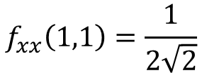
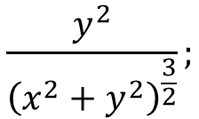
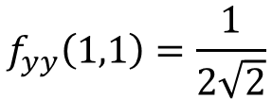
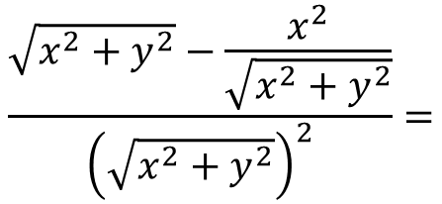
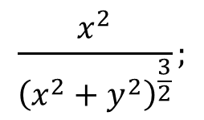
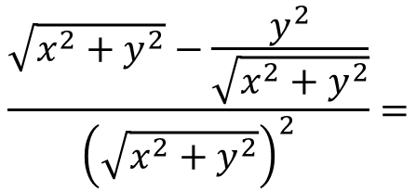
REMARK: $If z=f\left(x,y\right)is continuous then f_{xy}=f_{yx}$
$f_{yx}(1,1)=$ $−\frac{1}{2\sqrt{2}}$
$$f_{xx}=\frac{\sqrt{x^{2}+y^{2}}(1)−x\frac{2x}{2\sqrt{x^{2}+y^{2}}}}{{\left(\sqrt{x^{2}+y^{2}}\right)}^{2}}=$$
$$\frac{\sqrt{x^{2}+y^{2}}−\frac{x^{2}}{\sqrt{x^{2}+y^{2}}}}{{\left(\sqrt{x^{2}+y^{2}}\right)}^{2}}=$$
$$\frac{y^{2}}{{\left(x^{2}+y^{2}\right)}^{\frac{3}{2}}};$$
$$f_{xx}\left(1,1\right)=\frac{1}{2\sqrt{2}}$$
$$f_{yy}=\frac{\sqrt{x^{2}+y^{2}}(1)−y\frac{2y}{2\sqrt{x^{2}+y^{2}}}}{{\left(\sqrt{x^{2}+y^{2}}\right)}^{2}}=$$
$$\frac{\sqrt{x^{2}+y^{2}}−\frac{y^{2}}{\sqrt{x^{2}+y^{2}}}}{{\left(\sqrt{x^{2}+y^{2}}\right)}^{2}}=$$
$$\frac{x^{2}}{{\left(x^{2}+y^{2}\right)}^{\frac{3}{2}}};$$
$$f_{yy}\left(1,1\right)=\frac{1}{2\sqrt{2}}$$

Slide 5
Example 3: Find the four 2nd partial derivatives of $z=f(x,y)=x^{2}+y^{2}+\sin{x}y$
Example 4: If $f(x,y)=y^{2}e^{x}+\ln{(}xy)$ find $f_{xyy} \text{and} f_{yxx}$.

