Slide 1
15.3 Integration by Tables
Certain forms of integrals that occur frequently can be found in standard tables of integration formulas. A short table of integrals appears in Appendix B(Table (Appendix B) of selected Integral), and its use will be illustrated in this section.
A given integral may have to be replaced by an equivalent form before it will fit a formula in the table.
The equivalent form must match the formula exactly.
Consequently, the steps performed to get the equivalent form should be written carefully rather than performed mentally.
Before proceeding with the exercises that use tables, we recommend studying the examples of this section carefully.
In the following examples, the formula numbers refer to the Table of Selected Integrals given in Appendix B.

Slide 3
Example
Find
Solution: Formula (28) from Appendix B gives
If we let
and
then
We will transform the given integral into a form that matches Formula (28):

Slide 4
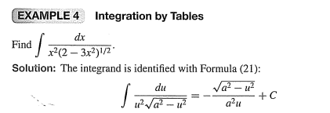

Slide 6
Example
Find
Solution: This is similar to Formula (42) with
If we let
then
Hence,

Slide 7
Example – Finding a Definite Integral by Using Tables
Evaluate
Solution: We will use Formula (32) to get the indefinite integral
first:
Letting
and
we have du = 2dx. Thus,
We determine the corresponding limits of integration with respect to u and then evaluate the last expression between those limits.
When x = 1, we have u = 2; when x = 4, we have u = 8. Hence,

