Slide 1
Chapter 15 Methods and Applications of Integration
We shall cover two sections from this chapter, namely, Section 15.1 and 15.3. The rest of the sections are omitted.

Slide 2
15.1 Integration by parts
If f and g are differentiable functions, then the product rule says that
$(f⋅g)^{′}=f⋅g^{′}+f^{′}⋅g$.
That is $f⋅g^{′}=(f⋅g)^{′}−f^{′}⋅g$.
Integrating both sides and using the fundamental theorem of calculus we see that:
This formula is called integration by parts.
Remark: Setting $u=f(x)$ and $v=g(x)$, then $du=f^{′}(x)dx$ and $dv=g^{′}(x)dx$. Substituting these values in equation (1) above, we get the equivalent formula:
$$\int_{a}^{b}{f\left(x\right)g^{′}\left(x\right)dx}={\left.f\left(x\right)g\left(x\right)\right|}_{a}^{b}−\int_{a}^{b}{f^{′}\left(x\right)g\left(x\right)dx}$$

Slide 3
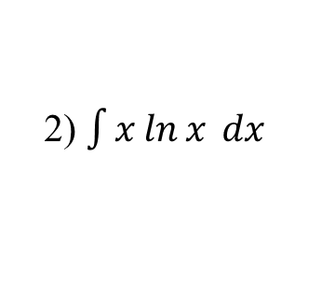
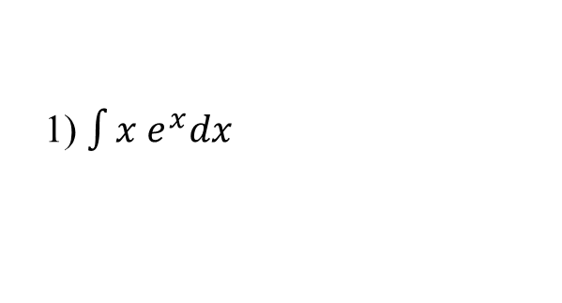
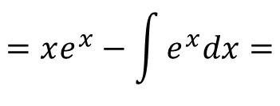
Examples: Evaluate the following integrals.
$$u=x and dv=e^{x}$$
1) $\int{x e^{x}dx}$
$$du=1dx, v=e^{x}$$
$$\int{x e^{x}dx=uv−\int{vdu}}$$
$$=xe^{x}−\int{e^{x}dx=}$$
$xe^{x}−$ $e^{x}$+C
2) $\int{x\ln{x} dx}$
$$u=lnx and dv=x$$
$$du=\frac{1}{x}dx, v=\frac{x^{2}}{2}$$
$\int{x\ln{x} dx=uv−\int{vdu=}}$ $\left(lnx\right)\left(\frac{x^{2}}{2}\right)−\int{\frac{x^{2}}{2}\frac{1}{x}dx=}$
$$\frac{x^{2}}{2}lnx −\frac{1}{2}\int{xdx=}$$
$\frac{x^{2}}{2}lnx −\frac{1}{2}$ $\frac{x^{2}}{2}+C$
$$=\frac{x^{2}}{2}lnx −\frac{x^{2}}{4}+C$$

Slide 4
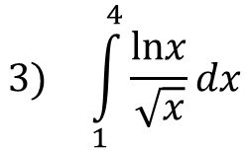
$$3) \int_{1}^{4}{\frac{lnx}{\sqrt{x}}dx}$$
First $\int_{1}^{4}{lnx\left(x^{−1/2}\right)dx}$
$u=lnx and dv=x^{−1/2}$dx
$$du=\frac{1}{x}dx, v=\frac{x^{1/2}}{1/2}$$
$\int_{1}^{4}{lnx\left(x^{−1/2}\right)dx}={\left(lnx\right)\left(2x^{1/2}\right)|}_{1}^{4}−\int_{1}^{4}{\frac{1}{x}}$ $\left(2x^{1/2}\right)dx=$
$${\left.=2\sqrt{x}lnx\right|}_{1}^{4}−2\int_{1}^{4}{x^{−1/2}}=$$
$${\left.2\sqrt{x}lnx\right|}_{1}^{4}−{\left.2\frac{x^{1/2}}{1/2}\right|}_{1}^{4}$$
$$={\left.2\sqrt{x}lnx\right|}_{1}^{4}−{\left.4\sqrt{x}\right|}_{1}^{4}$$
$$=2\sqrt{4}ln4−2\sqrt{1}ln1−\left(4\sqrt{4}−4\sqrt{1}\right)$$
$$=4ln4−4$$

Slide 5
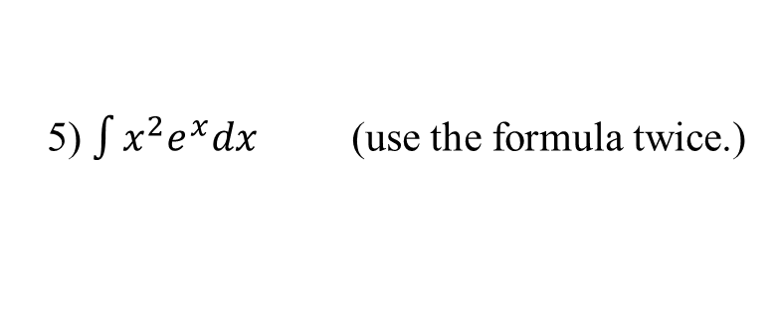
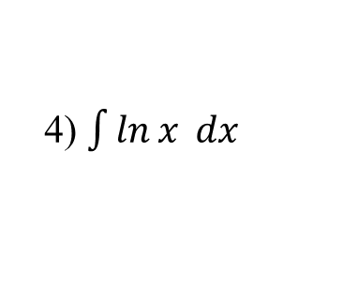
4) $\int{\ln{x} dx}$
$$u=lnx and dv=dx$$
$$du=\frac{1}{x}dx, v=x$$
$$\int{\ln{x} dx=\left(lnx\right)x−\int{\frac{1}{x}xdx=}}$$
$$\left(lnx\right)x−\int{1dx=}$$
$$xlnx−x+C$$
5) $\int{x^{2}e^{x}dx}$ (use the formula twice.)
$$u=x^{2} and dv=e^{x}dx$$
$$du=2xdx, v=e^{x}$$
$$x^{2}e^{x}−2\int{xe^{x}dx}$$
$\int{x^{2}e^{x}dx=}$ $x^{2}e^{x}−\int{2xe^{x}dx=}$
$$u=x and dv=e^{x}dx$$
$$du=dx, v=e^{x}$$
$$=x^{2}e^{x}−2\left[xe^{x}−\int{e^{x}dx}\right]=$$
$$x^{2}e^{x}−2\left[xe^{x}−e^{x}\right]+C$$
$${=x}^{2}e^{x}−2xe^{x}+{2e}^{x}+C$$

Slide 6
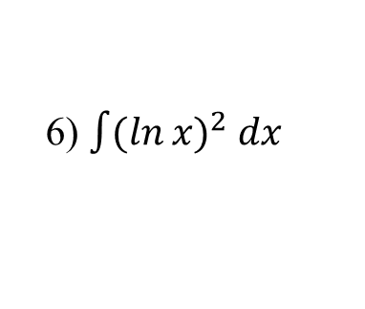
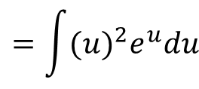
6) $\int{(\ln{x})^{2} dx}$
First by substitution
$u=lnx→du=\frac{1}{x}dx→dx=xdu$,
$$u=lnx→e^{u}=x$$
$$by (5)$$
$\int{(\ln{x})^{2} dx=}$ $\int{(u)^{2}xdu}$
$$=\int{(u)^{2}e^{u}du}$$
$${=u}^{2}e^{u}−2ue^{u}+{2e}^{u}+C$$
$${=(lnx)}^{2}e^{lnx}−2lnxe^{lnx}+{2e}^{lnx}+C$$
$${=(lnx)}^{2}x−2(lnx)x+2x+C$$
$${=(lnx)}^{2}x−2xlnx+2x+C$$

