Slide 1
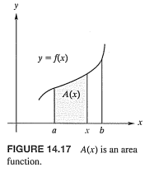
14.9 Area between Curves
Theorem B: If $f(x)≤0$ on $\left[a,b\right]$ then the area A bounded by the graph of$f(x)$ and the x-axis from $x=a$ to $x=b$ is $A=−\int_{a}^{b}{f(x)dx}$
Remark: If $f(x)≥0$ on part of $\left[a,b\right]$ and $f(x)≤0$ on another, we divide the region into two regions and calculate the area on each part $A=A_{1}+A_{2}$.

Slide 2
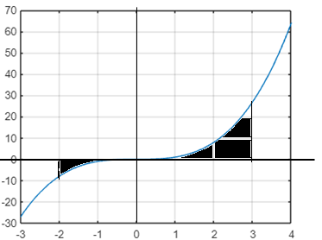
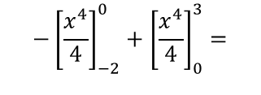
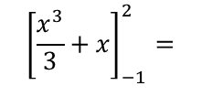
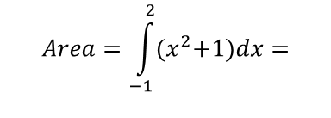
Example 1: Find the area bounded by the given function and the x-axis over the given interval.
$$1) f\left(x\right)=x^{2}+1, [−1, 2]$$
$$f\left(x\right)>0,$$
$$Area=\int_{−1}^{2}{{(x}^{2}+1)dx=}$$
$${\left[\frac{x^{3}}{3}+x\right]}_{−1}^{2}=$$
$$\left(\frac{8}{3}+2\right)−\left(\frac{−1}{3}+\left(−1\right)\right)=$$
$$6$$
$$2) f\left(x\right)=x^{3}, [−2, 3]$$
$$Area=−\int_{−2}^{0}{x^{3}dx}+\int_{0}^{3}{x^{3}dx=}$$
$${−\left[\frac{x^{4}}{4}\right]}_{−2}^{0}+{\left[\frac{x^{4}}{4}\right]}_{0}^{3}=$$
$$−\left(0−\frac{16}{4}\right)+\left(\frac{81}{4}−0\right)$$
$$=\frac{97}{4}$$

Slide 3
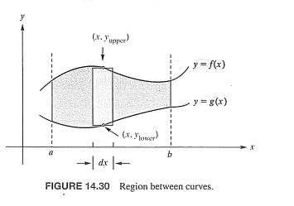
Remark: to find the area between curves, you need to know two things. First, you need to know which function is larger than the other, and second, you need to find the limits of integration.

Slide 4
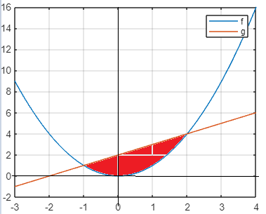
Example 2: Find the area enclosed by the graphs of $f\left(x\right)=x^{2} and g\left(x\right)=x+2$
Solution:
To find the intersections, solve${ x}^{2 }=x+2$
$${ x}^{2 }−x−2=0,$$
$$\left(x−2\right)\left(x+1\right)=0, x=2, x=−1$$
$$Area=\int_{−1}^{2}{\left[\left(x+2\right)−x^{2}\right]dx=}$$

Slide 5
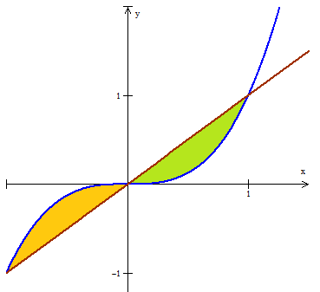
Example 3: Find the area enclosed by the graphs of $f\left(x\right)=x^{3} and g\left(x\right)=x$
To find the intersections, solve${ x}^{3 }=x$
$${ x}^{3 }−x=0,$$
$${ x(x}^{2 }−1)=0, x=0, x=−1, x=1$$
$$Area=\int_{−1}^{0}{\left[x^{3}−x\right]dx+\int_{0}^{1}{\left[{x−x}^{3}\right]dx}=}$$
$${\left.\frac{x^{4}}{4}−\frac{x^{2}}{2}\right]}_{−1}^{0}+{\left.\frac{x^{2}}{2}−\frac{x^{4}}{4}\right]}_{0}^{1}$$
$$=0−\left(\frac{1}{4}−\frac{1}{2}\right)+\left(\frac{1}{2}−\frac{1}{4}\right)=\frac{1}{2}$$

Slide 6
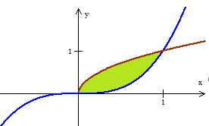
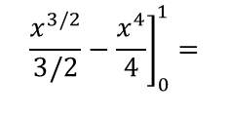
Example 4: Find the area enclosed by the graphs of $f\left(x\right)=\sqrt{x} and g\left(x\right)=x^{3}$
To find the intersections, solve${ x}^{3 }=\sqrt{x}$
$${ x}^{6 }=x$$
$${ x}^{6 }−x=0, x\left({ x}^{5 }−1\right)=0, x=0, x=1$$
$$Area=\int_{0}^{1}{\left[\sqrt{x}−x^{3}\right]dx=}$$
$${\left.\frac{x^{3/2}}{3/2}−\frac{x^{4}}{4}\right]}_{0}^{1}=$$
$$\frac{2}{3}−\frac{1}{4}−0=\frac{5}{12}$$
Remark: sometimes the rules of x and y are changed. That is, we may be given two functions where x is a function of y, and we need to find the area between them on a given interval [c, d]. In this case we have the following theorem:

Slide 7
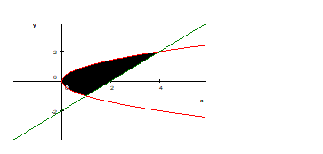
Example 5: Find the area enclosed by the graphs of $x=y^{2}, y=x−2$
To find the intersections, $x=y^{2}, x=y+2$ solve${ y}^{2 }=y+2$
${ y}^{2 }−y−2=0, \left(y−2\right)\left(y+1\right)=0, y=2, y=−$1
$$Area=\int_{−1}^{2}{\left[\left(y+2\right)−y^{2}\right]dy=}$$
$${\left.\frac{y^{2}}{2}+2y−\frac{y^{3}}{3}\right]}_{−1}^{2}=\frac{9}{2}$$

