Slide 1
13.6 Applied Maxima and Minima
We may use the derivative of functions to find optimal solutions to many world problems involving maximization or minimization of quantities. For example, in engineering, we need to maximize the strength of a structure and minimize the cost, while in economics, we need to maximize profit, and minimize the cost and taxes. Usually we need to maximize or minimize a function of single variable over an interval. In most word problems, we are faced with a situation where we need to find the function and its domain. To solve such problems, we do the following.

Slide 2
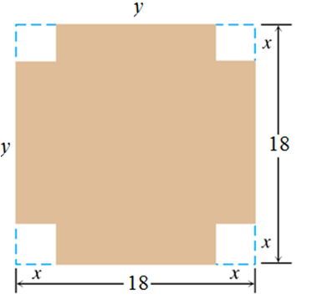
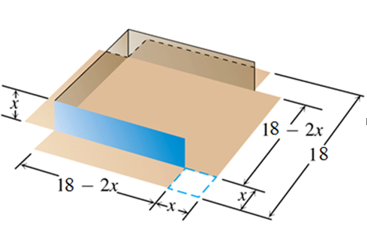
Example 1: From each corner of a square piece of sheet metal 18 cm. on a side, remove a small square and turn up the edges to form an open box. What should be the dimensions of the box so as to maximize its volume?
Solution:
$$x:side of the square$$
$$V:volume of the box=width×length×hight$$
$$V=x\left(18−2x\right)\left(18−2x\right)=x{\left(18−2x\right)}^{2},$$
$$x∈[0, 9]$$
$v^{′}=x\left[2\left(18−2x\right)\left(−2\right)\right]+$ ${\left(18−2x\right)}^{2}=−4x\left(18−2x\right)+{\left(18−2x\right)}^{2}=$
$$(18−2x)[−4x+\left(18−2x\right)],$$
$$v^{′}=\left(18−2x\right)\left[18−6x\right]=2\left(19−x\right)\left(18−6x\right)→$$
$$v^{′}=12\left(9−x\right)\left(3−x\right)=0→$$
$$the critical values x=3, x=9$$
$$v\left(0\right)=0, v\left(9\right)=0, v\left(4\right)=432{cm}^{3}$$

Slide 3
Guide for Solving Applied Max-Min Problems
Step 1. When appropriate, draw a diagram that reflects the information in the problem.
Step 2. Set up an expression for the quantity that you want to maximize or minimize.
Step 3. Write the expression in step 2 as a function of one variable, and note the domain of the function.
Step 4. Find and test the critical values of the function. Be sure to examine function values at the endpoints too.
Step 5. Based on the results of step 4, answer the questions posed in the problem.

Slide 4
Example 2: Minimizing Average Cost
A manufacturer’s total-cost function is given by
where c is the total cost of producing q units. At what level of output will average cost per unit be a minimum? What is this minimum?
Solution: The average-cost function
is
Here, q must be positive.
We differentiate:
To determine whether this level of output gives a relative minimum, we will use the second-derivative test:
which is positive for
We note that
is continuous for
Since
is the only relative extremum, we conclude that this
relative minimum is indeed an absolute minimum.
The minimum average cost is given by

Slide 5
Example 3: Economic Lot Size
A company annually produces and sells 10,000 units of a product. The 10,000 units are produced in several production runs of equal sizes. The number of units in a production run is called the lot size. Sales are uniformly distributed throughout the year. The company wishes to determine the lot size that will minimize total annual setup costs and carrying costs. This number is referred to as the economic lot size. The
production cost of each unit is
and carrying costs (insurance,
interest, storage, etc.) are estimated to be
of the value of the average
inventory. Setup costs per production run are
Find the economic lot size.
Solution:
Carrying costs are
Total setup costs are
Therefore, the total cost C is given by
Using the first-derivative test, we can conclude that there is an absolutea
minimum at
The number of production runs is
There would be 16 lots, each having the economic lot size of 625 units.

Slide 6
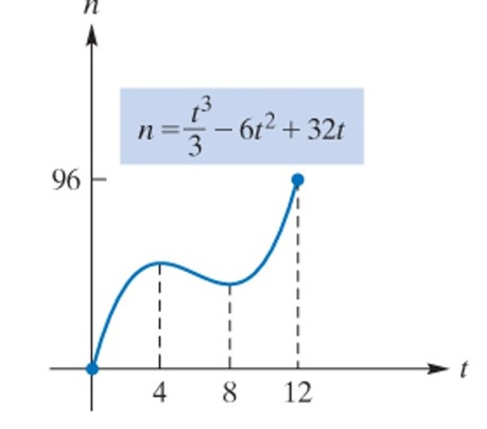
Example 4: Maximizing the Number of Recipients of Health-Care Benefits
An article in a sociology journal stated that if a particular health-care program for the elderly were initiated, then t years after its start, n thousand elderly people would receive
direct benefits, where
For what value of t does the maximum number receive benefits?
Solution:
therefore
Since the domain of n is the closed
interval
the absolute maximum
value of n must occur at
Thus, an absolute maximum occurs when

Slide 7
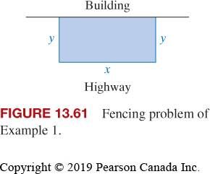
Example 5
Solution: we have labeled the length of the side parallel to the building x and the length of the other two sides y. Along the highway, the cost per foot is 3 (dollars), so the total cost of that fencing is 3x. Along each of the other two sides, the cost is 2y. Thus, the total cost is given by
$$C=3x+2y+2y=3x+4y.$$
$$y=\frac{10,800}{x}.$$
$$The storage area xy=10,800,$$
Substituting into the cost equation, we have
$$C=C(x)=3x+4\left(\frac{10,800}{x}\right)=3x+\frac{43,200}{x}.$$
Finally
$$C(120)=3(120)+\frac{43,200}{120}=720.$$

Slide 8
Example 6 The cost of producing x units is $C\left(x\right)=x^{3}−6x^{2}+15x.$How many units should be produced
in order to minimize the average cost?
Solution:
The average cost is
we have minimum average cost
When $x=3$units are produced

Slide 9
Example 4 An article in a sociology journal stated that if a particular health-care program for the elderly were initiated, then t years after its start, n thousand elderly people would receive direct benefits, where
$$n=\frac{t^{3}}{3}−6t^{2}+32t 0≤t≤12.$$
For what value of t does the maximum number receive benefits?
Solution
$$\frac{dn}{dt}=t^{2}−12t+32=0,$$
$$\left(t−4\right)\left(t−8\right)=0$$
$$t=4, t=8$$
Since the domain of n is the closed interval [0, 12], the absolute maximum value of n must occur at
$t=0, 4,8, or 12$
$$n(0)=0\text{; }n(4)=\frac{160}{3}\text{; }n(8)=\frac{128}{3}\text{; }n(12)=96$$
Thus, an absolute maximum occurs when $t=12$

