Slide 1
13.5 Asymptotes
Remark: V.A are $x=$ zeros of denominator after cancelation
Remark: the vertical and horizontal asymptotes are lines with equations, not numbers.
Remark: Polynomials have no vertical and no horizontal asymptotes.

Slide 2
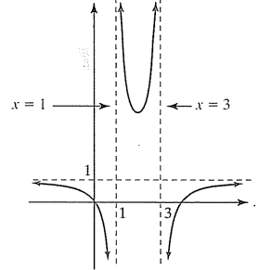
Example1: Find all vertical and all horizontal asymptotes if any .
$$1) f\left(x\right)=\frac{x^{2}−4x}{x^{2}−4x+3}.$$
$$f\left(x\right)=\frac{x(x−4)}{(x−3)(x−1)},$$
$$x=3, x=1 are vertical asymptotes$$
$$\lim_{x→∞}{f\left(x\right)=\frac{1}{1}=1} y=1 is a horizontal asymptote$$

Slide 3
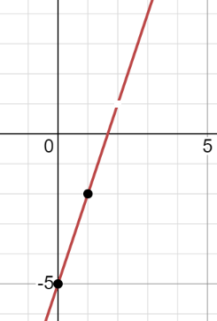
Example2: Find all vertical and all horizontal asymptotes if any .
$$f\left(x\right)=\frac{3x^{2}−11x+10}{x−2}$$
$$f\left(x\right)=\frac{3x^{2}−11x+10}{x−2}=\frac{\left(3x−5\right)\left(x−2\right)}{x−2}=3x−5, x≠2$$
There are no asymptotes

Slide 4
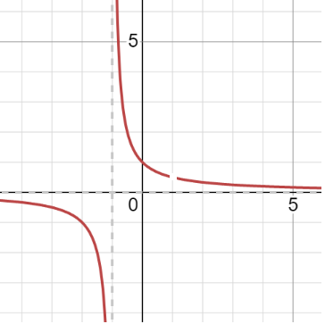
Example3: Find all vertical and all horizontal asymptotes if any .
$$f\left(x\right)=\frac{x−1}{x^{2}−1}$$
$$f\left(x\right)=\frac{x−1}{x^{1}−1}=\frac{x−1}{\left(x−1\right)\left(x+1\right)}=\frac{1}{x+1}, x≠1$$
$V.A x=−1$
$$H.A y=0$$

Slide 5
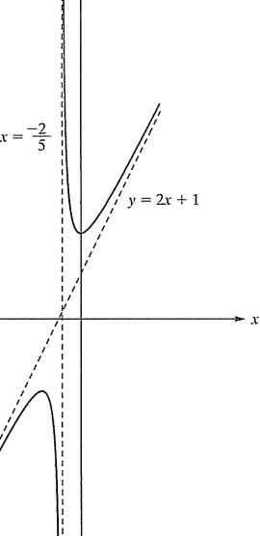
Oblique Asymptotes
Example4: Find all the asymptotes if any.
$$f\left(x\right)=\frac{10x^{2}+9x+5}{5x+2}$$
$$f\left(x\right)=\frac{10x^{2}+9x+5}{5x+2}=2x+1+\frac{3}{5x+2}$$
$$No H.A.$$
$$V.A. x=−\frac{2}{5}$$
Oblique Asymptote: $y=2x+1$

Slide 6
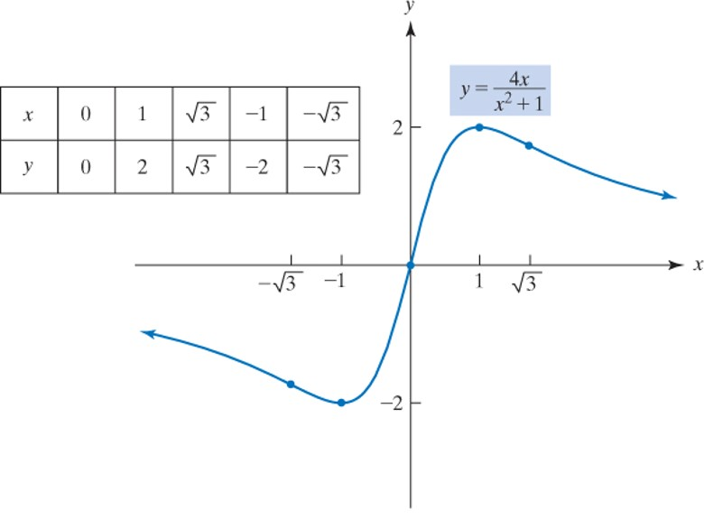
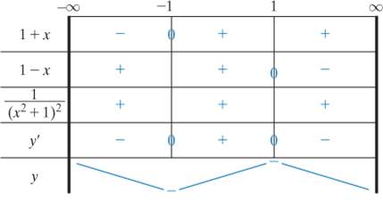
Example 5: Find all the asymptotes if any.
(0, 0) is the only intercept.
the only intercept. There is symmetry about the origin:
No other symmetry exists. The denominator of this function is never 0, so there are no vertical asymptotes. We have
is a horizontal asymptote and the only nonvertical asymptote.
Setting
we conclude that the possible
points of inflection are
This sign chart, and the graph of the function, is shown below.

Slide 7
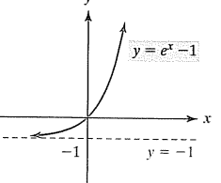
Example 6: Find all the asymptotes if any.
$$2) f\left(x\right)=e^{x}+1$$
$$No V.A.$$
No Oblique A.
$$\lim_{x→−∞}{f\left(x\right)=\lim_{x→−∞}{{(e}^{x}+1)}}=e^{−∞}+1=\frac{1}{e^{∞}}+1=0+1=1$$
$$H.A. y=1$$

Slide 8
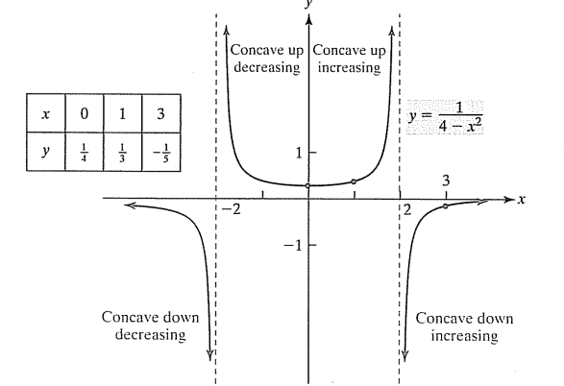
Example3 : Sketch the graph of $y=\frac{1}{4−x^{2}}$
$$if x=0→y=\frac{1}{4}→y−intercept (0, \frac{1}{4})$$
$$V.A. x=2, x=−2$$
$$y^{′}=\frac{2x}{{\left(4−x^{2}\right)}^{2}}$$
$$y^{′}=0→x=0$$
$$x=0 only the crirtical value$$
$$y^{′′}=\frac{2(4+3x^{2})}{{\left(4−x^{2}\right)}^{2}}$$
$$y^{′′}=0, no real solution$$

