Slide 1
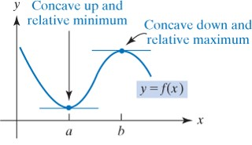
13.4 The Second-Derivative Test
13.4 The Second-Derivative Test
Second Derivative Test for Relative Extrema:
Suppose $f^{′}(x_{0})=0$.
If $f^{″}(x_{0})<0⇒f$has relative maximum at$x_{0}$.
If $f^{″}(x_{0})>0⇒f$has relative minimum at$x_{0}$.
If $f^{″}(x_{0})=0⇒$ test fails, and we use the first derivative test.
Remark: If $f$ has only one relative extrema on an open interval then it must be also absolute extrema.

Slide 2
Example 1: Test the following for relative maxima and minima. Use the second-derivative test, if possible.
Solution:
Solving
gives the critical values
If
then
There is a relative maximum at
If
There is a relative minimum
when

Slide 3
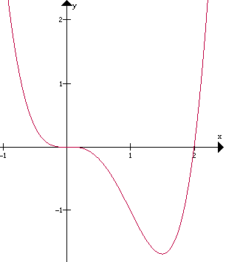
Example 2: Consider the function $y=f(x)=x^{4}−2x^{3}$
$f^{′}(x)=4x^{3}−6x^{2}=2x^{2}(2x−3)$.
To find the critical numbers we put $f^{′}(x)=4x^{3}−6x^{2}=2x^{2}(2x−3)=0$
and so the critical numbers are: $x=0, x=3/2$.
$$f^{′′}\left(x\right)=12x^{2}−12x$$
$$f^{′′}\left(\frac{3}{2}\right)=12{\left(3/2\right)}^{2}−12\left(\frac{3}{2}\right)=9>0$$
There is a relative minimum when $x=3/2$ is $−\frac{27}{16}$
$$f^{′′}\left(0\right)=0$$
So the second derivative test fail to determine the type of absolute extrema at $x=0$

Slide 4
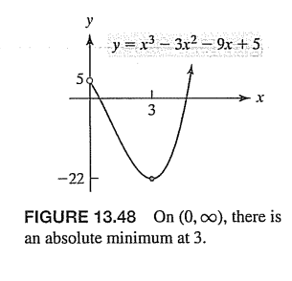
Example 2 : If $y=f\left(x\right)=x^{3}−3x^{2}−9x+5$ $, determine when absolute extrema occur on the interval (0,∞)$
$$x=−1, x=3$$
There is only one critical value which is relative minimum so its absolute minimum

