Slide 1
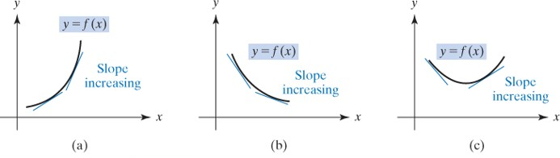
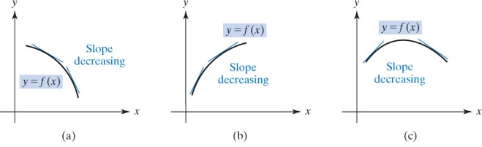
13.3 Concavity
Definition: Let $f$be a differentiable function on an interval I =$(a,b)$; $f$ is said to be concave up on $\left(a,b\right)$if $f^{′}$is increasing on $\left(a,b\right)$ and it is concave down on $\left(a,b\right)$if $f^{′}$is decreasing on $\left(a,b\right)$.
Each curve is concave up.
Each curve is concave down.

Slide 2
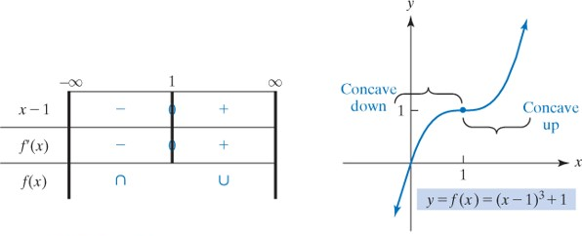
Definition: $f$has inflection point at $x_{0}$ if and only if it is continuous at $x_{0}$and $f$ changes concavity at $x_{0}$.
Example 1 Determine where the given function is concave up and where it is concave down
$$y=f(x)=(x−1)^{3}+1$$
$$y′=3{\left(x−1\right)}^{2},$$
$$y′′=6\left(x−1\right).$$
$$6\left(x−1\right)>0; when x>1$$
$$f concave up on interval (1,∞)$$
$$6\left(x−1\right)<0; when x<1$$
$$f concave down on interval (−∞,1)$$
The inflection point $\left(1,f\left(1\right)\right)=(1,1)$

Slide 3
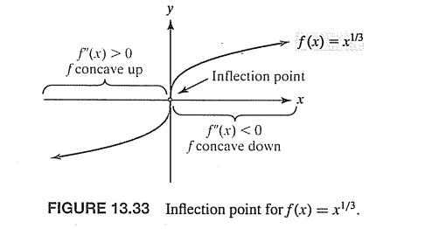
Example 2 Determine where the given function is concave up and where it is concave down
$$y=f\left(x\right)=x^{1/3}$$
$$f^{′}\left(x\right)=\frac{1}{3}x^{−2/3}$$
$$f^{′′}\left(x\right)=\frac{1}{3}\frac{−2}{3}x^{−5/3}=−\frac{2}{9}x^{−\frac{5}{3}}=−\frac{2}{{9x}^{\frac{5}{3}}}$$
$$f^{′′}\left(x\right)=0, no values$$
$$f^{′′}\left(x\right)=DNE, x=0$$
$$f^{′′}\left(x\right)>0, x<0,$$
$$f concave up on (−∞,0)$$
$$f^{′′}\left(x\right)<0, x>0,$$
$$f concave down on (0,∞)$$
The inflection point $\left(0,f\left(0\right)\right)=(0,0)$

Slide 4
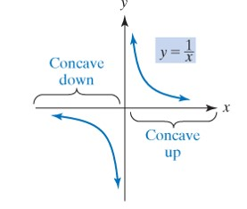
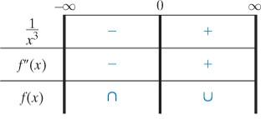
Example 3 Determine where the given function is concave up and where it is concave down
for
for
and
If
then
if
then
Hence, f is concave up on
and
concave down on

Slide 5
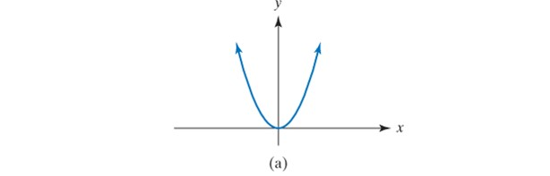
Example 4 Determine where the given function is concave up and where it is concave down
$$y=x^{4}$$
$$f′\left(x\right)=4x^{3}$$
$$f′′\left(x\right)=12x^{2}$$
$$f^{′′}\left(x\right)=0, x=0$$
$$f^{′′}\left(x\right)>0 for all x$$
$$f concave up on interval (−∞,∞)$$
There is no inflection point

Slide 6
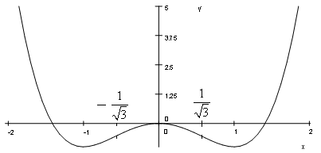
Example 5 Determine where the given function is concave up and where it is concave down
$y=f(x)=x^{4}−2x^{2}$
$f(x)=x^{4}−2x^{2}$ $=x^{2}\left(x^{2}−2\right)=0, x=0, x=±\sqrt{2}$
$f^{′}(x)=4x^{3}−4x=4x(x−1)(x+1)$. Critical numbers: $x=0, x=−1, and x=1$
Sign of | $$\left(−∞,−1\right)$$ | $$\left(−1,0\right)$$ | $$(\text{0,1})$$ | $$\left(\text{1,}∞\right)$$
x | - | - | + | +
x- 1 | - | - | - | +
x + 1 | - | + | + | +
$$f^{′}$$ | - | + | - | +
 | decreasing | increasing | decreasing | increasing
$$f^{′′}\left(x\right)=12x^{2}−4=4\left(3x^{2}−1\right)=0, x=±\frac{1}{\sqrt{3}}$$
$$f^{′′}\left(x\right)=12x^{2}−4=4(3x^{2}−1)$$
Sign of | $$\left(−∞,−1/\sqrt{3}\right)$$ | $$\left(−1/\sqrt{3}, 1/\sqrt{3}\right)$$ | $$\left(1/\sqrt{3}, ∞\right)$$
$$f^{″}$$ | + | - | +
Concavity | Concave Up | Concave Down | Concave Up
$\text{Inflection} \text{points}$ $(±\frac{1}{\sqrt{3}},f(±\frac{1}{\sqrt{3}}$)) = $(±\frac{1}{\sqrt{3}}$,-$\frac{5}{9})$

Slide 7
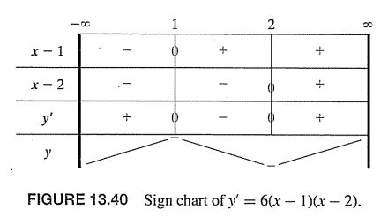
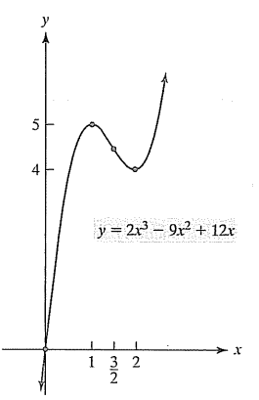
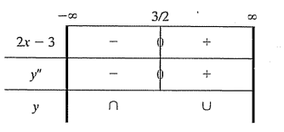
Example 3: Sketch the graph $y=f\left(x\right)=2x^{3}−9x^{2}+12x$
$$f\left(x\right)=x\left(2x^{2}−9x+12\right)=0, x=0, 2x^{2}−9x+12=0, No solution$$
Inflection point $(\frac{3}{2},f\left(\frac{3}{2}\right))=(\frac{3}{2},\frac{9}{2})$

