Slide 1
Chapter 13: Curve Sketching
13.1) Relative Extrema
13.2) Absolute Extrema on a Closed Interval
13.3) Concavity
13.4) The Second-Derivative Test
13.5) Asymptotes
13.6) Applied Maxima and Minima

Slide 2
Chapter Objectives
To find when a function is increasing or decreasing, to find critical values, to locate relative maxima and relative minima, and to state the first-derivative test. Also, to sketch the graph of a function by using the information obtained from the first derivative.
To find extreme values on a closed interval.
To test a function for concavity and inflection points. To sketch curves with the aid of the information obtained from both first and second derivatives.
To locate relative extrema by applying the second-derivative test.
To determine horizontal and vertical asymptotes for a curve and to sketch the graphs of functions having asymptotes.
To model situations involving maximizing or minimizing a quantity.

Slide 3
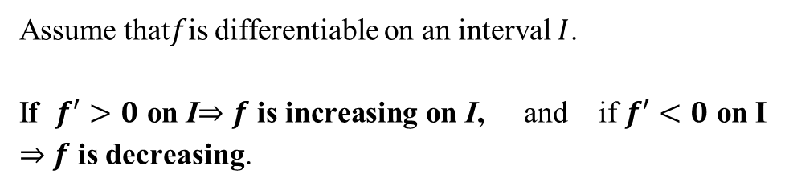
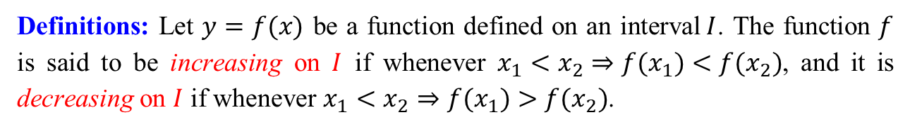
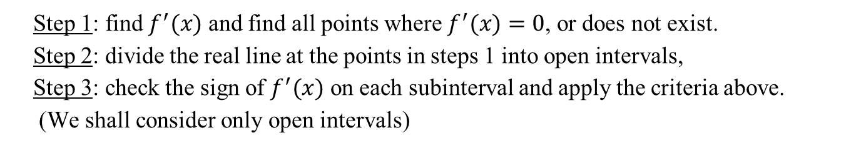
13.1 Relative Extrema
Definitions: Let $y=f(x)$ be a function defined on an interval$I$. The function $f$ is said to be increasing on $I$ if whenever $x_{1}<x_{2}⇒f(x_{1})<f(x_{2})$, and it is decreasing on $I$ if whenever $x_{1}<x_{2}⇒f(x_{1})>f(x_{2})$.
Criteria for increasing and decreasing:
Assume that$f$is differentiable on an interval $I$.
If $f^{′}>0$ on I$⇒$ $f$ is increasing on I, and if $f^{′}<0$ on I $⇒$ $f$ is decreasing.
Remark: To find intervals on which $f$ is increasing or decreasing:
Step 1: find $f^{′}(x)$ and find all points where $f^{′}(x)=0$, or does not exist.
Step 2: divide the real line at the points in steps 1 into open intervals,
Step 3: check the sign of $f^{′}(x)$ on each subinterval and apply the criteria above.
(We shall consider only open intervals)

Slide 4
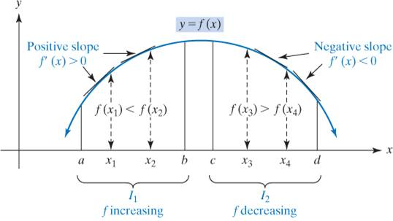
Increasing or decreasing nature of function.

Slide 5
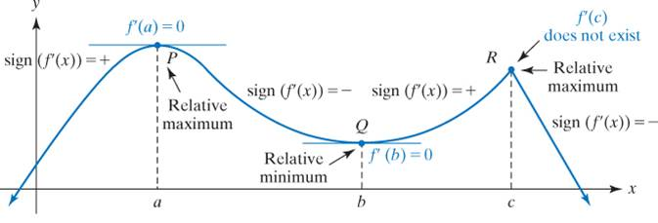
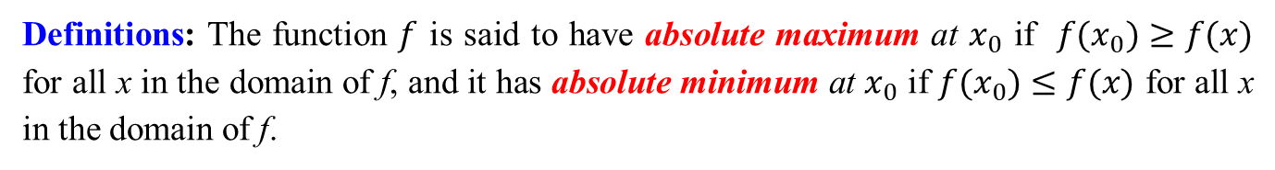
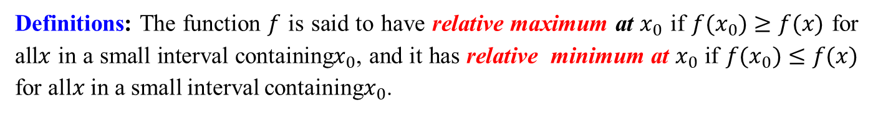
Definitions: The function $f$ is said to have relative maximum at $x_{0}$ if $f(x_{0})≥f(x)$ for all$x$ in a small interval containing$x_{0}$, and it has relative minimum at $x_{0}$ if $f(x_{0})≤f(x)$ for all$x$ in a small interval containing$x_{0}$.
Definitions: The function $f$ is said to have absolute maximum at $x_{0}$ if $f(x_{0})≥f(x)$ for all x in the domain of f, and it has absolute minimum at $x_{0}$ if $f(x_{0})≤f(x)$ for all x in the domain of f.

Slide 6
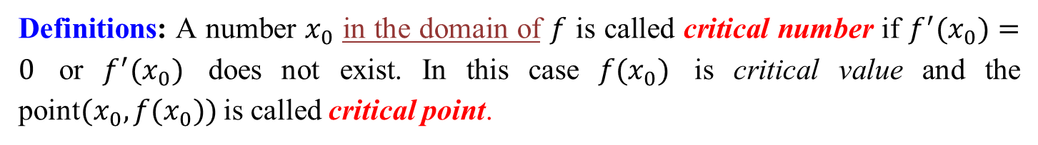
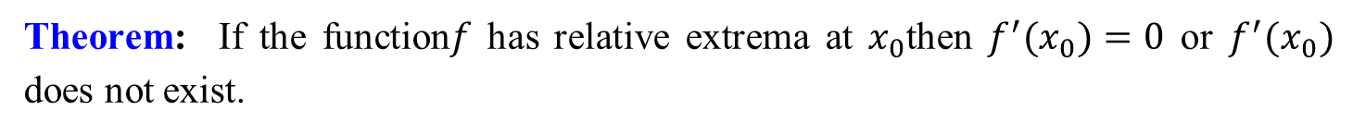
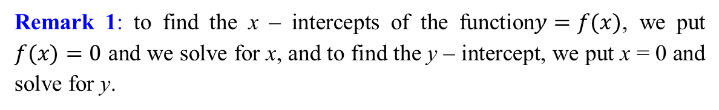
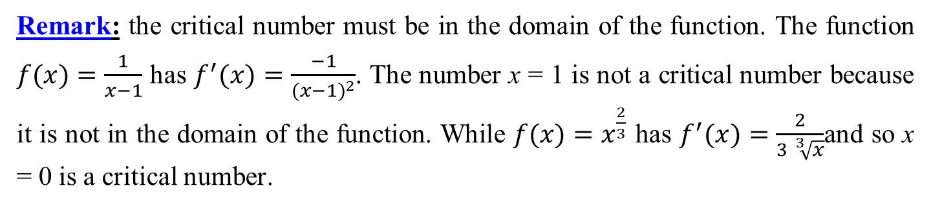
Theorem: If the function$f$ has relative extrema at $x_{0}$then $f^{′}(x_{0})=0$ or $f^{′}(x_{0})$ does not exist.
Definitions: A number $x_{0}$ in the domain of $f$ is called critical number if $f^{′}(x_{0})=0$ or $f^{′}(x_{0})$ does not exist. In this case $f(x_{0})$ is critical value and the point$(x_{0},f(x_{0}))$ is called critical point.
Remark: the critical number must be in the domain of the function. The function $f(x)=\frac{1}{x−1}$ has $f^{′}(x)=\frac{−1}{(x−1)^{2}}$. The number x = 1 is not a critical number because it is not in the domain of the function. While $f(x)=x^{\frac{2}{3}}$ has $f^{′}(x)=\frac{2}{3 \sqrt[3]{x}}$and so x = 0 is a critical number.
Remark 1: to find the x – intercepts of the function$y=f(x)$, we put $f(x)=0$ and we solve for x, and to find the y – intercept, we put x = 0 and solve for y.

Slide 7
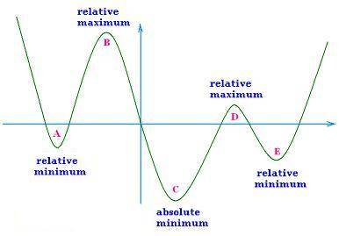
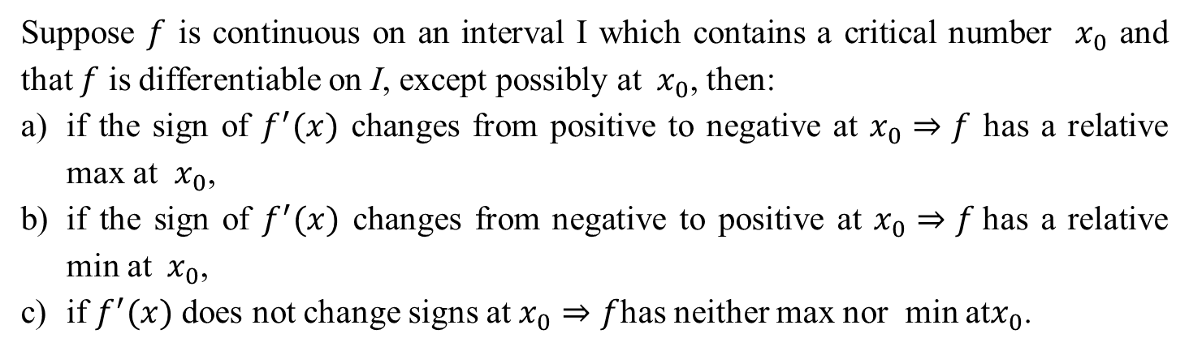
Criteria for relative extrema
Suppose $f$ is continuous on an interval I which contains a critical number $x_{0}$ and that $f$ is differentiable on I, except possibly at${ x}_{0}$, then:
if the sign of $f^{′}(x)$ changes from positive to negative at $x_{0}⇒f$ has a relative max at $x_{0}$,
if the sign of $f^{′}(x)$ changes from negative to positive at $x_{0}⇒f$has a relative min at${ x}_{0}$,
if $f^{′}(x)$ does not change signs at $x_{0}⇒f$has neither max nor min at$x_{0}$.

Slide 8
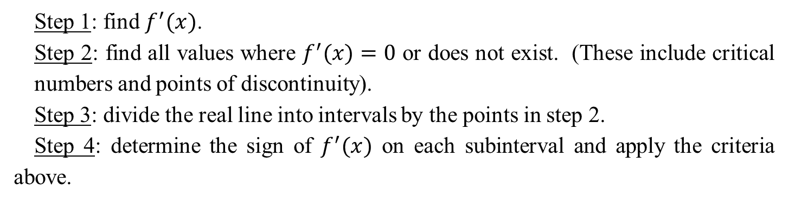
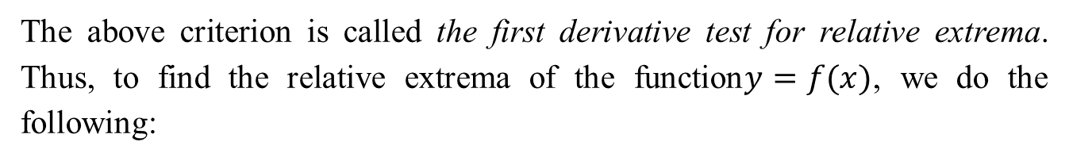
First derivative test for relative extrema:
The above criterion is called the first derivative test for relative extrema. Thus, to find the relative extrema of the function$y=f(x)$, we do the following:
Step 1: find $f^{′}(x)$.
Step 2: find all values where $f^{′}(x)=0$ or does not exist. (These include critical numbers and points of discontinuity).
Step 3: divide the real line into intervals by the points in step 2.
Step 4: determine the sign of $f^{′}(x)$ on each subinterval and apply the criteria above.

Slide 9
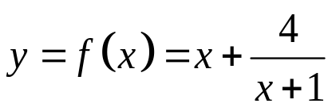
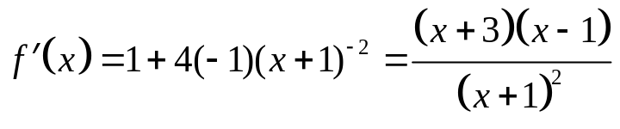
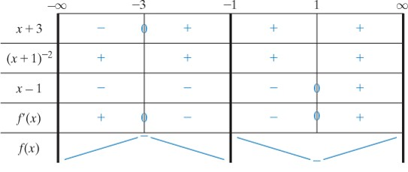
Example1) Use the first-derivative test to find where relative extrema occur.
Sign chart for

Slide 10
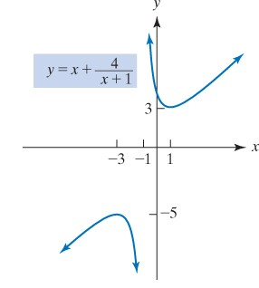

Slide 11


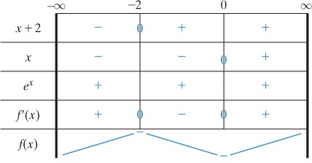
Example2) Use the first-derivative test to find where relative extrema occur.

Slide 12
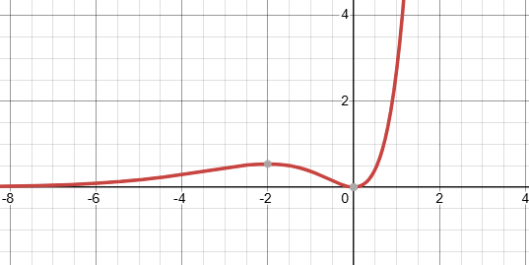

Slide 13
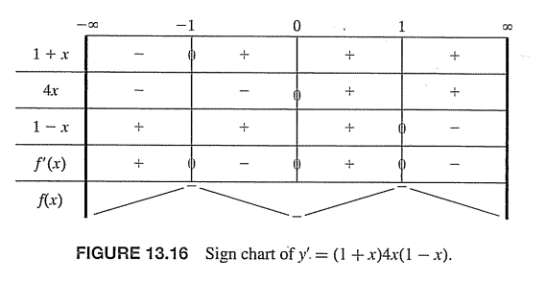




Example 3) Determine the increasing and decreasing intervals, find the critical numbers and also find the relative extrema
$$f\left(x\right)={2x}^{2}−x^{4}$$
$$f\left(x\right)={2x}^{2}−x^{4}=x^{2}\left(2−x^{2}\right),$$
$$f\left(x\right)=0→x^{2}\left(2−x^{2}\right)=0,$$
To find the critical points: $f^{′}\left(x\right)=0$
$$x=0, or x=±\sqrt{2}, x−intercepts$$
$$f^{′}\left(x\right)=4x−4x^{3}=4x(1−x)(1+x)=0→$$
$$x=0 or x=±1$$
$$f\left(x\right) increasing on \left(−∞, −1\right],[0,1]$$
$$f\left(x\right) decreasing on\left[−1,0\right], [1,−∞)$$
$$Relative maxima at \left(−1,f(−1\right))=\left(−1,1\right) is 1 and \left(1,f\left(1\right)\right)=\left(1,1\right) is 1$$
$Relative minima at \left(0,f(0\right))=\left(0,0\right)$ is 0

Slide 14
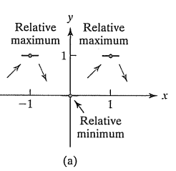
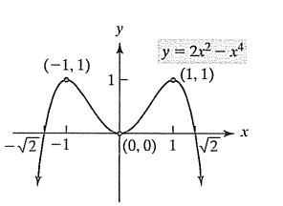

Slide 15
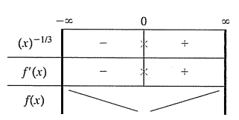






Example 4) Determine the increasing and decreasing intervals, find the critical numbers and also find the relative extrema
$$f\left(x\right)=x^{2/3}$$
$$f^{′}\left(x\right)=\frac{2}{3}x^{−1/3}→$$
$$f^{′}\left(x\right)=\frac{2}{3}\frac{1}{x^{1/3}}→$$
$$f^{′}\left(x\right)=0 No values, f^{′}\left(x\right)=DNE, x=0$$
$$The critical point (0,0)$$
$$f\left(x\right) increasing on [0,∞)$$
$$f\left(x\right)decreasingon (−∞,0]$$
$$Relative minima at \left(0,f(0\right))=\left(0,0\right) is 0$$

Slide 16
