Slide 1
Chapter Objectives
Chapter 11: Differentiation
11.1) The Derivative: Develop the tangent line concept, define the slope of a curve, and introduce derivatives with geometric interpretation.
11.2) Rules for Differentiation: Compute derivatives using the limit definition and learn basic differentiation rules.
11.3) The Derivative as a Rate of Change:Understand instantaneous rate of change through velocity, interpret the derivative, and introduce the "marginal" concept used in business and economics.
11.4) The Product Rule and the Quotient Rule: Apply product and quotient rules to find derivatives and explore marginal propensity to consume/save.
11.5) The Chain Rule: Introduce and apply the chain rule, deriving special cases and using it to develop the concept of marginal-revenue product.

Slide 2


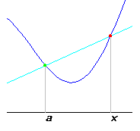
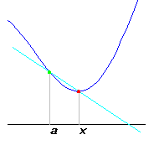
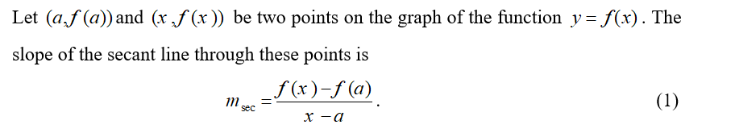

Slide 3
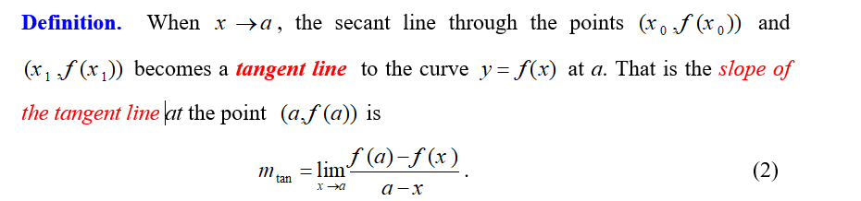
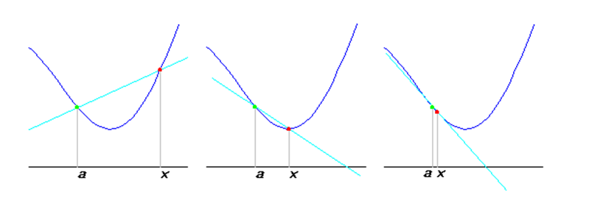

Slide 4
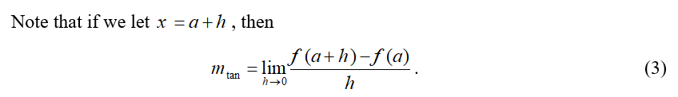

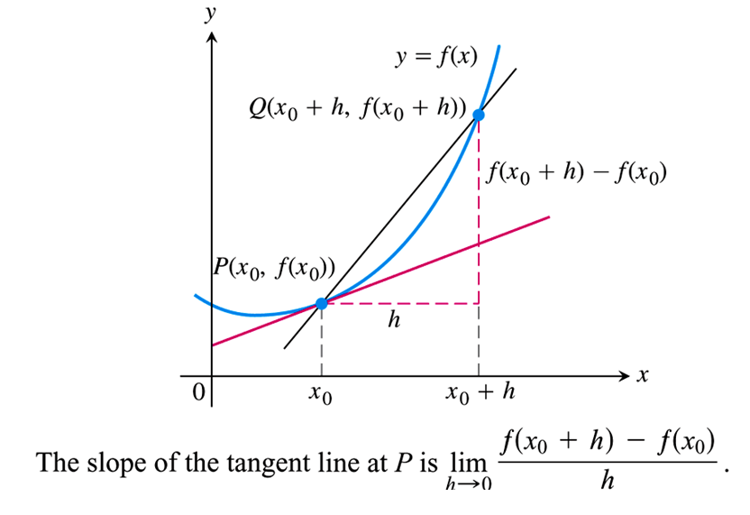

Slide 5
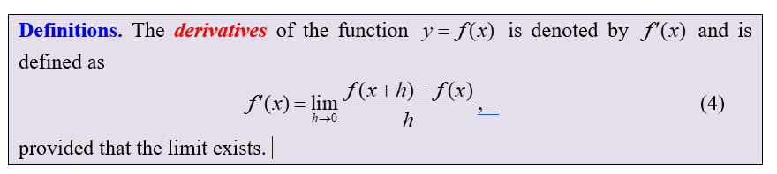

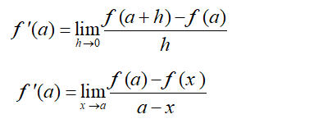


Slide 6
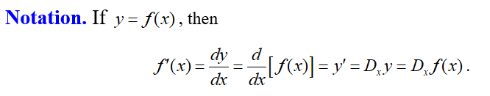
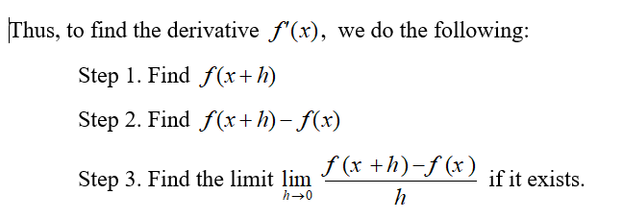

Slide 7
Example 1 – Finding the Slope of a Tangent Line
Find the slope of the tangent line to the curve
at the point (1, 1).
Solution: The slope is
Therefore, the tangent line to
at (1,1) has slope 2.

Slide 8
















Solution:
Solution:

Slide 9







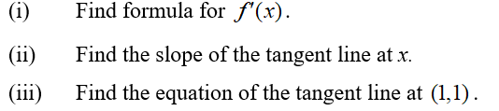



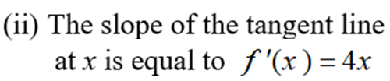


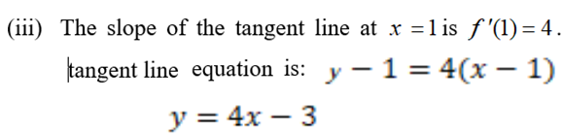

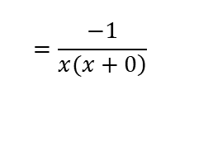
Solution:
$$=\frac{−1}{\left.x(x+0\right)}$$
Solution:

Slide 10


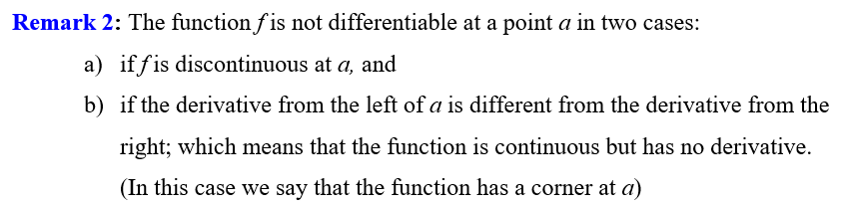



$$\lim_{x→0+}{\frac{\left|x\right|}{x}=\frac{x}{x}=1}$$
$$f^{′}\left(0\right)=\lim_{x→0}{\frac{f\left(x\right)−f(0)}{x−0}} DNE$$
$$\lim_{x→0−}{\frac{\left|x\right|}{x}=\frac{−x}{x}=−1}$$

Slide 11
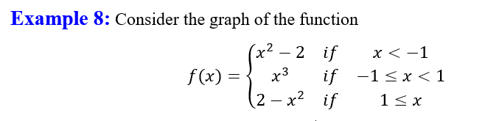

Slide 12
Example 5 – A Function with a Vertical Tangent Line
Find
Solution: Letting
we have
We can rationalize the numerator:
Therefore,

Slide 13
If f is differentiable at a, then f is continuous at a.
Example 7 – Continuity and Differentiability
Let
The derivative, 2x, is defined for all values of
of x, so
must be continuous for all values of x.
The function
is not continuous at
because
f is not defined there. Thus, the derivative does not exist at

Slide 14
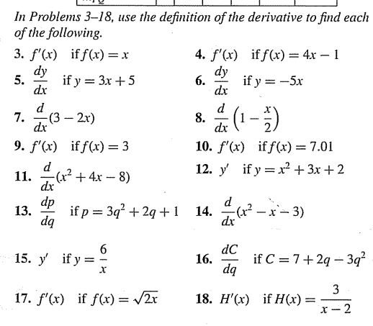

Slide 15


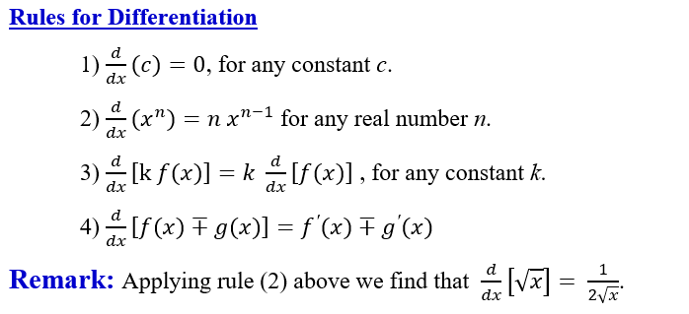

Slide 16




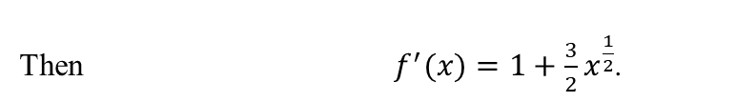

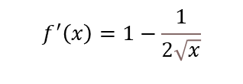


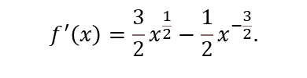
Example 1: Use the rules of differentiation to find $f′(x)$
a) $f(x)=5x^{4}+2x−1$
$f^{′}(x)=20x^{3}+2$.
b) $f(x)=x−\sqrt{x}+π^{3}$
$$f^{′}\left(x\right)=1−\frac{1}{2\sqrt{x}}$$
c) $f(x)=\frac{x^{2}+1}{\sqrt{x}}$.
Note first that $f(x)=x^{\frac{3}{2}}+x^{−\frac{1}{2}}$
$$f^{′}\left(x\right)=\frac{3}{2}x^{\frac{1}{2}}−\frac{1}{2}x^{−\frac{3}{2}}.$$
Example 2: If $f(x)=x(1+\sqrt{x})$, find $f^{′}(4)$ and also find the equation of the tangent line to the graph of the function at $x=4$.
Solution:
First, we write the expression in exponential form: $f(x)=x(1+\sqrt{x})=x+x^{\frac{3}{2}}$.
Then $f^{′}(x)=1+\frac{3}{2}x^{\frac{1}{2}}$.
Hence $f^{′}(4)=1+\frac{3}{2}\sqrt{4}=4$,
$$Slope=4, the point \left(4,f\left(4\right)\right)=(4,12)$$
The equation of the tangent line at this point is: $y−12=4(x−4)→$
$$y=4x−4$$

Slide 17
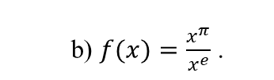
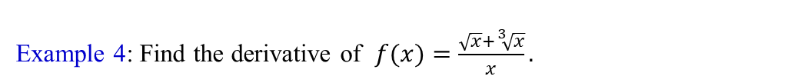




Example 3: Find the derivative of each function:
a) $f(x)=x^{e}$
b) $f(x)=\frac{x^{π}}{x^{e}}$ .
$$f\left(x\right)=\frac{x^{π}}{x^{e}}=x^{π−e}$$
$$f^{′}\left(x\right)=\left(π−e\right)x^{π−e−1}$$
c) $f(x)=\frac{1}{x\sqrt{x}}$ .
Example 4: Find the derivative of $f(x)=\frac{\sqrt{x}+\sqrt[3]{x}}{x}.$

Slide 18
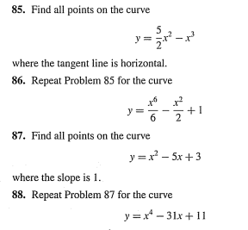

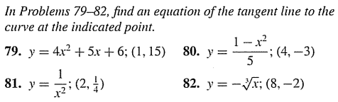

Slide 19
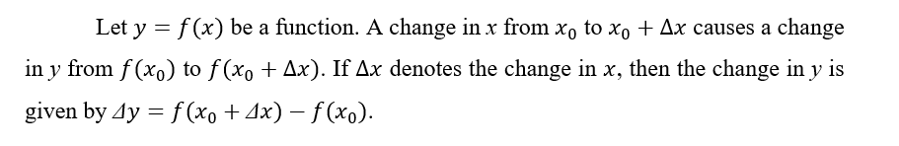
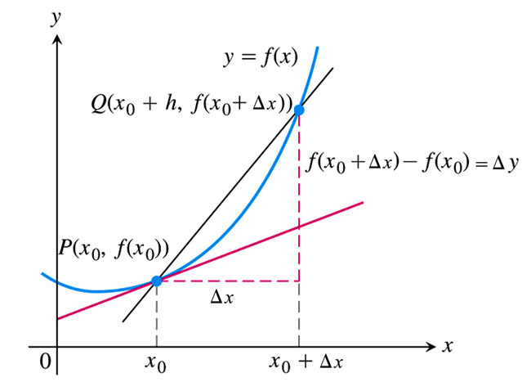
11.3 The Derivative as a Rate of Change

Slide 20
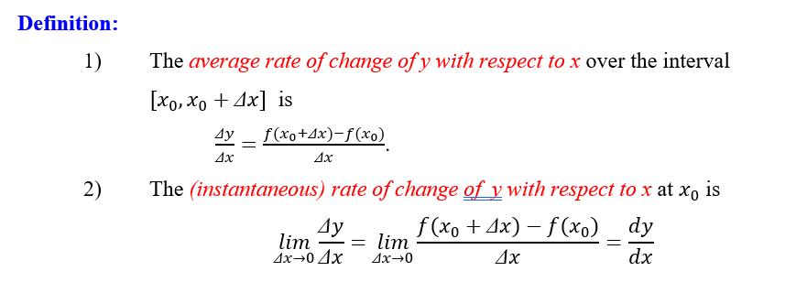



Solution:

Slide 21
If
is a position function of an object moving in a
straight line, then the average velocity of the object over the
time interval
is given by
and the velocity at time t is given by
Example 1 – Finding Average Velocity and Velocity
Suppose the position function of an object moving along a
number line is given by
where t is in seconds
and s is in meters.
Find the average velocity over the interval [10, 10.1].
Find the velocity when

Slide 22
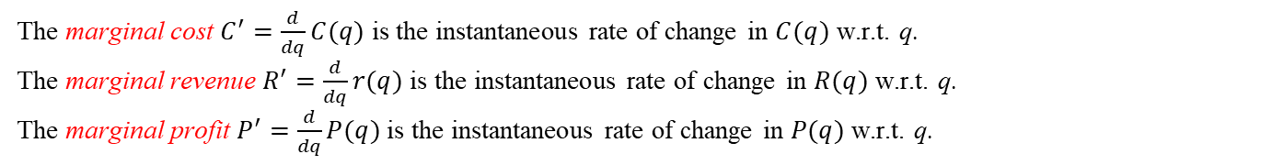
Applications of Rate of Change to Economics
A manufacturer's total-cost function,
, gives the total
cost c of producing and marketing q units of a product. The rate of change of c with respect to q is called the marginal cost.
Thus, marginal cost
Suppose
is the total revenue function for a
manufacturer. The marginal revenue is defined as the rate of change of the total dollar value received with respect to the
total number of units sold. Hence, marginal revenue
The marginal cost $C^{′}=\frac{d}{dq}C(q)$ is the instantaneous rate of change in $C(q)$ w.r.t. q.
The marginal revenue $R^{′}=\frac{d}{dq}r(q)$ is the instantaneous rate of change in $R(q)$ w.r.t. q.
The marginal profit $P^{′}=\frac{d}{dq}P(q)$ is the instantaneous rate of change in $P(q)$ w.r.t. q.
Thus the marginal cost $C′(q)≅C(q+1)−C(q)$ approximates the cost of producing the $(q+1)^{th}$ unit.

Slide 23
Example
If a manufacturer's average-cost equation is
find the marginal-cost function.
What is the marginal cost when 50 units are produced?
Solution:
Differentiating c, we have the
marginal-cost function:
The marginal-cost when 50 units are produced is
If c is in dollars and production is increased by 1 unit, from
to
, then the cost of the additional unit is approximately

Slide 24
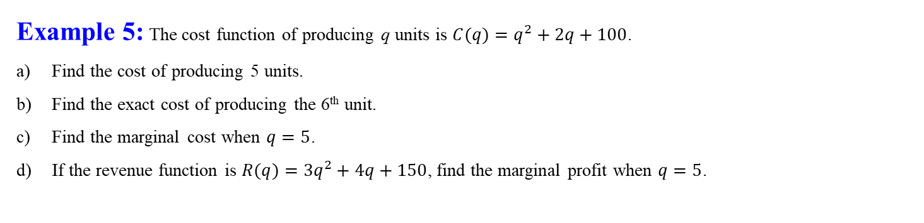
Example 5: The cost function of producing q units is $C(q)=q^{2}+2q+100$.
Find the cost of producing 5 units.
Find the exact cost of producing the 6th unit.
Find the marginal cost when $q=5$.
If the revenue function is $R(q)=3q^{2}+4q+150$, find the marginal profit when $q=5$.
Solution:
The cost of producing 5 units is $C(5)=135$.
b) The exact cost of producing the 6th unit is $C(6)−C(5)=13$.
The marginal cost $C^{′}\left(q\right)=2q+2,$when $q=5$ is $C^{′}\left(5\right)=2\left(5\right)+2=12$. (This approximates the cost of
producing the 6th unit).
d) The profit
Hence $P^{′}(q)=4q+2$and so $P^{′}(5)=4(5)+2=22$.

Slide 25

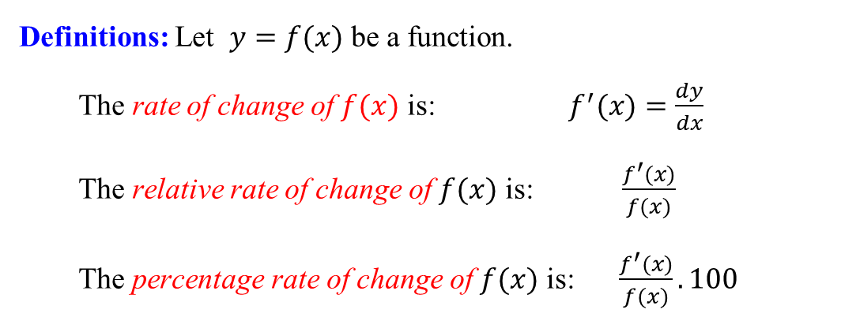


Definitions: Let $y=f(x)$ be a function.
The rate of change of $f(x)$ is: $f^{′}(x)=\frac{dy}{dx}$
The relative rate of change of $f(x)$ is: $\frac{f^{′}(x)}{f(x)}$
The percentage rate of change of $f(x)$ is: $\frac{f^{′}(x)}{f(x)}.100$
Example 6: Consider the function $f(x)=5−2x+x^{2}$.
(i) Find the rate of change of $f(x)$ at x = 3.
[Answer: $f^{′}(3)=−2+2x|_{x=3}=4$].
(ii) Find the relative rate of change of $f(x)$ at x = 3.
[Answer: $\frac{f^{′}(3)}{f(3)}={\left[\frac{−2+2x}{5−2x+x^{2}}\right]}_{x=3}=\frac{4}{8}=\frac{1}{2}$].
(iii) Find the percentage rate of change of $f(x)$ at x = 3.
[Answer:$\frac{f^{′}(3)}{f(3)}×100=\frac{1}{2}×100=50\%$]

Slide 26
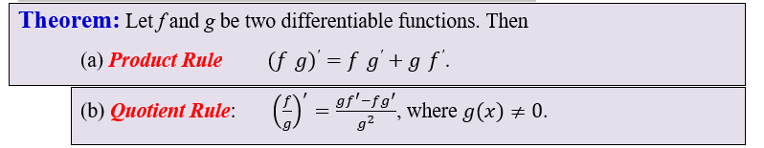
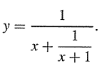




11.4 Product and Quotient Rule
Let $f(x)$ and $g(x)$ be differentiable functions. We define the product of two functions
as: $f.g(x)=f(x)g(x)$ and their quotient to be $\frac{f}{g}(x)=\frac{f(x)}{g(x)}$.
Example : Find $y^{′}$
(1) $y=(x^{2}+2)(3x−x^{3})$
(3)
(2) (Product of 3 or more terms) $y=(1−x)(x^{2}+1)(x+x^{3})$
If the cost function of a certain product is $C(q)=\frac{1−q+q^{2}}{q+1}$ find the marginal cost at $q=9$.
(4)
Solution
Marginal cost$=\frac{dC}{dq}=$
Marginal cost at $q=9 is =\frac{97}{100} ?$

Slide 27
Consumption function
The consumption function
expresses total national
consumption C as a function of total national income, I. The marginal propensity to consume is defined as the rate of change of consumption with respect to income. It is the derivative of C with respect to I:
Marginal propensity to consume
If we assume that the difference between income I and
consumption C is savings, S, then
Differentiating both sides with respect to I gives
We define
as the marginal
propensity to save.

Slide 28
Example Finding Marginal Propensities to Consume and to Save
If the consumption function is given by
determine
the marginal propensity to consume and the marginal
propensity to save when
Solution:
When
, the marginal
propensity to consume is
The marginal propensity to save when

Slide 29
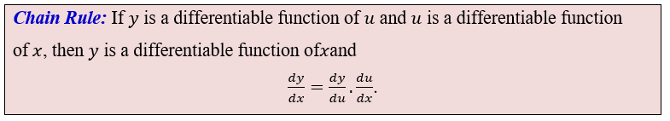
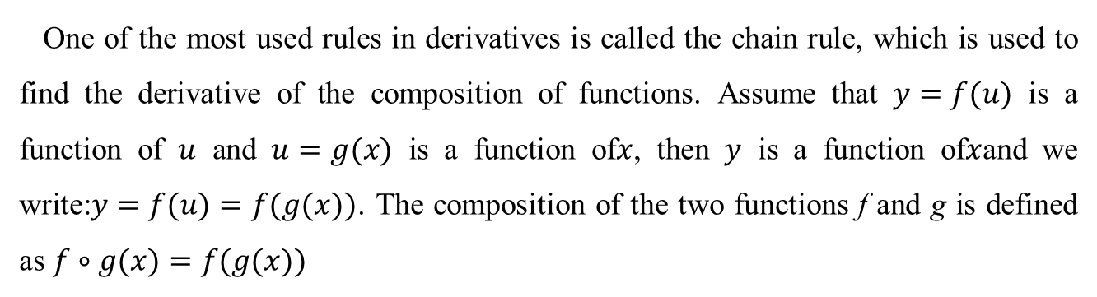
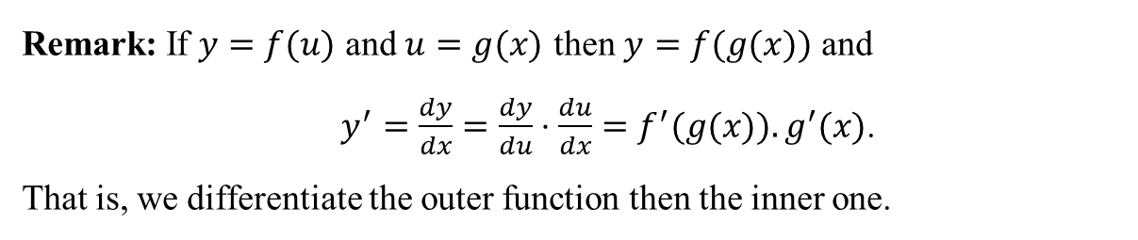
11.5 The Chain Rule
One of the most used rules in derivatives is called the chain rule, which is used to find the derivative of the composition of functions. Assume that $y=f(u)$ is a function of $u$ and $u=g(x)$ is a function of$x$, then $y$ is a function of$x$and we write:$y=f(u)=f(g(x))$. The composition of the two functions f and g is defined as $f∘g(x)=f(g(x))$
Remark: If $y=f(u)$ and $u=g(x)$ then $y=f(g(x))$ and
$y^{′}=\frac{dy}{dx}=\frac{dy}{du}⋅\frac{du}{dx}=f^{′}(g(x)).g^{′}(x)$.
That is, we differentiate the outer function then the inner one.
Power Rule: If u is differentiable function of $x$, then $\frac{d}{dx}(u^{n})=n u^{n−1}\frac{du}{dx}$

Slide 30


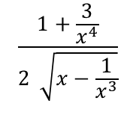

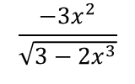
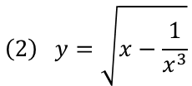












Example1: Find $\frac{dy}{dx}$ (write the answer in the variable x).
$$\left(1\right) y=u^{2}+2u−3, u=3x^{2}+4$$
$\frac{dy}{dx}=\frac{d}{du}(u^{2}+2u−3$)$∙\frac{d}{dx}(3x^{2}+4$)
$$=\left(2u+2\right)\left(6x\right)=$$
$2(3x^{2}+4$)$\left(6x\right)=$
$$36x^{3}+48x$$
$$\left(2\right) y=\sqrt{w}, w=3−2x^{3}$$
$$\frac{1}{2\sqrt{w}}\left(−6x^{2}\right)=$$
$$\frac{1}{2\sqrt{3−2x^{3}}}\left(−6x^{2}\right)=$$
$$\frac{−3x^{2}}{\sqrt{3−2x^{3}}}$$
$\frac{dy}{dx}=\frac{d}{dw}(\sqrt{w})\frac{d}{dx}(3−2x^{3}$)=
Power Rule: If u is differentiable function of $x$, then $\frac{d}{dx}(u^{n})=n u^{n−1}\frac{du}{dx}$
Example2: Find $\frac{dy}{dx}$
$$\left(1\right) y={\left(2x^{4}−3x+2\right)}^{4}$$
$\frac{dy}{dx}=4$ ${\left(2x^{4}−3x+2\right)}^{3}\left(8x^{3}−3)\right)$
$$\left(2\right) y=\sqrt{x−\frac{1}{x^{3}}}$$
First simplify
$$y={\left(x−x^{−3}\right)}^{\frac{1}{2}}$$
$$\frac{dy}{dx}=\frac{1}{2}{\left(x−x^{−3}\right)}^{\frac{1}{2}−1}(1−\left(−3\right)x^{−4})$$
$$\frac{1+\frac{3}{x^{4}}}{2 \sqrt{x−\frac{1}{x^{3}}}}$$
$$\frac{dy}{dx}=\frac{1}{2}{\left(x−x^{−3}\right)}^{\frac{−1}{2}}\left(1+3x^{−4}\right)=$$

Slide 31
Example Differentiating a Product of Powers
If
find
Solution: We first apply the product rule:
Now we use the power rule:

