Slide 1
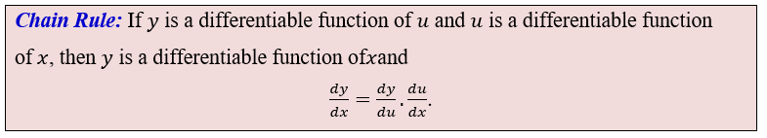
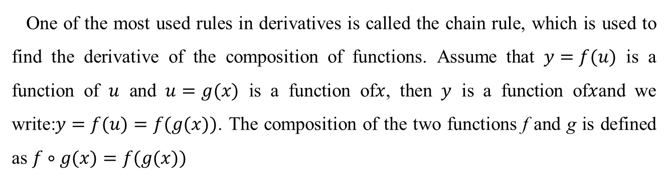
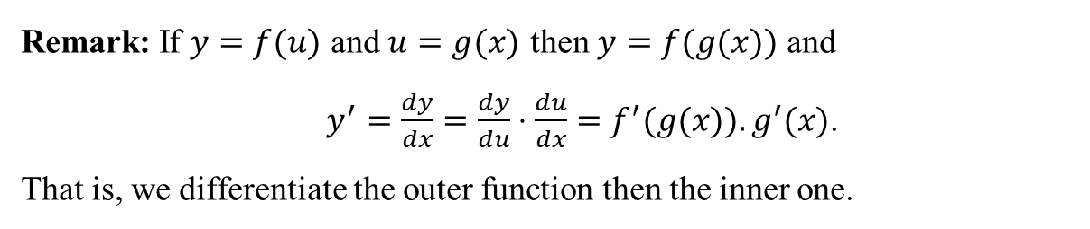
11.5 The Chain Rule
One of the most used rules in derivatives is called the chain rule, which is used to find the derivative of the composition of functions. Assume that $y=f(u)$ is a function of $u$ and $u=g(x)$ is a function of$x$, then $y$ is a function of$x$and we write:$y=f(u)=f(g(x))$. The composition of the two functions f and g is defined as $f∘g(x)=f(g(x))$
Remark: If $y=f(u)$ and $u=g(x)$ then $y=f(g(x))$ and
$y^{′}=\frac{dy}{dx}=\frac{dy}{du}⋅\frac{du}{dx}=f^{′}(g(x)).g^{′}(x)$.
That is, we differentiate the outer function then the inner one.
Power Rule: If u is differentiable function of $x$, then $\frac{d}{dx}(u^{n})=n u^{n−1}\frac{du}{dx}$

Slide 2


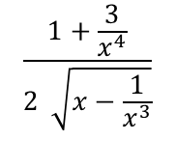

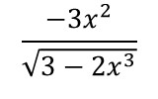
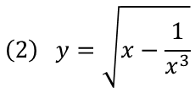












Example1: Find $\frac{dy}{dx}$ (write the answer in the variable x).
$$\left(1\right) y=u^{2}+2u−3, u=3x^{2}+4$$
$\frac{dy}{dx}=\frac{d}{du}(u^{2}+2u−3$)$∙\frac{d}{dx}(3x^{2}+4$)
$$=\left(2u+2\right)\left(6x\right)=$$
$2(3x^{2}+4$)$\left(6x\right)=$
$$36x^{3}+48x$$
$$\left(2\right) y=\sqrt{w}, w=3−2x^{3}$$
$$\frac{1}{2\sqrt{w}}\left(−6x^{2}\right)=$$
$$\frac{1}{2\sqrt{3−2x^{3}}}\left(−6x^{2}\right)=$$
$$\frac{−3x^{2}}{\sqrt{3−2x^{3}}}$$
$\frac{dy}{dx}=\frac{d}{dw}(\sqrt{w})\frac{d}{dx}(3−2x^{3}$)=
Power Rule: If u is differentiable function of $x$, then $\frac{d}{dx}(u^{n})=n u^{n−1}\frac{du}{dx}$
Example2: Find $\frac{dy}{dx}$
$$\left(1\right) y={\left(2x^{4}−3x+2\right)}^{4}$$
$\frac{dy}{dx}=4$ ${\left(2x^{4}−3x+2\right)}^{3}\left(8x^{3}−3)\right)$
$$\left(2\right) y=\sqrt{x−\frac{1}{x^{3}}}$$
First simplify
$$y={\left(x−x^{−3}\right)}^{\frac{1}{2}}$$
$$\frac{dy}{dx}=\frac{1}{2}{\left(x−x^{−3}\right)}^{\frac{1}{2}−1}(1−\left(−3\right)x^{−4})$$
$$\frac{1+\frac{3}{x^{4}}}{2 \sqrt{x−\frac{1}{x^{3}}}}$$
$$\frac{dy}{dx}=\frac{1}{2}{\left(x−x^{−3}\right)}^{\frac{−1}{2}}\left(1+3x^{−4}\right)=$$

Slide 3


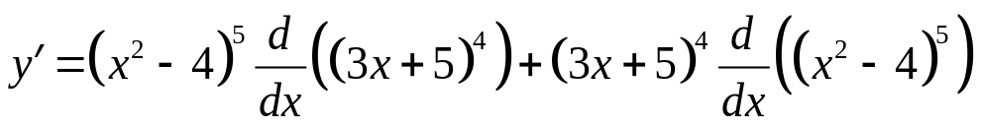


Example Differentiating a Product of Powers
If
find
Solution: We first apply the product rule:
Now we use the power rule:

Slide 4
Marginal Revenue Product
Calculus can be used to study the relationship between the number of employees and a manufacturer’s revenue.
Suppose that a manufacturer employs m workers, and that these workers produce a total of q units of a product each day.
Thus, the daily production q can be expressed as a function of the number of employees: q = q(m).
If the total revenue earned from selling these units is represented by r, then revenue can also be written as a function of the number of employees, r = r(m).
Therefore, the derivative dr/dm measures the rate at which total revenue changes as the number of employees changes. This derivative is known as the marginal-revenue product.
In practical terms, the marginal-revenue product estimates the additional revenue generated when the manufacturer hires one more employee.

Slide 5
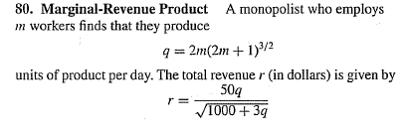
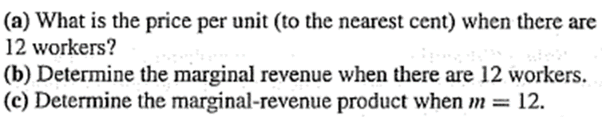
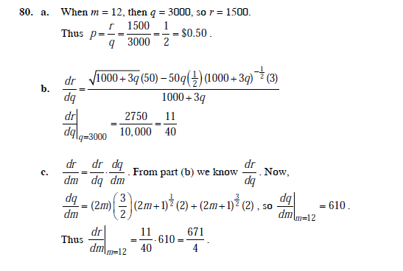
Example 80
Answer

Slide 6






Example
$$m$$
$$q$$
Manufacturer determines that employees will produce a total of units of a product per day, where
$$q= \frac{10m^{2}}{\sqrt{m^{2}+19}}$$
if the demand equation for the product is
$$p= \frac{900}{q+9}$$
determine the marginal revenue product when
$$m=9$$
Hint: r=pq
Solution
We need dr/dm =dr/dq . dq/dm
$$q= \frac{10m^{2}}{\sqrt{m^{2}+19}}$$
if m=9 then q=81 using

Slide 7
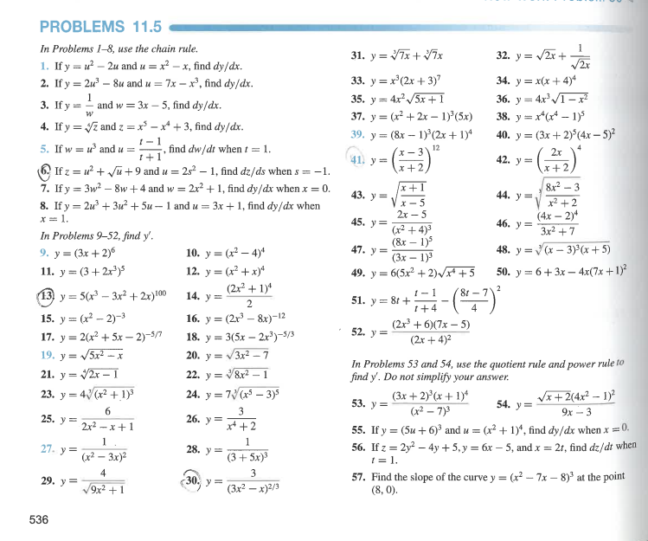

Slide 8
