Slide 1
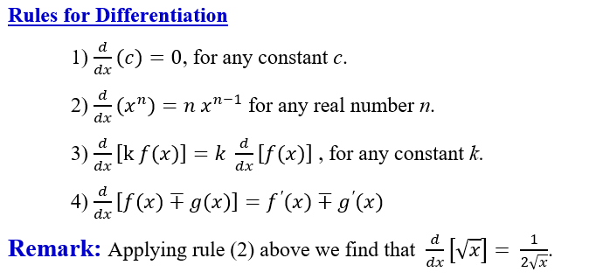

Slide 2
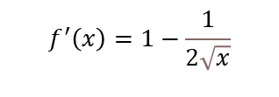
Example 1: Use the rules of differentiation to find $f′(x)$
a) $f(x)=5x^{4}+2x−1$
$f^{′}(x)=20x^{3}+2$.
b) $f(x)=x−\sqrt{x}+π^{3}$
$$f^{′}\left(x\right)=1−\frac{1}{2\sqrt{x}}$$
c) $f(x)=\frac{x^{2}+1}{\sqrt{x}}$.
Note first that $f(x)=x^{\frac{3}{2}}+x^{−\frac{1}{2}}$
$$f^{′}\left(x\right)=\frac{3}{2}x^{\frac{1}{2}}−\frac{1}{2}x^{−\frac{3}{2}}.$$
Example 2: If $f(x)=x(1+\sqrt{x})$, find $f^{′}(4)$ and also find the equation of the tangent line to the graph of the function at $x=4$.
Solution:
First, we write the expression in exponential form: $f(x)=x(1+\sqrt{x})=x+x^{\frac{3}{2}}$.
Then $f^{′}(x)=1+\frac{3}{2}x^{\frac{1}{2}}$.
Hence $f^{′}(4)=1+\frac{3}{2}\sqrt{4}=4$,
$$Slope=4, the point \left(4,f\left(4\right)\right)=(4,12)$$
The equation of the tangent line at this point is: $y−12=4(x−4)→$
$$y=4x−4$$

Slide 3
Example 3: Find the derivative of each function:
a) $f(x)=x^{e}$
b) $f(x)=\frac{x^{π}}{x^{e}}$ .
$$f\left(x\right)=\frac{x^{π}}{x^{e}}=x^{π−e}$$
$$f^{′}\left(x\right)=\left(π−e\right)x^{π−e−1}$$
c) $f(x)=\frac{1}{x\sqrt{x}}$ .
Example 4: Find the derivative of $f(x)=\frac{\sqrt{x}+\sqrt[3]{x}}{x}.$

Slide 4
