Slide 1
Chapter Objectives
Chapter 11: Differentiation
11.1) The Derivative: Develop the tangent line concept, define the slope of a curve, and introduce derivatives with geometric interpretation.
11.2) Rules for Differentiation: Compute derivatives using the limit definition and learn basic differentiation rules.
11.3) The Derivative as a Rate of Change:Understand instantaneous rate of change through velocity, interpret the derivative, and introduce the "marginal" concept used in business and economics.
11.4) The Product Rule and the Quotient Rule: Apply product and quotient rules to find derivatives and explore marginal propensity to consume/save.
11.5) The Chain Rule: Introduce and apply the chain rule, deriving special cases and using it to develop the concept of marginal-revenue product.

Slide 2


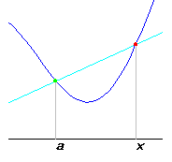
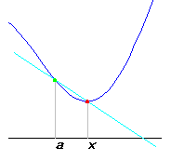
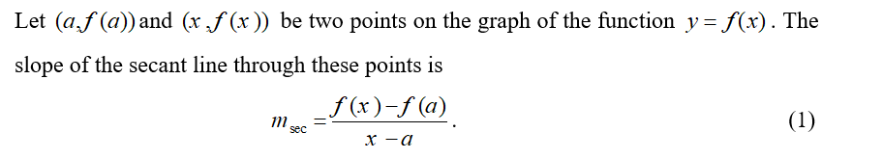

Slide 3
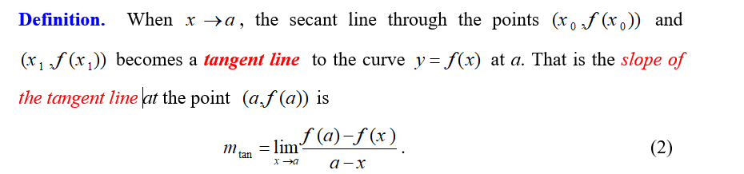
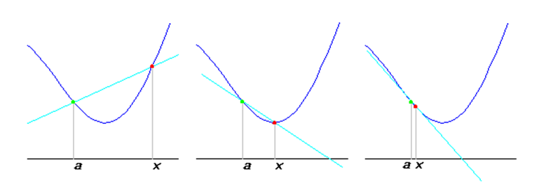

Slide 4
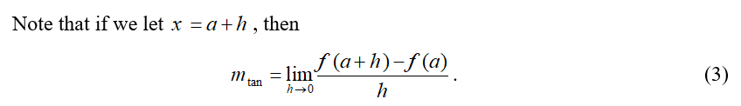

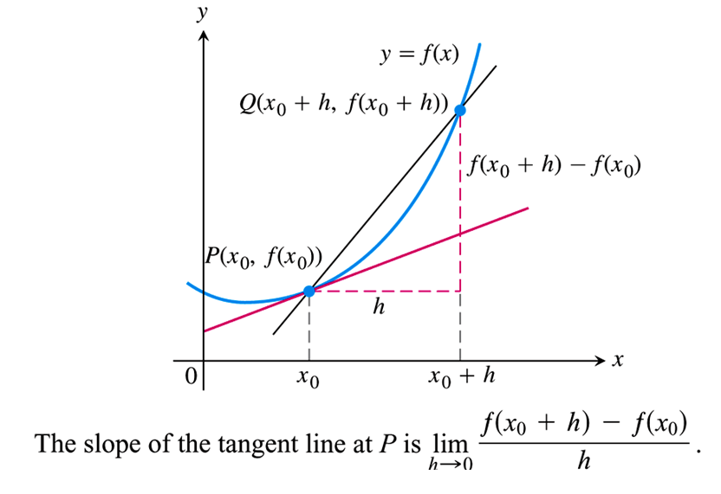

Slide 5
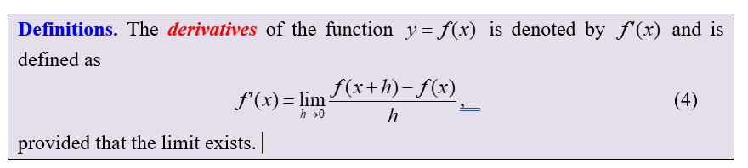

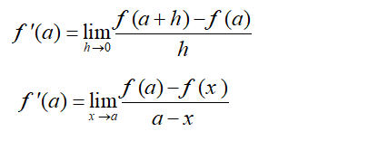


Slide 6
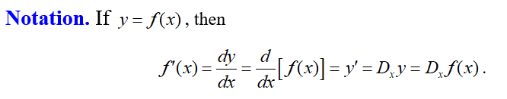
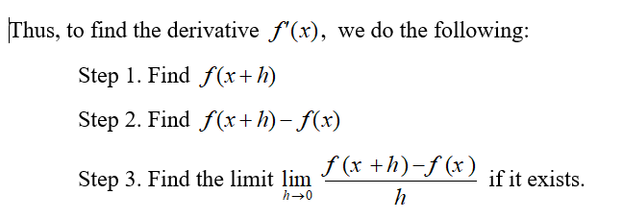

Slide 7
Example Finding the Slope of a Tangent Line
Find the slope of the tangent line to the curve
at the point (1, 1).
Solution: The slope is
Therefore, the tangent line to
at (1,1) has slope 2.

Slide 8
















Solution:
Solution:

Slide 9







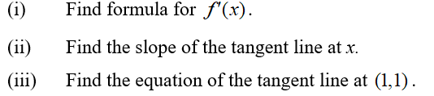



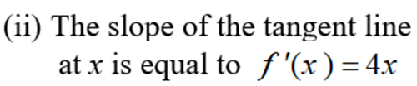


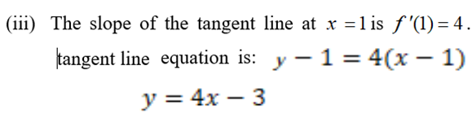

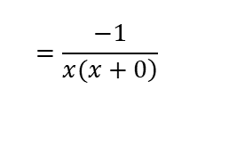
Solution:
$$=\frac{−1}{\left.x(x+0\right)}$$
Solution:

Slide 10


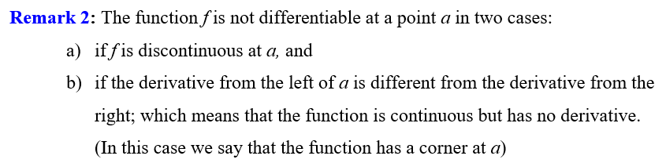



$$\lim_{x→0+}{\frac{\left|x\right|}{x}=\frac{x}{x}=1}$$
$$f^{′}\left(0\right)=\lim_{x→0}{\frac{f\left(x\right)−f(0)}{x−0}} DNE$$
$$\lim_{x→0−}{\frac{\left|x\right|}{x}=\frac{−x}{x}=−1}$$

Slide 11
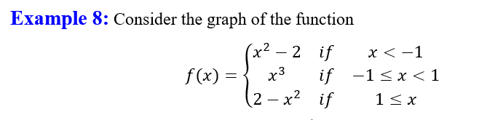

Slide 12
Example A Function with a Vertical Tangent Line
Find
Solution: Letting
we have
We can rationalize the numerator:
Therefore,

Slide 13
If f is differentiable at a, then f is continuous at a.
Example Continuity and Differentiability
Let
The derivative, 2x, is defined for all values of
of x, so
must be continuous for all values of x.
The function
is not continuous at
because
f is not defined there. Thus, the derivative does not exist at

Slide 14
