Slide 1
MATH 106: Applied Calculus
Dr. Suliman ALHomidan
Building 68 Room 261
E-mail: homidan@kfupm.edu.sa
Whatup: 0555861682
Website: https://faculty.kfupm.edu.sa/MATH/homidan/
Book: Introductory Mathematical Analysis For Business, Economics, and The Life and Social Sciences;
Fourteenth Canadian Edition
Notes:
If this PowerPoint presentation contains mathematical equations, you may need to check that your computer has the following installed:
1) MathType Plugin
2) Math Player (free versions available)
3) NVDA Reader (free versions available)

Slide 2
Chapter Objectives
Chapter 10: Limits and Continuity
To study limits and their basic properties.
To study one-sided limits, infinite limits, and limits at infinity.
To study continuity and to find points of discontinuity for a function.
Chapter Outline
10.1 Limits
10.2 Limits (Continued)
10.3 Continuity

Slide 3
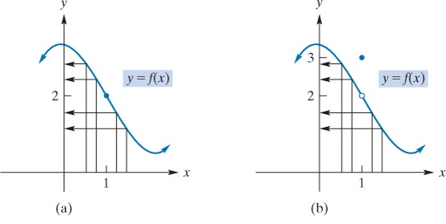
10.1 Limits

Slide 4
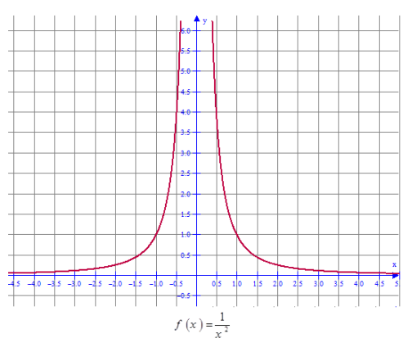
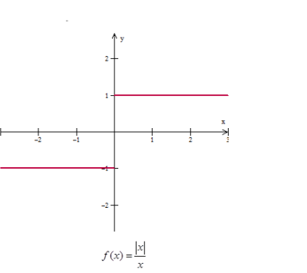
$$\frac{\left|x\right|}{x}=\left\{\begin{aligned}\frac{x}{x}=1, x≥0 \\ \frac{−x}{x}=−1, x≤0\end{aligned}\right.$$

Slide 5
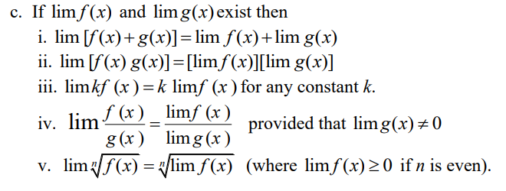
Example 1

Slide 6
$\frac{0}{0}$=
$$\frac{0}{0}=$$
$$\frac{0}{0}=$$

Slide 7
Example
If
find
Solution:
As
both the numerator and denominator approach 0.
Therefore, we will try to express the quotient in a different
form, for

Slide 8
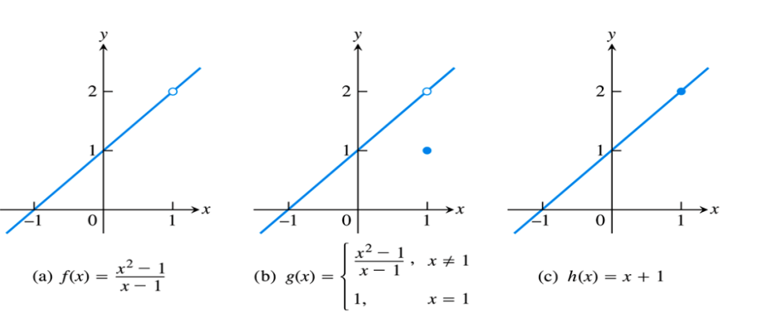

Slide 9
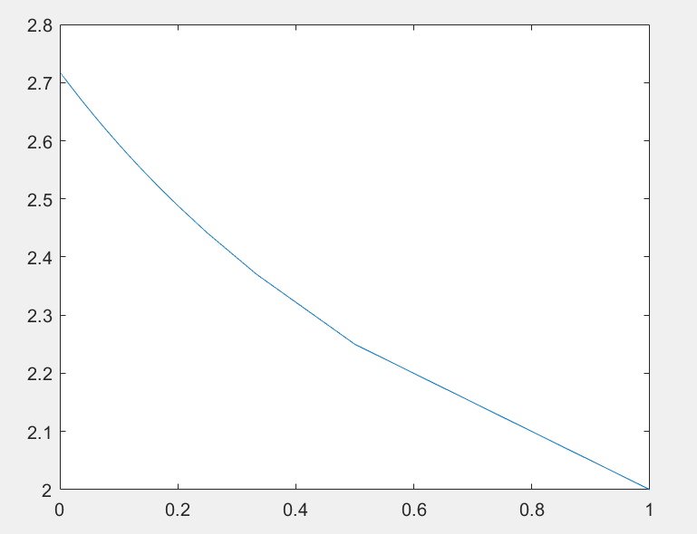
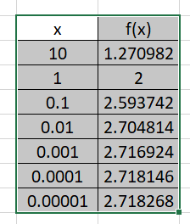

Slide 10
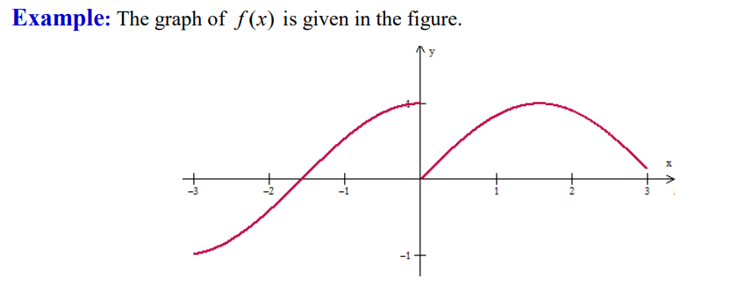
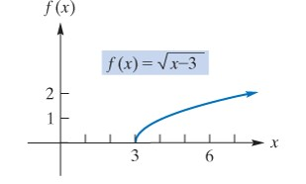
10.2 Limit (Continued)
A. One sided Limit
$$\left(c\right) \lim_{n→0}{f\left(x\right)=DNE}$$

Slide 11
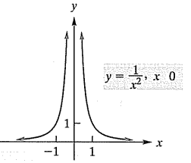
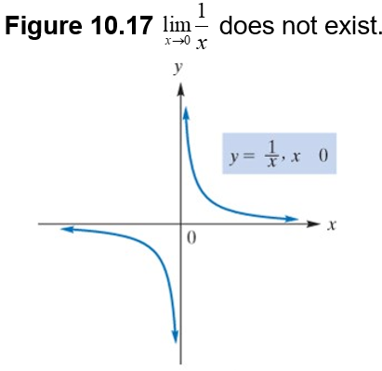
B. Infinite Limits

Slide 12
Example 1 – Infinite Limits
$$a) \lim_{x→−3}{f\left(x\right)=\lim_{x→−3}\frac{x+3}{x^{2}−9}=\frac{0}{0}=}$$
$$\lim_{x→−3}\frac{x+3}{\left(x+3\right)(x−3)}=$$
$$−\frac{1}{6}$$
$$b) \lim_{x→3+}{f\left(x\right)=\lim_{x→3+}\frac{x+3}{x^{2}−9}=\frac{0}{0}=}$$
$$\lim_{x→3+}\frac{x+3}{\left(x+3\right)(x−3)}=$$
$$\lim_{x→3+}\frac{1}{x−3}=$$
$$∞$$
$$c) \lim_{x→3−}{f\left(x\right)=\lim_{x→3−}\frac{x+3}{x^{2}−9}=\frac{0}{0}=}$$
$$\lim_{x→3−}\frac{x+3}{\left(x+3\right)(x−3)}=$$
$$\lim_{x→3−}\frac{1}{x−3}=$$
$$−∞$$
$$d) \lim_{x→3}{f\left(x\right)=DNE}$$

Slide 13
Example 2 – Infinite Limits
Find the limit (if it exists)
Solution: As x approaches
from the right,
approaches 0 but
always positive.
Thus,
and the limit does not exist.
Solution: Here we are dividing numbers near 4 by numbers near 0.
At this stage we can write.
does not exist.
Notice that
Since
and
is neither
nor

Slide 14
C. Limits at Infinity
$$Remark \frac{a}{±∞}=0$$
Example:
$$\underset{x→∞}{a) lim}{\frac{1}{x}=0}$$
$$\underset{x→∞}{b) lim}{\sqrt{x−4}=}$$
$$\sqrt{∞−4}=\sqrt{∞}=∞$$
$$c) \lim_{x→−∞}{\sqrt{4−x}=}$$
$$\sqrt{4+∞}=\sqrt{∞}=∞$$

Slide 15
Example 3
$$a) \lim_{x→∞}{4x^{3}+x^{2}−5=}$$
$$\lim_{x→∞}{4x^{3}=}$$
$$4∞=∞$$
b$) \lim_{x→∞}−{4x^{3}+x^{2}−5=}$
$$\lim_{x→∞}{−4x^{3}=}$$
$$−4∞=−∞$$
c$) \lim_{x→−∞}{4x^{3}+x^{2}−5=}$
$$\lim_{x→−∞}{4x^{3}=−∞}$$
Example:

Slide 16
$$\lim_{x→∞}{\frac{2x^{3}}{3x^{2}}=}$$
$$\lim_{x→∞}{\frac{2}{3}x=}$$
$$∞$$
$$v) \lim_{x→−∞}{\frac{2x^{3}−2x^{2}+5x}{3x^{2}−5x−2}}=$$
$$\lim_{x→−∞}{\frac{2x^{3}}{3x^{2}}=}$$
$$\lim_{x→−∞}{\frac{2}{3}x=−∞}$$
$$\lim_{x→1}{f\left(x\right)=2}$$

Slide 17
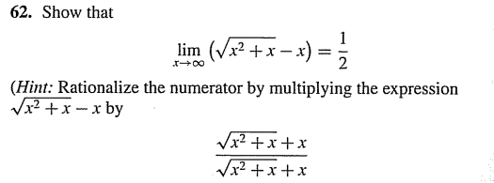
$$\lim_{x→∞}\left(\sqrt{x^{2}+x}−x\right){\frac{\sqrt{x^{2}+x}+x}{\sqrt{x^{2}+x}+x}=}$$
$$\lim_{x→∞}{\frac{x^{2}+x−x^{2}}{\sqrt{x^{2}+x}+x}=}$$
$$\lim_{x→∞}{\frac{x}{\sqrt{x^{2}+x}+x}=}$$
Divided by |x|=x, x$→∞$
$$\lim_{x→∞}{\frac{\frac{x}{x}}{\frac{\sqrt{x^{2}+x}+x}{x}}=}$$
$$\lim_{x→∞}{\frac{1}{\sqrt{1+\frac{1}{x}}+1}=}$$
$$\frac{1}{\sqrt{1+0}+1}=$$
$$\frac{1}{2}$$
$$\lim_{x→∞}{\frac{1}{\sqrt{\frac{x^{2}+x}{x^{2}}}+\frac{x}{x}}=}$$

Slide 18
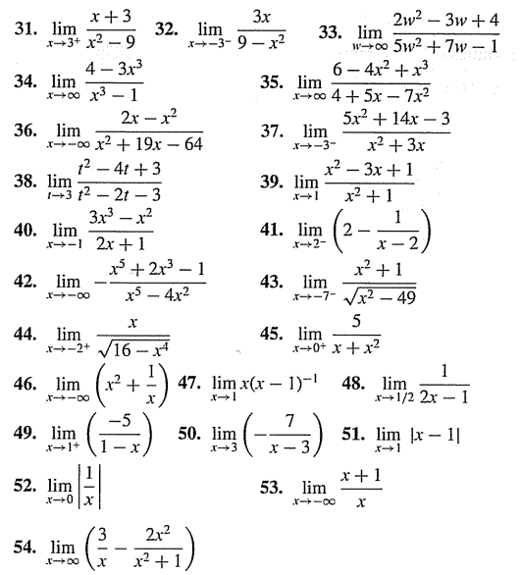
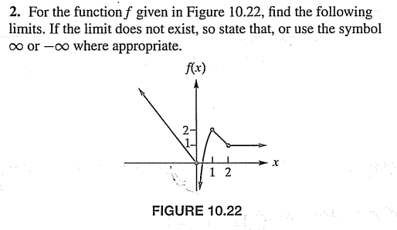

Slide 19
10.3 Continuity

Slide 20
Example 1 – Applying the Definition of Continuity
Show that
is continuous at 7.
Solution: First,
so f is defined at
Second,
thus, f has a limit as
Third,
Therefore, f is continuous at 7.
Show that
is continuous at
Solution: The function g is defined at
Also,
Therefore, g is continuous at

Slide 21
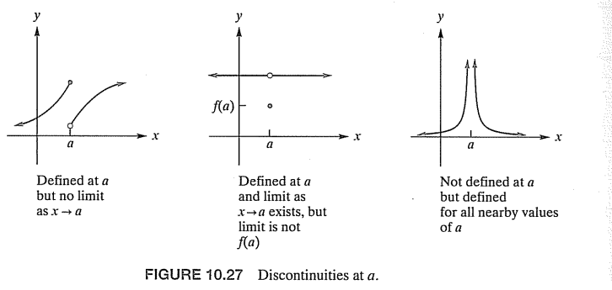
(B) Types of discontinuity

Slide 22
$$f\left(x\right)=\frac{x−2}{\left(x−2\right)\left(x+2\right)}=\frac{1}{x+2}, x≠2$$
$$\lim_{x→2}{f\left(x\right)=\lim_{x→2}{\frac{1}{x+2}=\frac{1}{4},}}$$
but f(2) undefined
$$\lim_{x→−2}{f\left(x\right)=\lim_{x→−2}{\frac{1}{x+2}=±∞,}}$$
Infinite discontinuity
$$f\left(x\right)=\frac{x−2}{x\left(x^{2}−4\right)}=\frac{x−2}{x\left(x−2\right)\left(x+2\right)}=\frac{1}{x\left(x+2\right)}, x≠2$$
Removable discontinuity at 2,but not removable at 0 and -2

Slide 23
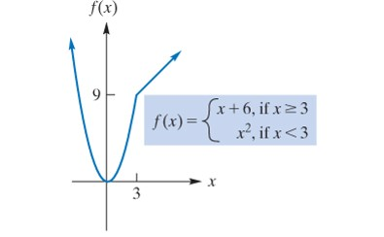
(C) Discontinuity in compound functions
Example
For each of the following functions, find all points of discontinuity.
We can conclude that
and the function has no points of discontinuity.

Slide 24
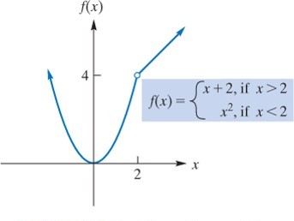
b.

Slide 26
